Slide 1

ESS Test Beamline PDR
Shane Kennedy, Gábor László
22.05.2017

Slide 2
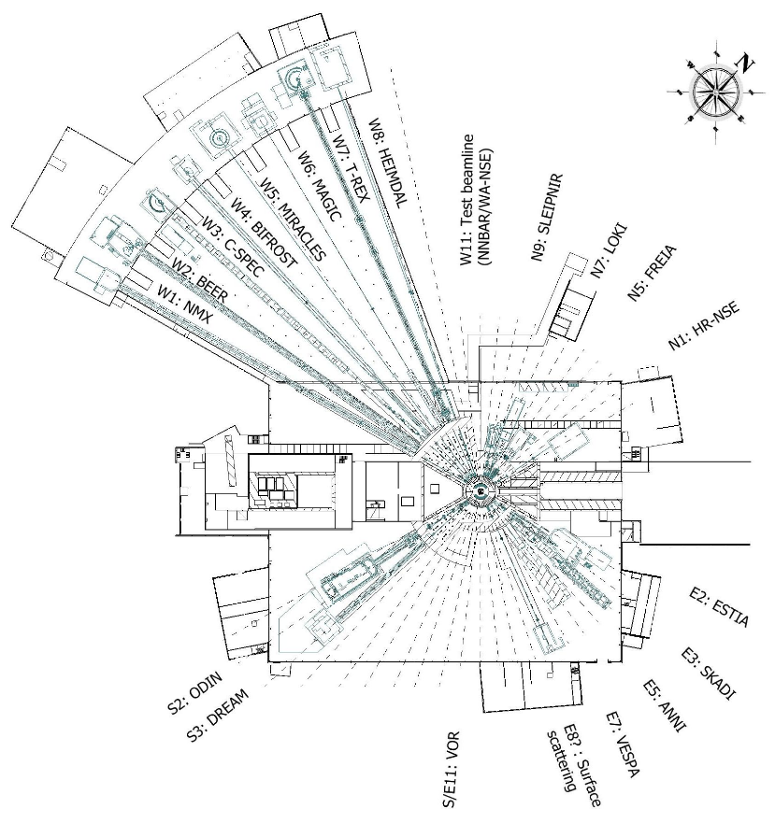
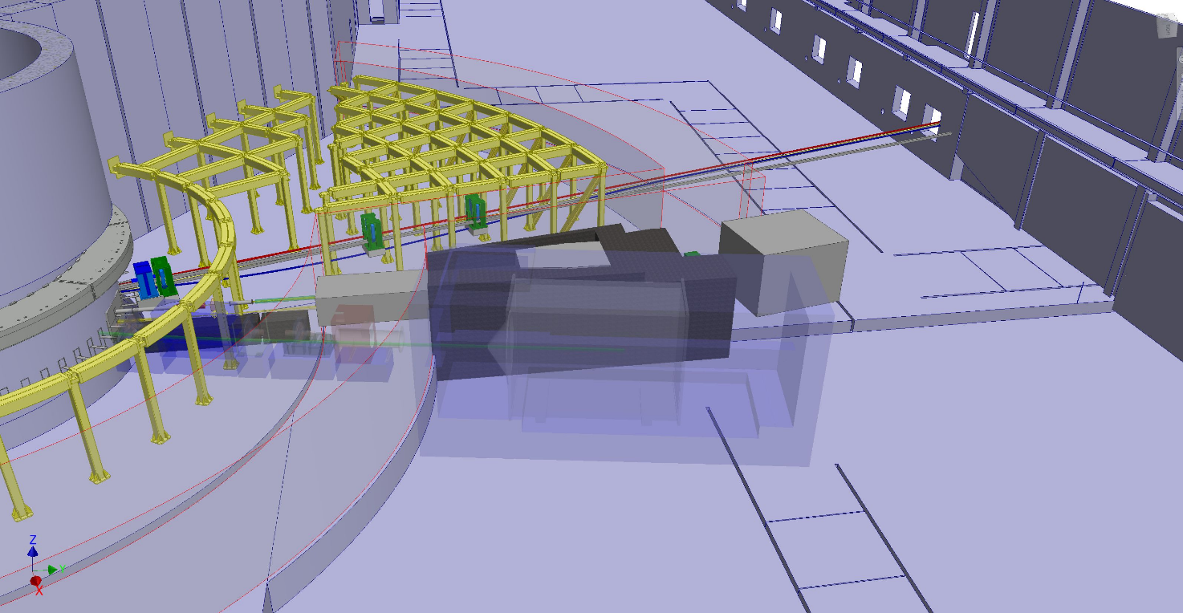
Placement: W11

Slide 3
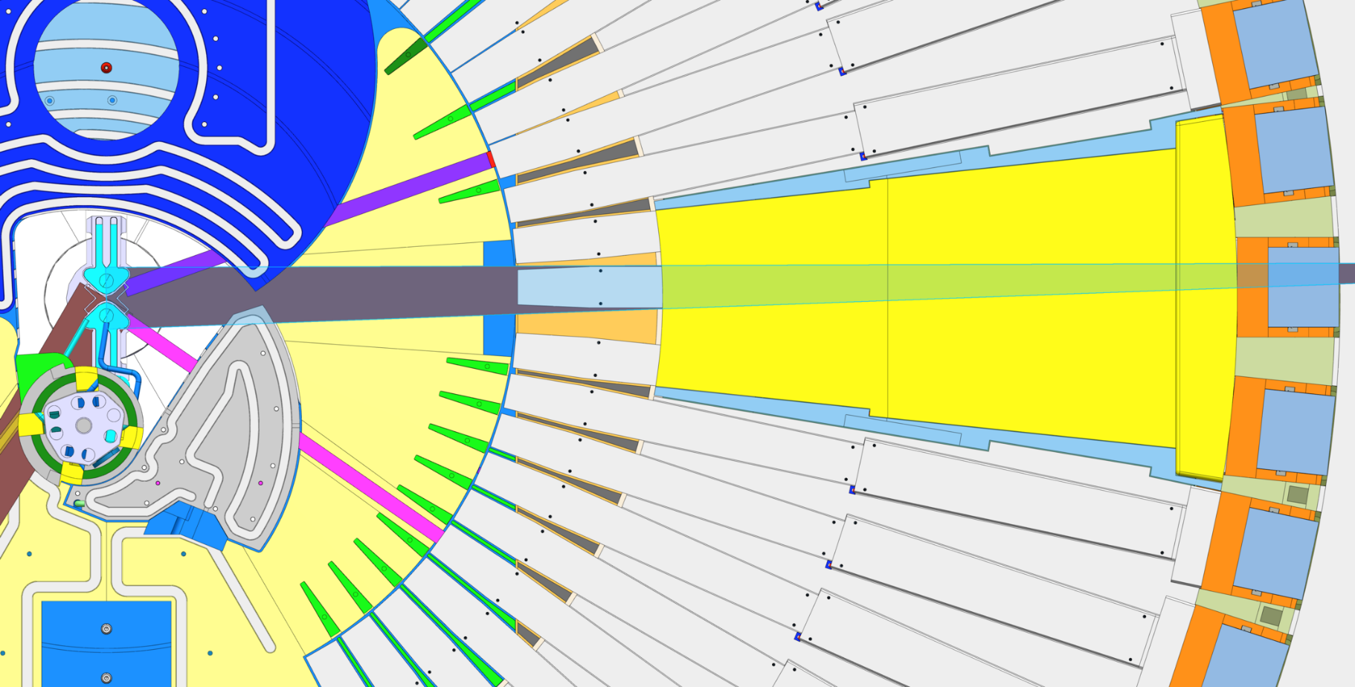
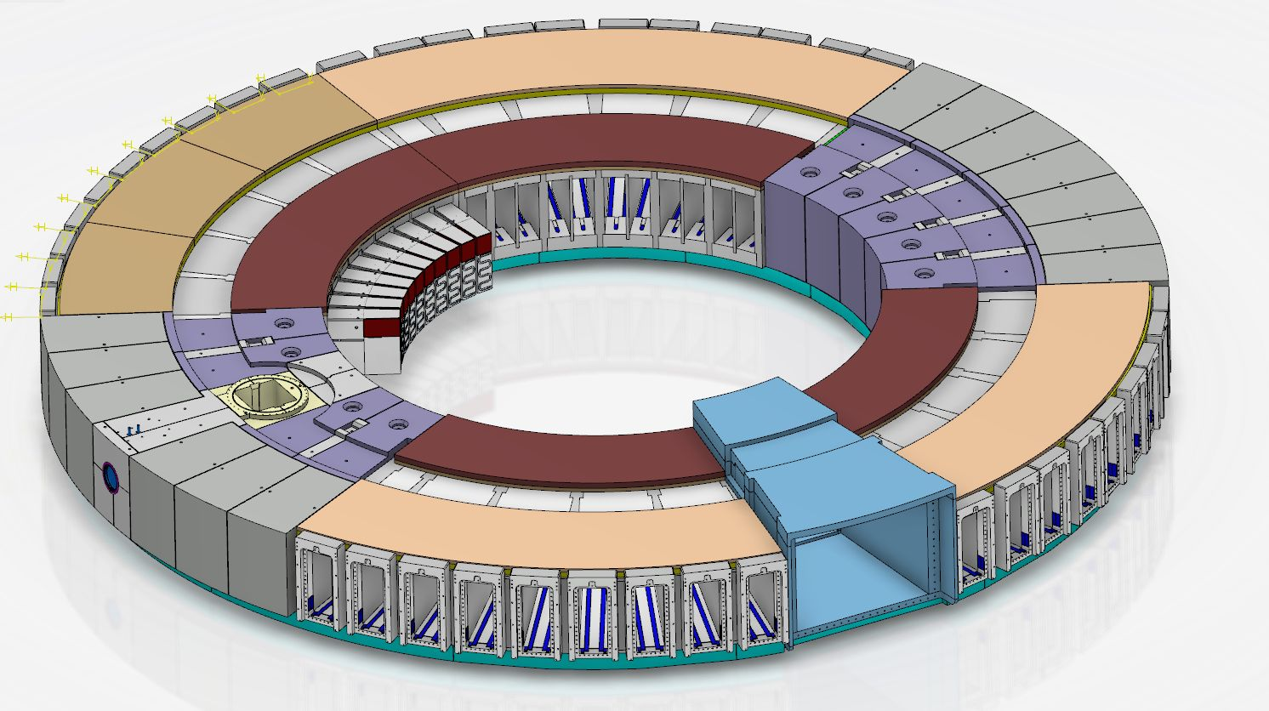
Placement: W11

Slide 4
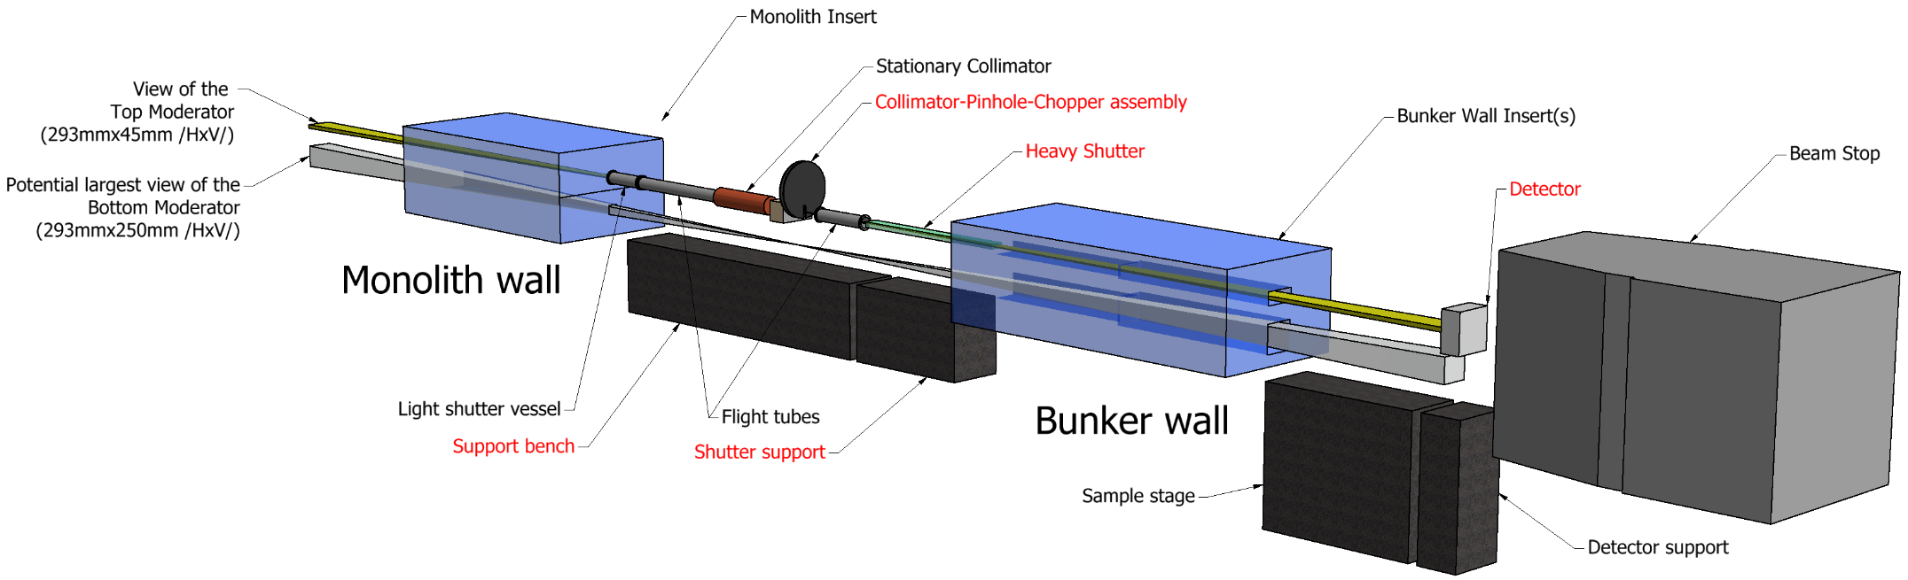
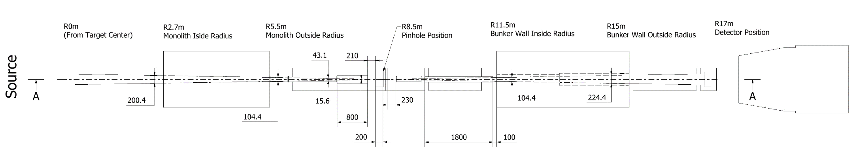
Layout

Slide 5
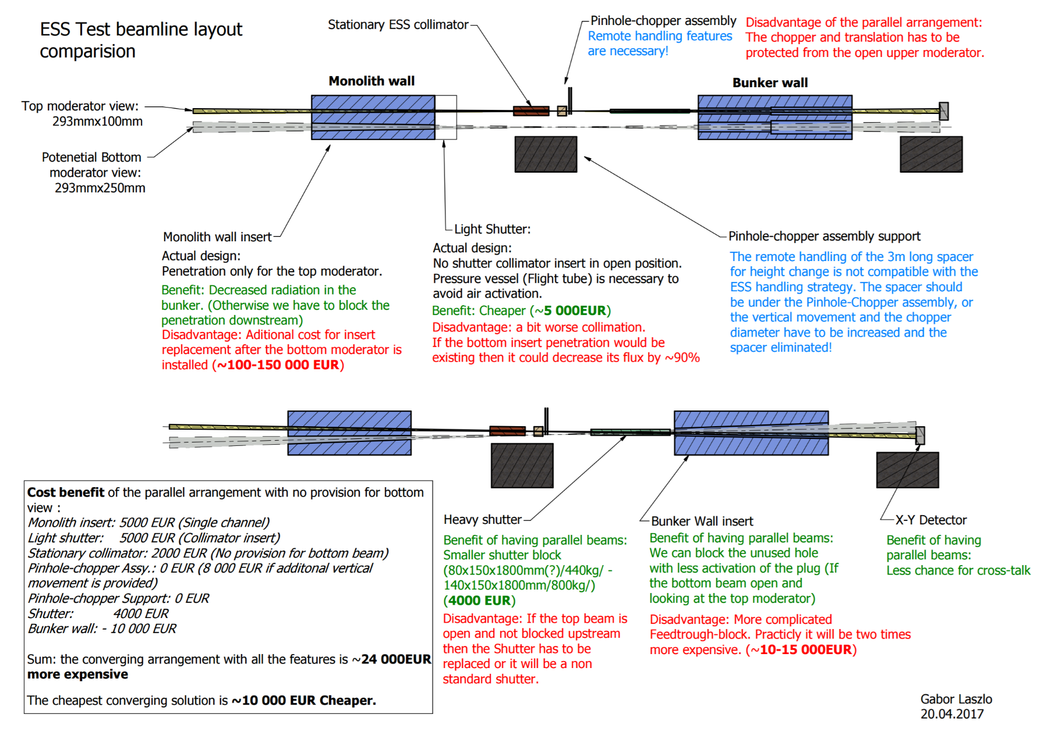
Layout

Slide 6
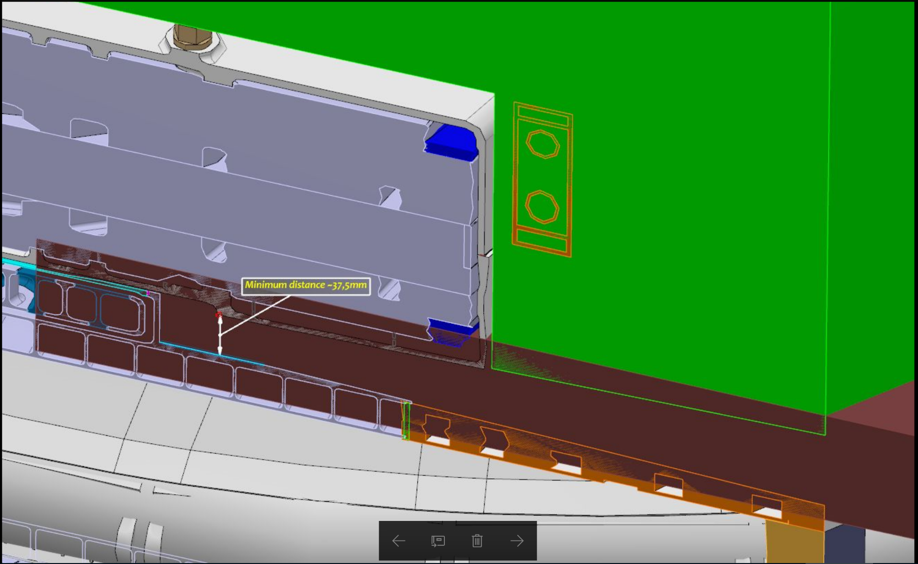
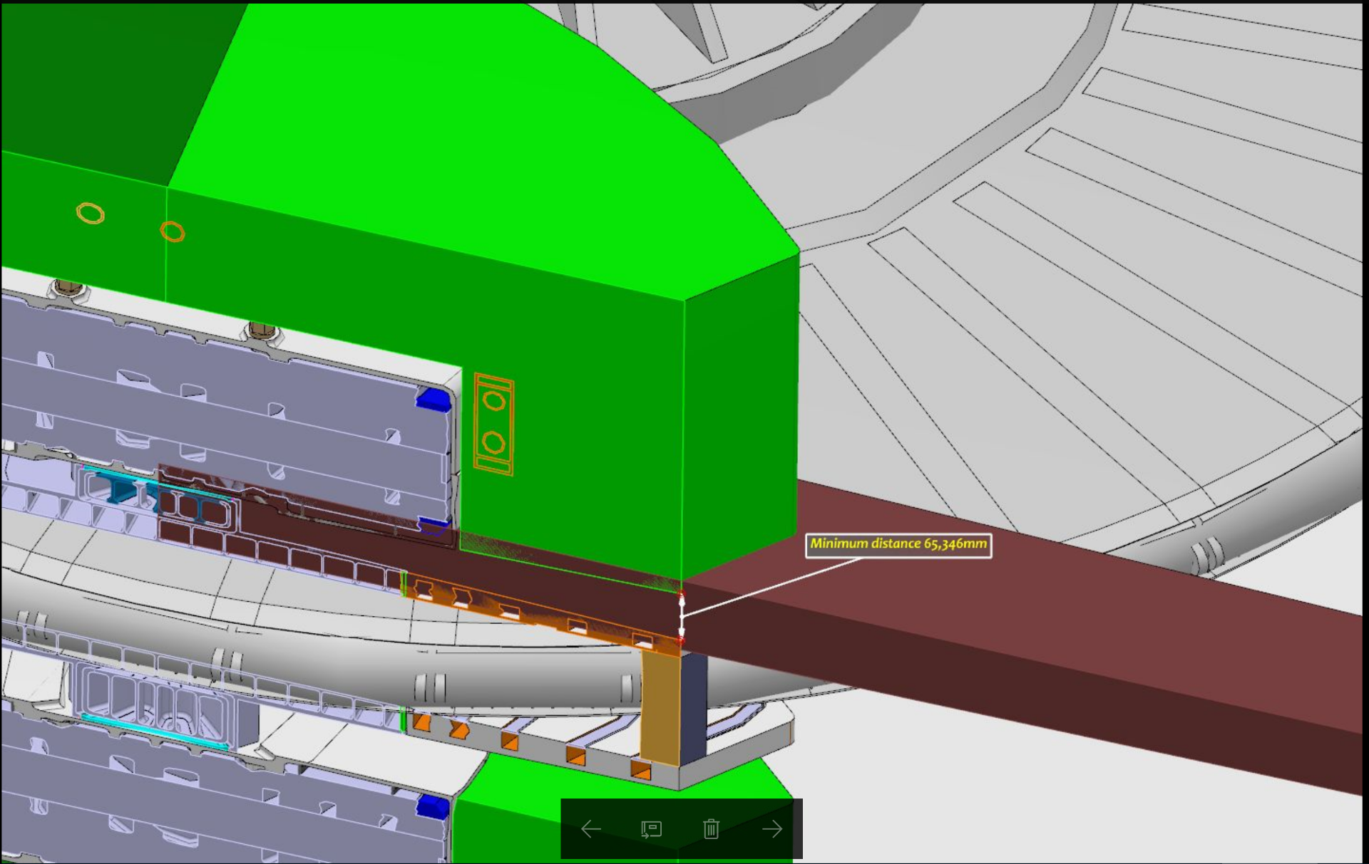
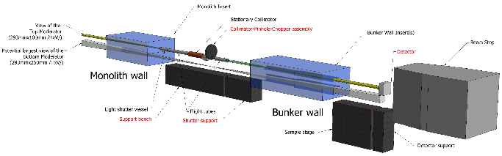
Monolith insert
Notes:
I think it is important to state the scope of delivery by BrightnESS in order to understand how stated operational requirements impact additional investments.
3rd ops requirement, ability to switch between upper and lower moderator, not needed on day 1.

Slide 7
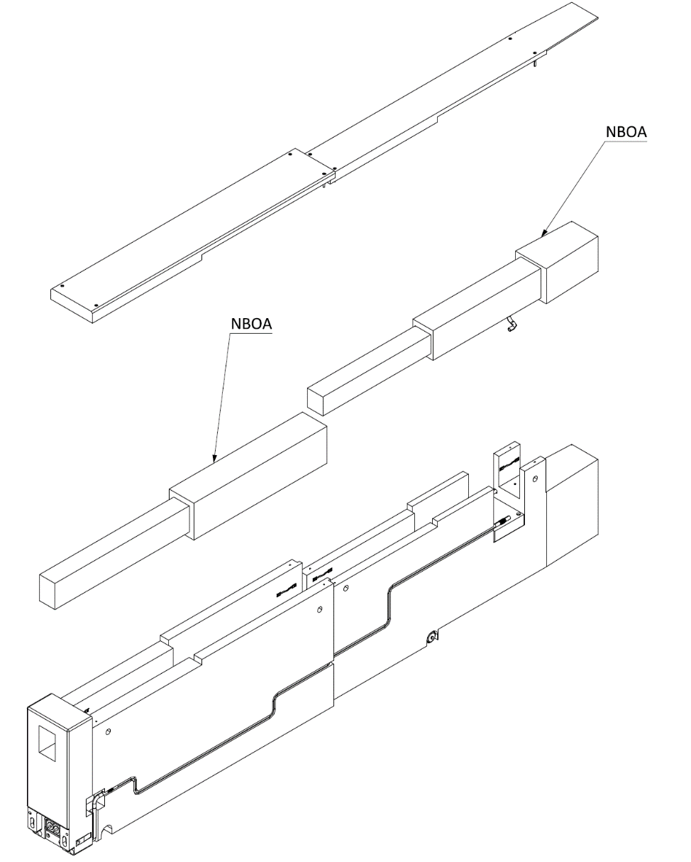
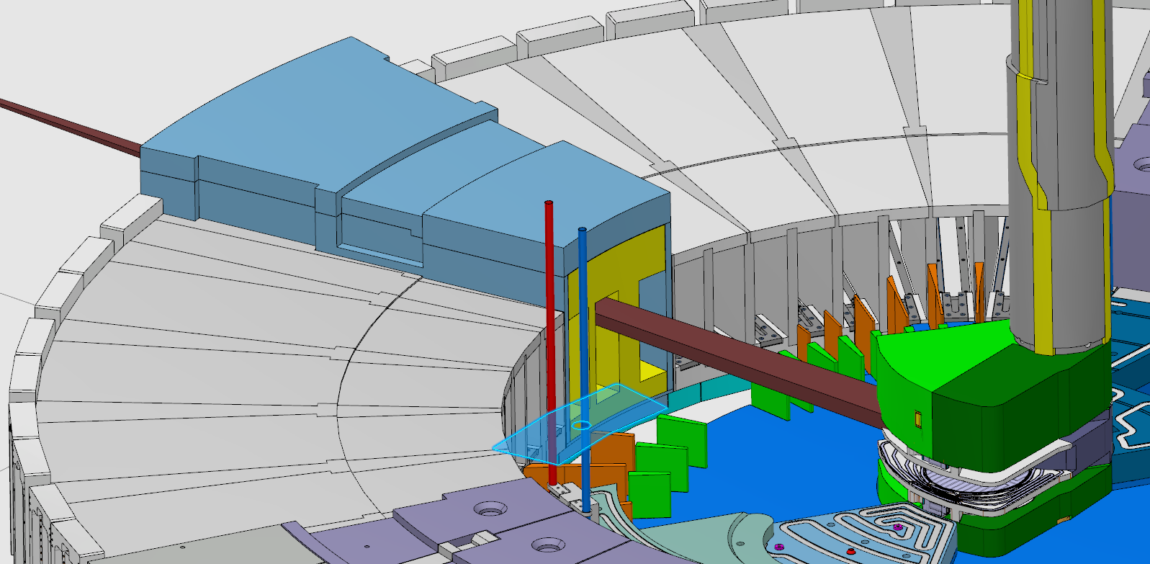
Monolith insert
Notes:
I think it is important to state the scope of delivery by BrightnESS in order to understand how stated operational requirements impact additional investments.
3rd ops requirement, ability to switch between upper and lower moderator, not needed on day 1.

Slide 8

Flight tubes
Simple steel tubes with B4C on the inside
0.5mm thick aluminum windows
Atmosphere
Pump down to 0.01mBar vacuum, measure the characteristics
open the valves, pressurize and re-measure at the same source power, then remove the vacuum system
Notes:
I think it is important to state the scope of delivery by BrightnESS in order to understand how stated operational requirements impact additional investments.
3rd ops requirement, ability to switch between upper and lower moderator, not needed on day 1.

Slide 9
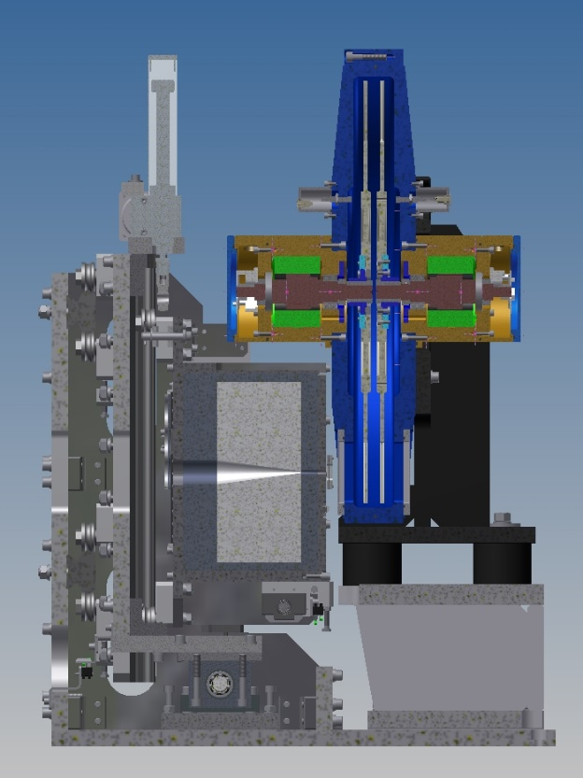
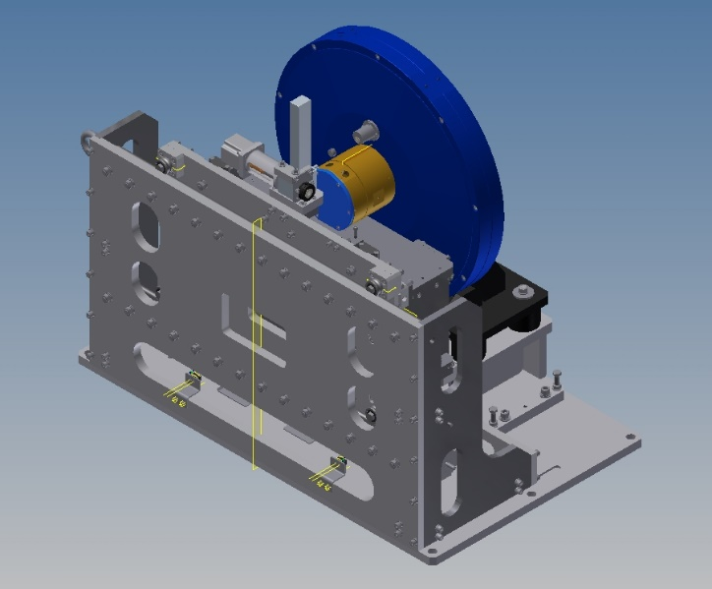
Collimator – Pinhole – Chopper Assembly
Collimator and pinhole translation mechanism
Double disk chopper
Adjustable collimator
Pinhole diaphragm
Attenuator
Notes:
I think it is important to state the scope of delivery by BrightnESS in order to understand how stated operational requirements impact additional investments.
3rd ops requirement, ability to switch between upper and lower moderator, not needed on day 1.

Slide 10
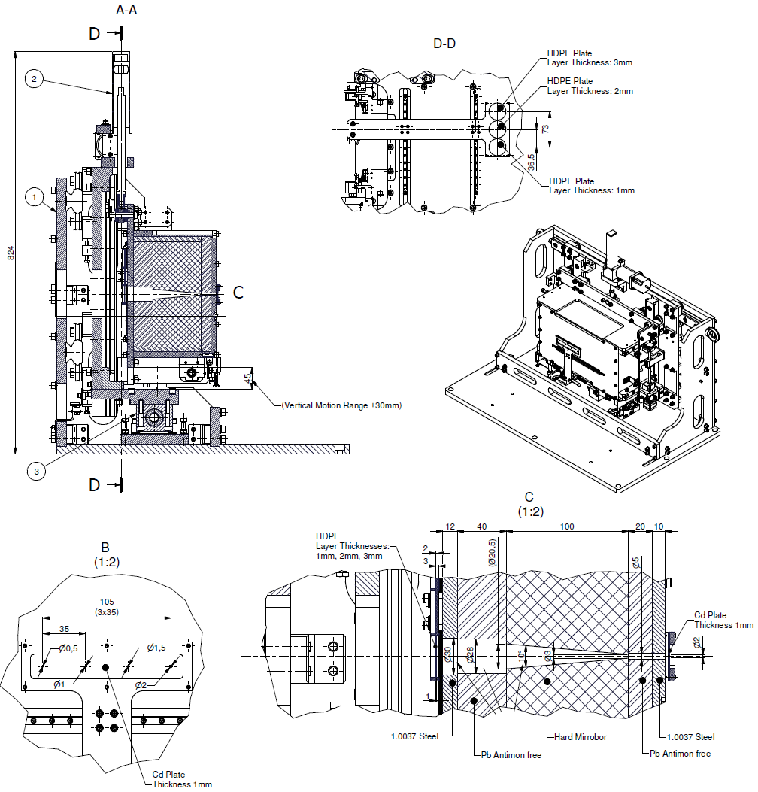
Collimator – Pinhole
Notes:
I think it is important to state the scope of delivery by BrightnESS in order to understand how stated operational requirements impact additional investments.
3rd ops requirement, ability to switch between upper and lower moderator, not needed on day 1.

Slide 11
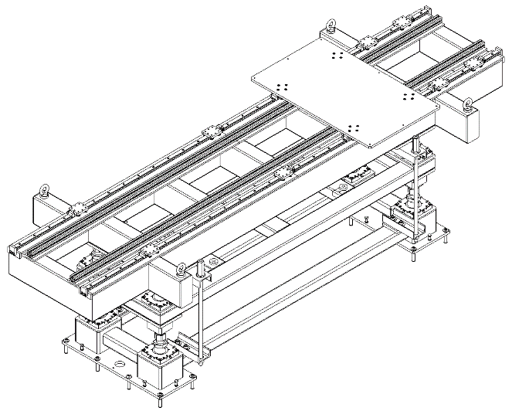
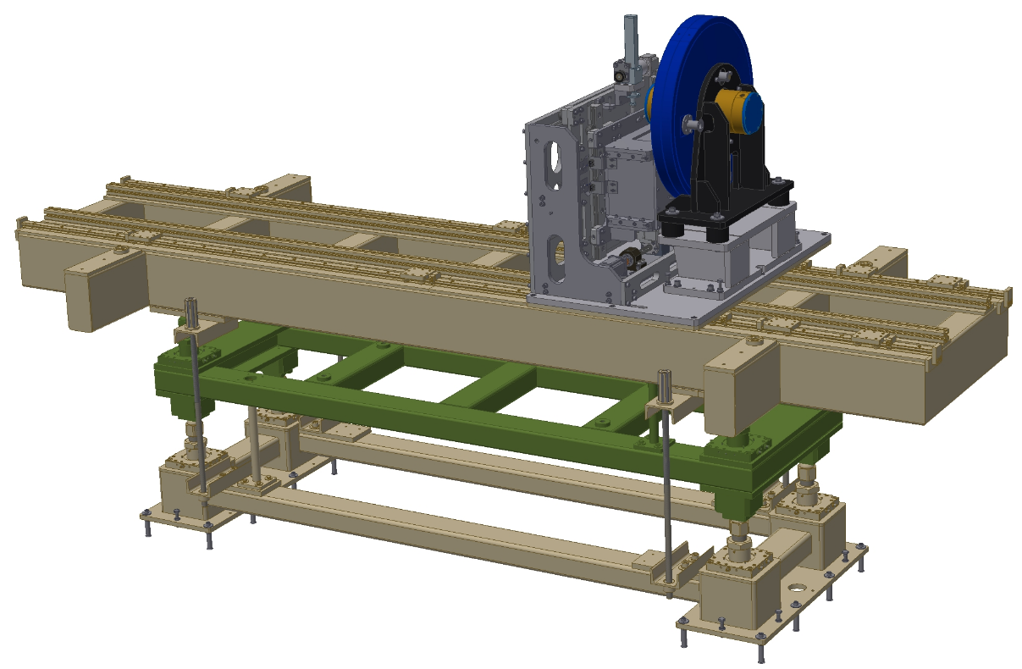
Collimator – Pinhole support
Collimator-Pinhole-Chopper assembly
Top of stage with rails (Optical bench)
Spacer component
Collimator-Pinhole-Chopper assembly
Notes:
I think it is important to state the scope of delivery by BrightnESS in order to understand how stated operational requirements impact additional investments.
3rd ops requirement, ability to switch between upper and lower moderator, not needed on day 1.

Slide 12
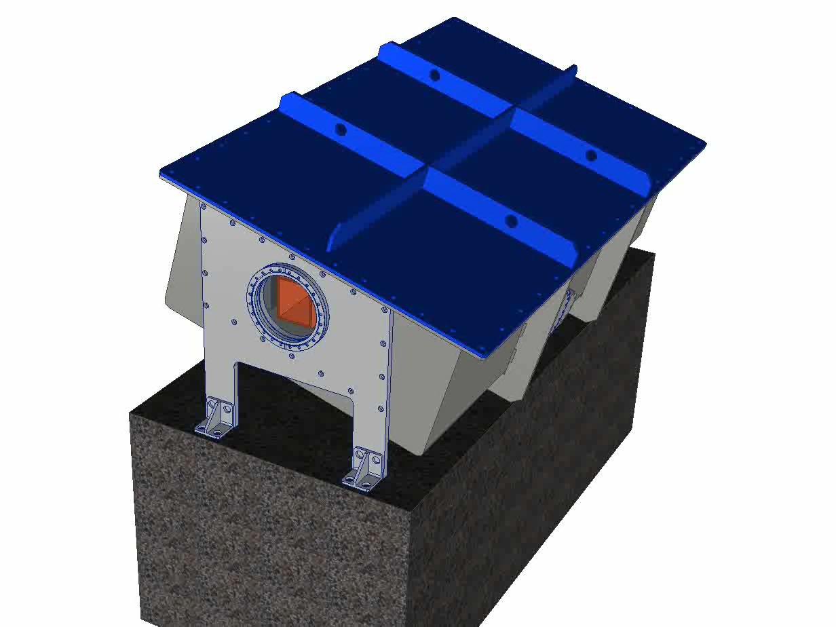
Heavy Shutter
Attenuator block
Pneumatic cylinder
Neutron Guide
Vacuum vessel
Rails
Notes:
I think it is important to state the scope of delivery by BrightnESS in order to understand how stated operational requirements impact additional investments.
3rd ops requirement, ability to switch between upper and lower moderator, not needed on day 1.

Slide 13
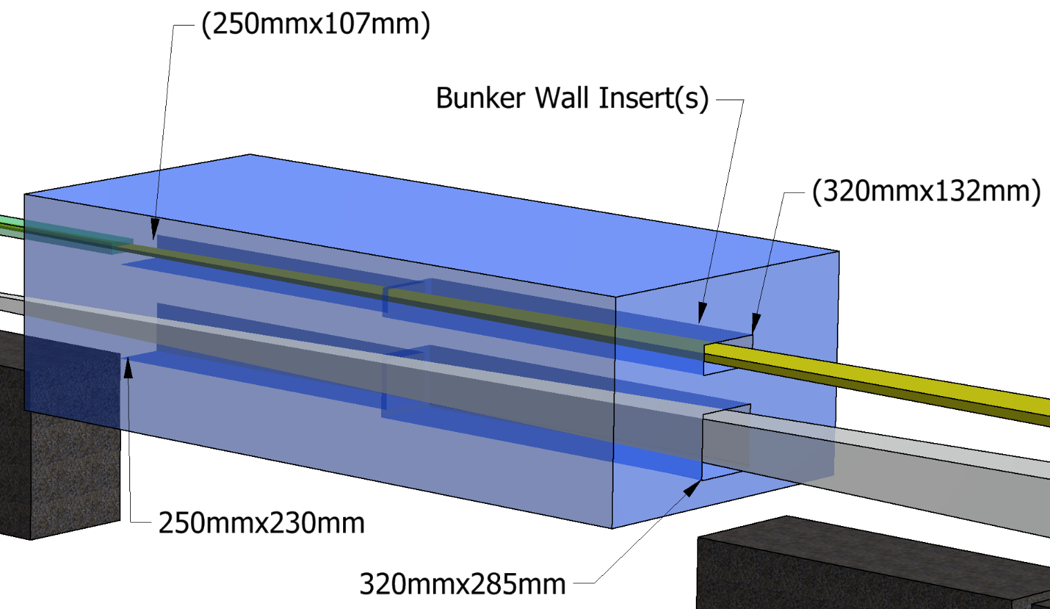
Bunker wall Inserts
Steel inserts with tapered holes
Notes:
I think it is important to state the scope of delivery by BrightnESS in order to understand how stated operational requirements impact additional investments.
3rd ops requirement, ability to switch between upper and lower moderator, not needed on day 1.

Slide 14
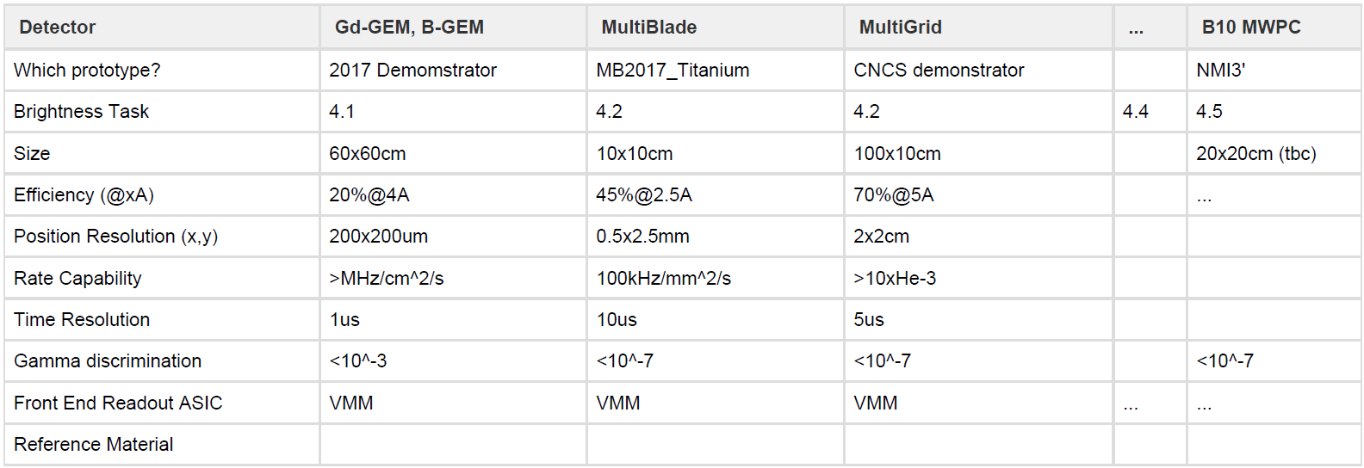
Detector
Notes:
I think it is important to state the scope of delivery by BrightnESS in order to understand how stated operational requirements impact additional investments.
3rd ops requirement, ability to switch between upper and lower moderator, not needed on day 1.

Slide 15
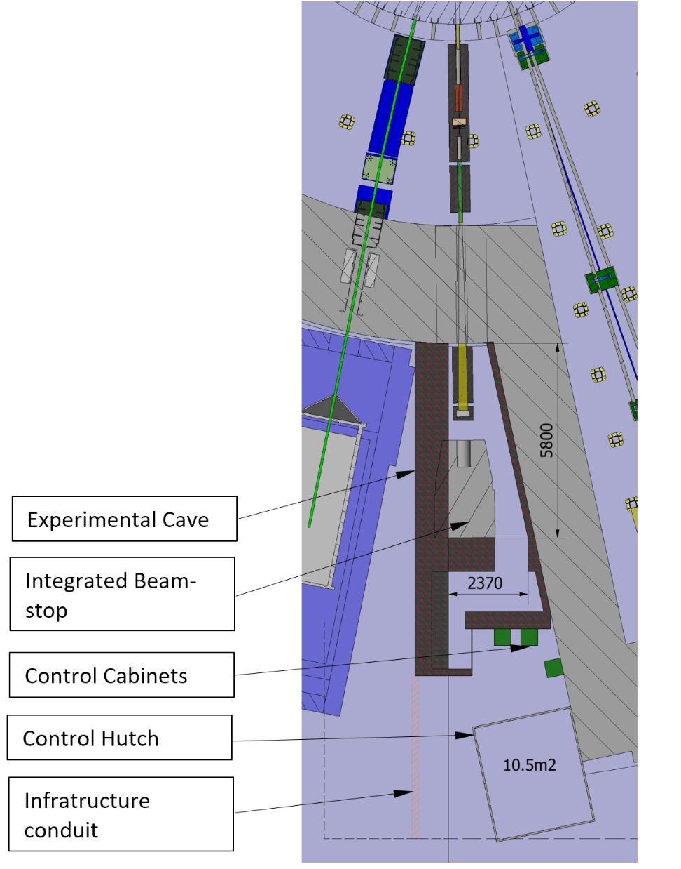
Beam Stop and Cave
Beam stop:
0.3m steel +
3m thick concrete shielding
Draft design for shielding:
B4C layer on the inside of the shielding
Local steel shielding around the sample area (0.3m thick, 2.9mx1mx1m)
0.6m thick concrete shielding
Provision for cave extension
Notes:
I think it is important to state the scope of delivery by BrightnESS in order to understand how stated operational requirements impact additional investments.
3rd ops requirement, ability to switch between upper and lower moderator, not needed on day 1.

Slide 16
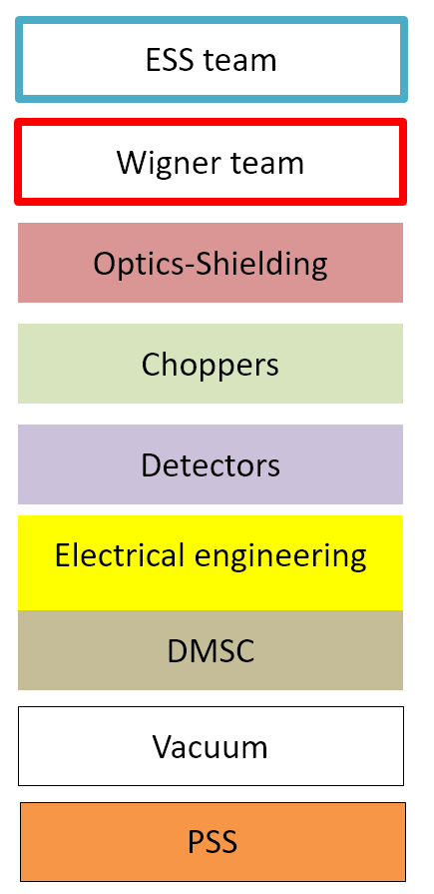
PBS
13.6.24 Test Beamline
13.6.24.6.6 Control Terminals
13.6.24.6.2 Utilities distribution
13.6.24.6 Control Hutch
13.6.24.3.2 Neutron Detector System
13.6.24.3 Scattering Characterization System
13.6.24.2.1 Sample Positioning
13.6.24.2 Sample Exposure System
13.6.24.1.8 Beam Cut Off
13.6.24.1.4 Beam Geometry Conditioning
13.6.24.1.3 Chopper system
13.6.24.1.2 Beam Delivery System
13.6.24.1.1 Beam Extraction System
13.6.24.1 Beam Transport and Conditioning
13.6.24.5.2 Utilities Distribution
13.6.24.5.3 Support Infrastructure
13.6.24.5.4 Shielding
13.6.24.6.5 Hutch Building
13.6.24.8 Utilities Distribution
13.6.24.12 Integrated Control and Monitor.
13.6.24.12.1 Instr. Control & Automation
13.6.24.12.3 DMSC
13.6.24.12.2 Personal Safety System PSS
13.6.24.5 Experimental Cave
13.6.24.1.9 Vacuum system
13.6.24.6.3 Support infrastructure
13.6.24.8.4 Bunker

Slide 17
Budget
 |  | HW | Labor
Monolith Insert |  | 10 000 € | 500 € | (customization+survey)
Flight Tubes |  | 6 000 € | 3 900 €
Flight Tube Support |  | 1 000 € | 3 900 € | (Riding on the MR support)
Double Disk Chopper |  | 0 € | 3 900 €
Chopper Control |  | 0 € | 3 900 € | (Cables(21m), connection plate and standard cabinet)
Collimator system/ Light |  | 0 € | 3 900 € | (With 21m cable)
Collimator system/ Heavy |  | 2 000 € | 3 900 €
Pinhole system |  | 0 € | 3 900 € | (With 21m cable, lifting frame and provisions for remote handling)
Support for collimator, pinhole and chopper |  | 0 € | 3 900 € | (Support for Beam conditioning)
Light Shutter insert |  | 1 500 € | 1 000 € | (Argon filled tube+survey)
Heavy shutter with support |  | 0 € | 3 800 €
Shutter attenuator |  | 8 000 € | <- | (1.8m long copper attenuator)
Bunker wall inserts |  | 40 000 € | 5 000 € | (2pcs. Wall inserts)
Sample stage |  | 1 500 € | 2 500 €
Beam stop |  | 15 000 € | 10 000 € | (~8m3 concrete+B4C)
Beam delivery and chopper vacuum system |  | 15 400 € | 12 000 € | (1pc. 20m pipe with four connections (ISO DN40) and four gauges for the flight tubes + Vacuum pump+Vacuum control)
Neutron Detector |  | 35 000 € | 15 000 € | (2D Detector+ cabinet + Cables+PSS beam monitor)
Neutron Detector Stage |  | 1 500 € | 3 000 €
Cave |  | 175 000 € | 93 000 € | (60m3, design+build)
Motion Control Integration |  | 31 000 € | <- | (Cables from the connection plates to the cabinet /21m/)
Motion Control Cabinet |  | 0 € | 2 000 €
PSS |  | 58 000 € | <- | (Cables to Heavy shutter switches(4pcs.), Cave interlock, PSS cabinet and connection to the main PSS system)
DMSC&ICS |  | 35 000 € | <-
Power infrastructure+Compressed air |  | 40 000 € | <- | (20m cable for In-buker cabinets+ 80m cable from substation for detector and SE + distribution cabinet+PSS UPS)
Hatch |  | 20 000 € | 15000
Shipping, packing |  | 1 200 € | 2 900 € | (1400 km, 1 crate+pallets)
Comissioning |  |  | 8 000 € | (5 days, 1.5 person)
Expected compatibility issues |  | 30 000 € |  | (PLC replacement, remote handling...)
Management and administration |  |  | 140 000 € | (Robin, Travel, meetings, occassional other things)
 |  | 527 100 € | 344 900 €
Sum |  | 872 000 €
 | 01 Phase 1 | 02 Project Management & Integration | 03 Design | 04 Procurement & Fabrication | 05 Installation | 06 Cold Commissioning | Total
01 Shielding | € 0 | € 0 | € 61 000 | € 190 000 | € 42 000 | € 0 | € 293 000
02 Beam delivery | € 0 | € 0 | € 4 500 | € 68 500 | € 25 300 | € 0 | € 98 300
03 Chopper | € 0 | € 0 | € 0 | € 0 | € 4 000 | € 1 000 | € 5 000
04 Sample Environment | € 0 | € 0 | € 2 000 | € 1 500 | € 500 | € 0 | € 4 000
05 Detector and Beam Monitors | € 0 | € 0 | € 5 000 | € 35 000 | € 5 000 | € 5 000 | € 50 000
06 Data Acquisition and Analysis | € 0 | € 0 | € 5 000 | € 15 000 | € 15 000 | € 1 000 | € 36 000
07 Motion Control and Automation | € 0 | € 0 | € 10 000 | € 10 000 | € 10 000 | € 1 000 | € 31 000
08 Instrument Specific Technical Equipment | € 0 | € 148 000 | € 15 000 | € 35 000 | € 20 000 | € 0 | € 218 000
09 Instrument Infrastructure | € 0 | € 0 | € 5 000 | € 24 000 | € 10 000 | € 1 000 | € 40 000
10 Vacuum | € 0 | € 0 | € 5 000 | € 15 400 | € 7 000 | € 1 000 | € 28 400
11 PSS | € 0 | € 0 | € 20 000 | € 18 000 | € 30 000 | € 5 000 | € 73 000
12 Contingency |  |  |  |  |  |  | € 78 500
Total | € 0 | € 148 000 | € 132 500 | € 412 400 | € 168 800 | € 15 000 | € 955 200
FTE | 0,0 | 1,1 | 1,2 | 0,0 | 1,6 | 0,1 | 4,0

Slide 18
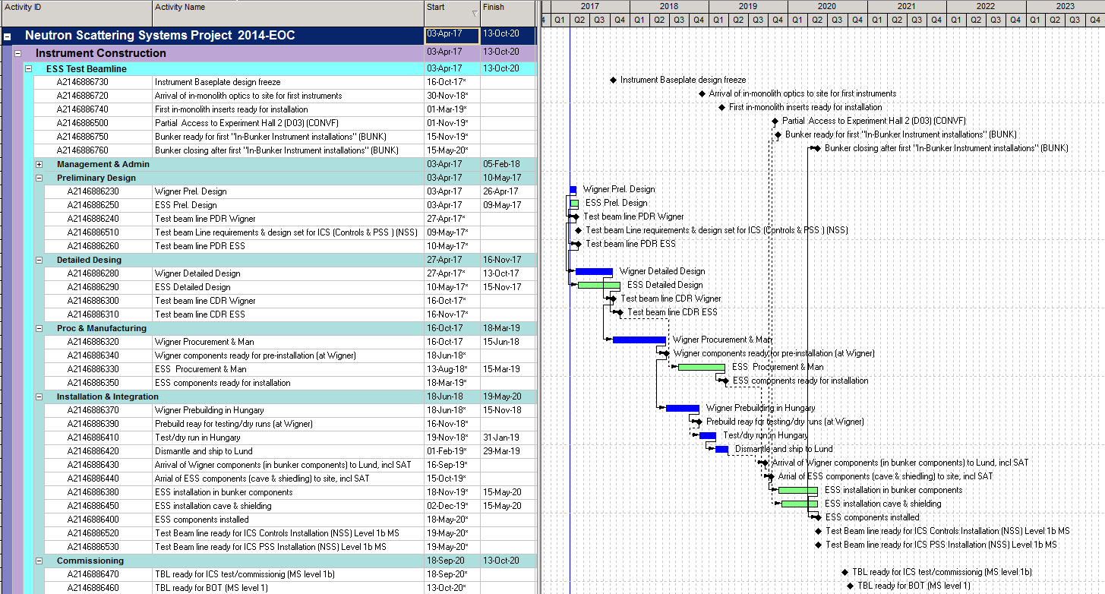
Schedule

Slide 19
Thank You!

Slide 20
Risk
Technical
 | Probability | Consequence | Risk level | Mitigation
Shielding does not meet requirements
High background in cave
Cost
Underestimated price and design of shielding
Increased cost exceeds available contingency
Schedule
Delays in procurement
InDelays in deliveries

Slide 21
BrigthnESS project
BrightnESS Goal: Help ESS!
" Special effort will be devoted by the ESS-Wigner collaboration to the experimental testing of moderators. A particular contribution from Wigner side is to propose the development and experimental realisation of the beam extraction monitoring by energy sensitive pinhole imaging (ESPI) technique. The planned moderator testing and characterisation equipment is proposed to be realized as a full-scale prototype instrument in two versions: one for the ESS test beam-line, and another for the reactor environment at BRR."

