Slide 1
Test Beamline System Requirements and Charge to PDR Committee
Shane Kennedy
NSS Project Leader
ESS TBL Preliminary Design Review
23 May 2017

Slide 2
Purpose & scope
To verify that the project has successfully delivered beam on target, and to characterize the pulsed neutron beam emitted from the upper moderator (time structure, spatial distribution, energy dependence etc.)
To characterize the moderator for the purpose of calibration of neutron beam instruments, to provide data to inform the development detectors and data processing systems
To serve in development of key neutron technologies, such as optical components, choppers and detector systems (through TBL upgrade path)
To provide valuable data for moderator development over the operating life of the ESS.
Upgradeable to view lower moderator & extendable for more applications

Slide 3
Accelerator & Moderator Characterization
Proton beam:
  power, energy, current, frequency, pulse length, raster
Target:
  variability of target wheel, moderator, proton beam window over lifetime & on replacement
  all have limited life ( from months to years at full power)

Slide 4
Schedule & responsibilities
ESS-TBL MUST be delivered in time for beam on target (15 October 2020).
Delivery of the test beamline will be achieved in collaboration of three projects (NSS, Target and a Brightness funded project, managed by the Wigner Institute)
  NSS Project has overall responsibility for delivery, for the cave & it’s contents, for safety interlock system (through ICS), for instrument control & data management (through DMSC).
  Target Division is responsible for in-monolith components: collimator and window, (and a light shutter –if needed) and
  the Brightness Project is responsible for specific in bunker components (i.e. heavy shutter, and optical bench with aperture, filters and disc chopper system).

Slide 5
Charge to the PDR Committee (s. 1/3)
To assess whether the design has progressed far enough to support the proposed technical and performance management baseline and is ready to proceed to the detailed/final design phase.
The focus should be on the ESS part, but compatibility of the Wigner (BrightnESS) components with the ESS framework should also be considered.

Slide 6
Charge to the PDR Committee (s. 2/3)
Specific questions that the committee should address:
Have system requirements been defined and are they complete and adequate enough to ensure acceptable system performance?
Is the proposed design expected to meet the functional and performance requirements, and are interfaces properly identified and defined?
Have appropriate options and alternatives been considered in selecting the design approach? Are there further value engineering opportunities that should be considered?
Is the proposed design sufficiently mature to proceed to final design?
Have major project risks and safety hazards been identified, characterized, and mitigated where appropriate?
Is the project plan and cost estimates reasonable?

Slide 7
Charge to the PDR Committee (s. 3/3)
The PDR Report:
Written report:
  Comments and recommendations in two categories,
  issues that need to be addressed prior to proceeding to final/detailed design, and
  issues that should be addressed in due course during the final design process.
Close-out report (today):
  Preliminary summary of issues to be addressed prior to proceeding to detailed design

Slide 8
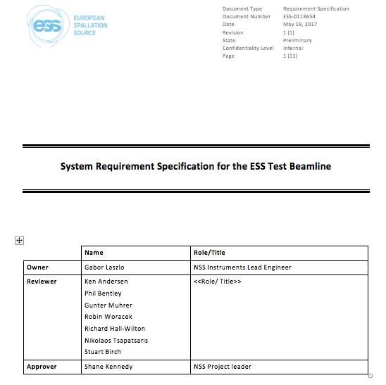
DRAFT TBL System Requirements Document

Slide 9
DRAFT TBL System Requirements (s. 1/4)
Beam Transport and Conditioning and Detector Systems
Wavelength Range – from 0.5 Å to 30 Å from the thermal and cold moderator surfaces
Wavelength Resolution – selectable wavelength resolutions from 0.2% to 4%.
Field of View – able to project the full image of the top moderator and the pre-moderator surfaces (300mm x 38 mm).
Pinhole Size – several settings up to 2 mm.
Background – Noise to Signal ratio less than 20%
Chopper – Operation speeds from 7Hz to at least 14Hz
Detection system – capable making measurement at source power from 50kW to 5MW.

Slide 10
DRAFT TBL System Requirements (s. 2/4)
Scattering Characterization System
Detector Area – able to record an image of the complete moderator in one shot.
Spatial resolution – effective resolutions of down to at least 3 mm.
Time resolution – detector time resolutions down to 100 usec
Maximum Count rate – > 10⁶ n/cm²/sec
Beam Stop – attenuation of a direct beam to a level < 3 µSv/hr outside Experimental Cave

Slide 11
DRAFT TBL System Requirements (s. 3/4)
Experimental Cave
Access - Cave shall provide access to all components downstream the bunker wall
Design - designed to allow easy extension of the beamline in case of future needs.
Biological shielding - shall prevent access to the cave while beam is on or safety monitor is triggered.
Dose attenuation - dose rate on outer surface of cave < 3 µSv/h when the shutter is open.
Beam access height - floor to beam axis height of 1.25 ± 0.1 m along beam for manual manipulations.
Cave Entry – to allow movement of personnel & apparatus up to 1m wide × 0.8 m thick × 2.5 m tall.
Object accommodation - Access from the roof possible for heavy or large objects.
Utilities - to have the provisions for standard sample environment feed-through to allows installation of future sample environment infrastructure, and one 10A x 230V (one phase) power line.

Slide 12
DRAFT TBL System Requirements (s. 4/4)
Control Hutch
Instrument control terminal(s) - shall allow the user to remotely control the technical components from dedicated computer terminals
Detector terminals - shall allow the user to remotely control detector systems from dedicated computer terminals, view live streams of detectors and store the data.
Data reduction terminal - shall allow the user to process the neutron data
Comfort - should be a comfortable working environment for up to 3 users.

Slide 13
Requirements of ESS Test Beam Line (TBL)
Operational Requirements (project scope):
Characterization of moderators & simple tests (e.g. optical & shielding devices) possible from Day 1.
Detector and testing station accessible when beam is on target.
Compliant with technical standards and maintenance requirements.
Assuming installation of a lower moderator remains within project scope: Ability to switch between the upper & lower beam ports without changing in monolith components.
Safety Requirements:
Design to be fully compliant with radiation safety standards of ESS
Meets SSM licensing requirements
No significant air activation in bunker (evacuated flight-path)
Project Requirements:
Low (minimal) investment cost
Upgradable to full scope test beamline (including extendability in length).
Compatible with Brightness funded TBL project (i.e. integration of scope and schedule).
Minimal schedule risk to availability for Beam On Target (BOT).
Notes:
I think it is important to state the scope of delivery by BrightnESS in order to understand how stated operational requirements impact additional investments.
3rd ops requirement, ability to switch between upper and lower moderator, not needed on day 1.

Slide 14
Test Beam line concept
Principles:
As defined in operational, safety and project requirements.
The pin-hole aperture for the test beam line is to be placed near the midway point between the monolith face and the inner wall of the bunker. e.g. ~ 8.5 metres from source.
This allows to view the whole width of the moderator(s) (~ 30 cm) with magnification 1 at an image plane of 17 metres (i.e. 2 - 3 metres beyond the outer wall of the bunker) without moving the pinhole.
If a lower moderator is installed and the test beamline used to characterize it, this would leave ample space at the face of the monolith for two independent heavy shutters (one for each moderator)
Two TBL concepts were considered,
where both moderators are installed (initial baseline), or
only upper moderator is installed (current baseline)
In each case the heavy shutter is placed in the upstream position, to minimize radiation entering the bunker and remove the need for a light (γ ray) shutter. However there may be a case to place the heavy shutter in a downstream position, just inside the bunker wall, to reduce scattering to neighbouring beam lines and facilitate maintenance of the shutter. In this case a light shutter may be needed for work on the upstream components of the TBL. Radiation dose distributions of these two possibilites should be simulated to determine the best option.
Notes:
Placement of a heavy shutter starting at R=5.5m may incur costs associated with changing the current light shutter design (i.e., removing the light shutter and instead accommodating the placement of a heavy shutter at this position. It may be cheaper to keep the current light shutter option in the design and instead start the heavy shutter at R=6m.

