Slide 1
Shielding and Neutronics for the test beam line
Valentina Santoro ESS

Slide 2
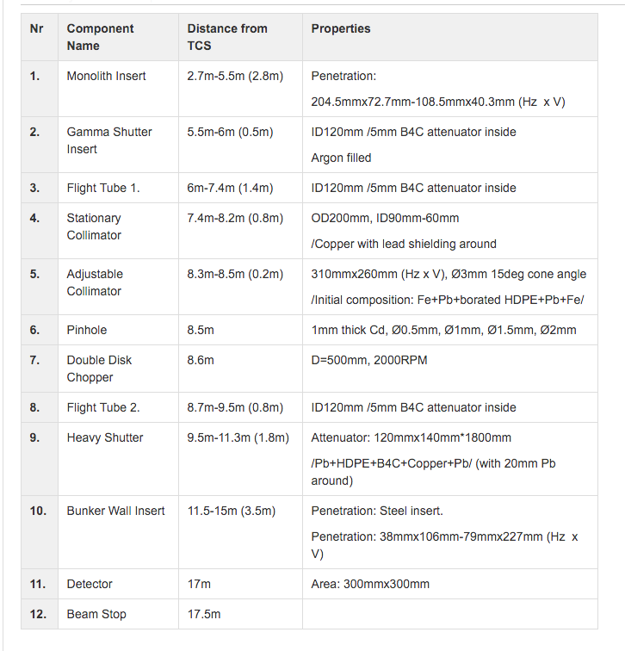
Test Beam line description (from Gabor)

Slide 3
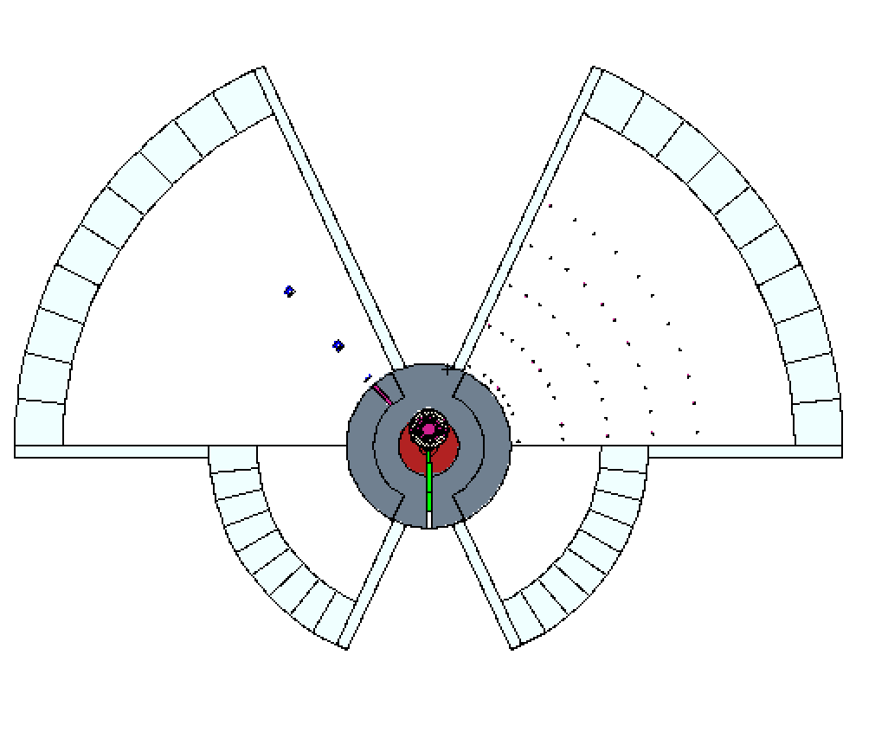
The MCNP model
Engineering Model
MCNP Model
SOUTH
WEST
EAST
NORTH
MCNP Model for target +Bunker+instrument hall +instrument cave
produced with Comblayer package developed by Stuart Ansell
https://github.com/SAnsell/CombLayer

Slide 4
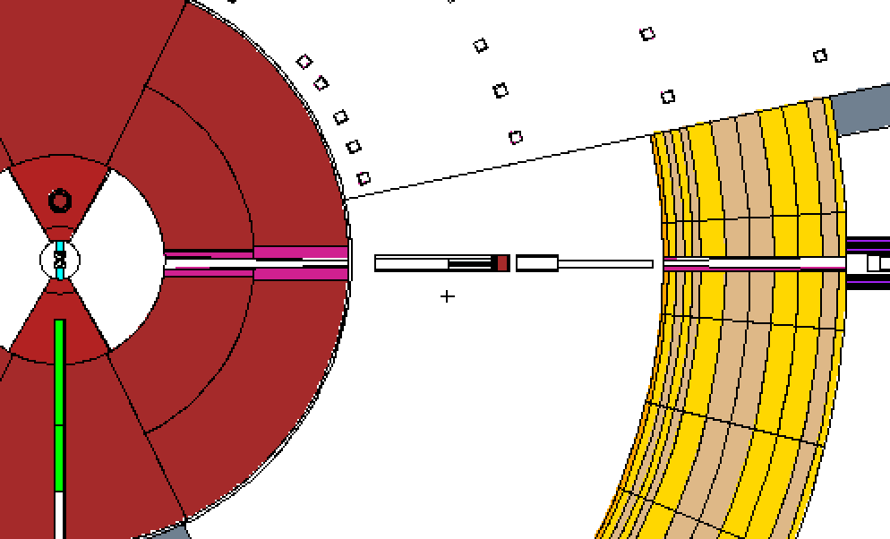
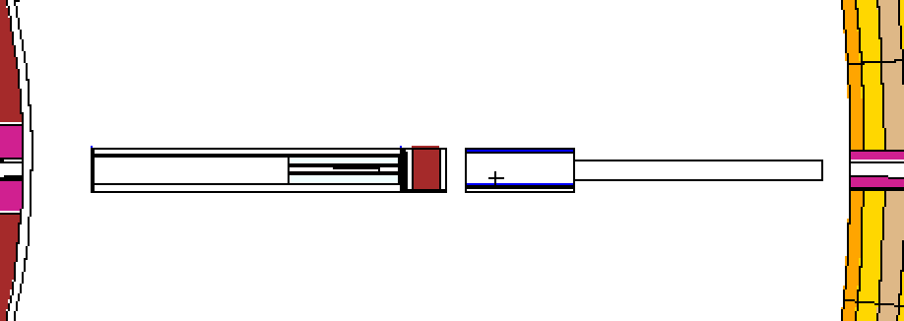
Test Beam Line @ W11 (I)
Zoom in the bunker region
Second
Collimator
First Collimator
Heavy Shutter
Pin-Hole

Slide 5
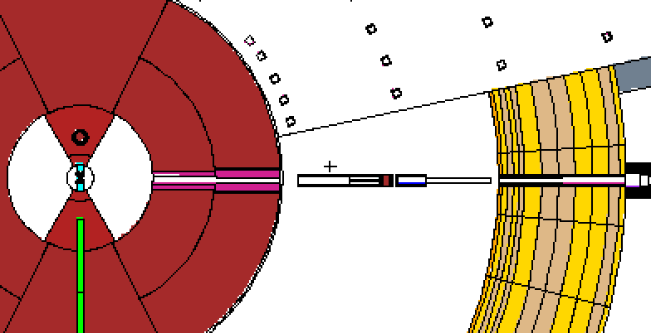
Test Beam Line @ W11 (II)
T0 Chopper
Spectrum and dose map
computed at the exit of the bunker wall ~15m after the moderator

Slide 6
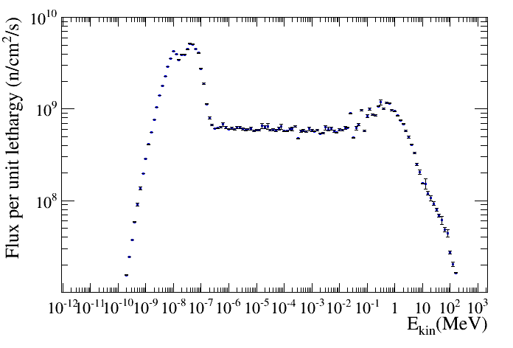
Neutron Energy Spectrum Out of the monolith
5.5m

Slide 7
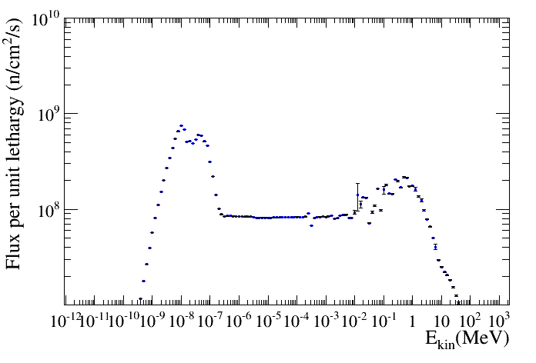
Neutron Energy Spectrum before the pin-hole
8.5m

Slide 8
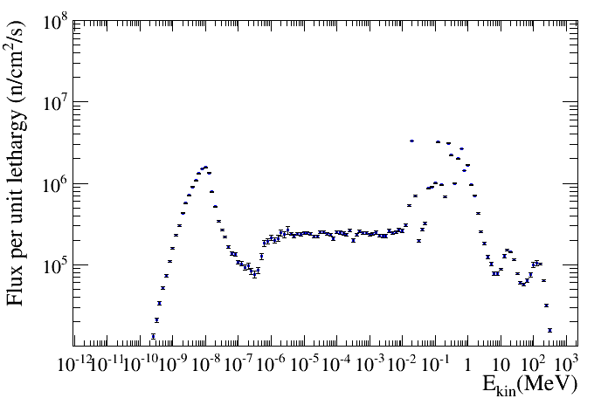
Neutron Energy Spectrum out the bunker wall
15 m

Slide 9
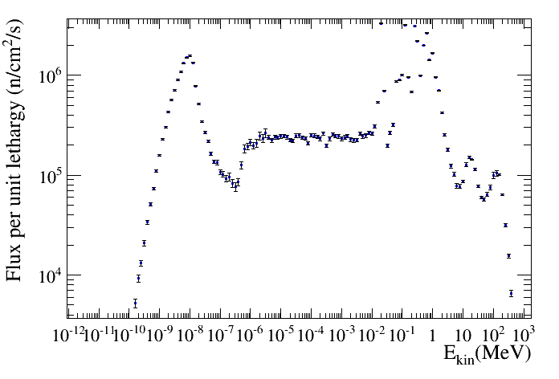
Spectrum out of the Bunker wall
Iron resonance
Cadmium pin-hole

Slide 10
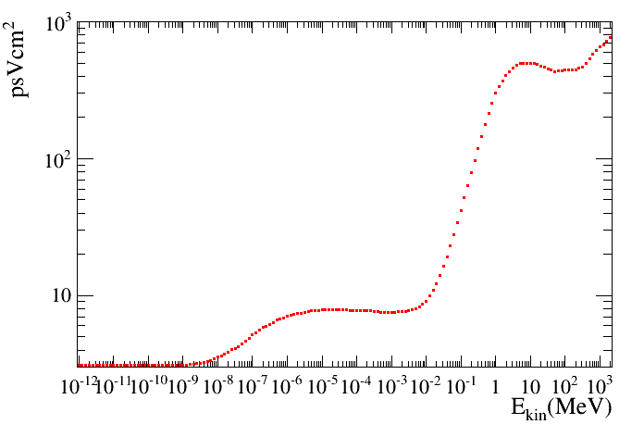
Dose conversion factor vs neutron energy

Slide 11
Some numbers
Φ= 1.28039e+07 (n/s*cm²)
(~15 m, out of the Bunker wall)
Total number of neutrons =Φ x Α =3.08087e+09
(~15 m, out of the Bunker wall)
A is the size of the opening at the end of the bunker
Wall
Total dose= 1100 Sv/h (~15 m, out of the Bunker wall)

Slide 12
The plots shown previously are produced
running from protons
Running from protons is easy if you need to estimate
the radiation dose in a point or a spectrum in a point
To produce dose map we need a source term

Slide 13
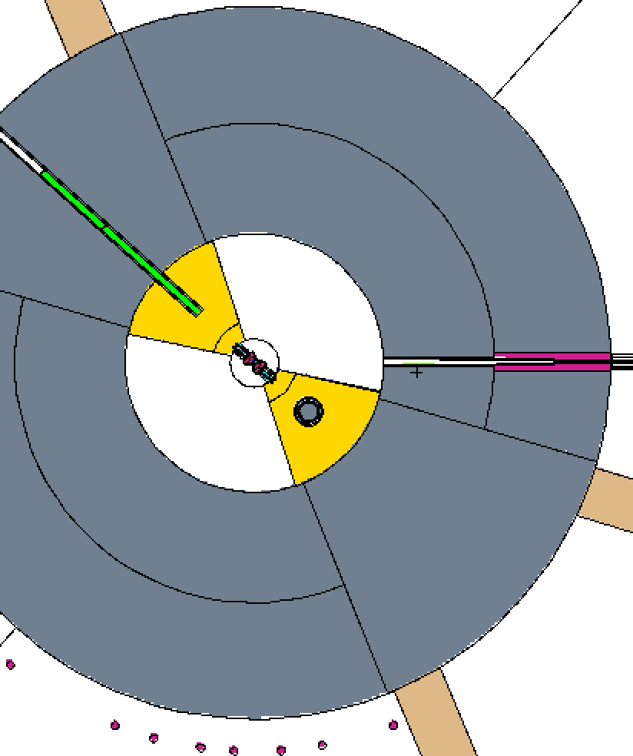
Source term @ 2m position (1)
Proton Beam
Zoom of the BeamLine in in the target region
Monolith
Beam Line
Moderator
2m from the moderator entrance of the beam line
The source term has been computed with the size of the aperture given on slide 2

Slide 14
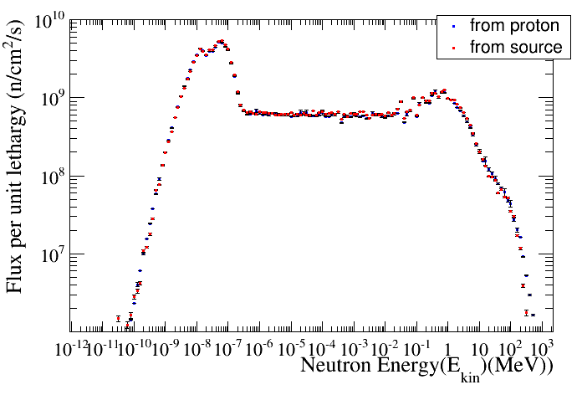
Source term @ 2m position (2)
The spectrum at 5.5m looks the same starting from proton and from source

Slide 15
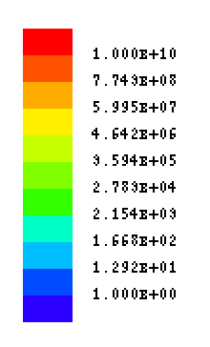
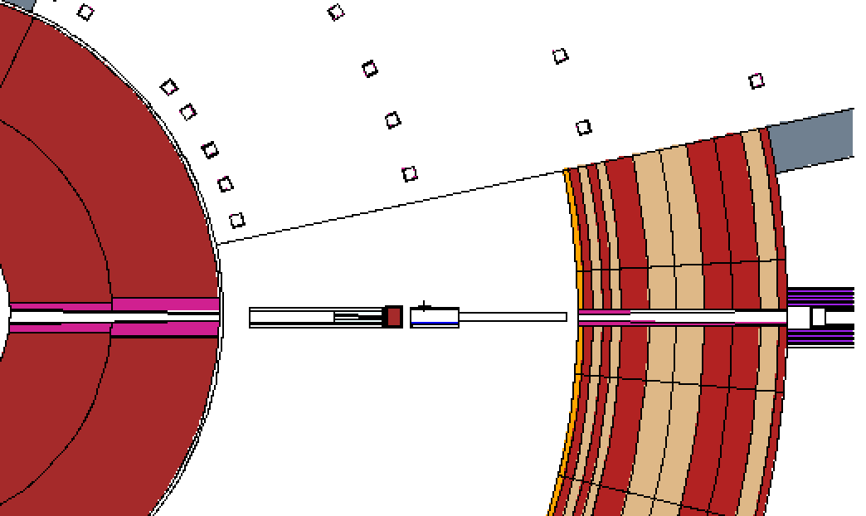
Dose Map of the test beam line (I)
μSv/h
1000Sv/h

Slide 16
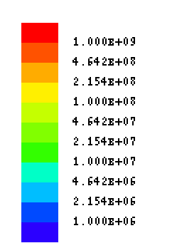
Dose Map of the test beam line (II)
Effect of copper collimator
μSv/h

Slide 17
HEAVY SHUTTER SIMULATIONS
The dose map you will see in the next slides are neutron dose map
The photon dose do not contribute out of the bunker wall

Slide 18
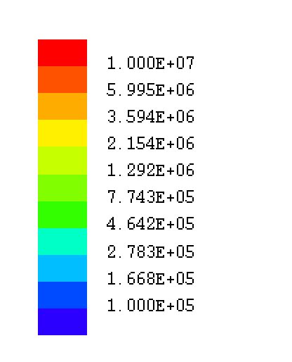
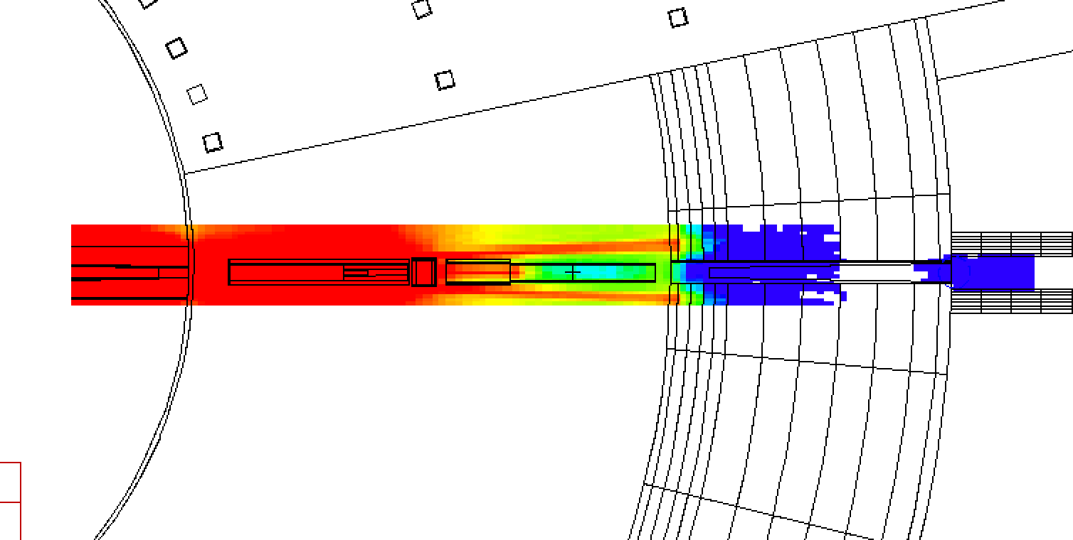
Heavy Shutter simulation
μSv/h
1.8 m of steel
30 μSv/h

Slide 19
Heavy Shutter simulation
μSv/h
2.2 m of steel
25 μSv/h

Slide 20
Heavy Shutter simulation
μSv/h
1.5 μSv/h
1.5 m of copper /steel

Slide 21
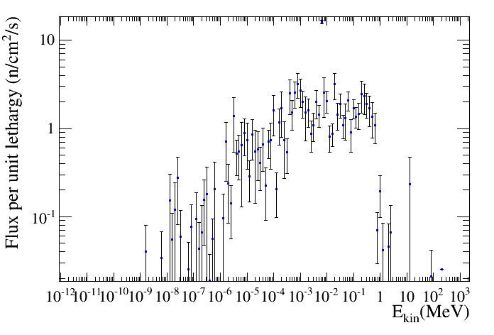
Spectrum out of the bunker with heavy shutter closed
If I converted this spectrum to
dose I obtain 2.5 μSv/h

Slide 22
Summary
Detailed geometry in place (everything is parameterized so easy to change)
We have information in almost all the point around the beam line
Heavy shutter design on – going almost finalized
Calculation of the activation of the current heavy shutter will be done soon
A new source term must be produced since there have been changes in the aperture of the monolith

