Slide 1
TBL Chopper System Neutronic Performance
N. Tsapatsaris
Neutron Chopper Group
www.europeanspallationsource.se
23 May, 2017

Slide 2
TBL Instrument Layout
Collimator/ Pinhole
Band Choppers
Moderator
Detector
2x2mm²
3 cm
0 m
8.5 m
8.6 m
Ø 50 cm,
5° slit
17 m

Slide 3
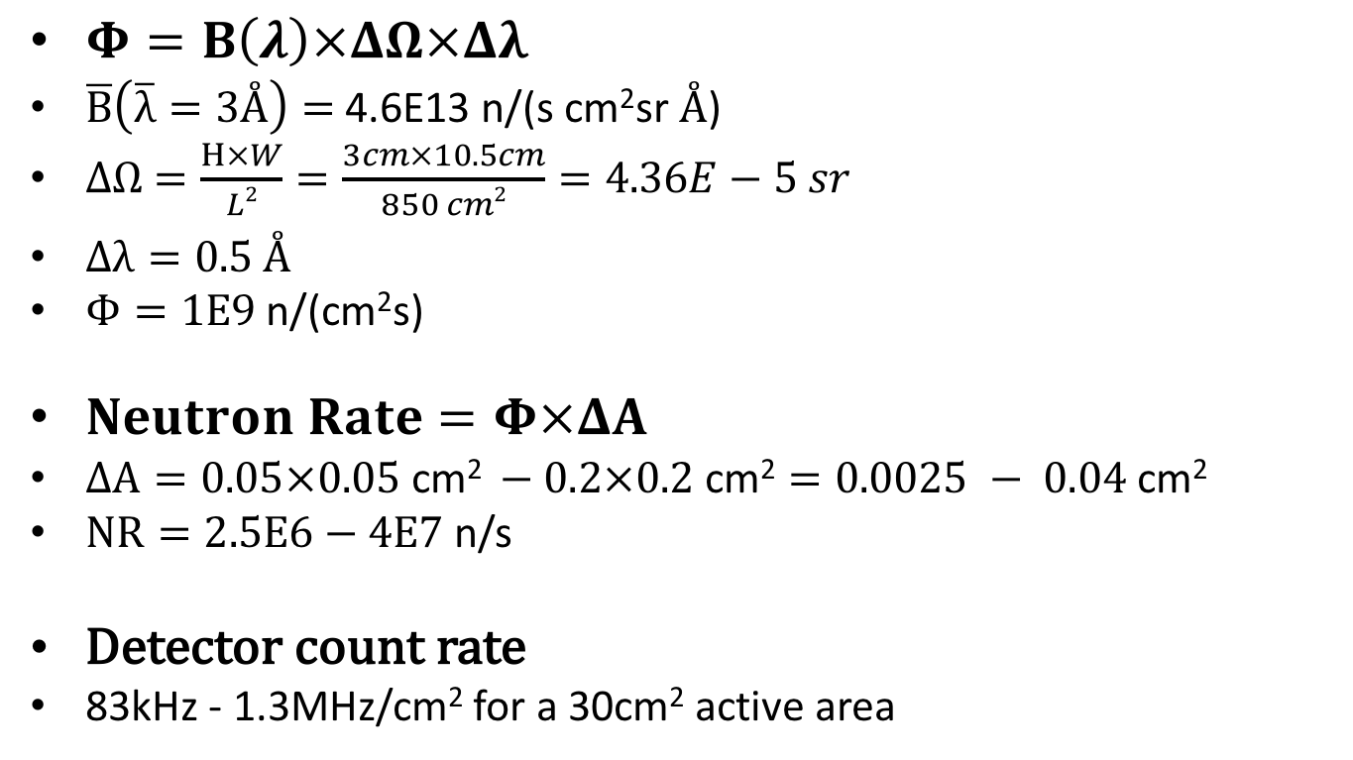
Flux at collimator exit
$Φ=B\left(λ\right)×ΔΩ×Δλ$
$\overline{B}\left(\overline{λ}=3Å\right)=$ 4.6E13 n/(s cm²sr $Å$)
$ΔΩ$ $=\frac{H×W}{L2}=\frac{3cm×10.5cm}{850 cm2}=4.36E−5 sr$
$Δλ=0.5 Å$
$Φ=1E9$ n/(cm²s)
$Neutron Rate=Φ×ΔA$
$ΔA=0.05×0.05 \text{cm}\text{2} −0.2×0.2 \text{cm}\text{2}=0.0025 − 0.04$ cm²
$NR=2.5E6−4E7$ n/s
Detector count rate
83kHz - 1.3MHz/cm² for a 30cm² active area

Slide 4
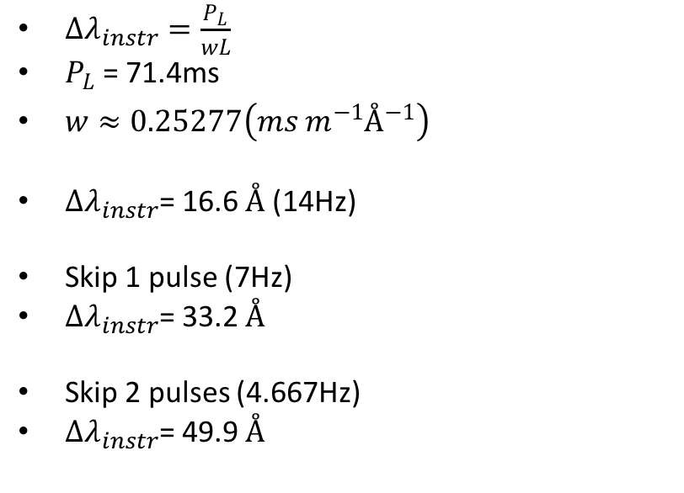
Instrument wavelength range
$∆λ_{instr}=\frac{P_{L}}{wL}$
$P_{L}$ = 71.4ms
$w≈0.25277\left(ms m^{−1}Å^{−1}\right)$
$∆λ_{instr}$= 16.6 $Å$ (14Hz)
Skip 1 pulse (7Hz)
$∆λ_{instr}$= 33.2 $Å$
Skip 2 pulses (4.667Hz)
$∆λ_{instr}$= 49.9 $Å$
17 m
0 m

Slide 5
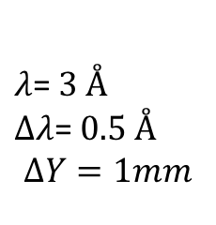
Useful wavelength range due to gravitation
$λ$= $3 Å$
$∆λ$= $0.5 Å$
$$∆Y=1mm$$

Slide 6
Chopper Permissible Bandwidth
1slit/rev
2slit/rev

Slide 7
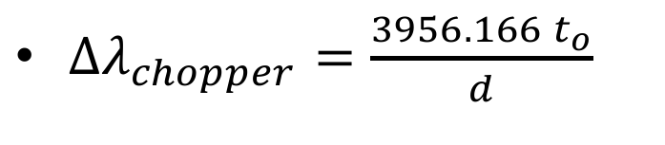
Chopper Permissible Bandwidth
$∆λ_{chopper}=\frac{{3956.166 t}_{o}}{d}$

Slide 8
Instrument wavelength resolution

Slide 9
Improving the λ resolution – reducing slit size

Slide 10
Frame overlap

Slide 11
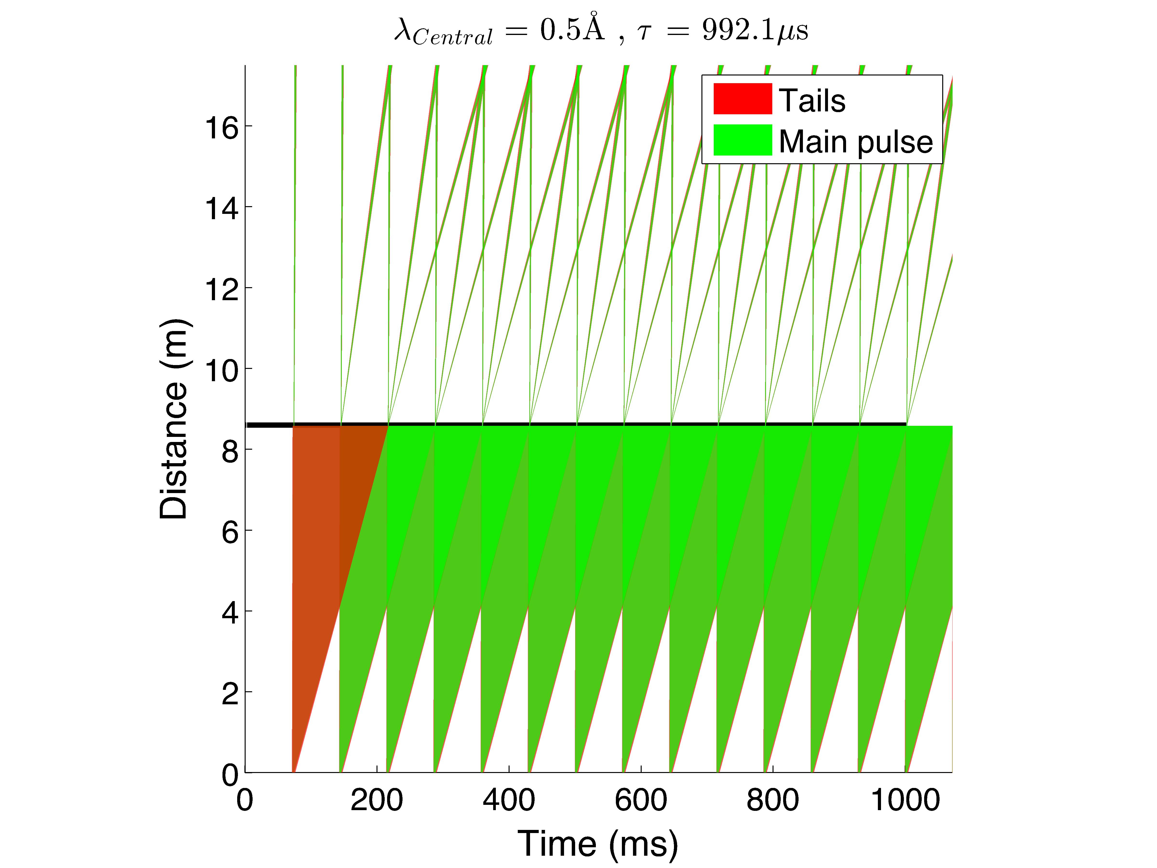

Frame overlap in TOF

Slide 12
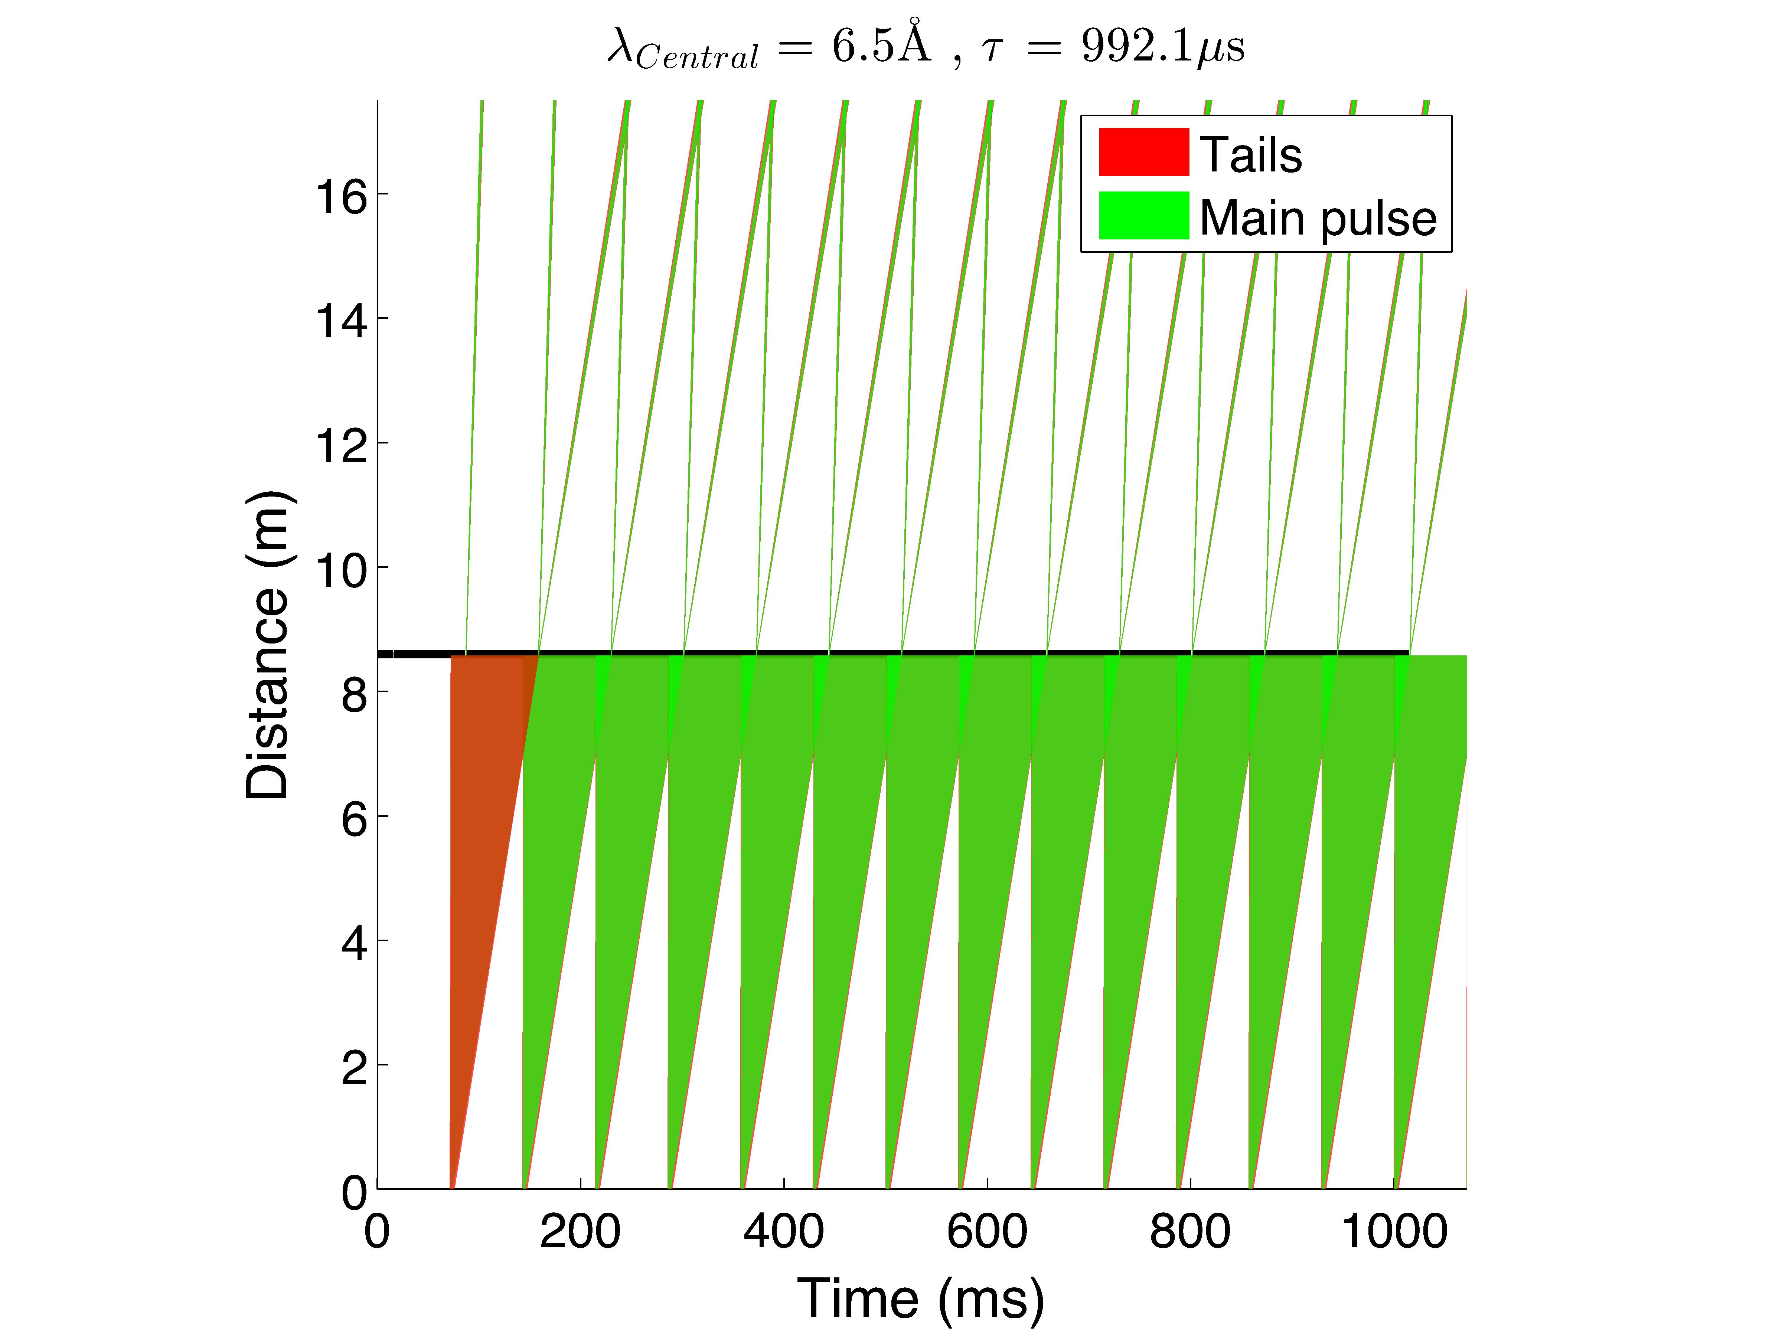

Frame overlap in TOF

Slide 13
Prompt pulse effect on λ_{min}
Minimum wavelength without prompt pulse
d=17m, @ 1.4 msec, λ_{min}=0.33 Å, S/N~2/1-1/1
At 2.86 msec λ_{min}=0.67 Å, S/N=10/1-2/1
At 6 msec, λ_{min}=1.4 Å, S/N>1E3
Depending on the decay time of the ESS pulse and the high energy neutron/gamma discrimination we expect a variation of the S/N ratio

Slide 14
Chopper disk absorber

Slide 15
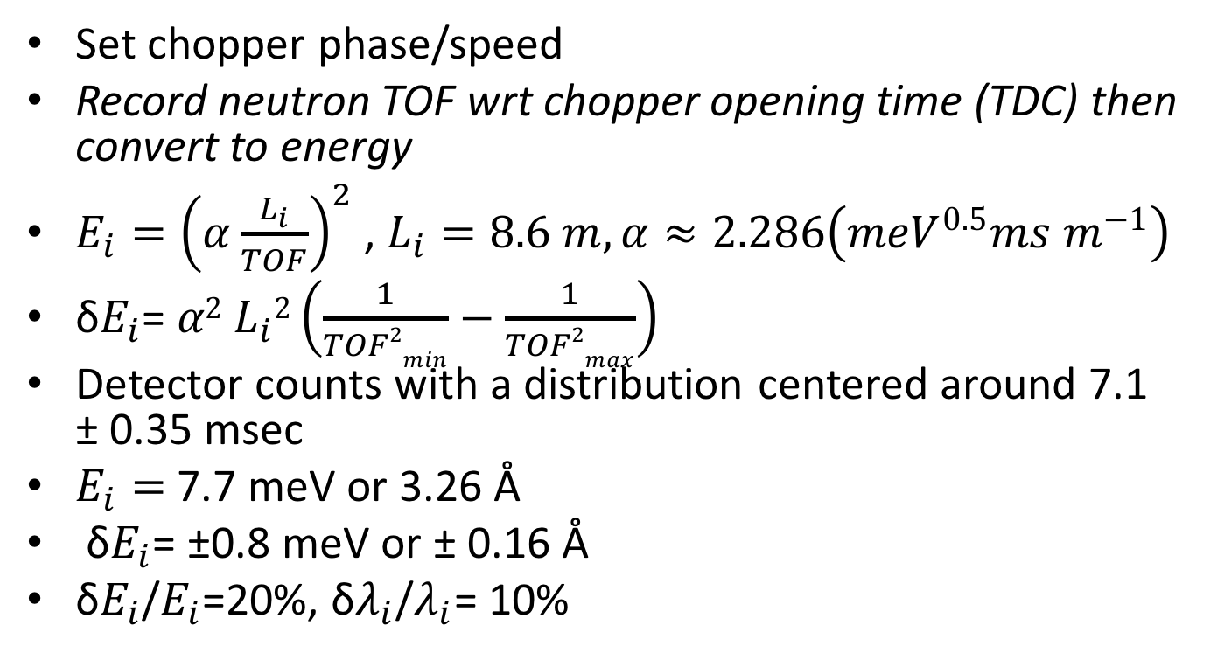
Determination of neutron energy
Set chopper phase/speed
Record neutron TOF wrt chopper opening time (TDC) then convert to energy
$E_{i}={\left(α\frac{L_{i}}{TOF}\right)}^{2}$ , $L_{i}=8.6 m, α≈2.286\left({meV}^{0.5}ms m^{−1}\right)$
δ$E_{i}$= $α2$ $L_{i}2\left(\frac{1}{TOF2min}−\frac{1}{TOF2max}\right)$
Detector counts with a distribution centered around 7.1 ± 0.35 msec
$E_{i}=$ 7.7 meV or 3.26 Å
δ$E_{i}$= ±0.8 meV or ± 0.16 Å
δ$E_{i}$/$E_{i}$=20%, δ$λ_{i}$/$λ_{i}$= 10%

