Slide 1
RF introduction
Anders Sunesson RF group leader
(assistance from the RF group kindly acknowledged)
www.europeanspallationsource.se
LLRF component PDR, May 30, 2017

Slide 2

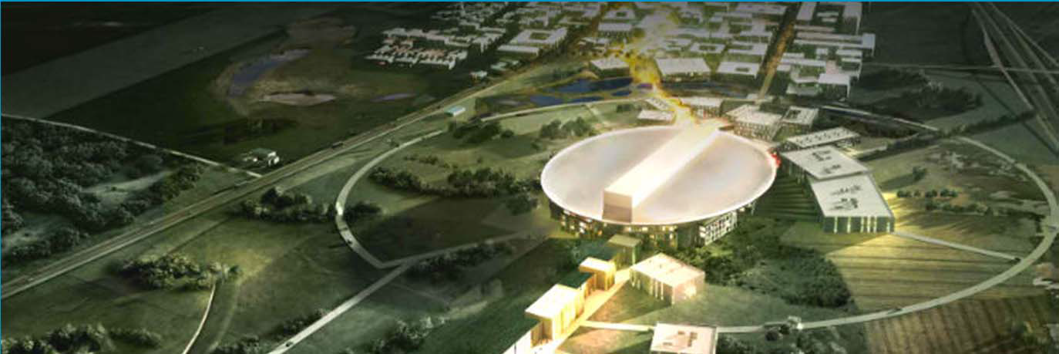


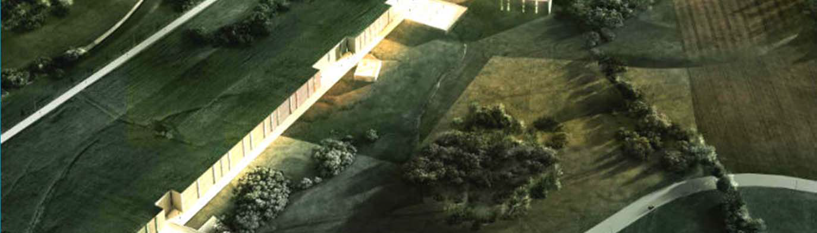
An artists impression of ESS

Slide 3
Overview
RF ESS status
Subsystems:
    HV modulators
    RF sources
    RF distribution systems
    Phase reference, master oscillator
    RF local protection system
    LLRF system
Installation
Next steps

Slide 4
Types: RFQ, MEBT, DTL, Spoke, M/H beta
352.21 MHz
704.42 MHz
2.4 m
4.5 m
3.6 m
40 m
54 m
75 m
174 m
Target
Source
LEBT
RFQ
MEBT
DTL
Spokes
Medium β
High β
HEBT & Contingency
75 keV
3.6 MeV
90 MeV
220 MeV
570 MeV
2000 MeV
 | Energy (MeV) | Frequency /MHz | No. of Cavities | βg | Temp / K | RF power /kW
Source | 0.075 | - | 0 | – | ~300 | –
LEBT | 0.075 | - | 0 | – | ~300 | –
RFQ | 3.6 | 352.21 | 1 | – | ~300 | 1600
MEBT | 3.6 | 352.21 | 3 | – | ~300 | 15
DTL | 90 | 352.21 | 5 | – | ~300 | 2200
Spoke | 220 | 352.21 | 26 (2/CM) | 0.5 βopt | ~2 | 330
Medium β | 570 | 704.42 | 36 (4/CM) | 0.67 | ~2 | 870
High β | 2000 | 704.42 | 84 (4/CM) | 0.86 | ~2 | 1100
HEBT | 2000 | – | 0 | – | ~300 | –

Slide 5
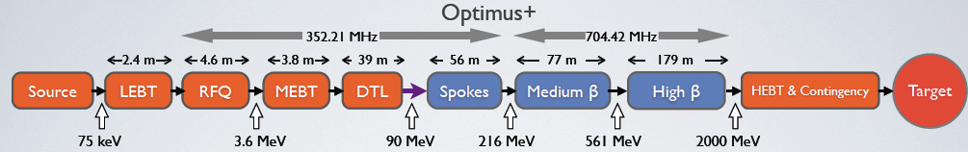
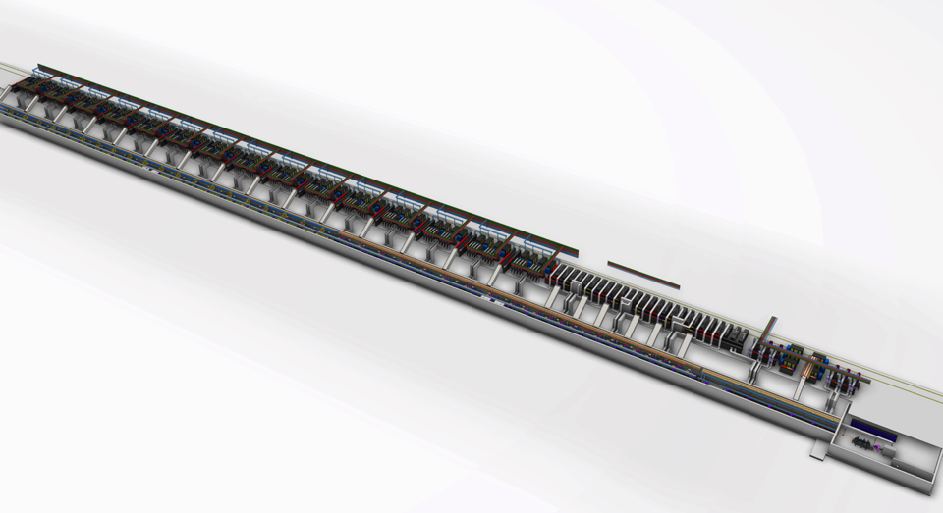
ESS Linac Layout
High beta RF
DTL RF
Medium beta RF
Low Energy Front end
Spoke RF
High beta cryomodules
Medium beta cryomodules
Spoke cryo-modules
DTL tanks

Slide 6
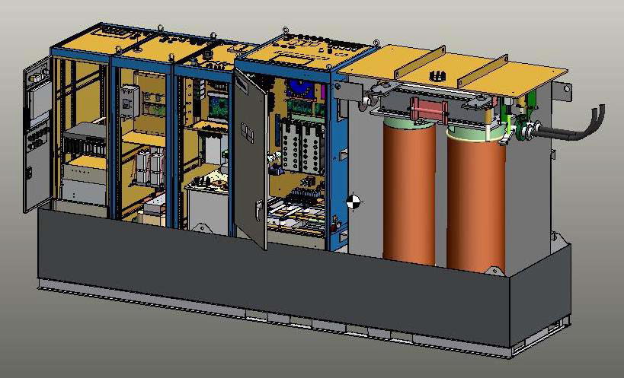
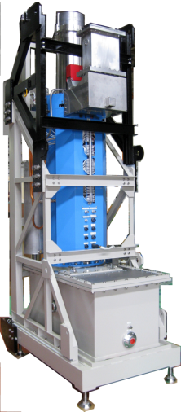
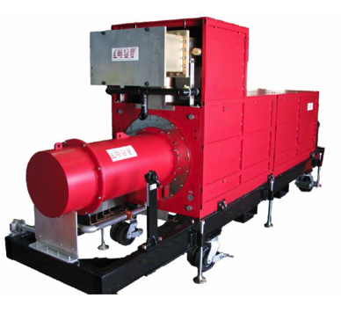
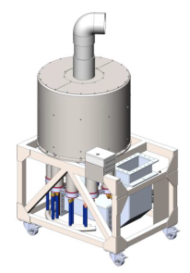
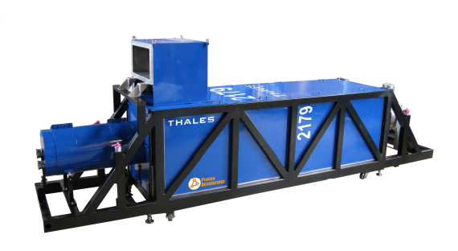
RF systems: the power to accelerate
Many, bulky, costly (~450 k€ per meter cavity length)
Consumes vast amounts of power and needs cooling
Many interfaces

Slide 7
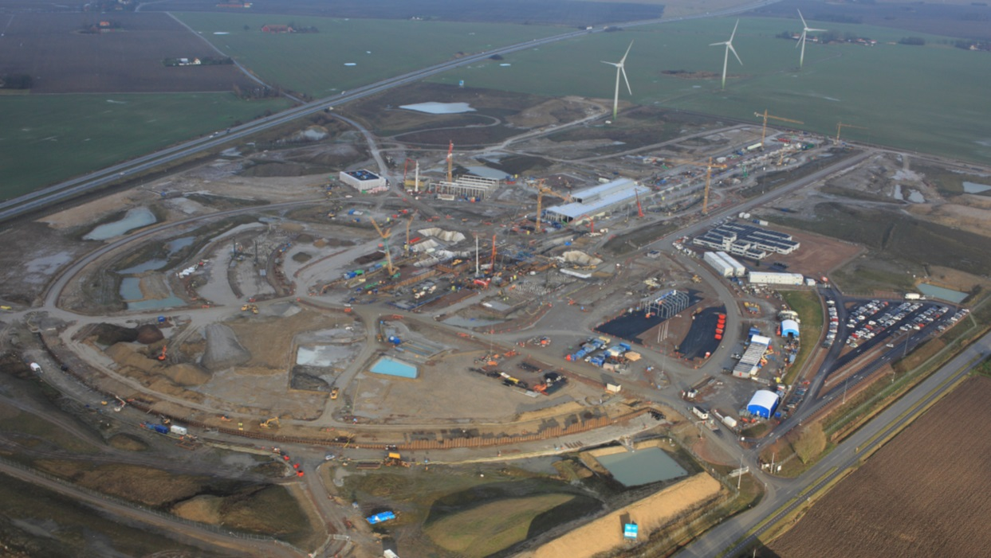
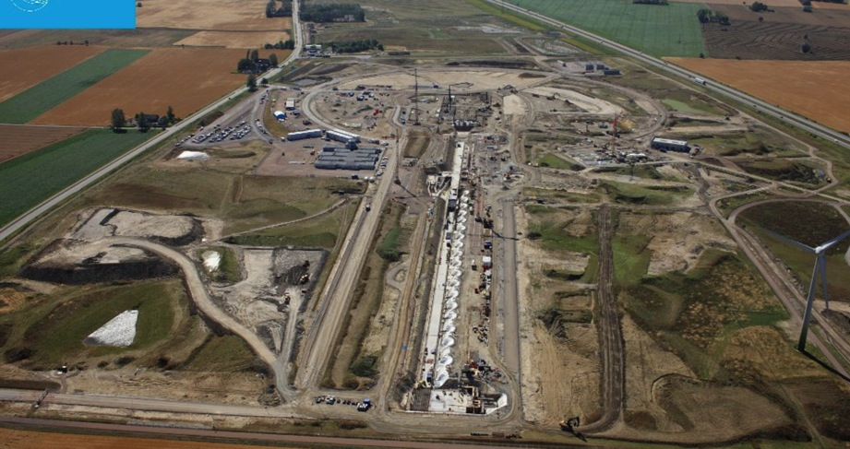
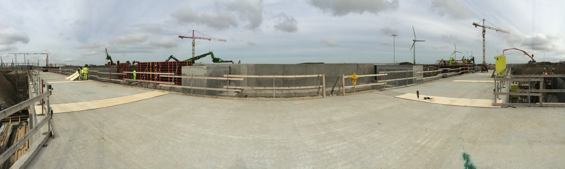
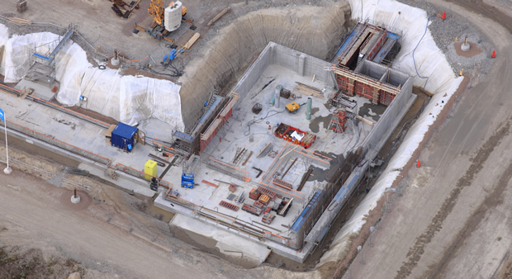
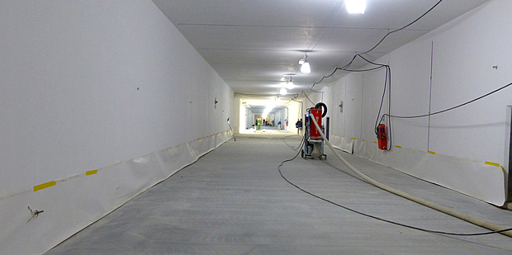
Site construction work

Slide 8
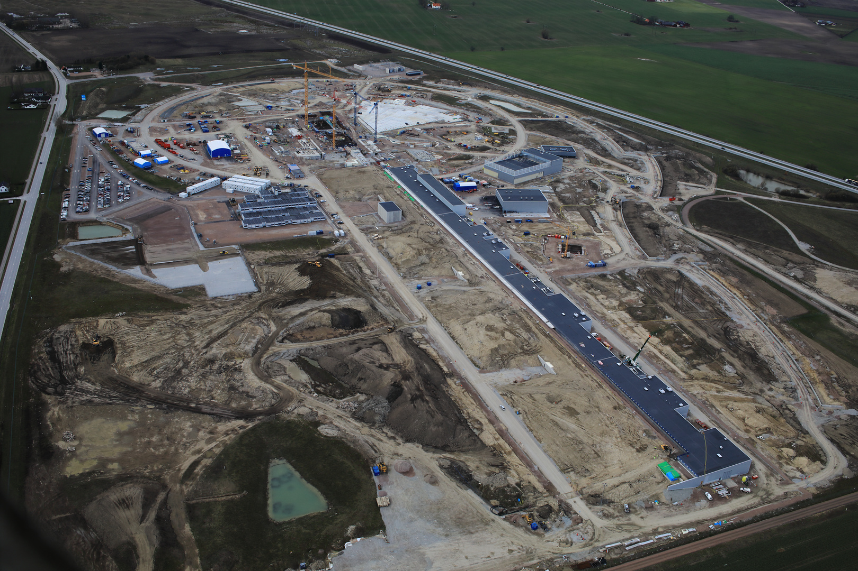
Gallery April 2017

Slide 9
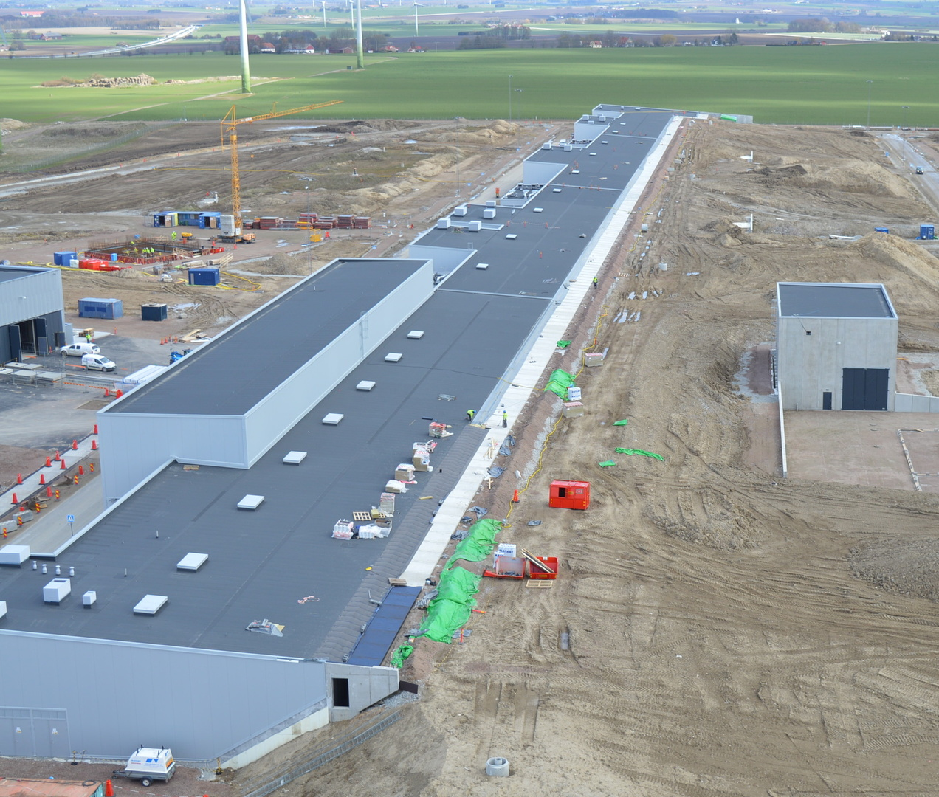
Gallery and tunnel berm April 2017

Slide 10
RF systems
Power to 155 cavities, one RF station/cavity
  High Voltage new development: SML modulator topology
  High Power RF Amplifier new development: MB-IOT amplifier (targeted for high beta)
A large part of the RF systems is provided in collaboration with partners
      RF NC linac (Spain) (complete RF systems)
      Spoke RF stations (Italy) (RF transmitters + interlocks)
      LLRF (Spain and Poland) (both NC and SC)
      RF high power distribution (UK) (SC linac)
      Phase ref distribution (Poland) (the whole linac)
      Installation (Poland)
Collaboration Lund Univ Uppsala Univ(FREIA facility)

Slide 11
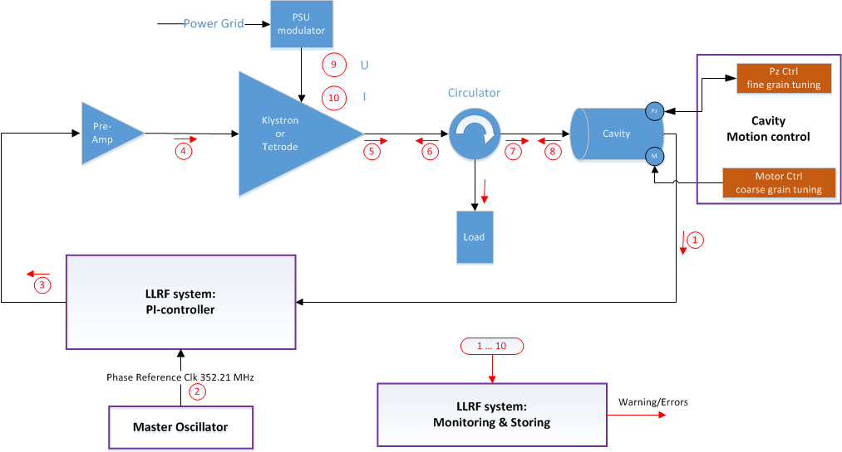
RF Cell
Interlock
Basic building block for RF systems is the RF cell:
High Voltage
Amplifiers
Regulation (LLRF)
Protection – Interlock
Waveguides

Slide 12
CELL Design and Status
Set of schematic produced for each linac section
Schematics to assist communication between external and internal interfaces
Includes communications channels, signal lists, all sub systems, utilities (water and power), MPS, PSS, and cryo-modules.
Owners and providers at sub system level identified
All ‘external’ interfaces should have been captured
  If it is not on the schematic, it is probably missing

Slide 13
RF cell medium beta

Slide 14
High Voltage
Needed to power RF amplifiers
Voltages to >100 kV
Currents 20-80 A
Pulsed or cw
Large and $$$

Slide 15
High power amplifiers
Amplifiers:
Generate High power RF
Power up to several MW
Typical example klystron
Large, $$$

Slide 16
RF distribution system
Transport RF to cavity:
Waveguides
Circulator (protect amp)
Load (reflected power)
Couplers for measurements
Arc detectors for protection

Slide 17
Phase reference, Master Oscillator
Phase reference:
What is the right phase?
LLRF regulates to that
Given by phase ref
All along the linac

Slide 18
Interlock
Protection:
Amplifier
Waveguides
Cavity
LLRF
Fast (μs) and slow (ms)

Slide 19
LLRF
LLRF regulates cavity amplitude and field:
PI-control
Adaptive feedforward
Inner klystron loop
Beam current variation
compensation

Slide 20
Installation
Installation manpower provided in-kind from IFJ PAN Krakow for most RF systems
Installation starts summer/autumn 2017 (phase ref)
Requires very precise planning and great flexibility
Installation plan v 3 for ACCSYS is being drafted

Slide 21
Next Steps RF systems
Order NC and MB modulators
Order MB klystrons
Follow up of the in-kind contracts
Installation
Commissioning
Starting operation 2019
Full installation in 2022

Slide 22
Thank you

