Slide 1




Multi-Grid Detector for Neutron Spectroscopy: Results Obtained on Time-of-Flight Spectrometer CNCS and Methods Used
Anton Khaplanov
On behalf of ESS Detector Group and Collaborators
www.europeanspallationsource.se
May 31, 2017

Slide 2



Introduction
ILL:
Bruno Guerard, Jean-Claude Buffet,
Jean-Francois Clergeau, Anthony Leandri
ESS:
Anton Khaplanov, Fatima Issa, Richard Hall-Wilton, Oliver Kirstein, Tomasz Brys, Michail Anastasopoulos, Isaak Lopez Higuera, Richard Bebb, Sara Arranz, Carina Höglund*, Linda Robinson*, Susan Schmidt*
Centre for Energy Research (Hungary):
Eszter Dian
Linköping University:
Jens Birch, Lars Hultman, (also *)
SNS:
Ken Herwig, Georg Ehlers, Michelle Everett, Kevin Berry
Earlier – the participants of the CRISP project on Large-Area detectors.
Horizon 2020 grant agreement 676548
WP 4.3: Large-Area Detectors
Previous publications:
B4C layers:
*C. Höglund et al, J of Appl. Phys. 111, 104908 (2012)
Characterization:
*A. Khaplanov et al., arXiv:1209.0566 (2012)
*B Guerard et al., NIMA, 720, 116-121 (2013), http://dx.doi.org/10.1016/j.nima.2012.12.021iJ
*J. Correa et al., Trans. Nucl. Sc. (2013), DOI: 10.1109/TNS.2012.2227798
*A. Khaplanov et al., (2014) J. Phys.: Conf. Ser. 528 012040 doi:10.1088/1742-6596/528/1/012040
Gamma sensitivity:
*A. Khaplanov et al., JINST 8, P10025 (2013), arXiv:1306.6247
Alpha background:
*A. Khaplanov et al., JINST 10, P10019 (2015); doi:10.1088/1748-0221/10/10/P10019
Current work:
A.Khaplanov et al. “Multi-Grid Detector for Neutron Spectroscopy: Results Obtained on Time-of-Flight Spectrometer CNCS" https://arxiv.org/abs/1703.03626
2017 JINST 12 P04030

Slide 3
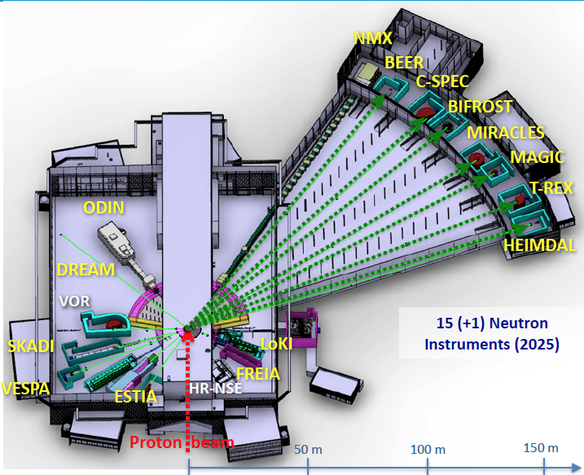
Time-of-Flight Spectrometers at ESS
First 16 instruments chosen
3 ToF spectrometers for ESS
CSPEC and T-REX – design phase
VOR – accepted proposal
Multi-Grid as baseline detector technology
Instrument | C-SPEC | T-REX | VOR
Sample – detector | 3.5 m | 3 m | 3 m *
Detector height | 3.5 m | 2.2 m | 3 m *
Detector area | 29 m² | 21 m² | 37 m² *
*preliminary

Slide 4


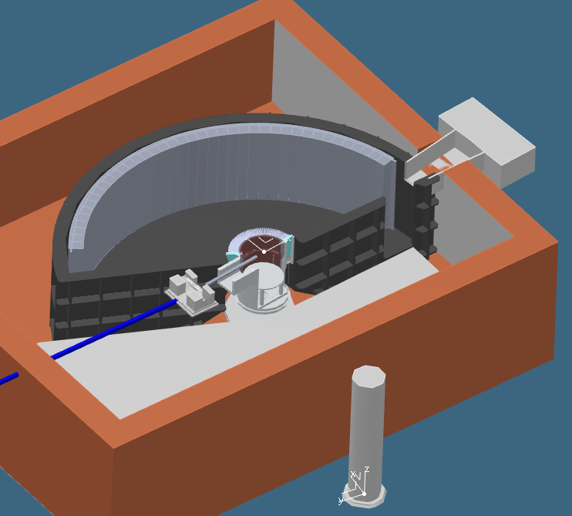
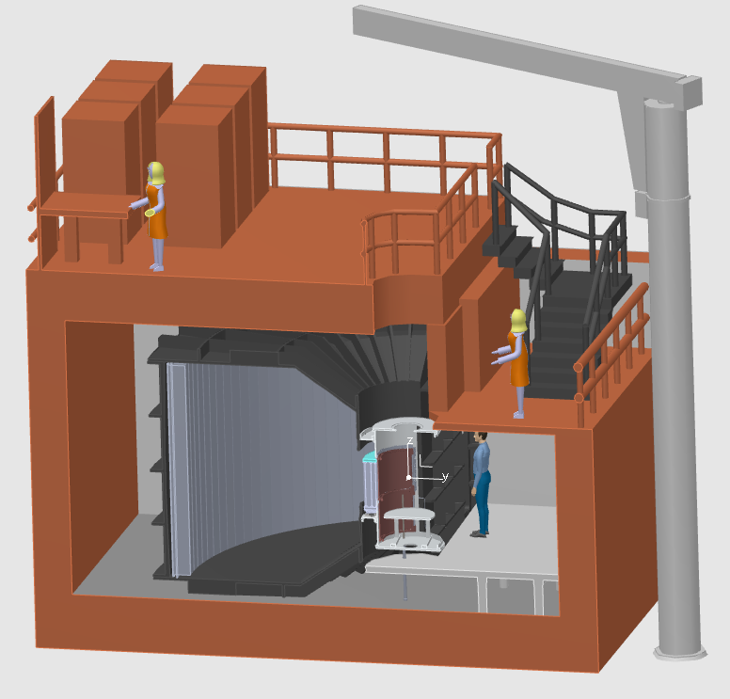
CSPEC at ESS
Cold spectrometer
0.2 meV < E_{i} < 20 meV
29m² detector
Horizontal coverage 5° to 135°
Vertical coverage -25° to 25°

Slide 5


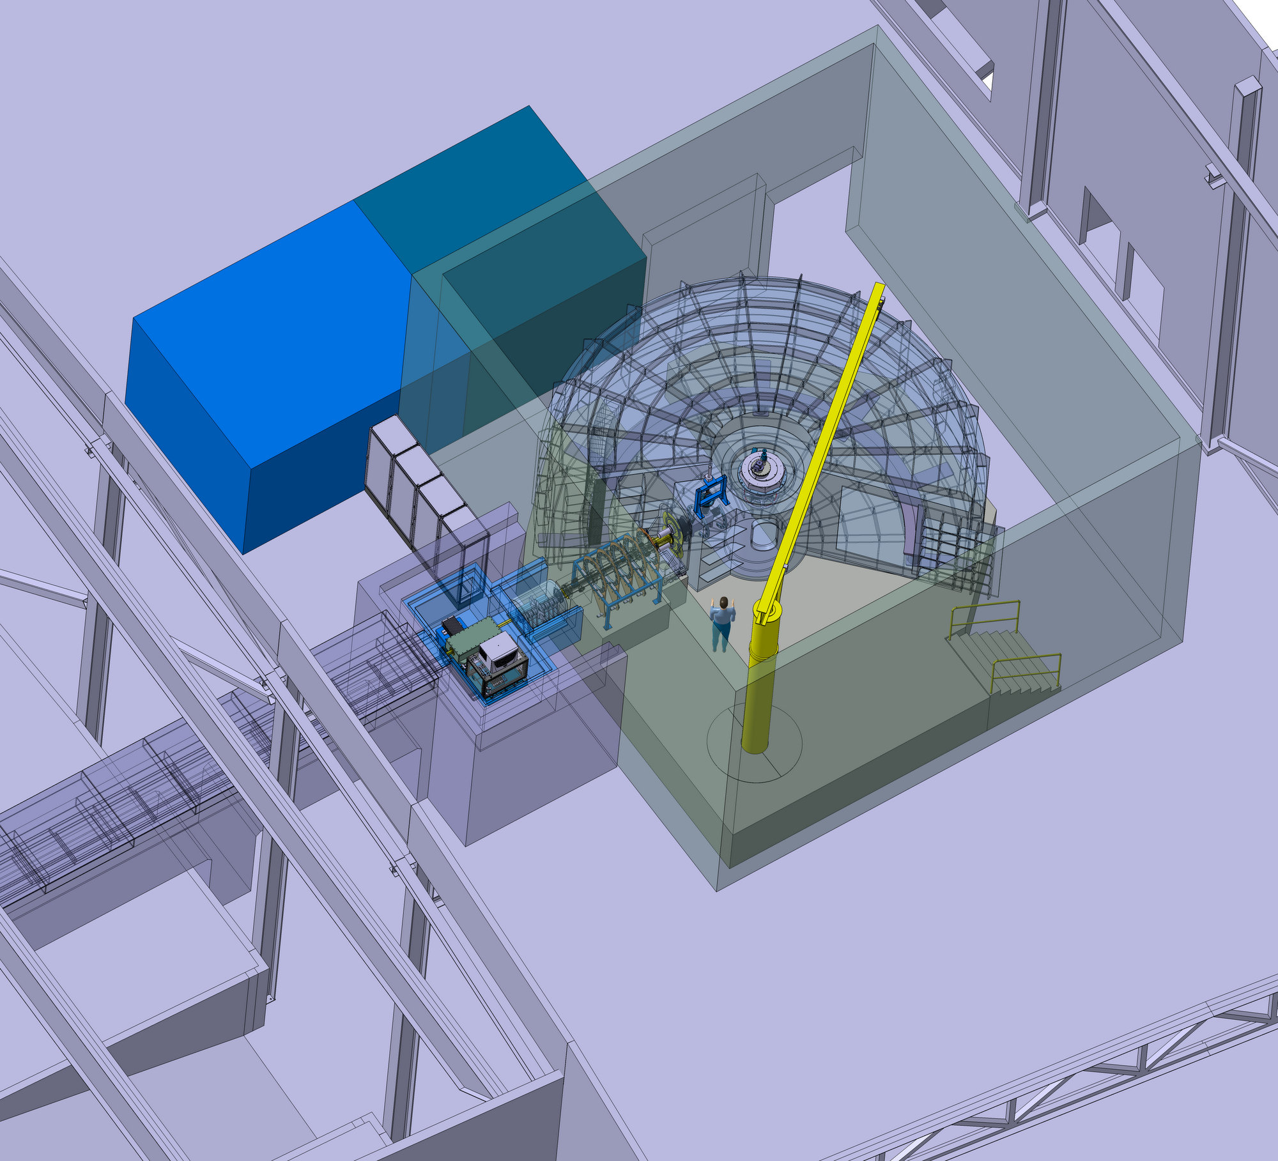
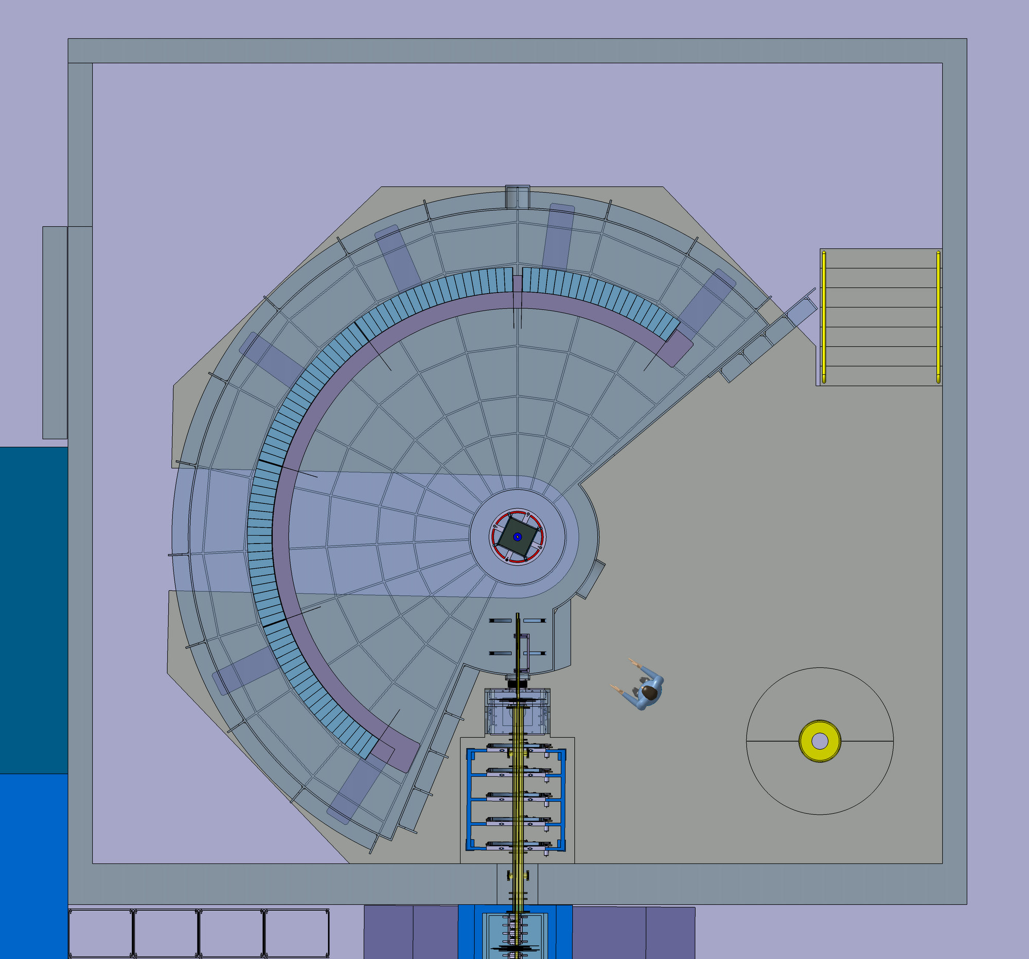
T-REX at ESS
Thermal / bispectral spectrometer
2 meV < E_{i} < 160 meV
21m² detector
Horizontal coverage -36° to -1° and 1° to 144°
Vertical coverage -25° to 15°

Slide 6
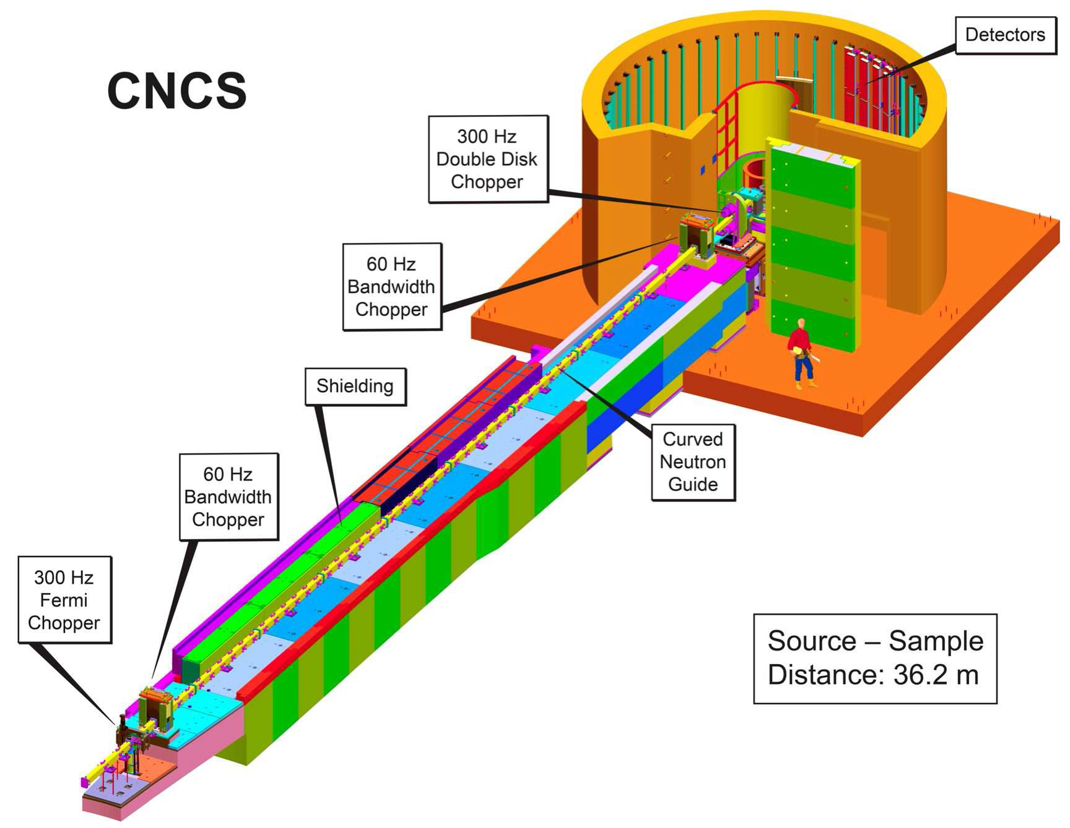
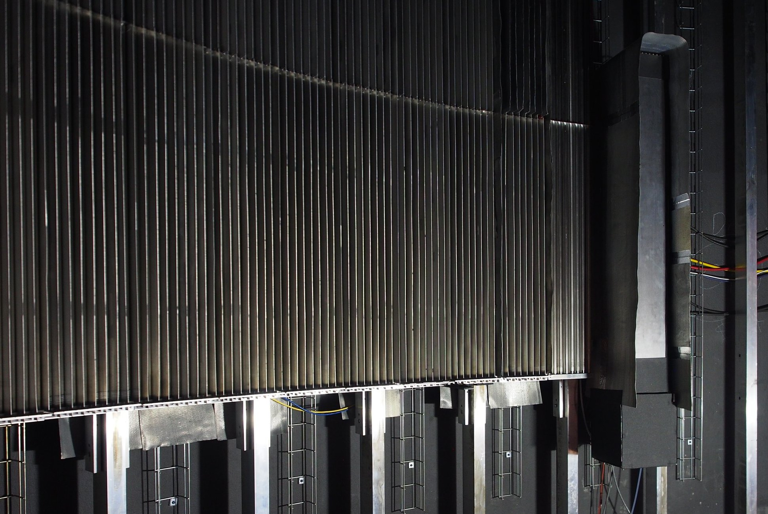
Test on CNCS
A kind offer by K. Herwig to test MG at SNS
Recommendation of 2015 ESS annual review
Goals:
Test at spectrometer
Side-by-side comparison to He3
In parallel with user experiments
Dedicated tests
Long-term operation
Solution:
Size = half of “8-pack” module – 1.1m x 19cm
Installation June-July 2016
96 grids in 2 modules
32 layers
Adapted layer thickness
Gas flow-through

Slide 7
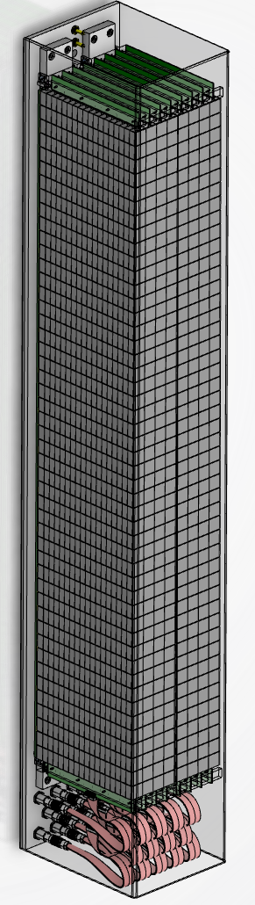
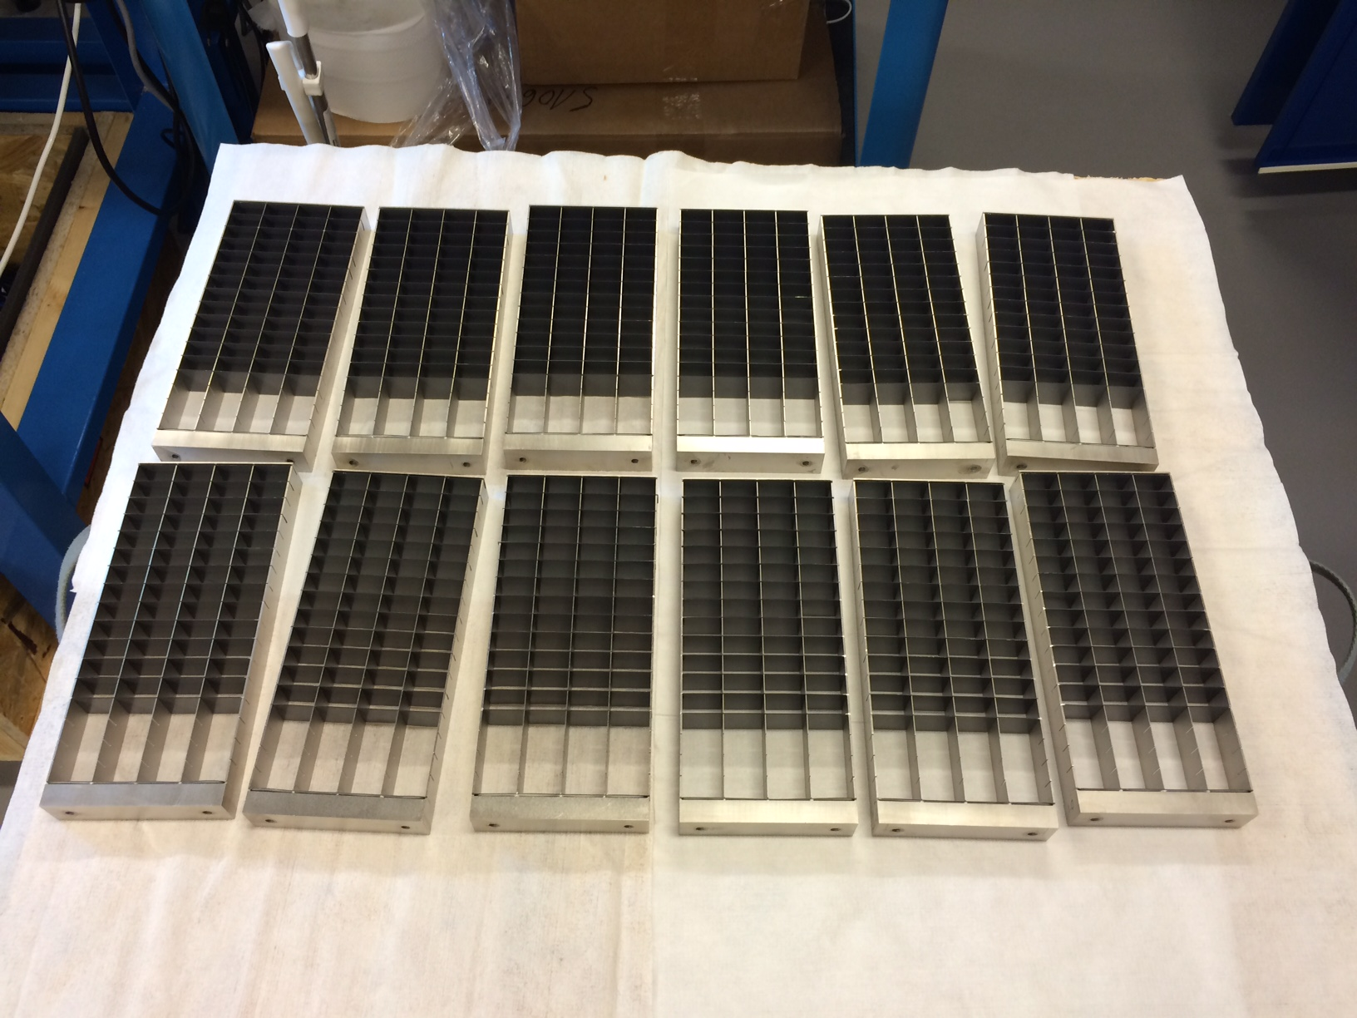
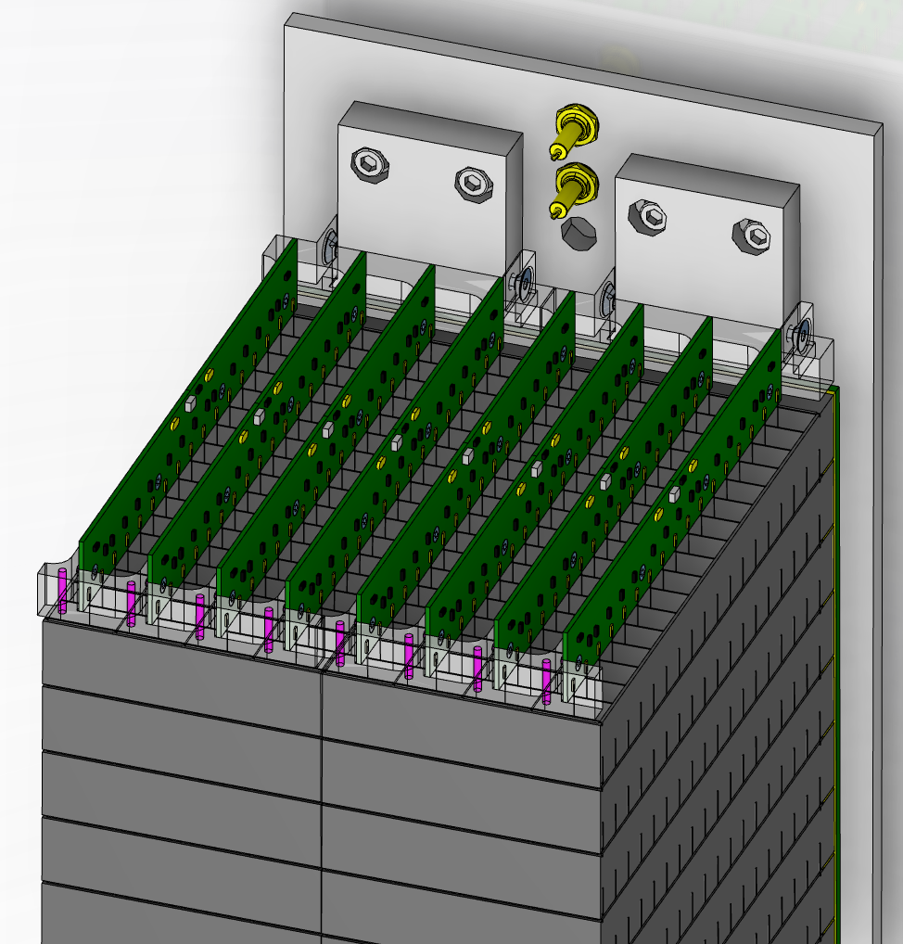
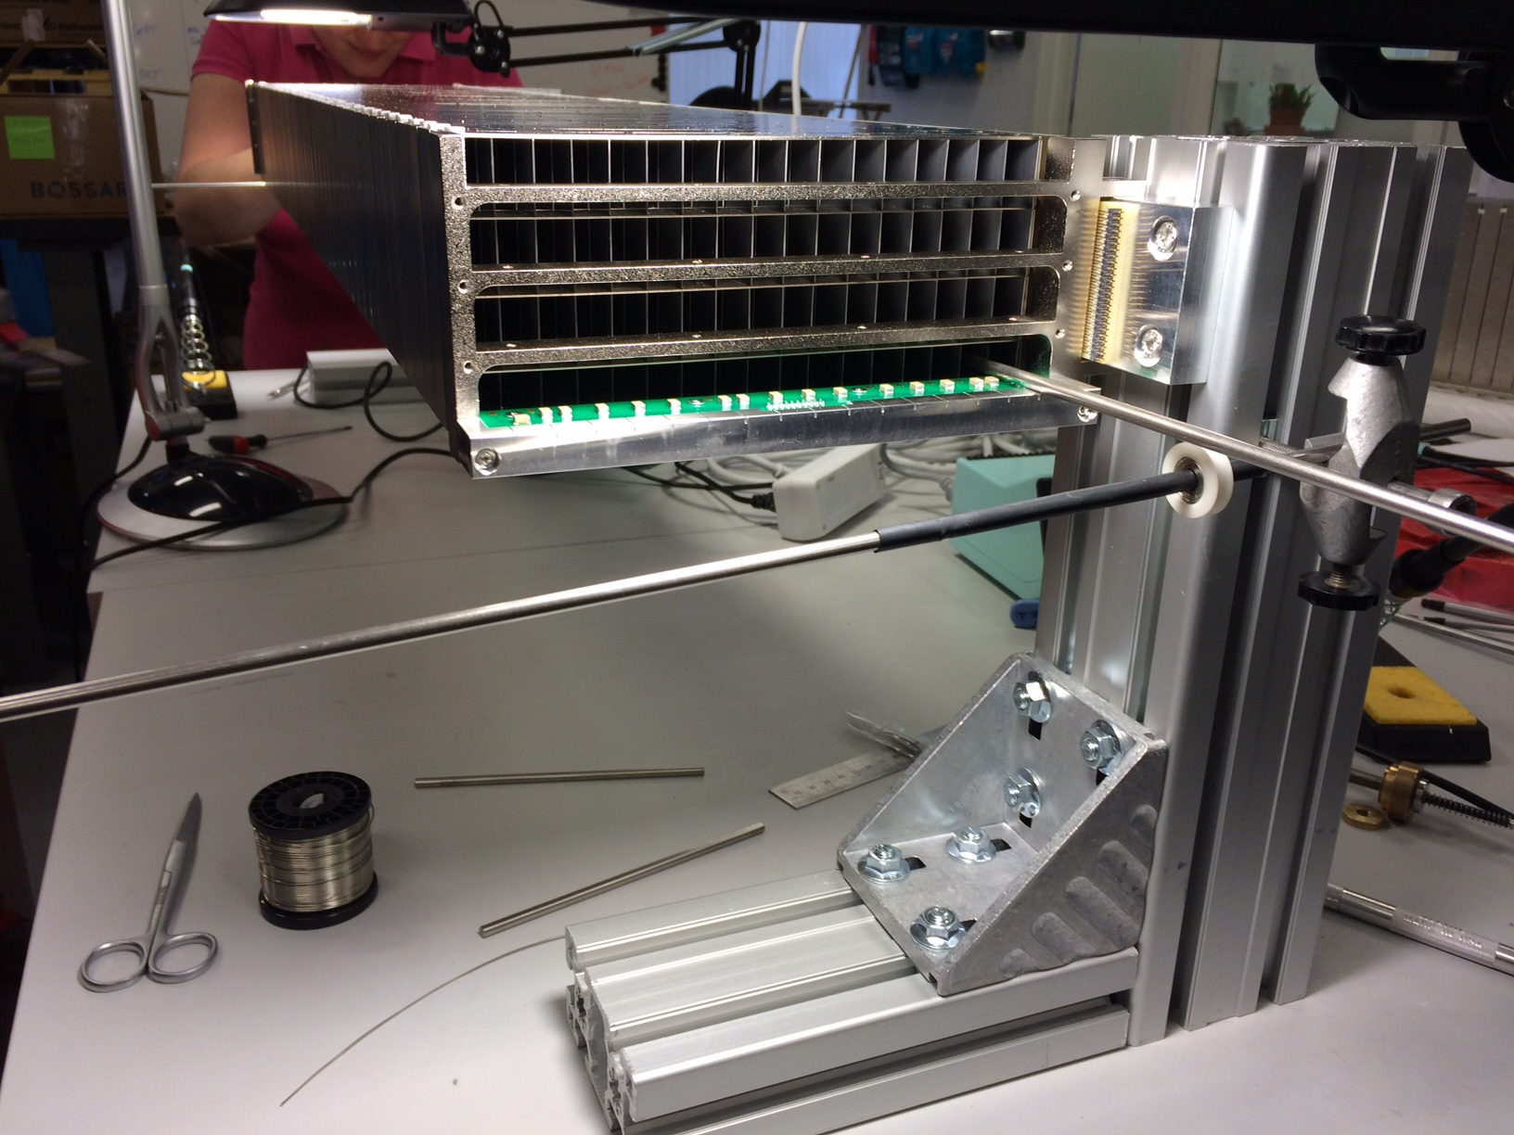
Construction of MG.CNCS in Lund
1.1m

Slide 8
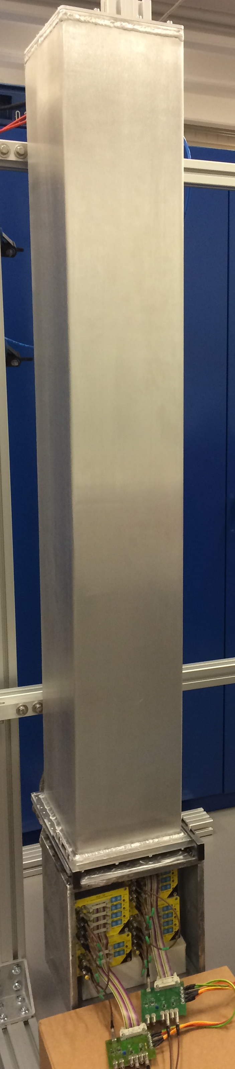
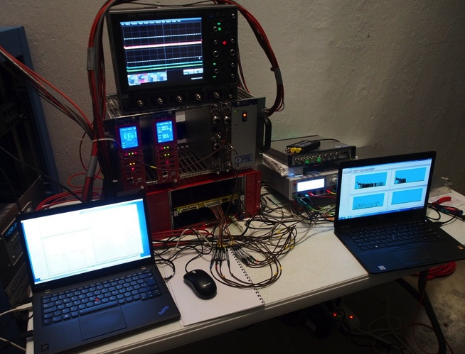
Multi-Grid installed at CNCS
Detector installed at 57° scattering angle
Inaccessible between summer and winter shutdowns
DAQ setup outside, accessible remotely
He-tubes
MG
View from sample
³He 8-packs
M-G
2m
1.1m
20cm
19cm

Slide 9
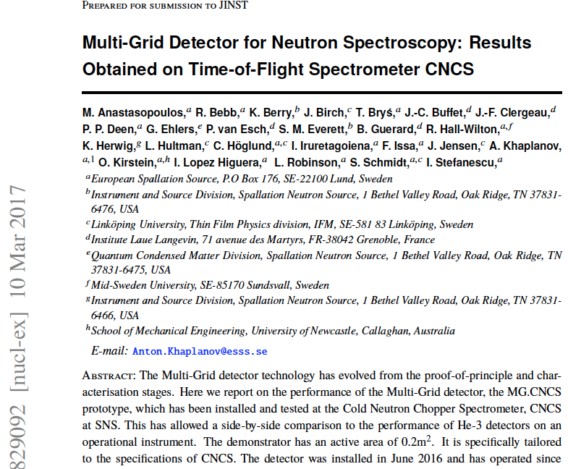
Results of CNCS Test
Operation with no access for 11 months, until yesterday.
Essential demonstration. MG is now the baseline detector for CSPEC and T-REX
Energy resolution, efficiency, backgrounds
    shown to be comparable between MG and He3.
Better performance in high rate in Multi-Grid
JINST paper, 2017 JINST 12 P04030 https://arxiv.org/abs/1703.03626 for all results
Thanks to the colleagues at SNS for this opportunity and cooperation!
These results would not be possible without you!

Slide 10
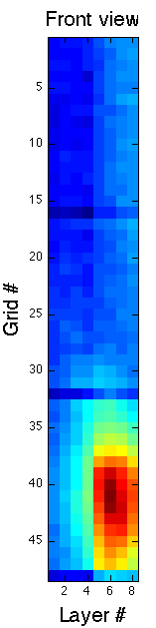
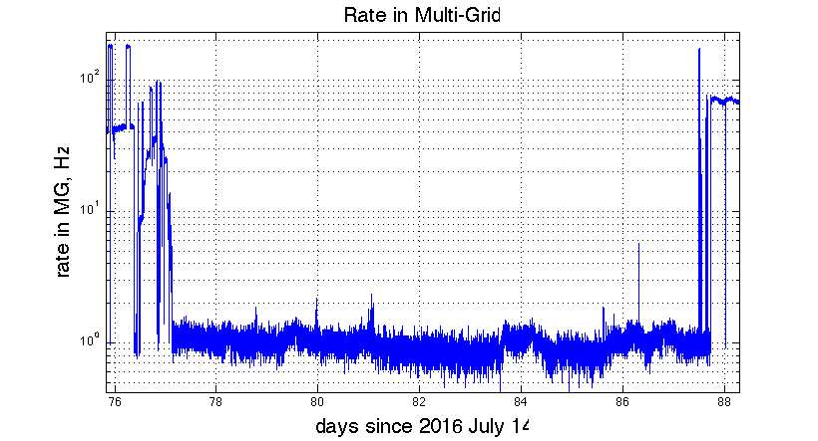
Methods Used for Tests
Vanadium
Fast neutrons (fission, prompt)
Single crystal
Water, Ice
Background
Gamma background
(NaI detector)
Allowing to measure:
Energy resolution, efficiency, scattering, background sensitivity, saturation

Slide 11
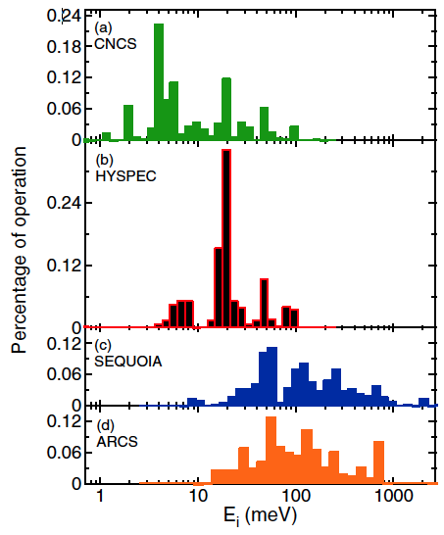
Energy Ranges for ESS Spectrometers
Energy ranges of the first ESS ToF spectrometers
 | CSPEC | T-REX
Typical initial λ, Å (meV) | 2 to 15 Å (20 to 0.36 meV) | 0.7 to 6.4 Å (160 to 2 meV)
Measurements needed for thermal range, up to 160 meV
Cold range, 0.76 to 15 meV measured
Incident energies used at CNCS
(M. Stone et al.)

Slide 12
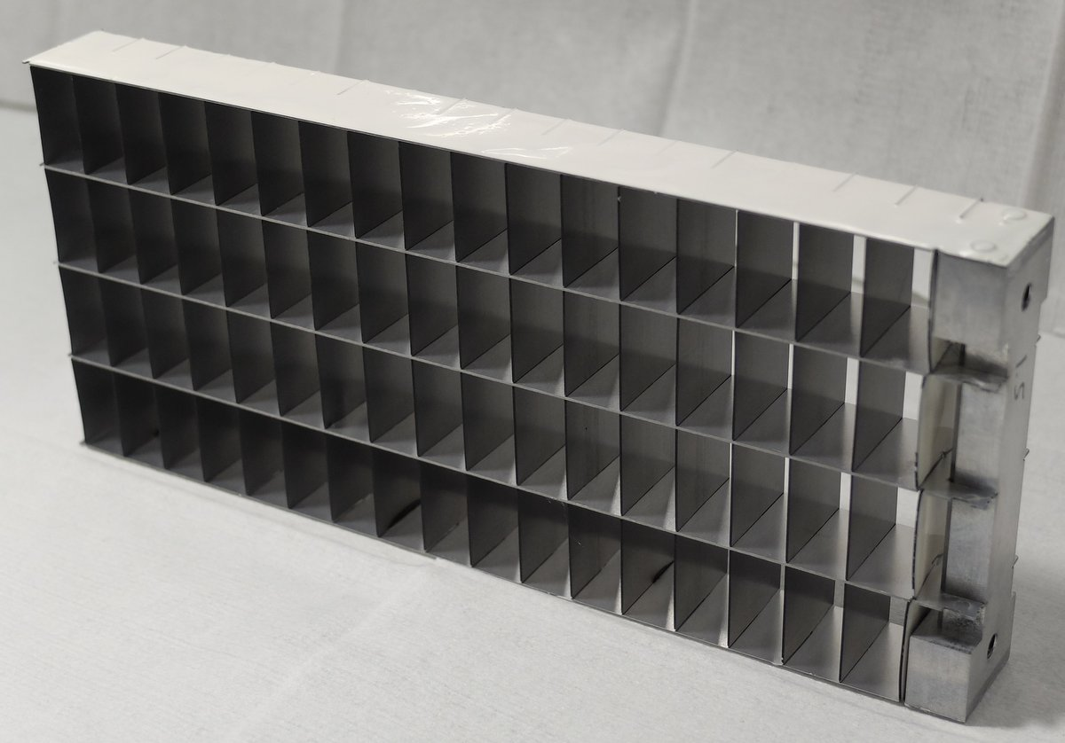
Efficiency Optimizations
Optimized grid
n
Efficiency as a function of wavelength for MG optimized for cold vs. thermal spectrum
Tested at MG.CNCS
0.5μm
Would like to test:
1.0μm
1.5μm
Layer thicknesses in MG.CNCS (16 blades):
7 blades 0.5μm,
7 blades 1.0μm,
3 blades 1.5μm
Proposed for a thermal detector (20 blades):
4 blades 1.0μm,
10 blades 1.25μm,
6 blades 2.0μm.
Would like to test:
Cold – optimization centered on 4Å
Thermal – optimization centered on 1Å

Slide 13
Why we are here this week
We are interested in testing the Multi-Grid on a thermal instrument, similar to T-REX
Missing a demonstration of Multi-Grid on a thermal instrument
Need to engineer the Multi-Grid for operation in vacuum
A test at SEQUOIA would be very helpful to prepare Multi-Grid for T-REX
Detector to be designed specifically for the test
Incoming energies used at SEQUOIA
(M. Stone et al.)

Slide 14
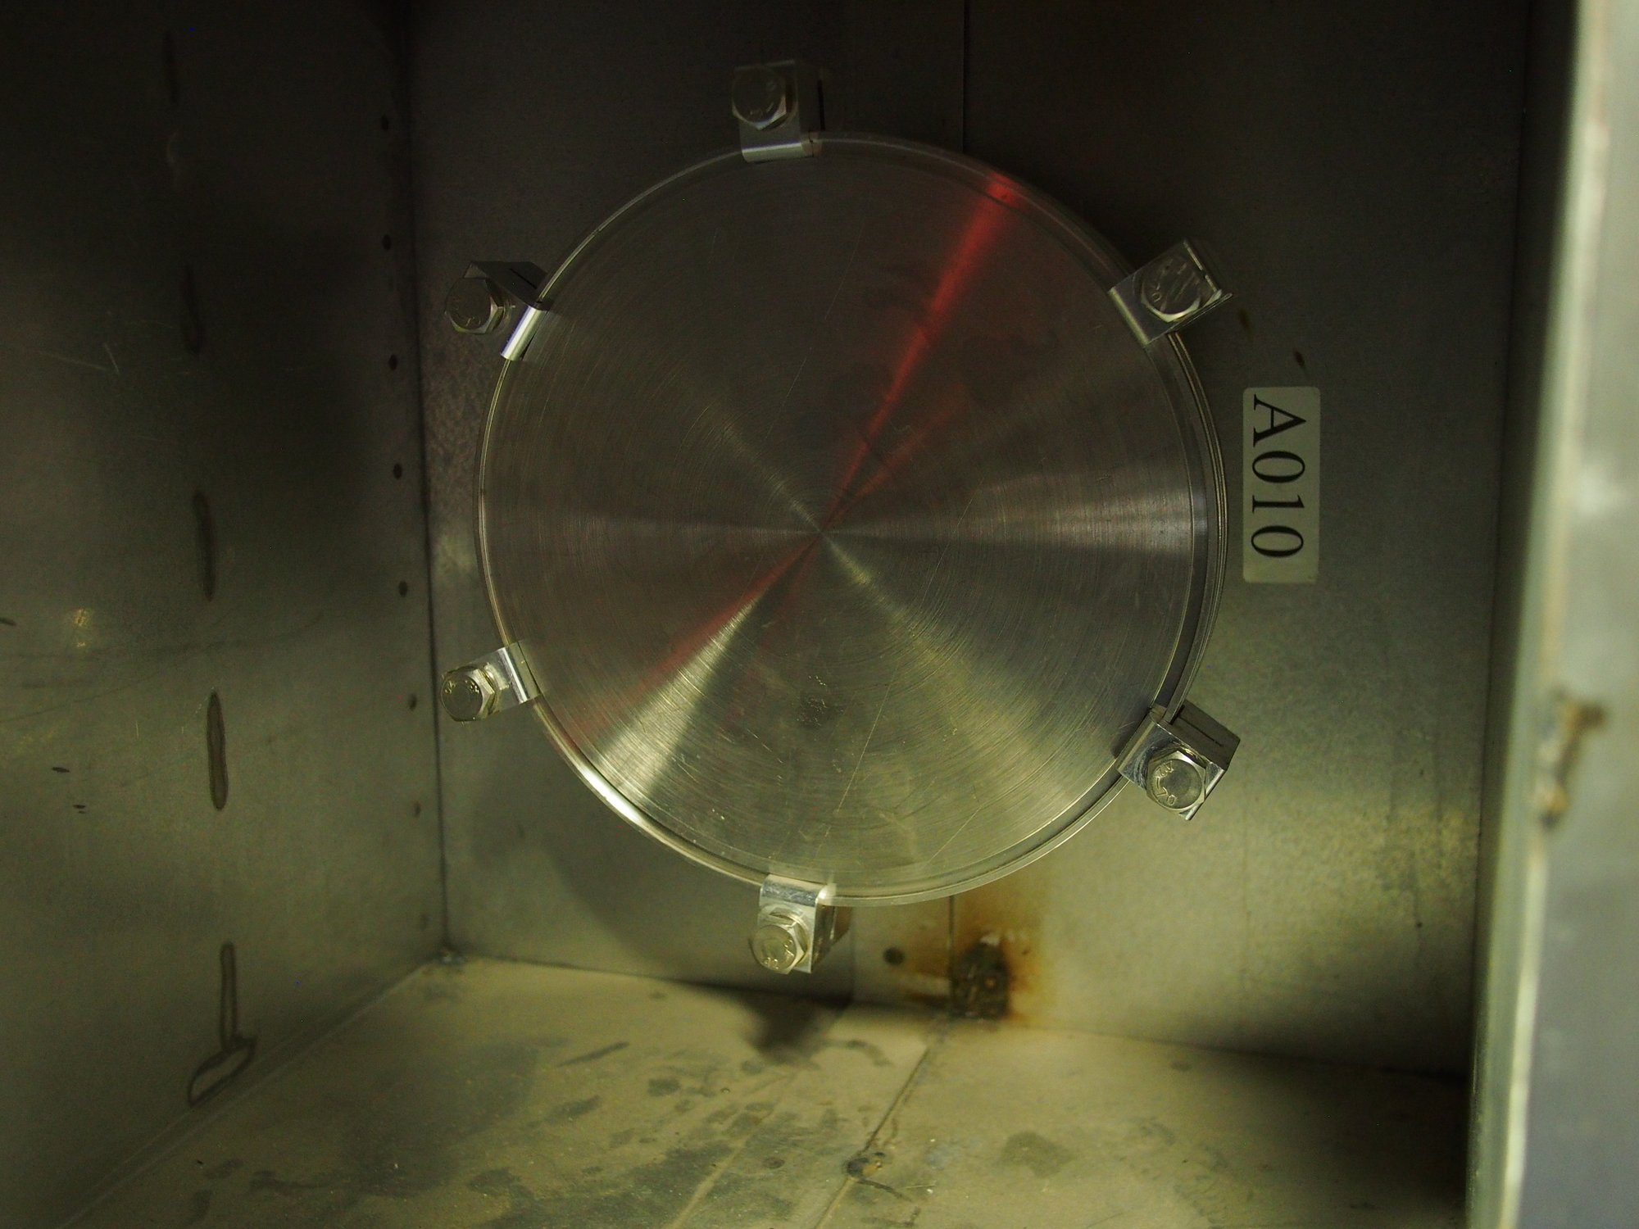
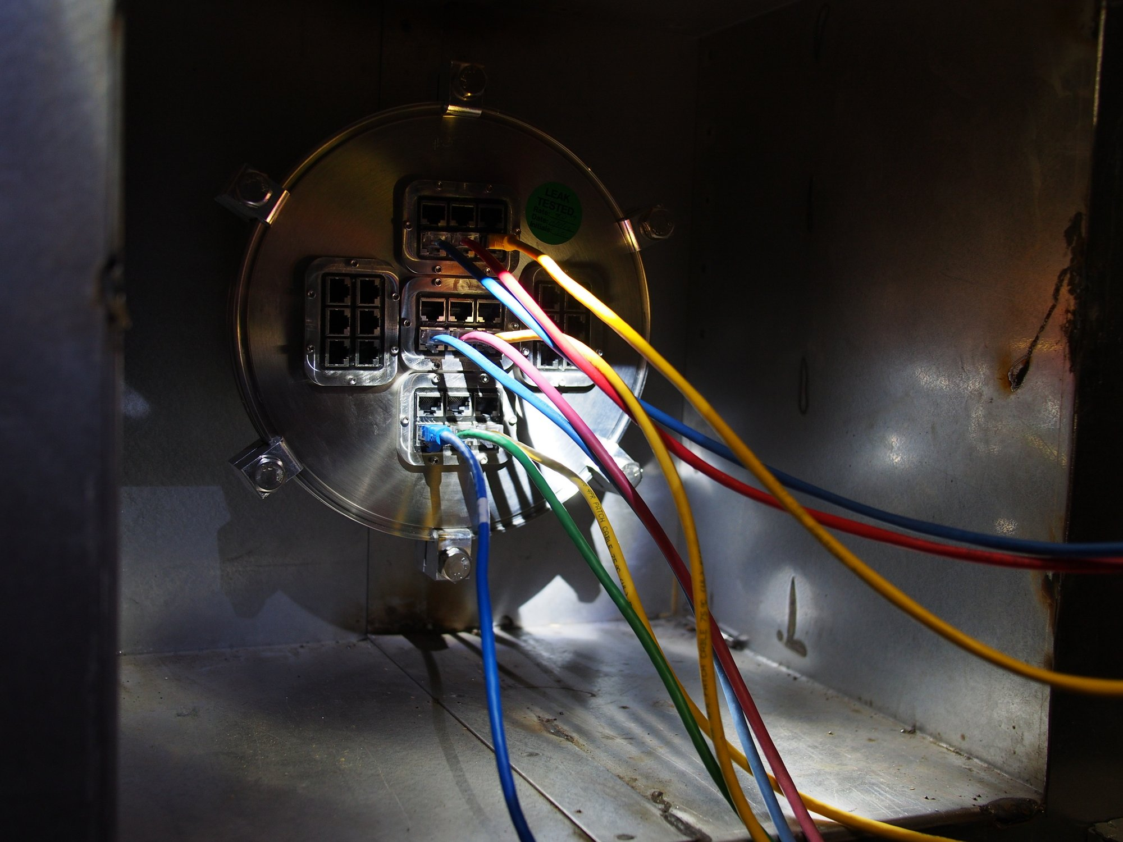
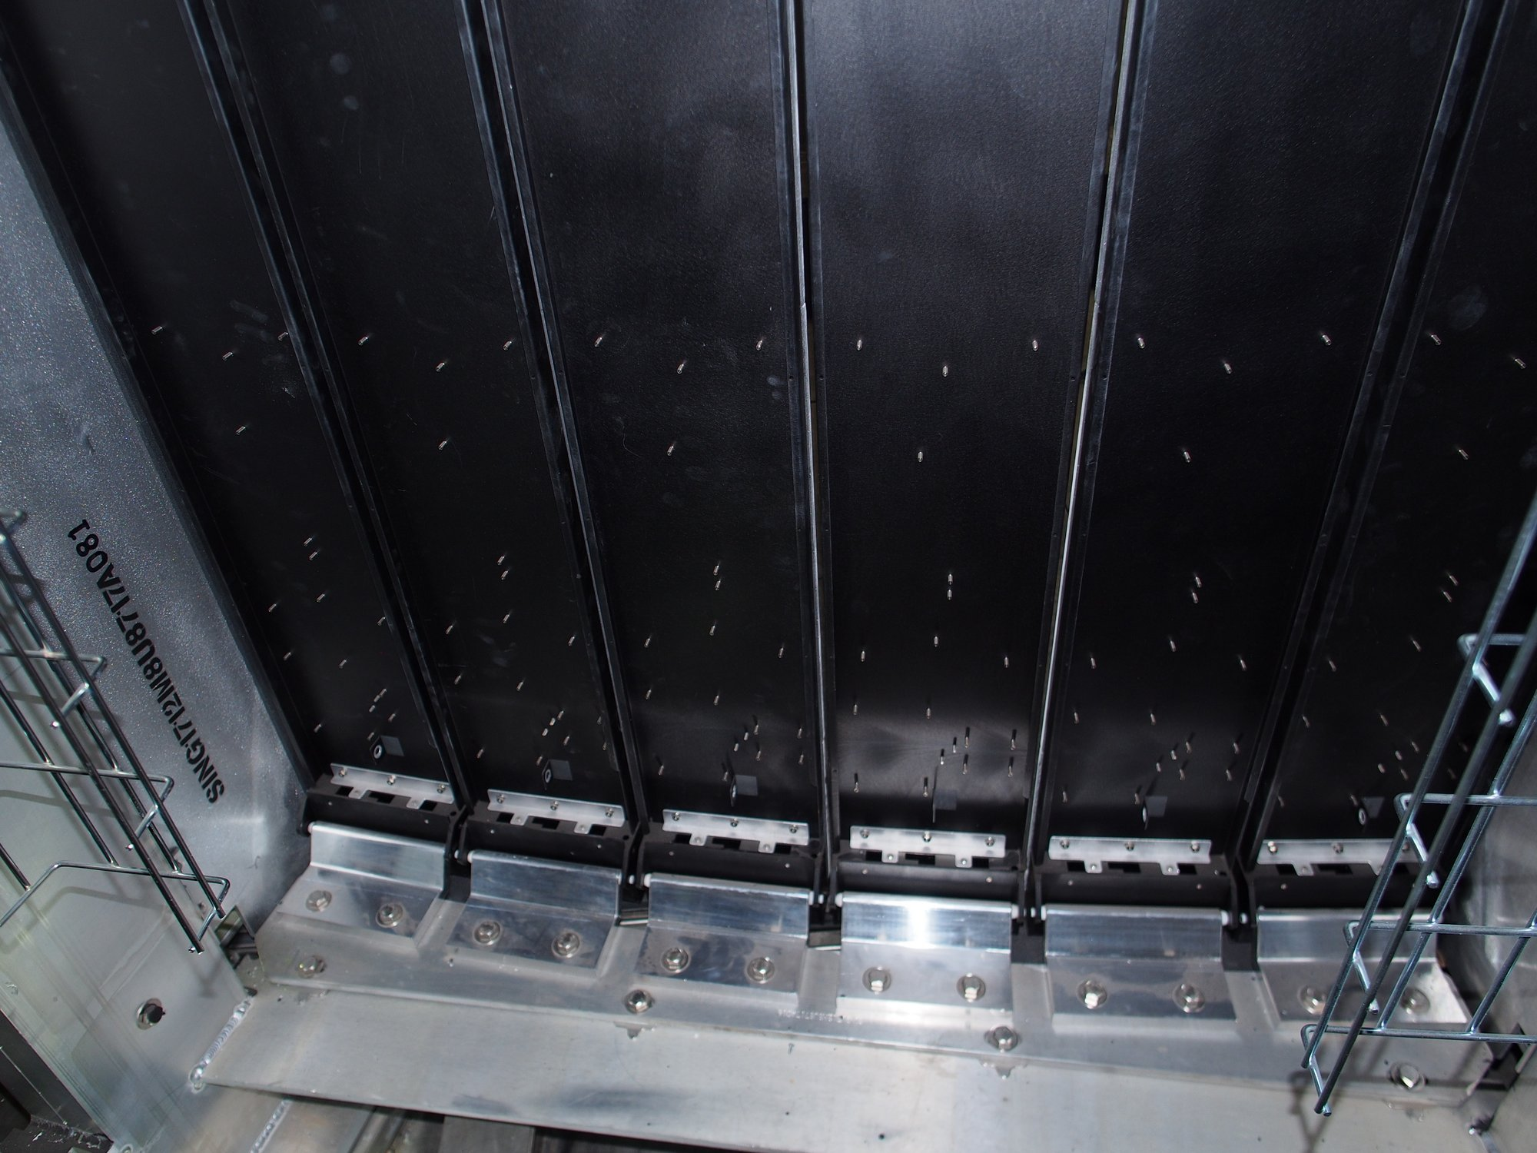
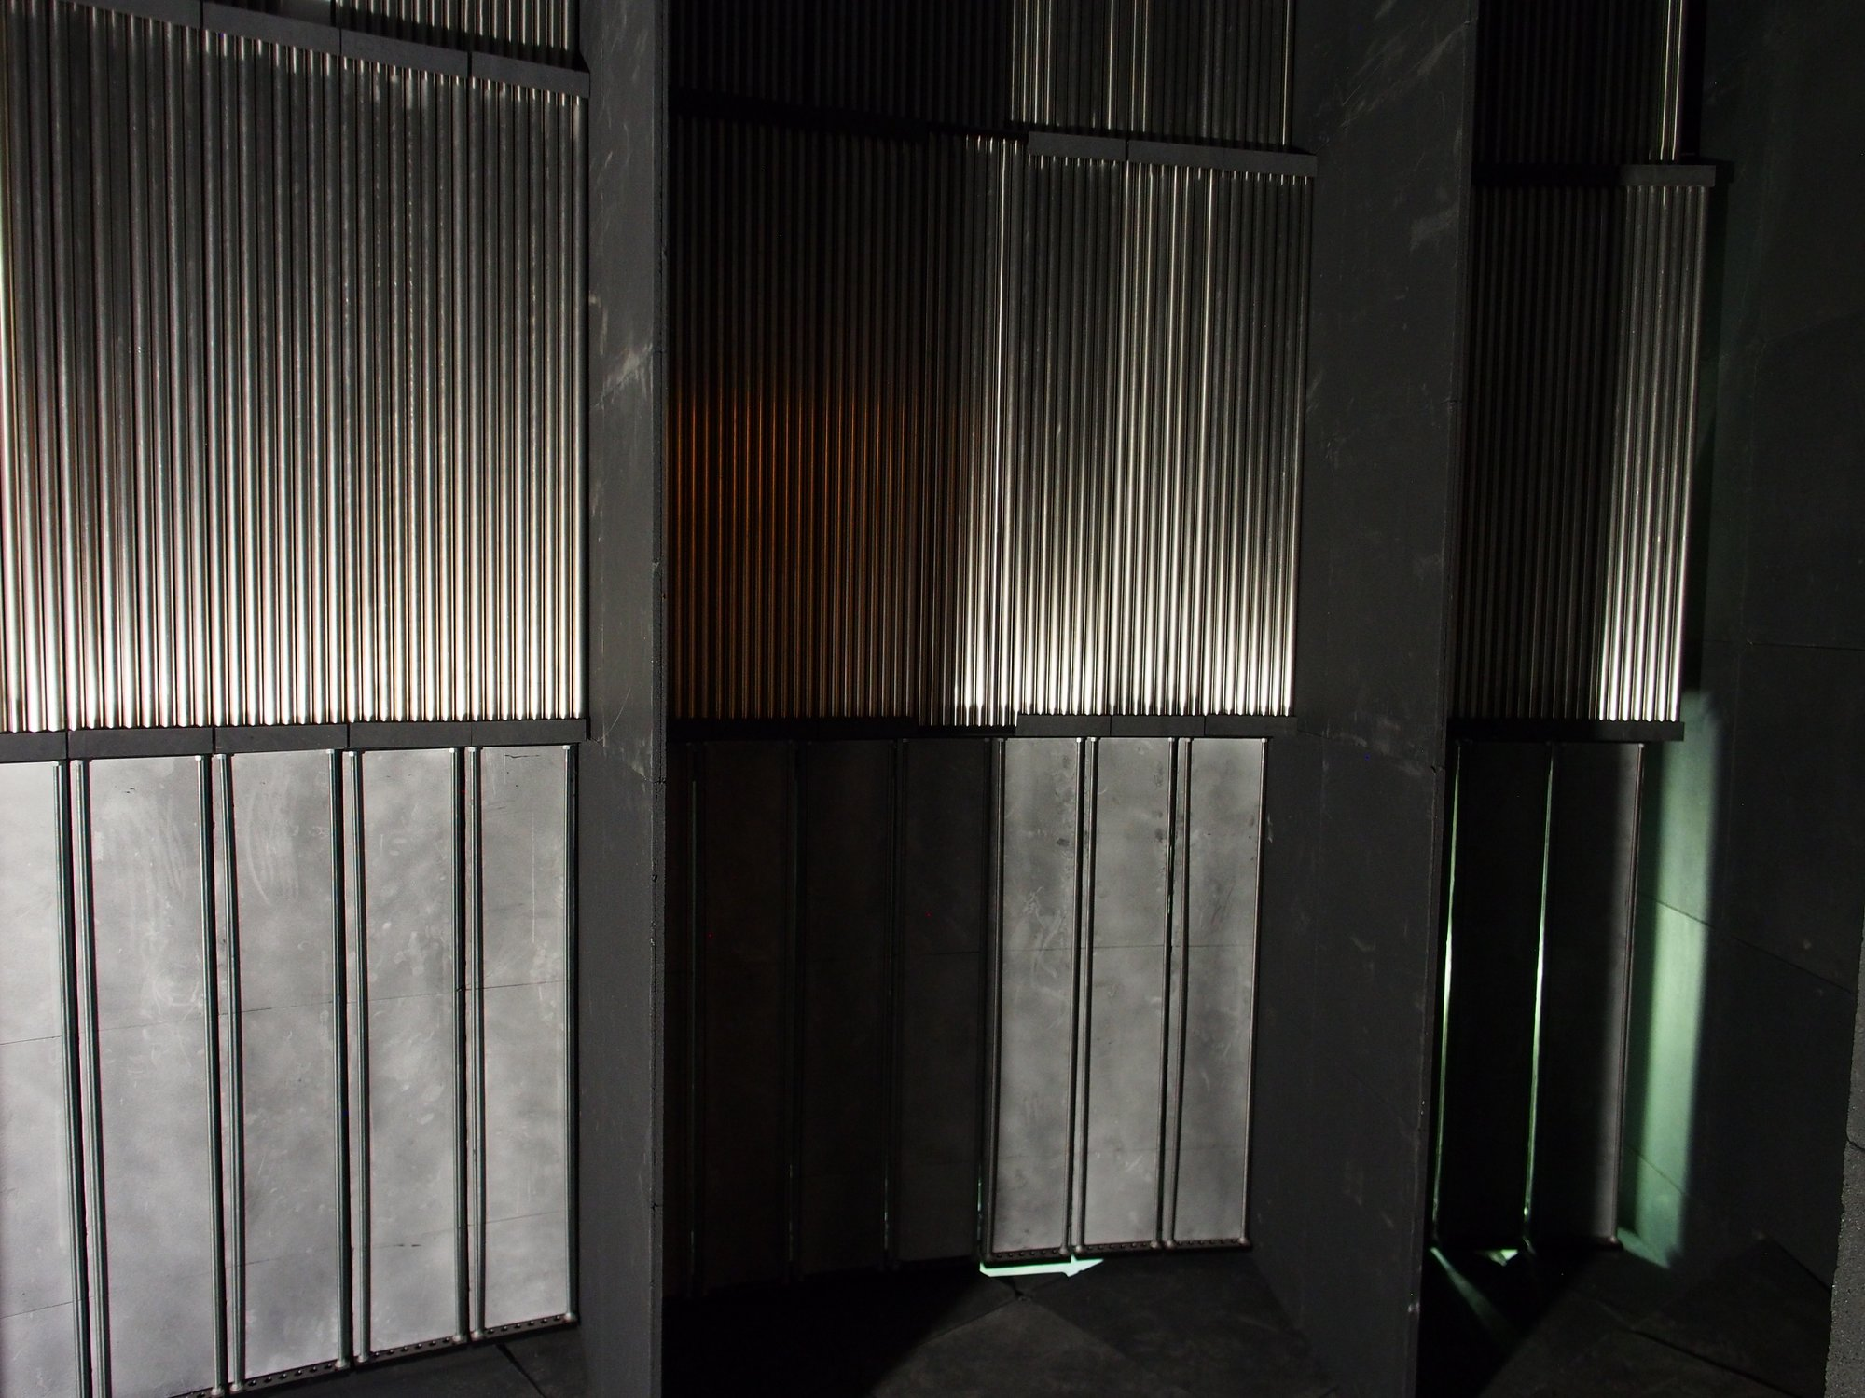
Why we are here this week
Where to install in SEQUOIA?
Lower detector bank.
Several mounting points possible.
On the floor? Weight limit?
How to make sure we do not affect vacuum?
Qualification procedure (vacuum, materials, mechanics)
How to bring it inside?

Slide 15
Possible Schedule
Following this meeting:
Choose which instrument is most appropriate
By end of summer – proposal for the facility to consider the test (end of summer)
Start mechanical design (end of summer)
Aim to start qualification of vacuum vessel, vacuum equipment by Jan 2018
Detector ready by Mar 2018

Slide 16
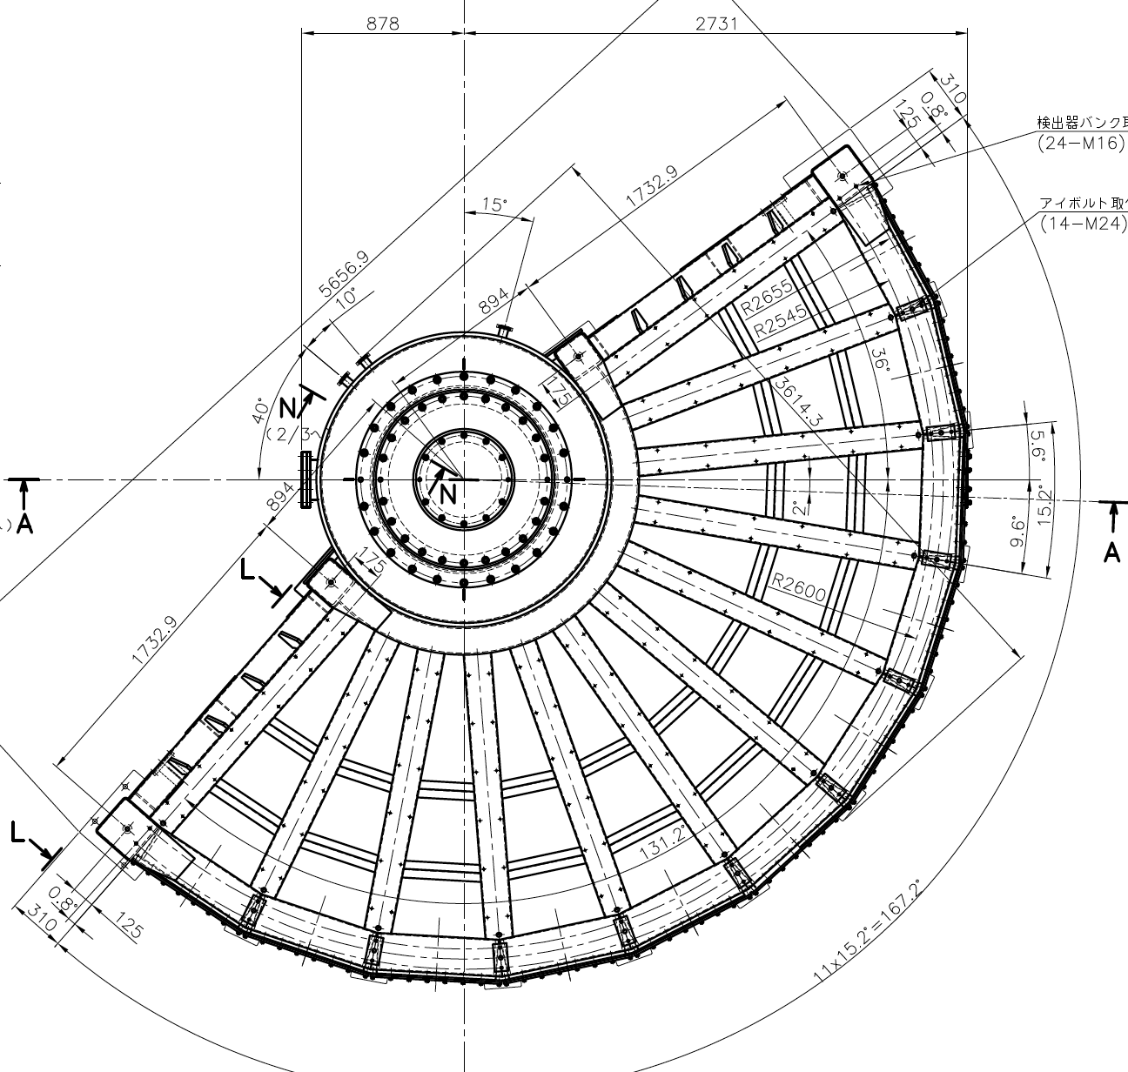
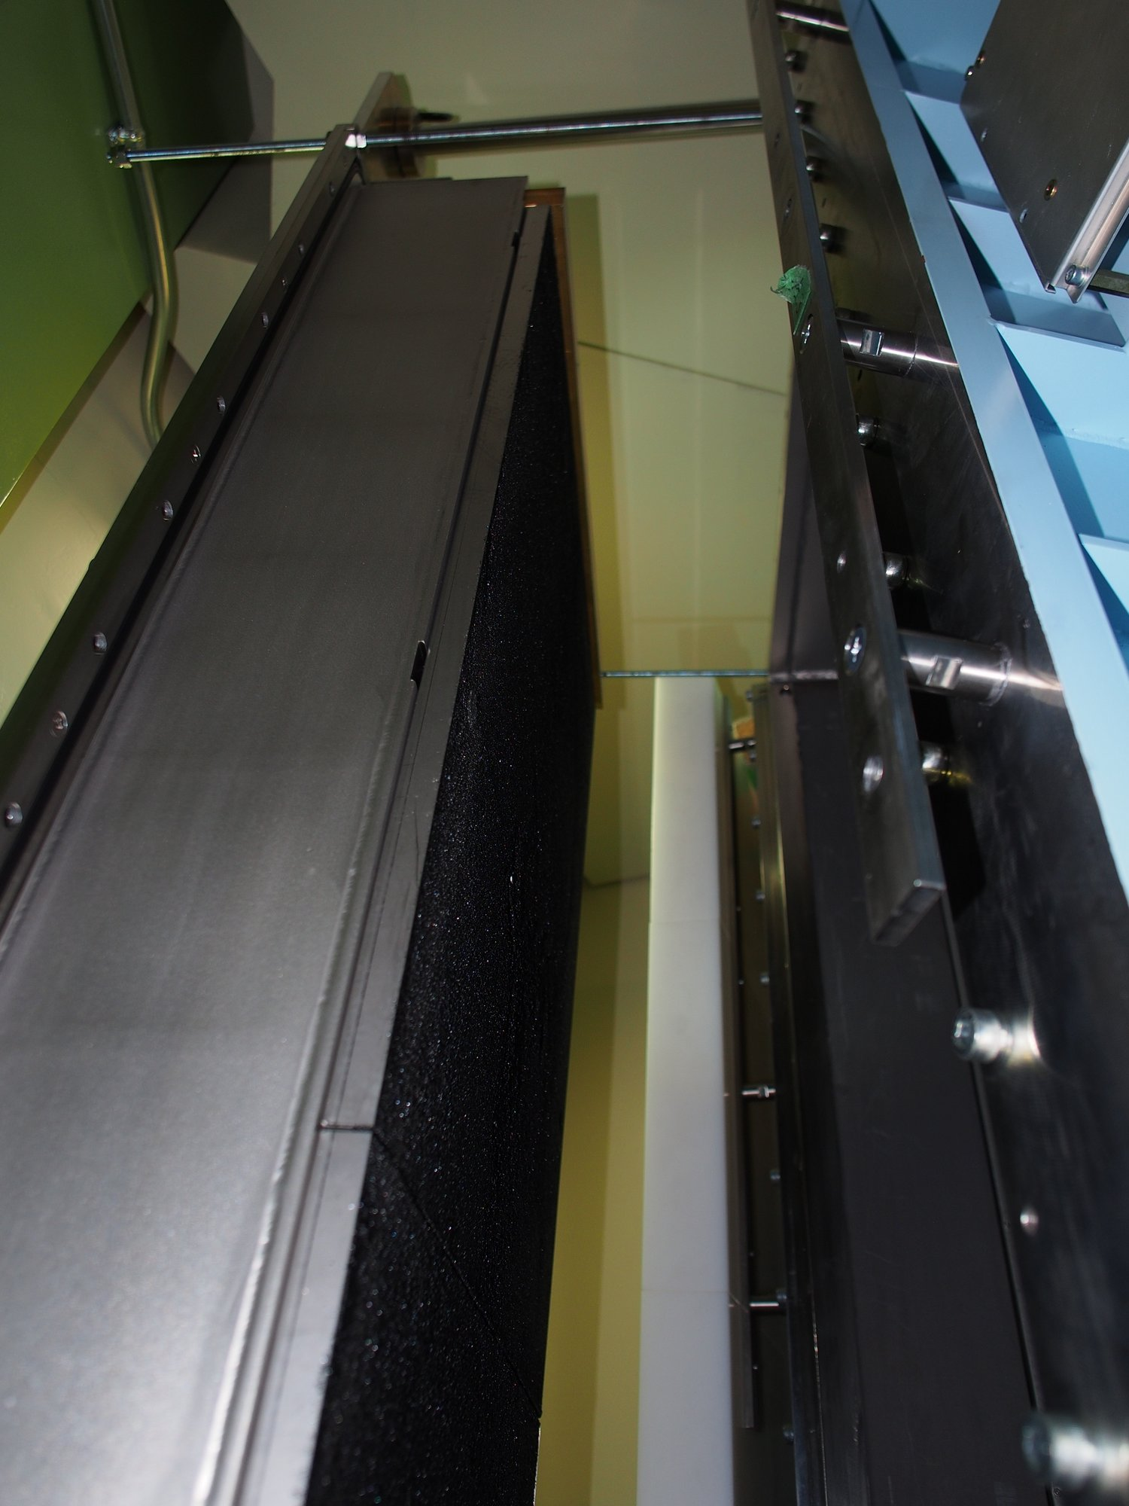
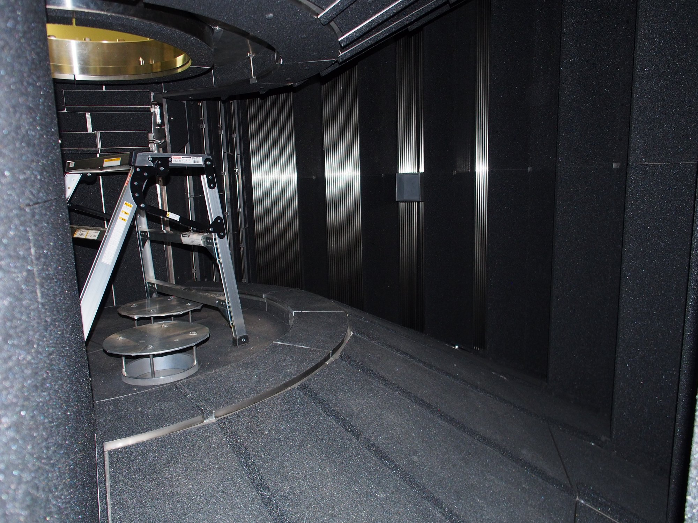
Visit to J-PARC, April 2017
We’ve investigated a comparable possibility at J-PARK instrument 4SEASONS
Relatively difficult installation and mounting
All He3 electronics outside of vacuum
Detector can be placed out of LoS of He3 tubes
Big thanks to Ryoichi Kajimoto, Kenji Nakajima, Wataru Kambara and others at J-PARC for the welcome and help!

Slide 17
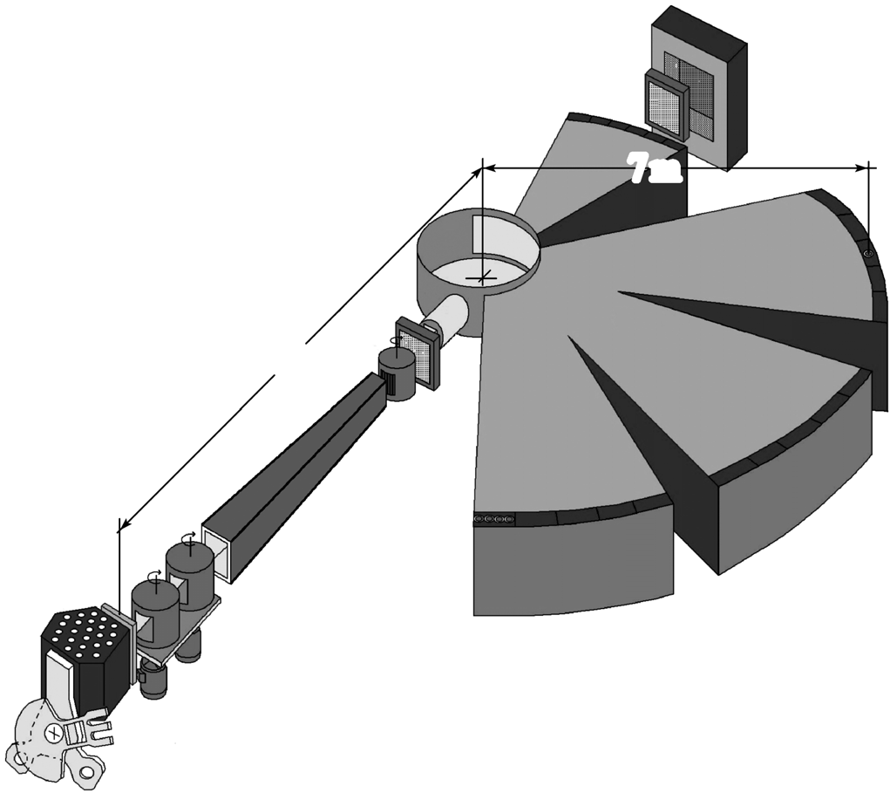
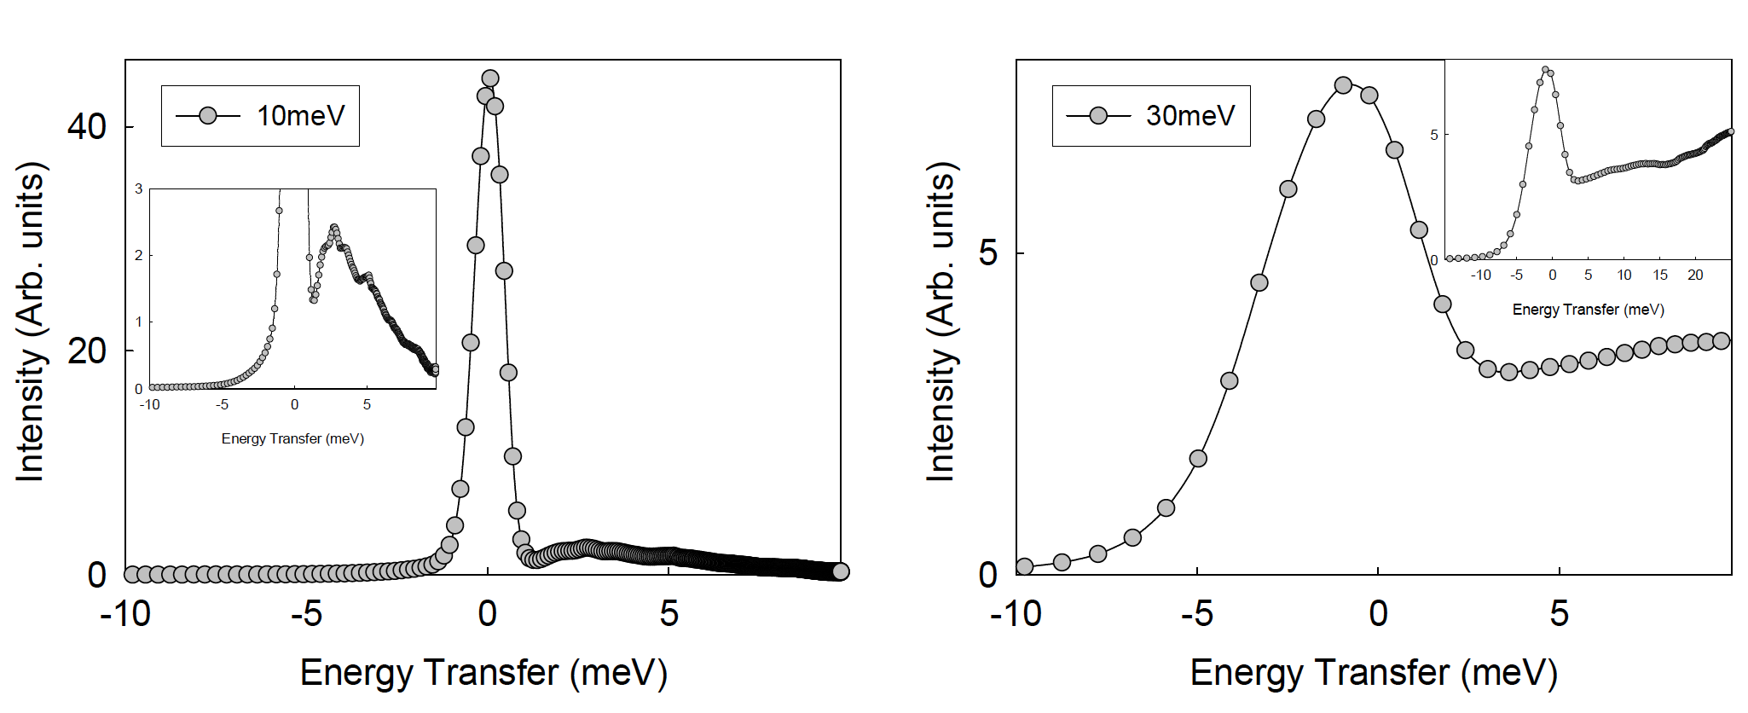
DIN-2Pi in Dubna
Energy resolution will not allow to see possible effects due to scattering
Energy resolution limits maximum energy to ~30-50meV
Detectors not in vacuum

Slide 19

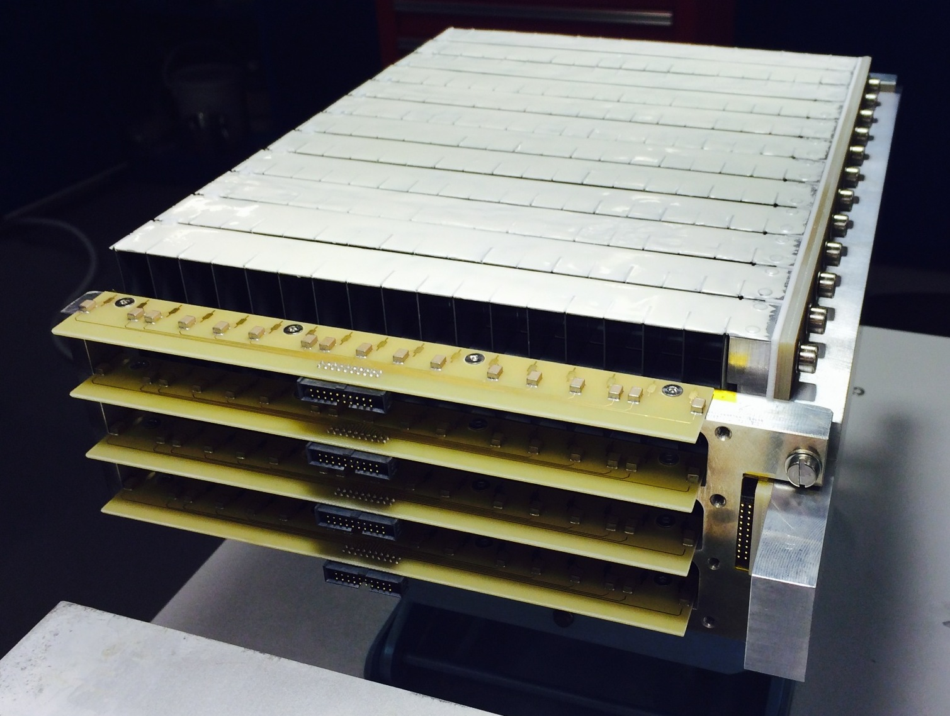
Multi-Grid Principle
gas
n
conversion
fragment 2
n
fragment 1
gas
B-10 film
Al substrate
Low cost for large area
High total efficiency
Readout split over many layers – lower local rate
No need for resistive readout – low gain
n
Introduced at ILL, jointly developed by ILL and ESS under CRISP project, and now under BrightnESS

Slide 20
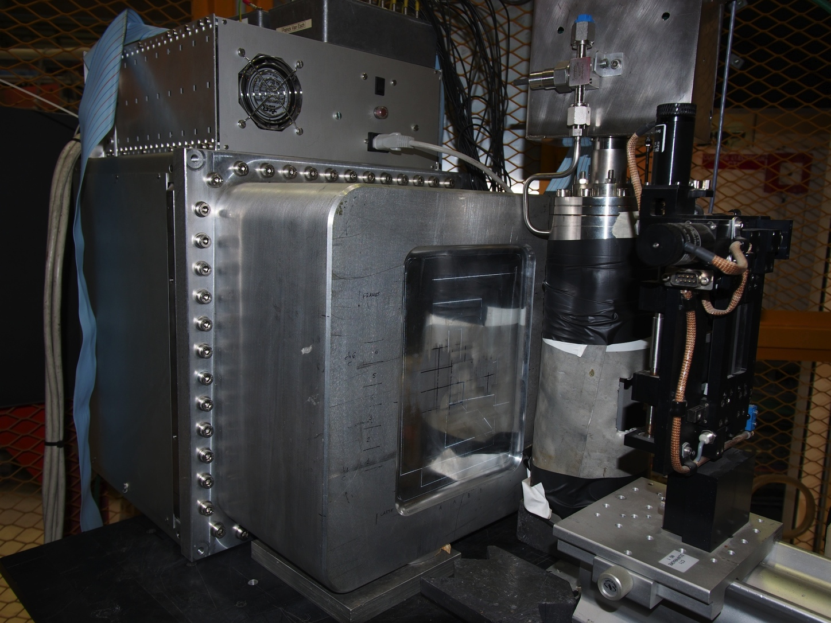
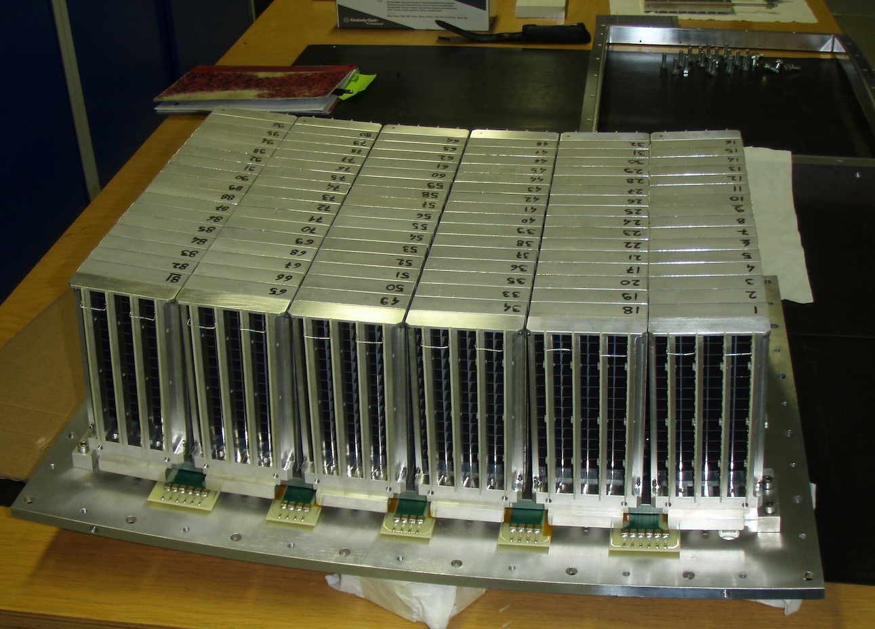
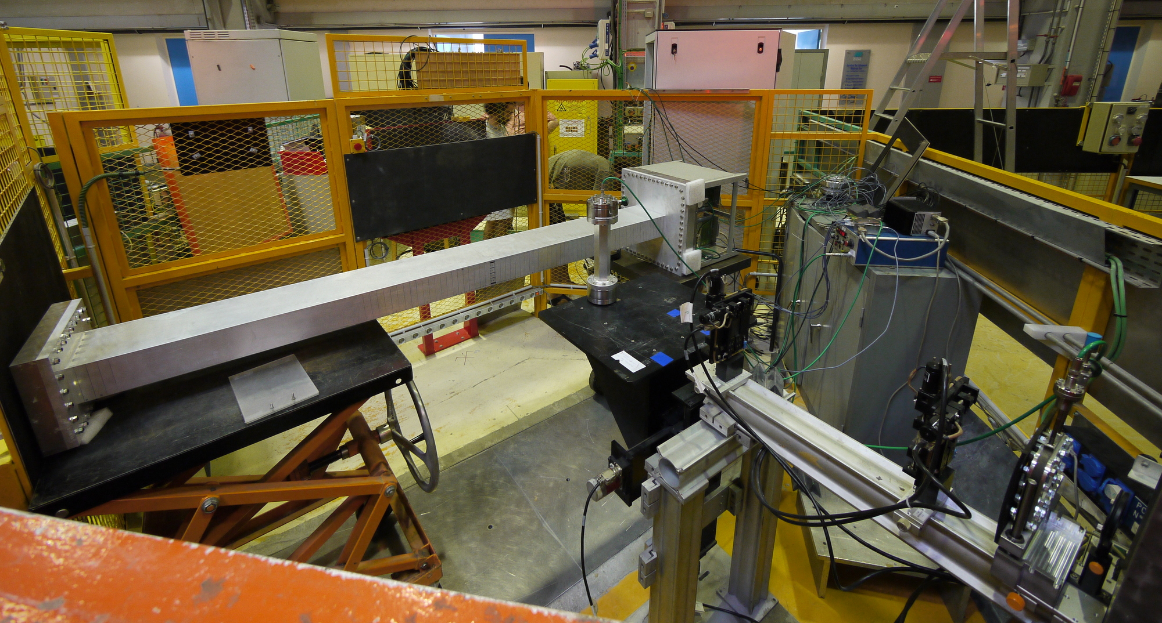
Multi-Grid Prototypes
Proto1 – 6 / 12 grids – Dec 2010
IN6 demo – 96 grids – Oct 2012
Proto2 – 96 grids – Jul 2011

Slide 21
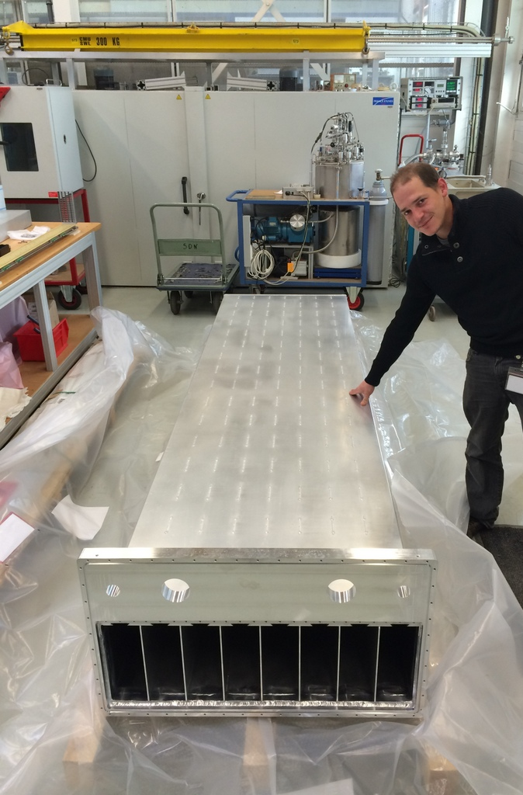
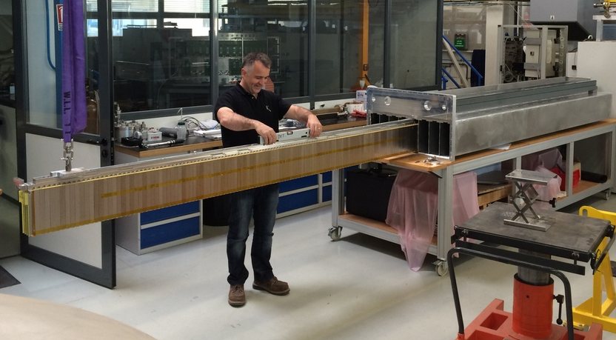
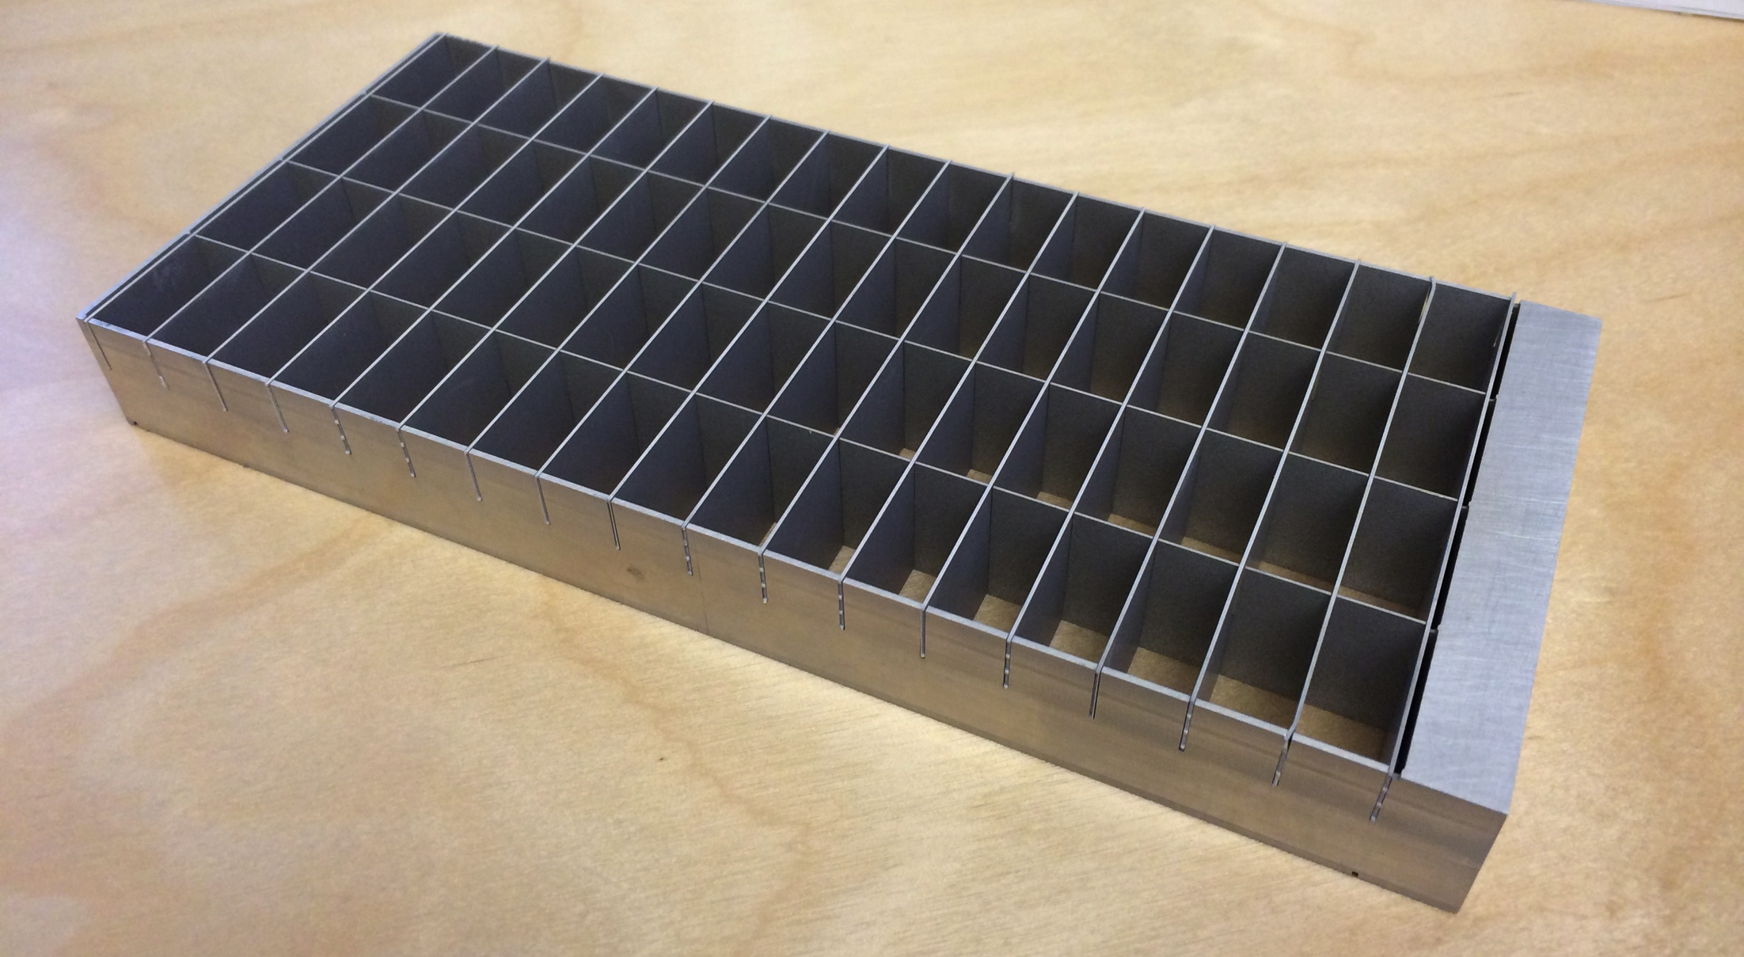
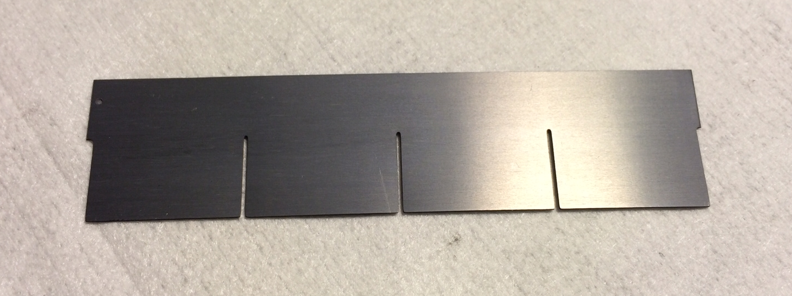
IN5 Demonstrator
Column x8:
wire-frame coincident readout
3 m
Grid x1024:
low activity,
minimal dead material
Blade x18432:
enriched B4C coating
good adhesion, uniformity,
80cm
Detector:
2.4 m² active area

Slide 22
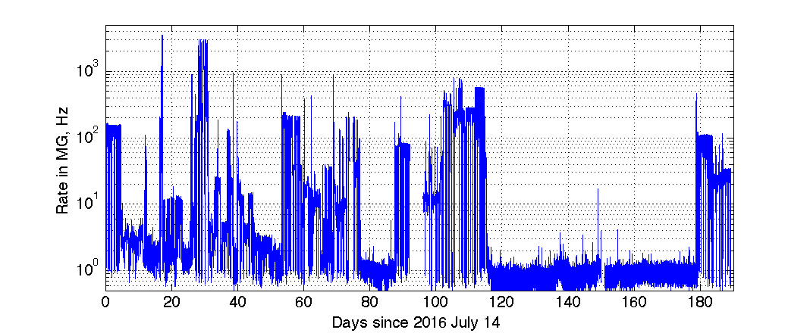
Continuous Operation
July 2016
Feb 2017

Slide 23
Time-of-Flight Spectrum
Prompt peak
Elastic peak
Neutron energy gain
Neutron energy loss
Time between source pulses

Slide 24
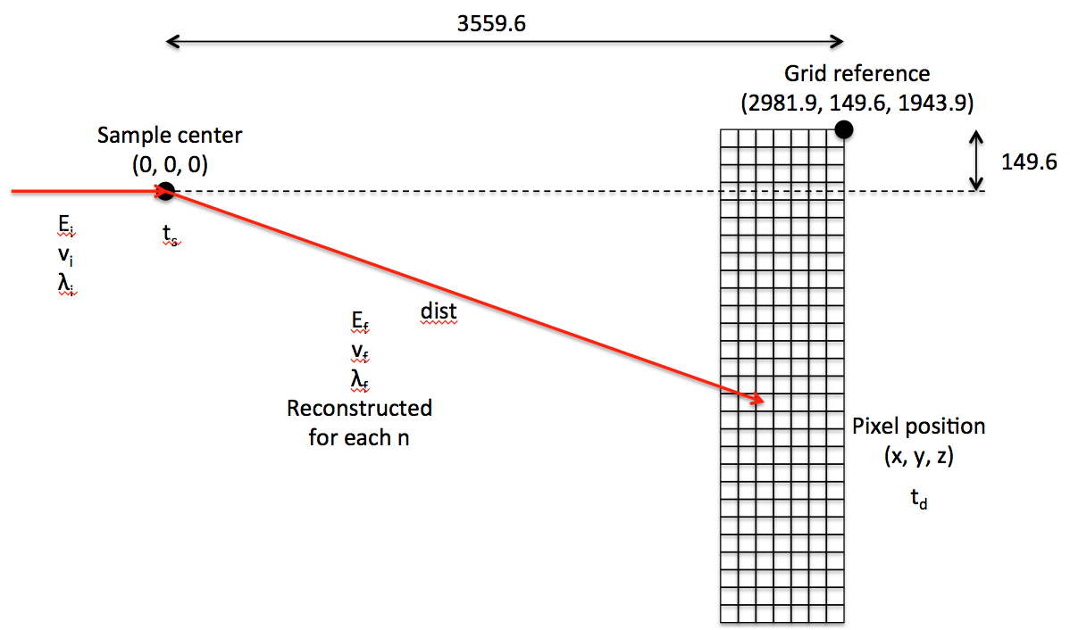
Energy Reconstruction
Energy transfer:
E_{f}-E_{i}

Slide 25
Elastic Energy Resolution

Slide 26
Efficiency
Counts from integral of the elastic peak in dE
Efficiency measured relative to the nearest He3 tubes
Calculated tube efficiency for 6bar He3

Slide 27
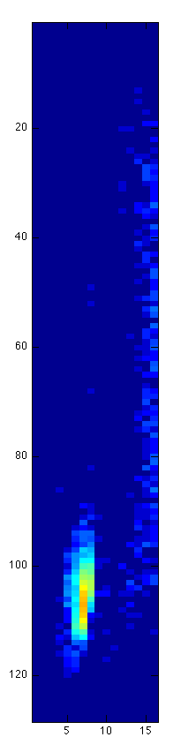
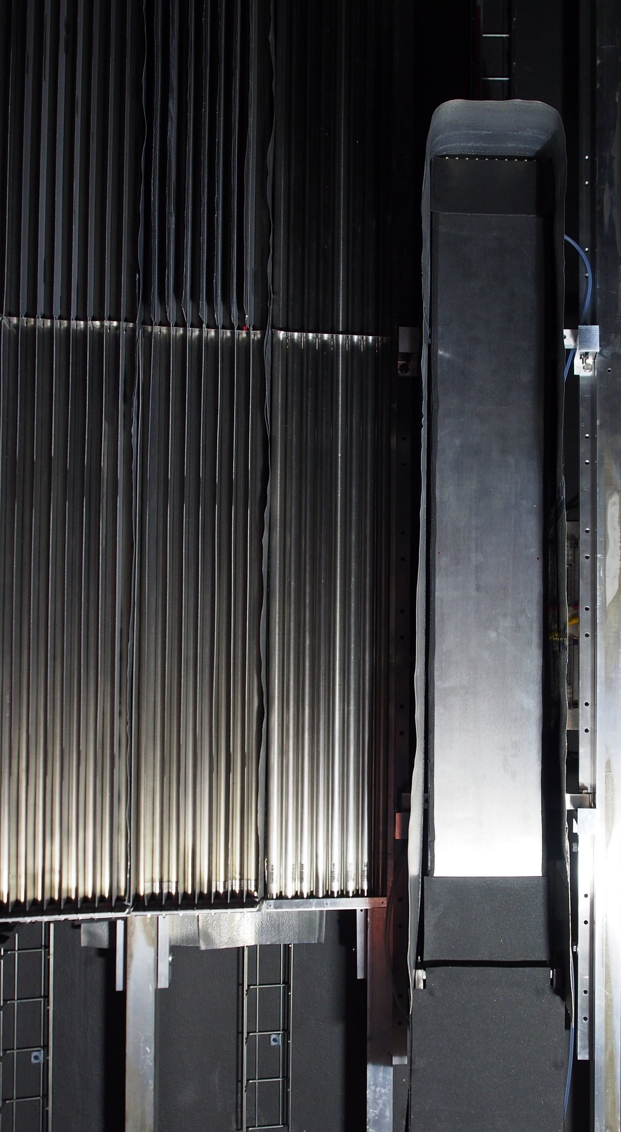
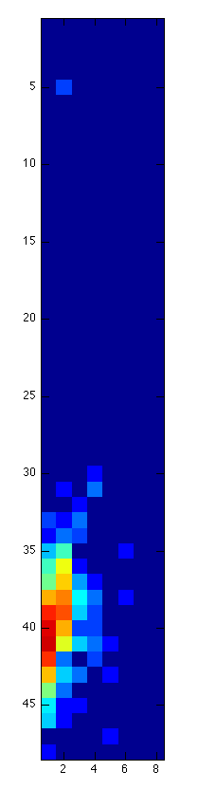
Single Crystal Reflection
He3
A single crystal reflects neutrons according to Bragg’s law:
Resulting in an intense spot seen by detector
MG
Reflected beam at E_{i} = 17.20meV
Crystal
Reflected beam at E_{i} = 13.74meV
Incident beam

Slide 28
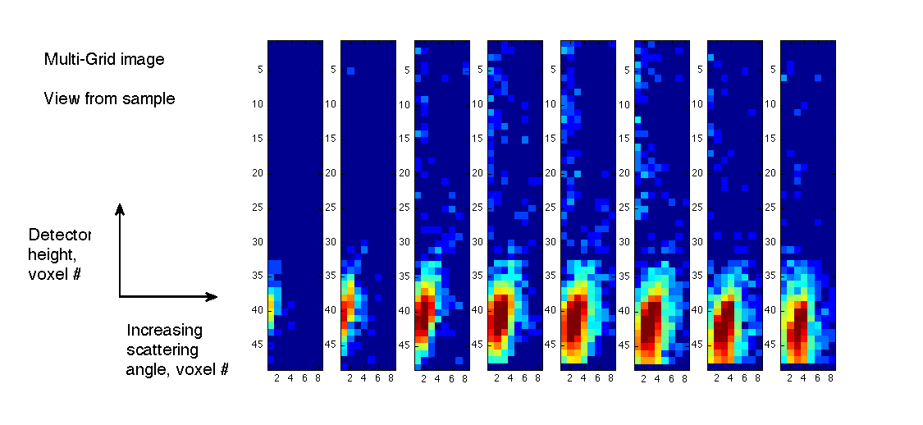
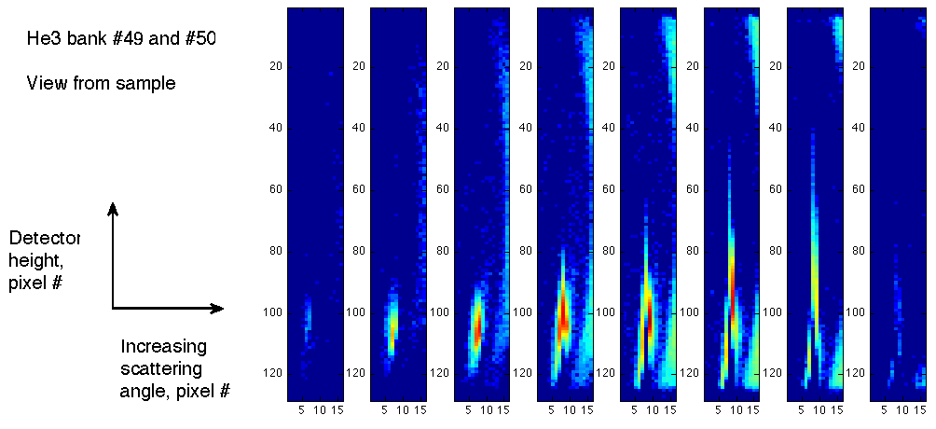
Single Crystal Reflection
Image recorded in each detector as a function of time during elastic peak
Each frame advances 30 μs
Multi-Grid
He3

Slide 29
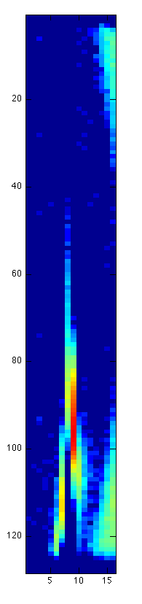
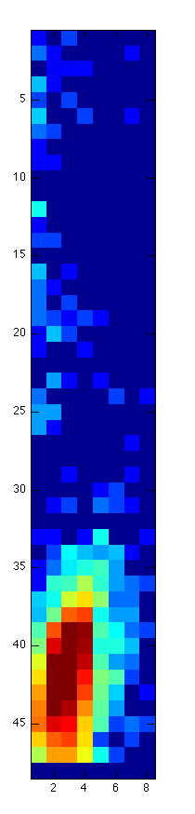
Single Crystal Reflection
He3
The 6th image frame from previous slide
(Peak rate in 1 tube / 1 line of pixels ≈ 150kHz)
Position:
Charge division in He3 PSD – saturation causes loss of position resolution
Coincidence between grids and wires in Multi-Grid
Local count rate limit:
space charge in gas (*)
  x10 lower in MG per event
  x10 lower in MG due to lower gain
Dead time of electronics
depends on electronics, similar
MG

Slide 31
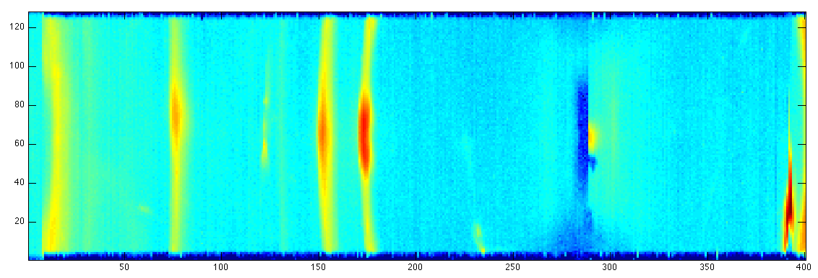
Time-of-Flight Spectrometers
Time-of-flight information
2-5 m sample to detector distance
→ Energy transfer
20-40 m² detector area
Position resolution O(1inch)
Momentum transfer
High dynamic range
Low background
Detected image
Detected ToF spectrum
Incident beam
n E_{i}, Q_{i}
n E_{f}, Q_{f}
Sample

Slide 32
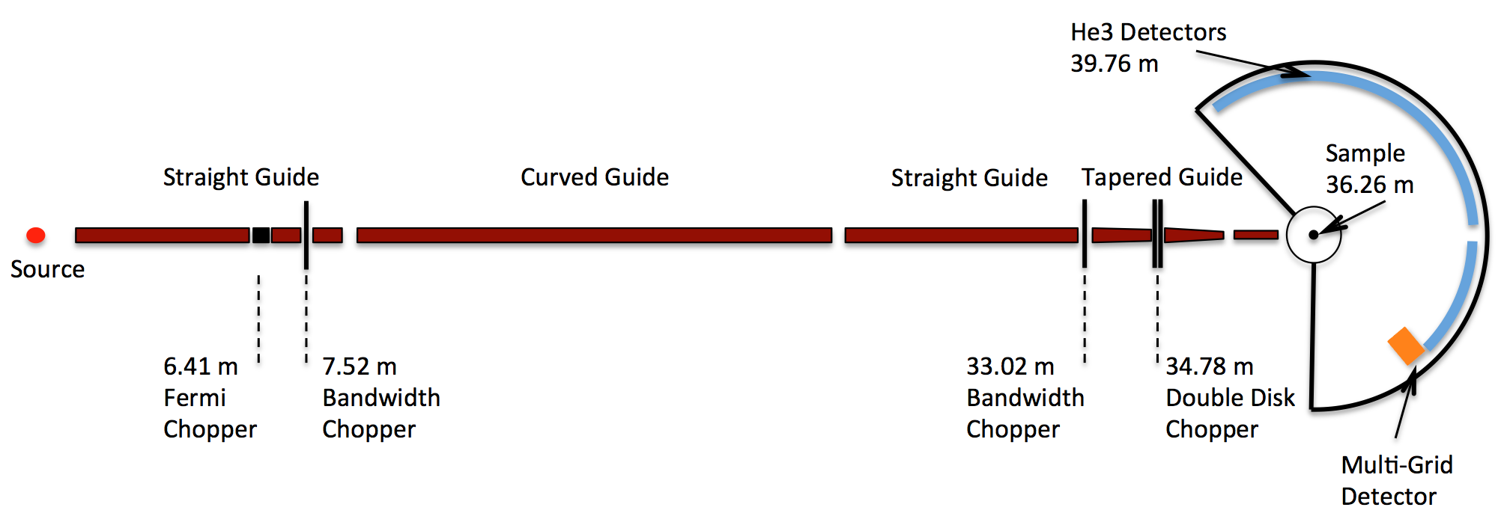
Layout of CNCS at SNS
Cold Neutron Chopper Spectrometer
Topics:
Magnetism
Structural excitations
Dynamics in confined geometries

Slide 33
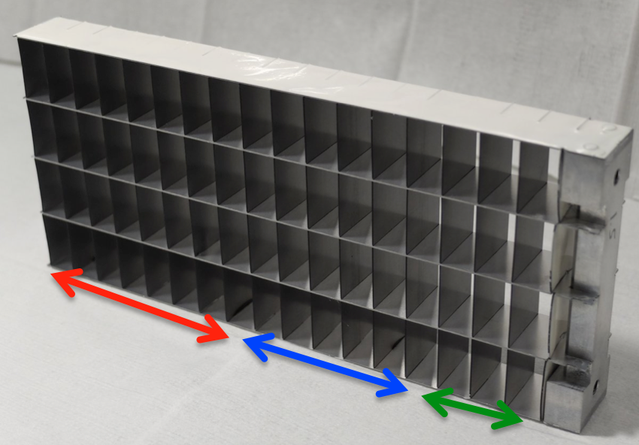
Choice of ¹⁰B₄C Layer Thickness
Efficiency optimized for λ=4Å
¹⁰B₄C coating thicknesses:
7 blades with 0.5 um
7 blades with 1.0 um
3 blades with 1.5 um

Slide 34
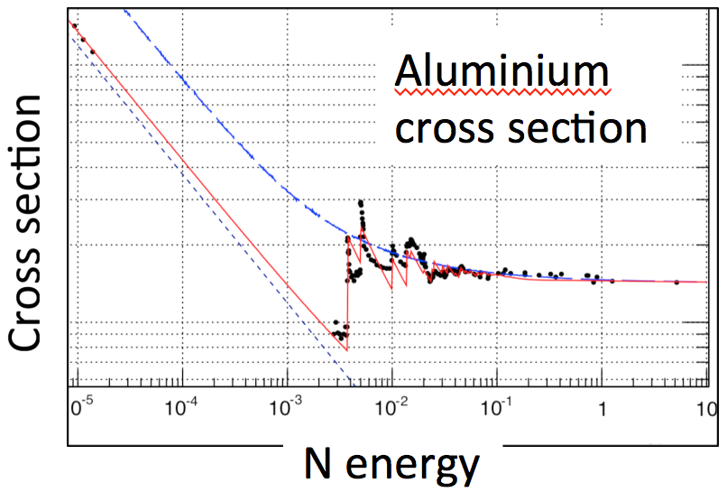
Aluminium Bragg Edge
Scattering effects from SE and detector
Sample
Sample environment
Detector
Incident n

Slide 35
Fast Neutron Background

Slide 36
Gamma Background

Slide 37
Energy Reconstruction
3559.6
Grid reference
(2981.9, 149.6, 1943.9)
Sample center (0, 0, 0)
149.6
E_{i}
v_{i}
λ_{i}
t_{s}
dist
E_{f}
v_{f}
λ_{f}
Reconstructed for each n
Pixel position (x, y, z)
t_{d}

Slide 38
Energy Reconstruction
Front Cells Only
Correction for depth does not compromise data quality
Detector equivalent to a flat detector
Grid reference
(2981.9, 149.6, 1943.9)
E_{i}
v_{i}
λ_{i}
Sample center (0, 0, 0)
149.6
t_{s}
E_{f}
v_{f}
λ_{f}
dist
~16% of events in 1st cells for 9Å
Pixel position (x, y, z)
t_{d}

Slide 39
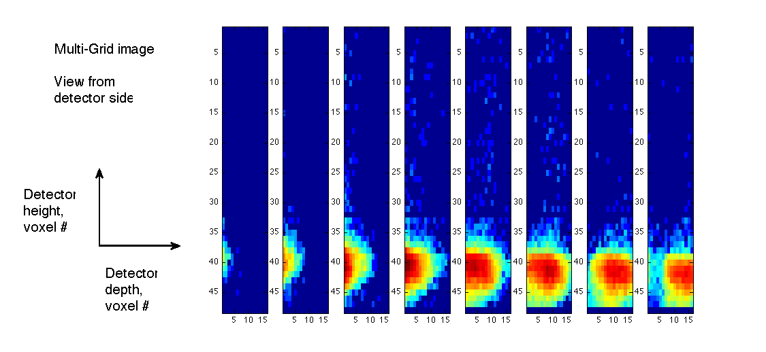
Single Crystal Reflection

Slide 40
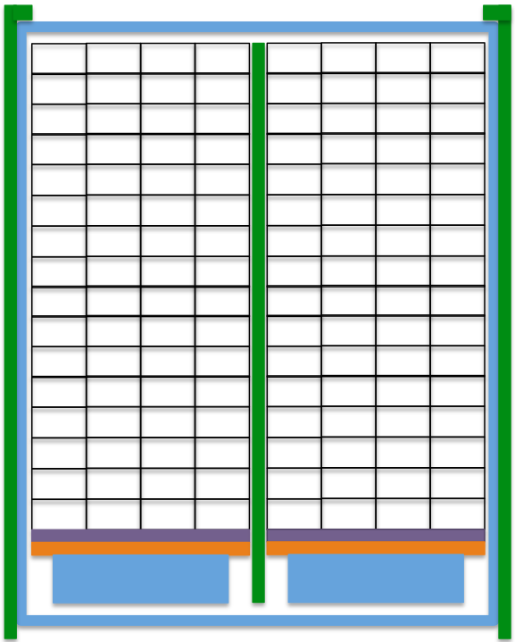
Shielding Used in MG.CNCS
B4C
Gd2O3
PCB
Aluminium

Slide 41


¹⁰B₄C coatings
If you are interested in coatings, please contact us

Slide 42










What we have shown so far
Detectors based on ¹⁰B-enriched B₄C thin films are a
competitive alternative to ³He gas based detectors
Some of our new challenges:
Temperature sensitive substrates
No substrate bending when 1-side coated
Pre-defined coating resistivity
Complex substrate shapes
Publications:
*C. Höglund et al, J of Appl. Phys. 111, 104908 (2012)
*S. Schmidt et al, J. of Materials Science 51, Issue 23 (2016)
*C. Höglund, Rad. Phys. and Chem. 113 , 14-19 (2015);

