Slide 1

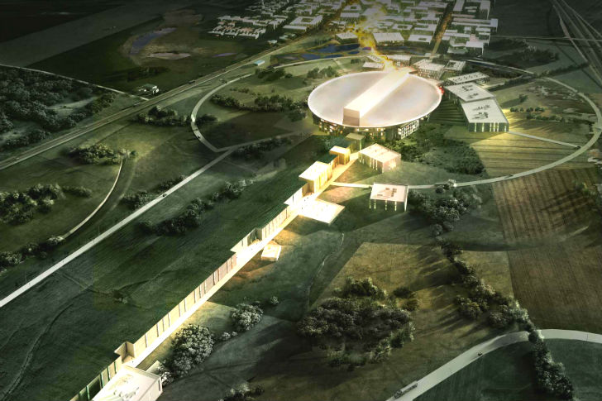

PDR on Power Converters for Magnets D1, Q8 and C8
IKC and PDR Scope
Carlos Martins
ESS – Accelerator Division - RF
Power Converters Section
www.europeanspallationsource.se

Slide 2
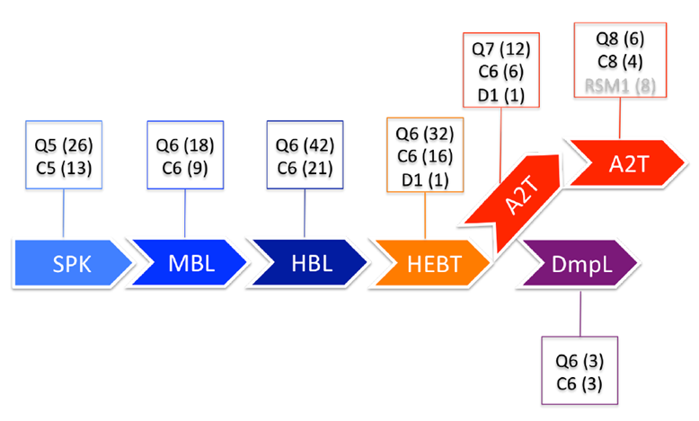
PDR on Power Converters for Magnets D1, Q8 and C8
IKC and PDR Scope
Magnets list with types and location

