Slide 2
4-Quadrant Power Converters Design Report
Corrector DCPC - C8
Marco Cautero
Elettra Sincrotrone Trieste

Slide 3

Introduction: requirements for the PC
Magnets, cables, and power converters
Three types of correctors: C5, C6, and C8
Full design of C5, C6, C8 completed
Goal: standardize the 4-Q power converter for correctors
Use also for DTL pulsed correctors (not part of this CDR)
Parameter | C5 | C6 | C8 | Cable | Unit
Maximum current I_{MAX} | 16 |  |  |  | A
Conductor cross section | 11.2 |  |  | 6 | mm²
Maximum current density J | 1.5 |  |  | 2.66 | A/mm²
Max Cable length (full loop) | - |  |  | 200 | m
Resistance (double coil) | 32 | 81 | 507 | 600 | mΩ
Voltage Drop @ 16 A | 0.5 | 1.3 | 8.1 | 9.6 | V
Est. Max Resistance (Magnet + Cable) | 1150 |  |  |  | mΩ
Maximum Voltage Drop (Magnet + Cable) | 18.5 |  |  |  | V

Slide 4
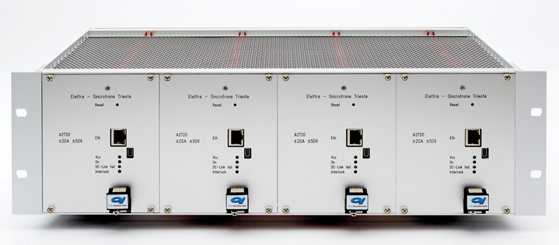
Introduction – The System A2720
Four independent units in a 3U, 19” crate.
Parameter | Value | Unit
Output Stage DC-DC Topology | 4-Q
Input voltage (V_{Bulk}, power part) | 24 | VDC
Maximum Input Current (power part) | 20 | A
Nominal (MAX) output current | ±16 (±20) | A
Nominal output voltage | ±22 | V
Nominal output power | 352 (440) | W
Current Resolution (20 bit) | 40 | µA
Switching Frequency | 100 | kHz
Long-term Output Stability (24h) | <25 | ppm F.S.
Max Ripple (pk-pk, resistive load, 1 Hz filter) | 600 | µA
DC-DC Efficiency @ 16 A, 20 V output | 94 | %

Slide 5
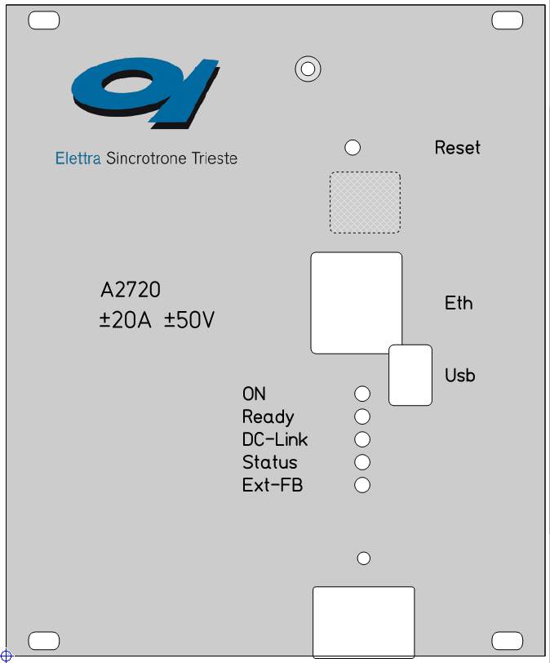
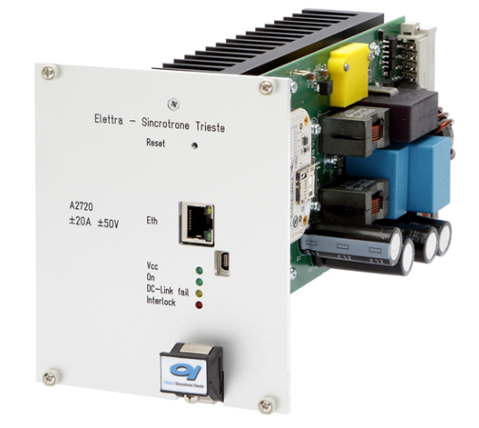
Description and Key Features
In-house design
Derived from a previous successful Elettra in-house design for FERMI (~300 PC installed, 5 A and 20 A units)
Fan-less operations for increased reliability (natural convection) below 16 A DC
Native Ethernet via RJ-45 port
Interface to MPS/PSS
Reset button
Ethernet RJ-45 port
Serial on Mini-USB port
Five Status LEDs

Slide 6
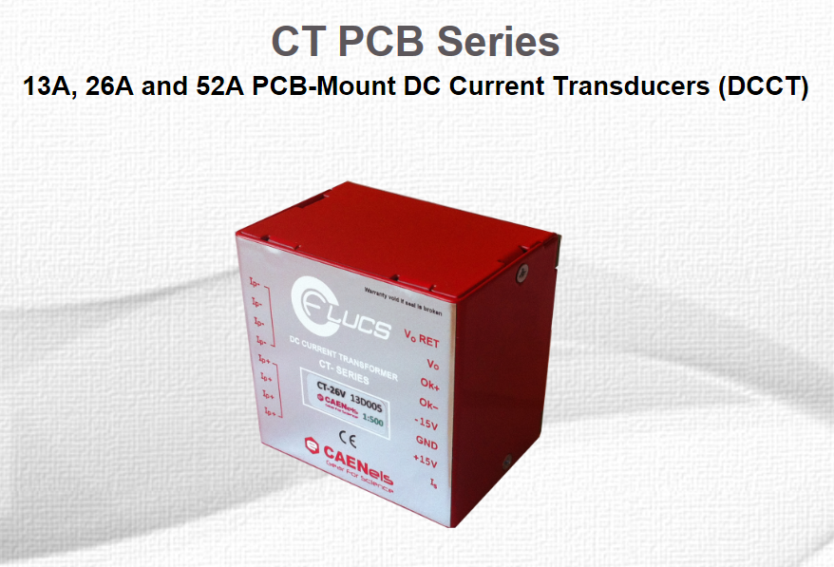
Description and Key Features
In-house design
A new DCCT with better specification was used (26 A version)
Better linearity (no need to keep a 4th order interpolation polynomial in loop)
Better EMI shielding and insulation, higher noise immunity reducing undesired noise pick-up from external sources
Current output, higher immunity than previous DCCT
But it has bigger dimensions → new PCB is larger

Slide 7
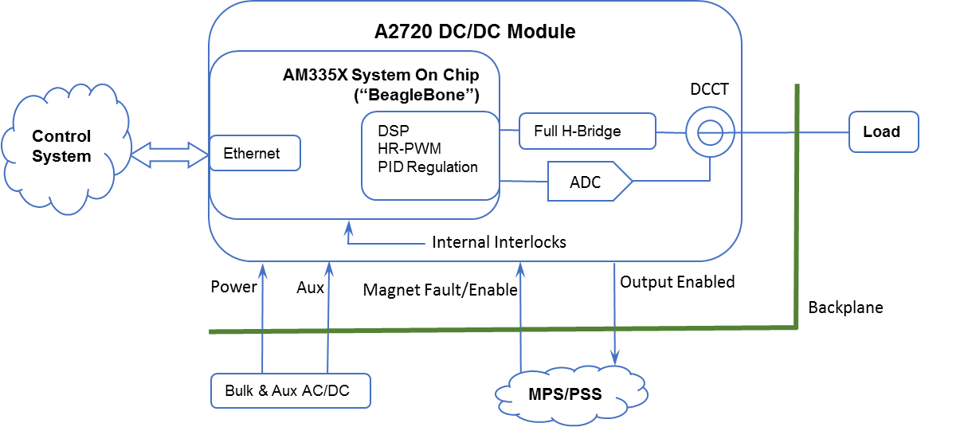
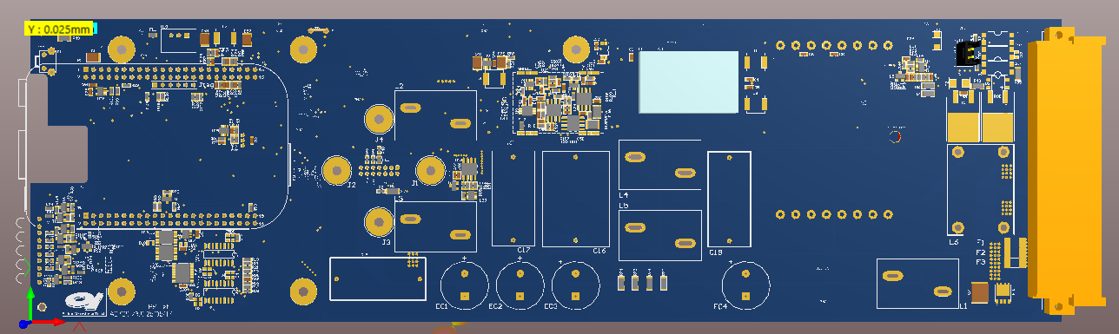
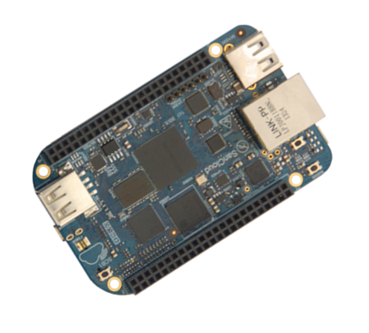
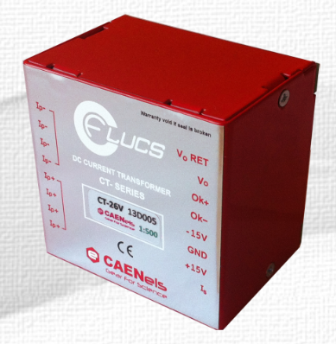
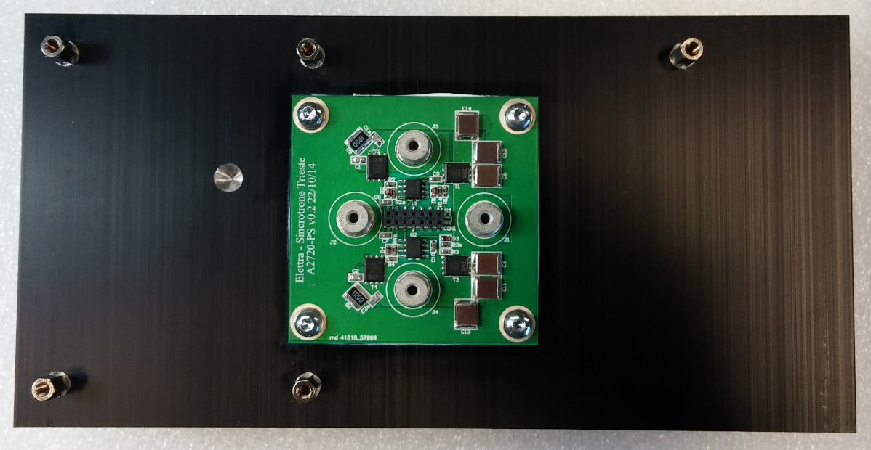
A2720 DC/DC module

Slide 8
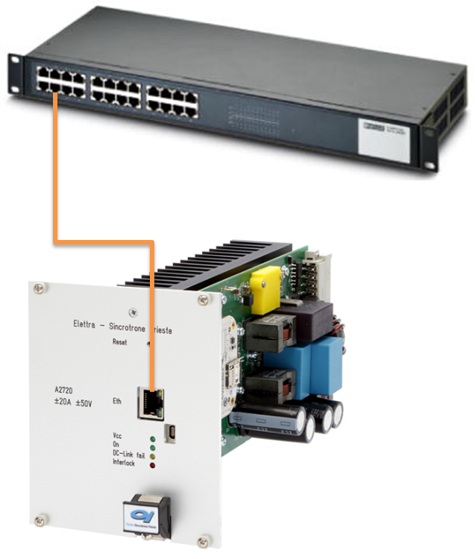
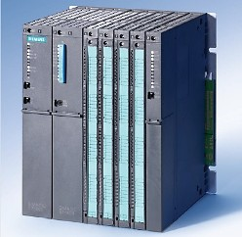
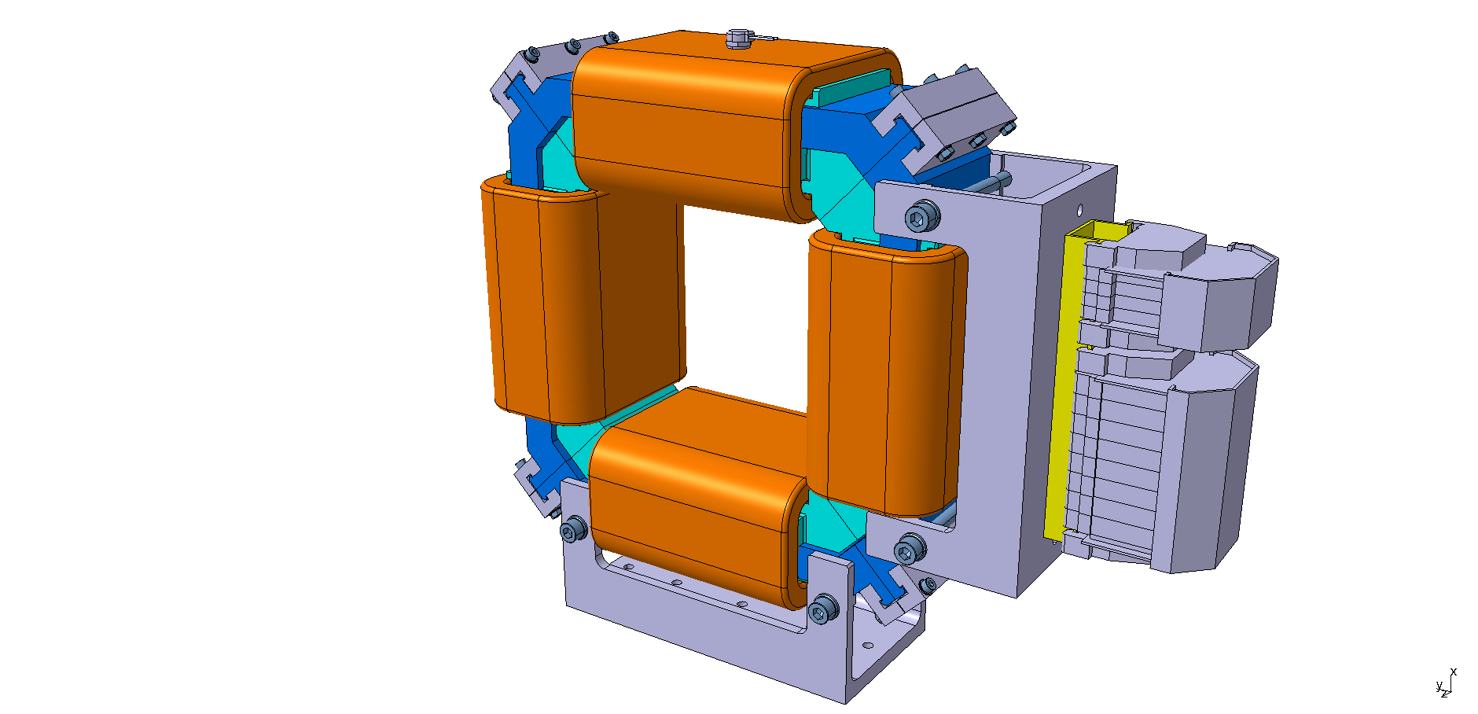
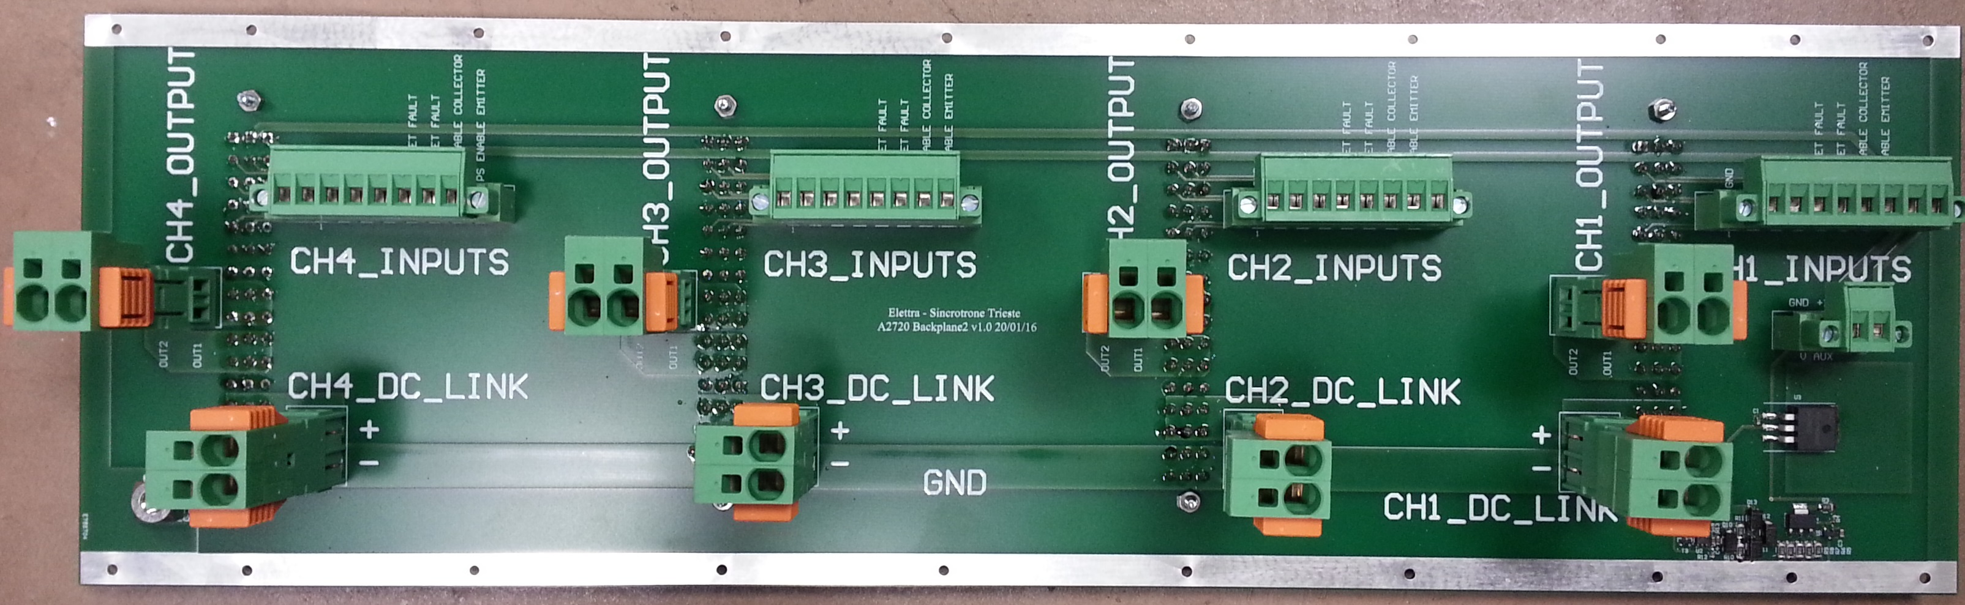
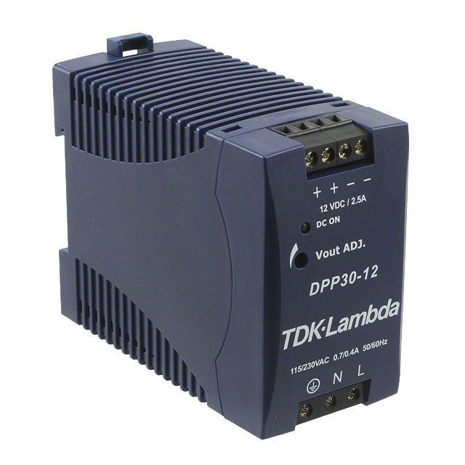
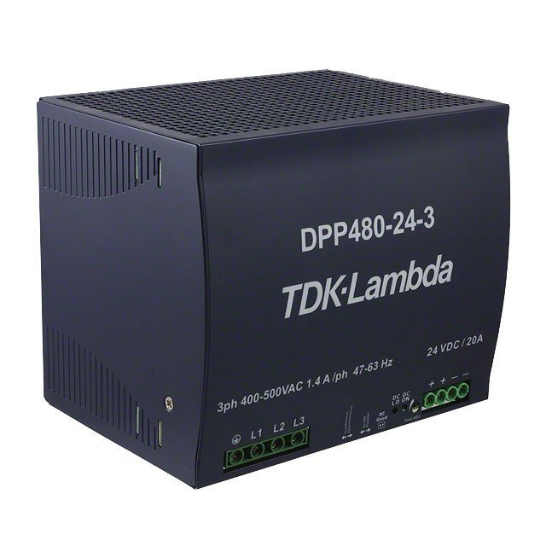
A2720 Connections
4
3
2
1
Notes:
The BeagleBone (BB) “Black”, a credit-card-sized Linux computer (SOC – System on Chip), manages the A2720 module.
Via the native Ethernet connection, it interfaces the module to the remote control system.
The BB provides the PWM pattern to the MOSFET H-Bridge according to the results from the PID fully digital regulation that utilizes the output from the AD7691, 18-bit, successive approximation, analog-to-digital converter (ADC) via SPI. A double shielding encloses the ADC: the inner one for EMI reasons, the outer one acts as a thermal insulator for the circuitry with heaters that thermally stabilize it (the red, square, box almost in the center at the bottom of Figure 4).
A new DCCT type from CaenEls (CT-PCB) reads the output current, galvanically isolating the power stage from the control and regulation.
Digital lines on the BB provide the status and read the interlock signals generated internally or externally.
The large heatsink hosts the H-Bridge PCB and allows the fan-less operation of the A2720 module.
Each channel/power supply is equipped with multiple internal protections (hardware and software) to avoid unwanted behaviors or potential damages.
The hardware protections installed on the A2720 Power Board are:
DC-Link Fuses;
H-Bridge MOSFET cross-conduction protection;
There are also some software protections:
DC-Link under-voltage protection;
H-Bridge MOSFET over-temperature;
Crowbar protection;
Output Overcurrent.

Slide 9
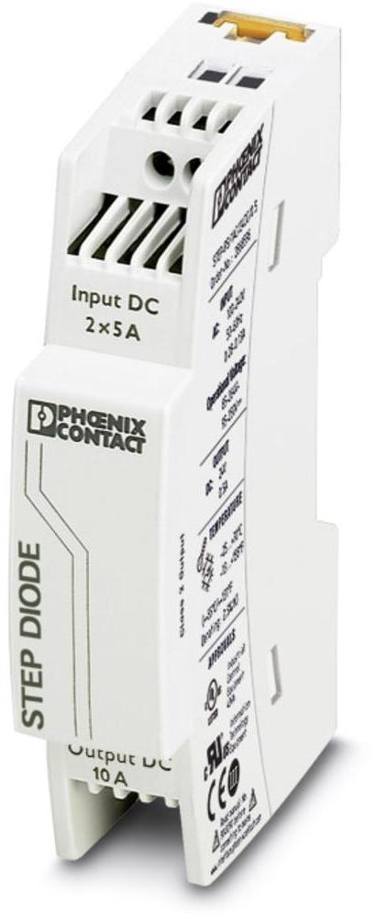
Bulk and Auxiliary power converters
ESS asked for independent 3-phase AC/DC bulk converters with MTBF>100,000 hours.
Required maximum output voltage of A2720: ~18 VDC
Optimal value for DC-Link voltage is 24 VDC – 20 A.
Electronics requires 12 VDC – 2 A per crate (common to 4 x A2720)
Two 12 VDC Aux per Crate: TDK-Lambda DPP30-12 (MTBF >288,000 hours), DIN rail mount with Step-Diode by Phoenix-Contact in between.
One 24 VDC Bulk per Unit: TDK-Lambda DPP480-24-3 (MTBF >400,000 hours), DIN rail mount

Slide 10
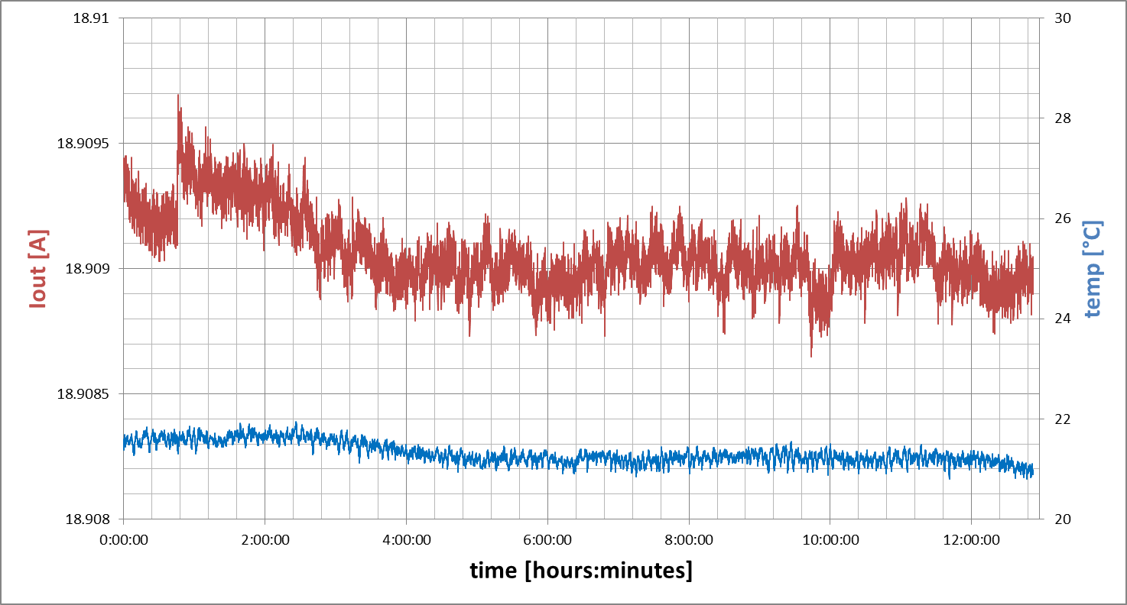
A2720 measured performances
Climatic Chamber, natural cooling.
Example of test for the units shipped to MaxIV
12 hours at 18.9 A DC, controlled ambient temperature 21.5 ºC ±0.5 ºC
  1 mA
28 ppm

Slide 11
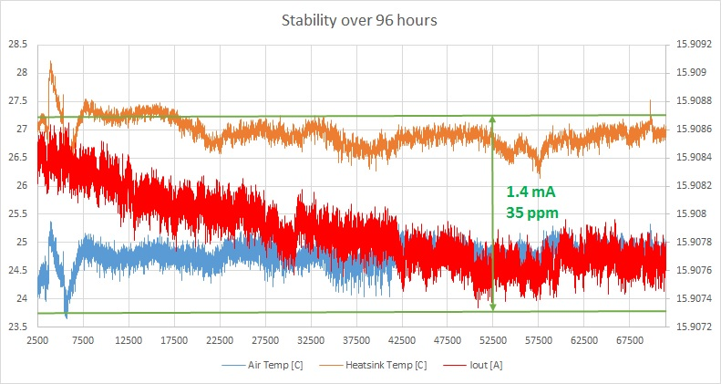
A2720 measured performances
Climatic Chamber, natural cooling.
V_{DCLink} = 30 V instead of V_{DCLink} = 24 V
96 hours at 15.9 A DC, controlled ambient temperature 24.5 ºC ±0.5 ºC
Measured efficiency ~96%

Slide 12
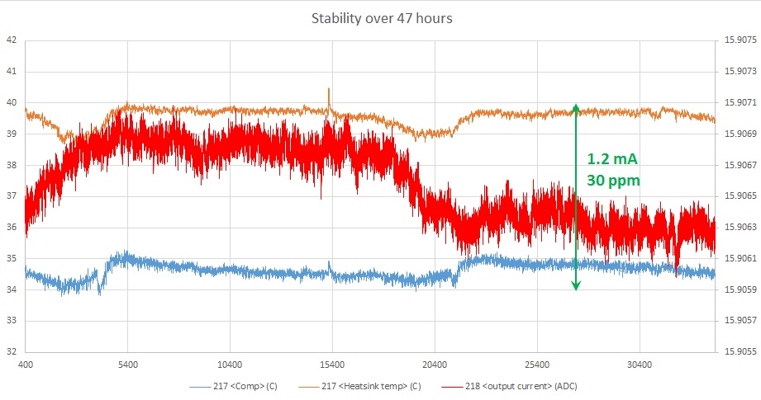
A2720 measured performances
Climatic Chamber, natural cooling.
V_{DCLink} = 30 V instead of V_{DCLink} = 24 V
47 hours at 15.9 A DC, controlled ambient temperature 34.5 ºC ±0.5 ºC
Measured efficiency ~96%

Slide 13
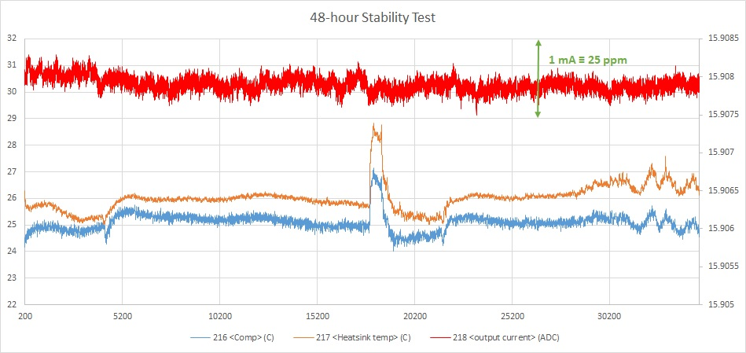
A2720 measured performances
Climatic Chamber, natural cooling.
Nominal V_{DCLink} = 24 V and nominal ambient temperature 25.5 ºC ±0.5 ºC
48 hours at 15.9 A DC, controlled ambient temperature
Measured efficiency ~96%

Slide 14
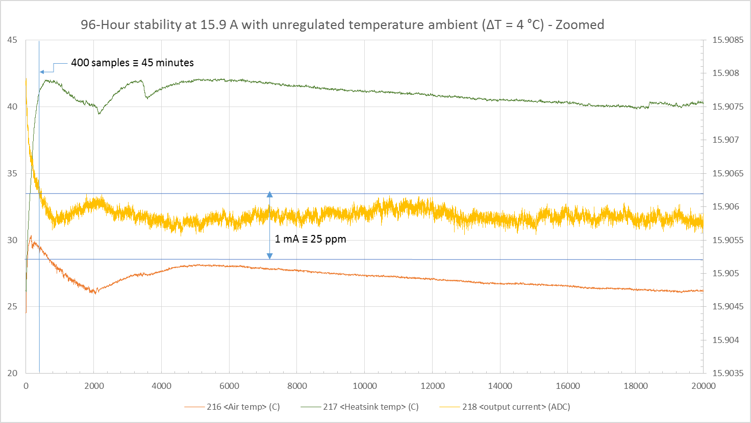
A2720 measured performances
Uncontrolled ambient temperature, natural cooling.
Nominal V_{DCLink} = 24 V
96 hours at 15.9 A DC, switching from controlled to uncontrolled ambient temperature
Measured efficiency ~96%
Zoom over the first 28 hours.
<3 mA ≡ 75 ppm

Slide 15
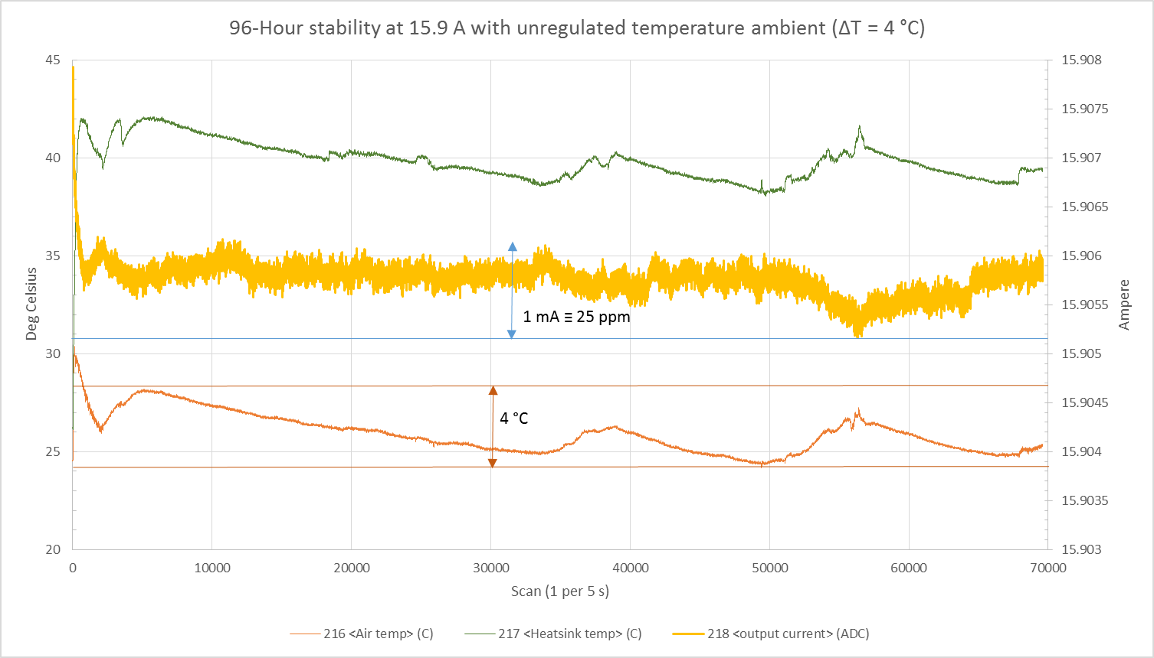
A2720 measured performances
Uncontrolled ambient temperature, natural cooling.
Nominal V_{DCLink} = 24 V
96 hours at 15.9 A DC, switching from controlled to uncontrolled ambient temperature
Measured efficiency ~96%
<3 mA ≡ 75 ppm
Full Period of test

Slide 16
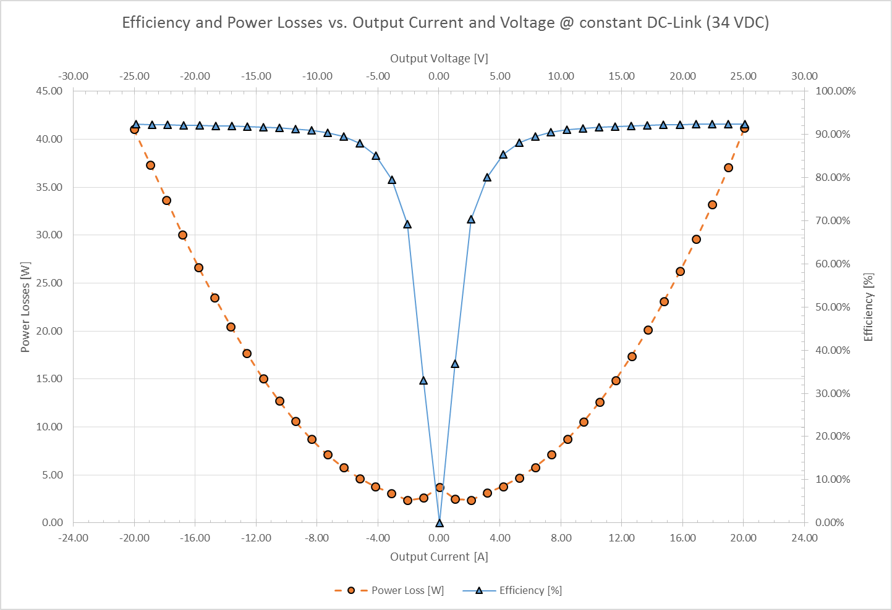
A2720 efficiency

Slide 17
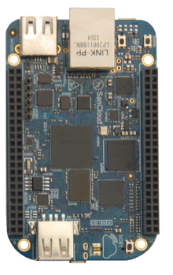
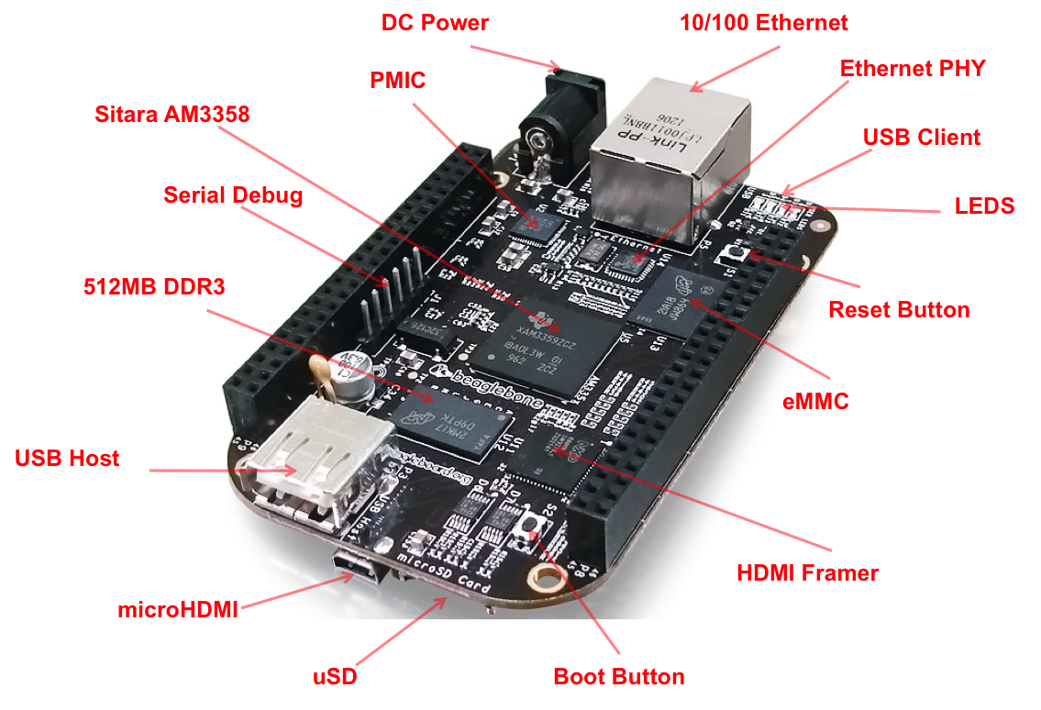
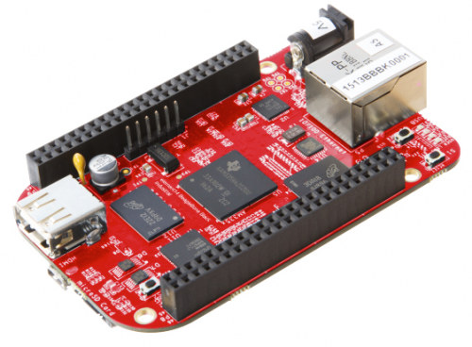
A2720 next steps
Adoption of a more recent controller (BB-Red or SanCloud BB enhanced version with Gigabit Ethernet)
Integration within the “fast feedback” system of Elettra (input and handling of an external reference along with the “static” reference from the Control System)

Slide 18
A2720 on-field experience: Elettra Storage Ring
Two “pre-series” units are installed on the two planes of an “8th-Corrector” in Storage Ring.
Connected to the Elettra Control System
Elettra operate ~ 6500 hours/year (~ 4500 hours for Users)
Operating since Mar’15, total of 26000 h achieved with 2 units
No hardware faults occurred since then.

Slide 19
Thank You!

