Slide 2
Dipole and Quadrupole Power Converters Extended Technical Specifications
PCD1 and PCQ8
Roberto Visintini
Elettra Sincrotrone Trieste

Slide 3

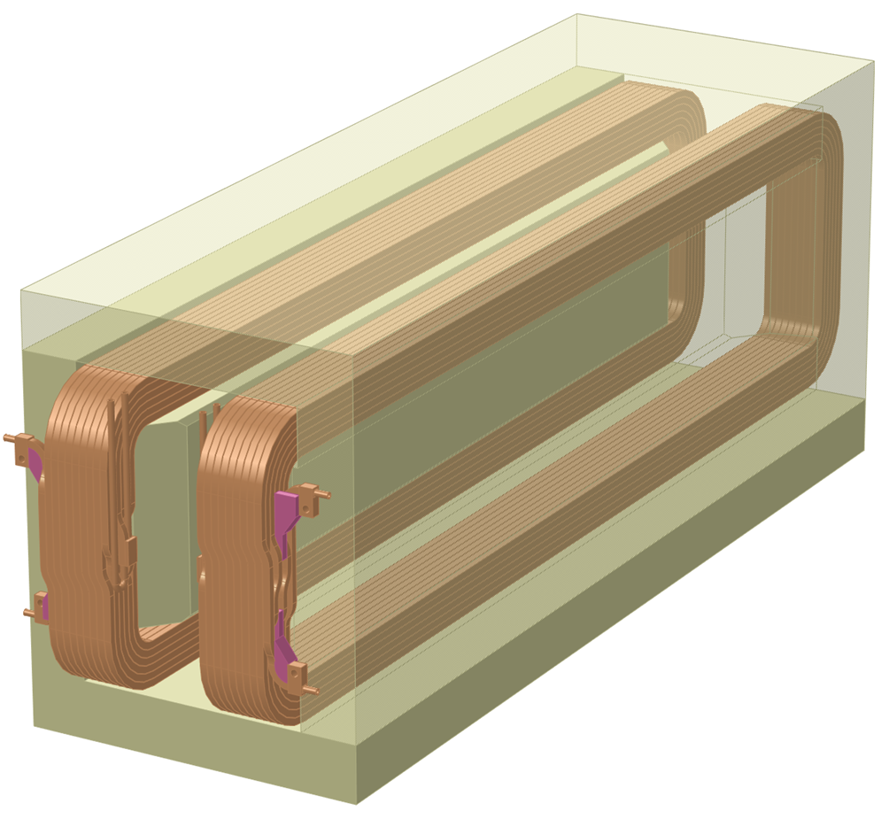
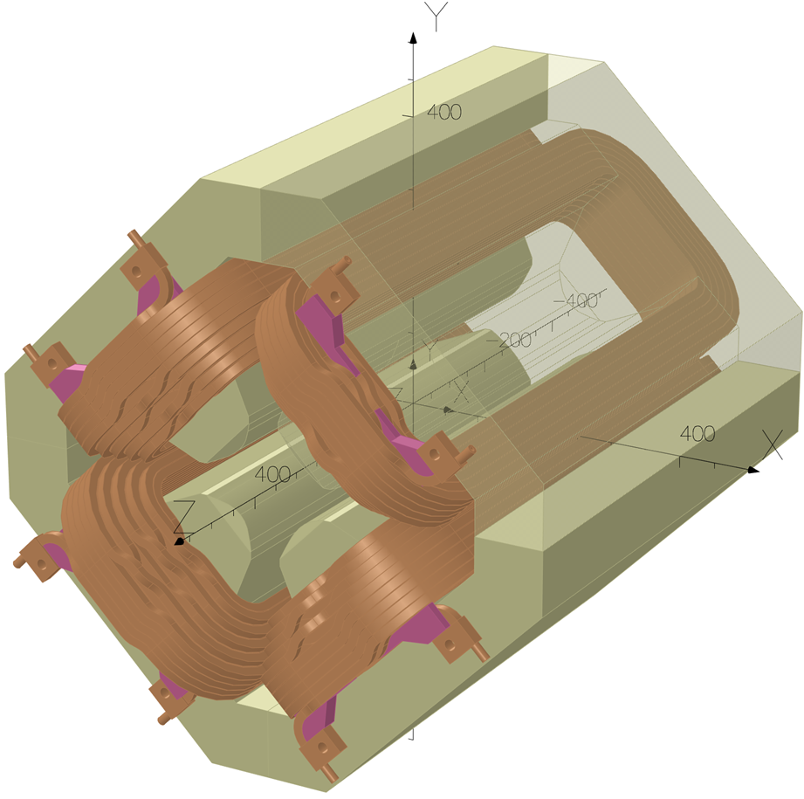
Introduction: requirements for the PC - 1
Magnets & cables
Two Dipoles D1 in series (cable: 300 m “round loop”)
Quadrupole single (cable: 200 m “round loop”)
Cables: 2x120 mm² = 240 mm² (Nexans FXQJ EMC 1kV 2x120/70)
Magnet | D1 | Q8 | Unit
Max Current | 400 | 400 | A
Mag Nominal Current (I_{mag_nom}) | 371 | 371 | A
Resistance | 81 | 53.2 | mΩ
Inductance | 860 | 83.6 | mH
Max Voltage Drop | 32.4 | 21.3 | V
Voltage Drop at I_{mag_nom} | 30 | 19.7 | V
Current Density in cable | 1.7 | 1.7 | A/mm²
Cable resistance | 23 | 15.3 | mΩ
Max voltage drop on cable | 9.2 | 6.1 | V

Slide 4
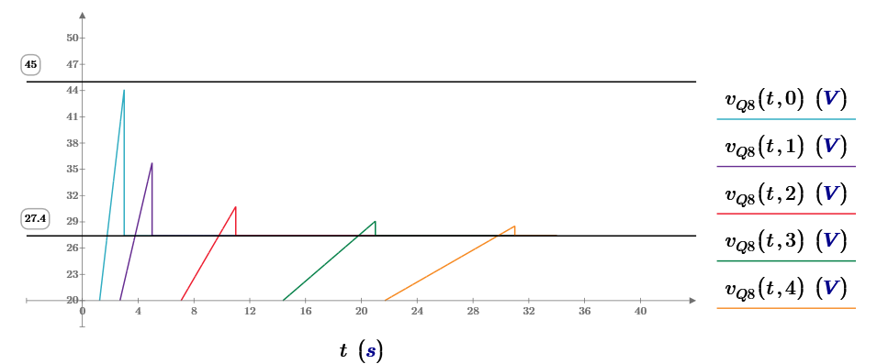

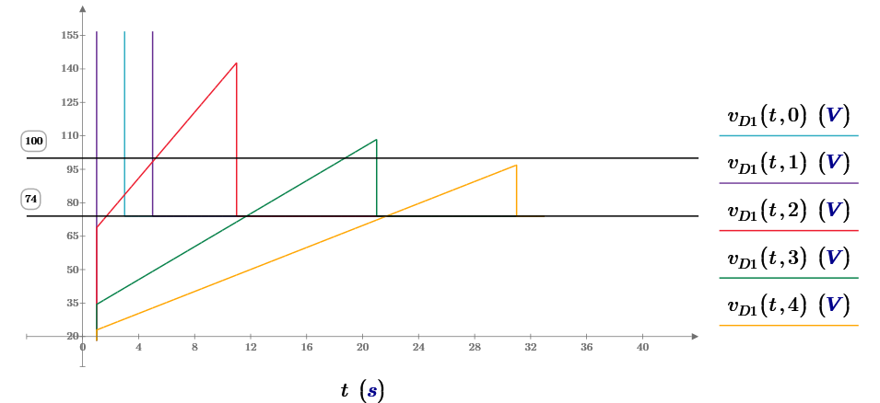
Introduction: requirements for the PC - 2
Power Converters – Dynamics
Quadrupole: 2 s ramping from 0 A to 400 A
Dipole large inductance: 30 s ramping from 0 A to 400 A

Slide 5
Introduction: requirements for the PC - 3
Power Converters – minimum output parameters
Output voltage calculations include dynamics
Output voltage guaranteed at nominal current and lowest AC mains voltage (400 VAC -10%).
Type | Number of PC | Rated DC output Current [A] | Calculated Max DC Output Voltage [V] | Minimum PC Nominal Output Voltage [V]
PCD1 | 1 | 400 | 74 | 100
PCQ8 | 6 | 400 | 27.4 | 45

Slide 6
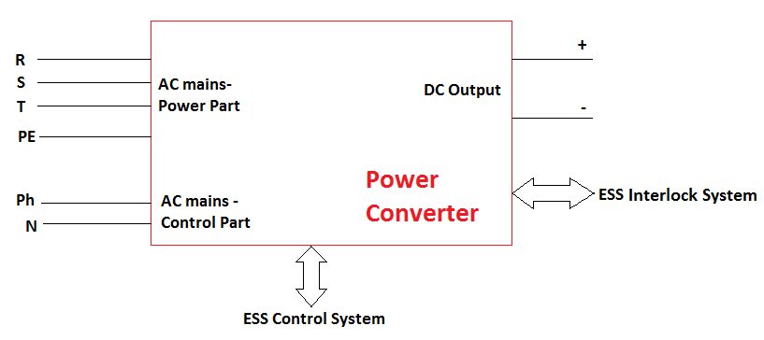
Power Converters – Limit of Supply
    The AC input terminals (3-phase+PE, 400 VAC, 50 Hz) for supplying the main power part;
    The AC input terminal for supplying the power supply control electronics (1-phase+Neutral, 230 VAC, 50 Hz from UPS);
    The DC output terminals for connecting to the magnets;
    Terminal blocks or connectors for the connections to the ESS Interlock System;
RJ45 ETH connector to the ESS Control System

Slide 7
Required PC performance - 1
Power Converters – Main output parameters
 | Symbol | PCD1 | PCQ8 | Note
Type | SMPS, Single quadrant, DC, current regulated
# of Power Converters |  | 1 | 6
Nominal Output Current [A] | I_{nom} | 400 | 400
Nominal Output Voltage [V] | U_{nom} | 100 | 50 | Guaranteed at I_{nom} and lowest AC mains voltage (400 Vac -10%)
Nominal Output Power [kW] |  | 40 | 20
Maximum load inductance [mH] | L_{M} | 1720 | 83.6 | Estimated from calculations
Maximum load resistance [mΩ] | R_{M} | 185 | 69 | Magnet + cables
Table 5 of Tech Specs.

Slide 8
Required PC performance - 2
 | Symbol | Value | Note
Maximum current ripple [ppm] | Δi_{pk-pk} | ±50 | Referred to I_{nom} on smallest inductive load
Minimum current reproducibility [ppm] |  | ±50 | Referred to I_{nom}
Stability of current [ppm]: over 5 hours, without warm-up : over 24 hours, after 5 hours warm-up : over 1 year, after 5 hours warm-up : | _{k} | ±100 ±50 ±200 | Referred to I_{nom}
Line Voltage Regulation [ppm] | LI_{K} | ±100 | ±10% line voltage change, instantaneous step change on all three phases. Worst load case, referred to I_{nom}
Output current Range [A] | I_{min,} I_{max} | 37-370 | 10% - 100% of I_{mag_nom}
Maximum current settling time [s] | T_{R} | 30 s – 2 s | From I_{min} to I_{max} (D1 – Q8)
Output current overshoot/undershoot [ppm] |  | 100 | Of the setting value; in the range I_{min} to I_{max}
Resolution of the Output Current setting [bit] |  | ≥16
Resolution/accuracy of the read back values of Output Current and Output Voltage [bit] |  | ≥16
Table 6 of Tech Specs.

Slide 9
Required PC performance - 3
 | Symbol | Value | Unit
Nominal line-to-line AC voltage, power part | U_{AC_P} | 400 | V
Nominal line-to-neutral AC voltage, control part | U_{AC_C} | 230 | V
AC voltage source type, power part |  | 3-phase + PE, 50 Hz
AC voltage source type, control part |  | 1-phase + N, 50 Hz
Earthing system, control/power part (common to both) |  | TNS
Line voltage operating variations, step changes simultaneously on the 3-phases, permanent (maximum), power part | ΔU_{AC} | ±10 | %
Line voltage total harmonic distortion (maximum), power part | THD (U_{AC_P}) | 10 | % rms
Line short circuit power (maximum), power part | S_{AC}sc | 30 | MVA
Line voltage peak mains surges, phase-to-phase, power part (95% of all mains surges; remaining 5% outside this range). |  | 1.5 | kV, for 0.2 ms
Line voltage over-voltage, power part (95% of all over voltages; remaining 5% outside this range). |  | 1.5 x nominal voltage, for 20 ms
Table 7 of Tech Specs – part 1.

Slide 10
Required PC performance - 4
 | Symbol | Value | Unit
Minimum efficiency at nominal conditions | η | 85 | %
Ambient Temperature: Operating range (@ 100% load) Expected operating point for accuracy Storage |  | 0…40 27,5 -10….50 | °C
Ambient Humidity (non-condensing) |  | 20…90 | % RH
Input power factor (nominal conditions) |  | >0.8
Input current harmonic distortion | THDi | < 30 | %
Cooling of Power Converter |  | Forced air/Water
Table 7 of Tech Specs – part 2.

Slide 11
Required PC Interfaces
“Other digital interfaces for remote control must be converted to Ethernet with suitable and reliable adapters. These adapters must be provided with the power converters and previously accepted by Elettra and ESS.”
Item | Description
Remote control fieldbus | Ethernet (RJ45 socket), TCP-IP protocol
Local control interface | Local/remote selector (selectable only locally); Setting of current reference; Diagnostics of internal and external faults; Indication of actual output current and output voltage; Local reset of faults.
Hardwired status and interlock signals: Outputs from each power converter Inputs to each power converter | PC ON/OFF status. External interlocks 1 & 2 – require Reset.
Table 8 of Tech Specs.

Slide 12
PC compliance and reliability
Description
EMC standard on emission conductive disturbances | according to CISPR 11; EN 55011 class B, for AC mains
EMC standard on immunity to fast transients | according to IEC-61000-4-4 (Level 4)
EMC standard on electrostatic discharge immunity test | According to IEC 61000-4-2: Part 4-2: Testing and measurement techniques
EMC standard on voltage dips, short interruptions and voltage variations immunity tests | According to IEC 61000-4-11: Part 4-11: Testing and measurement techniques
Safety requirements for power electronic converter systems and equipment | According to IEC 62477-1: Part 1: General
Mean Time Between Failures (MTBF) | 70’000 hours or better
Table 9 of Tech Specs.

Slide 13
Commands and Status Indications
Commands
Command LOCAL/REMOTE (only locally selectable)
Command ON/OFF
Command RESET (of faults)
Command Output current set
Note
The “local control” must be possible without disconnecting physically the power converter from the ESS control system. The “local control” can be provided either via a dedicated panel mounted on the power converter (preferred solution) or via a serial connection (RS232 or USB), requiring the use of a portable computer.
Status/Indication
Presence of the voltage of the 3-Ph mains (or, alternatively, “Mains Fault”).
Status ON/OFF
Status READY/NOT READY
Status PS FAULT
Status EXTERNAL Interlock 1
Status EXTERNAL Interlock 2
Status LOCAL/REMOTE
Read Output current set (read set value)
Read Output current (from the internal current transducer)
Read Output voltage

Slide 14
Additional requirements
Access to regulation parameters:
“the final user must have local access to the internal regulation parameters of the PC to tuning it according to the final application.’’
Firmware updates:
“the final user must have local access for firmware upgrades.”
Output current limit:
“the PC shall have a local adjustable parameter to allow the user setting its maximum output current. This maximum output current value shall not be overridden by any external command or control.”
Power Converter Enclosure:
“The enclosure (sub-rack) must respect the standards for its easy mounting in a 19” rack. In order to optimize the distribution of PC racks in the ESS Service Area, each sub-rack must stay within the following dimensions (depth x width x height): 700 mm x 19” x 8U.
    For the dipole PC only, it is possible to consider an independent 19” rack, that is part of the delivery.
    All screws, bolts, nuts, etc. must have ISO metric threads.”

Slide 15
Interlock - Internal
Minimum Internal Protection
Output overvoltage (e.g. freewheeling diodes or crowbar systems)
Over temperature switches for semiconductors, transformers and chokes.
PC must not suffer any damages due to interruptions of the AC mains voltage of any kind.
Overcurrent
“The contractor is encouraged to add or modify some items according to his experience, standards and design.”.

Slide 16
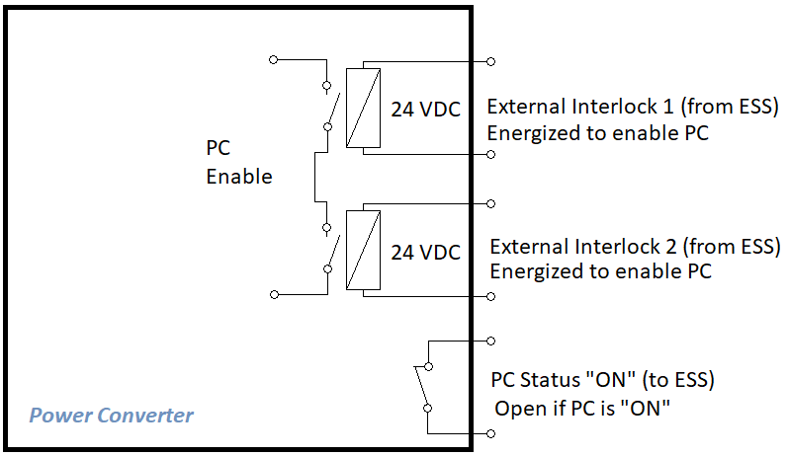
Interlock - External
External
Interlock Inputs:
“the ESS Interlock System will provide two separated 24 VDC signals to enable the switching on of the power converter. If any of these signals is not present, the power converter cannot be switched on. If the power converter is on and at least one of the signals is not anymore present, the power converter must be immediately switched off”
Interlock Output:
“potential free normally open contacts (e.g. relay contacts) indicating the ON/OFF of the power converter. The contacts must be open when the power converter is “ON” and supplying current (output enabled) to the load.”

Slide 17
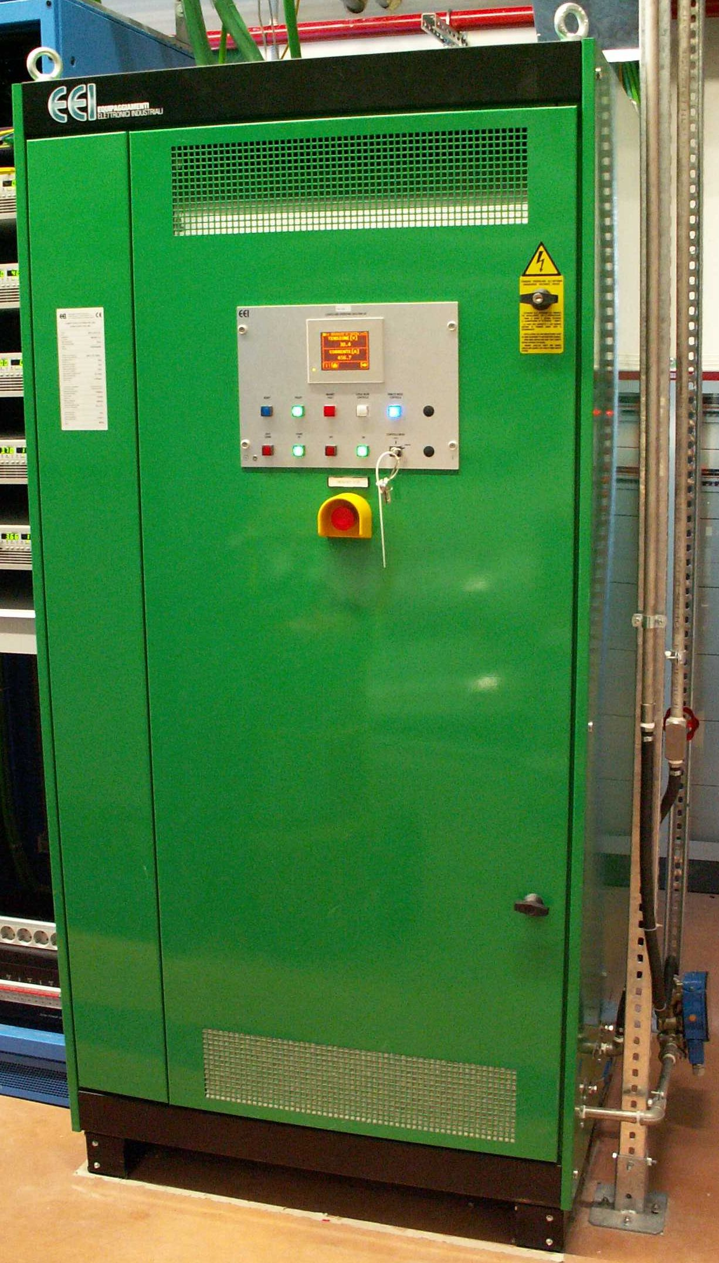
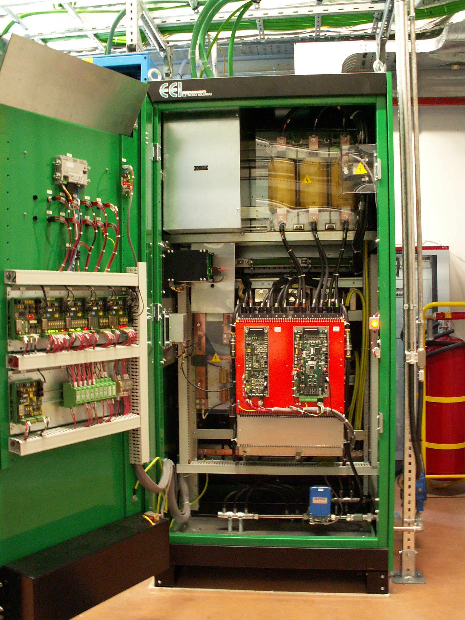
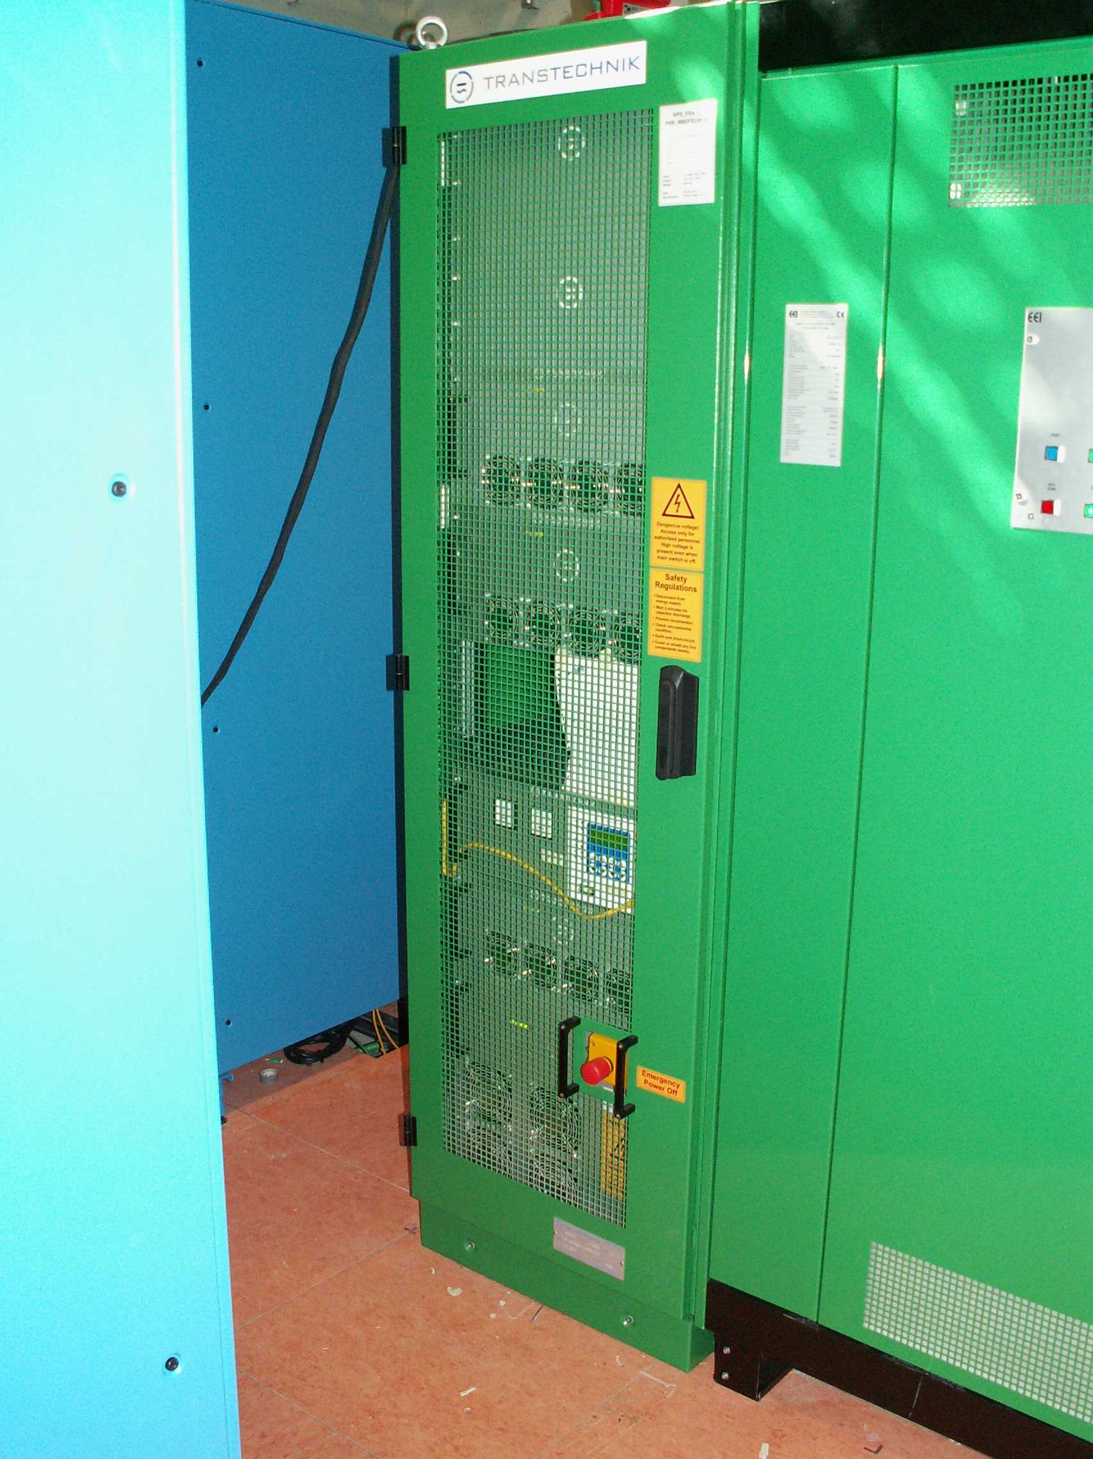
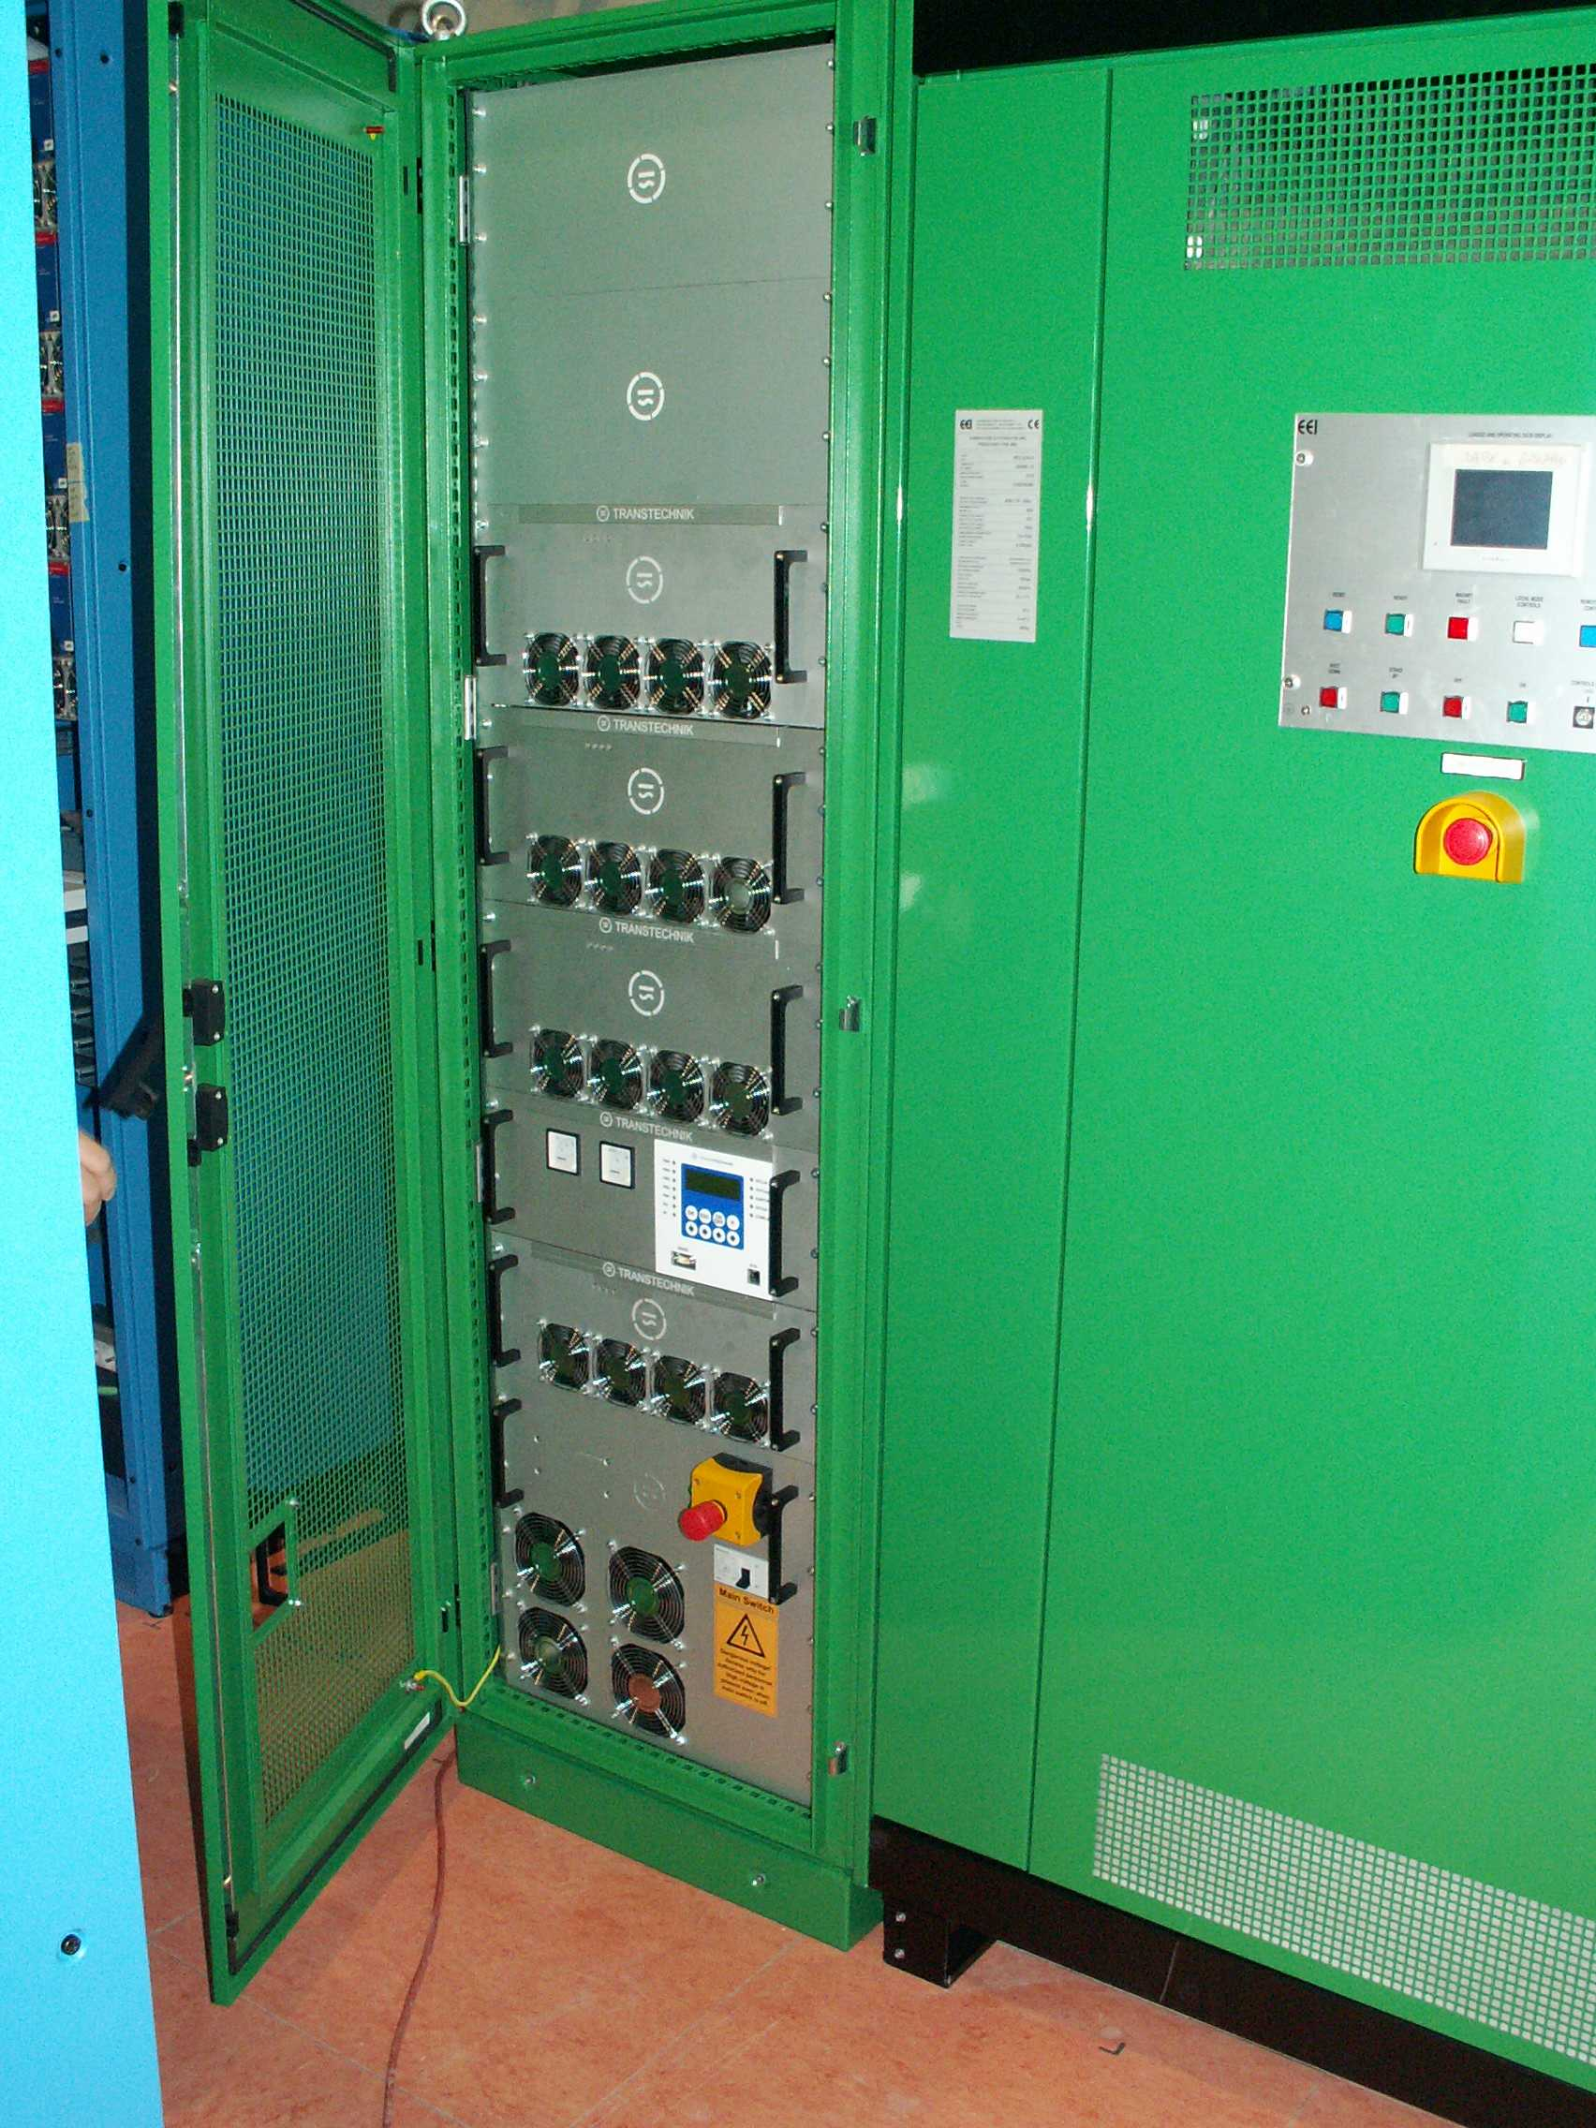
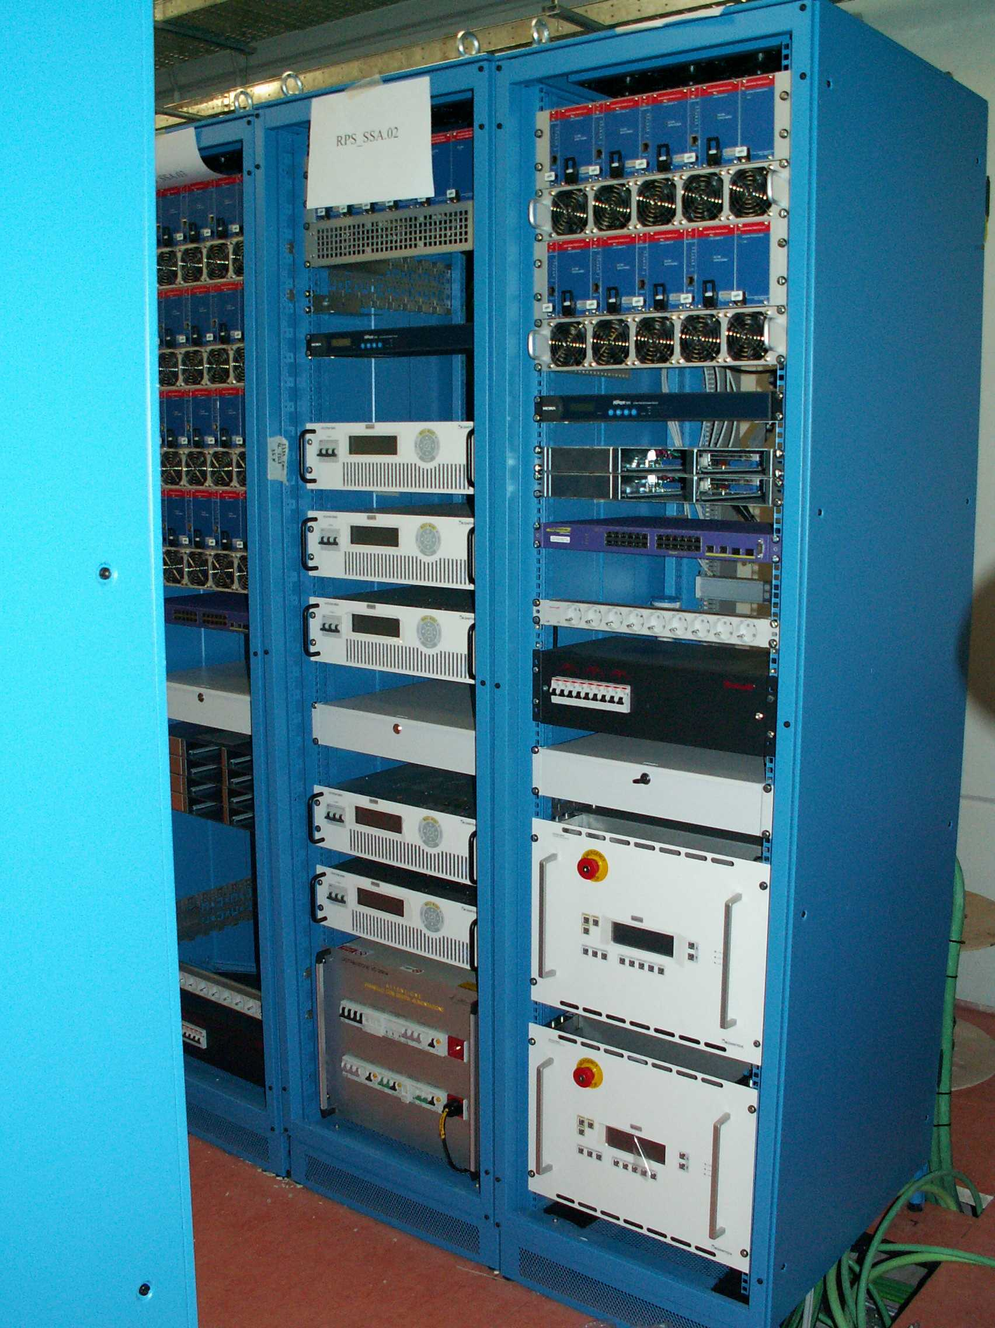
Examples of ~20 kW and 40 kW PC from FERMI
FERMI Main Beam Dump (MBD) Power converters
25 V / 750 A = 18.8 kW
Modular design
Air cooled
1 x 19” rack
55 V / 750 A = 41.3 kW
Single – well sized – unit, not modular
Water-cooled
1 x 1 m x 1 m cabinet
Up to 25 kW (max current 500 A)
NOT anymore in production

Slide 18
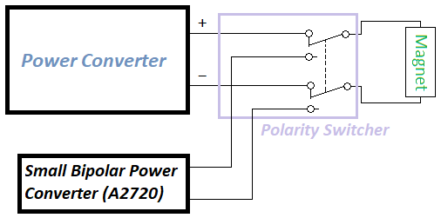
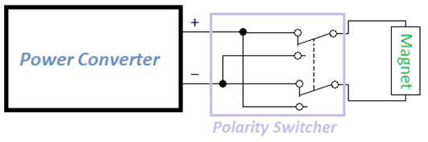
Degaussing of Dipoles
Not a routine operation
Normally protons are sent to the Target, Dump Line used only for commissioning or proton beam optimization.
4-Quadrant Main PC (±400 A / ±100 V):
Allows the cycling of the magnet but requires a fully bipolar (and very likely more expansive) power converter for an operation occasionally done.
Polarity switcher (electromechanical or solid state):
Remotely operated;
Operates with PC off (interlocked);
Possible use of 20 A bipolar PC for the remnant field cancellation;
Fast (ramping up to 20 A in 2 s requires 21 Vpk)
Double interlock on switcher (main PC and Bipolar PC)

Slide 19

…any Question?
Archivio Barcolana/StudioBorlenghi
Notes:
…offering a view of Trieste from the opposite side of the previous one, during the most crowded sailing race of the Mediterranean.
Elettra is located approximately up here…

Slide 20
Thank You!

