Slide 2
Dipole and Quadrupole Power Converters Procurement & Time Schedule
PCD1 and PCQ8
Roberto Visintini
Elettra Sincrotrone Trieste

Slide 3

What has to be procured?
PCD1:
1 unit
400 A / 100 V
Call for tender “Build to Specification”
“Custom made” as a single unit
“Custom made” as the series of two 400 A / 50 V units
PCQ8:
6 unit
400 A / 50 V
Call for tender “Build to Specification”
“Custom made” as a single unit
“Custom made” as the parallel of two 200 A / 50 V units

Slide 4

What about PCQ5, PCQ6, and PCQ7?
From PDR-2: 133 units, 200 A / 30 V
Call for tender “Build to Specification”
Required parameters within the capabilities of several high-level and well-known manufactures
COTS-like products available on the market that match the required performances
What if…
Elevate the output voltage to 50 V
No effect on the performances (to be checked and guaranteed)
Can be connected in parallel

Slide 5
Procurement Strategy - alternatives
PCQ8
6 units, 50 V / 400 A;
12 units, 50 V / 200 A, connected in couples in parallel (these could be included in the same lot of PCQ5, PCQ6, PCQ7).
PCD1
1 unit, 100 V / 400 A;
2 units, 50 V / 400 A, connected in series (that could be included in the same lot of PCQ8 in case a.).
b. & d. Reduction of PC Types from 3 to 2
c. & d. Compatible with Polarity switcher
Avoid series & parallel combination of PC

Slide 6
Procurement Strategy - proposal
One Call for Tender, “Build to Specification”, for PCQx and PCD1
Three separate Lots:
133 units 30 (50) V / 200 A for Q5, Q6, and Q7;
the tenderer can choose and quote option a. or b. for PCQ8;
the tenderer can choose and quote option c. or d. for PCD1.
Possible mergers of the lots according to the chosen options.
Tenderers can quote single lots or combination of lots.
Separated lots can be assigned to different tenderers.
Agreed and developed also with whom will operate the European Call for Tenders.
X = 5, 6, 7, and 8
6 units, 50 V / 400 A;
12 units, 50 V / 200 A, connected in couples in parallel;
1 unit, 100 V / 400 A;
2 units, 50 V / 400 A, connected in series.

Slide 7
Current “Time Plan”
 |  |  |  |  |  |  |  | t0-6/8 | Call for Tender
-8 | -7 | -6 | -5 | -4 | -3 | -2 | -1 | t0 | Order signed | 1 | 2 | 3 | 4 | 5 | 6 | 7 | 8 | 9 | 10 | 11 | 12 | 13 | 14
 |  |  |  |  |  |  |  | t0+6 | First Batch
 |  |  |  |  |  |  |  | t0+8 | 2nd Batch
 |  |  |  |  |  |  |  | t0+10 | 3rd Batch
 |  |  |  |  |  |  |  | t0+12 | 4th or Last Batch
 |  |  |  |  |  |  |  | t0+14 | Last Batch
Comments
At the date “t0” the order is signed, and the production starts
The production and batch delivery have been estimated from budgetary offer.
The time required by the Call for Tender is estimated between 6 to 8 months.

Slide 8
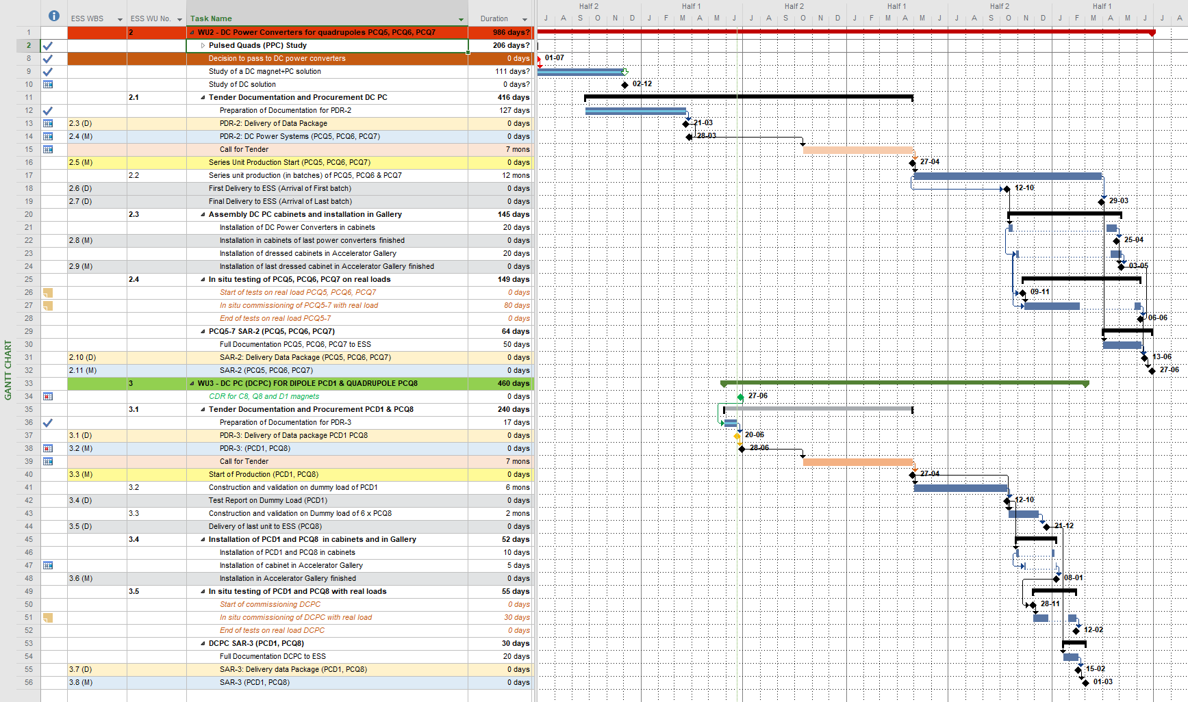
Time Plan – an exercise: Option a + (c or d)
Call for Tender duration estimated in 7 months

Slide 9
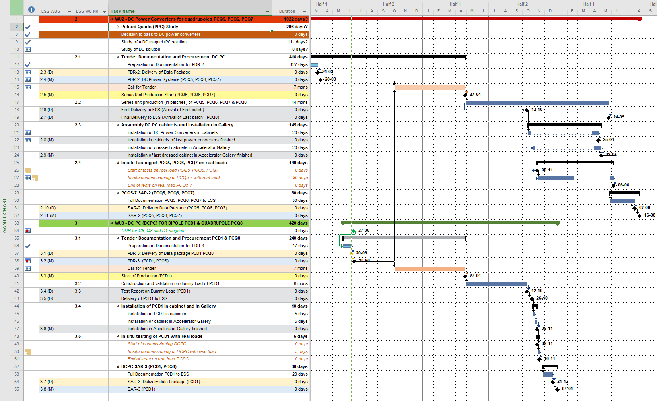
Time Plan – an exercise: Option b + c
Call for Tender duration estimated in 7 months

Slide 10
Thank You!

