Slide 1

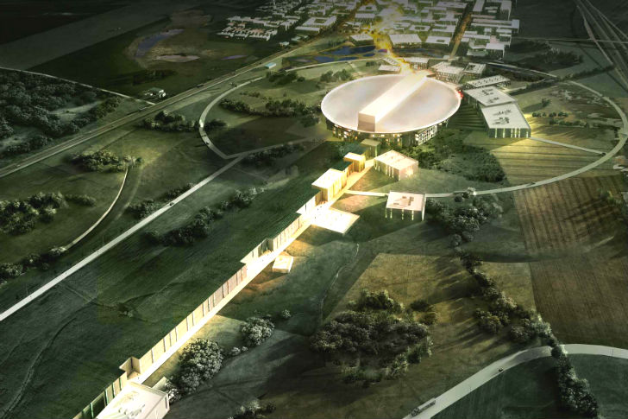

PDR for Power Converters of Dipoles D1, Quadrupoles Q8 and Correctors C8
Power cable interfaces to the cabinets and location of these PC’s inside the cabinets
Paulo Torri
ESS – Accelerator Division - RF
Power Converters Section
www.europeanspallationsource.se

Slide 2
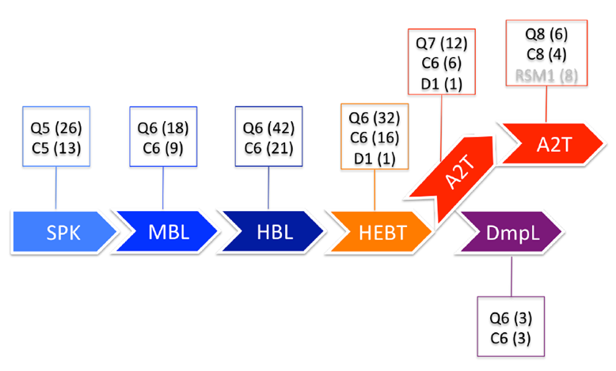
PDR for PC of Dipoles D1, Quadrupoles Q8 and Correctors C8
Magnets list with types and location
Magnets list with types and location

Slide 3
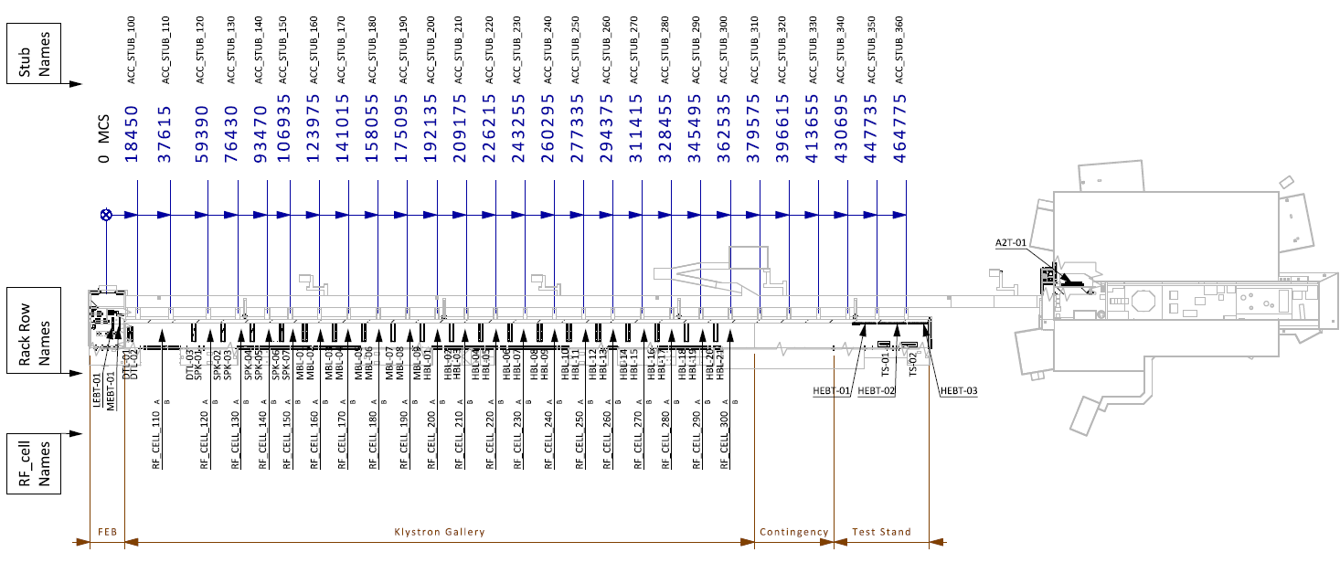
PDR for PC of Dipoles D1, Quadrupoles Q8 and Correctors C8
Racks disposition in the gallery

Slide 4
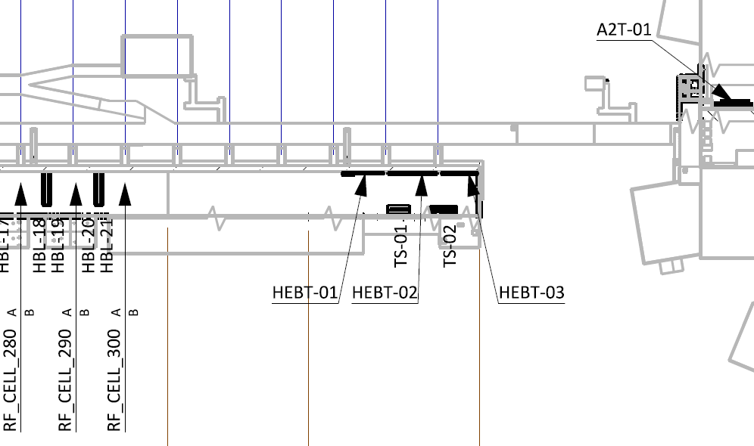
PDR for PC of Dipoles D1, Quadrupoles Q8 and Correctors C8
Racks disposition in the gallery
Stub_360

Slide 5
PDR for PC of Dipoles D1, Quadrupoles Q8 and Correctors C8
Racks disposition in the gallery
HEBT-030ROW | Name | System | Power(kW) | Installed Fuse (A) | UPS (kW) | UPS Fuse (A) | Heat Dissipation (kW) | Temperature (°C) | Type
Rack #
1 | HEBT-030ROW:CNPW-U-001 | PS (A2T) | 21,8 | 50 | N/A | N/A | 2,22 | 25°C, +/-10°C | I
2 | HEBT-030ROW:CNPW-U-002 | PS (A2T) | 21,8 | 50 | N/A | N/A | 2,22 | 25°C, +/-10°C | I
3 | HEBT-030ROW:CNPW-U-003 | PS (A2T) | 18,0 | 50 | N/A | N/A | 1,89 | 25°C, +/-10°C | I
4 | HEBT-030ROW:CNPW-U-004 | PS (Dipole) | 60,2 | 125 | N/A | N/A | 6,00 | 25°C, +/-10°C | L
5 | HEBT-030ROW:CNPW-U-005 | PS (A2T) | 33,2 | 63 | N/A | N/A | 3,30 | 25°C, +/-10°C | I
6 | HEBT-030ROW:CNPW-U-006 | PS (A2T) | 33,2 | 63 | N/A | N/A | 3,30 | 25°C, +/-10°C | I
7 | HEBT-030ROW:CNPW-U-007 | BI | 4,05 | 10 | N/A | N/A | 2,835 | 25°C, +/- 1°C | V10
8 | HEBT-030ROW:CNPW-U-008 | BI | 2,05 | 10 | N/A | N/A | 1,435 | 25°C, +/- 1°C | V10
9 | HEBT-030ROW:CNPW-U-009 | BI | 3,55 | 10 | N/A | N/A | 2,485 | 25°C, +/- 1°C | V10

Slide 6

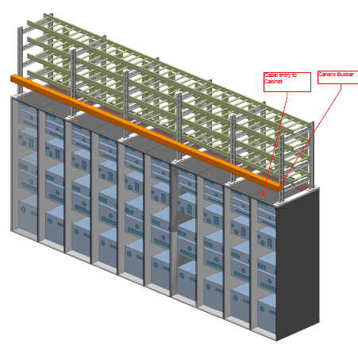
PDR for PC of Dipoles D1, Quadrupoles Q8 and Correctors C8
Rack row design

Slide 7
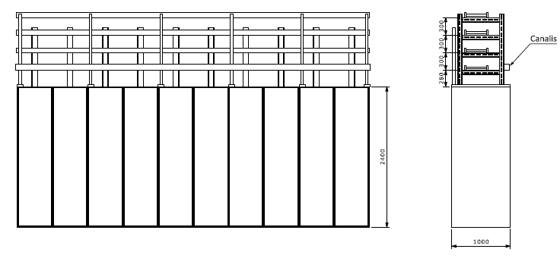
PDR for PC of Dipoles D1, Quadrupoles Q8 and Correctors C8
Rack row design
From: Jörgen Jönsson - Electrical and I&C Engineering And Integration Support Division

Slide 8
PDR for PC of Dipoles D1, Quadrupoles Q8 and Correctors C8
Racks

Slide 9
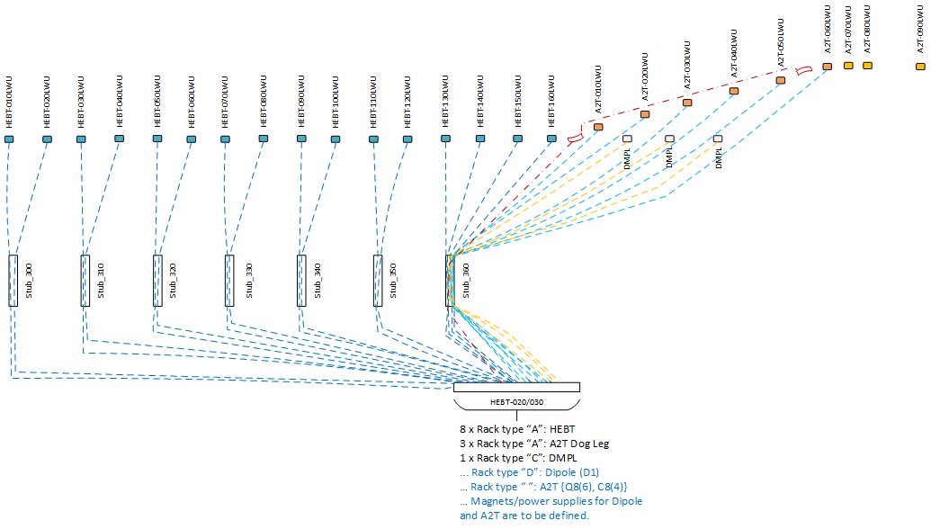
PDR for PC of Dipoles D1, Quadrupoles Q8 and Correctors C8
Racks disposition in the gallery
Magnet cables routing

Slide 10
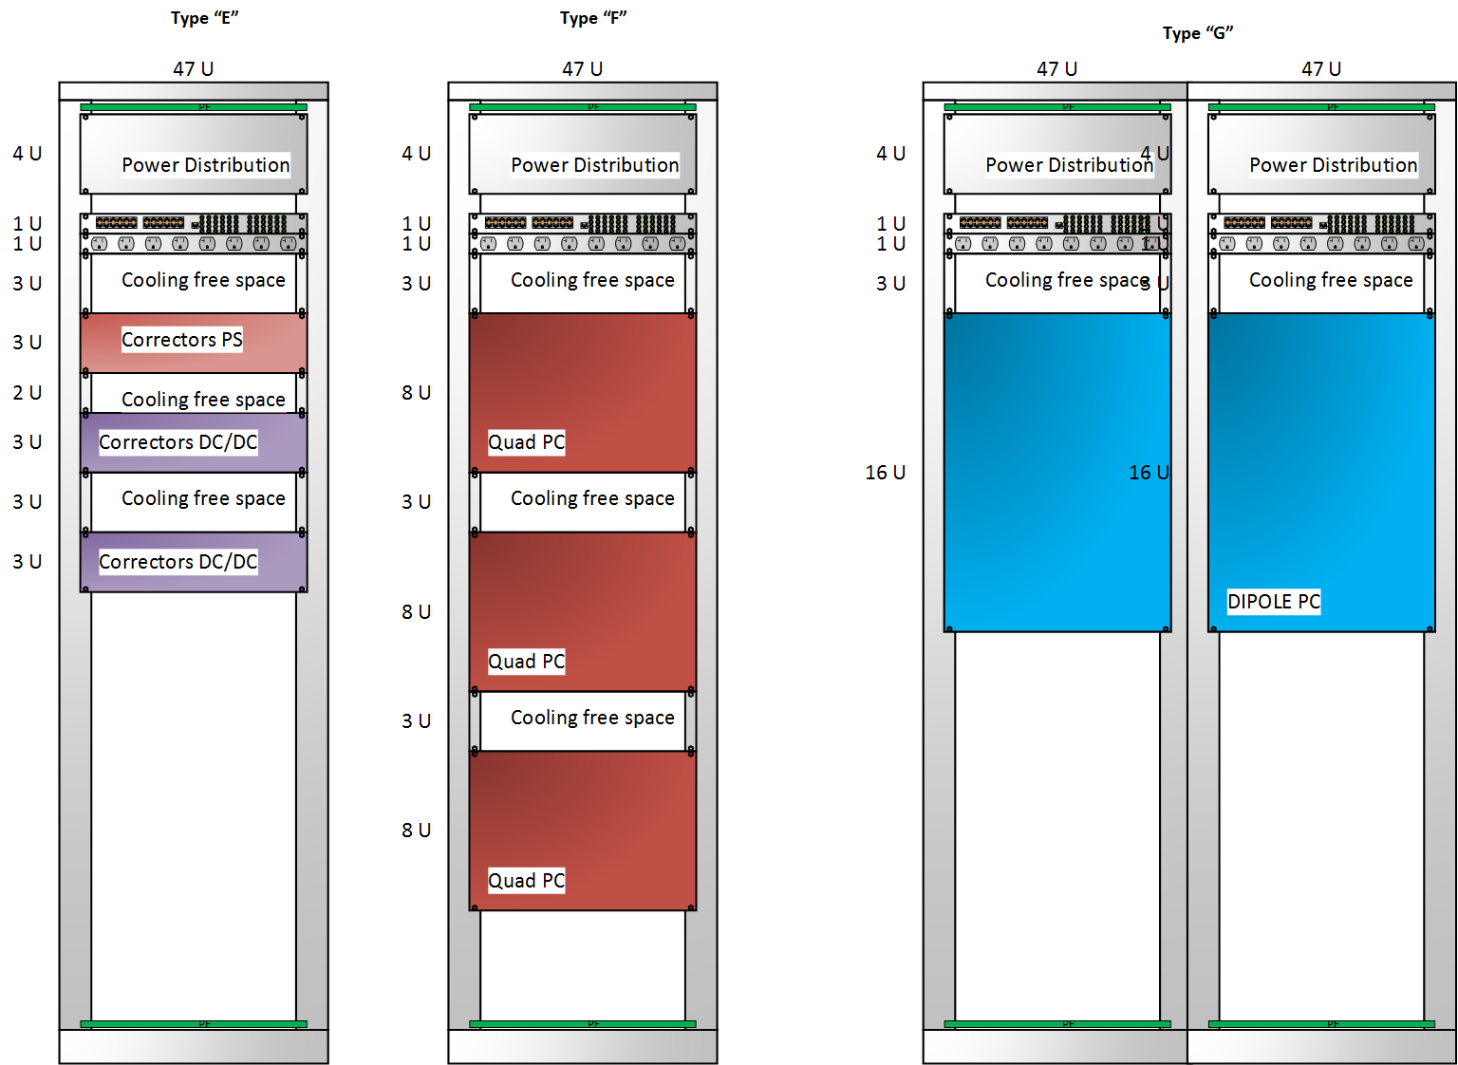
PDR for PC of Dipoles D1, Quadrupoles Q8 and Correctors C8
Rack lay-out

Slide 11
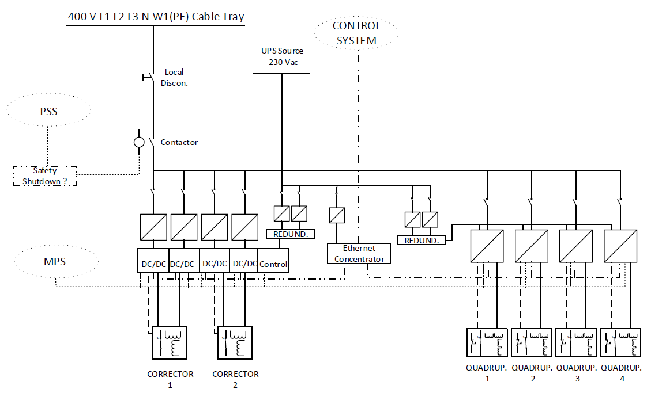
PDR for PC of Dipoles D1, Quadrupoles Q8 and Correctors C8
Rack single electrical line diagram

Slide 12
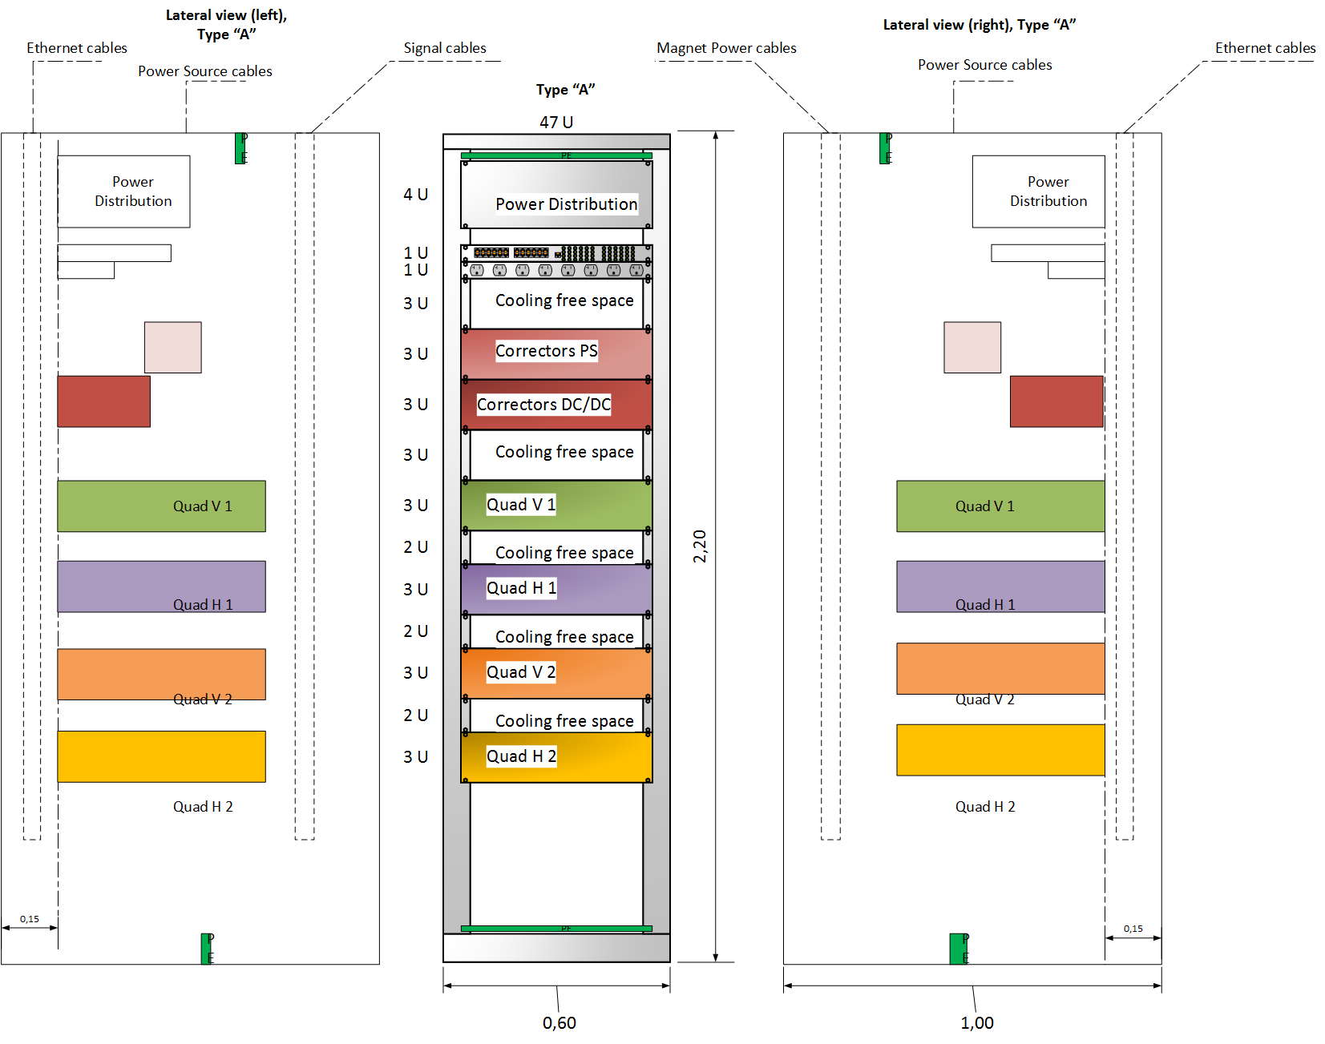
PDR for PC of Dipoles D1, Quadrupoles Q8 and Correctors C8
Rack internal lay-out

