Slide 1
ESS IKON 13
Detector Group September 2017
Välkommen Alla!
Welcome Everyone!
Presented by: Paul Spiteri. (ESS Electronics Technician).

Slide 2
Four Cabinets and Three UPS Units:
At the ESS Daresbury UK location, there are four 19 inch rack cabinets.
Two of which are Verotec, one Rittal and one Pantair/Schroff. Three of these cabinets contain uninterruptable power supply units, (UPS). Two of the UPS units are Eaton 8KVA and 11KVA, the third is an APC 8KVA unit.
Some very similar cabinets and UPS units were currently on display at the Utgard Laboratory open day.
The cabinets and the UPS units have had and will still have several rigorous and various tests carried out on them in order to, not only learn about the limitations of each unit in general terms but to prove some of the specifications stated and to try and highlight any undesired features.
All of the tests on the UPS units were carried out by STFC Electrical and Electronic Engineers and ESS staff.

Slide 3
Cabinets and UPS’s:
The Four cabinets will be Electromagnetic Compatibility, (EMC) tested, by a specialist EMC testing company. Tenders and specifications for this work has already been obtained and all intended work to be carried out on these cabinets has already been reviewed, not only by STFC staff but also by ESS staff.
Electromagnetic compatibility, (EMC) is a characteristic of electrical and electronic equipment that permits it to operate as intended in the presence of other electrical and electronic equipment, and not to adversely interfere with that other equipment.
The three UPS units required bespoke and specialized equipment to be designed and installed by STFC staff in order to carry out the specific electrical tests. Health and safety implementations and requirements were mandatory at this stage, in order to comply with not only STFC regulations but also with UK safety requirements.

Slide 4
Typical EMC Tests:
Four main types of tests are usually carried out: All utilizing special equipment and techniques in controlled environments.

Slide 5
UPS Testing:
A series of tests were carried out at ESS/STFC labs at Daresbury.
All three UPS units were put through the same tests.
However the individual power ratings of the UPS units were taken into consideration.
Bespoke equipment was designed and built.
The equipment was firstly installed.
Additional earths were installed in the cabinets.
Then all installations were tested for health and safety, and then integrity.
The test results will be viewed later.

Slide 6
Bespoke Equipment:
This equipment is made up from several individual items:
Miniature Circuit Breakers, (MBCs).
Residual Current Detectors, (RCDs).
Mains voltage distribution boxes.
Heavy duty three and single phase cables.
Heavy duty three and single phase connectors.
Bespoke computer controlled interface controller.
Supporting metal frame work.
Additional installation of earth cables on cabinets.

Slide 7
Three phase safety distribution unit

Slide 8
Cabinet power distribution unit.

Slide 9
Eaton UPS 8KVA Cabinet Wiring.

Slide 10
Eaton UPS 11KVA Cabinet Wiring.

Slide 11
APC UPS 8KVA Cabinet Wiring.

Slide 12
Eaton UPS unit. (Power rating: 11KVA).

Slide 13
APC UPS Unit. (Power rating 8KVA).

Slide 14
Single phase power distribution cables and sockets.

Slide 15
Bespoke three phase computer controlled switching unit. Incorporating a USB interface.

Slide 16
Internal view of controller

Slide 17
Internal view of controller:

Slide 18
Close up view of controller pcb.

Slide 19
UPS unit failed under tests. (Fast switching test).

Slide 20
Failed UPS replacement:
The failed UPS unit has already be replaced under the manufactures warranty and installed in the 19 inch rack cabinet.
All exchange arrangements, logistics etc. were carried out by Andrew Hill of STFC and the physical removal of the failed unit and subsequent reinstatement of the new unit was carried out by ESS staff.
Initial testing of the new replacement unit is still pending.

Slide 21
Faulty UPS:
Repackaged and ready to go!
Contents include battery packs and all the original support literature.

Slide 22
The test results:
Setup of pre-test requirements:
Cables, connectors MCBs and RCDs additional earths etc.
Please refer to .XLS files:
Results:
Conclusions: Still pending and still awaiting EMC tests.

Slide 23
UPS general setup requirements: listing of parameters.

Slide 24
Eaton UPS: load test 8KVA and 11Kva
Test results:

Slide 25
APC UPS: load test 8KVA
Test results

Slide 26
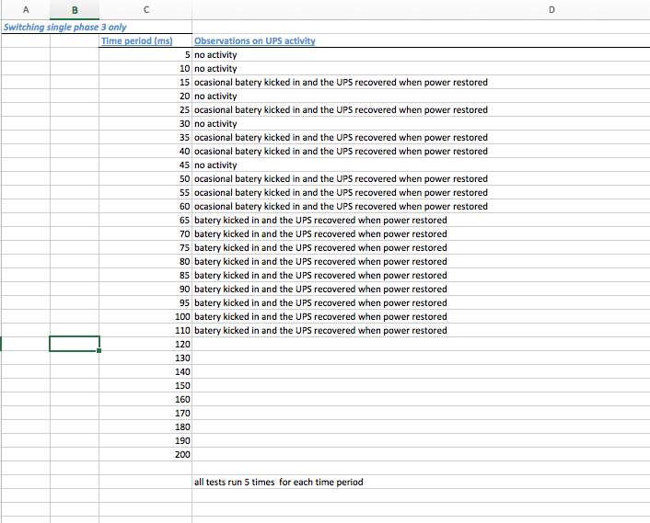
Eaton 11KVA fast switching test results

Slide 27
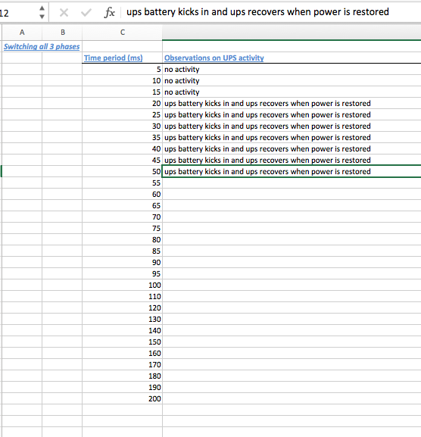
Eaton 9KVA fast switching test results

Slide 28
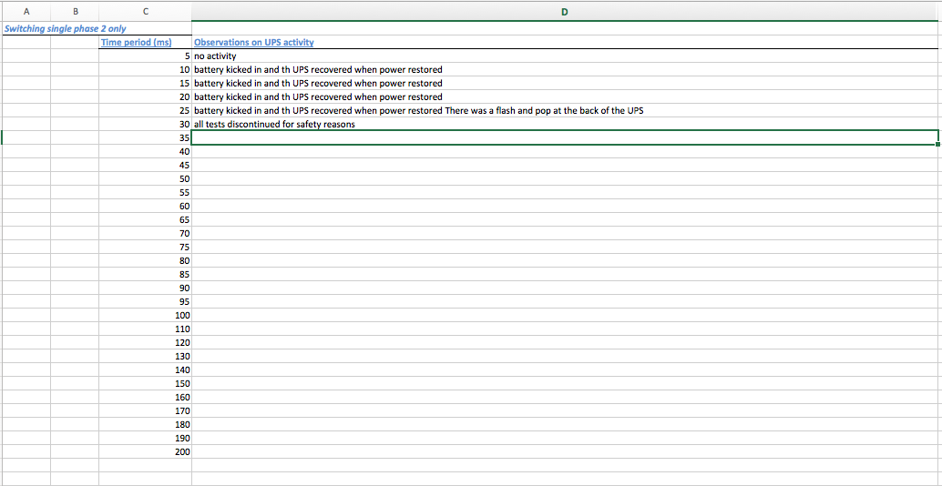
APC 9KVA fast switching test results (Failed unit).

Slide 29
The cabinets and UPS units:
When the EMC testing company is chosen to carry out the tests:
Transportation is required for all four cabinets to and from the company test sites. Logistics organization required etc.
Compliance with EMC company policies whilst on site.
Special request! (Coffee).
One of the EMC testing company’s has made provisions for an ESS member of staff to be present at the EMC testing. Not all companies will allow this to happen. Mainly due to intellectual copy write and H&S reasons. The fact is: We can observe and experience specialized EMC testing for future benefit and reference…….

Slide 30
Any questions?
Please feel free to ask any questions and I will try and answer them.
Thank you for your time and patience!
Tests and results carried out by: Andrew Hill of STFC. Andrew Gallagher of STFC. George Gimas of ESS, and Scott Kolya of ESS.
Presented by: Paul Spiteri/Scott Kolya of ESS.

Slide 31
Le Fin.

