Slide 1
ESS Sample Environment Control System – Reference Document for WBS 13.6.X.5.7 Chess doc: ESS-0038165
Anders Pettersson
Mechatronics and Controls Integration
IKON 13 2017-09-27

Slide 2
Sample Environment at ESS
SES = Sample Environment System = The In-beam Sample environment equipment plus the auxiliary equipment required to run it.
To be able to control and log data from a Sample Environment System (SES) at ESS it needs to:
Be integrated into ESS EPICS – Experimental Physics and Industrial Control System
Be connected to the ESS EPICS network
Be integrated into the ESS Experiment Control System (NICOS)

Slide 3
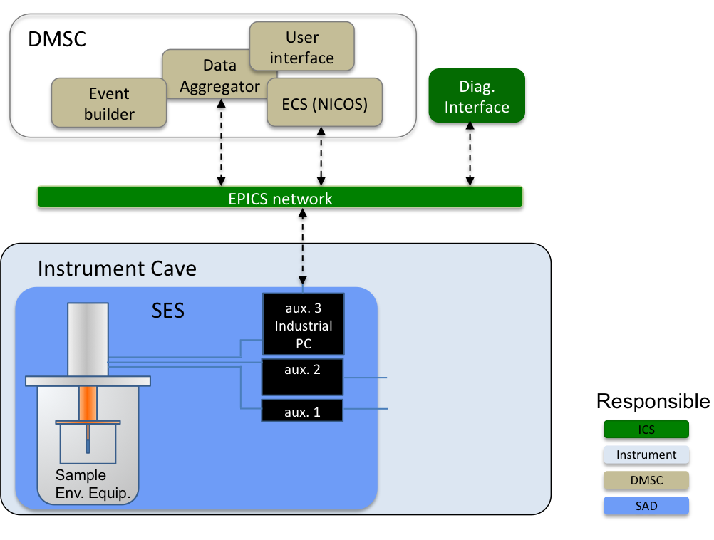
Sample Environment System (SES): Control system overview

Slide 4
Also..
Each SES will be controlled by a Industrial PC mounted with the SES.
Time-stamping is required
Logic, sequences, control algorithms can be implemented at different levels.
One size does not fit all (but standards are important)

Slide 5
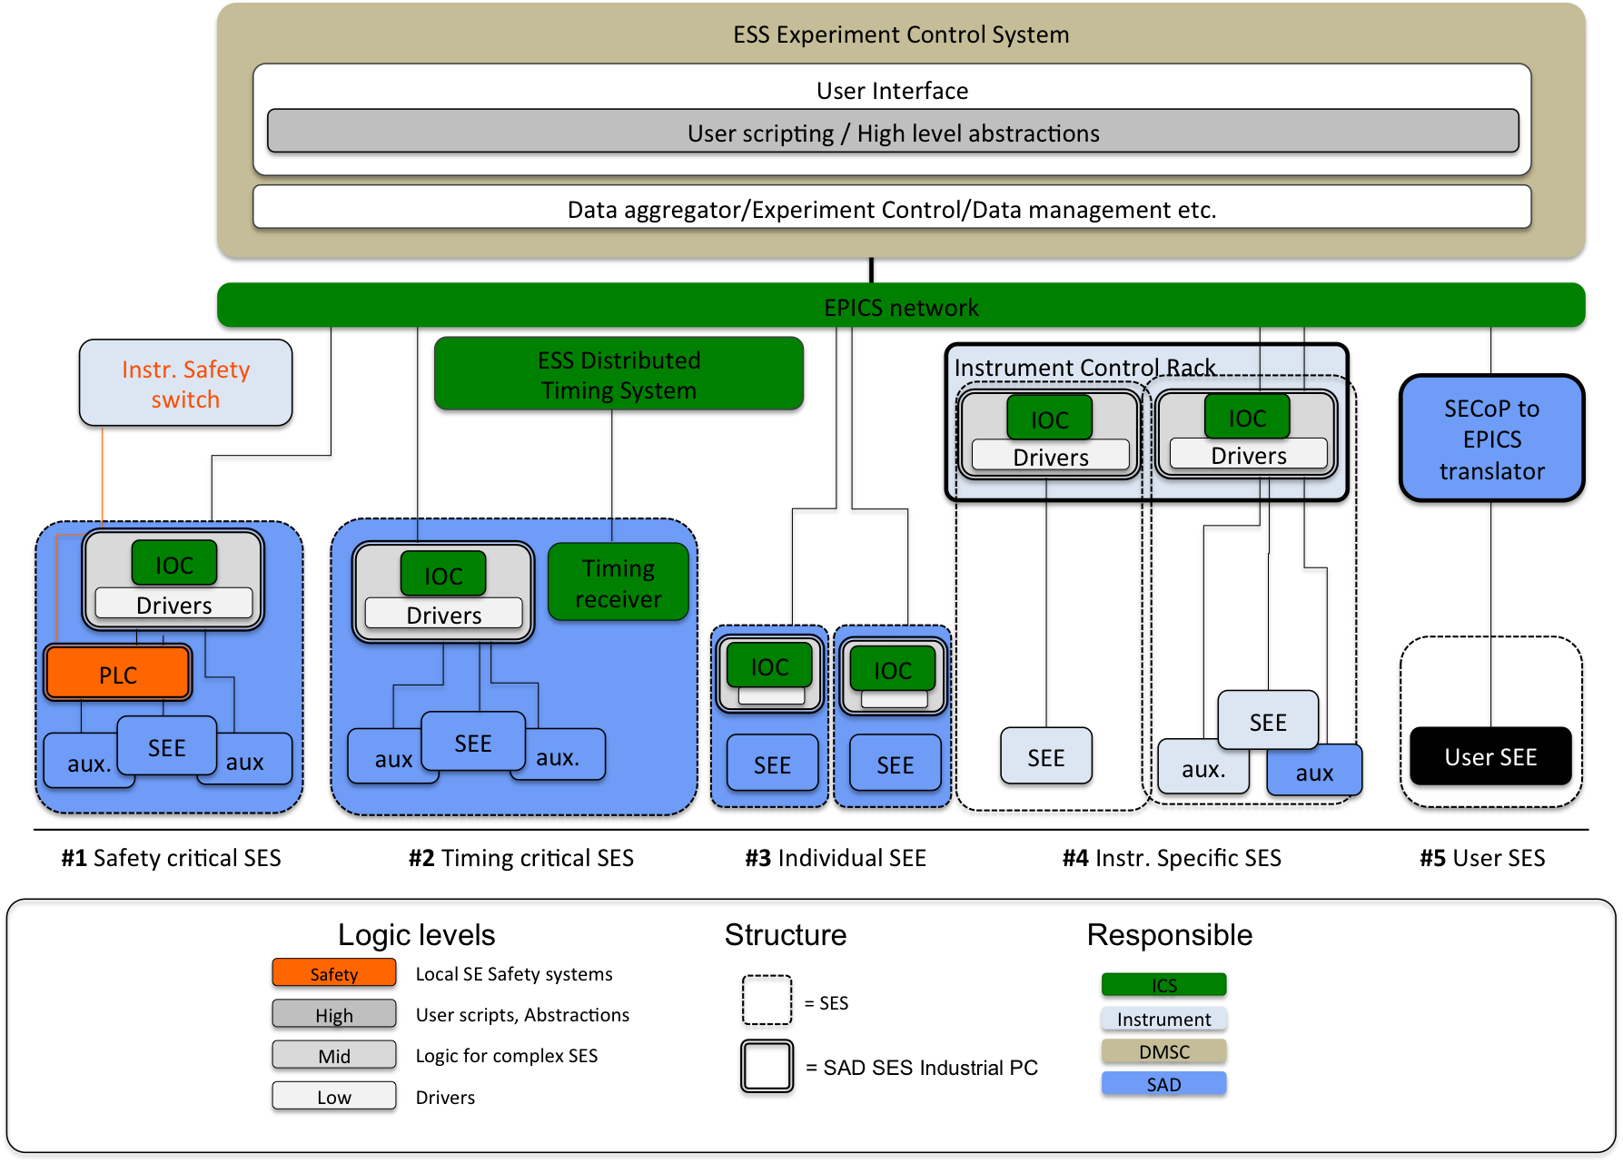
Use cases

Slide 6
ESS Experiment Control System
User Interface
User scripting / High level abstractions
Data aggregator/Experiment Control/Data management etc.
EPICS network
Instr. Safety switch
ESS Distributed
Timing System
Instrument Control Rack
IOC
IOC
SECoP to EPICS translator
IOC
IOC
Drivers
Drivers
IOC
IOC
IOC
Timing receiver
IOC
Drivers
Drivers
IOC
IOC
PLC
IOC
IOC
SEE
SEE
aux
SEE
aux.
SEE
User SEE
aux.
aux
SEE
SEE
aux.
aux
#1 Safety critical SES
#2 Timing critical SES
#3 Individual SEE
#4 Instr. Specific SES
#5 User SES
Logic levels
Structure
Responsible
Safety
Local SE Safety systems
User scripts, Abstractions
= SES
ICS
High
Instrument
Mid
Logic for complex SES
= SAD SES Industrial PC
DMSC
Low
Drivers
SAD

Slide 7
Requirements
If a rack is used it shall follow ESS standard and infrastructure need to be supported by the instrument.
Communicate procurement of a SE control device or auxiliary equipment (AE), to verify that it complies with ESS SE standards
Instrument teams shall supply requirements for fast data transfer, and time-stamped data.
Cooling water, power, space etc.
Temperatur controller, Water-cooler bath, PLC, etc.
Stroboscopic measurements?, Fast pulsed experiments? Etc.

Slide 8
Requirements
The instrument shall provide a safety contact for the cave door.
Integration and controls logic that is required for SEE setups shall meet the SAD standard to ensure SAD maintenance
Instrument specific SES: The instrument shall together with SAD provide requirements on the EPICS and ECS integration and implement additional required logic.
For SES local safety
PID controller code, cryostat cooldown sequence, state machines
New SEE should be integrated with both instrumnent specific needs and with ESS SE standard approach in mind.

Slide 9
The SAD division will provide resources to support integration of instrument specific SES, when requested, and all pool SES during the construction and operational phases.
SES integration will be provided by SAD through coordination with the Integrated Control Systems Division (ICS) and the Data Management and Software Centre (DMSC). In the operational phase, SAD will also handle integration of user SES.
By meeting the requirements in this document, in ref [1], and in ref [2] the instrument will be able to use the common pool SES.

Slide 10
Benefits
All pool SE equipment will be integrated by SAD
By choosing from the list of ESS standard SEE the integration effort will be minimal (and spares and maintenance will be available) .
By meeting the requirements in this document, and the other SAD reference documents, the instrument will be able to use the common pool SES
SAD can, if requested, provide all or part, of the integration tasks for instruments specific SES, on instrument budget.

Slide 11
Questions
Thank you for listening.

