Slide 1
Event Formation Overview
Tobias Richter
DMSC
European Spallation Source ERIC, Lund, Sweden

Slide 2
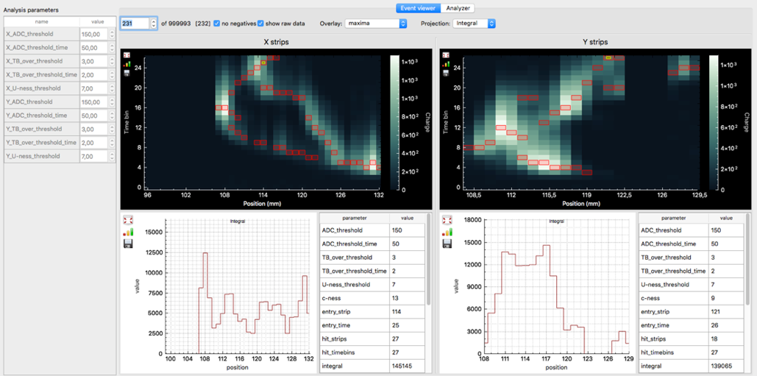
What is Event Formation?
Convert digitized raw detector signals to pixel ID & timestamp per event
in a detector type specific way
technical scope traditionally covered by detector electronics
done in software running on commodity hardware
provides flexibility and extensibility
of a software package
shared responsibility of
DMSC and Detector Group
performance and correctness
challenging task to get right
enables expected ESS count rates
and detector capabilities
GEM

Slide 3
Instrument Readout Architecture
Instrument Hardware
DMSC Hardware
Detector Backend
Event Formation Unit
MRF
100 GB/s fibre
Detector Backend
Event Formation Unit
NeXus File Writing
Data Aggregation (Kafka)
Chopper
Live Feedback
EPICS
EPICS Bridge
MRF
Motion
BrightnESS is funded by the European Union’s Horizon 2020 research and innovation programme under grant agreement No. 676548

Slide 4
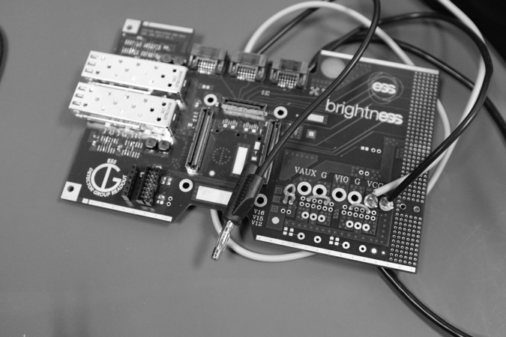
Detector Backend = Standard Interface
What sits on your end?
for event recording
common physical interface and network stack
generic interface and protocol for
transmitting diverse information
  detector specific raw signals
  from the front-end
  global absolute timing

Slide 5
What sits
on your end?
--------------
see
Scott Kolya’s
presentation
X

Slide 6
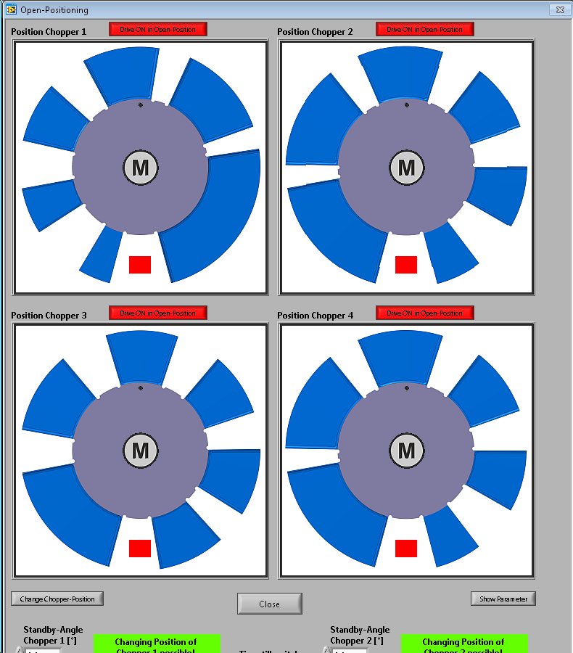
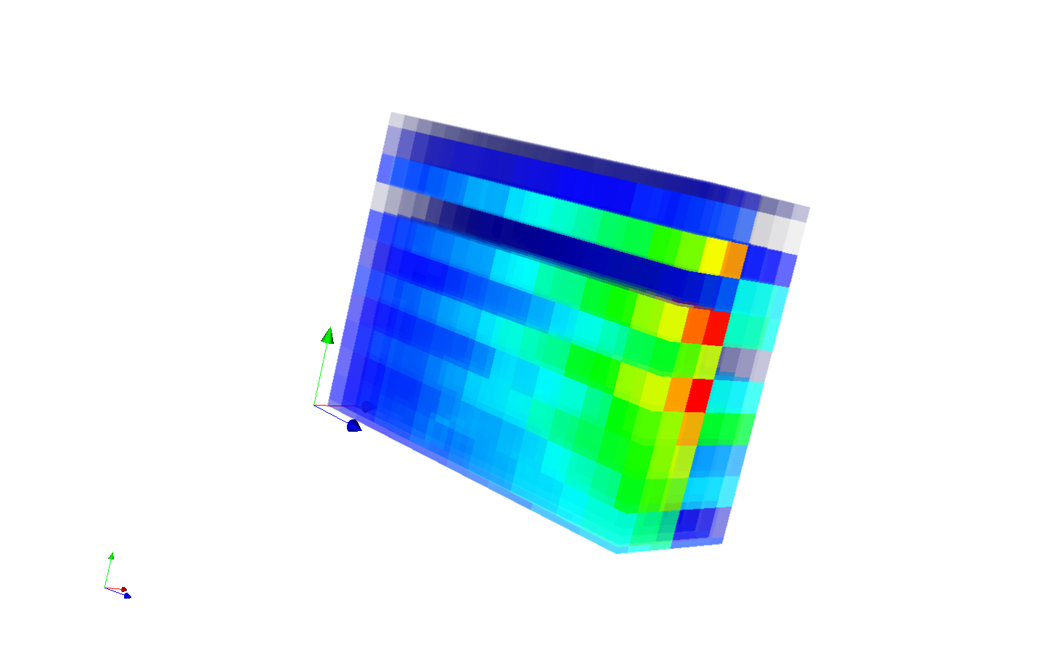
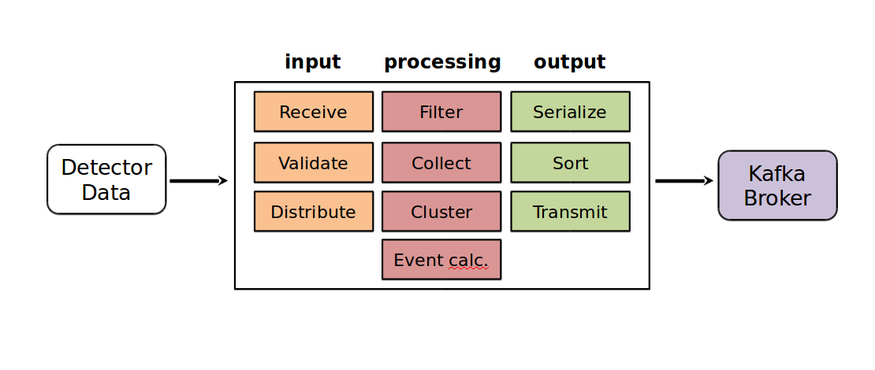
What does this offer?
readout and streaming of all data
timing in sync with metadata at all rates
clustering and coincidence building
abstraction of logical coordinates and geometry
algorithms and raw data can be
inspected “live”
commissioning tools
BrightnESS is funded by the European Union’s Horizon 2020 research and innovation programme under grant agreement No. 676548

Slide 7
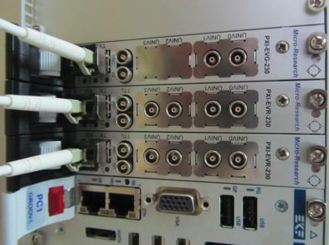
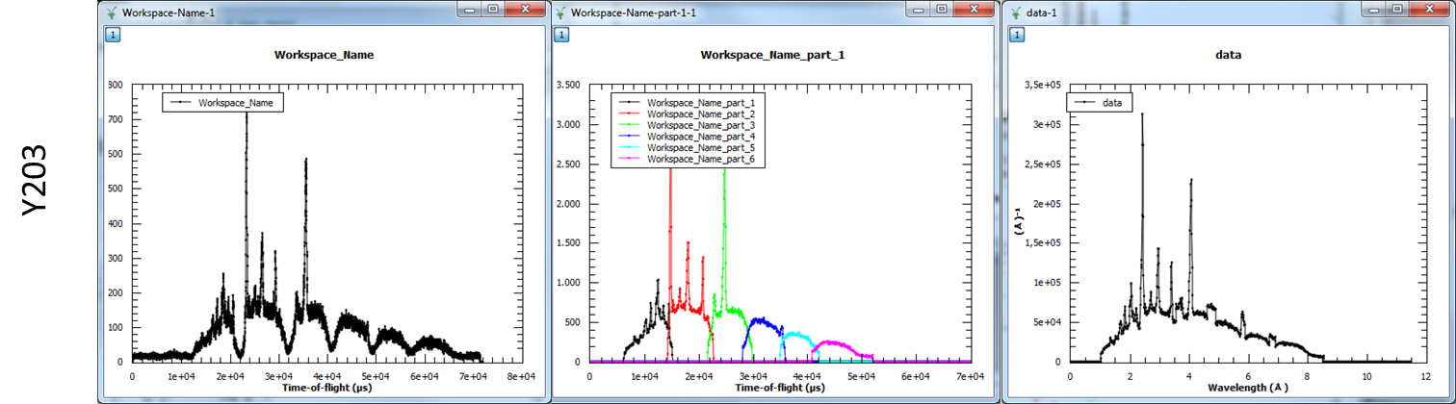
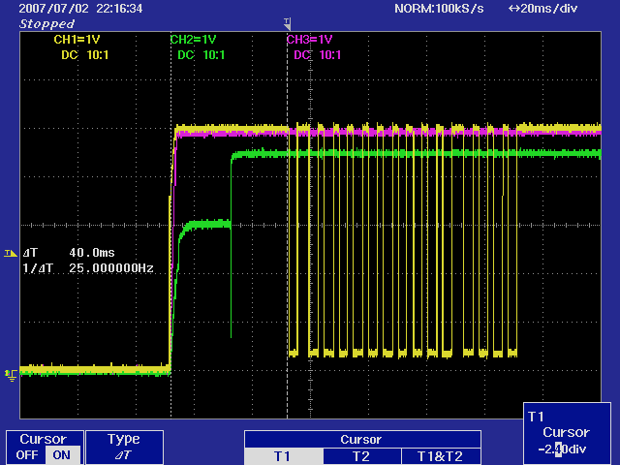
Integrating Absolute Timing
Crucial at ESS
choppers (wavelength frame multiplication)
pulse to pulse beam variations
stroboscopic experiments

Slide 8
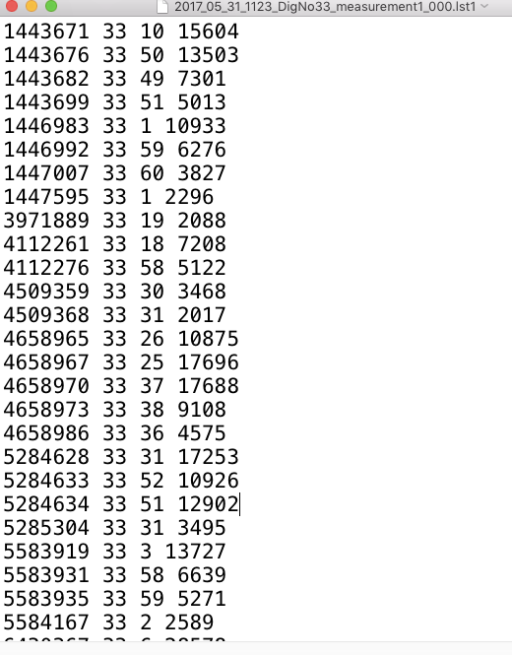
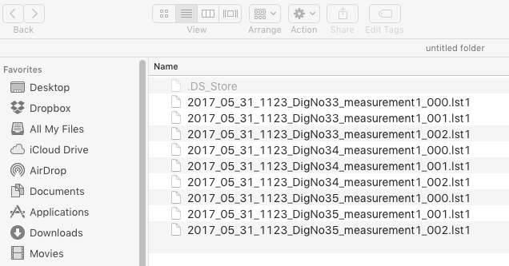
Event Formation Status
32 wires
Pre-amp
Shaper
ADC
Wires/
strips/
grids
Digital
wires X
32 strips
x32
x32
x32
substrate
cassette
¹⁰B₄C
neutrons
strips Y
θ
Cluster: 1 wire 3 strips
θ = 5 degrees
Cluster: 1 wire 1 strip
No Cluster: 2 wires 0 strip
Cluster: 2 wires 3 strips
Graphics courtesy of
Francesco Piscitelli
Cluster: 1 wire 2 strips

Slide 9
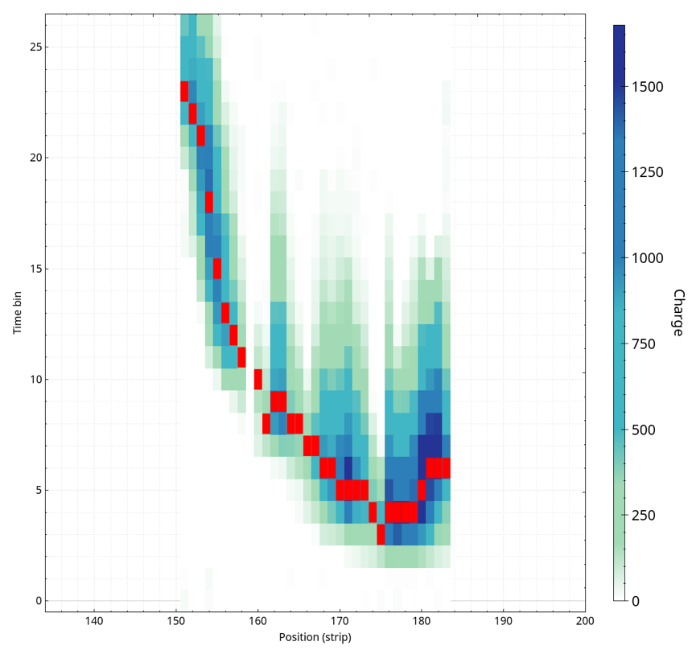
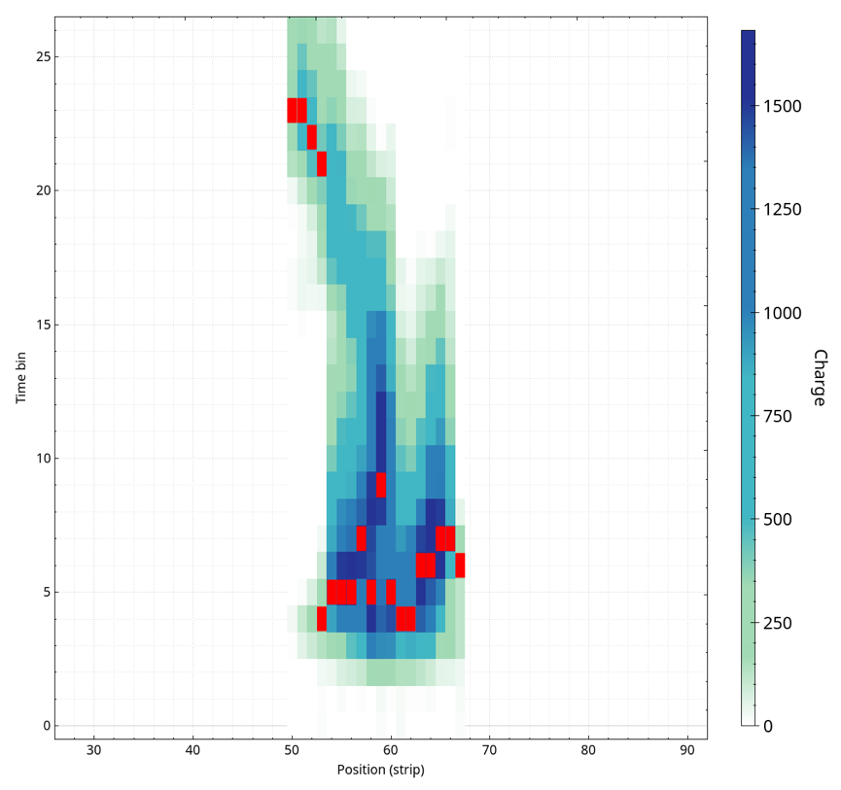
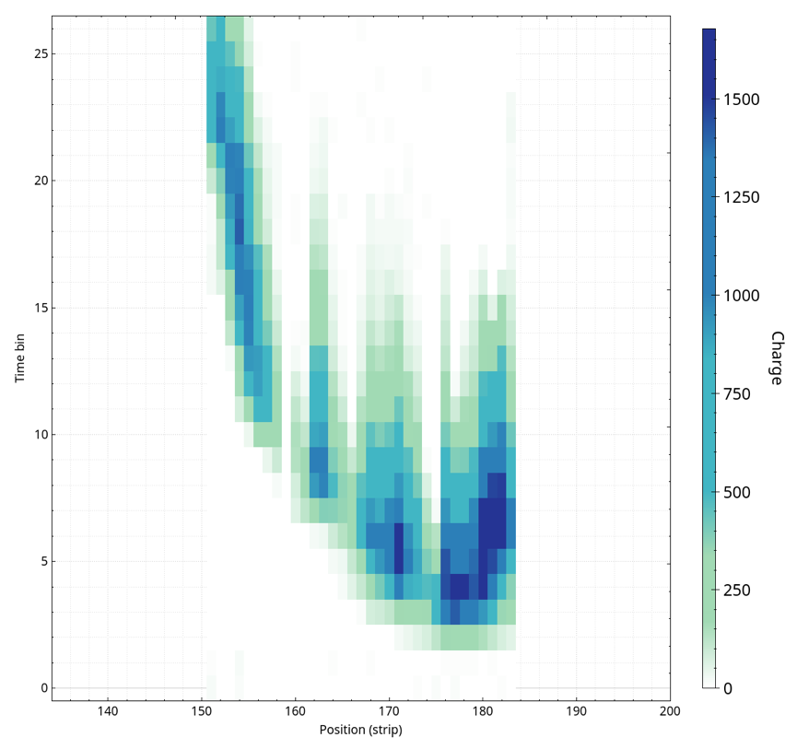
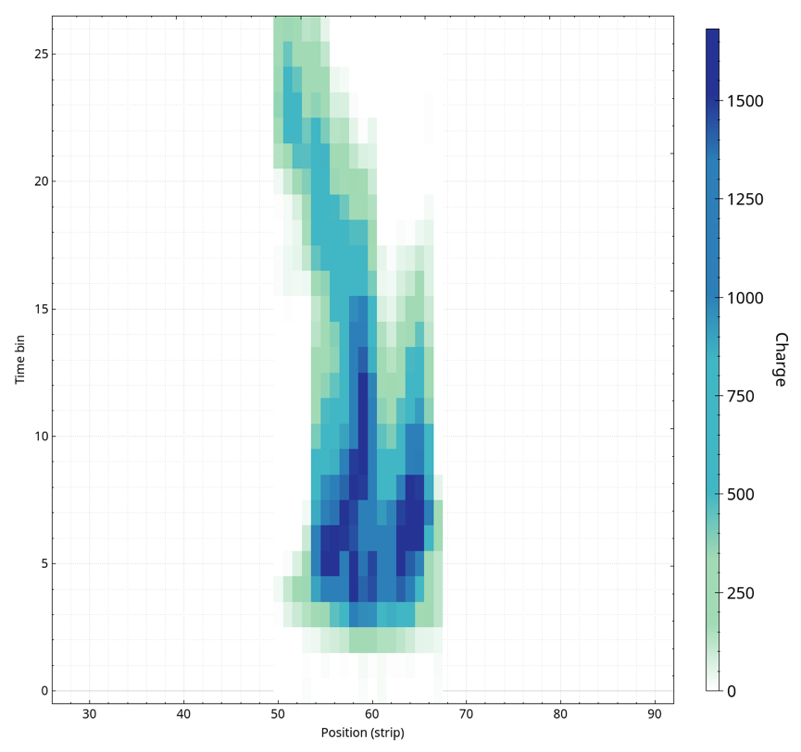
Gd-GEM Example Traces
Data for X and Y with time and spatial dimension
To be reduced to two numbers
Converter layer (neutron entry point) at the top
APV test data with 25ns time resolution
Final timing will be on a high precision absolute clock
Reduced VMM data (red) simulated

Slide 10
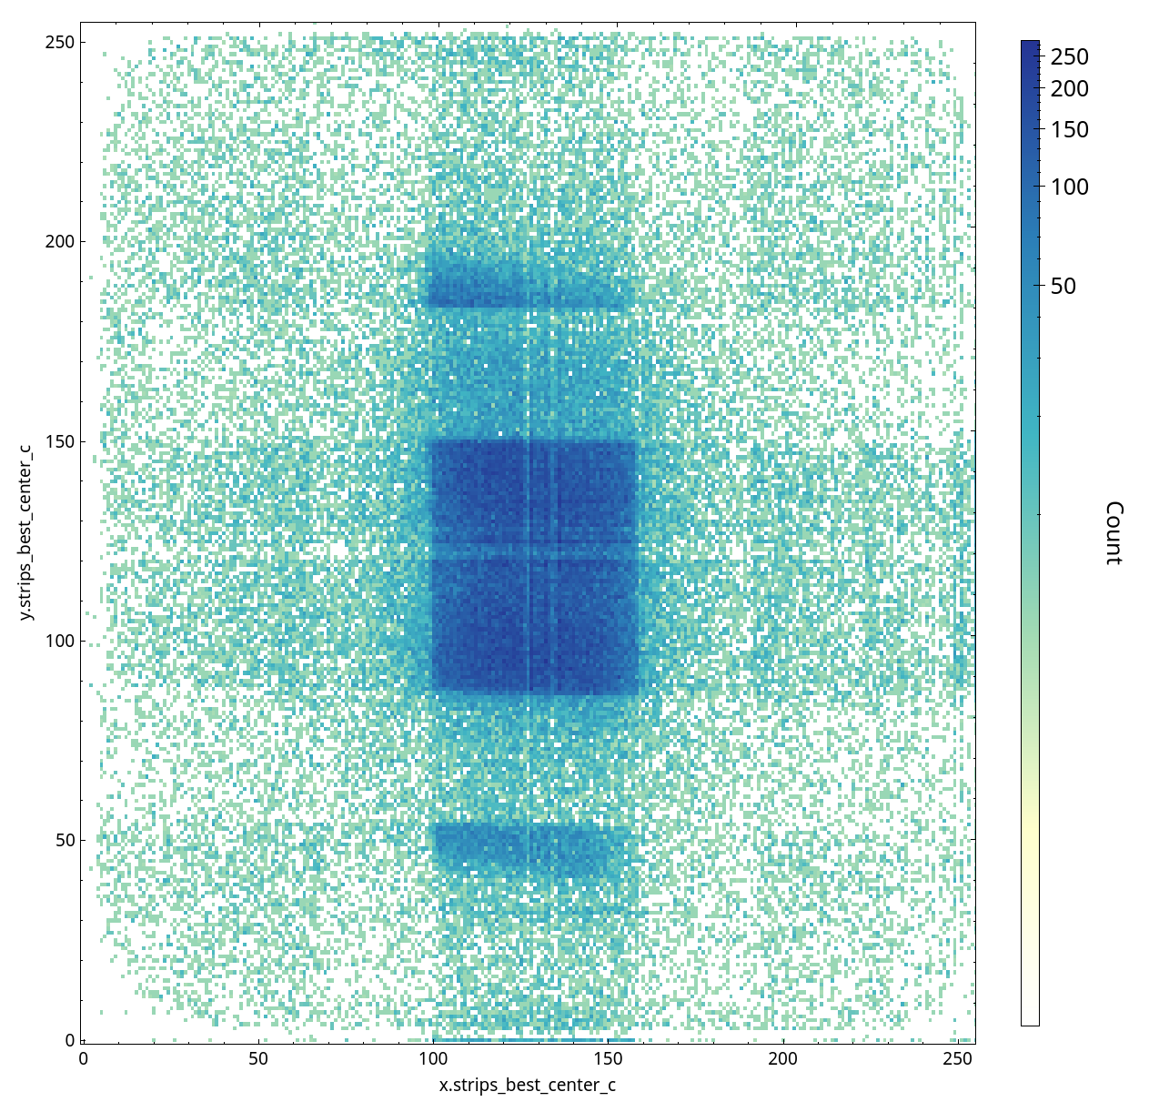
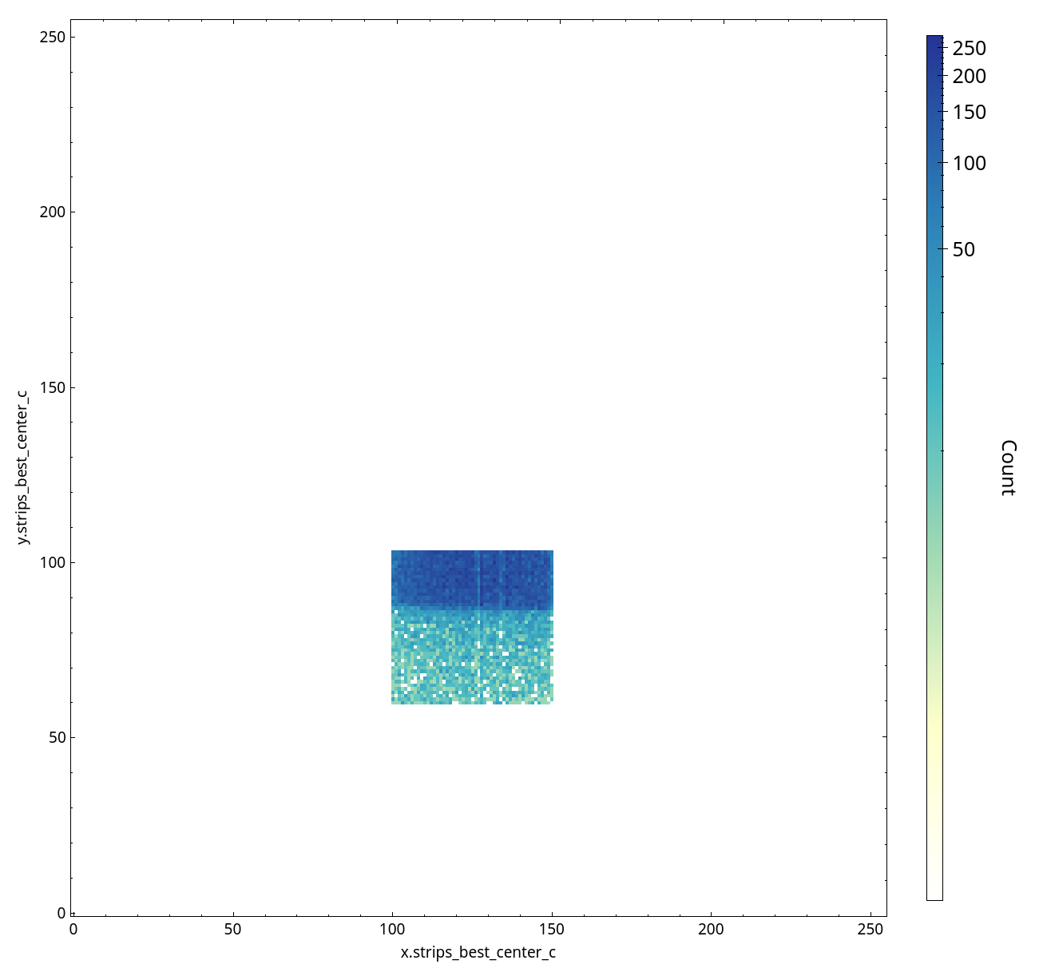
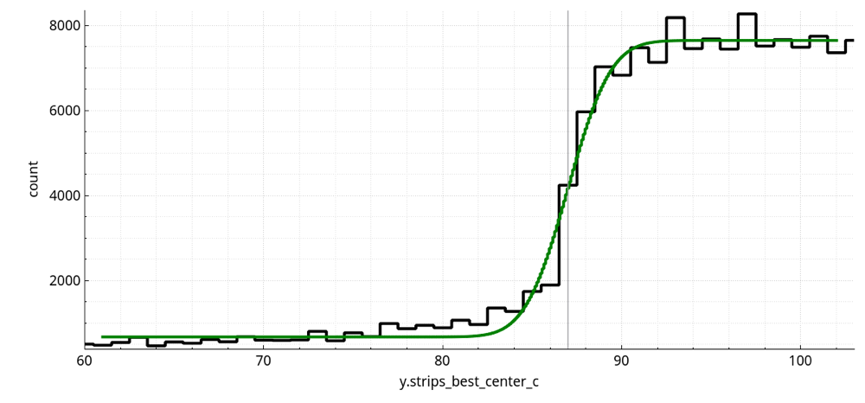
2D Detector Image
How do we pick the right locating algorithm and rejection filters?
Success can be quantified.

Slide 11
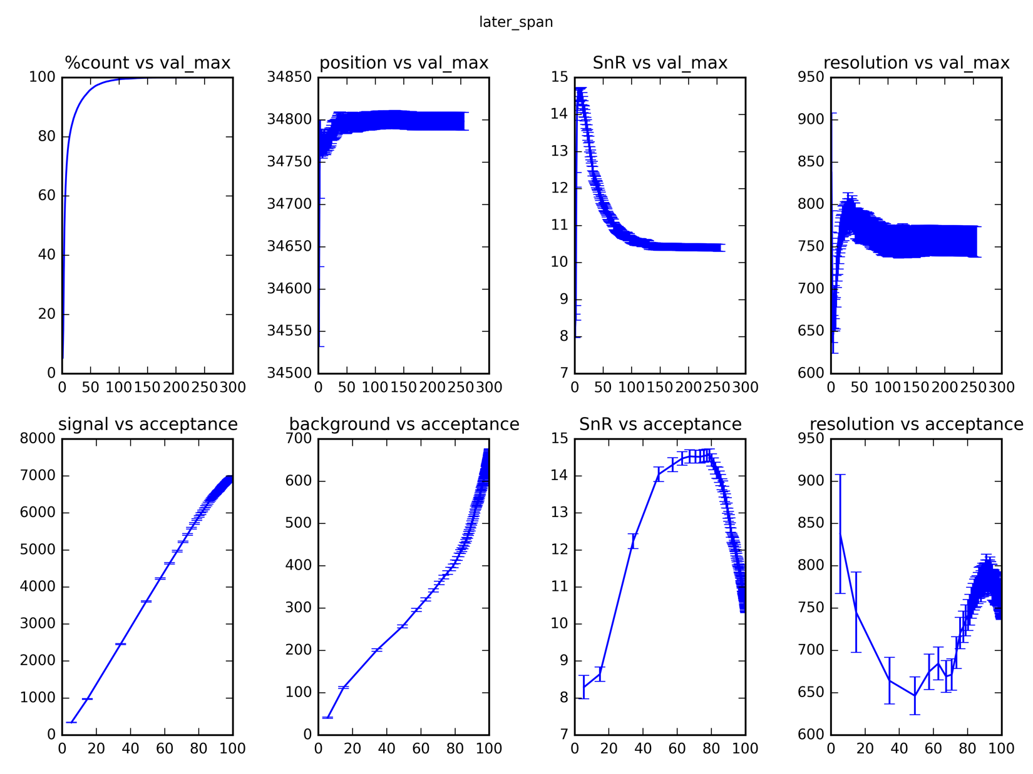
Optimization of Processing Parameters

Slide 12
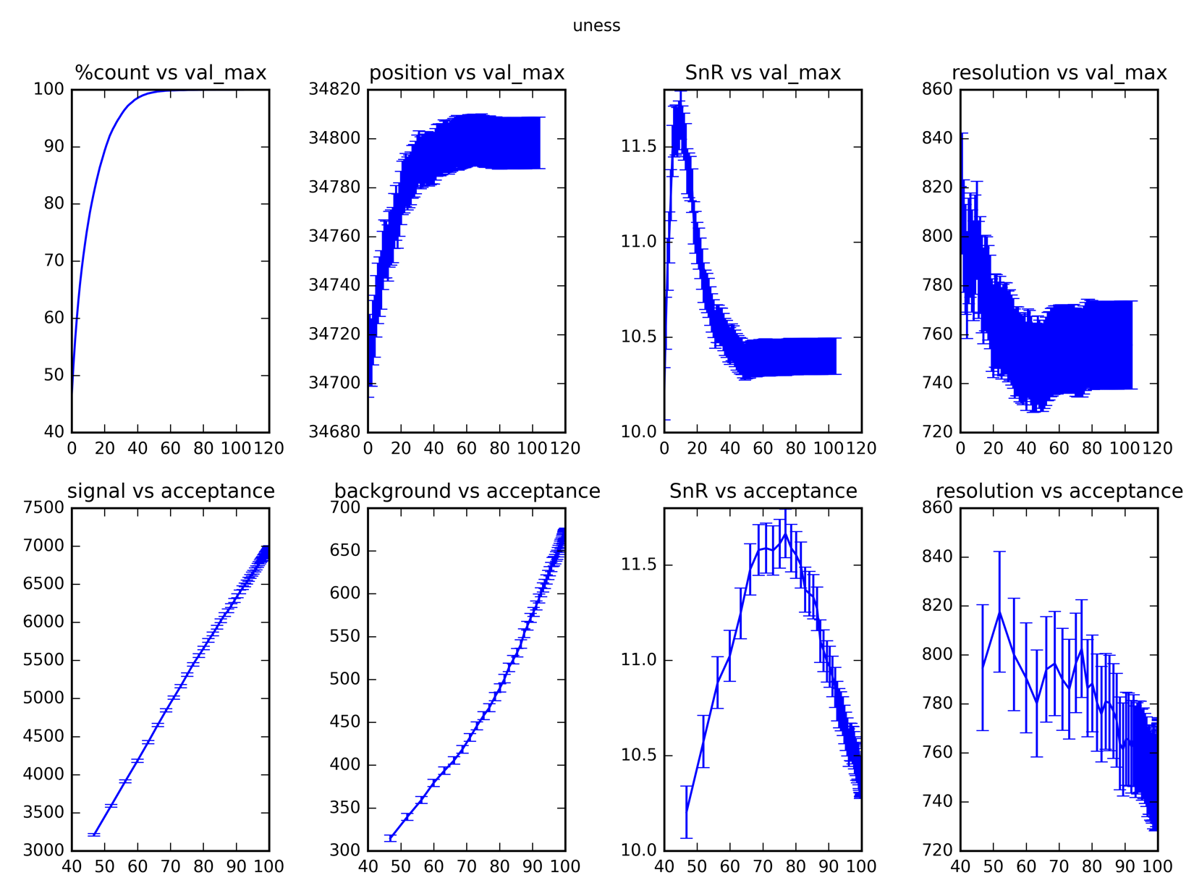
Optimization of Processing Parameters

Slide 13
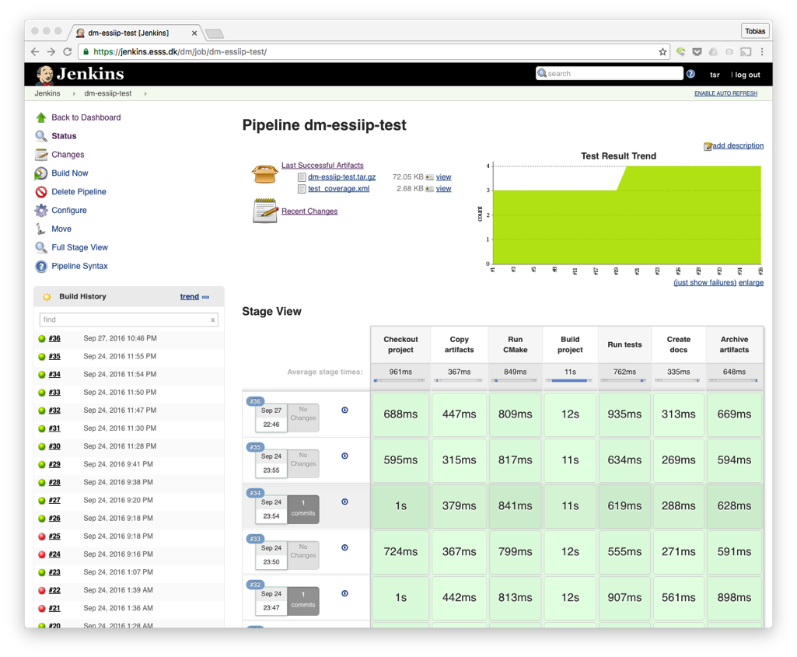
Software Testing
The scientific record of ESS experiments depends on software to function
correctly, reliably, in real time
Testing can be automated for generic infrastructure and detector specific processing
BrightnESS is funded by the European Union’s Horizon 2020 research and innovation programme under grant agreement No. 676548

Slide 14
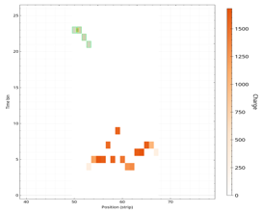
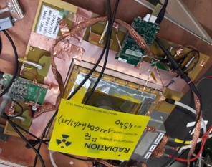


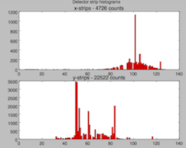
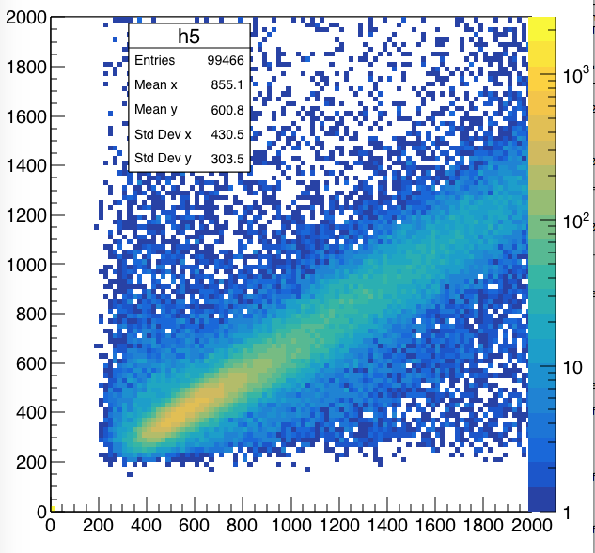
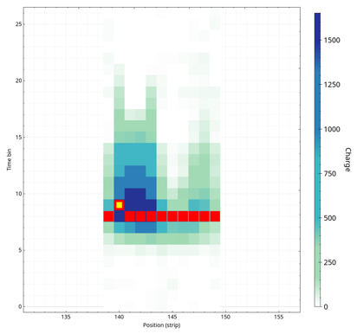
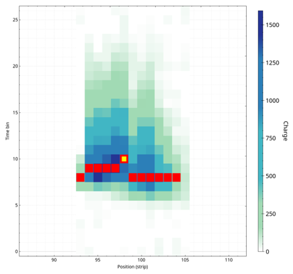
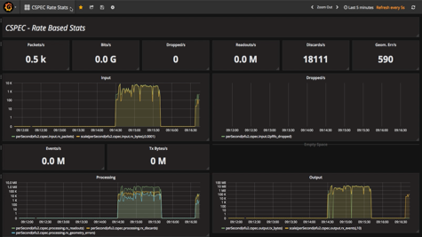
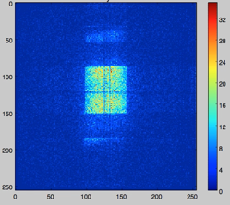
GEM/VMM DAQ & Monitoring
Event formation
Detector and readout
Aggregation
Live View
Installation live in CERN detector lab
Gives faster feedback than legacy DAQ system
RD-51 SRS
Gd-GEM
Application Monitoring
Added Bonus Outcome!

Slide 15

Next Steps
Please talk to us.
More importantly talk to the detector group about your readout integration.
Decide with them what the right integration path is.
See upcoming presentations.
Then we can identify the best strategy for processing the data and see what support we can provide for commissioning.
Discussions about slow control will follow.
Disclaimer:
Different story for cameras.

Slide 16
Thank you
Data Management Group, DMSC

