Slide 1
Event formation visualization and prototypes
Martin Shetty & Dorothea Pfeiffer
www.europeanspallationsource.se
17-09-28

Slide 2
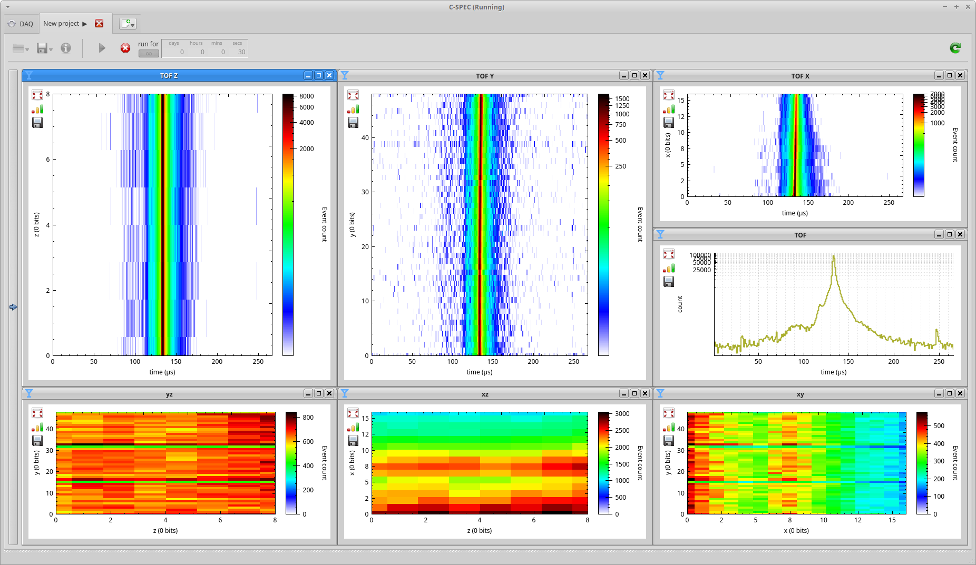
Tools to help detector development

Slide 3
DAQUIRI Features
Live monitoring of EFU
Histograms and visualizes event data
Review detector-specific raw data
Useful in detector development, commissioning & diagnostics
Receives event data from EFUs (via Kafka)
Uses global timing information
Not a data reduction tool

Slide 4
Generic features

Slide 5
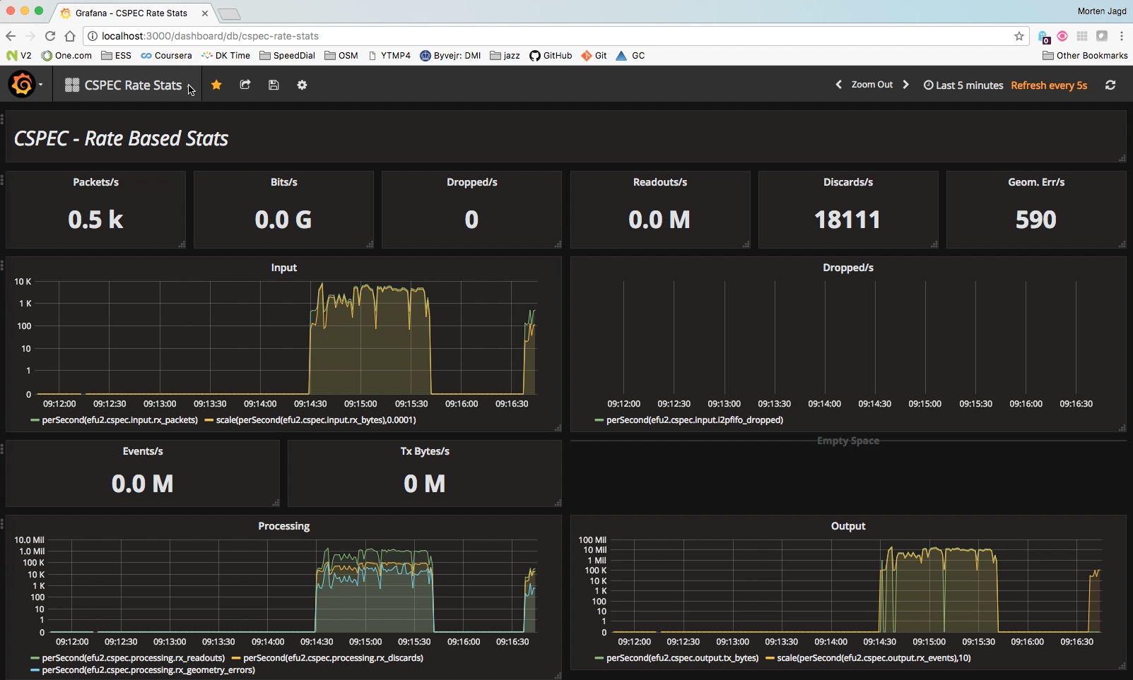
Grafana

Slide 6
Features
Data stream format from EFU:
Pulse time
List of Events
Event = (time, pixelid)

Slide 7
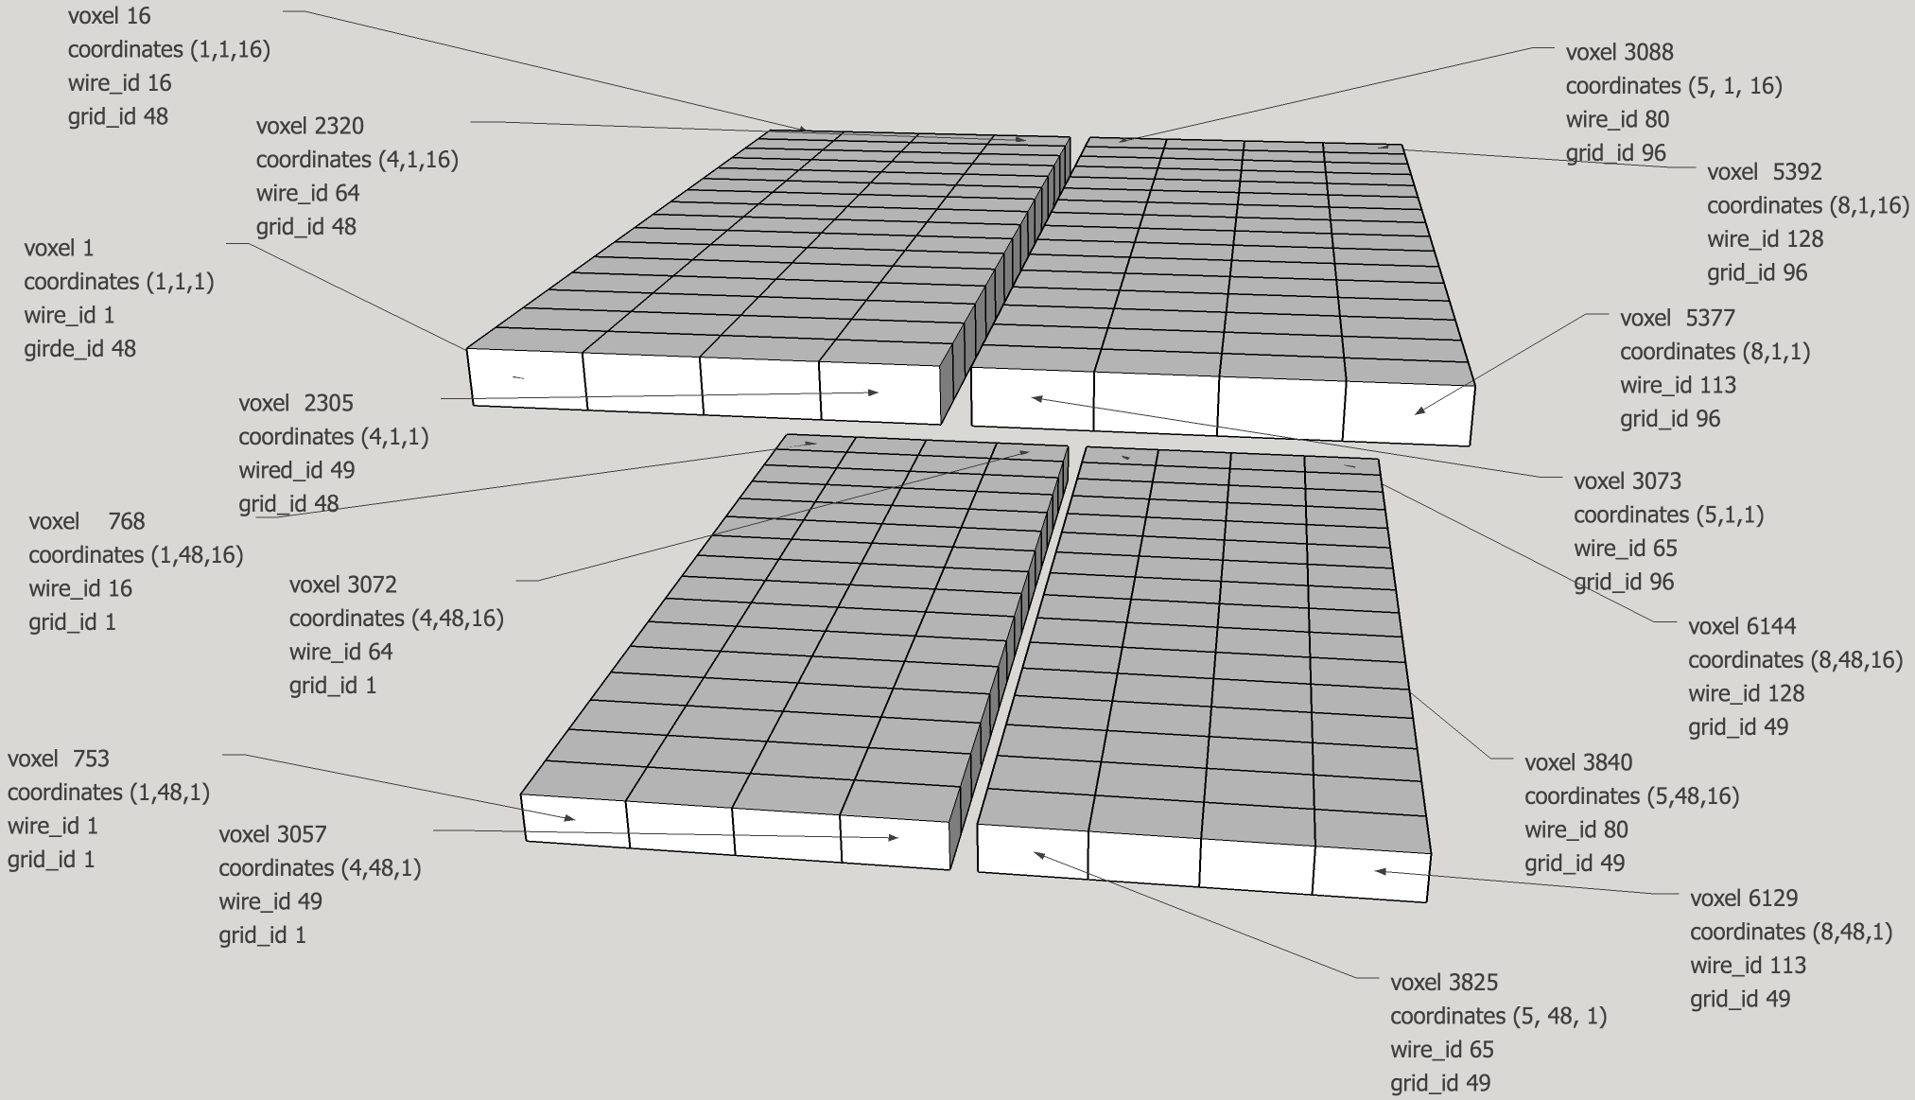
Logical detector geometry
Pixel-id ↔ (x, y, …) mappings

Slide 8
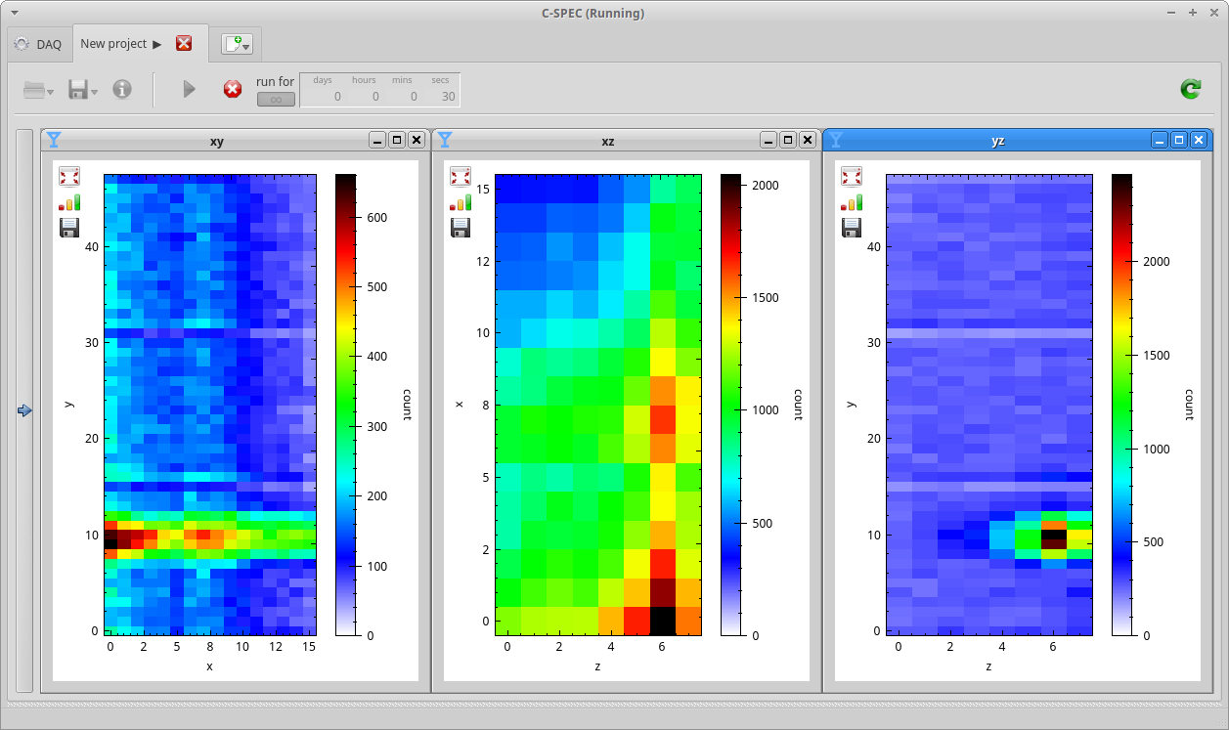
Projections of volume detectors

Slide 9
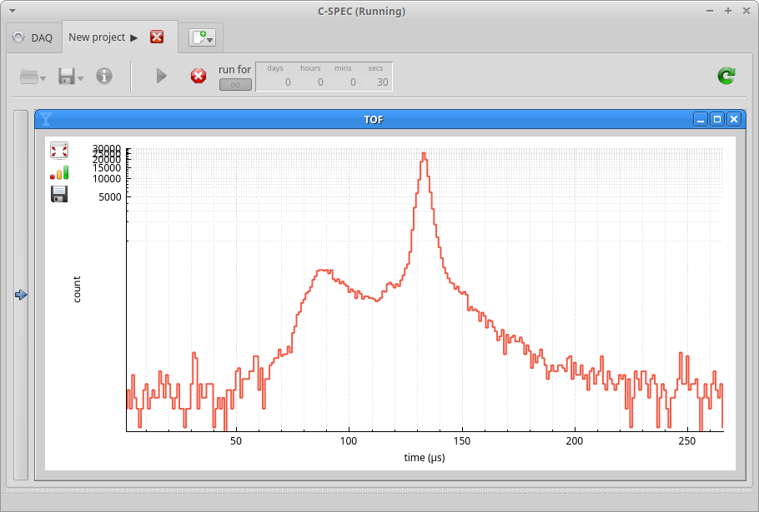
Time of Flight
Plug & play
TOF

Slide 10
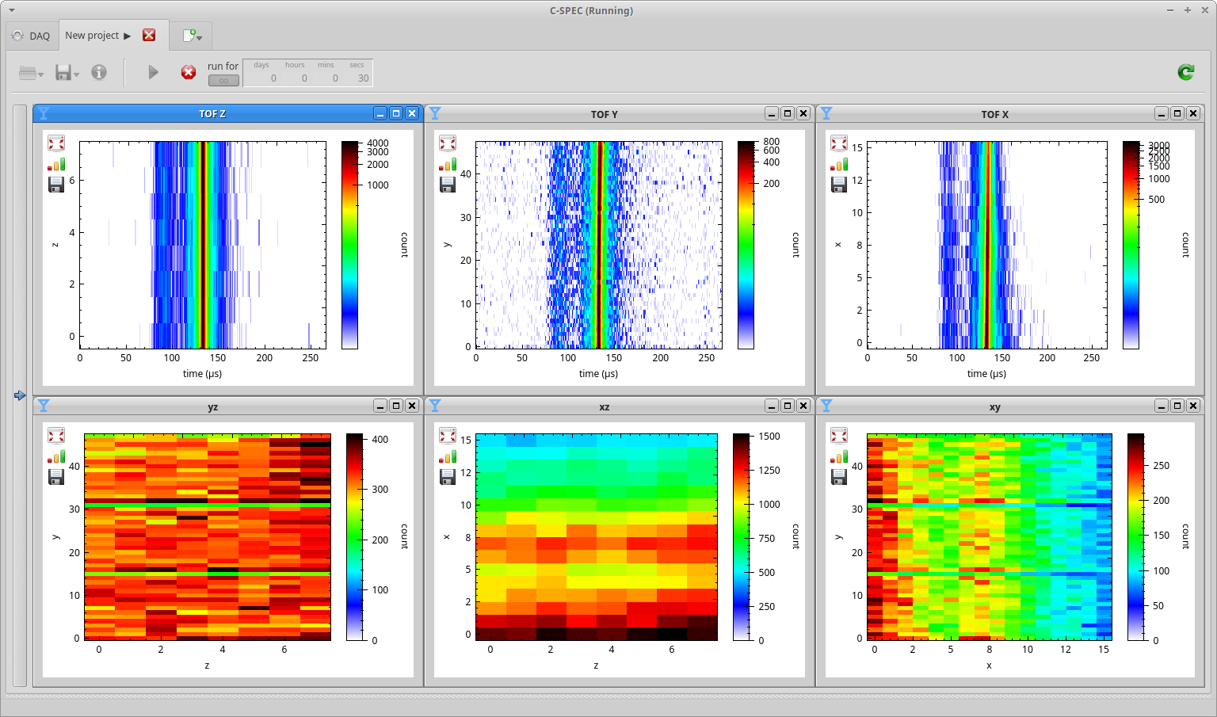
TOF vs. Value

Slide 11
Detector-specific features

Slide 12
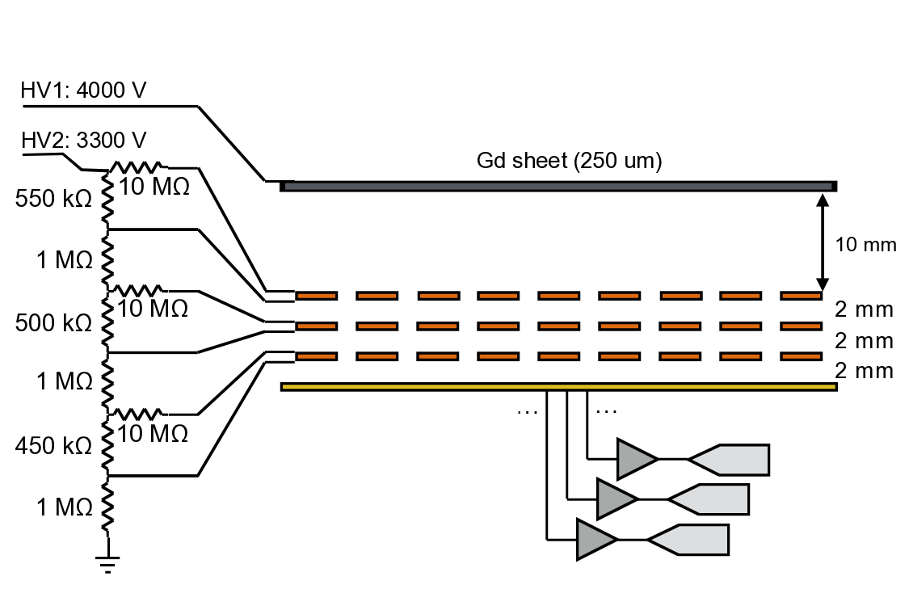
NMX - Gd-GEM setup
conversion electron
Start of track
neutron

Slide 13
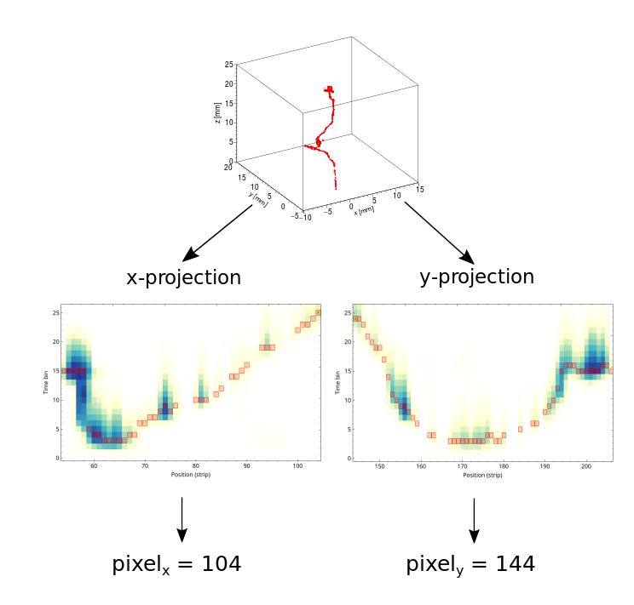
NMX – Event formation

Slide 14
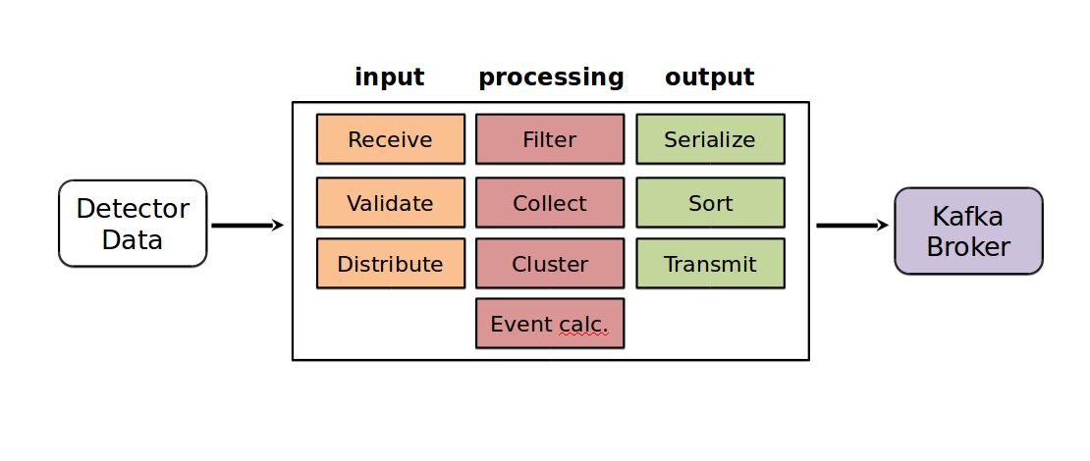
NMX – Event formation
Per one detected neutron (efficiency 15%-35% depending on Gd isotope) on the detector
On average 20 strips/channels hit (in x and y)
Per hit: VMM-ID (physical position and coordinate x or y), channel, pulse height and time
Must first cluster the events, then determine x and y entry positions

Slide 15
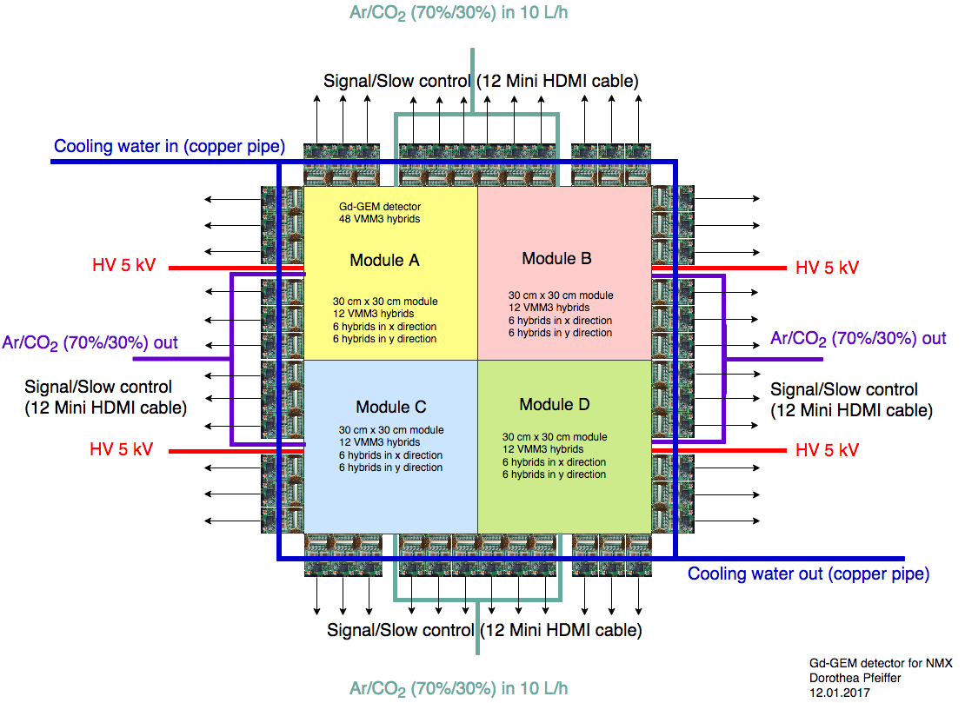
NMX – Logical geometry
Readout partitioned into 4 quarters to reduce capacitance and multiplicity of hits
5 VMM3 hybrids in x and y each per module
40 VMM3 in total
One VMM3 covers 5.12 cm of readout
VMM3 chip-ID matched to physical position
Schematic drawing (Old design):
Now 5 VMM3 instead of 6 per coordinate per module
No water cooling

Slide 16
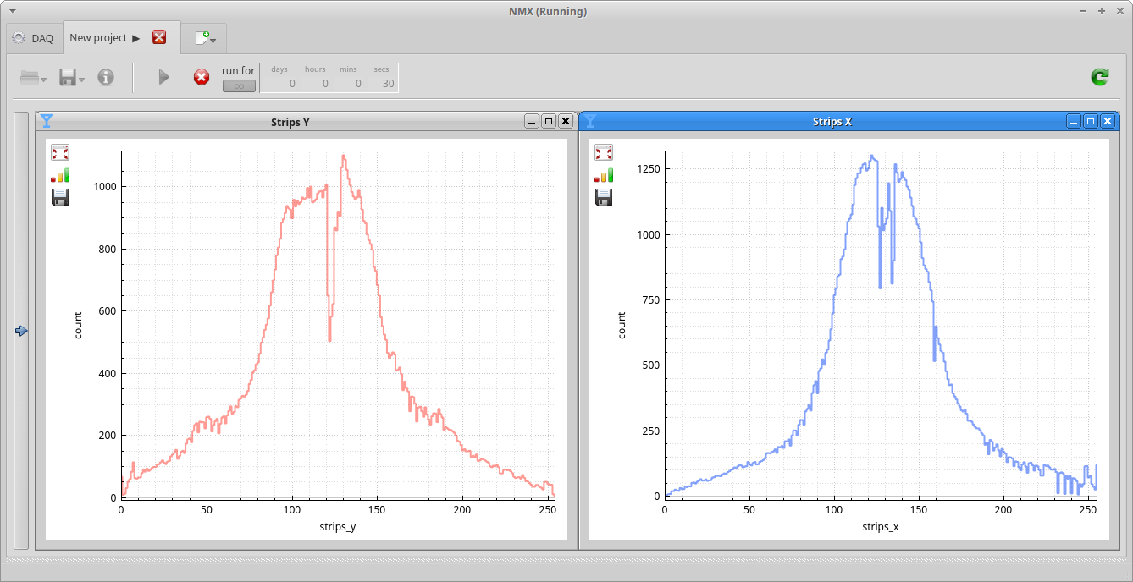
Raw strip data
Thresholds, voltages, dead strips, gain settings, efficiency

Slide 17
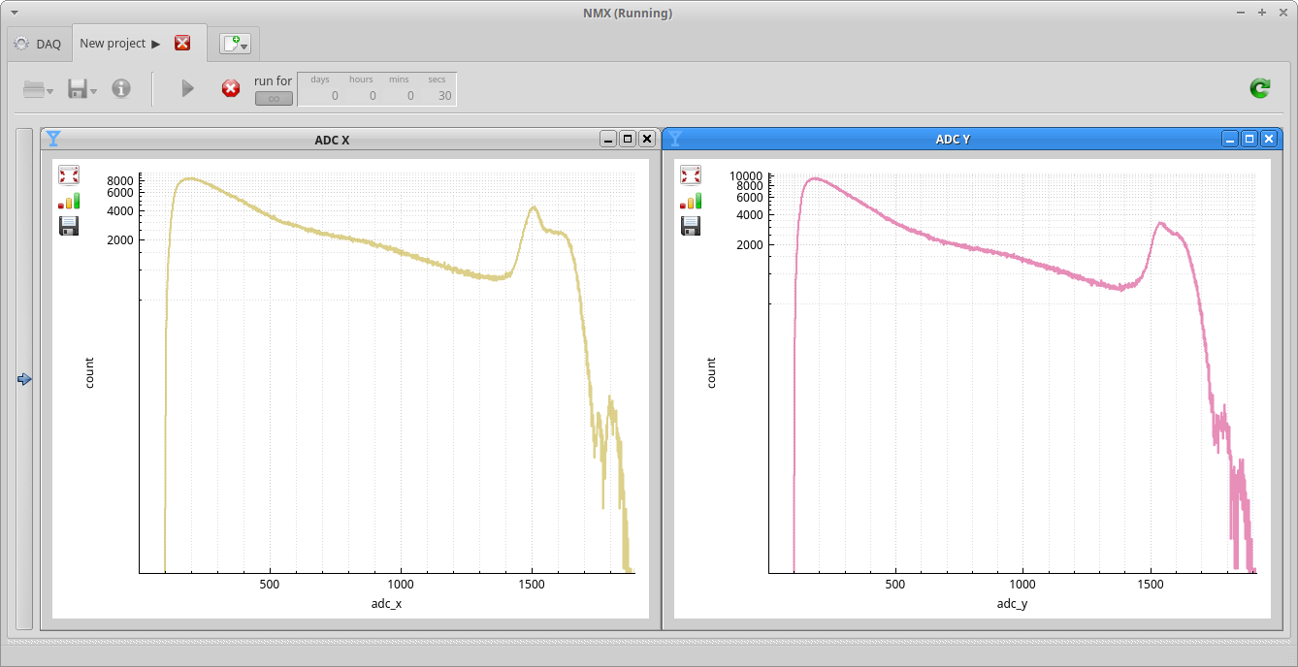
Pulse height spectrum

Slide 18
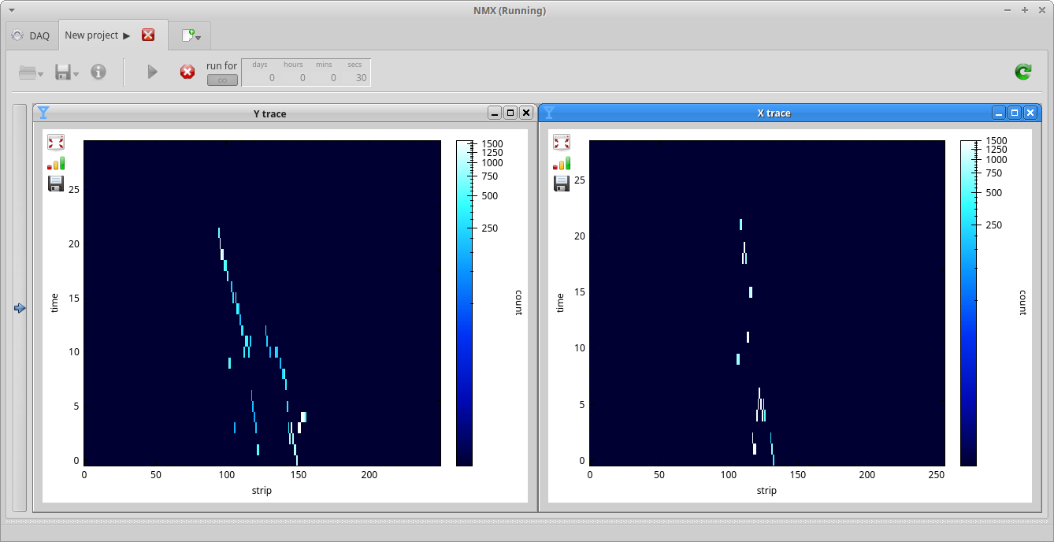
Raw clusters
Cluster data per dimension (x,y) in time and space
Per cluster: physical position in x or y, time
Second clustering step matches x and y
Per cluster: (x,y), time

Slide 19
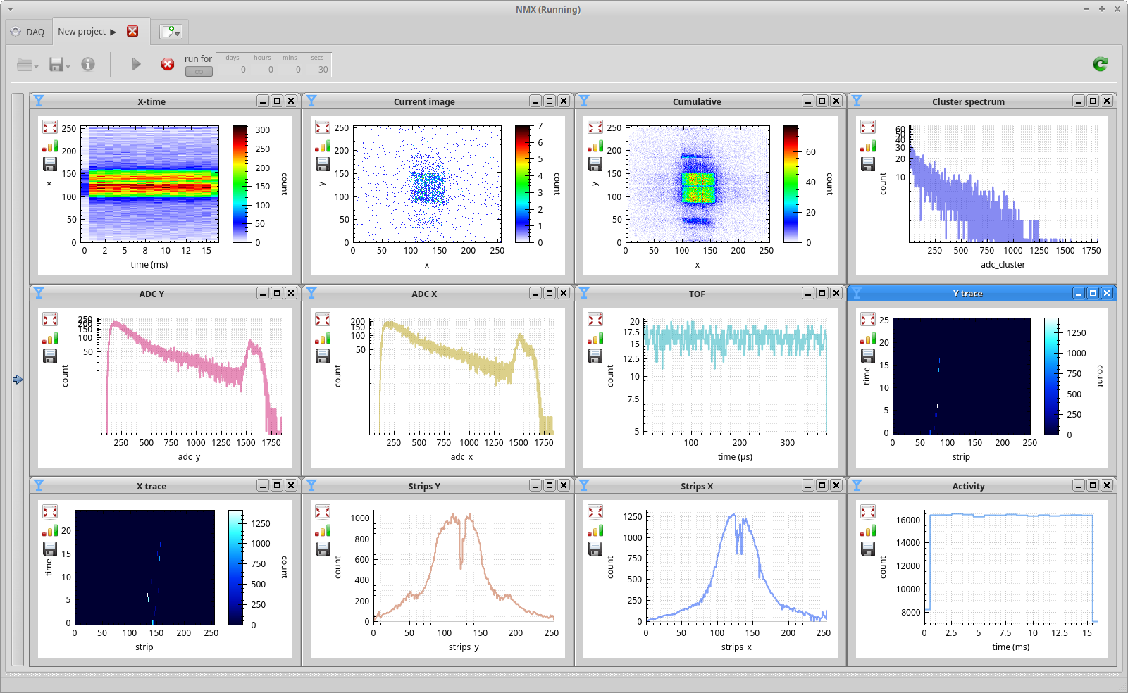
Putting it all together at CERN

Slide 20
DAQUIRI - Current features
detector images
projections of 3d voxel detectors
instantaneous and cumulative histograms
time-of-flight spectra
rate vs. time
coordinate vs. time
custom values received by or generated in EFU:
spectra of deposited charge
raw strip & wire data
Clusters
...
diagnostics only, low count rates

Slide 21
Summary
Detector development made fun
Commissioning made easy
Diagnostics made meaningful
Confirmation of EFU processing steps:
What do you want?
If you want feature-complete data reduction, use Mantid

