Slide 1
Present developments on Am-CLD at HZG and report from ³He tube tests
G. Nowak¹, C. Jacobsen¹, J. Plewka¹, J. Burmester¹ , S. Kleeband¹, R. Woracek⁴, M. Störmer¹, C. Horstmann¹, H.-W. Becker²,
R. Kampmann³ M. Haese¹, J.-F. Moulin¹, M. Pomm¹, J. Fenske¹,
T. Kühl³, E. Prätzel³, D. Höche¹, I. Stefanescu⁴, R. Hall-Wilton⁴,
M. Müller¹
¹Helmholtz-Zentrum Geesthacht, Max-Planck-Str. 1, 21502 Geesthacht, Germany
²Ruhr-Universität Bochum, RUBION, Universitätsstr. 150, 44801 Bochum , Germany
³DENEX – Detectors for Neutrons – GmbH, Stöteroggestr. 71, 21339 Lüneburg, Germany
⁴European Spallation Source ESS (ERIC), P.O. Box 176, SE-221 00 Lund, Sweden
IKON 13, 2017 28th September, Lund, Sweden

Slide 2
Outline
Current results from Am-CLD detector tests at the ESS-Test Beamline (HZB)
Set-up of the Am-CLD demonstrator detector
Current results from TOSHIBA ³He-Toshiba tubes
tested at the ESS Test Beamline (HZB)

Slide 3
A1- and Am-CLD detector concept: neutron incidence geometries
A1-CLD ( Absorption in 1 Layer Conversion Detector):
n
high conversion efficiency (++)
effective position resolution: sub-mm! (++)
fixed detector-sample distance (o)
mechanically challenging (-)
Θ_{in} = 2-5°
stopping gas
converter
1 µm ¹⁰B₄C
¹⁰B abs. length: 32 µm - 12 µm
ion range: 3.9-1.5 µm
Am-CLD ( Absorption in multiple Conversion Detector):
1 µm ¹⁰B₄C (2x converter per det. plane)
position resolution: wire pitch mm (+)
variable detector-sample distance (++)
variable converter layer thickness (++)*
additional absorption by substrates (-)
stopping gas
stopping gas
stopping gas
stopping gas
n
Θ_{in} = 90°
…
…
converter
converter
*F. Piscitelli and P. Van Esch JINST 8, P04020, 2013
x6 - 15

Slide 4
Current results from Am-CLD detector tests at the ESS-test beam line (HZB)

Slide 5
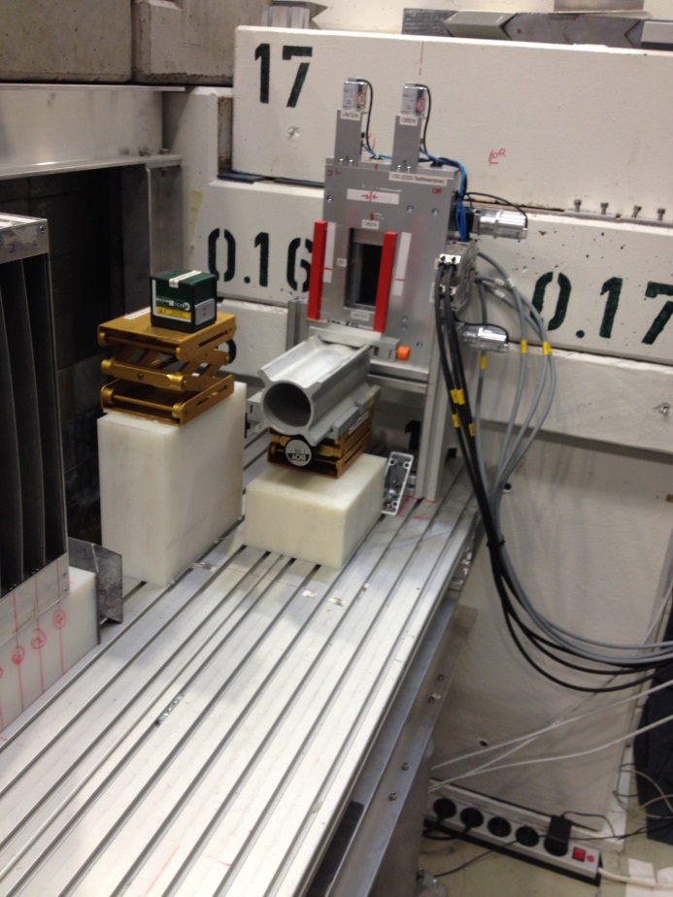
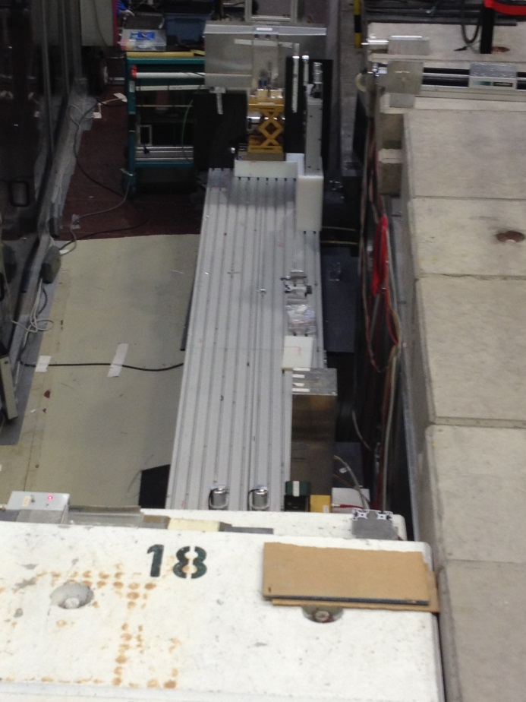
The V20:
ESS-Test-beamline @ HZB
neutrons
neutrons out of the wall (choppers)
through primary slit:
table allows multiple set-up’s:
cold
source
chopper
cascade
BER-II
“only limited by phantasy boarders of the users”
R. Woracek, T. Hofmann, M. Bulat, M. Sales, K. Habicht, K. Andersen, M. Strobl ” The test beamline of the European
Spallation Source – Instrumentation development and wavelength frame multiplication ” ,NIMA, 839, 102-116, (2016)

Slide 6
Used experimental set-up at the
ESS-Test beam line
MB
slit
@
49.87 m
detector
@
51.04 m
1st
slit
Plexiglas plates
25 mm thick
@ 50.55 m
cold
source
chopper
cascade
sample
@ XX m
BER-II

Slide 7
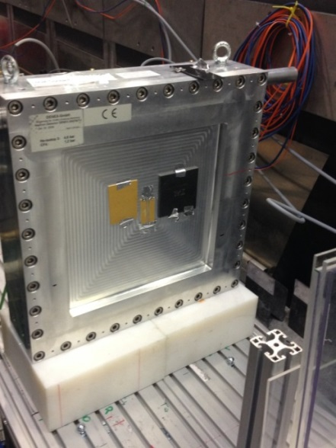
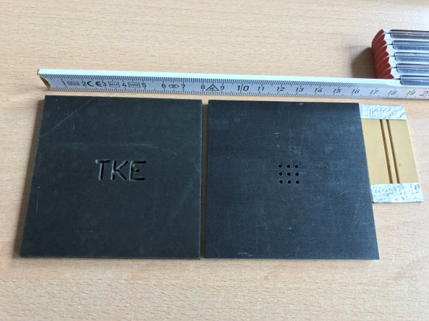
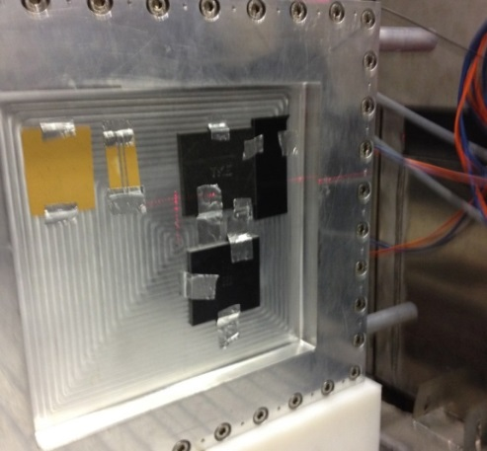
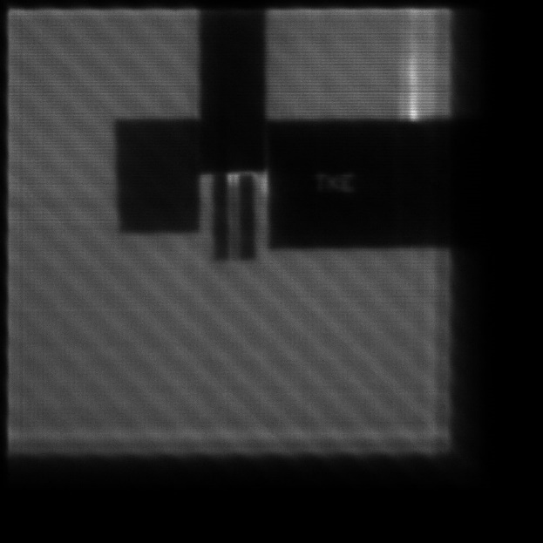
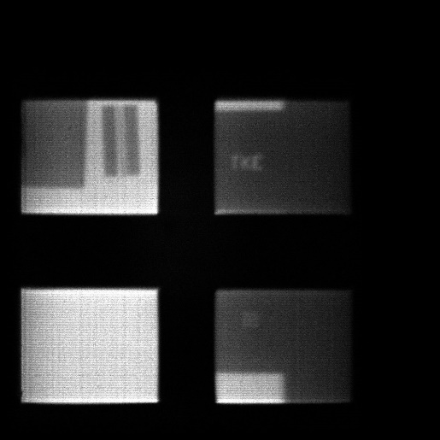
Simple Imaging tests of a “single plane
Am-CLD”: comparison MWPC ³He vs. ¹⁰B₄C
ToF experiments at ESS test beamline V20, Helmholtz-Zentrum, Berlin
³He-MWPC-Denex:
double slit:
- 1.6 mm opening
- 2 mm fillet
¹⁰B₄C-MWPC-Denex:
3x3 hole
array
TKE-Logo
4.8 bar ³He
=>45% @ 1 Å
1.2 µm ¹⁰B₄C
=> 3% @ 2 Å
³He and ¹⁰B₄C delay-line based
MWPC have very similar
imaging properties at
perpendicular incidence!
pos. res.:3 mm x 4 mm
t = 50400 s
t = 50000 s

Slide 8
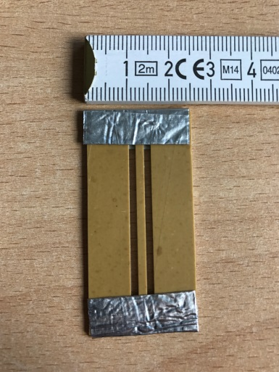
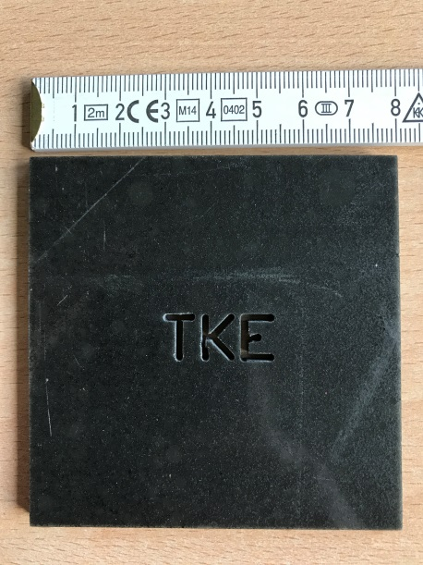
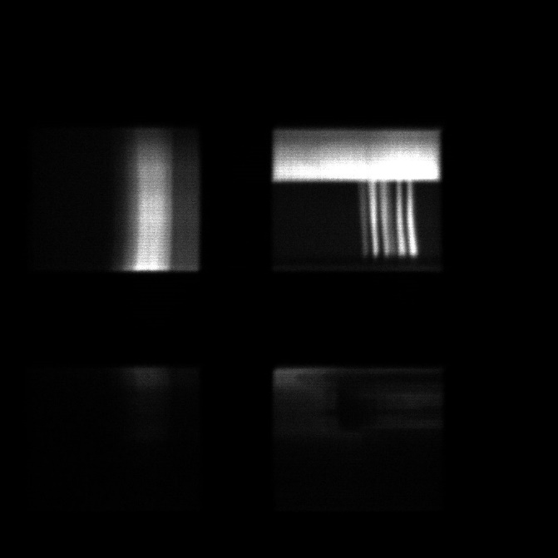
Imaging tests at inclined incidence on the
¹⁰B₄C test detector
double slit:
set-up view from top:
TKE-logo:
sample: double slit, gradient, TKE-logo
divergent neutron beam
¹⁰B₄C-converter
multi- wire planes
Sample with chem. gradient:
t = 3600 s
t = 200 s
t = 120 s

Slide 9
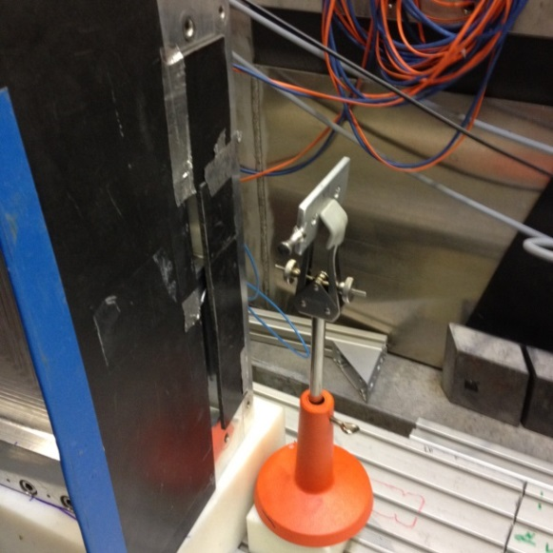
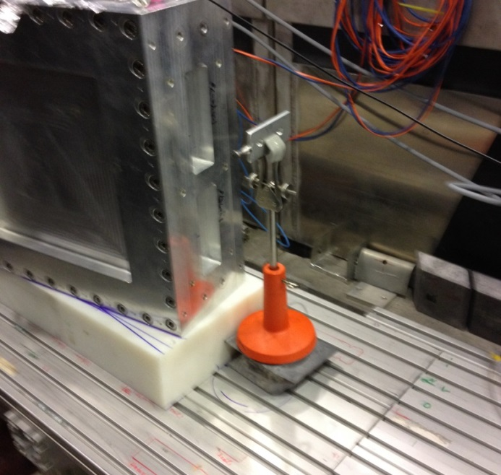
Imaging tests at inclined incidence after transmission on the ¹⁰B₄C detector
ToF experiments at ESS test beamline V20, Helmholtz-Zentrum, Berlin
set-up:
top view
sample: Fe
25 mm
divergent neutron beam
¹⁰B₄C-converter
multi- wire planes
100 mm
t = 3600 s;
sizes: 4416 MB/10630MB

Slide 10
Spatial resolved Bragg-edge detection
by the ¹⁰B₄C detector
ToF experiments at ESS test beamline V20, Helmholtz-Zentrum, Berlin
Single pulse mode:
No sample in beam
WFM-mode:
t = 3600 s
2324.7 MB/5585.5 MB
t = 1800 s
287 MB/678 MB
transmission through
Fe-sample
t = 3600 s
2167 MB/5200.6 MB
Fe-Bragg
edge!
width = 2.15 ms
∼31 points
t = 3600 s
543.2 MB/1278.9 MB
-real.ToF-resolution: width about 700 µs
-Fe-edges in both modes visible!
-WFM–mode produce 4x less data!

Slide 11
Count rate capability for one detection plane
with delay-line read-out:
ToF experiments at ESS test beamline V20, Helmholtz-Zentrum, Berlin
One layer of 1.2 µm ¹⁰B₄C illuminated at about 5 ° incidence
Slit was closed vertically with a fixed width of 55 mm
background (closed shutter) was about 100 cps!
55 mm
95-> 5 mm
measure. direction!
intensity
slit area (in mm²)
proportional up to 270 000 cps per plane!

Slide 12
Set-up of the Am-CLD demonstrator
detector

Slide 13
Electrode set up of detection planes in demonstrator Am-CLD detector
Multiwireanode (y)
2x B₄C coated Al-plate
(drift electrode) (back-to-back)
Multiwirecathode (x)
B₄C coated Al-plate
(drift electrode)
one detection plane (x,y)
window
neutrons
*
*
*
U_{+HV}
U_{+HV}
U_{+HV}
U_{-HV}
U_{-HV}

Slide 14
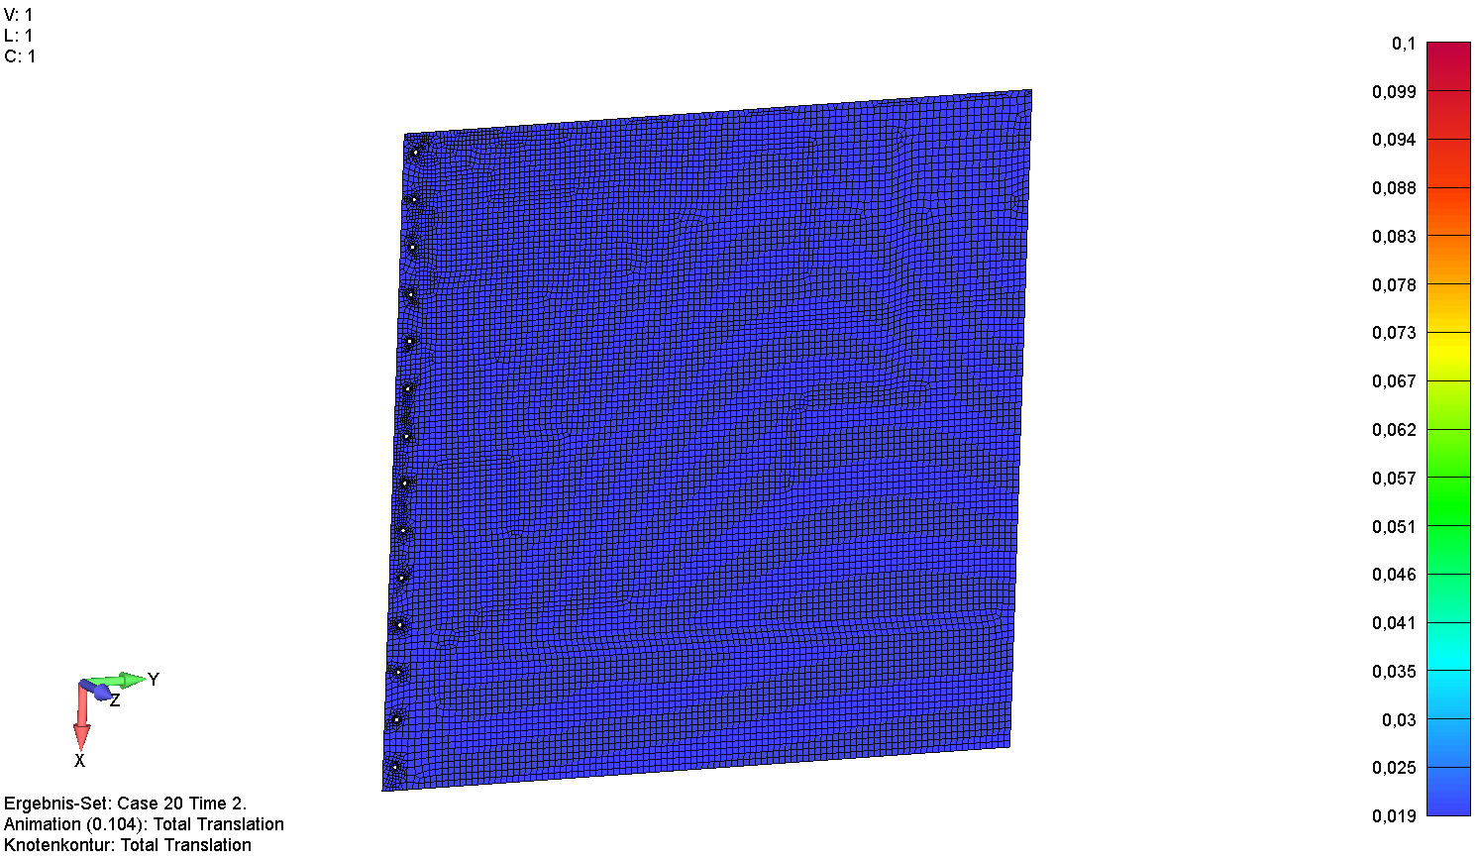
FEM calculation of converter bending caused by application of electrostatic force
1000 mm
Vertical orientation:
horizontal orientation:
= converter bending
due to applied voltage
= converter bending
due to applied voltage
+
-
g
min. 30 µm
+
>>100 µm
g
-
vertical deformation: up to 1.3 mm
horizontal deformation: up to 1.6 mm

Slide 15
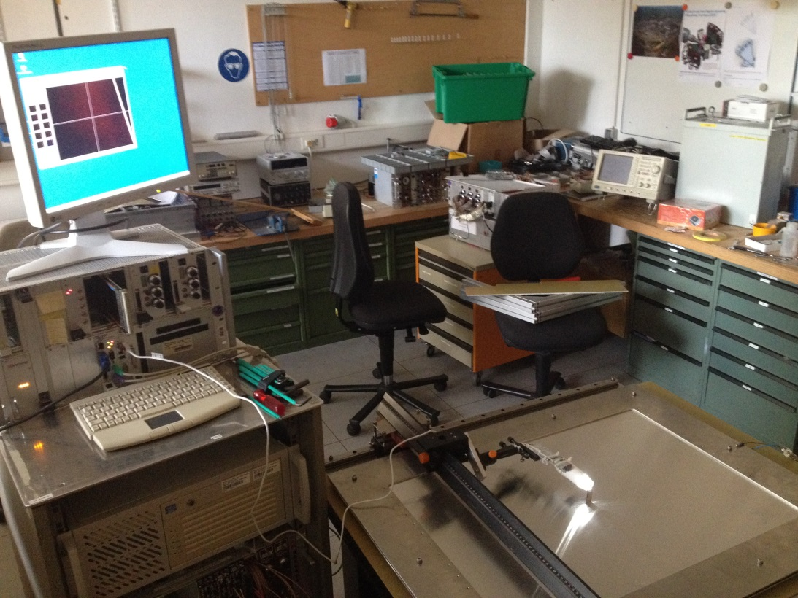
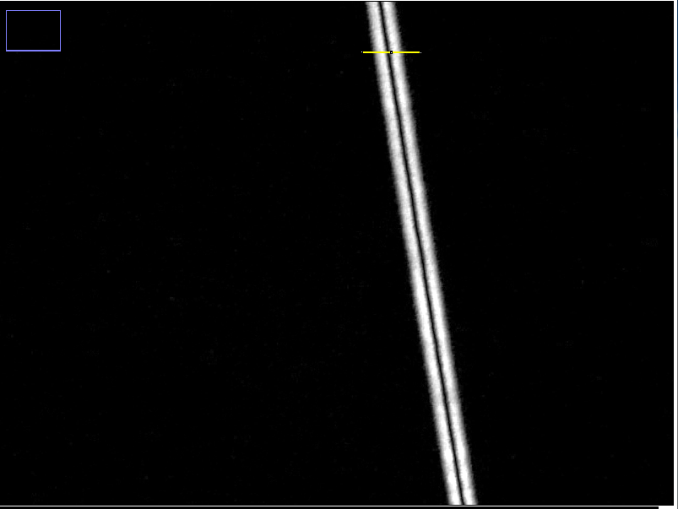
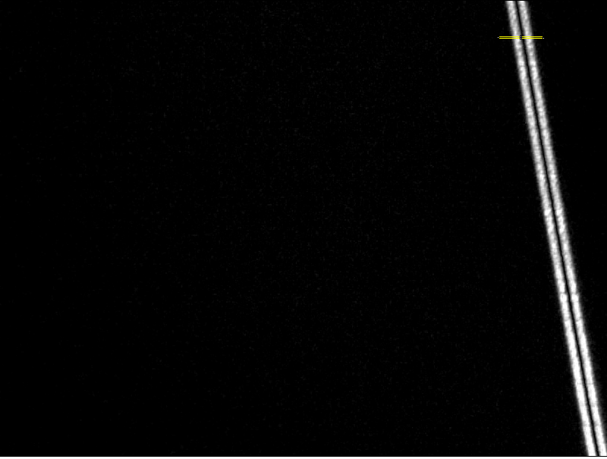
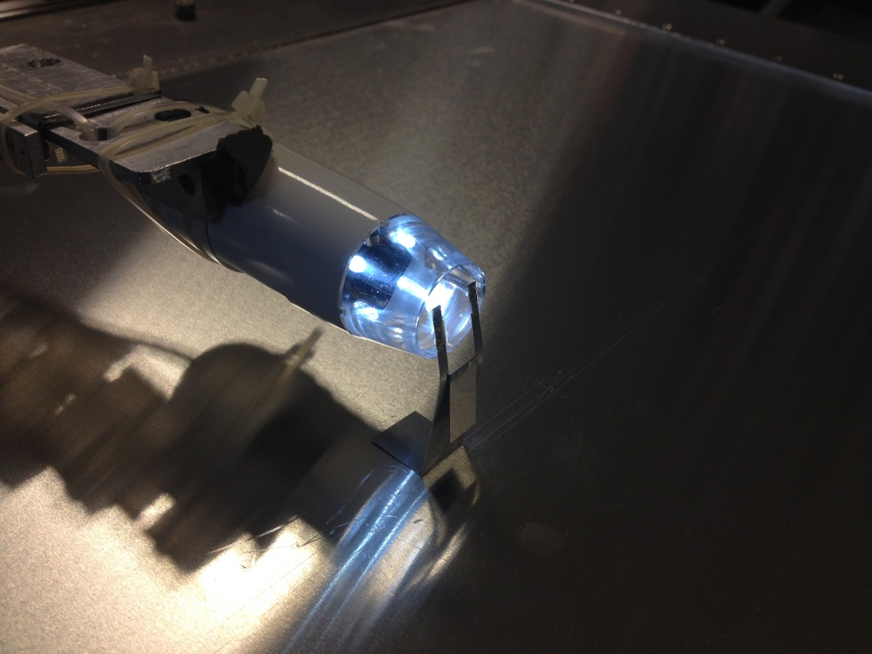
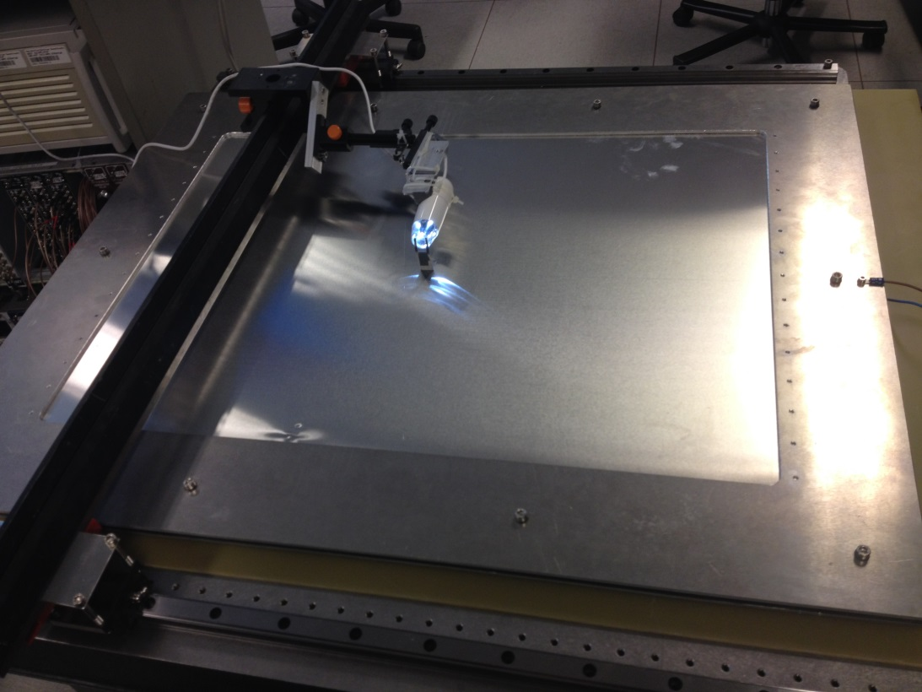
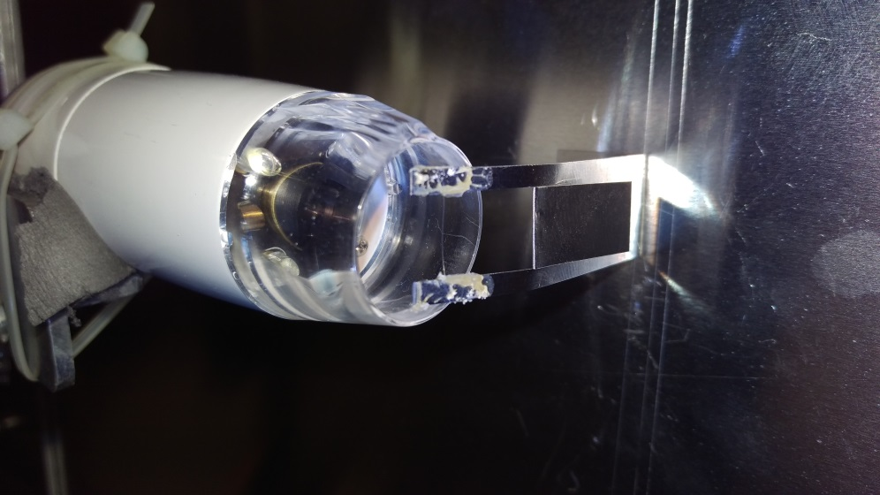
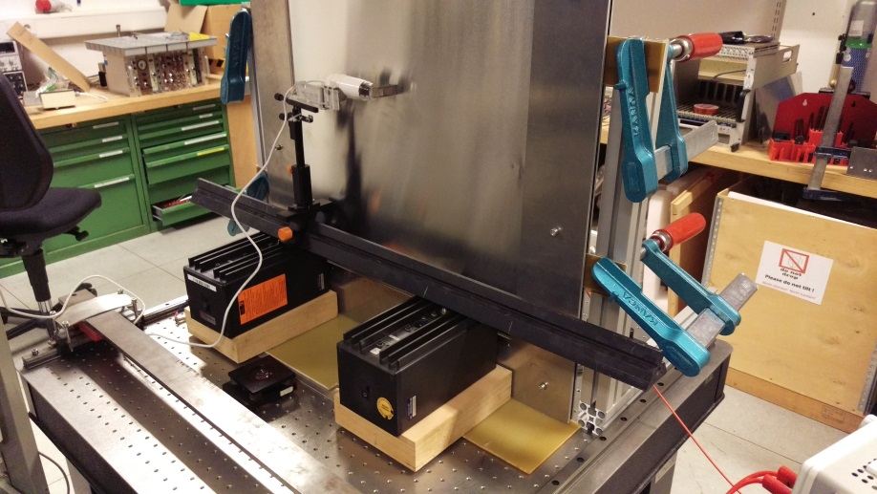
In-situ measurement of converter bending due to electric field
1)Video: ramp 0V-> 5000V -> 0V applied voltage:
2)Deformation at 0 V and 3000V :
5000 V
5000 V
0 V
0 V
vertical orientation:
40 µm deformation at 3000 V
horizontal orientation:
45 µm deformation 3000 V

Slide 16
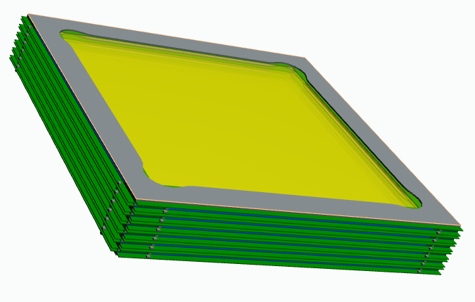
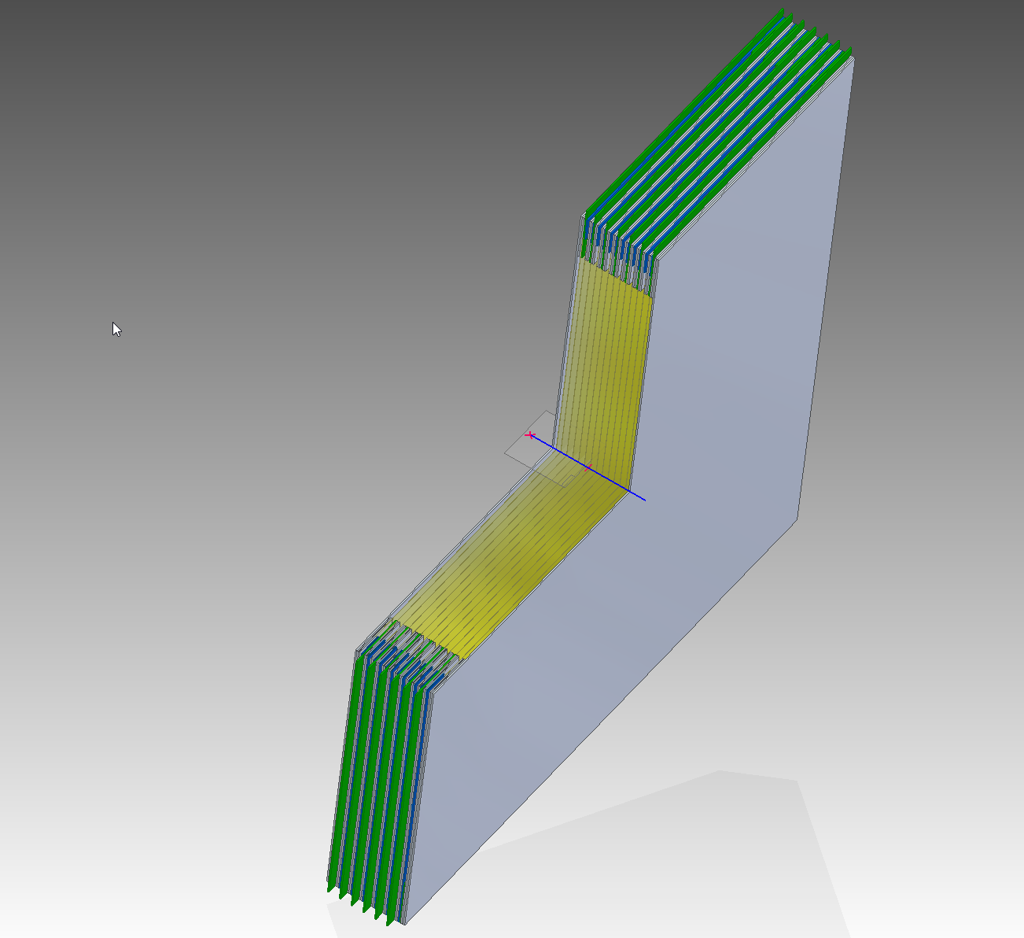
Am-CLD demonstrator detector layout
cross-section:
Sandwich-like self-supporting device:
force-
compensation-volume
1200 mm
detection vol. n
detection vol.n+1
p_{f-c-v}<p_{dv}
…
…
No pressure vessel needed!
¹⁰B₄C coating
filed European Patent: EP 17184906.0 (04.08.2017)

Slide 17
Set-up of Am-CLD detection planes
Multiwireanode (y)
2x B₄C coated Al-plate
(drift electrode) (back-to-back)
Multiwirecathode (x)
force compensation volume
B₄C coated Al-plate
(drift electrode)
one detection plane (x,y)
window
neutrons
*
*
*
U_{+HV}
U_{+HV}
U_{+HV}
U_{-HV}
U_{-HV}

Slide 18
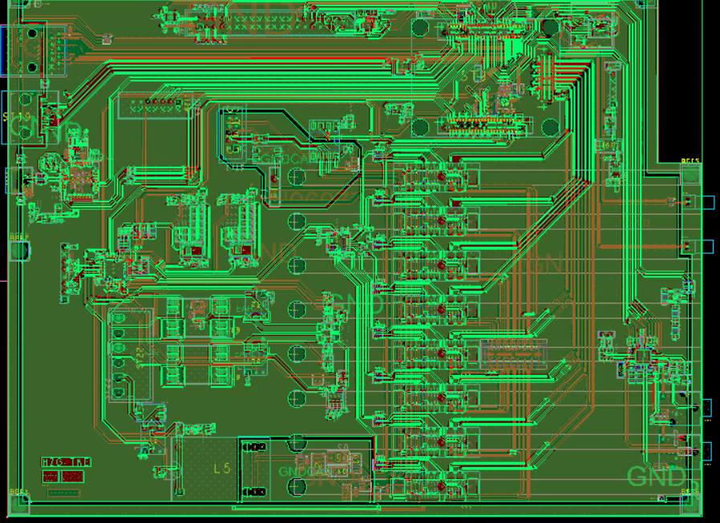
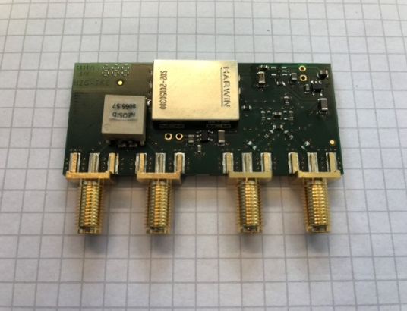
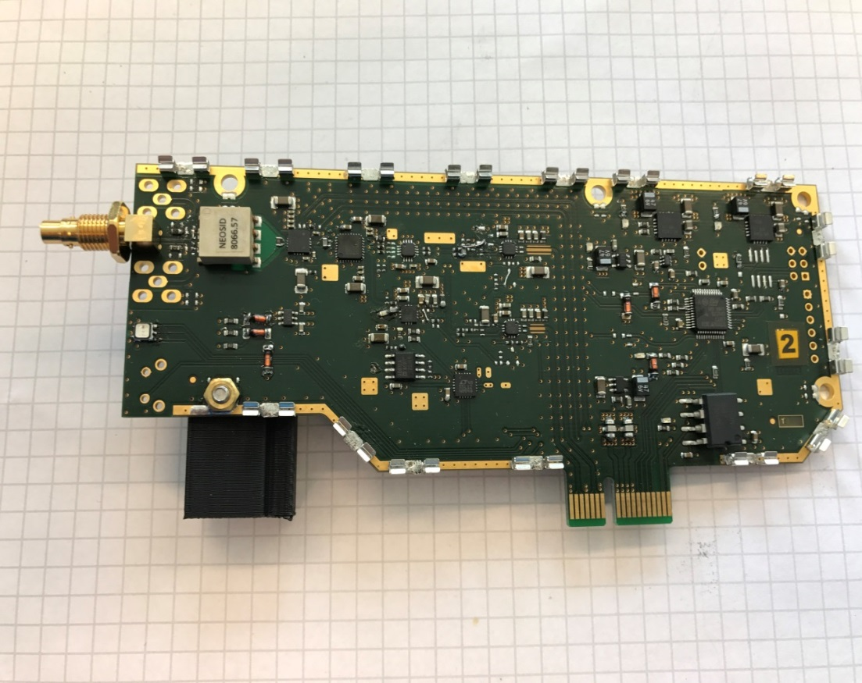
Prepared Electronics
Pre-Amplifier.:
-integrated on the delay-line PCB
-low noise Amp., differential, gain: up to 30 dB
(Main-Board) TDC on FPGA:
-Linux OS
-208 ps = one “Tick”,
Delay-line step 1 ns
-16 channel on one FPGA
-one FPGA for 2 planes
Main-Amplifier + CFD:
-differential signal
-remote controlled: Gain (2-26 dB),
Bandwidth (20-800 MHz), Delay (0-50ns)
-Detector backside
-positive and negative edge detection
-time over threshhold

Slide 19
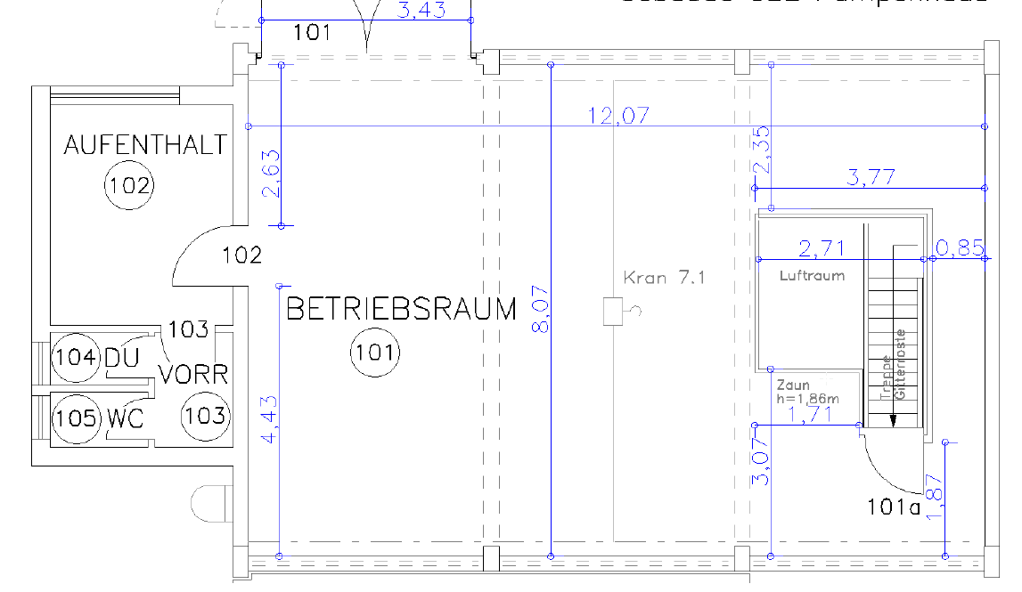
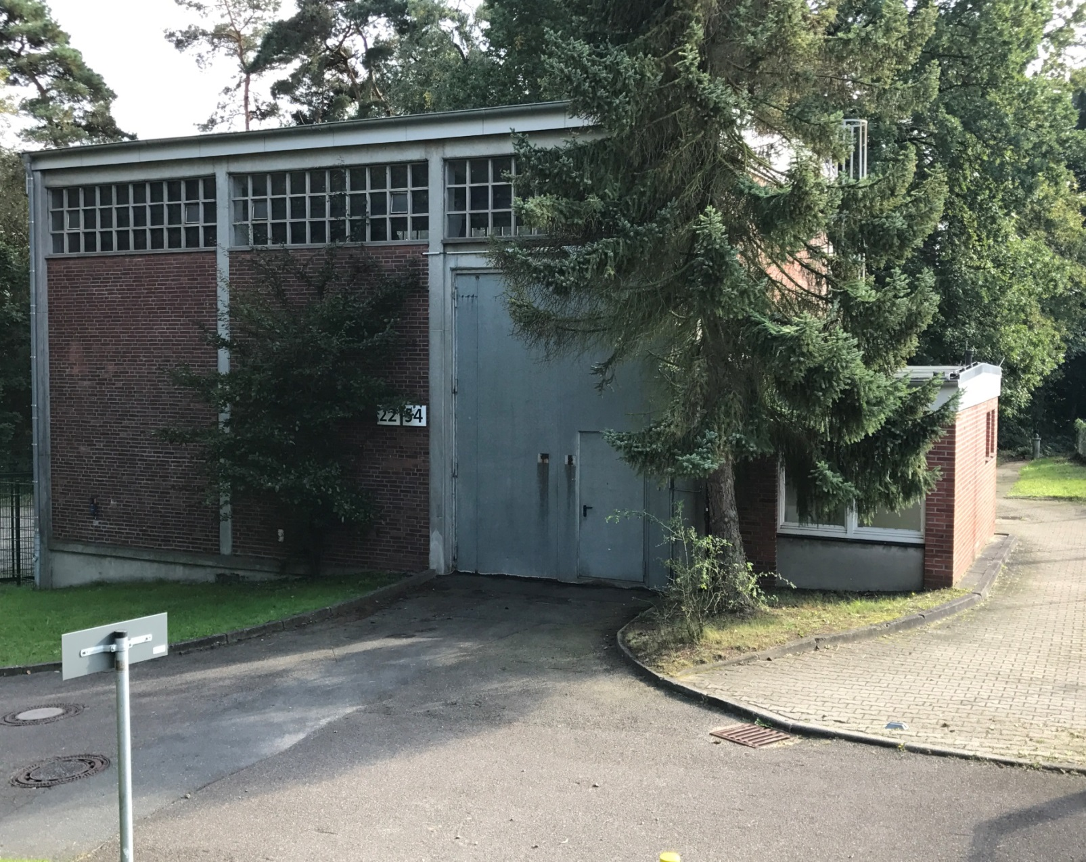
Upcoming detector lab at HZG
Floor plan:
Restored Building for detector lab at the HZG site:
-lab at ground level
-lorry 3.5 t can
drive in
Tresor
detector
lab source
shelf
clean room
about 90 m²
1.5 ton crane
pressed air,
heating,…
Work
bench
shelf
vaccuum-shelf

Slide 20
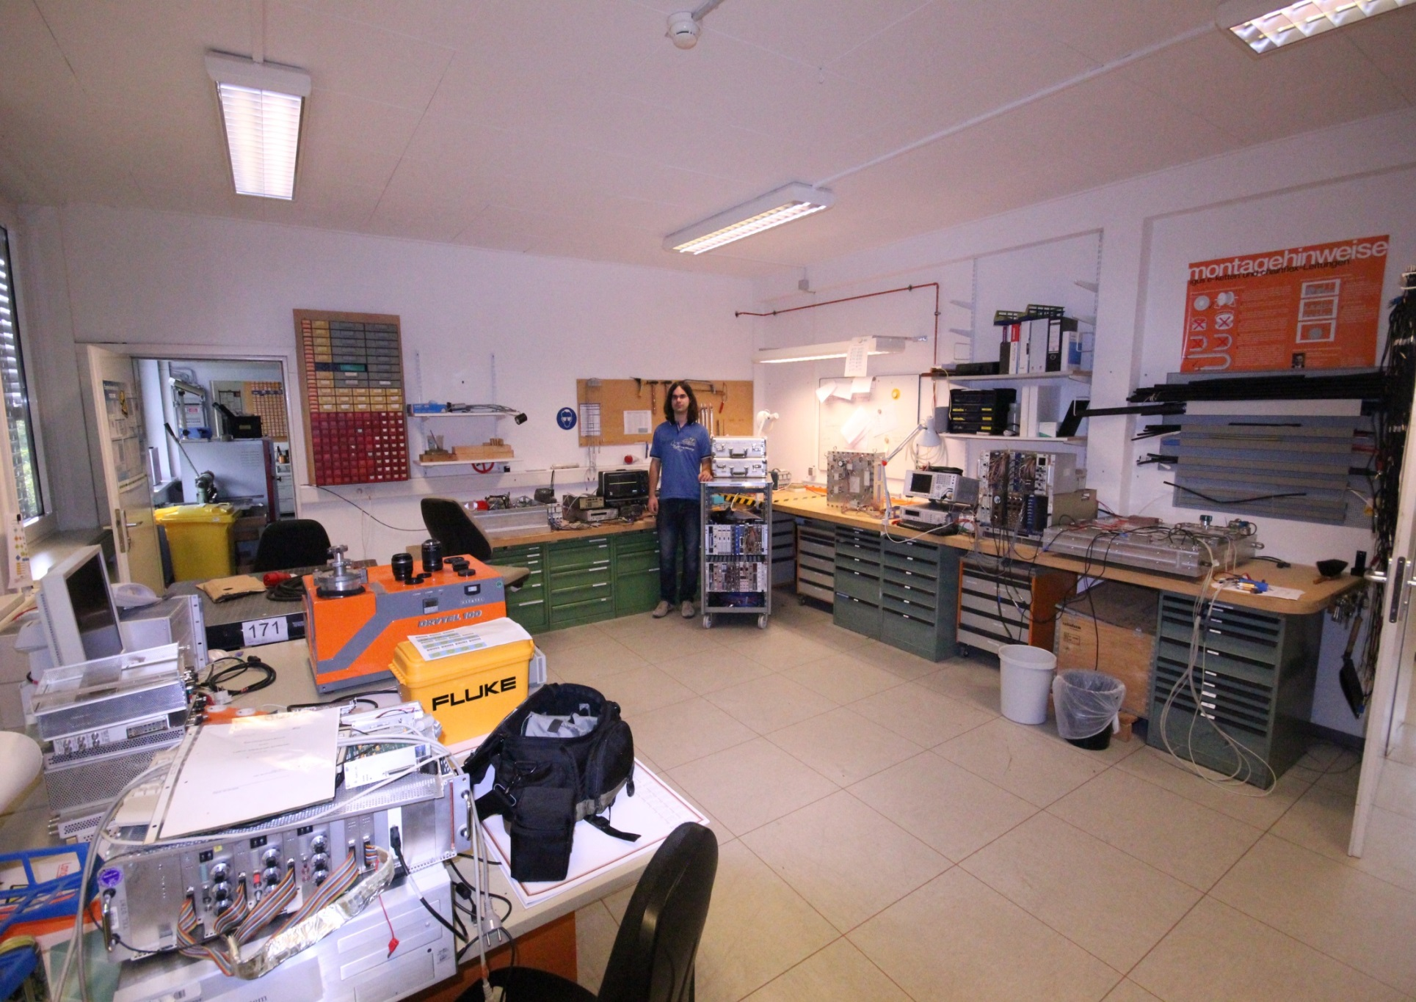
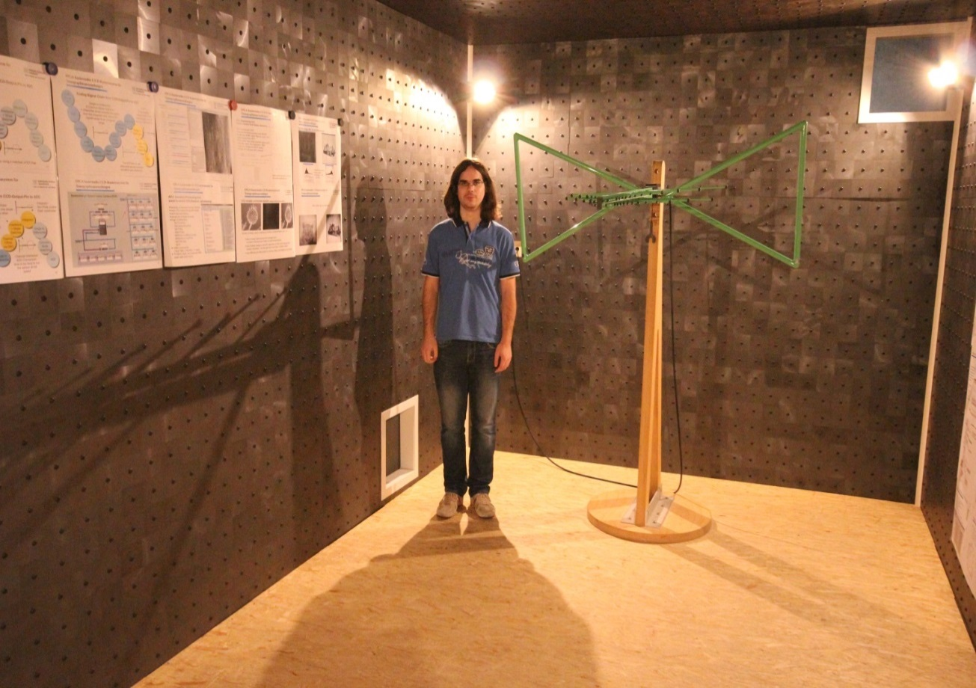
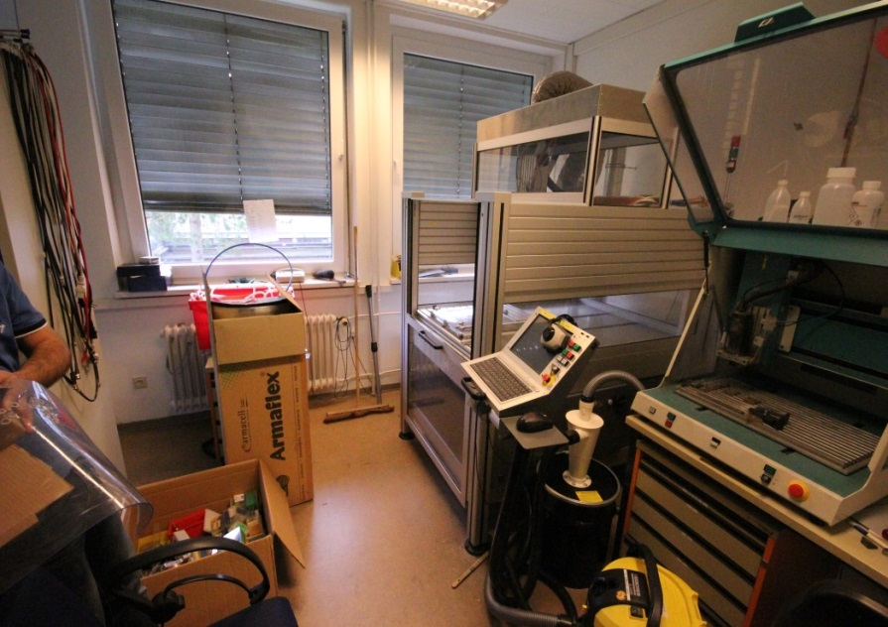
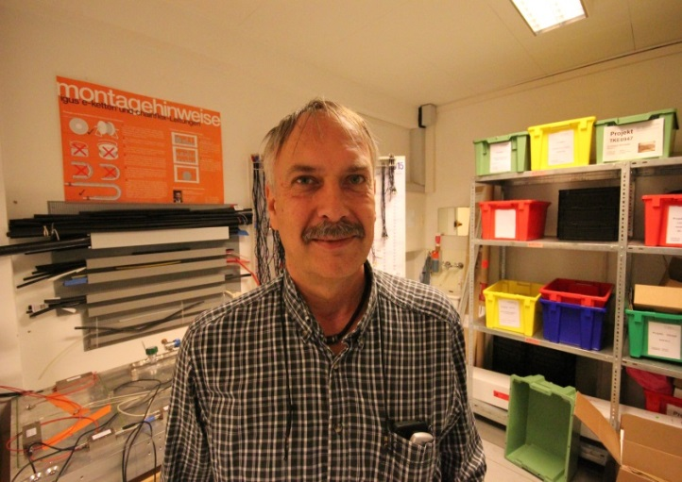
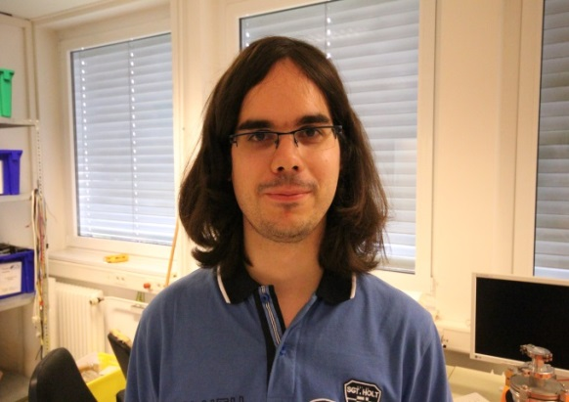
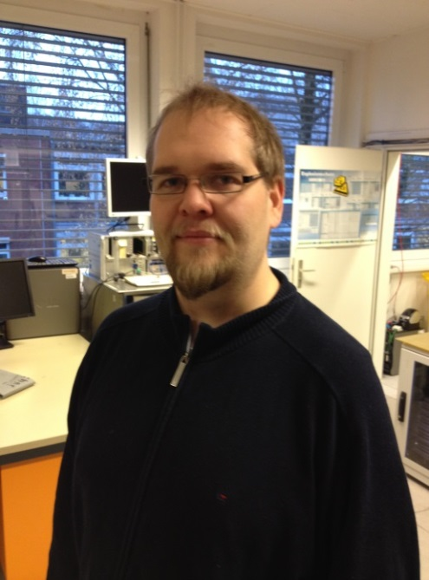
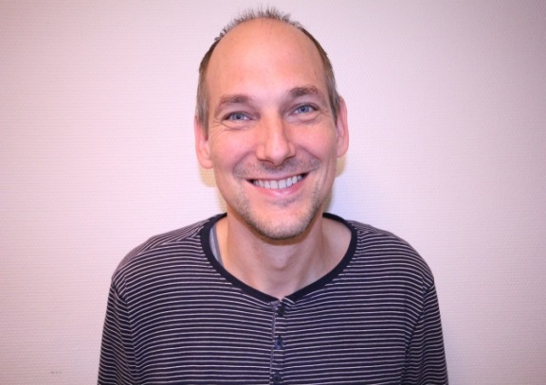
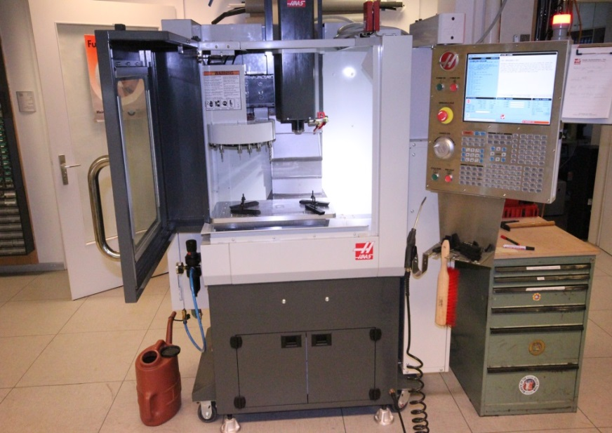
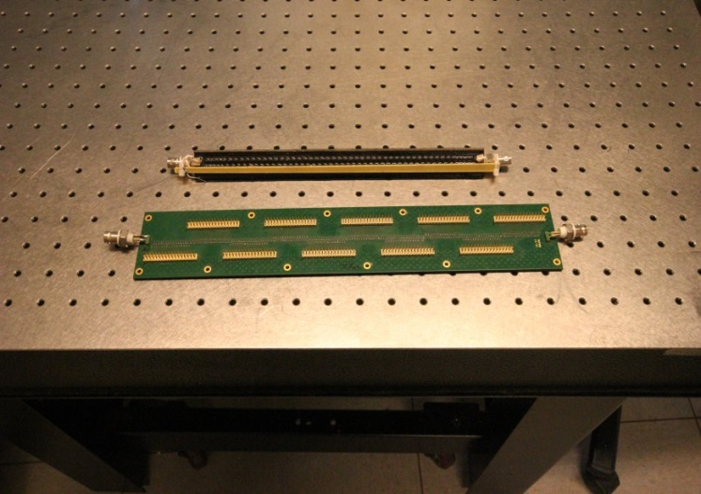
Detector people at HZG
Detector LAB @ HZG:
J. Burmester
1 m
Detector experience
C. Jacobsen
large area milling cutters:
C. Gregersen
J. Plewka
(100 mm x 1430 mm)
new delay-lines:
EMI-chamber:
FPGA, programming
choice of ele.hardware
Electronic board
development
small area milling cutter:

Slide 21
Current results from TOSHIBA ³He-Toshiba tubes tested at the ESS Test Beamline (HZB)

Slide 22
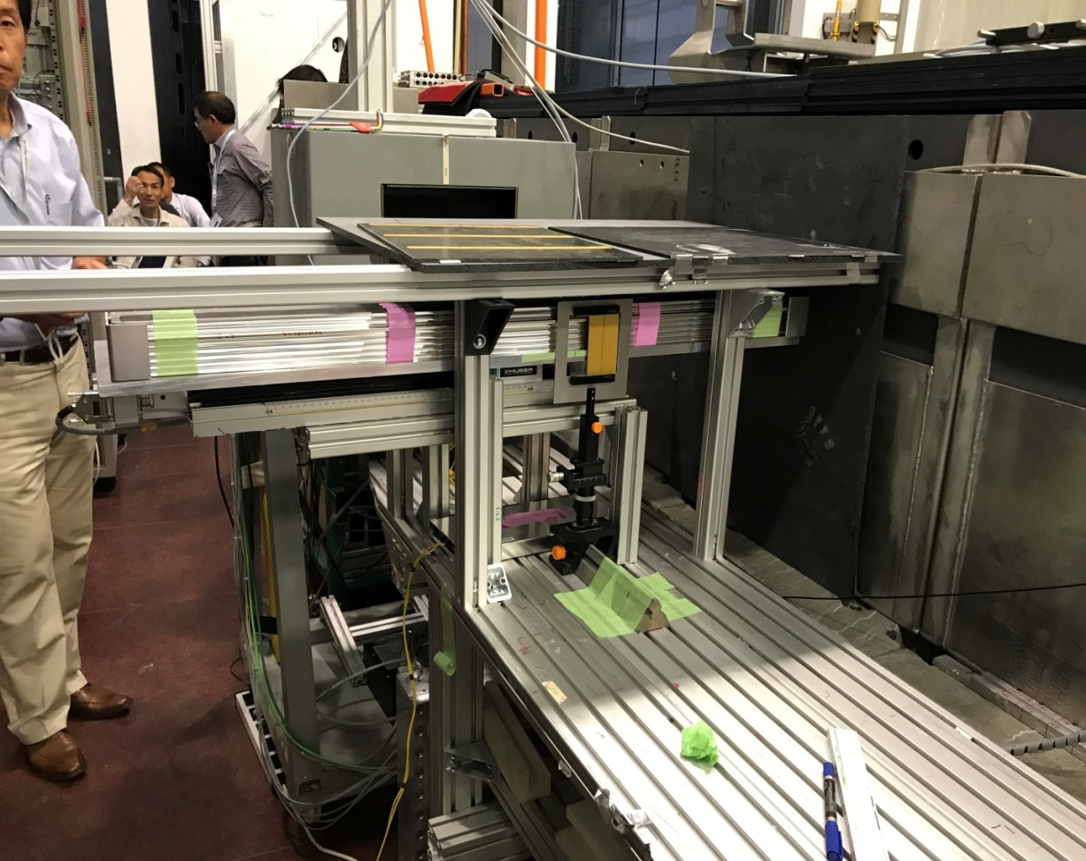
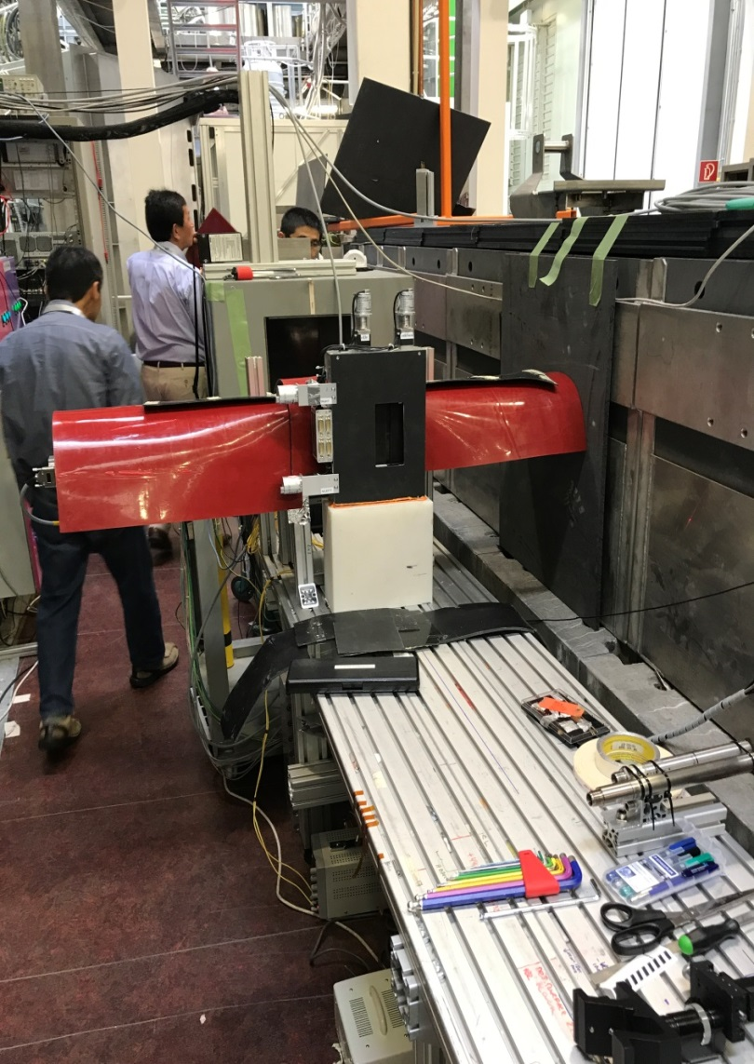
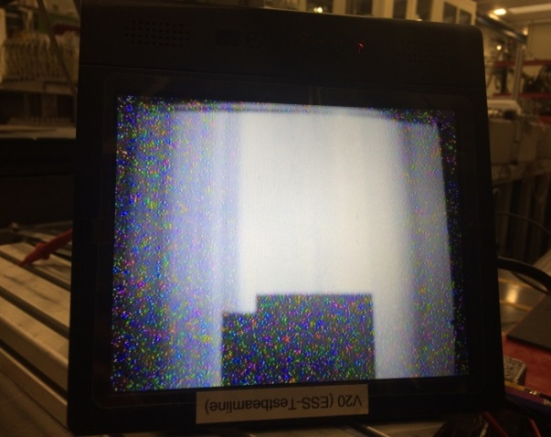
Set-up for characterization of ³He-tubes
ESS-Testbeamline (V20) at HZB
³He-tubes with holder
shielding
Mirrobor ^{tm}
slit
linear drive (400 mm)
holder (x-y-z move.)
with absorb. edge
beam profile
Applied neutron spectrum: 2 - 10 Å

Slide 23
Position resolution determination from edge profile
0 ch.
4096 ch.
line profile:
1st deriv. of line profile:

Slide 24
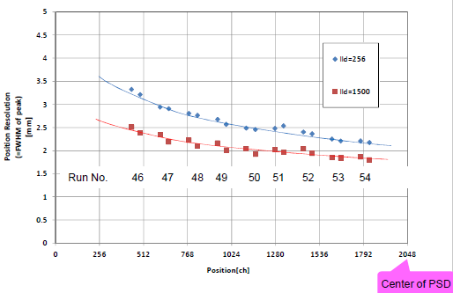
Distribution of spatial resolution along a 1 m ³He-tube (7 bar, 8 mm dia.)
absorber with two edges
derivative of edge profile:
FHWM of the edge profile in mm:
spatial resolution for LLD= 0
from 3.2 mm (FWHM) to 2.2 mm (FWHM)
spatial resolution for LLD= 256-1500
from 3.2 mm (FWHM) to 1.8 mm (FWHM)

Slide 25
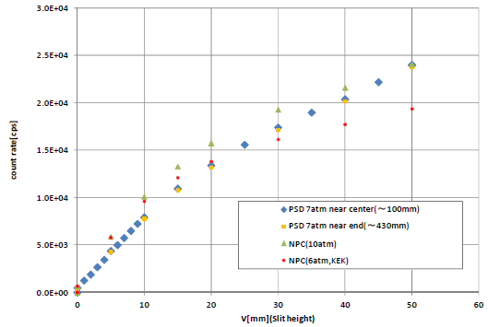
Count rate response on linear change of incident neutron intensity
2 mm
0 - 50 mm
linear response
up to 7000 cps
on one 8 mm tube!
slit width in mm

Slide 26
Summary and Future
¹⁰B₄C coating driven detectors are an full replacement to ³He detectors surpassing them in flexibility, position and time resolution
ToF resolution allows for Bragg-edge imaging
high rate capability (270 000 cps per plane!) of the Am-CLD detector has been demonstrated
Preparations in electronics, mechanics and infrastructure of demonstrator detector project are finished
tests on ³He tubes from Toshiba show a good performance in rate capability and a clear reduction of spatial resolution from centre to edge of the tube. Nevertheless they are regarded as an back-up option for example the BEER beamline.
Thank you for your attention!

Slide 27
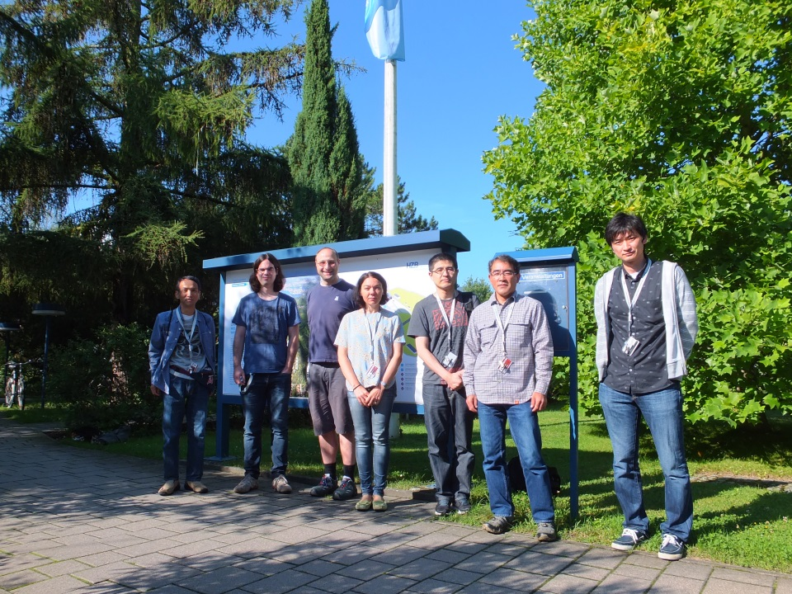
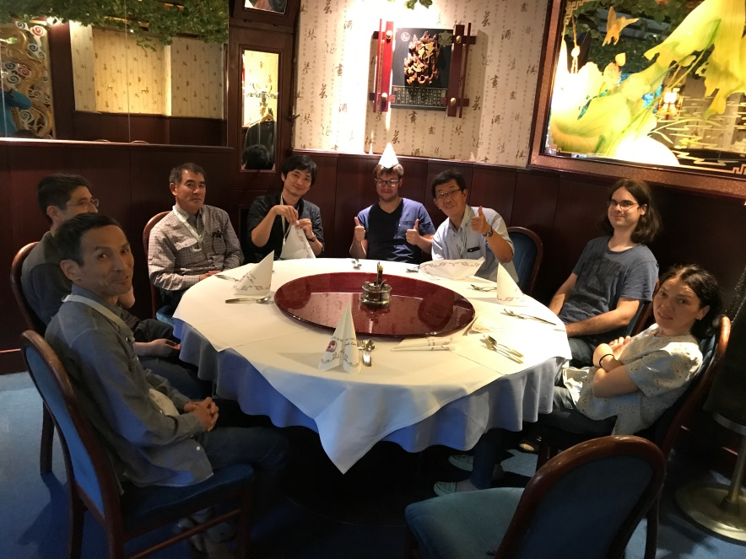
Acknowledgement
R. Woracek, J. Plewka, C. Jacobsen, J. Burmester ,
TOSHIBA-Group, M. Störmer, C. Horstmann, R. Kampmann, M. Haese¹,
J.-F. Moulin, M. Pomm, J. Fenske, T. Kühl, E. Prätzel, I. Stefanescu⁴, R. Hall-Wilton
and M. Müller

