Slide 1

Infrastructure on Bifrost for Sample Environment
Liam Whitelegg, DTU Physics
Lead Instrument Engineer
Bifrost – 27/09/2017

Slide 2
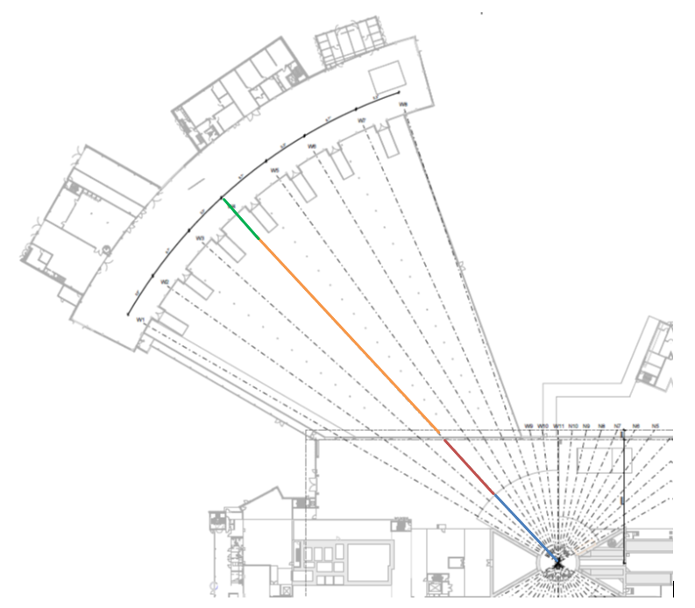
Bifrost Instrument Details
Bifrost is a cold neutron spectrometer
Positioned in the middle of the West Sector (W4)
Almost all modes will employ the full “white” beam on samples
Aim to study physics of magnetism and superconductivity
5 instrument partners
  DTU (lead)
  KU
  PSI
  LLB
  IFE

Slide 3
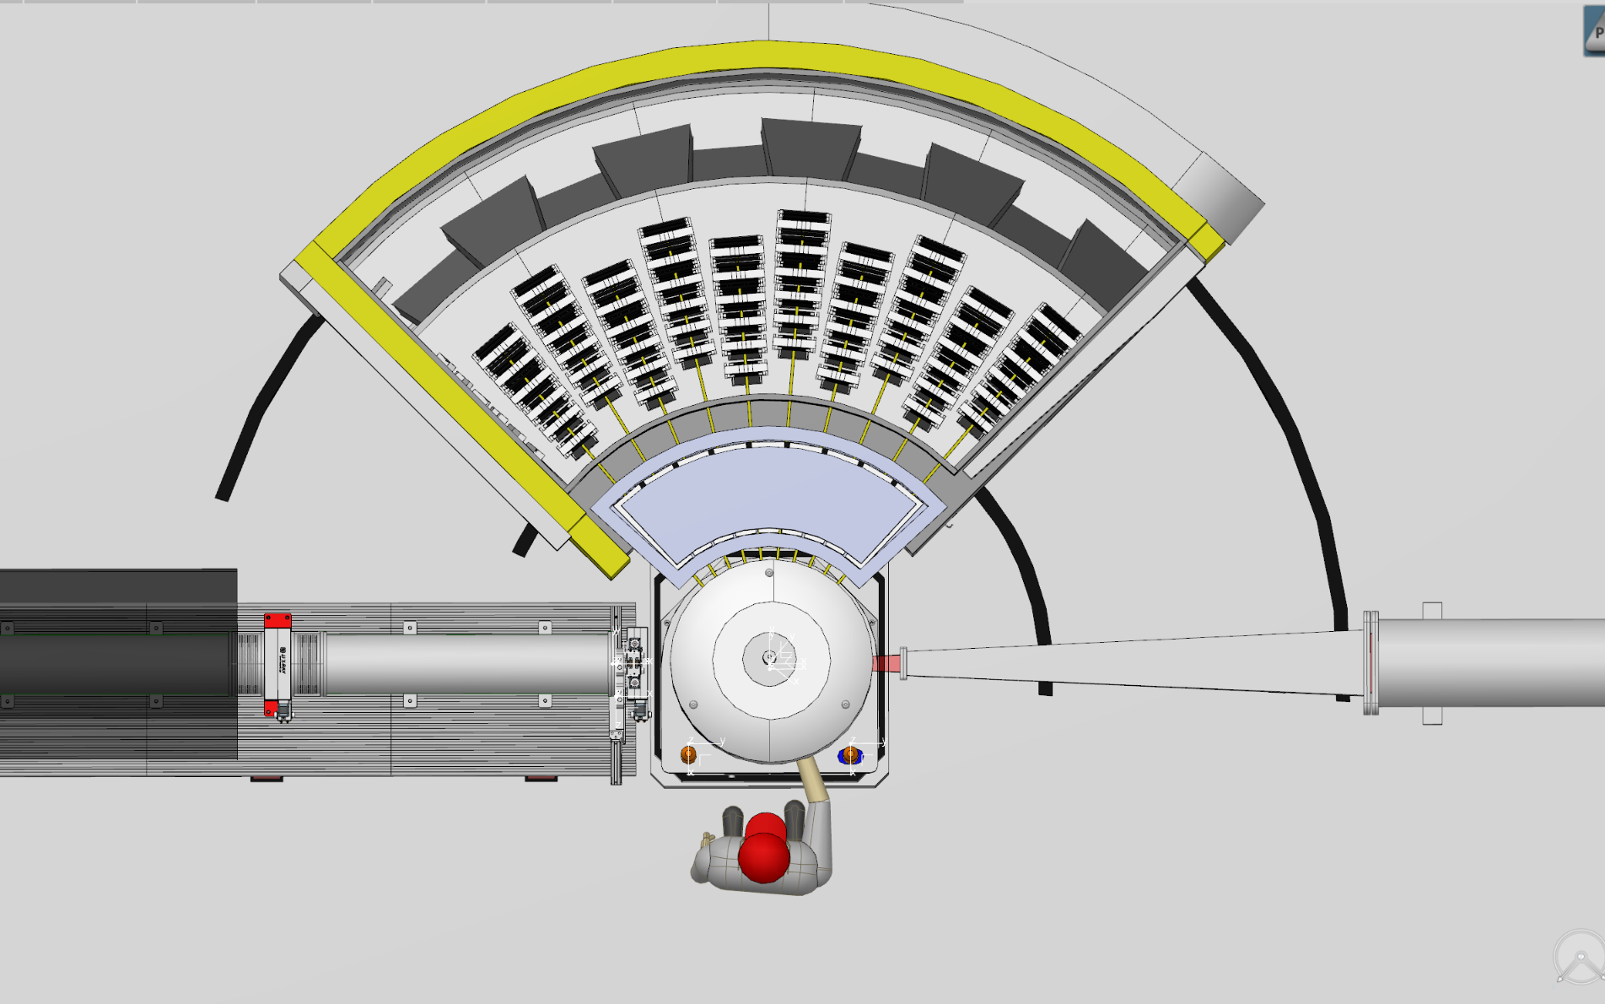
Bifrost Sample Area
Design of cave driven by;
  Beamline components
  Radiation
  Activation
  Sample environment
  Sample access
Rotating Spectrometer Tank
Beryllium Collimator
Get Lost Tube
Neutron Guide
Sample Position

Slide 4
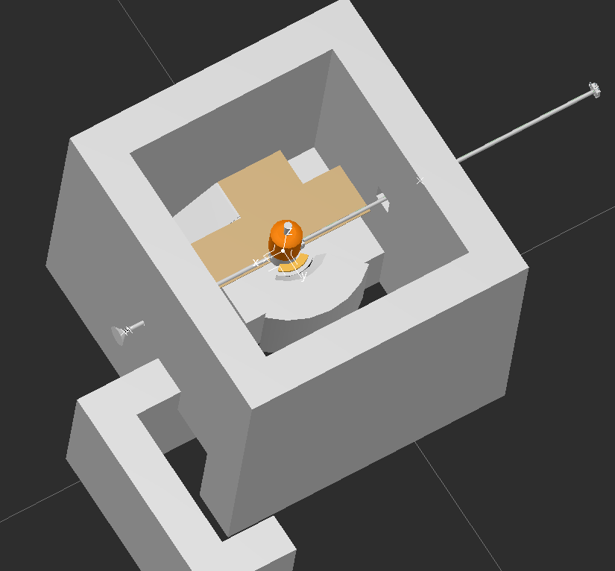
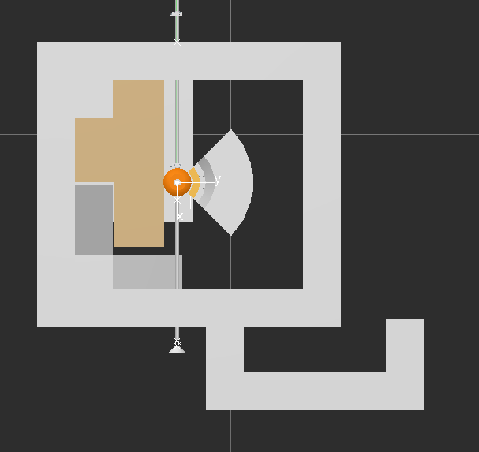
Very First Design
Stairs up to sample position (3.137m above floor)
Labyrinth entrance with internal crane in cave
Hatch above to crane items in

Slide 5
Activation of Samples & Equip
Bifrost requires large flux on samples
Experiments could range from 1 to 14 days
Typical experiments could use samples containing Iridium and Lanthanum
Aluminium in sample env. could have a dose rate of 150mSv/hr on contact after 5 minutes of beam.
Could take 30 minutes to access sample position
Necessity for strategy
☹
☹
☹
☹
☹
☹

Slide 6
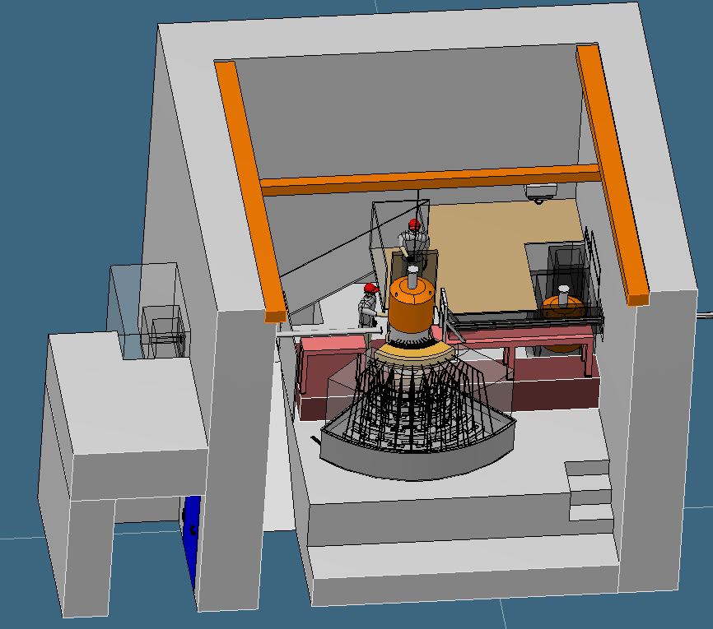
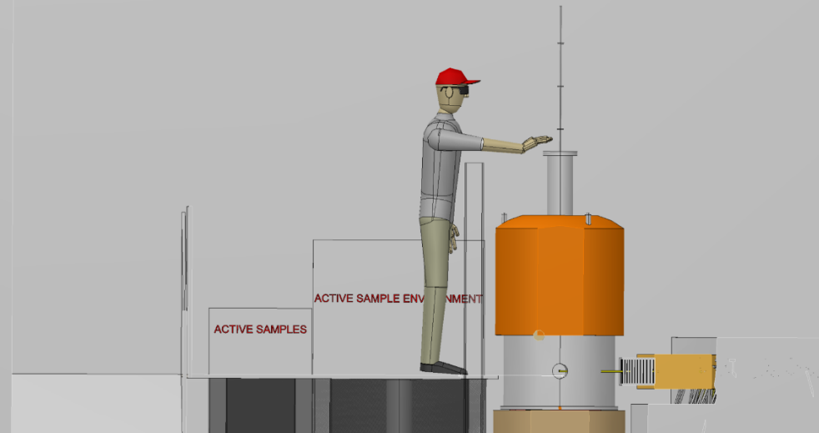
TG-2 Design
Lead barrier at sample position
Barrier would have to translate to allow for access
Storage inside cave for active samples and equipment
Internal crane to transport items to sample position
Non-magnetic crane, rad-hard crane

Slide 7
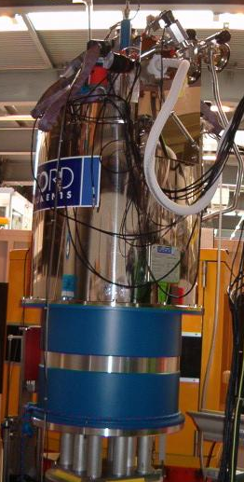
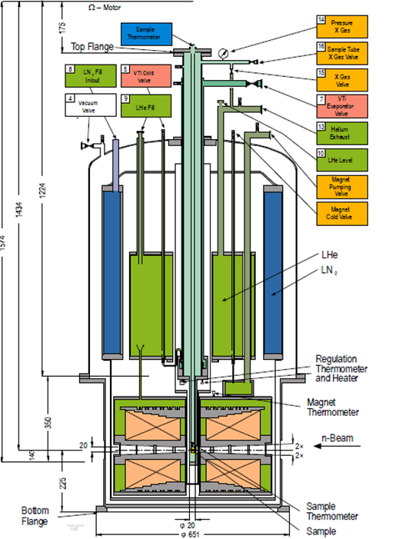
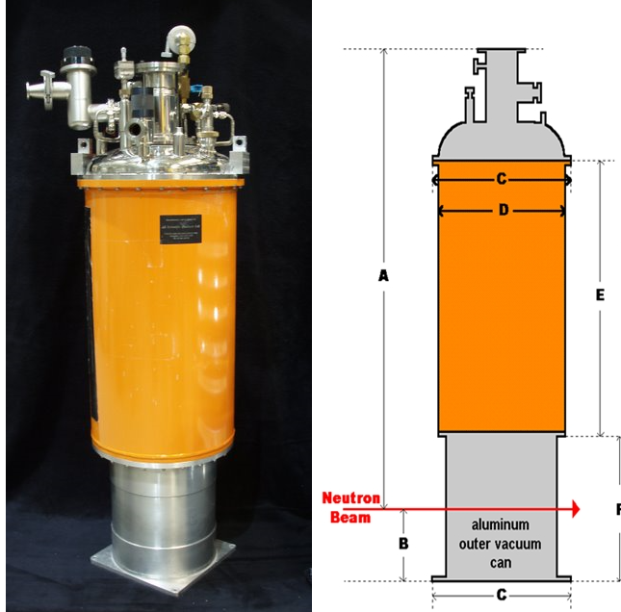
Sample Environment Equipment
Estimated equipment usage
  60% VM-1B Magnet
  30% OC 70 (with anvil)
  10% other….
VM-1B Magnet
Beam height to flange = 1259mm
Weight ~ 750Kgs
OC 70 – Orange Cryostat

Slide 8
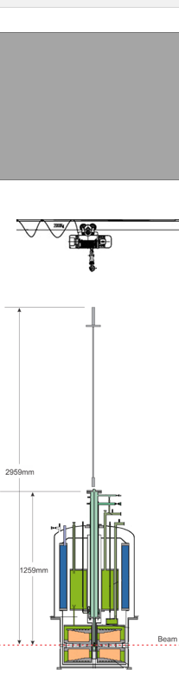
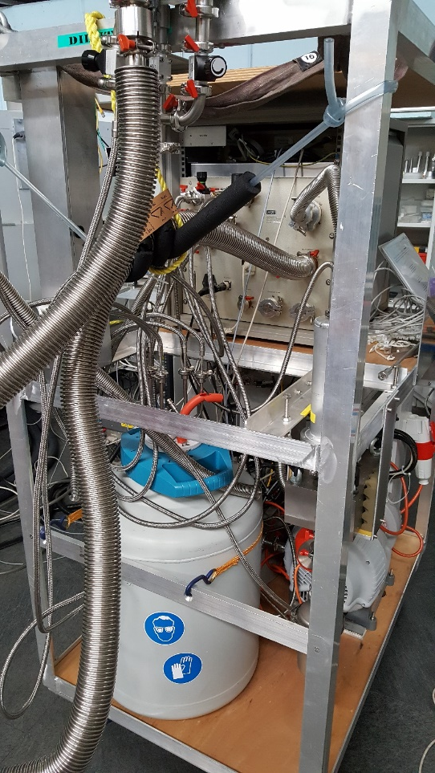
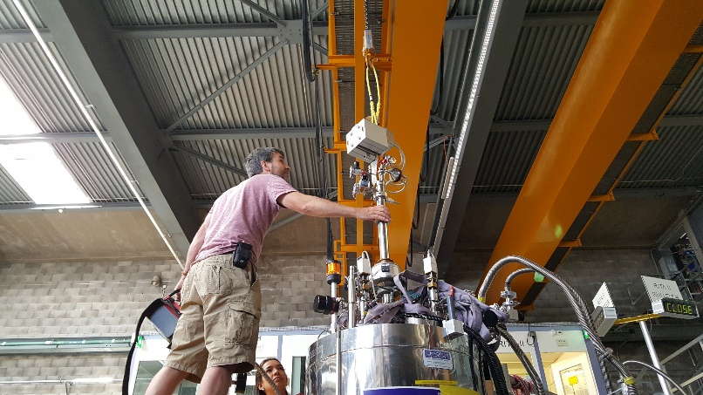
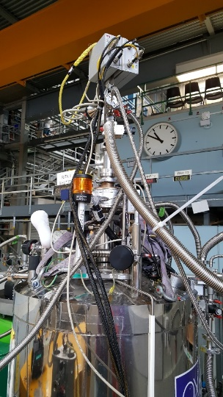
“Dilution Stick Effect”
Weight of dilution stick ~ 50Kgs
Length of dilution stick ~ 1700mm
Hook height required ~ 7.2m
All of this converges on a 9m tall cave
Structural difficulties
Additional racks and supplies
If stored within cave, larger footprint needed

Slide 9
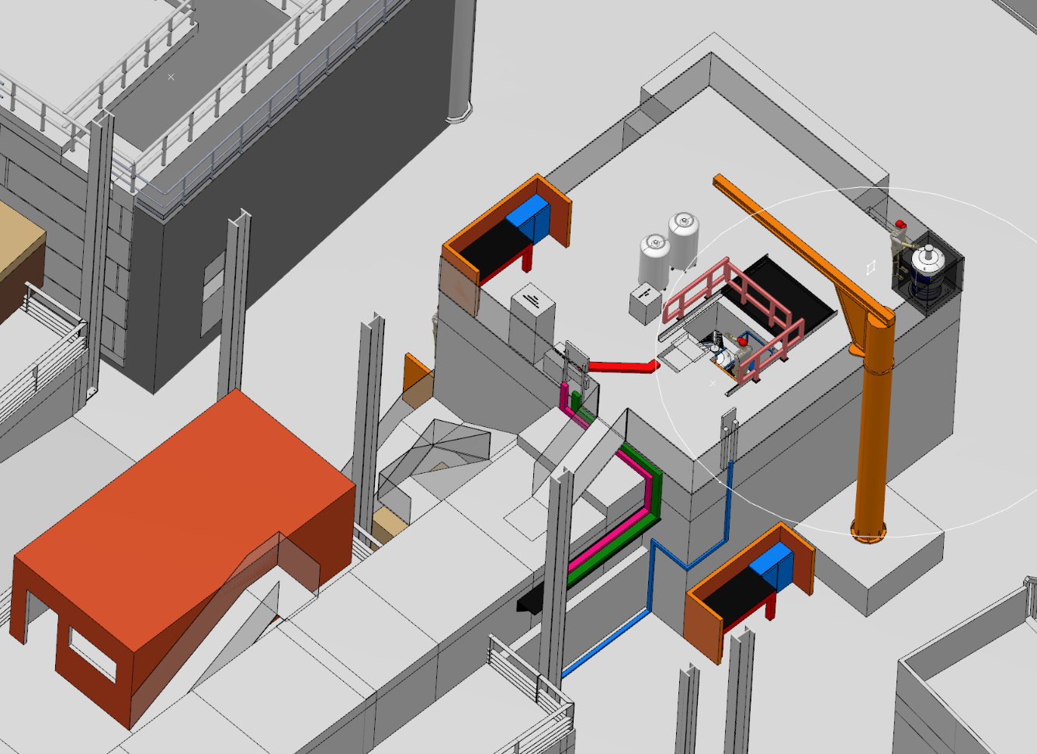
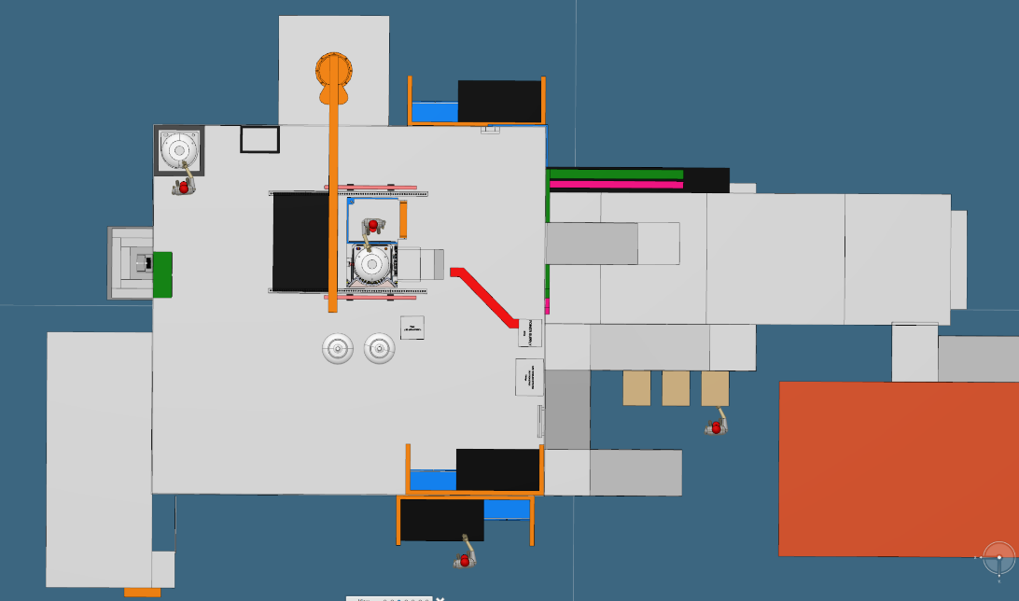
New Design
Predominant sample access now from roof through top loading
Moved to dual access via platform access
Crane now external to cave
Cave height reduced from 9m to 5.2m
Sample environment auxiliary equipment positioned on roof
Another picture here

Slide 10
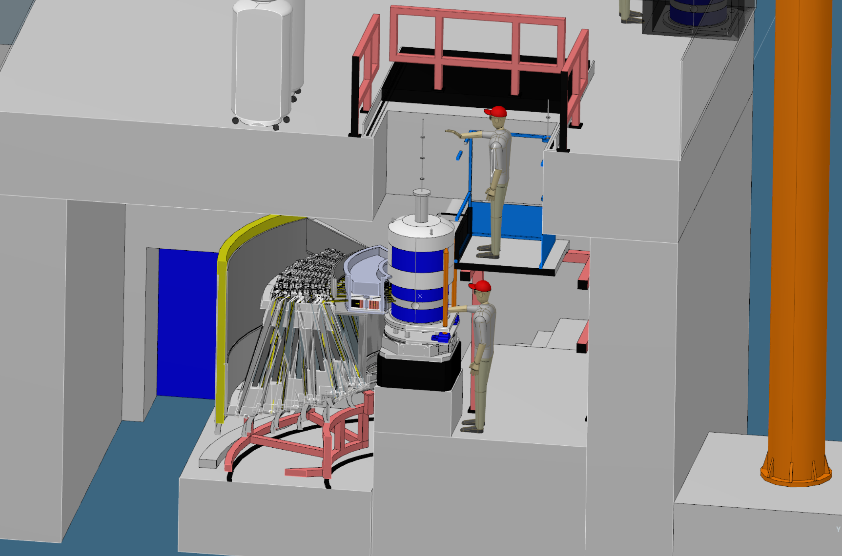
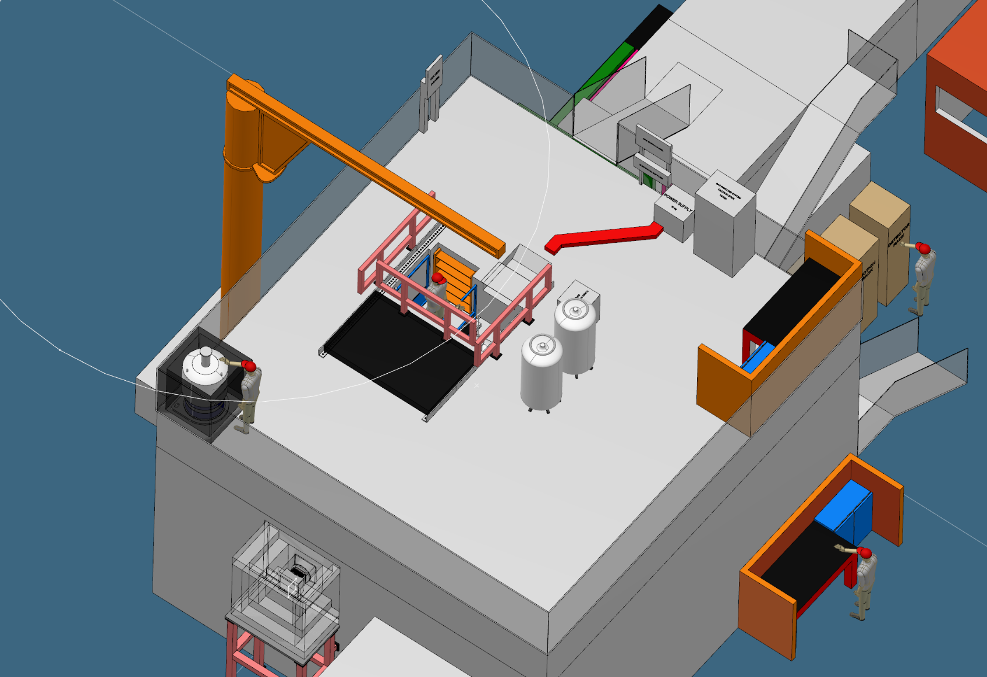
Personnel Access to Sample
Lead access hatch linked to PSS system
Ladder access down to platform
Lead lining along base and side to provide shielded access
Secondary access through cave labyrinth to sample position
Picture of sample platform

Slide 11
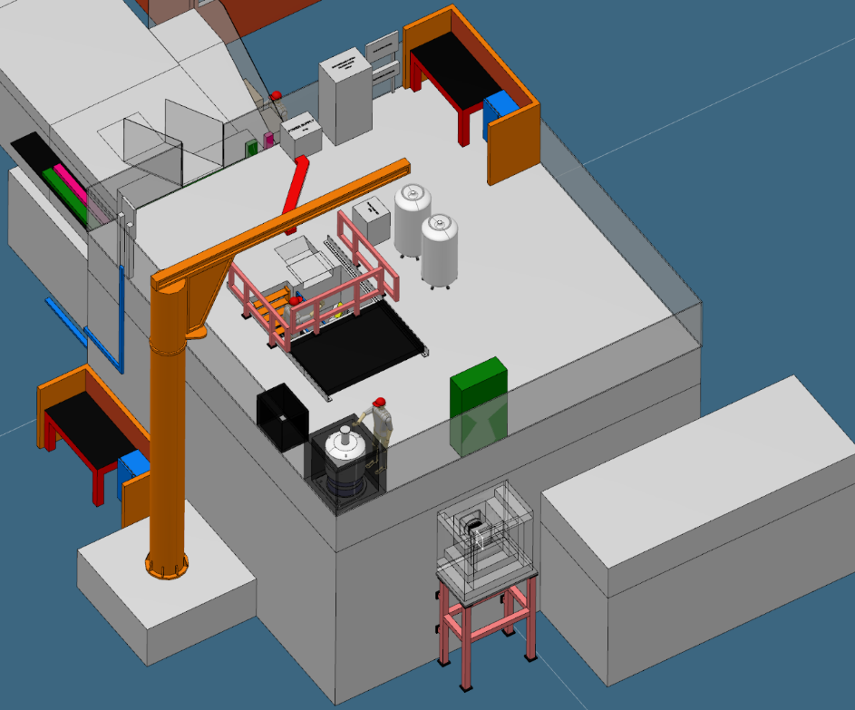
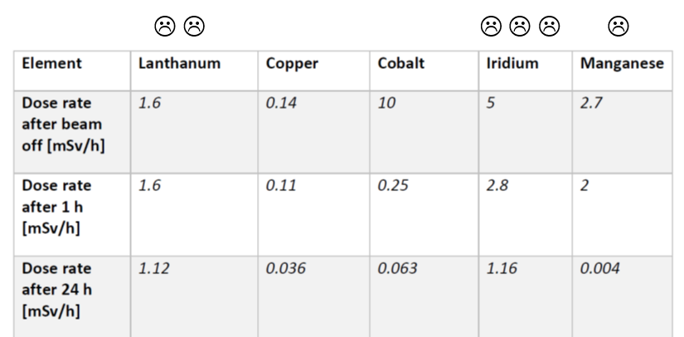
Activated Equipment
Several procedures to be developed for varying scenarios
More space to deal with these items
Limits need for internal cave access
Potential for remote, sample removal equipment via crane
Lead lined storage areas and caskets
Guide pins and remote removal possible
Pictures & maybe activation table

Slide 12
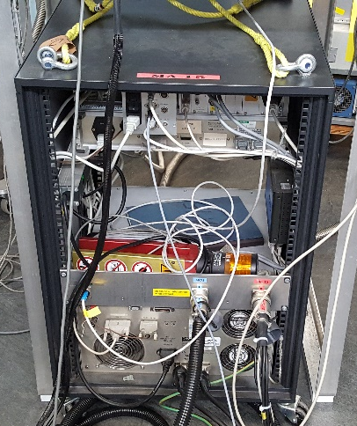

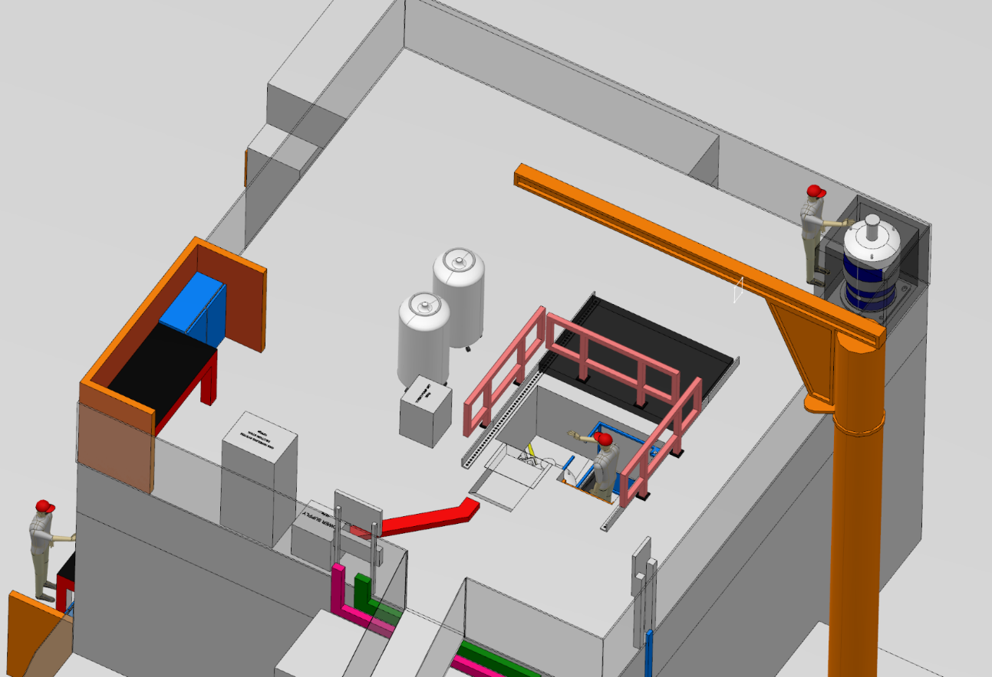
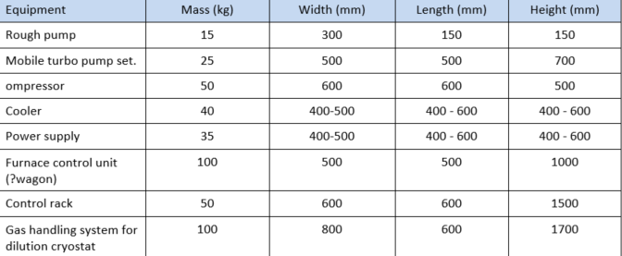
Auxiliary Equipment & Services
Sample prep area near kit being used
Danger of radiation damage to components reduced
Space for all auxiliary equipment
No fixed chicanes or patch panels
Aim would be to allow full access to the roof for sample preparation
Service panels all up on the roof
Mobile Filling Dewar
Turbo Pump
Gas Handling System
Magnet Power Supply Rack

Slide 13
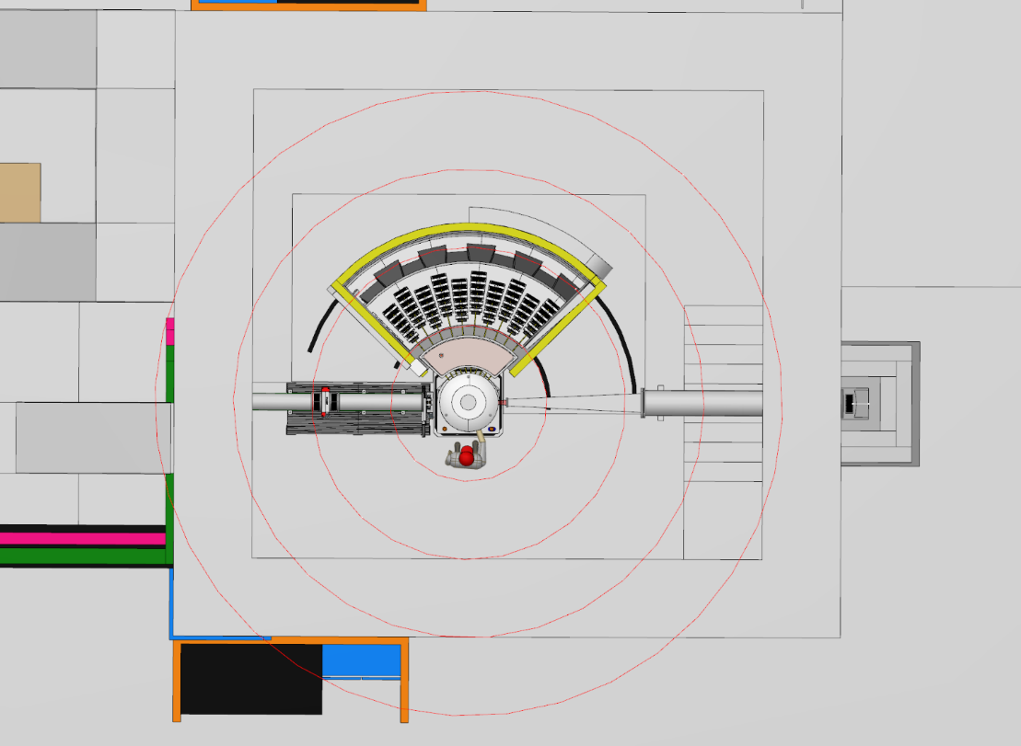
Non-magnetic Requirements
Lead and concrete (with SS re-bar) shielding
No magnetic materials within 1m
Specify appropriate motors and position as far from the magnet as possible
All tools to be non-magnetic
Reason | Approx. range (for 15T) Scale as B^{m/n} | Affected item | Effect
Magnetic forces (unsaturated, dipole approx.) | 0-1m | Cryomagnet, nearby objects | Quench, damage, injury, death
 | 1-2m | Moveable magnetic objects | Pulled towards cryomagnet (see <1m)
 | > 2m | Moveable magnetic objects | Equilibrium positions disturbed
 | <5m | Reed switches (including pacemakers!!!) | Erroneous readings, malfunction
Magnetic forces (permanent magnets/ saturated ferro-magnets) | 0-1m | Motors, encoders, magnetic bearings | Failure, damage
1mT
66mT
8.3mT
2.4mT

