Slide 1
MI Ref doc
Malcolm Guthrie
www.europeanspallationsource.se
22 September, 2017

Slide 2
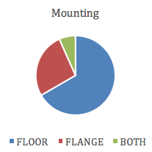
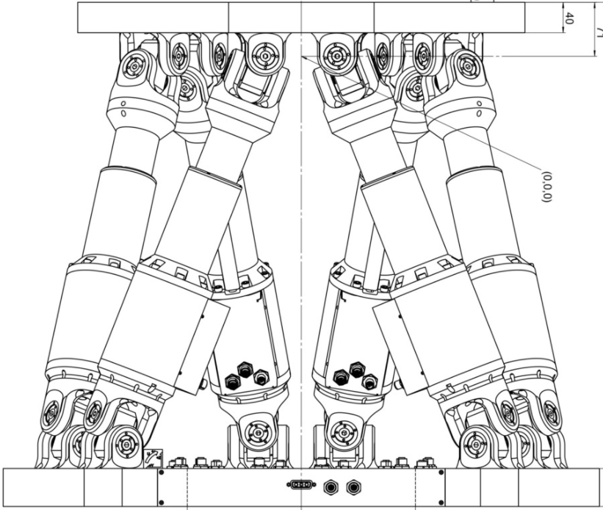
Nomenclature: instruments
BEAM
KM
KM
Base support
”Flange”
”Floor”

Slide 3
Nomenclature: Sample environment
van can
PE
cryostat
cryomagnet
“L”
“XL”

Slide 4
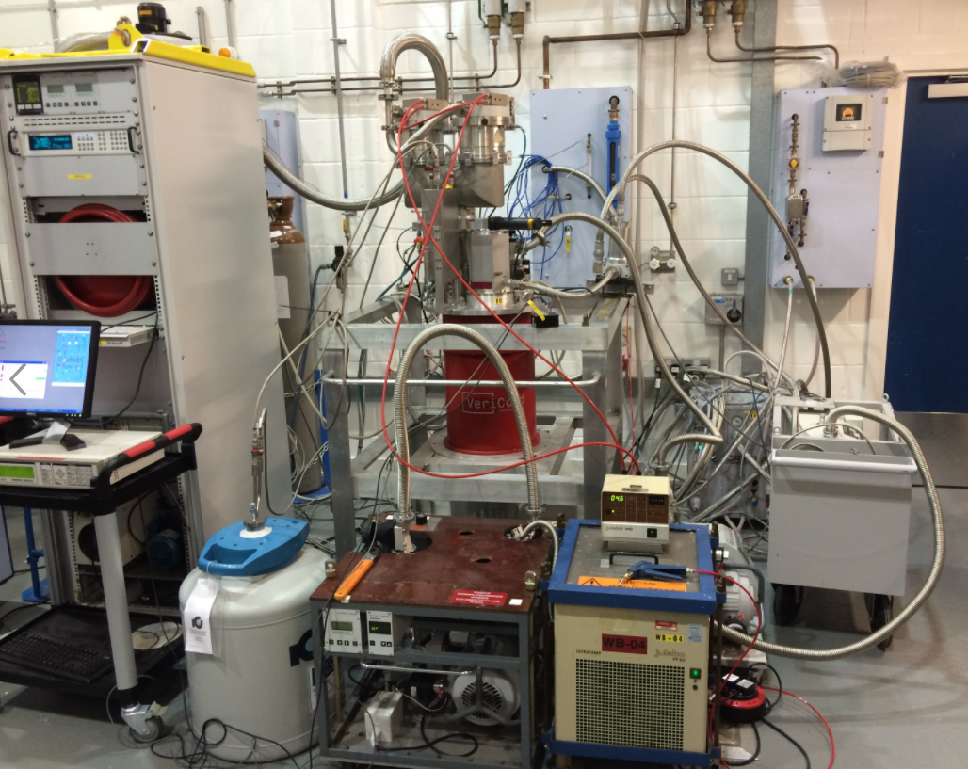
Nomenclature: The Sample Environment System
Contains:
The Sample Environment Equipment (cryostats, furnaces, pressure cells etc.)
Auxilliary Equipment (vacuum pumps, control PC, chillers, etc.)
Connects to:
1) Utilities Supplies (power, gas, vacuum etc.)

Slide 5
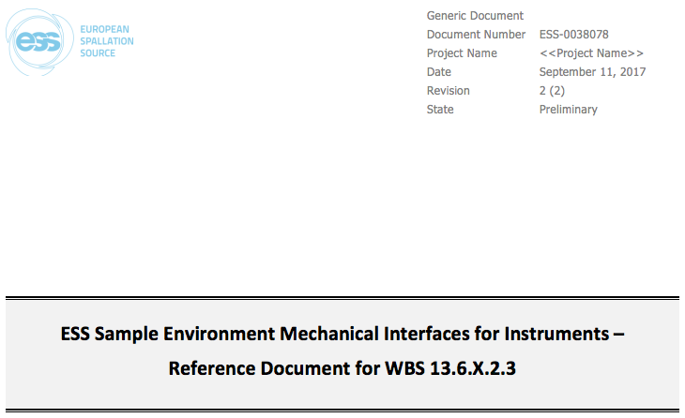
ESS-0038078
47 pages, 33 requirements:
Space logistic and ergonomic requirements
Mechanical interface
Magnetic requirements

Slide 6
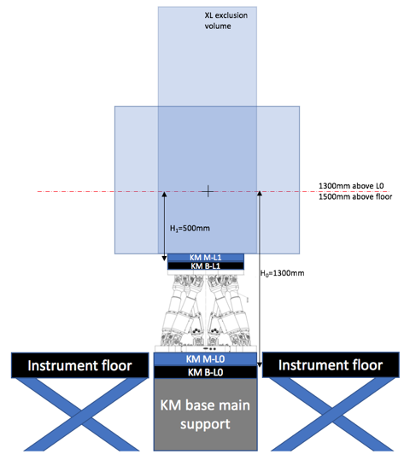
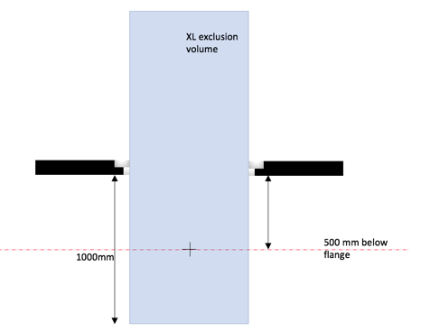
Space: Sample environment

Slide 7
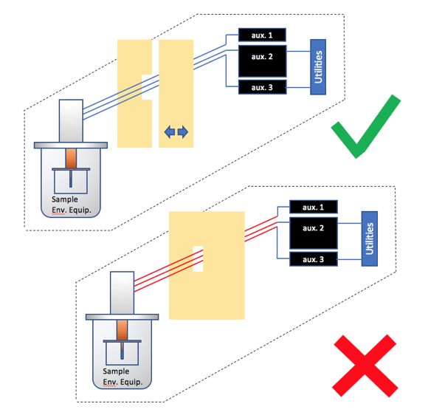
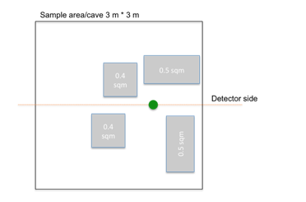
Space: Auxiliary equipment

Slide 8
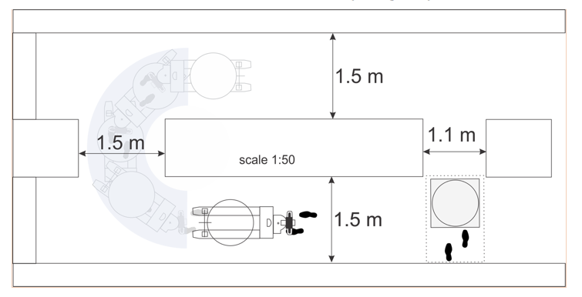
Access (Equipment)

Slide 9
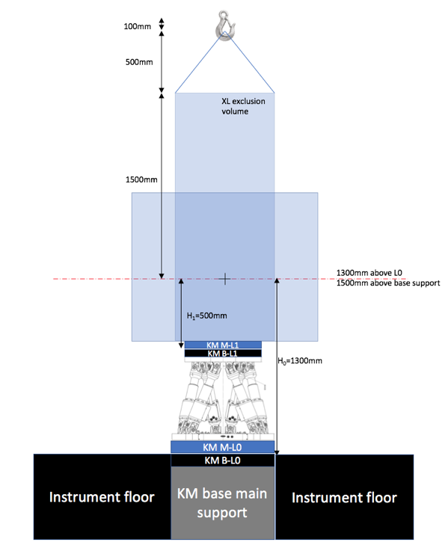
Cave heights
floor mounted:
XL - 2.1m above beam
L - 1.9m above beam
Flange mounted:
XL = 2.6m above beam
L = 2.4m above beam

Slide 10
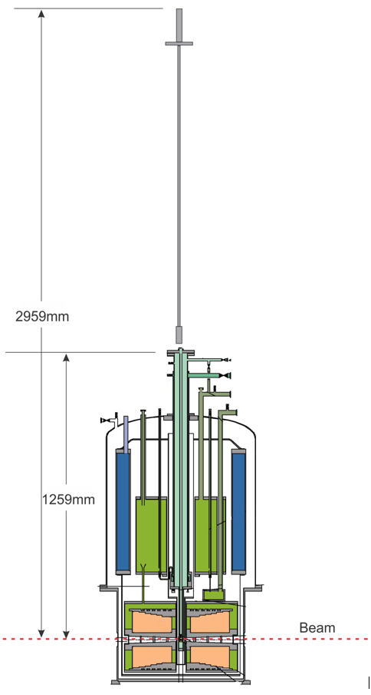
Cave heights
Cryostat stick change:
Minimum 3.5m above beam
(4m to use crane)

Slide 11
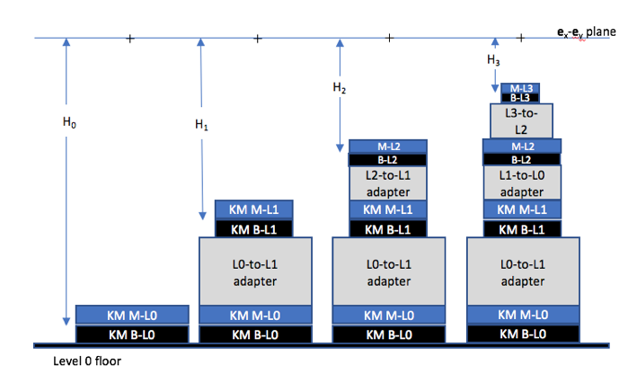
Alignment – floor mount

Slide 12
ESS-0038078
47 pages, 33 requirements:
Space logistic and ergonomic requirements
Mechanical interface
Magnetic requirements
For details see ESS-0038078!!

