Slide 1
Welcome to IKON13!
ESS Status in a nutshell
Construction continues to make excellent progress
High tech equipment arriving
Plans for moving all ESS staff out to the construction site
Annual Review 2017

Slide 2
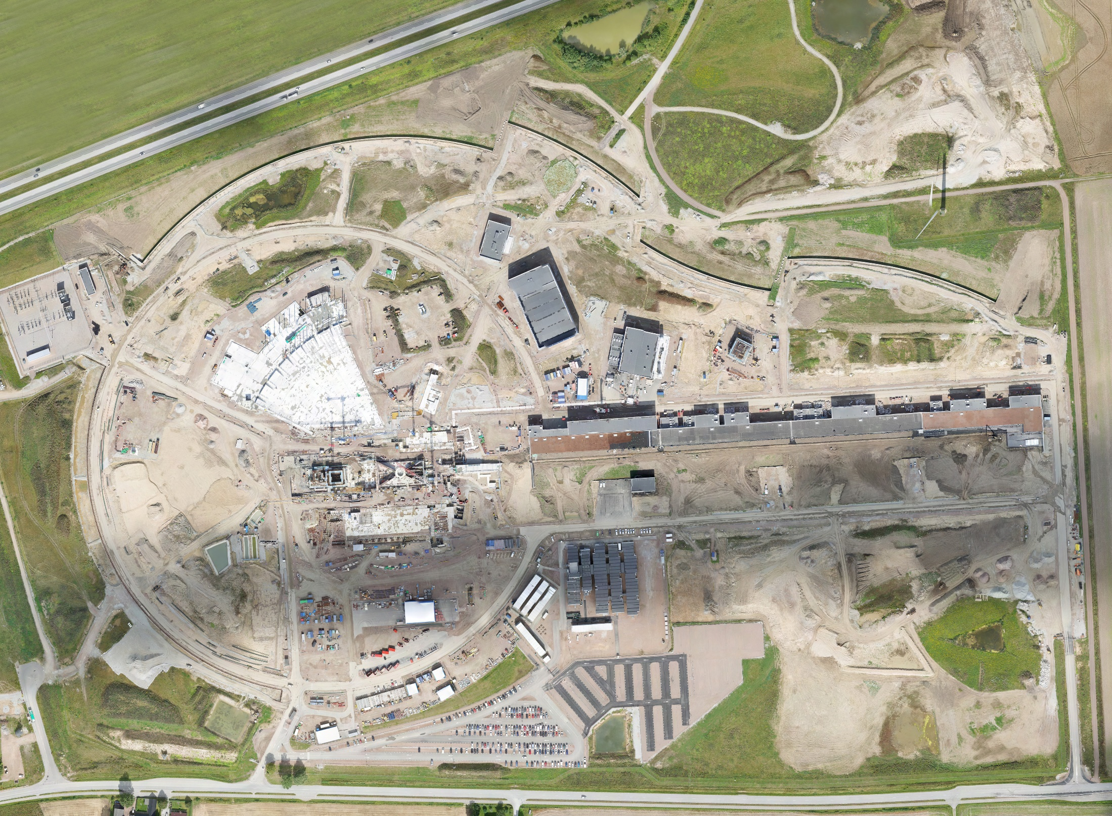
August 2017

Slide 3
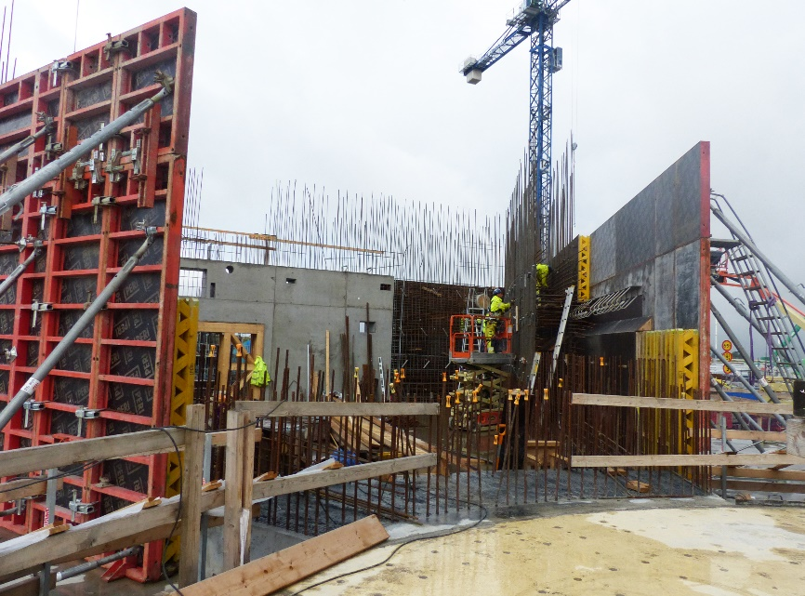
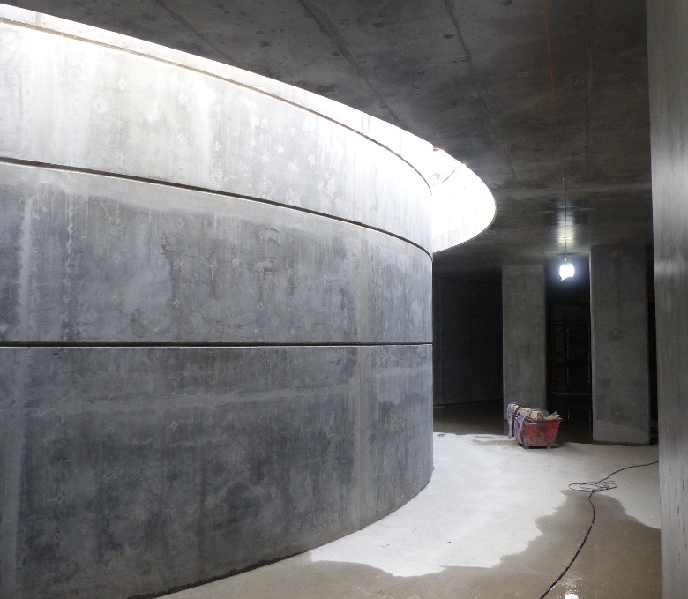
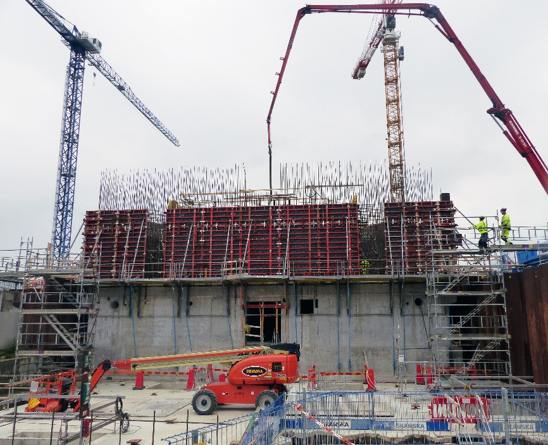
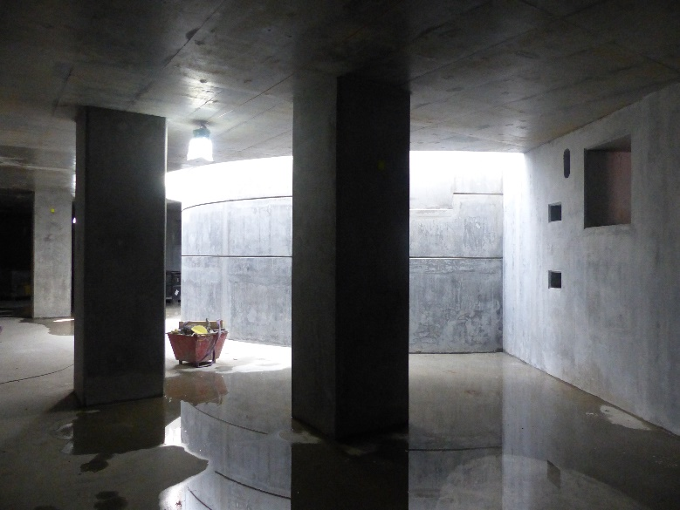
Monolith

Slide 4
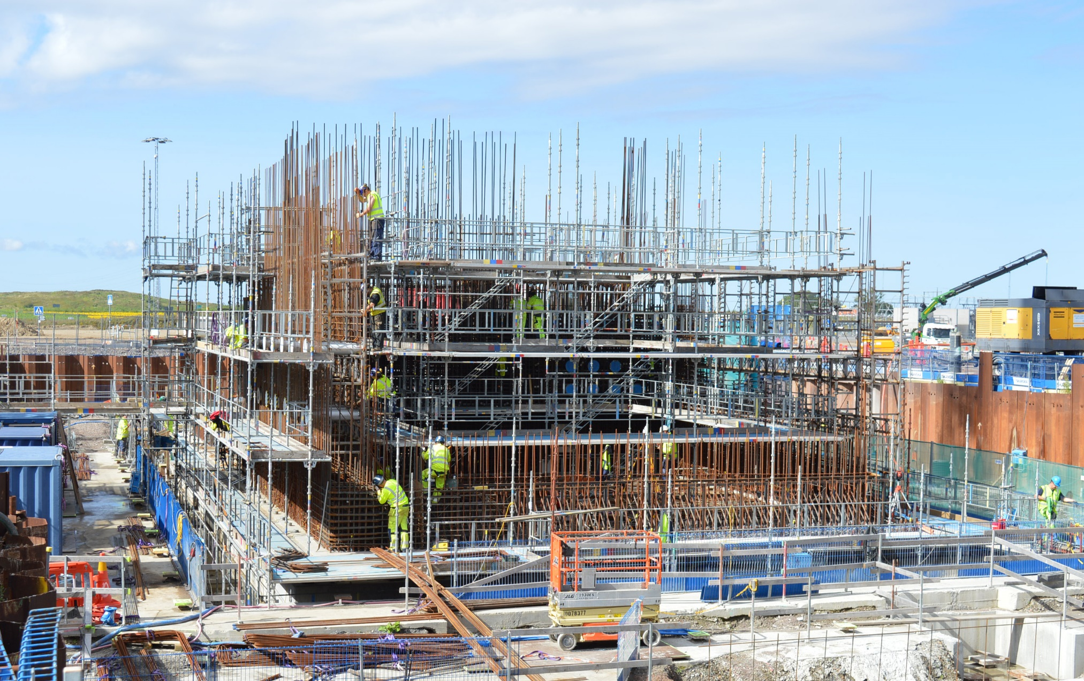
Active Cells

Slide 5
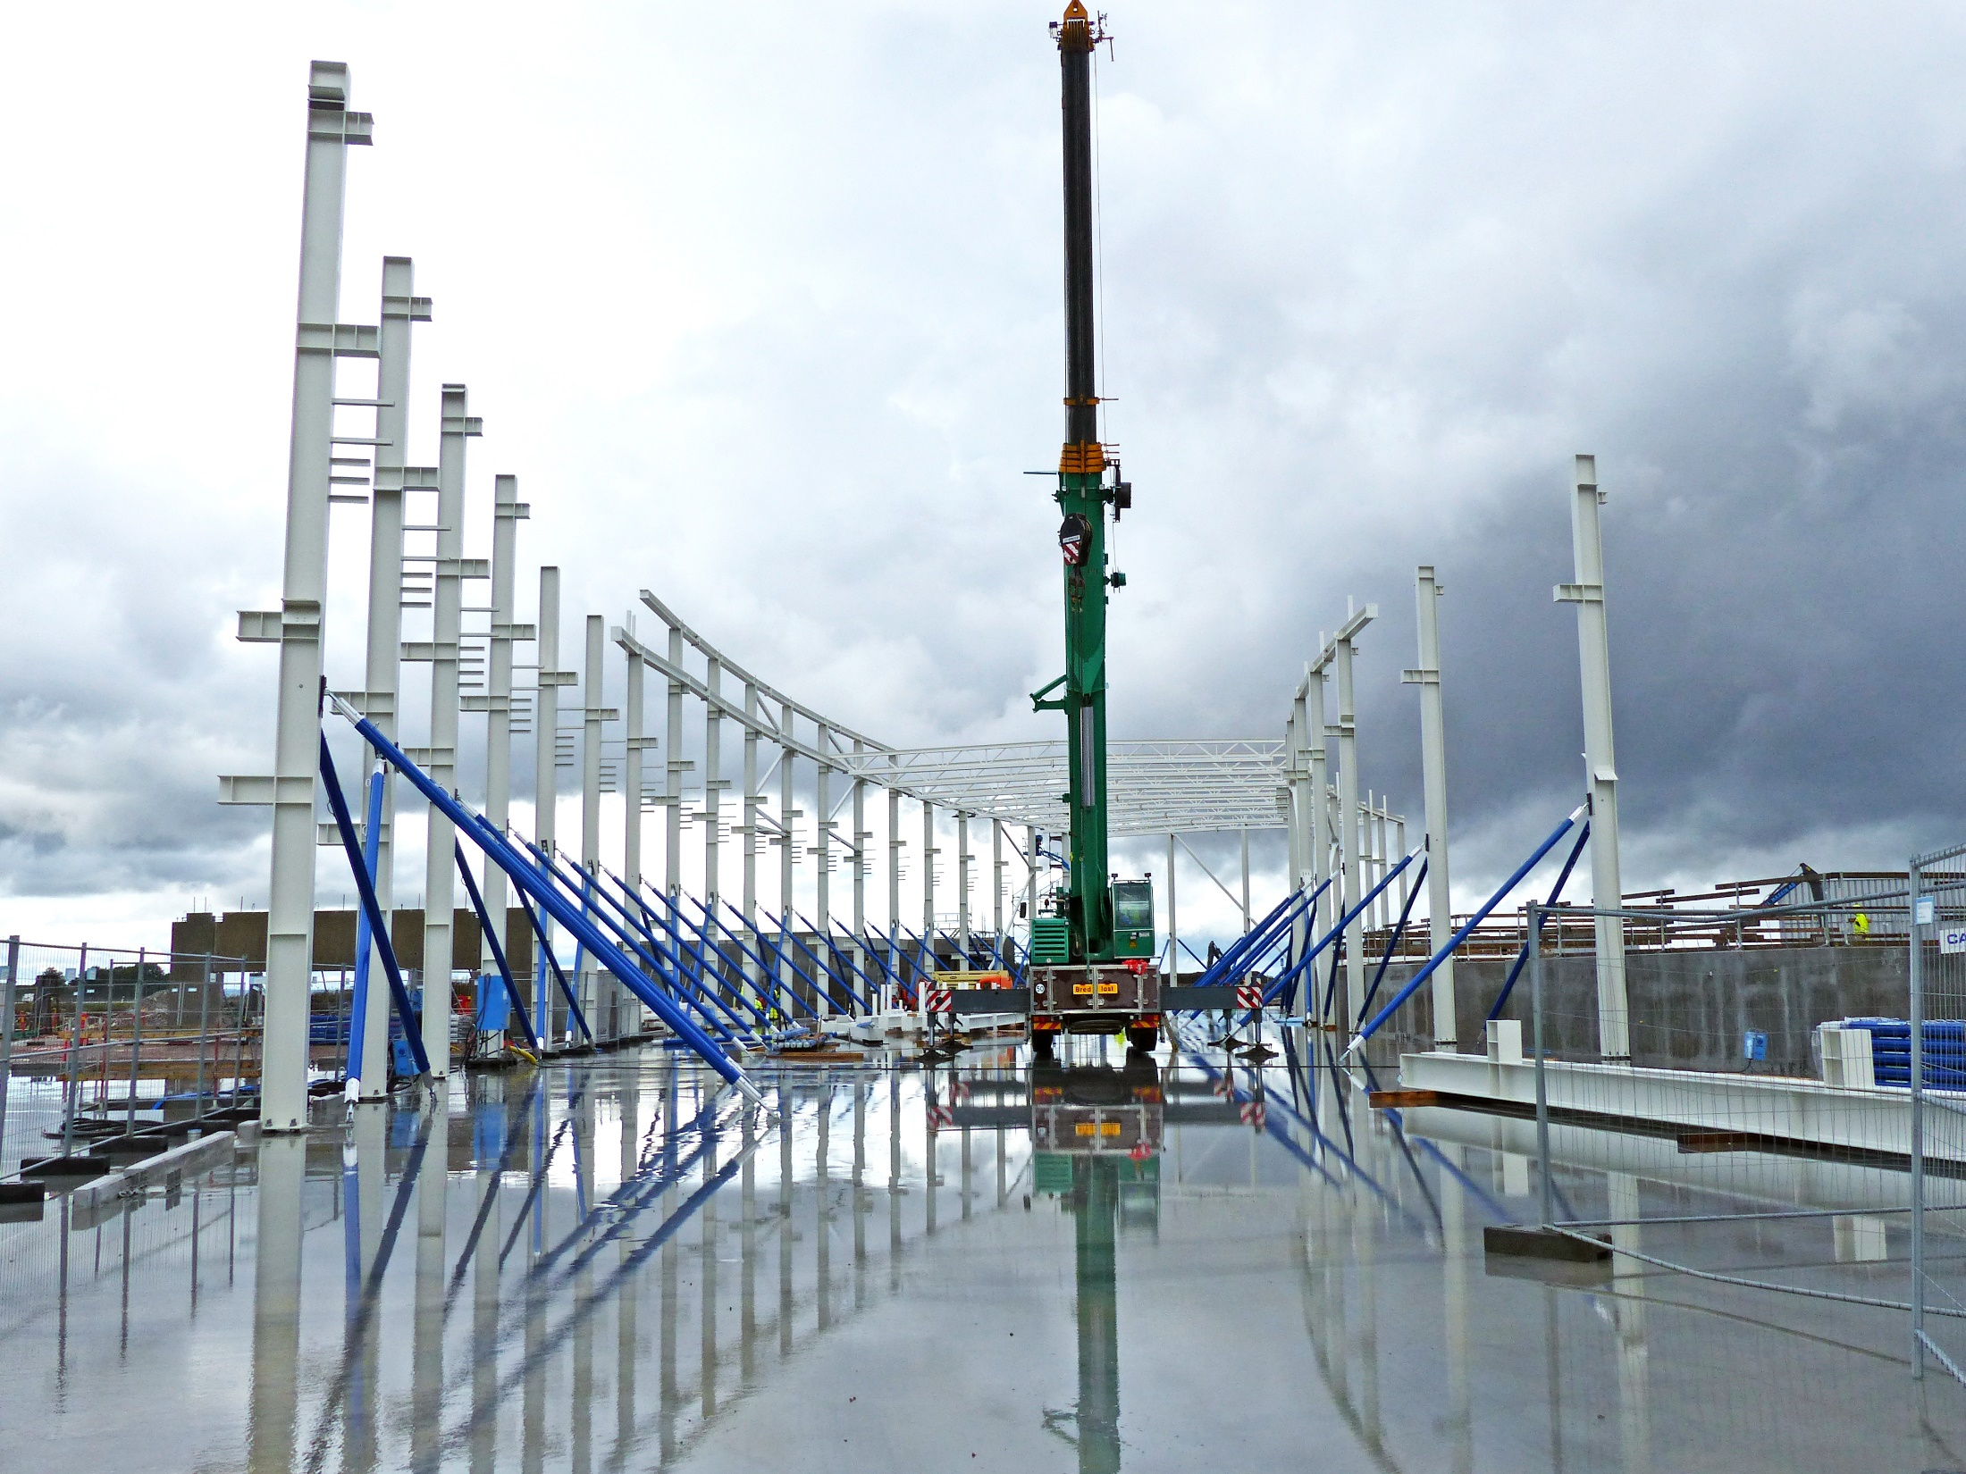
E01 Superstructure 14 September 2017

Slide 6
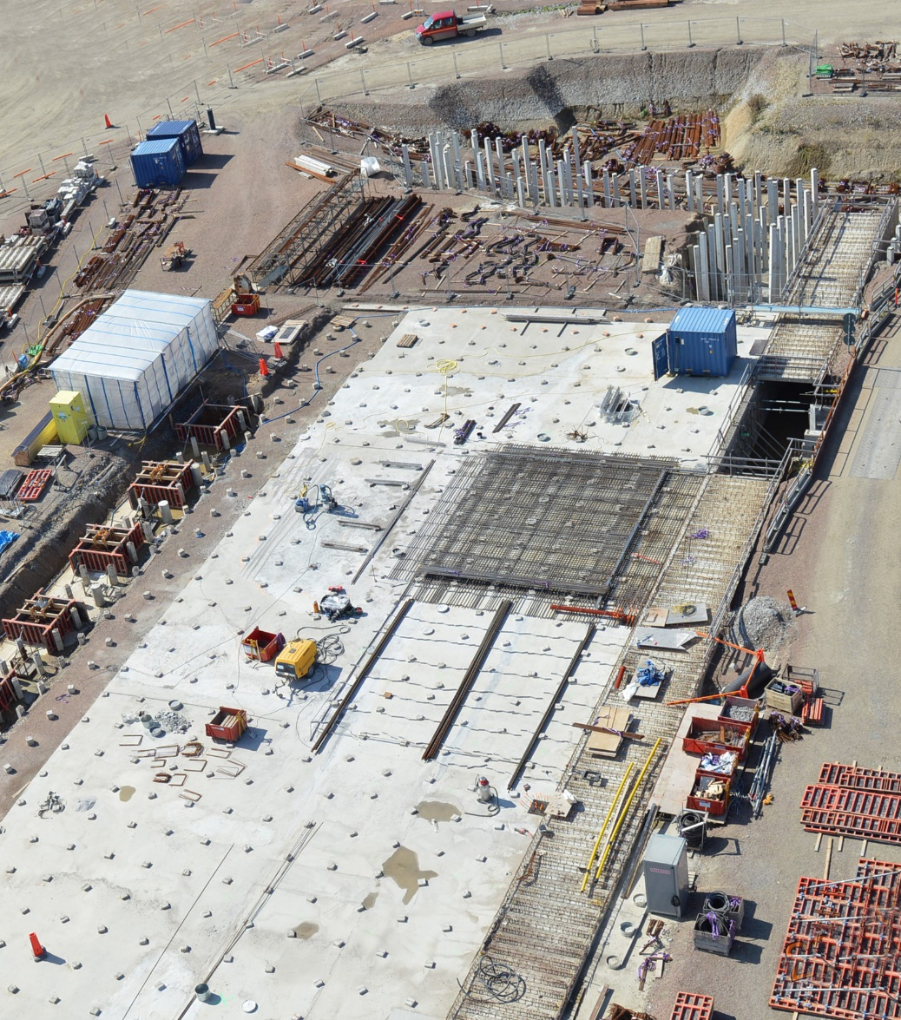
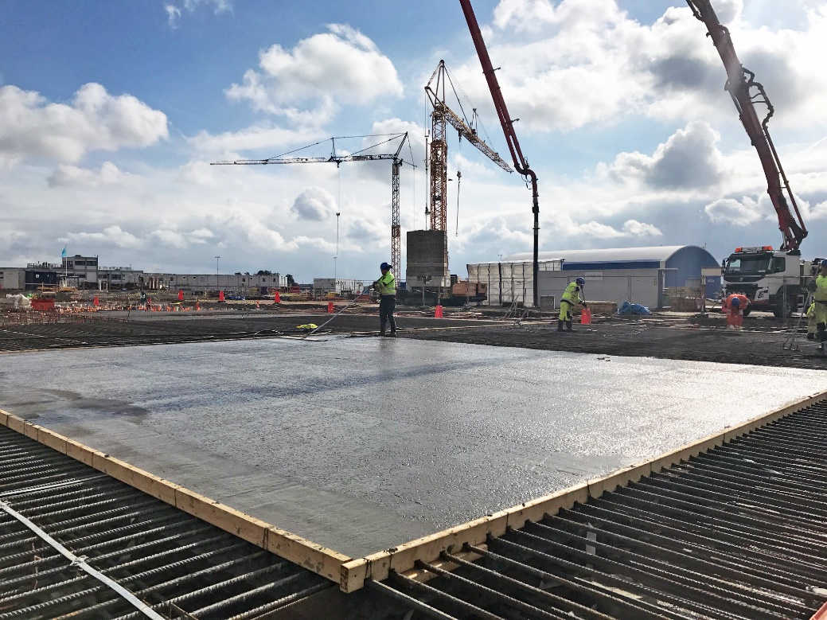
D01, base slab for Exp. Hall 1
D01 First bottom slab casting
12 September 2017

Slide 7
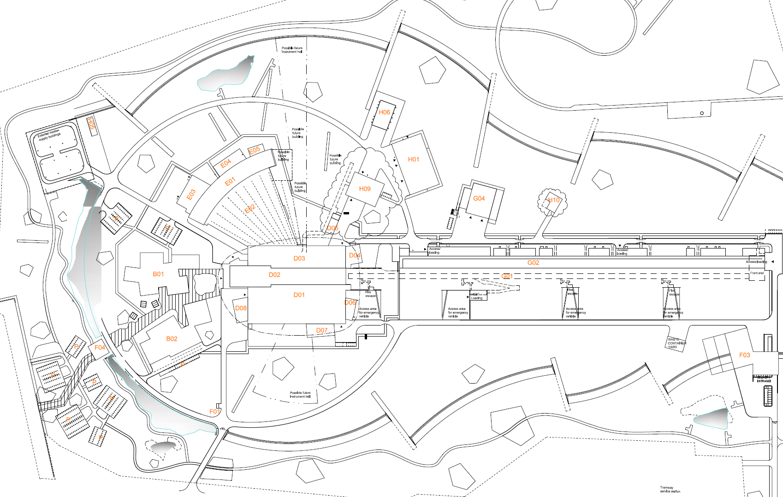
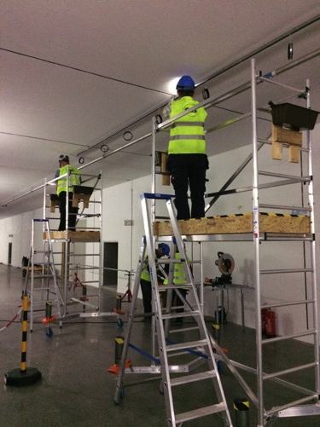
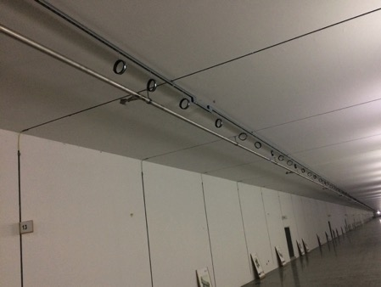
Reference line installation in G01
Reference line

Slide 8
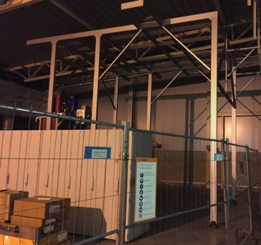
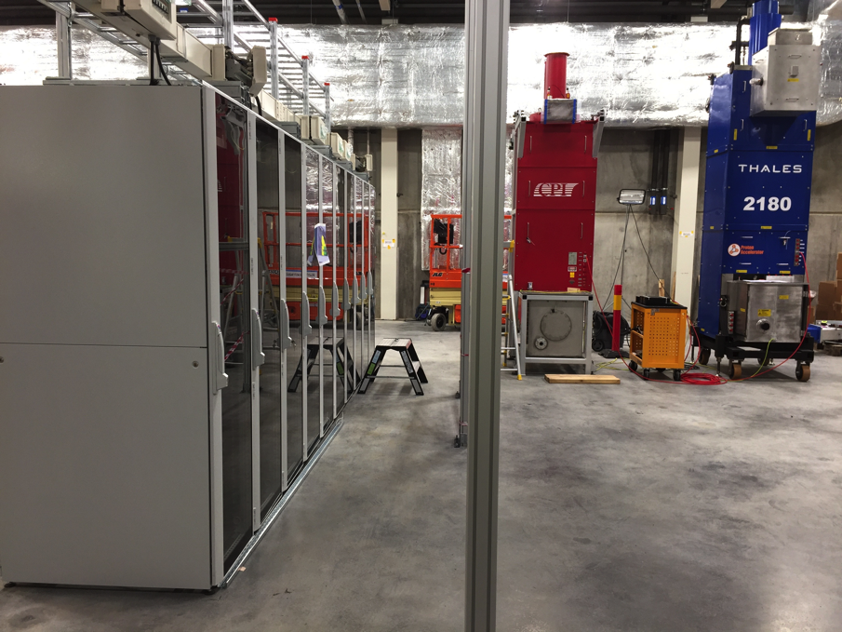
Progress on RF Test Stand 2 in G02
Installation of Racks, Cable Trays and Power Distribution
RF test stand 2
Support structure for RF Distribution System and Water Piping

Slide 9
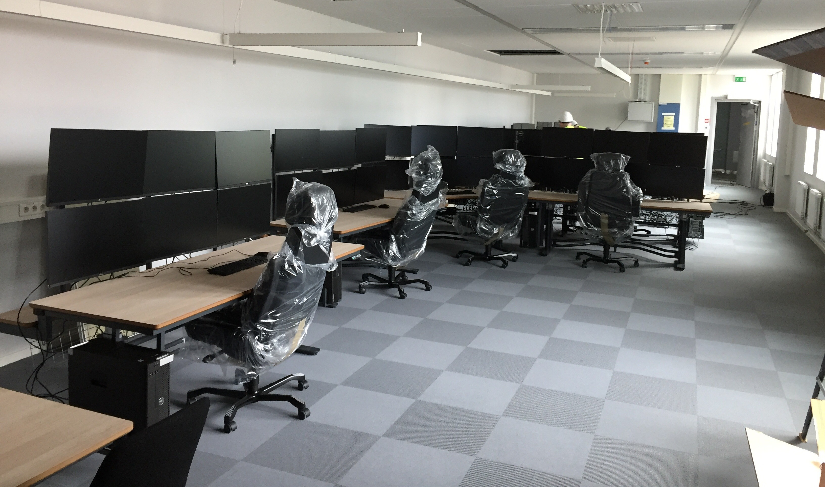
Temporary Control Room
Temporary Control Room

Slide 10
Annual Review October 2017
Council October and December 2017
Ensure that the full baseline funding level (1843 M€₂₀₁₃ plus host state contributions) is available. Ensures completion of the facility for initial science.
Sufficient spares and capital investment in initial operations. Ensures reliable operation of the facility for initial science.
Rolling programme of additional instruments and instrument upgrades. Ensures the ongoing scientific excellence of the facility.
+ upgrades
+ 10% operations
Original funding levels
When we ask for additional resources, also need to describe the savings we plan to make!

Slide 11
Highest Level Risks
Failure to secure Initial Operations funds in 2019
Failure to secure full member commitments to fully fund project (currently 5.7% is missing)
Failure to properly prepare for technical equipment installation and commissioning
In-Kind VAT costs cannot be avoided
Delivered In-Kind equipment does not fulfil requirements
Inadequate preparation of the organisation for ES&H responsibilities during installation, commissioning and operations
Difficulty in transitioning to installation, commissioning and operations phase with regard to staffing, logistics, contracts, etc.
In-Kind Partners fail to deliver full contributions because of their funding agencies failure to provide additional funds if costs exceed cost book value
Delay in securing licenses and permits from Swedish nuclear regulator

Slide 12
My Current Concerns
Developing a realistic schedule
Finalising in-kind funding (ES, NL…)
and agreements (UK, DE…)
Continuing cost pressures
  Earthquake and radiation safety requirements
Managing the transition to initial operations

