Slide 1

TG3 Process
Gábor László
NSS Lead Instrument Engineer
25.09.2017

Slide 2
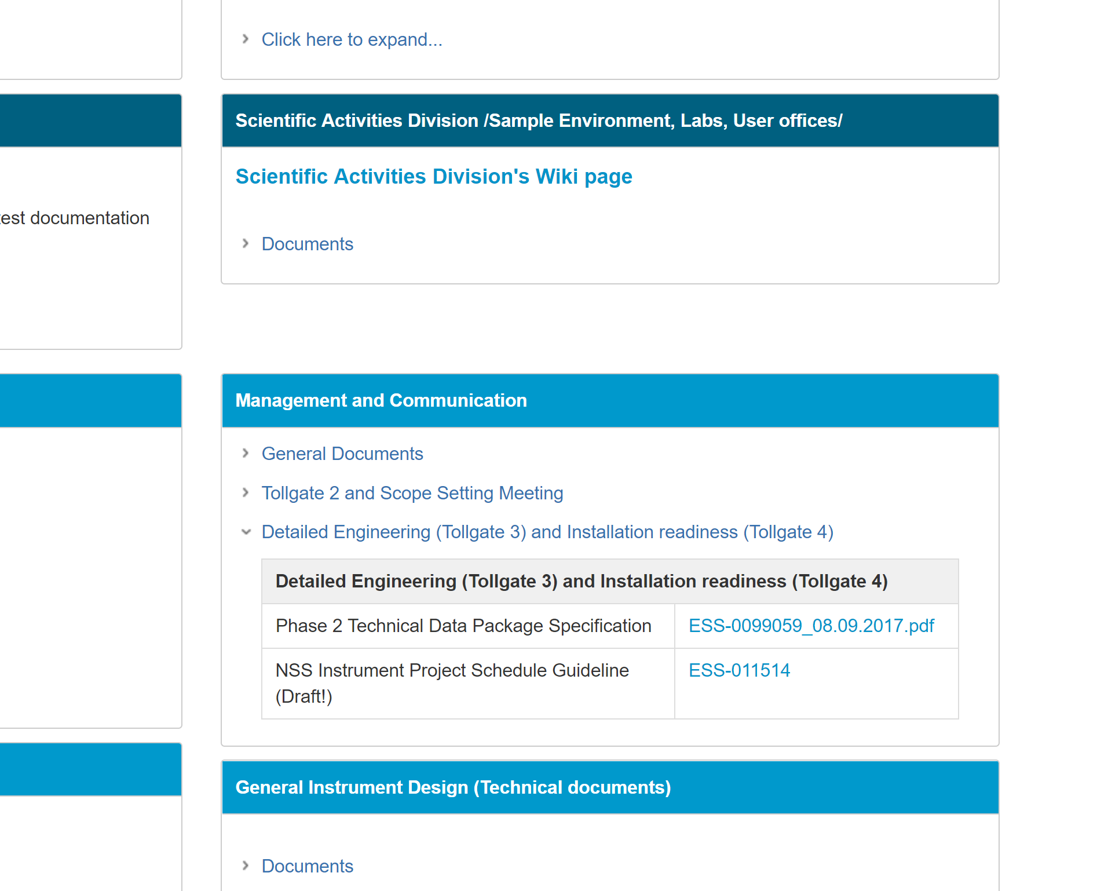
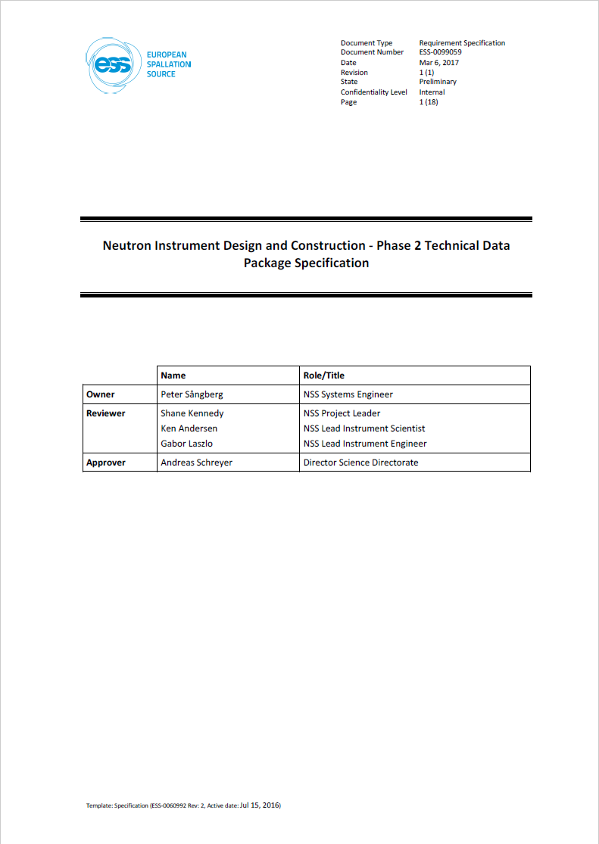
TG3 Description document: ESS-0099059
/Phase 2 Technical Data Package Specification/

Slide 3
Goal and Approach
We aim to define and request the minimum content of the design process, to allow us to trace the completeness and to facilitate integration.
We are going to give support
Set the basic framework of communication and cooperation
Set a unified document structure to be able to handle your data from NSS side.
We handle the instruments as mature design teams. Instead of micromanage them, we try to give the freedom and flexibility, within our boundaries, that allows the most effective design process.

Slide 4
Staged Phase 2 Process Example
Phase 2
Phase 2/1
(In monolith optics)
Phase 2/2 (TG3-2)
In bunker components
(TG3-n-1)
Phase 2/n-1
(Final TG3)
Phase 2/n
TG3-1
TG3-2
TG3-n-1
Final TG3

Slide 5
NSS support for Call for tender
NBOA:
  Iain has created a document structure as well as
  a template for the technical part (See his presentation)
Chopper:
  CSPEC and the NSS Chopper team has made a technical specification, that will be shared as an example, and can be used to create the call for tender.
Optics:
  You can find guidelines for the tender evaluation in the NOSG handbook: ESS-0039408

Slide 6


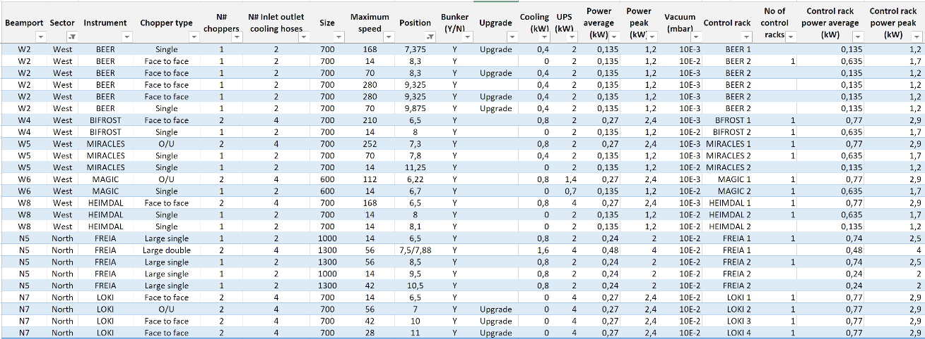
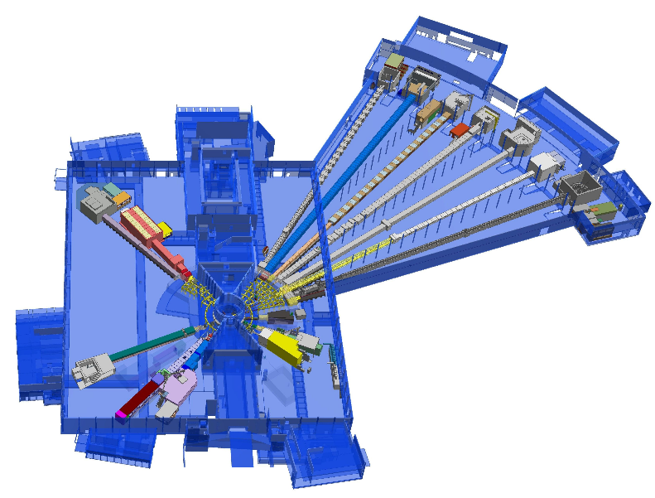
NSS Integration effort
/Layout discrepancies/
Optical analysis data
Mostly doesn’t received
WE NEED IT !
Instrument schematics /Optics+Choppers+Vacuum+beam monitors+rest/
Extracted from TG2 documents. (https://confluence.esss.lu.se/x/tYArDg)
Chopper master table
TG2 documents combined with further communication
https://confluence.esss.lu.se/display/CG/Neutron+chopper+registry+@+ESS
3D models
In CATIA
https://confluence.esss.lu.se/
display/SPD/Instrument+Models

Slide 7
Outsourced ESS Instrument Design Process of a Stage /Scenario 1
Instrument -
Subcontractor activity:
Tendering /contracting
PDR
CDR
Phase 1
Definition of base parameters and requirements
Tendering
Phase 2: Outsourced Design
Manufacturing
Preliminary engineering, or design change
Detailed engineering
ESS - Instrument
action:
TG2
Design review by ESS technology group
Sub TG3
Procurement verification
(Before CDR)
Example: NMX Guide Procurement
/*: See ESS-0099059 for the detailed descriptions of the deliverables/

Slide 8
Procurement verification
Deliverables:
Call for tender /Technical parts shall be in english/
Schedule
Declaration of conformity with Appendix 1
ESS action:
Approval for Schedule and Resources
Comment the content (optional)
No personal meeting is necessary unless the NSS integration group, via the NSS Lead Instrument Engineer, recommends it.
NSS Response time: less than a week

Slide 9
APPENDIX 1
/Procurement verification/
The Contract/Tender shall contain the following points
There has to be a CDR between the Instrument team and the supplier.
(For the approval of the CDR, ESS shall approve the design.)
Sub TG3
Scope of the work / Expected execution of the specified product or service /
Performance requirements /Acceptable products or acceptable substitutions/
List of required submittals including documents list, language requirement
Request of a Quality-assurance plan from the supplier in the tender documentation
If the NSS requirements are not compatible with the rules of the partner institute, or instruments schedule or the resource plan is conflicting with NSS planning then the issue has to be discussed and addressed by a common agreement.
List of applicable codes and standards
The product has to be designed and manufactured according to ESS and European standards.
Details about the verification process (SAT, FAT), the delivery and the handover of the product/service

Slide 10
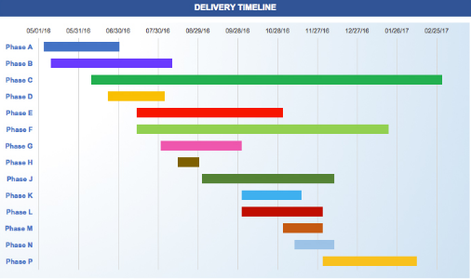


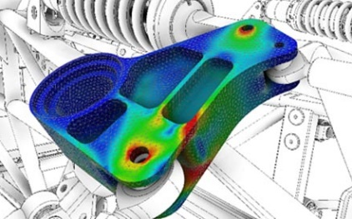
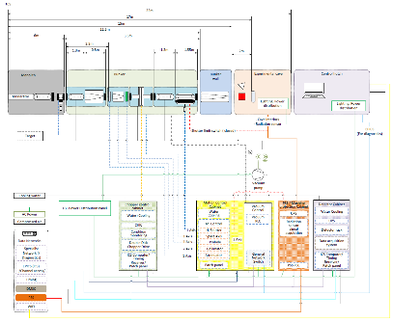
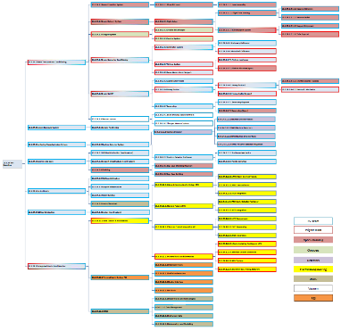
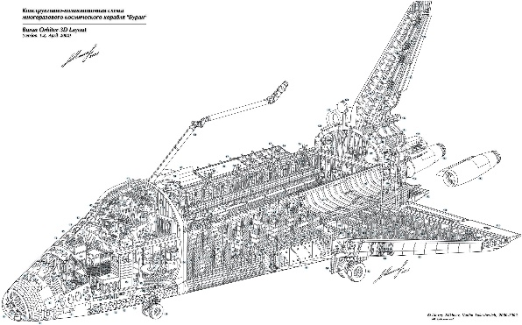
Sub TG3
Project Documentation
Safety Documentation
System Documentation
Detailed Technical Design

Slide 11
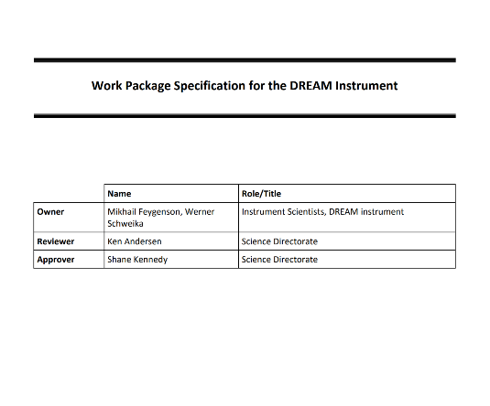
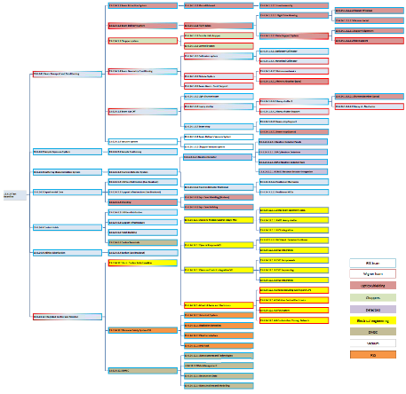
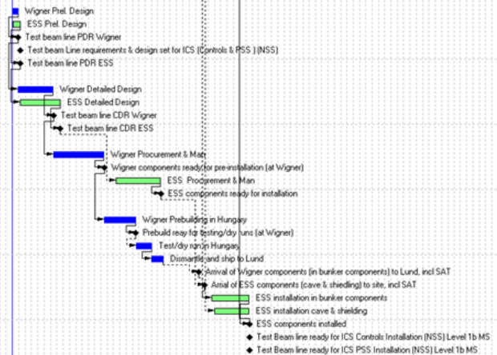
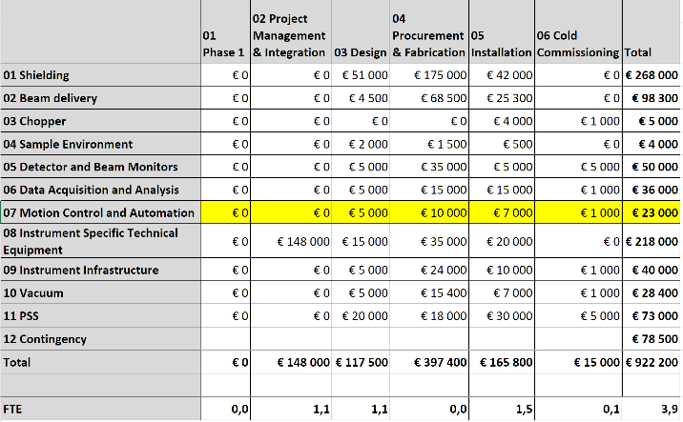
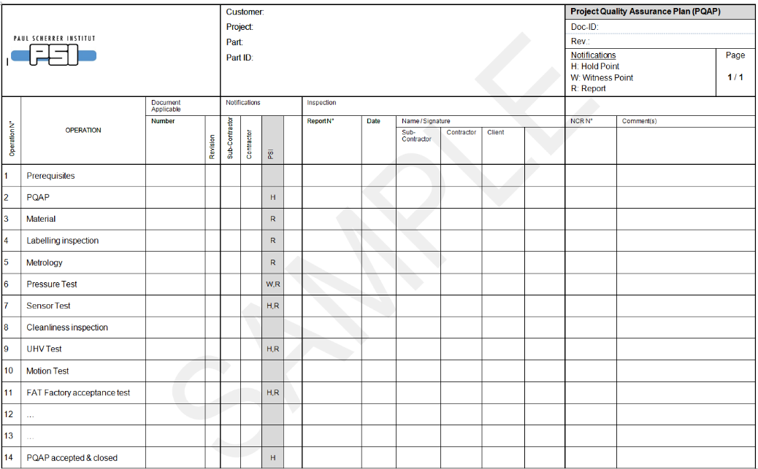
Project Documentation
      Update of the Work Package Specification (WPS) Schedule, PBS, Budget etc. if applicable.
      Project Quality Plan (PQP)
It shall include identification of standards and procedures applied in design, procurement, manufacture and assembly, and planning for compliance testing and inspection.

Slide 12

Safety Documentation
Instrument Hazard Analysis
  References:
  ESS-0047810 /ESS Guideline for Instrument Hazard Analysis/
  ESS-0100583 /Template for Instrument Hazard Analysis/
  ESS-0016468 / ESS rule for identification and classification of safety important components/
Radiation Safety Analysis
  References (Not exclusive):
  ESS-0052625 /NOSG phase 2 guidelines for designing instrument shielding for radiation safety/
  ESS-0100307 /NMX Cave shielding: H1 and H2 scenarios/

Slide 13
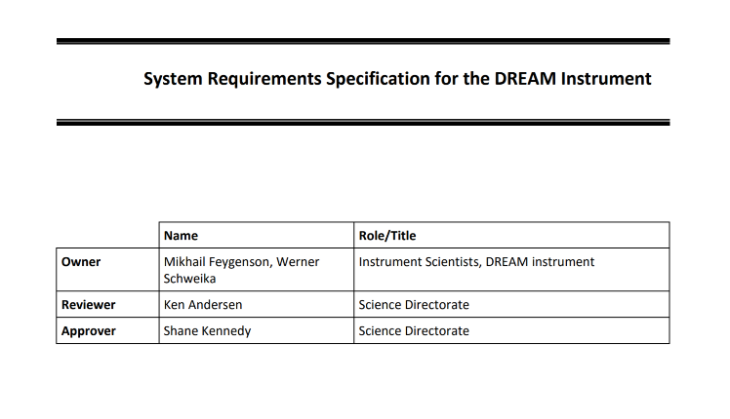
System Documentation
System Requirements Specification update
  Update of the Phase 1 document, if necessary.
Sub-System Design Description (SSDD)
  List of characteristic sub-system properties and solutions derived from requirements, with references to the requirements in the System Requirement Specification (SRS).
  Low level Component(s) or unit(s) description with critical technical parameters and requirements /E.g.: RH compatibility, temperature stability, accuracy, range, load capacity( of Structural components, Bearings, Pressure systems, Lifting features), The compliance to requirements shall be indicated, with references, if applicable.
  The components that are detailed in the technology documents should be not detailed again, but has to be included. (Appendix 2./ next slide)

Slide 14
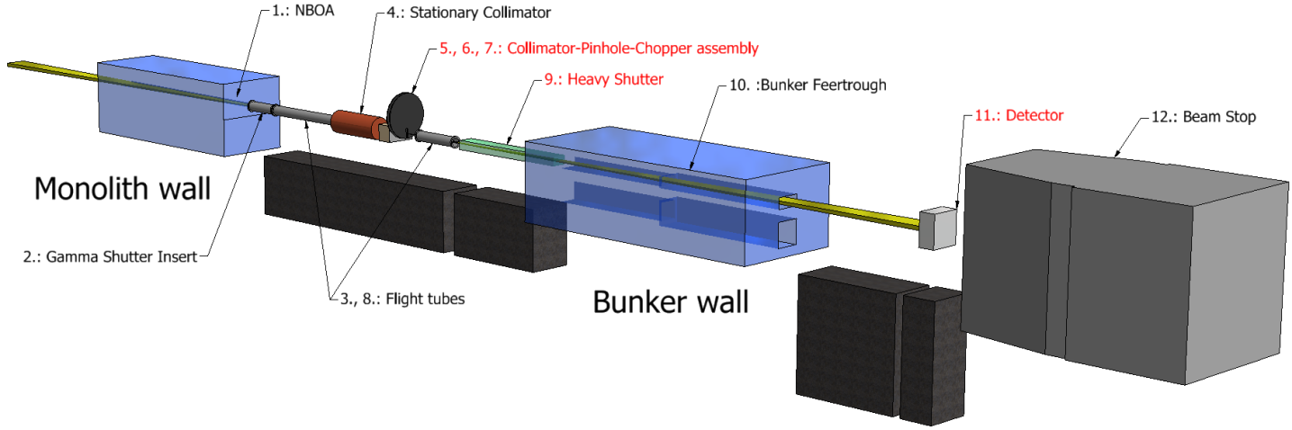
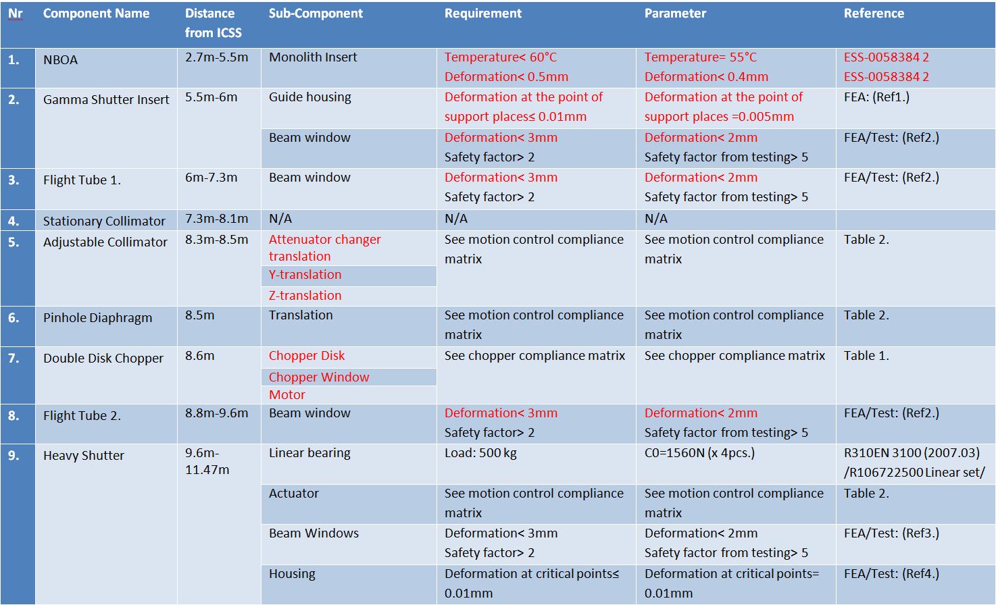
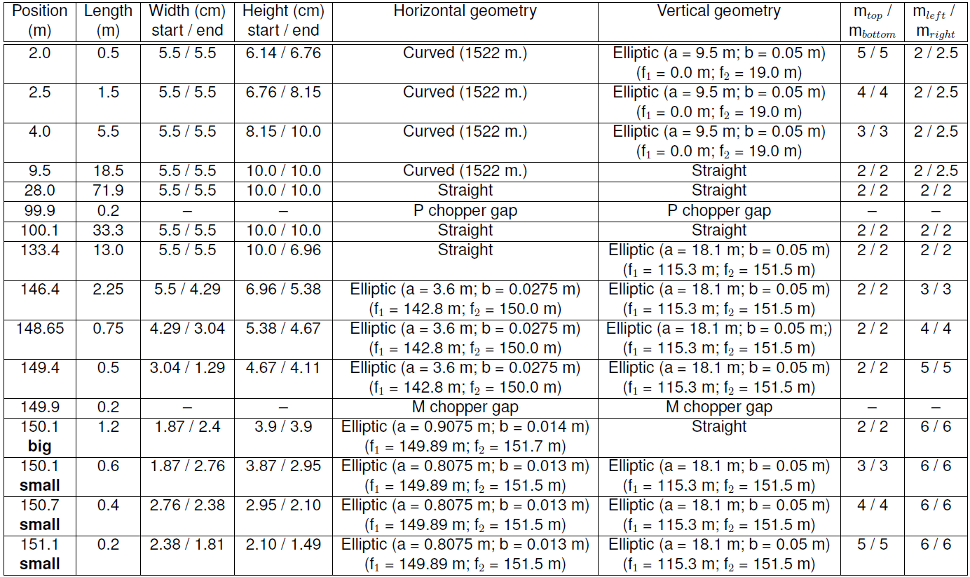
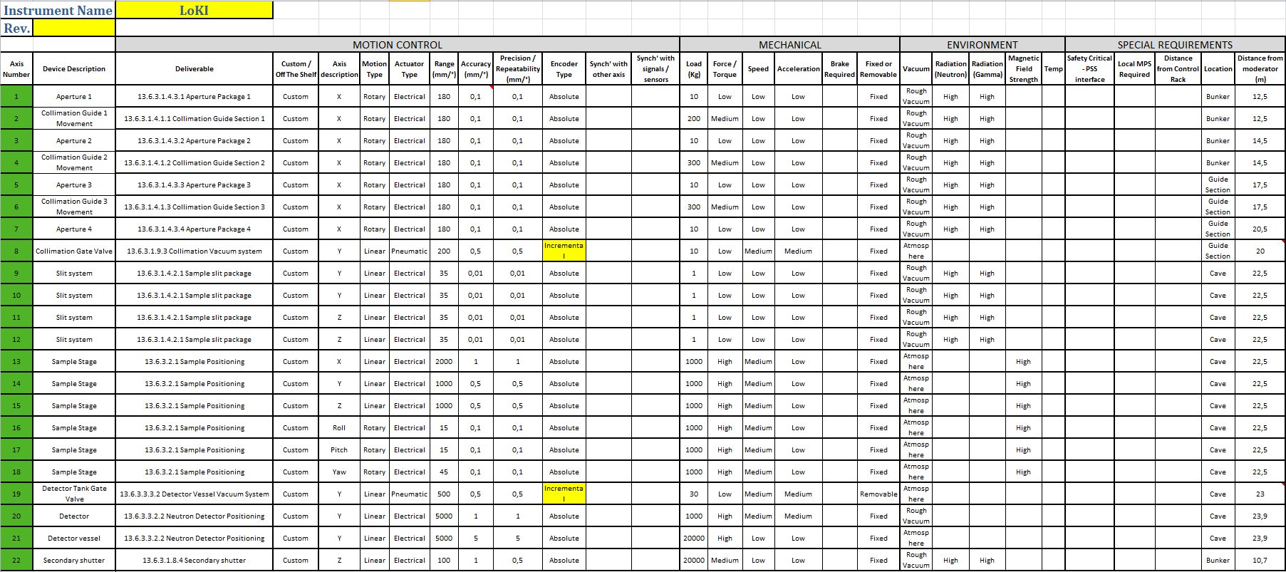
Sub-System Design Description (SSDD) 2.

Slide 15
Sub-System Design Description (SSDD) 2.
PSS Check-list
Design considerations, as applicable, to record the justification of the selection of a particular design solution in case there are several obvious alternatives. Selection criteria could be any combination of, but may not be limited to, the following aspects; maintenance, operations, remote handling, decommissioning, installation, cost-efficiency .
Integration Data:
  External interfaces of the instrument sub-system
  System- Sub-System internal interfaces
Sub-system 1.
This information can be written or visual (2D drawings, 3D model views etc. with dimensions) and/or reference to such.
Sub-system 2.

Slide 16

Final TG3/
System Documentation
System Design Description (SDD)
References to the SSDDs.
Integration data:
  External interfaces to the Instrument. Shall include infrastructural interfaces and visual information on allocated footprint for the Instrument and the utilised area within this footprint - thus verifying the geometry. This information shall display that the instrument is not interfering with the local environment, the requested free path is available and there are no logistic issues around it.
  System design for integration to Data acquisition and analysis systems
  Operational analysis of integration to Sample Environment Equipment and Laboratory Infrastructure and logistics
This information can be written or visual (2D drawings, 3D model views etc. with dimensions) and/or reference to such.

Slide 17
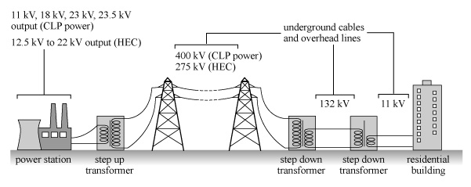

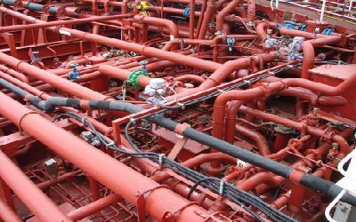
System Design Description (SDD)
Preliminary design for the following cross system sub-systems (utilities), with references to the requirements in the System Requirements Specification:
  /Only include in the SDD if not entirely covered in the sub-systems/
  Power distribution
  Control system
  Personnel Safety System, PSS
  Cooling and other fluid systems
  Vacuum and gas support systems
Certificate of Conformity for Hazardous Materials and Sustainability [ISS]; - Specify exceptions to the list stipulating what materials not to use. Could be a separate attachment.

Slide 18
System Documentation
      System Integration and Verification Plan
Describes the activities and resources (heavy equipment, special tools, staff etc.) required for installation, integration and verification of the technical requirements and the schedule for these. These activities shall be described in accordance to ESS-0115143, NSS project schedule guideline.
      System Validation Plan,
Preliminary plan for cold and hot commissioning
Defining content and depth of detail of all activities to validate the realized product against the high level scientific requirements (CONOPS).
      Draft of System Operations & Maintenance Manual
The document is to be started early in the design work and is intended to evolve throughout the phase and into the coming phases as the design gradually matures.

Slide 19
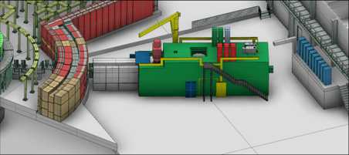
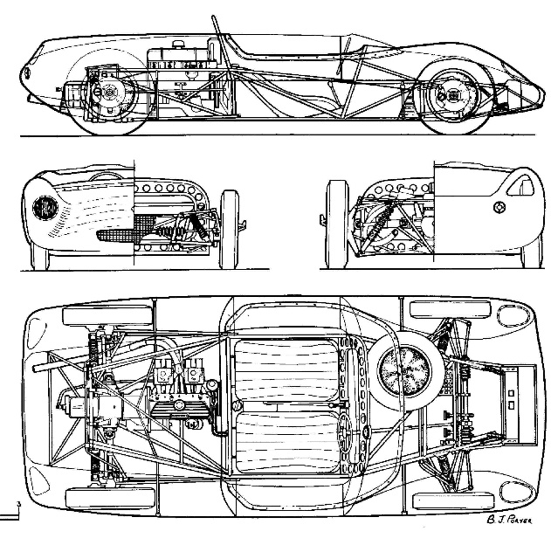
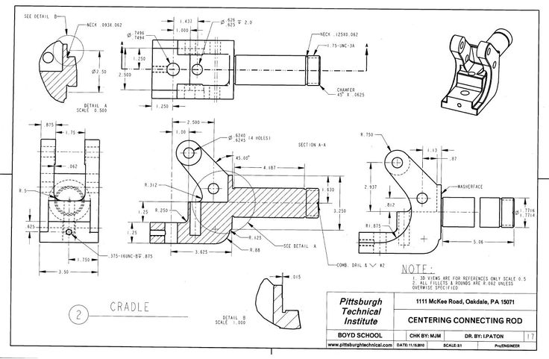
Detailed Technical Design
3D model
Detailed Drawing documentation

Slide 20
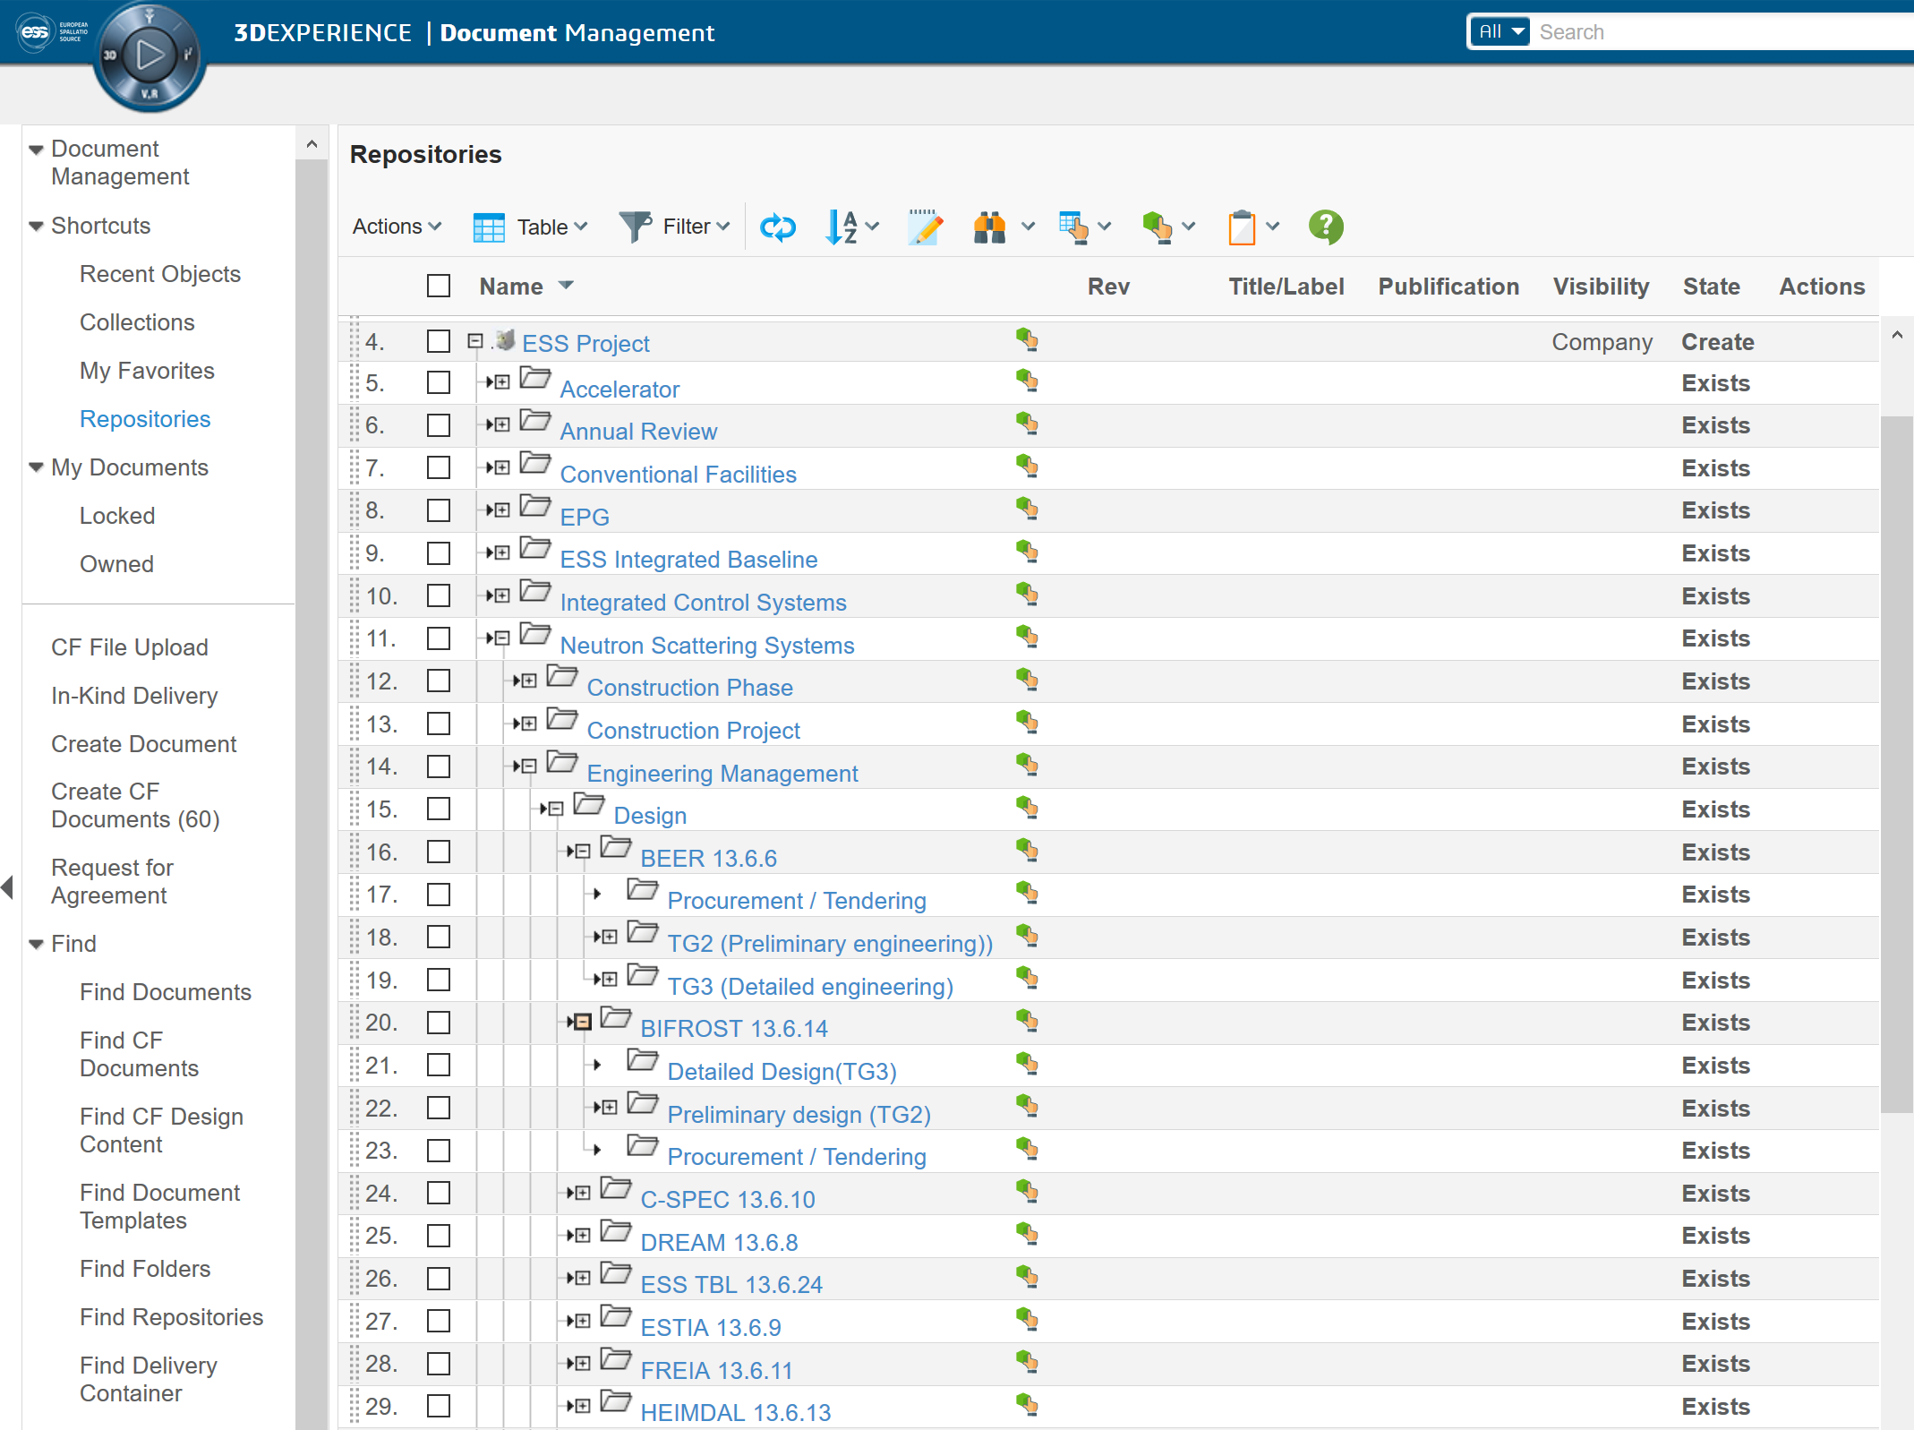
CHESS

Slide 21
Thank You!

Slide 22
Brief Explanation of ESS Activities
Phase 1
Definition of base parameters and requirements
Tendering
Phase 2: Outsourced Design
Manufacturing
Preliminary engineering, or design change
Detailed engineering
TG2
Design review by ESS technology group
Sub TG3
Procurement verification
Procurement verification (reply: 1 week)
Deliverables:
The technical part of tender
Schedule
Declaration of conformity with Appendix 1
ESS action:
Approval for Schedule and Resources
Comment the content (optional)
No personal meeting is necessary unless the NSS integration group recommends it.
Interim Review (if necessary)
Deliverables:
New technical information
ESS action:
Verification of Integration
Verification of change
Informal meeting. Either personal or via Vidyo/Skype
Sub TG3 (2 weeks)*
See below
Formal meeting with the involved ESS group(s)
/*: See ESS-0099059 for the detailed description of the deliverables/

Slide 23
Outsourced ESS Instrument Design Process of a Stage /Scenario 2
Phase 1
Definition of base parameters and requirements
Preliminary engineering, or design change
Tendering
Outsourced Design
Manufacturing
Detailed engineering
ESS - Instrument
action:
TG2
Procurement verification
Potential Checkpoint
Sub TG3
(Before CDR)
Design review by ESS technology group
Example: NMX Sample environment robots

Slide 24
Outsourced ESS Instrument Design Process of a Stage /Scenario 3
Phase 1
Definition of base
parameters and
requirements
Tendering
Outsourced Design
Manufacturing
Preliminary engineering
Detailed engineering
ESS - Instrument
action:
TG2
Sub TG3
Procurement verification
(Before CDR)
Example: NMX Chopper procurement

