Slide 1
IKON 13 NBOA and beyond...
25 Sept 2017
NSS Engineering Integration team
I.Sutton
Notes:
Good morning fellow collaborators

Slide 2
Agenda
Neutron Beam Optical Assembly
What is NBOA
Fast track objectives & schedule
Status
Current activities
Preparation for procurement
After procurement
Key dates and deliverables

Slide 3
NBOA DELIVERY COMMENCING IN …..
13-1-2017
0
1
6
WEEKS

Slide 4
NBOA in a nutshell
NBOA is a 3,5m of neutron optics installed within the target monolith.
It’s job is to extract the good neutron from the moderator for use by instruments ...
…. and to stop as many of the bad ones from getting out.
The installation of NBOA is on the critical path of all instruments
The design and procurement is the responsibility of individual instrument teams …. however the integration into the facility is shared.
It is the first part of all of the facilities neutron instruments …. each one is unique and critical their performance

Slide 5
Objectives NBOA ‘FAST TRACK’
FAST TRACK is a suit of targeted activities undertaken NSS engineering integration team with partners in addition to the normal integration and support activities.
These initiatives are reserved for system critical to the ESS or the NSS project as a whole on grounds of performance, safety, schedule, risk or cost.
The objective of these initiatives is to assist partners ensure the quality, performance, integration and timely delivery of the critical systems within their responsibility
Activities may include;
Conceptual design
Integration
Selection and validation of technical solutions
Technical support during procurement
Pre-competitive discussion with potential suppliers
Discussion with authorities

Slide 6
Schedule Welcome to procurement
TODAY
DESIGN
PROCUREMENT
PDR
Q4 2018
Delivery
Q2 2019
Install
Notes:
Same schedule as a year ago
Happy to say that we are pretty much on schedule
With the preliminary design phase behind us
An one foot in procurement
And that good because the end milestones have not changed and there remains a lot to be done
Closure on Monolith vessel End Q2
Installation inserts Q2
Delivery of inserts Q1
Procurements – Supply ~12month
Which implies order placement for in-monolith optics Q2-Q3 2017

Slide 7
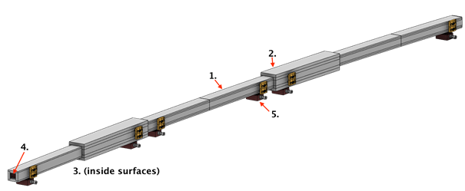
STATUS REPORT PDR
Completed 16 June 2017
Design
Interfaces (with NBPI)
In progress
Tender document preparation
NBPI design work
https://confluence.esss.lu.se/display/BO/NBOA+Preliminary+design+review

Slide 8
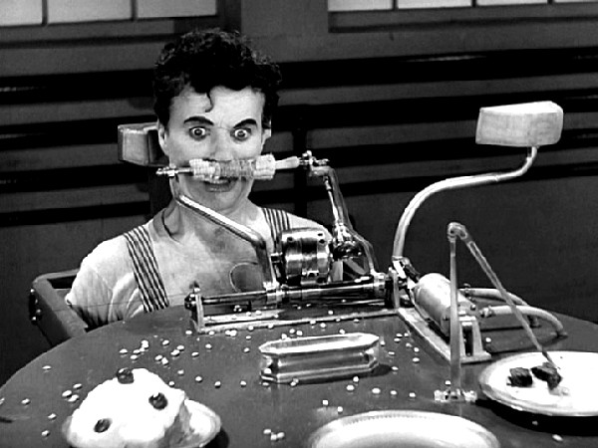
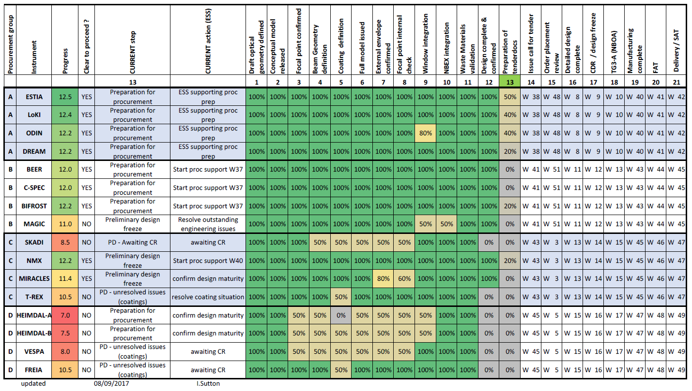
STATUS REPORT Design maturity
Group A
Ready for Tendering
Design is complete & stable
Group B
Ready for tendering
Design is complete & stable
Group C
partial completeness
further work required
Group D
partial completeness,
further work required
Notes:
You are all aware of the first 8
But to make this more manageable for suppport in this phase we have broken the 15+1 into 4 smaller groups

Slide 9
Post PDR Change control
All changes now require formal
approval by ESS lund prior to implementation.
Change request + Justification
Approval process
Space claim
Interfaces
Materials
Neutronics
Schedule
Late change = change request = delay
= risk to miss installation

Slide 10
Welcome to Procurement ….
The next big thing

Slide 11
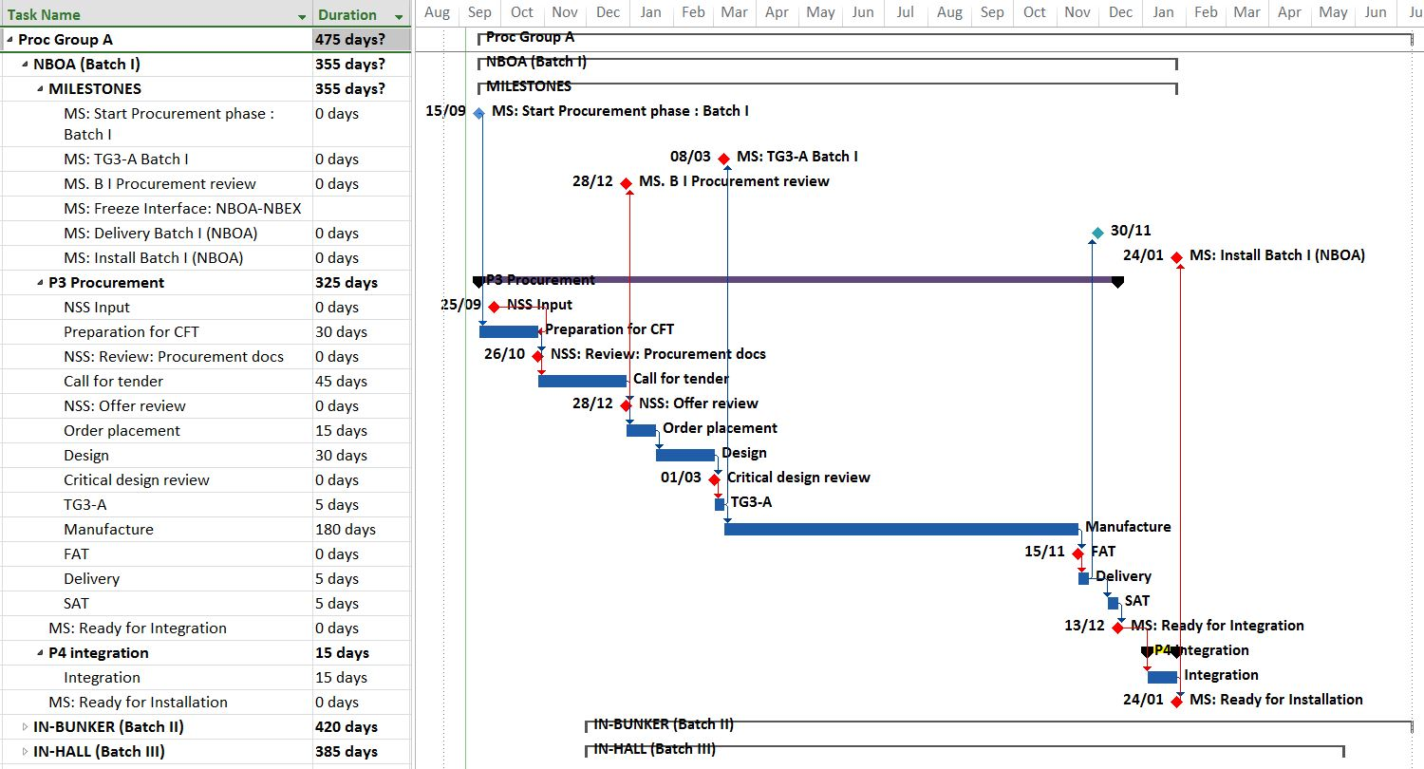
Procurement Schedule
TENDER DOCS
PROC REVIEW
TG3-A
FAT / SAT
INSTALL
MANUFACTURE

Slide 12
Procurement key dates
W40
2018 > 2019

Slide 13
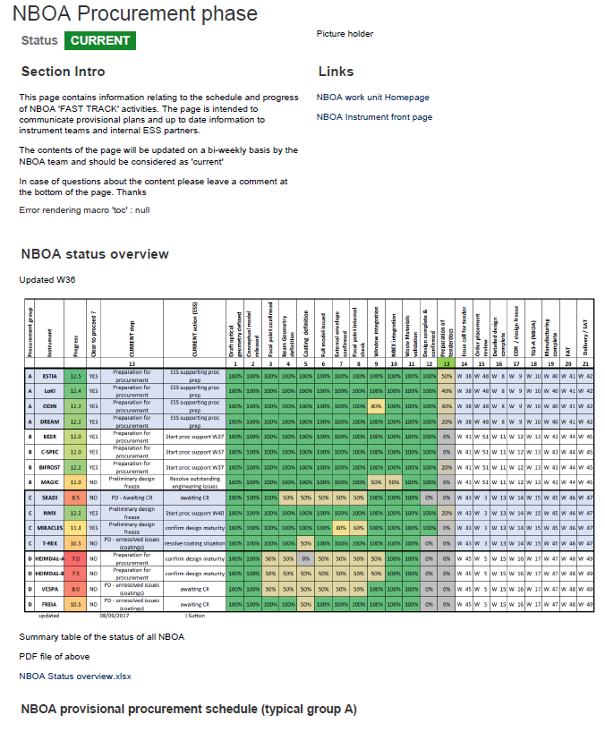
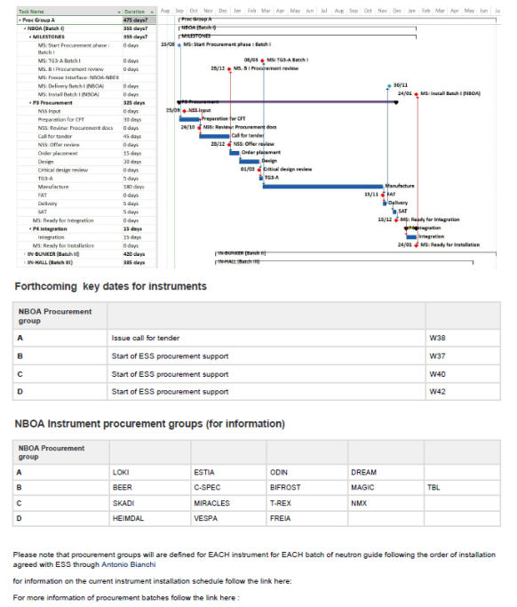
Procurement support How can we support you ?
Preparation for tender
Technical drawings
Template technical specification
Provisional Delivery dates
Input to Terms and conditions
Input to VVP
Reviews / TG3
Check compatibility
Technical
Schedule
Throughout process
Technical advice
Limited technical support
All communication via confluence
https://confluence.esss.lu.se/display/BO/NBOA+Procurement+phase
https://confluence.esss.lu.se/x/JIPxDQ

Slide 14
NBOA TENDER ISSUE GROUP ‘A’ COMMENCING IN …
13-1-2017
0
1
0
1/2
WEEKS

Slide 15
Procurement Broader context
Monolith feed through (B1) 52.5m
In-Bunker(B2)
300m
Bunker
feed through (B2.1) 50m
1
SEE MY PARALELL SESSION PRESENTATION
Thursday
SOURCE
D building (B3)
400m
E building (B4)
1000m
SAMPLE
Notes:
Guide procurement is another talk – parallel session BUY-INSTALL-ALIGN

Slide 16
Post procurement
61 weeks

Slide 17
NBOA DELIVERed …..
13-1-2017
0
1
6
WEEKS LATER …

Slide 18
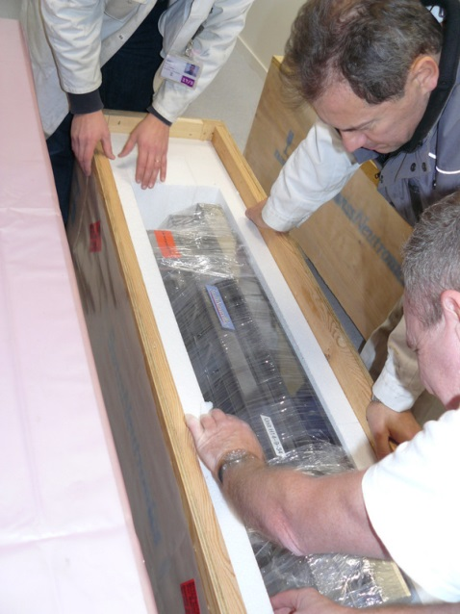
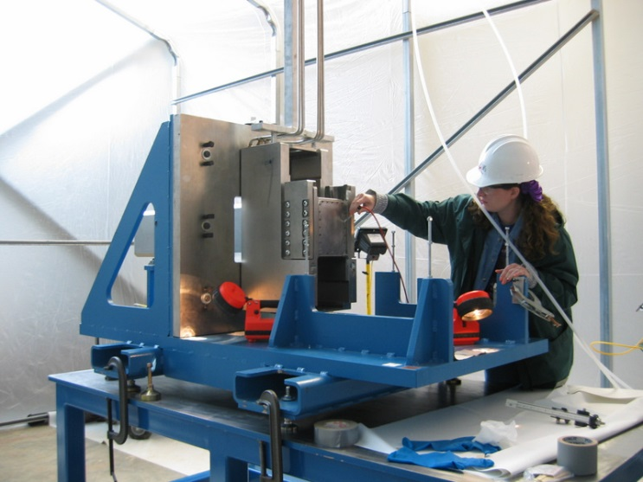
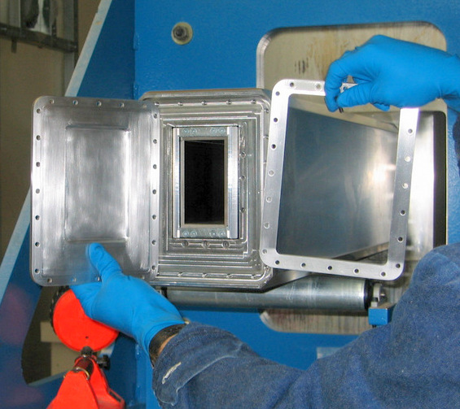
Phase 4 Integration activities
Delivery
SAT
Prep’
Integration
Alignment
Clean up
Close up
P. Test
INST INST / NSS NSS NSS NSS/SA NSS TD TD
(Most) Activities will be carried out by ESS internal team

Slide 19
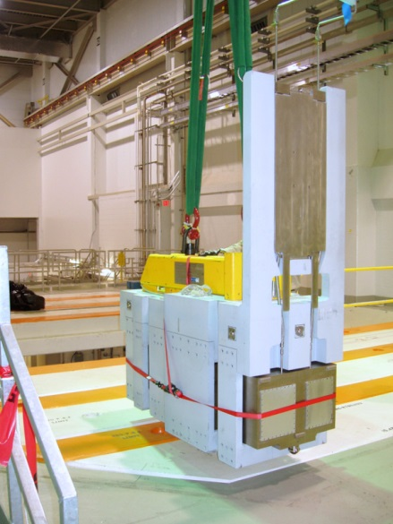
Phase 5 Installation
Transport
Insertion
Verif’
Clean up
Closure
Survey
Set up
TD TD TD NSS/TD SA TD TD
Activities will be carried out by ESS internal team

Slide 20
SUMMING UP

Slide 21
Key points
NBOA design are under change control
Prepare your own documents for procurement
We will be contacting you shortly…
NBOA Procurement groups
A | Issue call for tender | W40
B | Start of procurement support | W39
C | Start of procurement support | W41
D | Start of procurement support | W43

Slide 22
Thanks for joining us Questions are welcome !
On behalf of
NSS Engineering integration
NBOA – NBEX Team

Slide 23
Outsourced ESS Instrument Design Process of a Stage /Scenario 2
Phase 1
Definition of base parameters and requirements
Preliminary engineering, or design change
Tendering
Outsourced Design
Manufacturing
Detailed engineering
ESS - Instrument
action:
TG2
Tender review
Order review
Sub TG3
(Before CDR)
Design review by ESS technology group
SEE Gabors TG3 slide

