Slide 1
The Bunker Project
Overview
Zvonko Lazic
www.europeanspallationsource.se
27 September 2017

Slide 2
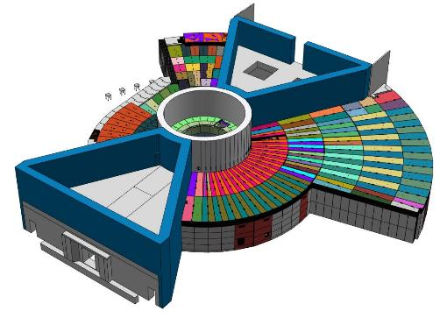
The bunker - content
Project overview
Design status
Frame
Roof
Walls
Instrument interfaces
Schedule
Neutronics status (Günter M.)
Requirements review
Roof optimization
Walls optimization

Slide 3
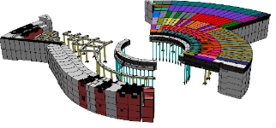
The Bunker - Overview
The project is progressing well, with delays on expected mechanical design deliveries, and on finalizing the neutronics validation analyses. This is due to continued VE effort.
- CDR dec.’17
Purchasing strategy has been discussed. The timeline for executing purchase of this project is very aggressive.
- Place purchase order jan.’18
Overall schedule is unaffected.
Documentation is being updated (following the internal review, changes in the bunker construction, and in the interface environment). This is addressed by Mark R. + Peter S.; Alexander S.

Slide 4
The bunker – Design status
~ 7000t of steel
~ 300t of Borated HDPE
~ 750t of virgin HDPE/LDPE
~ 620t of concrete
~ 970t of heavy concrete
~200t of construction steel
Each bunker side measures approx. 40m long x 26m wide x 5m high
~ 10,000 tones total mass
~1400 wall & roof blocks

Slide 5
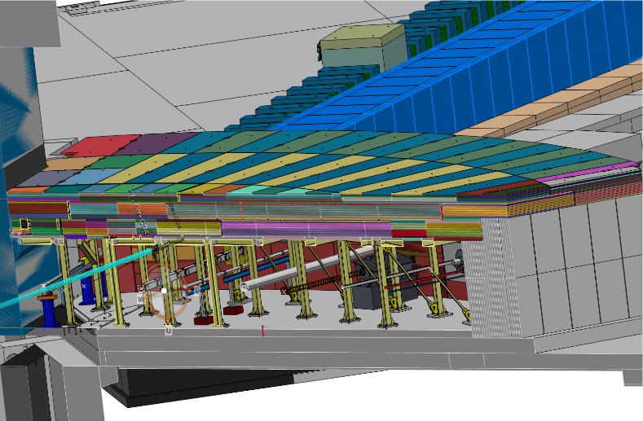
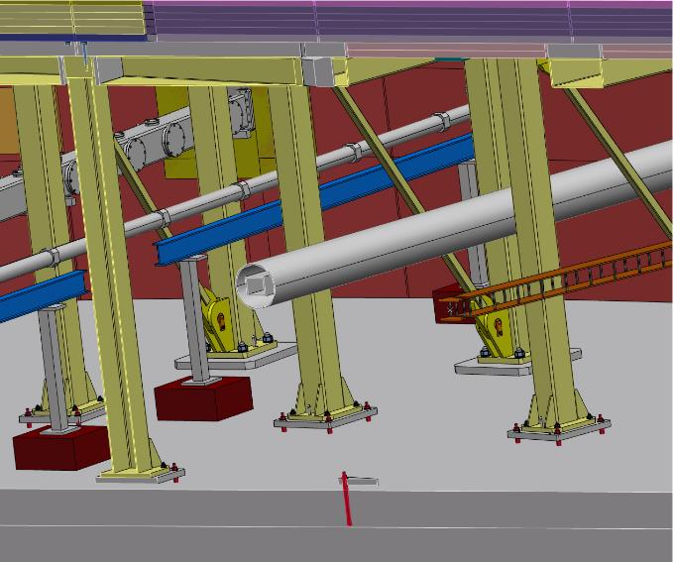
The bunker – Design status Frame and roof position
1700 TCS-to-bottom of the roof
1500 TCS-to-bottom of the frame
TCS

Slide 6
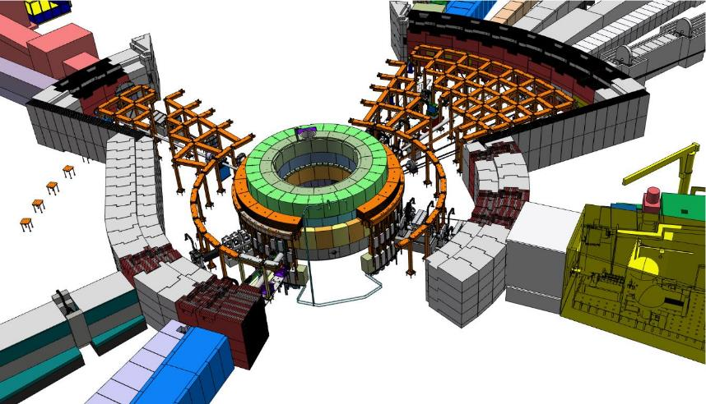
The bunker – Design status SUPPORT FRAME
The bunker frame has to:
Support the roof load;
Sustain seismic loads (up to H4);
Allow easy disassembly;
Ensure that blocks stacked on top, fit;
Ensure repeatability of stacking/unstacking of blocks;

Slide 7
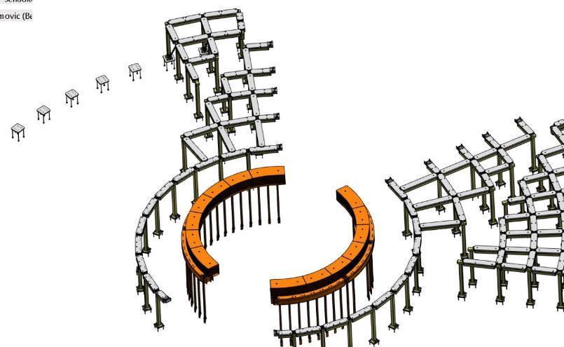
The bunker – Design status SUPPORT FRAME
The bunker frame is divided into sub-assemblies based on the area the frame is covering.
R6m frame structure

Slide 8
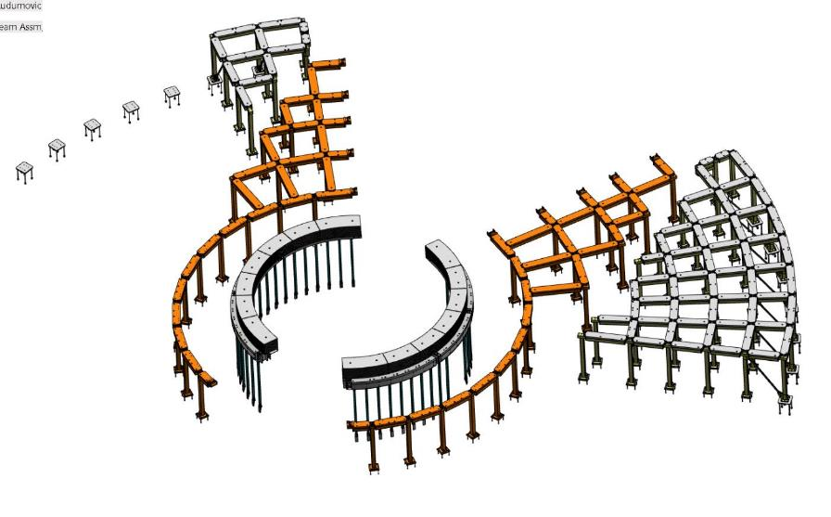
The bunker – Design status SUPPORT FRAME
D02 frame structure

Slide 9
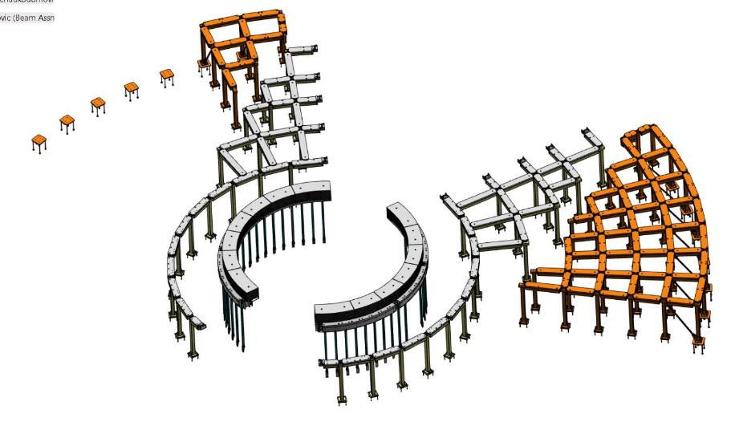
The bunker – Design status SUPPORT FRAME
D01/03 frame structure

Slide 10
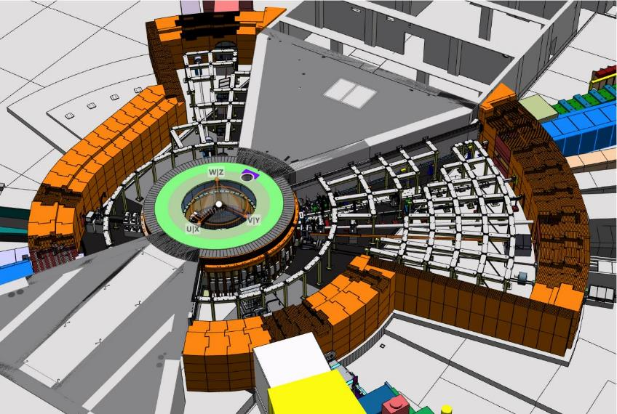
The bunker – Design status WALLS
The bunker walls function is to:
Shield (from radiation);
Support (roof above);
Integrate (beam feed-throughs);

Slide 11
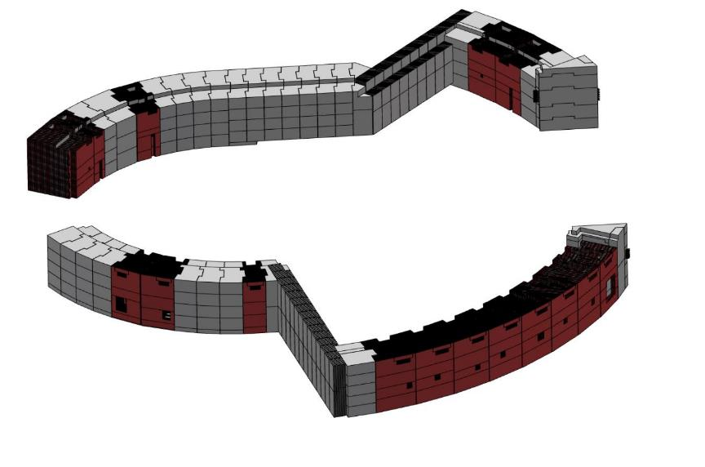
The bunker – Design status WALLS
Temporary shielding
SOUTH
EAST
NORTH
WEST
Full specification shielding

Slide 12
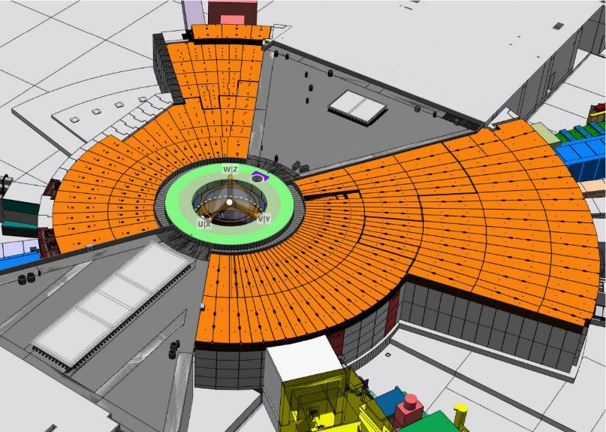
The bunker – Design status ROOF
The bunker roof function is to:
Shield (from radiation);
It also has to allow for:
Reasonably fast access into the bunker cavity;
Ability to unstack and stack blocks repeatedly;

Slide 13
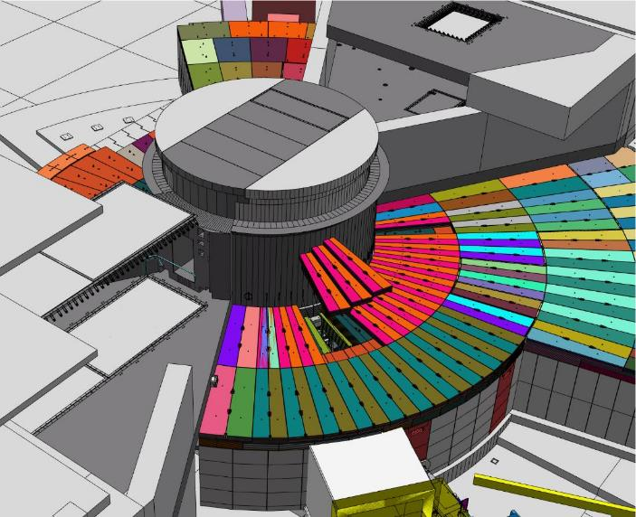
The bunker – Design status ROOF
The bunker roof is made out of blocks;
The blocks are arranged in 3 overlapping levels;
Lifting times depend on the particular point of entry;

Slide 14
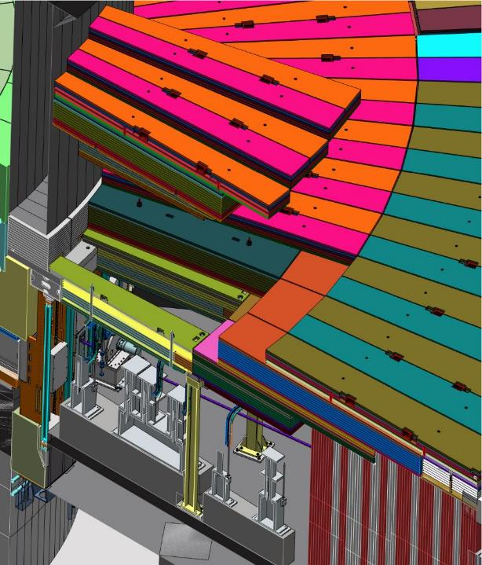
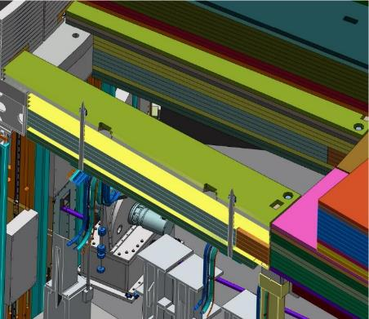
The bunker – Design status ROOF
The bunker roof is made out of blocks;
The blocks are arranged in 3 overlapping levels;
Lifting times depend on the particular point of entry;

Slide 15
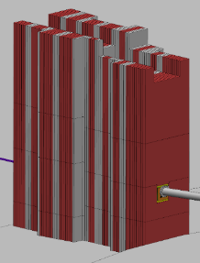
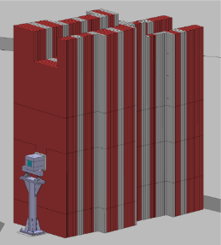
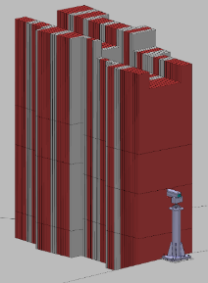
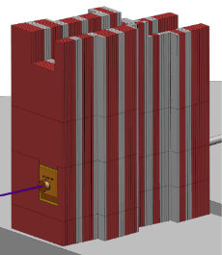
The bunker – Instruments integration
Two main strategies for the beamline feedthrough through the bunker wall are:
Support feedthrough element before and after the wall;
Support the feedthrough element within the wall
Integration effort is working well but;
I don’t see consistency in the flow of information;
Some instrument teams have set wall feedthrough geometry, some don’t;
This is fine, but we (the bunker design team) have to stop integration adjustment effort;
N7 wall segment - LOKI Feedthrough
E3 wall segment - SKADI Feedthrough

Slide 16
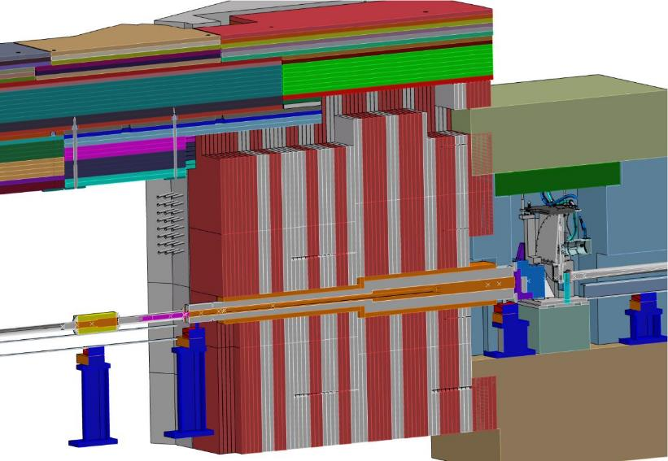
The bunker – Instruments integration NMX

Slide 17
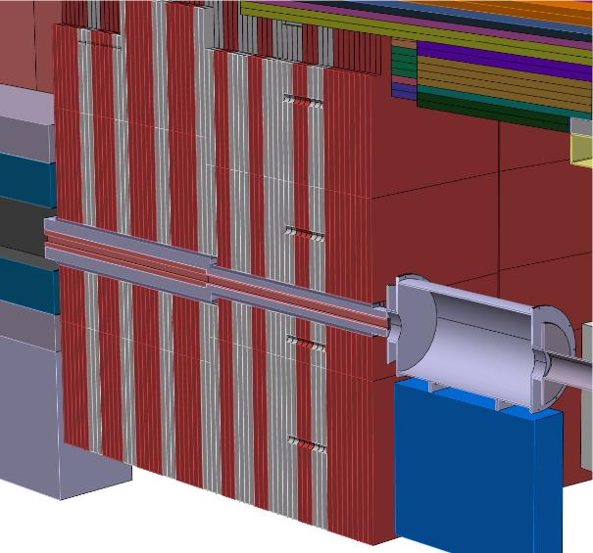
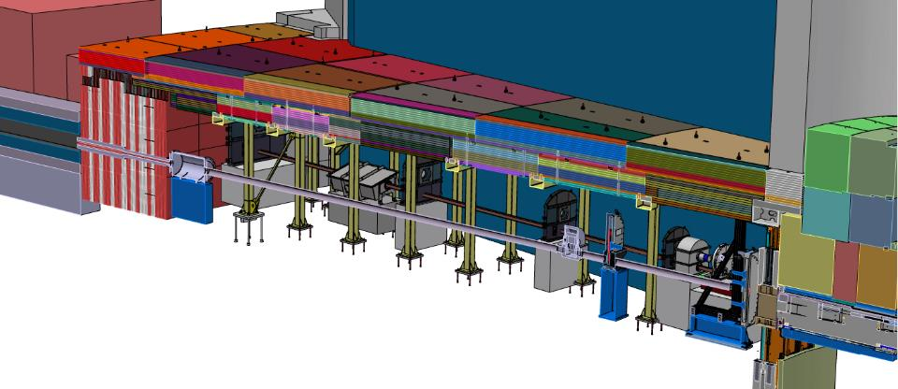
The bunker – Instruments integration DREAM

Slide 18
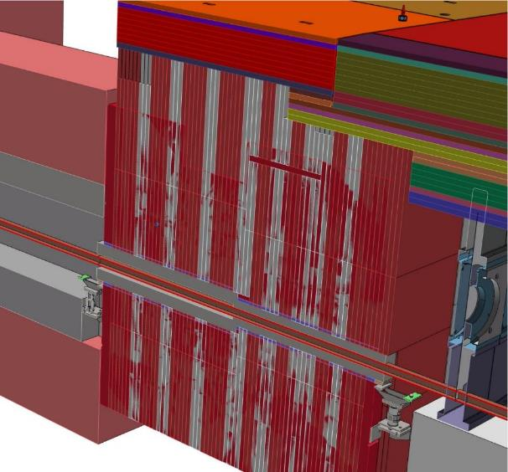
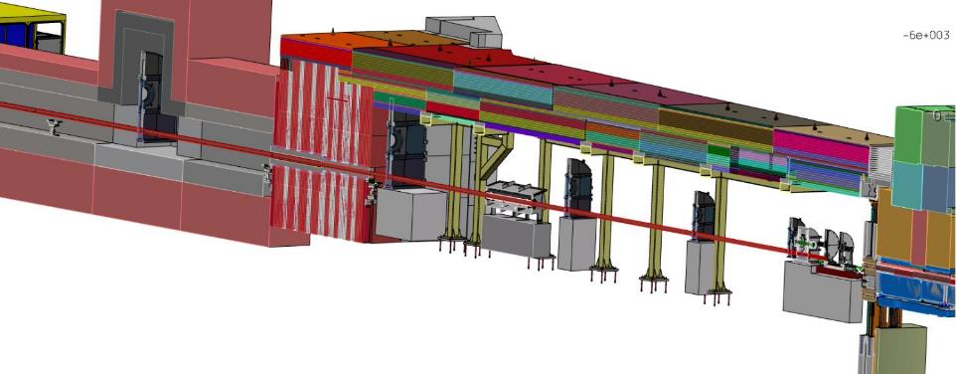
The bunker – Instruments integration ODIN

Slide 19
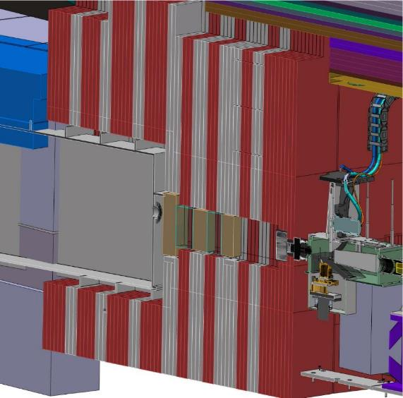
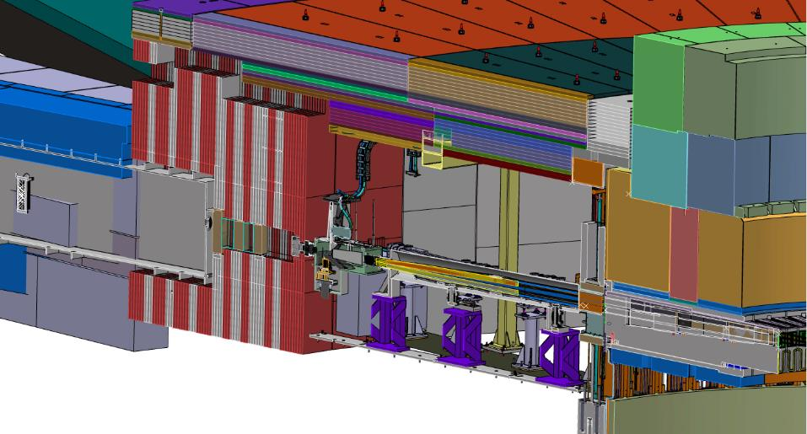
The bunker – Instruments integration ESTIA

Slide 20
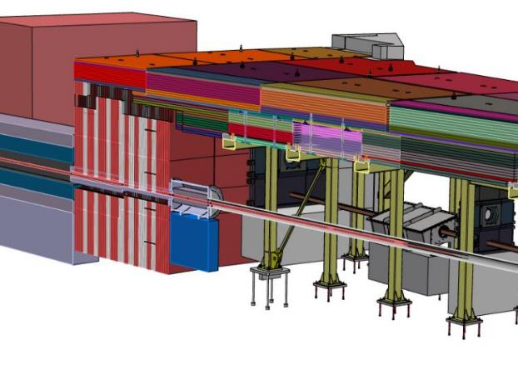
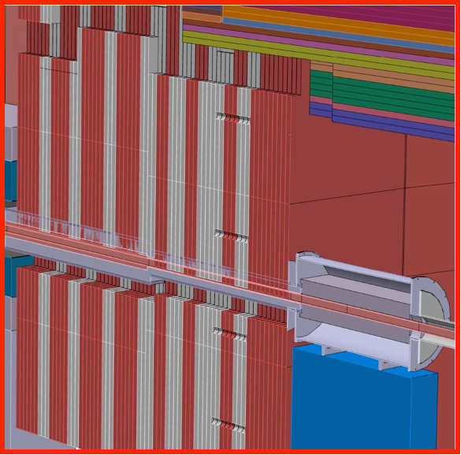
The bunker – Instruments integration Nightmare
To get the LATEST layout
Explore
Expand the whole tree
Select (things you don’t want to see)
Remove (things you don’t want to see)
Select all
Filter
Minor overload
Unselect the check box
Select the check box
Click ‘ok’ and wait
Open advanced (and wait)
And I still didn’t get the correct models.
This is a note to the users to pay CLOSE ATTENTION to their design/modelling work and interfaces.

Slide 21
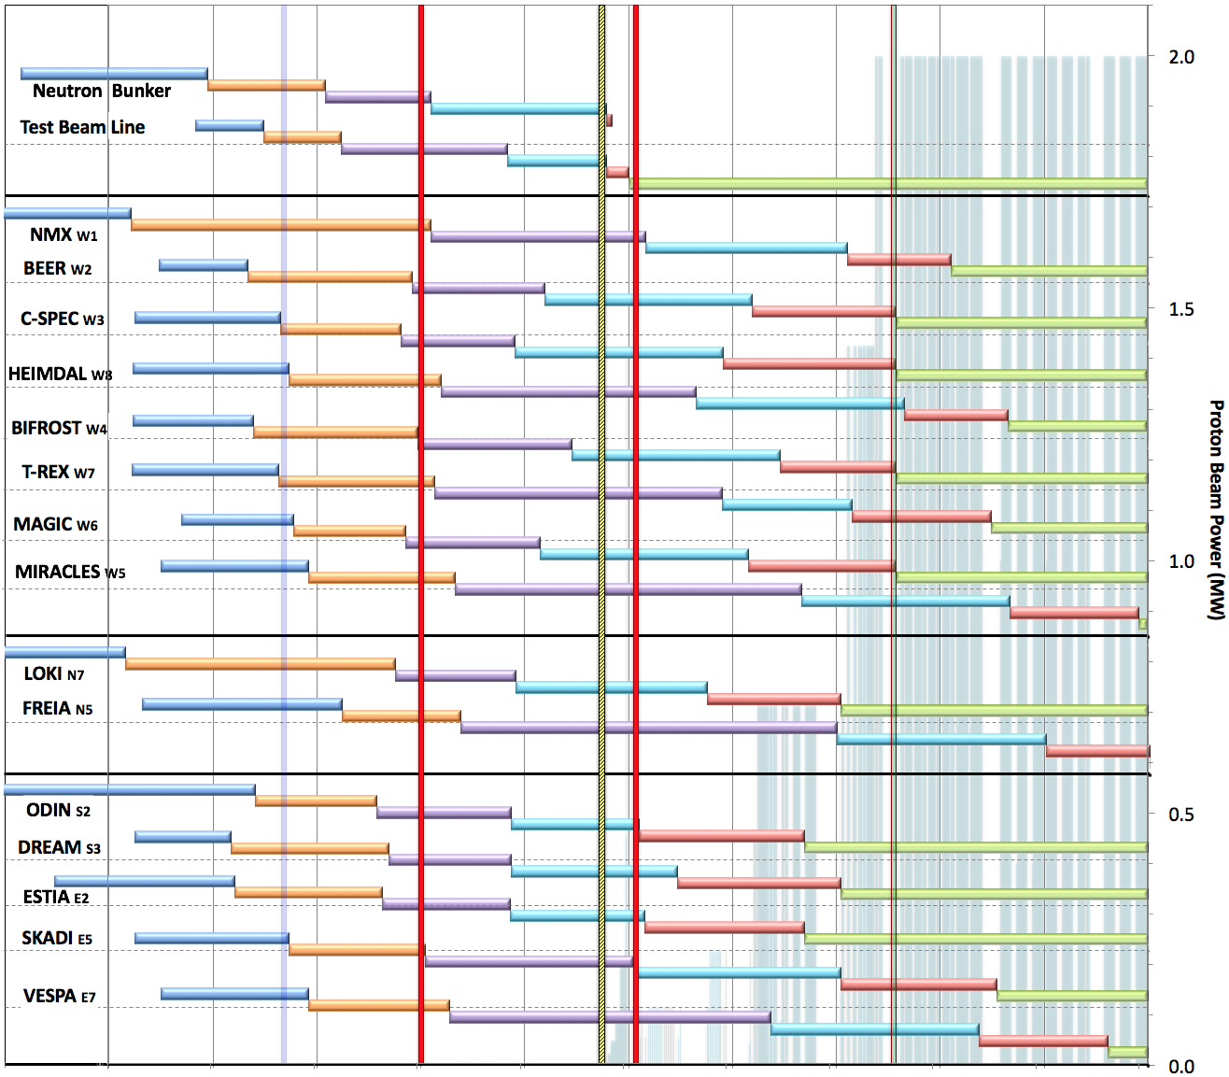
Internal* Neutron Beam Instrument Schedule Draft for Discussion V3.4, 15th September 2017
Shane K.
Current date
First access to NSS areas
Hot Commission
instruments
Start User Program
* still under discussion with ESS-ERIC Council
Beam on Target
NOTES:
Assumes 2MW maximum power until end 2025
Phases aligned with TG2 reviews on 1st 10 NBIs
Installation & Integration (TG4) + Hot Commissioning (TG5) for first 8 NBIs aligned with draft BOI plan (schedule match typically within 1 month)
West sector
North sector
East and South sectors
Preliminary Design
Detailed Design
Manufacturing & Procurement
Installation & Integration
Hot Commissioning/Early science
Operation
2016 2017 2018 2019 2020 2021 2022 2023 2024 2025
Notes:
This schedule assumes
obtaining the radiological licenses in a timely fashion from SSM. A trigger ‘first optical instrument component outside the monolith’ and a 6 months period from submission of the application to obtaining the SSM license - have been assumed (pending formal confirmation from ESH).
an initial hot commissioning of Accelerator and Target (A&T) to establish reliable beam on target at design frequency and pulse width.
In 2021, commissioning of the first (4-5) neutron instruments is to be conducted at low power, where possible, in order to minimize activation of in-bunker components of the neutron instruments. In the current plan, the duration of this initial commissioning period is 10-12 weeks.
Over 2022 and 2023 beam power and availability will increase, as the first 8 or more neutron instruments start hot commissioning, with a goal of reaching 2 MW source power by the start of the user program and maintaining that level until 2026.
Commencement of hot commissioning for the first 8 neutron instruments (TG5 in Table 1) is closely aligned with the schedules presented by those instrument build teams at TG2. This order matches well with the NSS “Early Science Success” strategy, and distributes responsibility for delivery widely among our experienced In-Kind partners. Changes to this order will be made if necessary to mitigate effects of delays to individual neutron instrument projects.
TG5 dates for neutron instruments 9-15 will be delayed to concentrate on-site resources for installation and commissioning (both cold commission and hot commissioning) on the first eight instruments to facilitate early science success for those instruments. This is discussed further below and illustrated in the NSS Installation and Commissioning schedule (Fig. 3).
TG3 dates refer to “final” approval of detailed design, when the integrated design of all major components is judged to be complete, and beyond which no further approval from NSS management is required for manufacturing. At this point in time these TG3 dates are not fixed, but NSS management plans for this to occur in staged manner. “Early procurement” approval dates for in-monolith optics and other critical path procurements (such as in-bunker components for the first instruments) are not shown in the figure

Slide 22
High level Bunker manufacturing and Installation Schedule
Sofie O.
R6
(Jan 2019)
Critical Design Review Dec 2017
Issue of tender for Manufacturing Q4 2017
Contract for manufacturing Q1 2018
First Delivery to ESS site (R6 & steel sructure) Dec 2018
Mid delivery to ESS site (wall blocks & first roof layer) June 2019
Final delivery to ESS site (final roof layer) July 2020
LS & Insert (with Target)
installation
(Feb-Sep 2019)
Bunker Pillars
& Beams
(June-Oct 2019)
Bunker walls & first roof layer
(Aug-Nov 2019)
Instrument & TBL installation
(Nov 2019 – May 2020 )
First neutron instruments planning for “In-Bunker” installation within this 6 month period.
Bunker roof
outer layer
(June-Aug 2020)
Beam on Target
Oct 2020
Utilities/Infrastr. & ICS installation & test
(Sep-Oct 2020)
Installations assumes normal working hours and summer/Christmas holidays

Slide 23
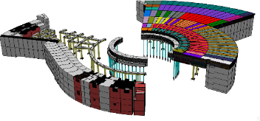
The Bunker Overview Outlook
Mechanical Design – is continuing while maintaining VE effort. The plan is to complete the mechanical design by the CDR (models only); detailing (drawings) will be performed by the supplier (manufacturer).
Physics – Change in the bunker material composition meant a fresh (updated) battery of analyses needed to be done. Continuous VE efforts also introduce additional and longer workload. However, the outlook is good provided we conclude all VE effort by the time the ‘metal is cut’.
Documentation – Following ramp up in resources addressing this body of work, we are on track to complete the documentation bundle by the CDR
Purchasing/schedule – At current state, the schedule and budget are unaffected (provided tendering/purchasing is conducted on time and within the budget).

Slide 24
The Bunker Overview Q/A
End of presentation
Q/A

