Slide 1
ES&H and Licensing and Quality IKON September 2017
Ralf Trant
ESS Associate Director ESH & Q
Peter Jacobsson Mattias Skafar
Head of ES&H division Head of Quality division
www.europeanspallationsource.se
2017-06-13

Slide 2
Our vision is to build and operate the world’s most powerful neutron source, enabling scientific breakthroughs in research related to materials, energy, health and the environment, and addressing some of the most important societal challenges of our time
To do this, we commit to deliver ESS as a facility that:
Is built safely, on time and on budget
Produces research outputs that are best-in-class both in terms of scientific quality and in terms of socioeconomic impact
Supports and develops its user community, fosters a scientific culture of excellence and acts as an international scientific hub
Operates safely, efficiently and economically and responds to the needs of its stakeholders, its host states and member states
Develops innovative ways of working, new technologies, and upgrades to capabilities needed to remain at the cutting edge

Slide 3
ESH & Q
ESH & Q
Ralf Trant (Ass. Director)
Nina Åsvatne (Assistant)
Security (Physical & Information; CM & ER)
Ulrika Agnvik N.N.
Licensing
Johan Waldeck
ESH Division
Peter Jacobsson (HoD)
Training: L. Aprin
Environment: E. Lindström
Radiation Safety: T. Hansson, F. Javier
Quality Division
Mattias Skafar (HoD)
Radiation Protection (RP) Group N.N.
Occupation Health & Safety (OHS) Group N.N.
HR: K. Anderberg
Planner: C. Matheron

Slide 4
ESH&Q functions
ESH&Q is responsible for developing and maintaining the ESH&Q strategy, in particular the regulatory compliance strategy for ESH, developing an ESS safety and quality culture incl. the continuous improvement of related programs and activities, as well as the coordination of licensing activities and contacts with the host state(s) in ESH&Q matters.
ESH&Q develops, supports, monitors and assures the implementation of policies, rules, processes, objectives and best practices at all levels of the organization in matters of ESH&Q.
Environmental protection, Safety & occupational Health (incl. RP)
Quality
Licensing (SSM, Env. Court, Länsstyrelsen Skåne, Fire Brigade, Municipality)
Security, crisis management and emergency response coordination
Notes:
Reasonable to show?

Slide 5
What we expect from you and what you can expect from us
Your partner is NSS
and NSS / ESH&Q are closely collaborating!
i.e. rules/guidelines/procedures are elaborated in close collaboration
What do we expect from you
Hazard inventory (chemical, pressure, cryogenics, bio …)
Risk assessment
Define/implement/verify mitigation measures
and you have ESH rules/guidelines for this from your NSS partner
Radiation Protection e.g. shielding calculations in line with the relevant ESS procedure
ESH&Q will review the ‘Safety readiness’ for commissioning/operation as part of TG5

Slide 6
Swedish Legislation
The Swedish Environmental Code General assurance for protection of environment and public
Radiation Protection Act Assure that environment, public and workers do not get exposure of ionisation radiation above given thresholds. Specifically for
Operation of equipment that generate ionisation radiation
Handling of radioactive material, including waste
Work Environment Act Assure that employees are protected
A number of specific acts & codes for different hazards Examples: Electricity, chemicals, explosives, pressurized devices….

Slide 7
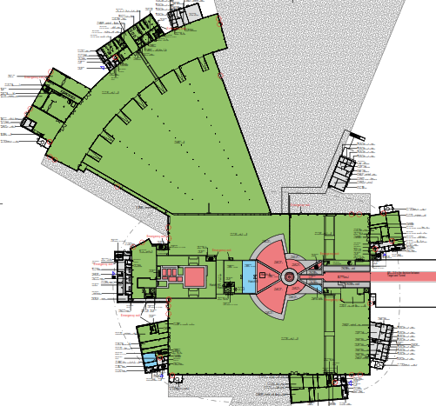
Radiological Zoning and Access [see presentation this afternoon by M. Hartl]
Supervised zone (no contamination)
Unrestricted controlled zone
Restricted controlled zone
Highly restricted controlled zone
Experimental halls, workshops and labs are a supervised zone with some controlled zones, e.g.
Radioactive Materials Lab.
Beamlines
Portal monitors/hand&foot monitor => access control by card reader

Slide 8
Operational Radiation Protection [see presentation this afternoon by M. Hartl]
Shutter closed
Experimental
Cave -
Closed
Shutter
Operations/maintenance
e.g. ‘flexible zoning’ for exp. cave
Operational safety, e.g.:
access to exp. cave (PSS)
rad. surveys by RPTs (ESH)
training (ESH)
sample management procedure
shutter
sample
beamline
Shielding with active
Personal Safety System (PSS)
shutter
Experimental
Cave –
Open
Shutter
sample
beamline
Shutter open
Outside the shielding: 3 μSv/h
Notes:
Safety Readiness Review as part of TG5 - ESH = OHS & RP

Slide 9
Licensing … an ESS business
Detailed design
Procurement and Installation
Commissioning
Operation
Preliminary Design
ESS project phases
Permissibility
Permit
Installation
Permit
Trial operation
Permit staged: 4/18, 11/18, 10/19
Routine operation
Permit
SSM stepwise licensing process
Note:
Installation License received from SSM covers accelerator and target

Slide 10
Licensing … an ESS business
ESS received 30 June 2017 the conditional permit to install equipment intended to generate ionizing radiation, including the Accelerator, Klystron, and Target buildings.
The Swedish radiation safety authority mentions for the ‘NSS installations’: “ESS shall provide the more detailed documentation required before installation for the neutron scattering systems (NSS) at a later stage in the incremental licensing process, in order to be able to handle radiation sources and so the installation of a technical device may be allowed.”

Slide 11
Quality Management [see presentation this afternoon by M. Skafar]
ESS
IKC Contract
Technical Annex
Project Quality Plan
Applicable standards
Non-conformity reports
Quality visits
Supplier audits
High
(Right)
Quality
Delivery
External provider
In-Kind Collaborator
Commercial contract
Technical specification
Notes:
ESS-0055446 ESS procedure for Graded approach.
ESS-0016468 ESS rule for identification and classification of safety important components

Slide 12
Fundamental questions to ask ourselves
Do we want to be compliant with applicable laws?
National and European legislation, standards and directives
Requirements
Do we want to have a facility that we can up-date and repair with high availability?
Drawings, material certificates, test/inspection reports etc.
Technical file
Do we want to have a safe facility with a high quality user program?
Safety/risk assessment
Safety file

Slide 13
ESS Strategy for CE Marking [see presentation this afternoon by M. Skafar]
The Strategy applies to:
Internal deliverables
Commercial contracts
In-Kind Contributions
CE marking is mandatory.
when there is an applicable European Directive.
The delivery shall include:
Risk assessment (ISO 12100)
Technical File, drawings, wiring diagram, P&ID, test reports etc.
Operational Manual/instructions, in English
Declaration of Conformity (ISO 17050)

Slide 14
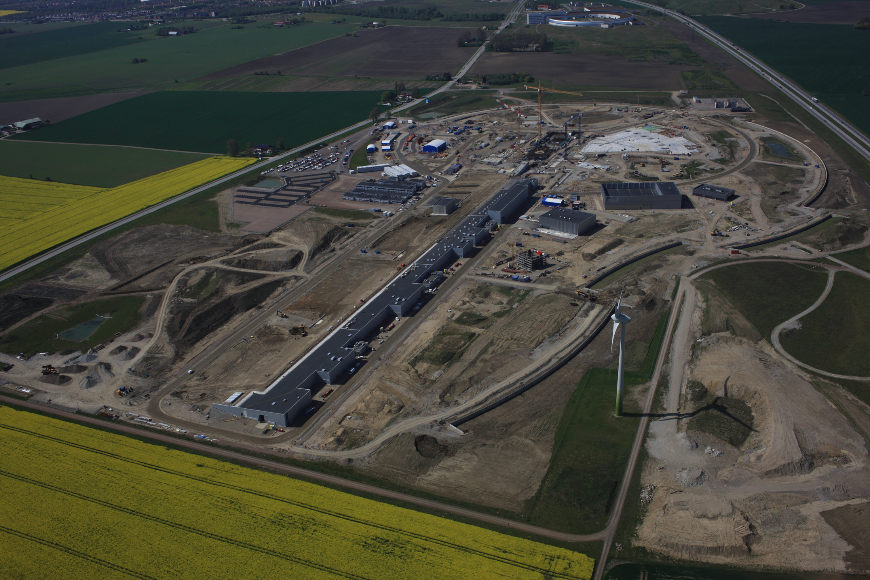
Thank you for your collaboration!
Remember: we work safely or not at all

