Slide 1
BEER Status Update
IKON13 – September 26, 2017

Slide 2
NPI Workpackage Status
Design of the shielding and cave/hutch outsourced to NUVIA
Contract for shielding and cave/hutch already signed and processed
  First phase is the final design – CDR at Q1-Q2/2018
  Second phase fabrication and installation – signed NIK is NEEDED before CDR!
Preparation of the tender for the transport guide section
  Planed two phases – design & fabrication/installation
  Call already made – two candidates
  Negotiation about the technical specifications just started
  Budget schedule mismatch between NPI & ESS (discussion tomorrow)

Slide 3
Preliminary cave concept
Technical issues with lift to the elevated cave floor
  50 cm dead-height for the lift
Design modification
  Use 2x3.5 m shaft in the cave
  Cave crane increased to 4 tons
  Future lift installation possible
  Air-pads platform still in use
  Heavy doors on hall floor
  No elevation of the prep. lab
Personal access

Slide 4
Preliminary cave concept
Roof access from the rear – 2.2x3 m blocks
Preparatory lab height 3.2 m & heavy doors height 2.2 m

Slide 5
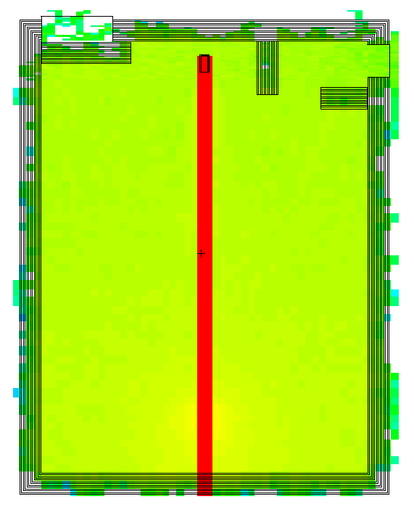
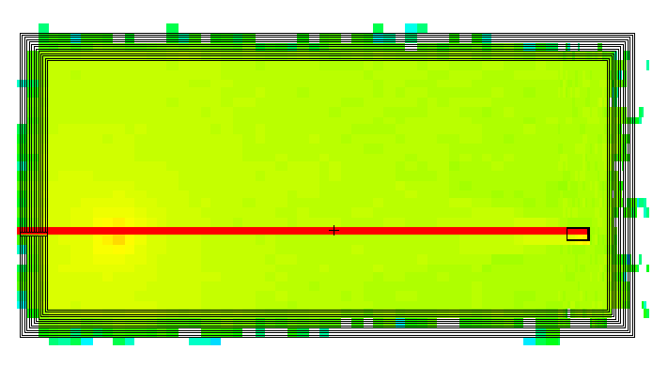
Cave and guide shielding concept
MCNP calculations ongoing – needed for cave and shielding design
Preliminary wall thickness for the cave about 50 cm will be OK
Concept of guide shielding will be presented on workshop
Neutron
Gammas

Slide 6
Cave and guide shielding concept
MCNP calculations ongoing – needed for cave and shielding design
Preliminary wall thickness for the cave about 50 cm will be OK
Concept of guide shielding will be presented on workshop
 | Dose rate (μSv/h)
Sample | 0.1 cm³ Mn |  |  | 1 cm³ H₂O
Wall thickness | 50 cm | 55 cm | 60 cm | 50 cm | 55 cm | 60 cm
P1 (back wall) | 0.75 | 0.64 | 0.48 | 1.83 | 1.13 | 0.67
P2 (back wall) | 1.31 | 1.09 | 0.57 | 1.63 | 1.14 | 0.68
P3( back wall) | 0.80 | 0.78 | 0.45 | 1.25 | 1.20 | 0.95
P4 (roof) | 3.24 | 2.26 | 1.67 | 3.04 | 2.21 | 1.18
P5 (side wall) | 1.78 | 1.17 | 1.03 | 2.56 | 1.46 | 0.95

Slide 7
Cave and guide shielding concept
100 MeV neutrons after the bunker (in total ~15 mSv)
Cave shielding recommendation
  Heavy concrete with thickness of 30-35 cm
  Normal concrete with thickness of 50-55 cm
Guide shielding recommendation
  Heavy concrete equivalent with thickness of 55-60 cm
  First 2-4 m after the bunker thickness of 80 cm
Shutter material recommendation
  Steel with thickness of 80-85 cm with 2 cm of B₄C at front and back
  Shutter pit with inner wall with thickness of 20-30 cm of steel
  Shutter pit outer wall same as guide shielding
Further simulation needed

Slide 8
Current issues
Checking the bunker wall feedthrough position
Prioritisation of upgrade agreed with NSS – comments discussed
New NSS schedule V3.4
  In-bunker installation within 3 month (planned 6 month)
  Installation in the same time as Bifrost and Magic
  Hot commissioning just after in-bunker installation (no cold commissioning)
  First access (??) to D & E buildings Mar-20 (shielding and/or cave before 2020)
  When installation of the shutter after the bunker? (planned for 5/2020)
Financing budget schedule mismatch under discussion
NIK under negotiation – text needed at last on December 2017
BEER documents twice on CHESS – need to be solved
SE – pool deformation rig need to be specified (discussed with SAD)
Data reduction for multiplexing technique – needed at Day-one

Slide 9
HZG Workpackage Update
Frame work contract in preparation
Minor work on NBOA and bunker throughput
Specification of choppers
Support in Cave design (cable traces, …)
Comparison of detector technology

