Slide 1
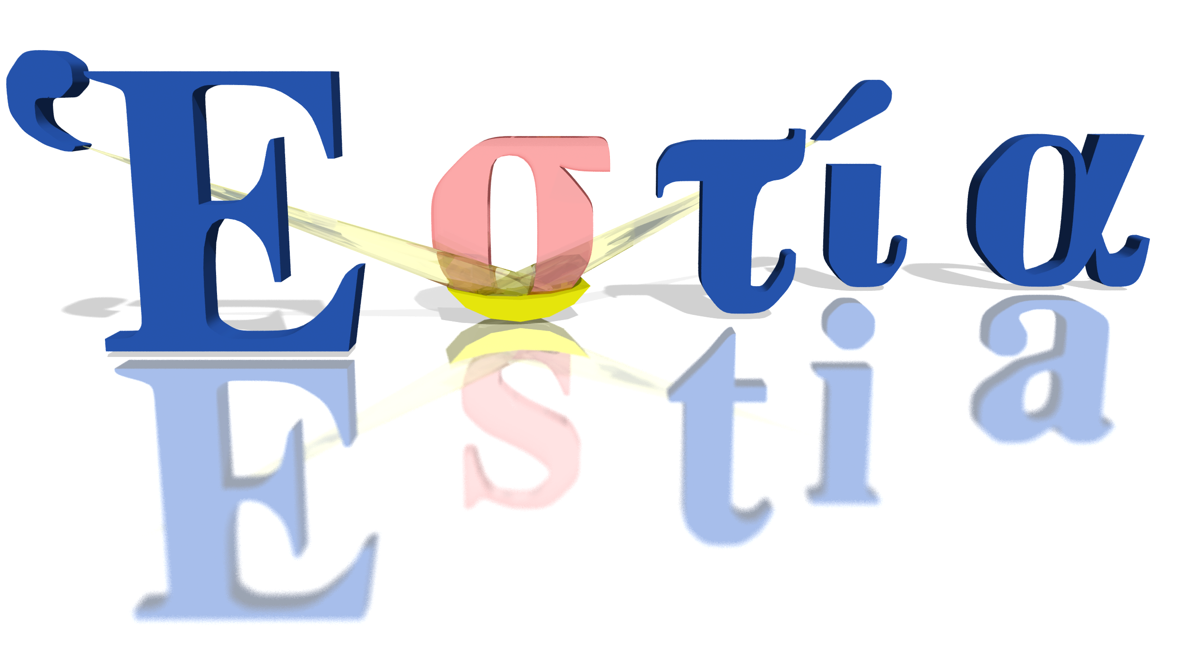
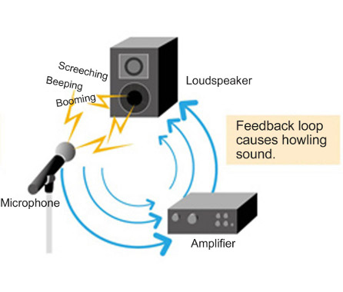
B
Artur Glavic, Sven Schütz :: Lead Scientist, Lead Engineer :: Paul Scherrer Institut
IKON 13 – Feedback from Estia

Slide 2
Pros & Cons
Well organized distribution of sessions
Most subjects of interest covered
Going into more technical details than on earlier IKONs
Detailed planning meeting good idea
Some rooms to small for size of session
Not enough time (none) between session and discussion sessions to change location => reduced time for these discussions
Scheduling meeting too chaotic, should have collected information in advance
Changing rules/boundary conditions repeatedly
Room map on schedule would have been helpful
Page <number>
Notes:
Artur
<number>

