Slide 1
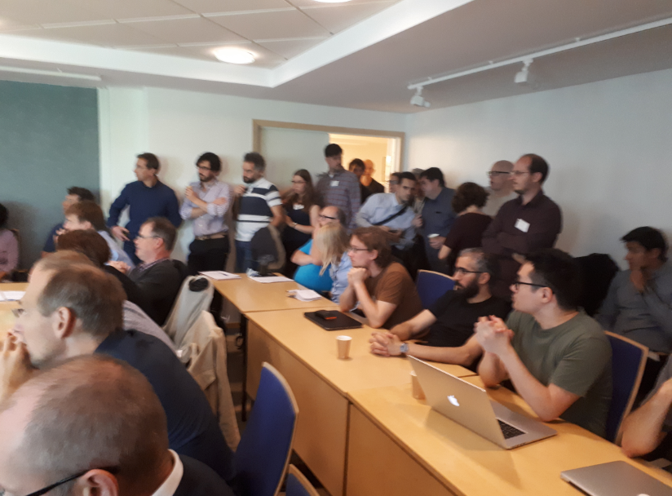
IKON 13
Feedback from DREAM
« Integrated Schedule and Prioertization »
Good idea BUT
teams should have been warned
… to be present
… to prepare answers
Need for bigger parallel session rooms (60 pers. Min)
Site visit
Always good BUT
Walking visit next time
→ Adds value (cf Brightness visit on Monday)
Free slots
VERY good BUT
1h30 probably even better
No group photo during that time

Slide 2
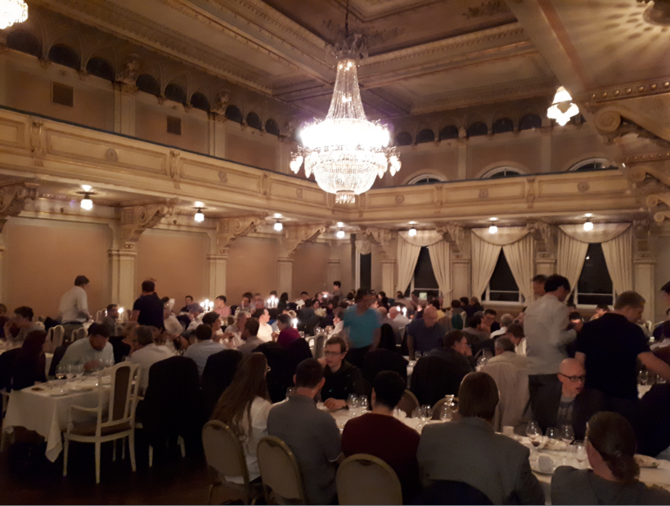
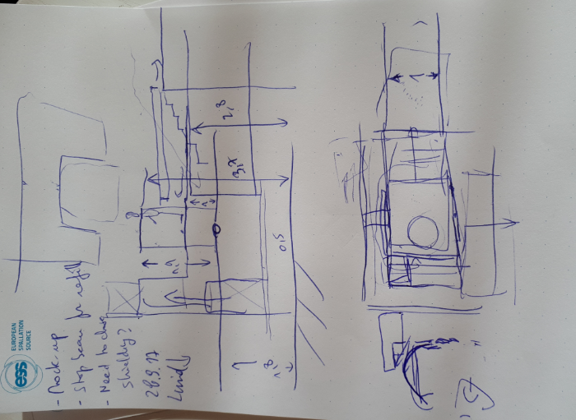
Great Organization
Clear location of rooms
Schedule respected
Great dinner
Free slots
Physical meetings
… scheduled
… improvised
Feedback session
IKON 14
Topics of presentations
Up-to-date information in phase with the project
TG3 oriented / Schedule / Integration

