Slide 1
NSS installation plan (neutron bunker, test beam line and n. 15 instruments)
Antonio Bianchi
NSS Installation Co-ordinator
European Spallation Source ERIC
www.europeanspallationsource.se
28th September 2017

Slide 2
NSS installation work
The NSS installation work includes:
The construction of the Neutron Bunker;
The installation of the test beam line (T.B.L.);
The installation of n. 15 instruments;
The current integrated installation plan take into account the following main milestones:
The Master Schedule rev. 3.4 defines a priority in the installation of the following 8 instruments:
NBOA Monolith insert assembly | Dec - 18
Bunker ready for BOT | Oct-20
Test Beam Line ready for BOT | Oct-20
First Instrument ready for Hot Commissioning | feb-21
First call for experiments in full User program | Jan-23
Start of User Program | Aug-23

Slide 3
First 8 instruments to be installed
DRAFT
N.I. | B.P. | First eight Instruments to install | D&E Halls access | Bunker priority access | TG5: Hot Comm. start
1 | S3 | ODIN (TUM/PSI) | April 2020 | December 2019 | Feb 2021
2 | E2 | ESTIA (PSI) | February 2020 | December 2019 | March 2021
3 | S2 | DREAM (FZJ) | April 2020 | December 2019 | June 2021
4 | N7 | LOKI (ISIS) | December 2019 | July 2021 (1st shut down after B.o.T.) | Oct. 2021
5 | W3 | C-SPEC (TUM) | November 2019 | July 2021 (1st shut down after B.o.T.) | Nov 2021
6 | W6 | MAGIC (LLB) | February 2020 | December 2021 (2st shut down after B.o.T.) | Feb. 2022
7 | W2 | BEER (HZG/NPI) | March 2020 | December 2021 (2nd shut down after B.o.T.) | March 2022
8 | W4 | BIFROST (DTU) | June 2020 | December 2021 (2nd shut down after B.o.T.) | June 2022
Follow a brief analysis of the Master Schedule rev. 3.4 from construction perspective:

Slide 4
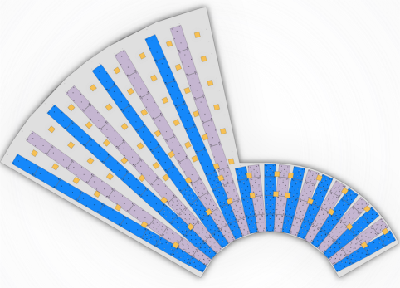
Q1 - 2019
DRAFT
Full access 27 May 2019
NSS Early Access
Dec 2018
BUNKER BASEPLATES
INSTALLATION
CF works
D&E buildings
CF/NSS/TD
Coordination is on- going since now

Slide 5
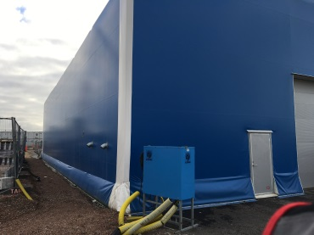
Q2 - 2019
DRAFT
Alternative Bunker
Storage area
PARTIAL ACCESS
E02.1
27.05.2019

Slide 6
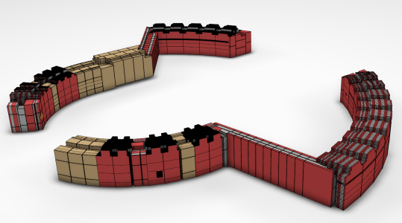
Q3 - 2019
DRAFT
E02.2
Partial access 15.11.2019
20 t/m2
Storage Areas
Temporary mobile cranes to be placed into D01 and D03
(Facility cranes not available yet)

Slide 7
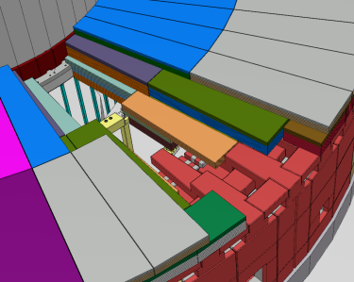
Q4 - 2019
DRAFT
C-SPEC
E01 ACCESS
NOV 2019
E01 main constraints
Slab load capacity 20 t/m2
Crane capacity 10 t
Hook height 10 m
DETAILED DESIGN
NSS
FIRST LAYER ROOF INSTALLATION
C.F./SKANSKA
Works into
D01-D03 buildings

Slide 8
Q1 - 2020
DRAFT
BEAM SUPPORT CONCEPT DESIGN
FEB 2020
MAGIC FIRST ACCESS
FEBRUARY E01 BUILDING
C-SPEC INSTALLATION PROGRESS
INTO E02.1 GUIDE HALL
T.B.L. INSTALLATION
LOKI FIRST ACCESS
D03 BUILDING DECEMBER 2019
CONV FACILITIES WORKS
D01/D03
CLOSE TO COMPLETATION
IN BUNKER COMPONENT INSTALLATION
ODIN
DREAM
ESTIA
DEC 2019 – MAY 2020
PARTIAL ACCESS
02.04.2020
PARTIAL ACCESS
06.02.2020

Slide 9
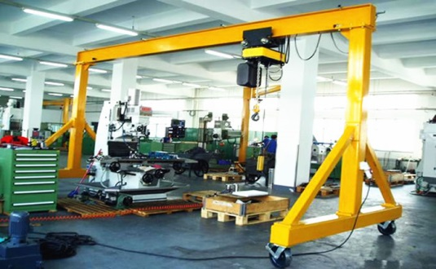
Q2 - 2020
DRAFT
BIFROST
FIRST ACCESS JUNE 2020
E01 BUILDING
ALL THE FIRST 8 INSTRUMENTS INVOLVED
BUNKER ROOF TO BE COMPLETED
C-SPEC INSTALLATION OF NEUTRON GUIDE, CHOPPERS, VAC. SYSTEM
E02.2 AREA
BEER
FIRST ACCESS MARCH 2020
E01 BUILDING
T.B.L. COLD COMMISSIONING
D03 30 t CRANE
AVAILABLE FOR LOKI INSTALLATION
GANTRY CRANE AVAILABLE 10 ton
D01 30 t CRANE
AVAILABLE
ODIN, DREAM, ESTIA
OUT OF BUNKER INSTALLATION

Slide 10
Q3 - 2020
DRAFT
E02 main constraints
Slab load capacity 5 t/m2
Forklifts 10 ton
BEER, C SPEC, BIFROST AND MAGIC
PROGRESS IN THE E02 BUILDING
T.B.L. COLD COMMISSIONING
NSS
2ND AND 3RD ROOF LAYERS INSTALLED
ODIN, DREAM, ESTIA
PROGRESS IN THE INSTALLATION OUT OF BUNKER
Temporary Mobile Crane to support instruments installation if necessary

Slide 11
Q4 - 2020
DRAFT
BEER, BIFROST AND MAGIC
PROGRESS IN THE E02 BUILDING
C SPEC ACCESS INTO D03 BUILDING
LOKI PROGRESS
INSTALLATION INTO
D03 BUILDING
15.10.2020
BUNKER AND TBL READY FOR
B.o.T.
ESTIA, ODIN AND DREAM CLOSE TO
COLD COMMISSIONING

Slide 12
Q1 - 2021
DRAFT
MAGIC AND BEER SHIELDING INSTALLATION INTO E02 BUILDINGS
NMX
FIRST ACCESS
E01 BUILDING
MARCH 2021
LOKI
MAJORITY OF HEAVY COMPONENTS OUT OF BUNKER INSTALLED
1
2
FEBRUARY 2021
ODIN READY FOR HOT COMMISSIONING
MARCH 2021
ESTIA READY FOR HOT COMMISSIONING
SKADI FIRST ACCESS D01
JANUARY 2021

Slide 13
Q2 - 2021
DRAFT
NMX BEAM GUIDES INSTALLATION
INTO E02
LOKI INSTALLATION OUT OF BUNKER CLOSE TO BE COMPLETED
3
APRIL 2021
DREAM READY FOR HOT COMMISSIONING
SKADI PROGRESS INSTALLATION INTO D01

Slide 14
Q3 - 2021
DRAFT
SEPTEMBER 2021
T REX ACCESS TO E01 BUILDING
JULY – SEPTEMBER 2021
FIRST BUNKER SHUT DOWN
(AFTER B.O.T.)
C SPEC INSTALLATION
IN BUNKER COMPONENTS
LOKI INSTALLATION
OF IN BUNKER COMPONENTS
SKADI

Slide 15
Q4 - 2021
DRAFT
NOVEMBER 2021
C SPEC READY FOR HOT COMMISSIONING
DECEMBER 2021
HEIMDAL ACCESS TO E01 BUILDING
+
DECEMBER 2021
T REX – NEUTRON GUIDES INSTALLATION INTO E02
5
BIFROST
OCTOBER 2021
LOKI READY FOR HOT COMMISSIONING
4
SKADI

Slide 16
Q1 - 2022
DRAFT
FEBRUARY 2022
MAGIC READY FOR HOT COMMISSIONING
2nd BUNKER SHUT DOWN
(after B.o.T.)
W3: C SPEC COMPONENTS ALREADY INSTALLED
W4: BIFROST COMPONENTS
TO INSTALL
W2: BEER COMPONENTS
TO INSTALL
W6: MAGIC COMPONENTS
TO INSTALL
6
MARCH 2022
BEER READY FOR HOT COMMISSIONING
+
Nuclear Physics Institute
SKADI
7

Slide 17
Q2- 2022
DRAFT
MIRACLES FIRST
ACCESS E01 BUILDING
Q3 2022
HEIMDAL PROGRESS INSTALLATION INTO E01 BUILDING
JUNE 2022
BIFROST READY FOR HOT COMMISSIONING
T REX PROGRESS INSTALLATION INTO E01 BUILDING
NMX
PROGRESS INSTALLATION INTO D03 BUILDING
FREIA FIRST
ACCESS D03
Q1 2023
8
MAY 2022
VESPA FIRST ACCESS
INTO D01

Slide 18
Conclusions
2019 is expected a challenging year, due to CF, TD and NSS Divisions simultaneous construction/installation works. NSS priority is to prepare suitable site access condition for the first instruments teams at the beginning of 2020;
The “in-Bunker shut down” with “priority access” for two or three instruments maximum, provide a benefit to better guarantee the on-time installation of the in-Bunker components (in Bunker wall feedthrough installation to be analysed in detail);
A progressive site access in the D&E buildings can be really helpful to have proper working areas for each instrument team, resources optimisation, avoiding time loss, lack of cranes availability (even if a certain degree of flexibility shall be required anyway);
A well defined storage-plan from each instrument team is necessary to define a full picture of the on-site status trough the different facility zones (it is preferable condition do not storage material into the facility for long time in advance to the components installation);
A common structure in the installation-plan development from any Instrument team can be really helpful to a proper integration of the information between NSS and the instrument teams (please find the reference document ESS-0115143)

Slide 19
Questions

