Slide 1
IKON13 LoKI Instrument
LoKI Team
www.europeanspallationsource.se
25 September, 2017

Slide 2
Instruments overview
Optics and procurement
Bunker feedthrough
Aluminium wire seal test
Integration LoKI and Freia in D03
Installation

Slide 3
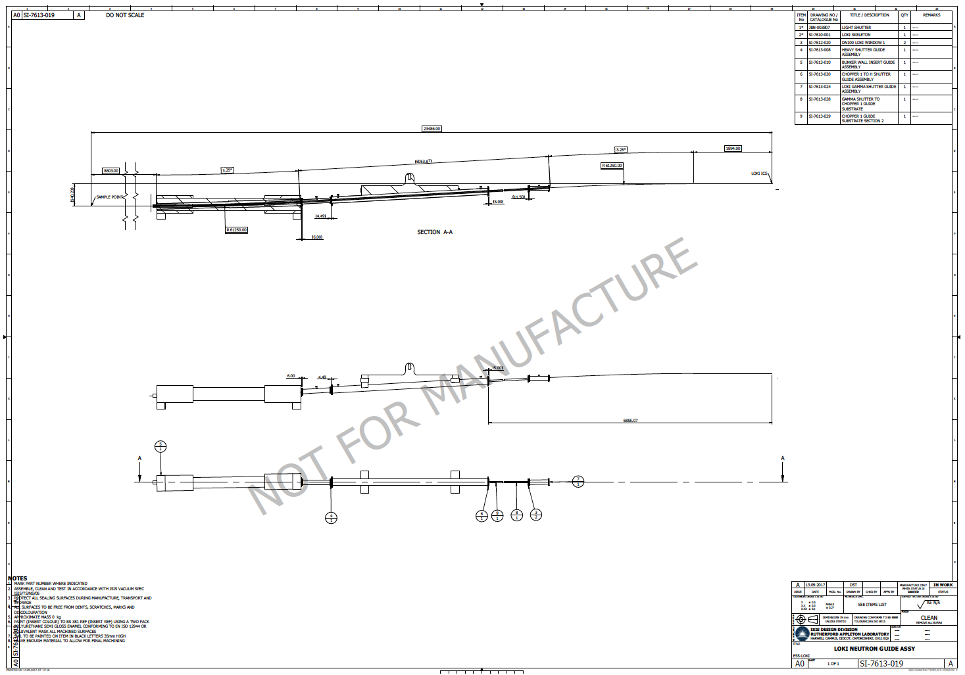
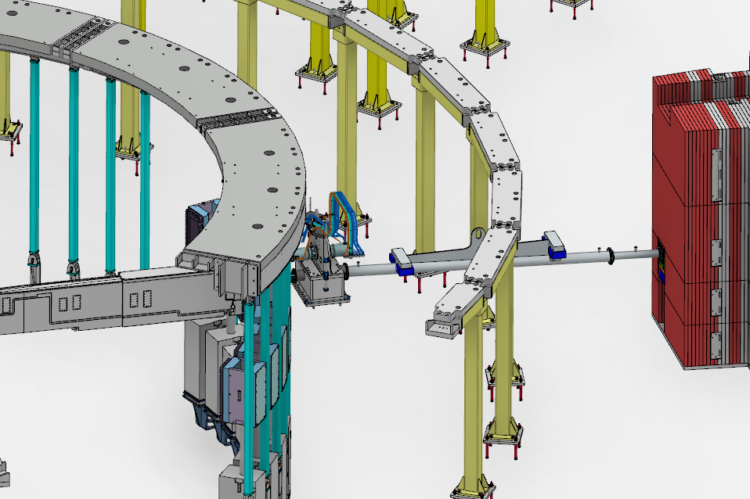
Guide concept

Slide 4
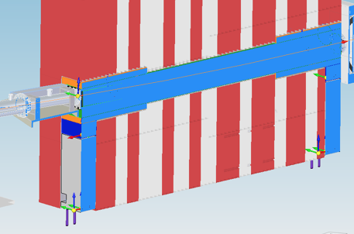
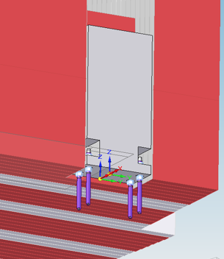
Guide Insert in bunker wall

Slide 5
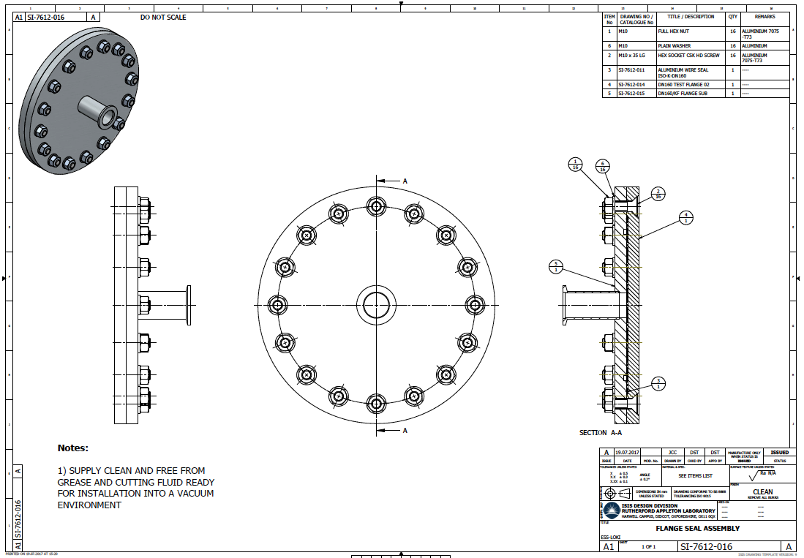
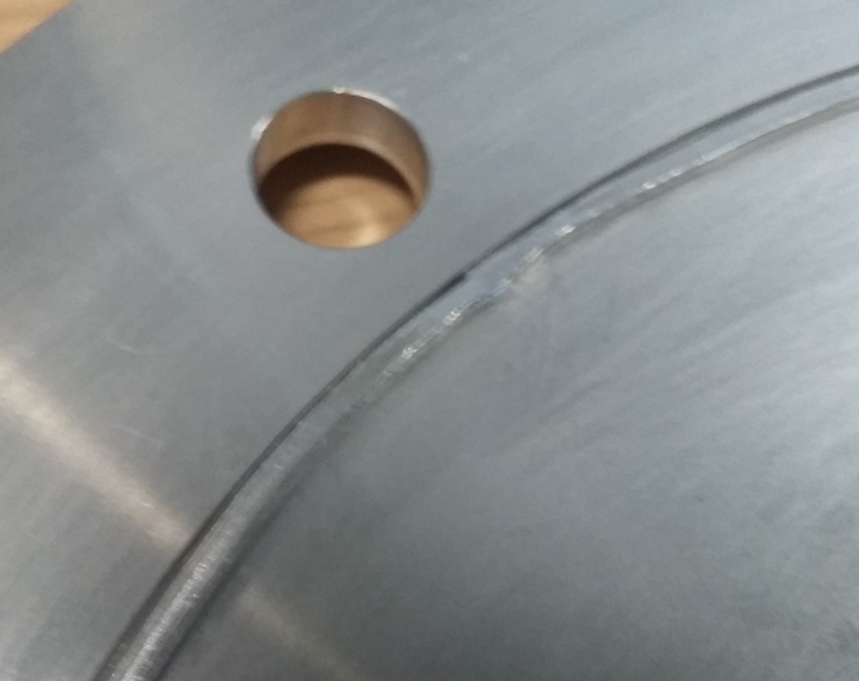
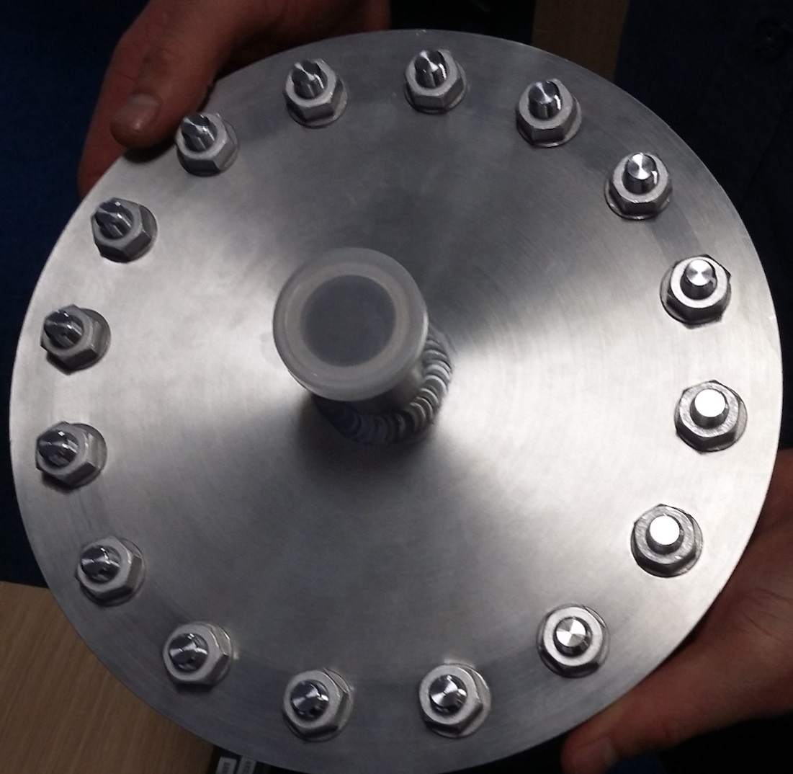
Aluminium sealing test
Seal, flanges and bolts in aluminium - 6082 and 6061 grade aluminium

Slide 6
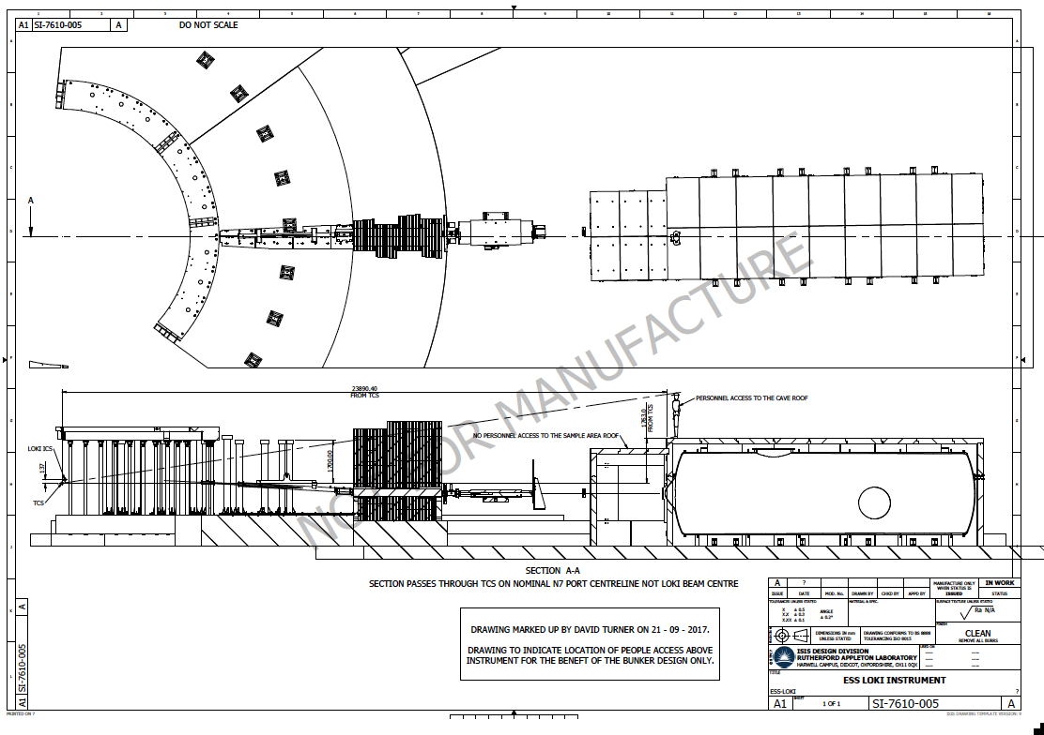
Loki Overview

Slide 7
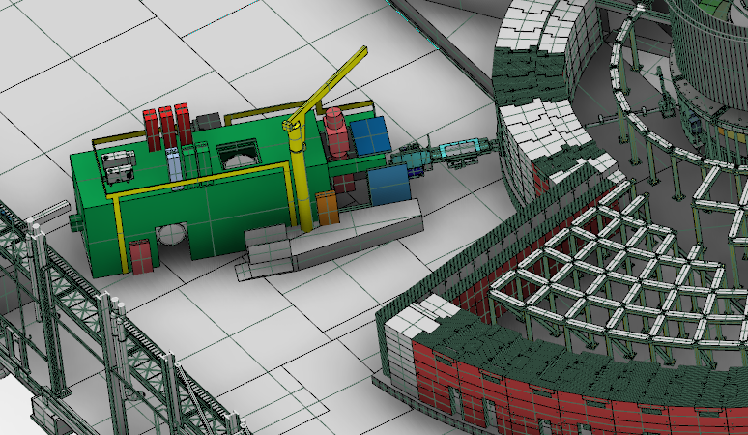
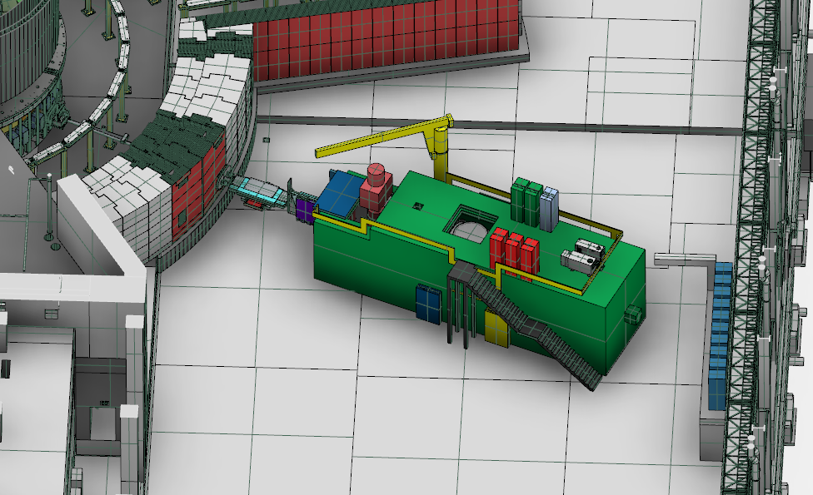
Instrument example
Notes:
Explain the whole interface, services, access to sample and preparation areas, access to buildings. ETC, example of applied rules generated by Technical groups and ESS in general

Slide 8
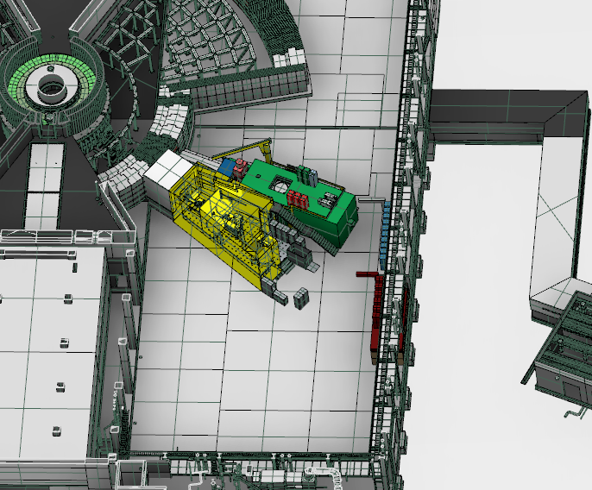
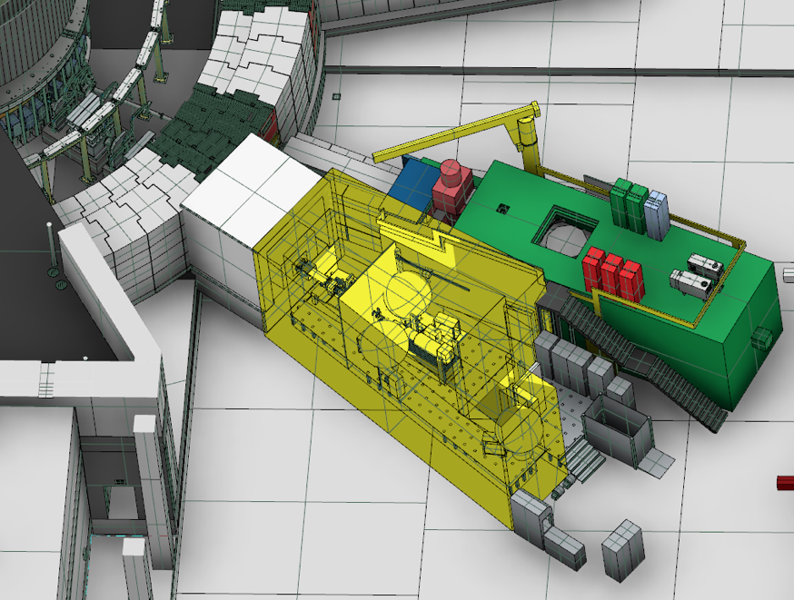
Instruments overview North Sector D03
Port N5 Freia
Port N7 LoKI
Notes:
Boundary for instruments Sector North
Physical: base plates – floor levels and floor loading, neighbor instruments, bunker wall 11.5 m to 15m, hall buildings and access to the buildings like doors sizes, crane height and crane capacity inside bunker and hall, access to services, Functional: Operability in specific areas, safety, machine protection, etc.
Contractual: relation between IKP/suppliers/ESS, scope of work, assumptions, etc.
Organizational: Exchange of information – communication strategy, reporting, etc.
Resources: manpower, equipment, labor, transportation, logistics, etc.

Slide 9
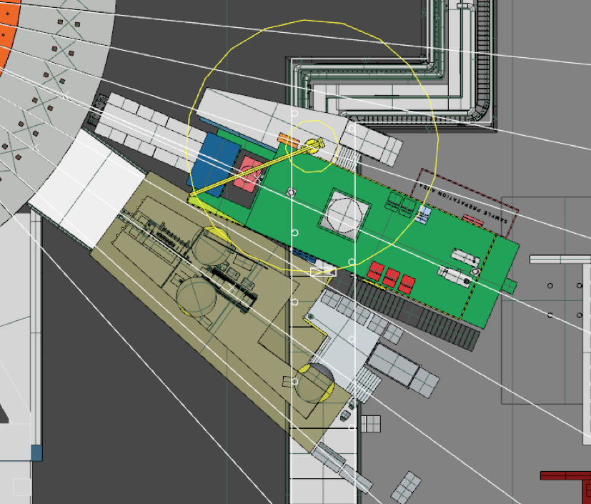
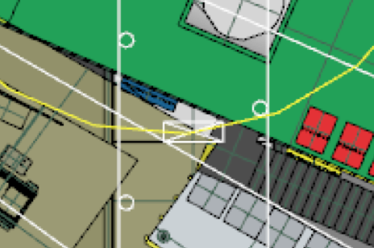
Interface examples
Penetration to galleries for access services

Slide 10
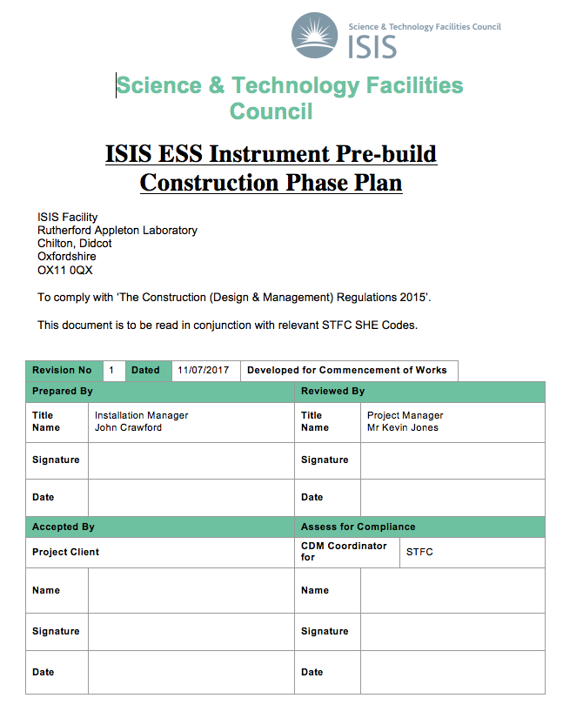
Installation
Pre-installation for LoKI- Freia and Vespa
Installation at ESS

Slide 11
Loki Instrument Build Sequence
Monolith Insert
Gamma Shutter
Loki within bunker
Generic Cables/pipes
Bunker wall
Bunker wall insert
Bunker wall
Services through wall
Bunker roof
concrete base
Alignment base
Post bunker components
Beamline shielding
PSS
Safety systems
First Neutrons
Sample area access floor
Sample area Components
Jib Crane
Vacuum pumps
End wall and beam-stop
Detector vessel
Cave walls & roof
Services from Gallery
Detectors
Loki cabin
DAE Racks
Racks and services

Slide 12
Questions and comments

