Slide 1
SKADI
Progress Update
26. September 2017 | S. Jaksch

Slide 2
Overview
Current Instrument overview
Dogleg Neutron Extraction Update
Sample Area
Scheduling
SoNDe Detector

Slide 3
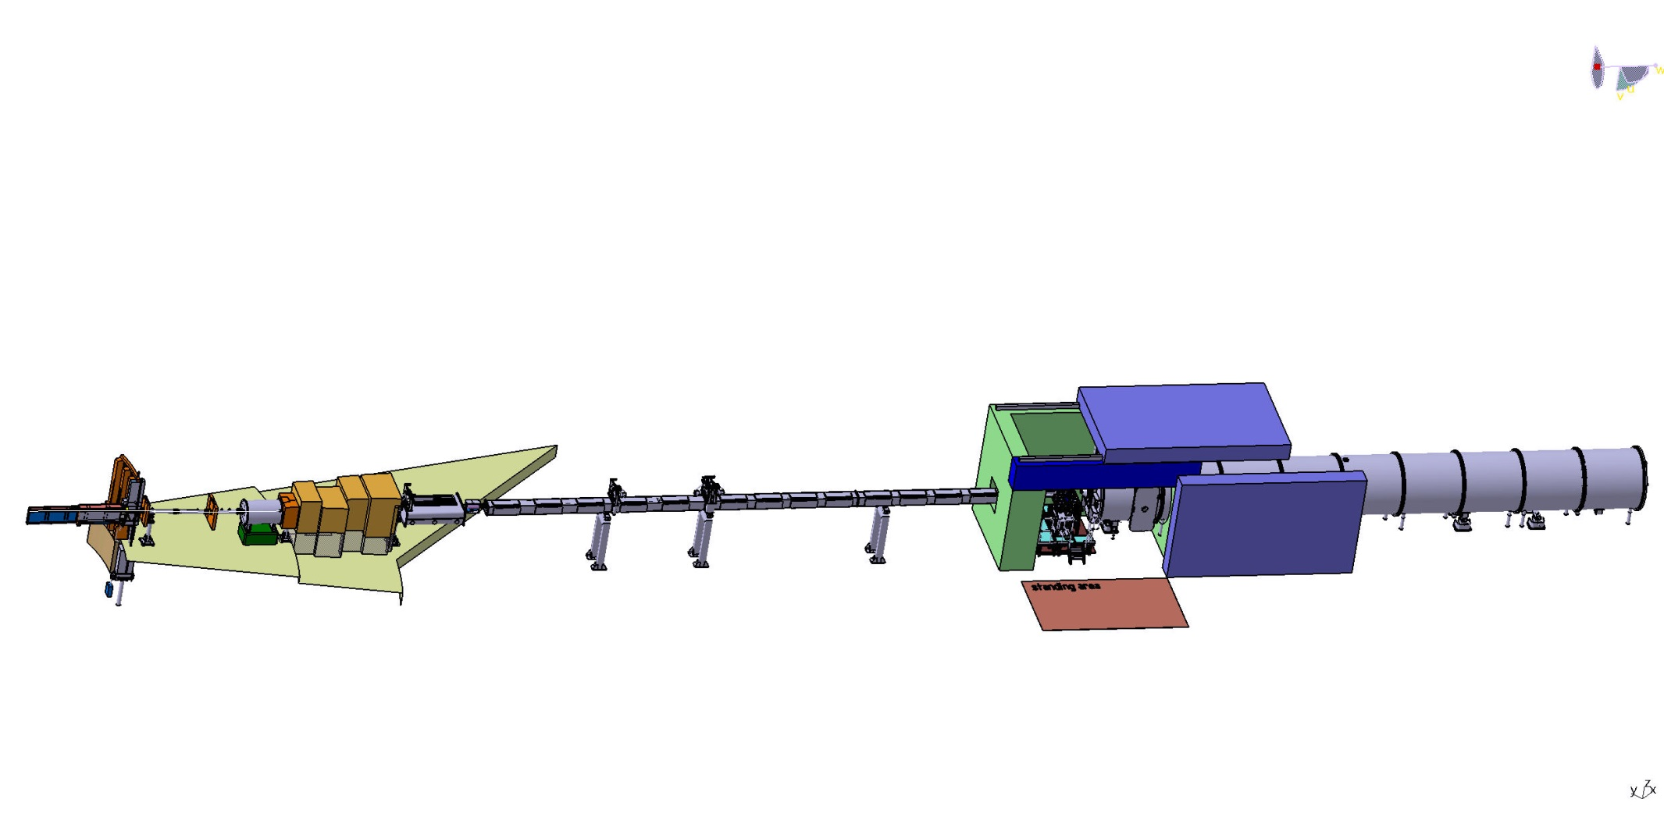
SKADI layout
Neutron
Extraction
Choppers
Sample Area
Detectortube
Bunker
Heavy shutter
Polarizer, Spin Flipper
Collimation
Shutter inside bunker (Gabor‘s design)
All choppers outside bunker

Slide 4
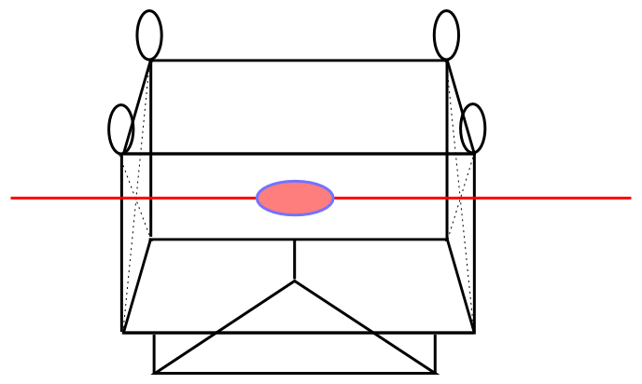
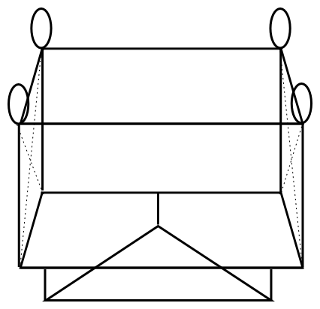
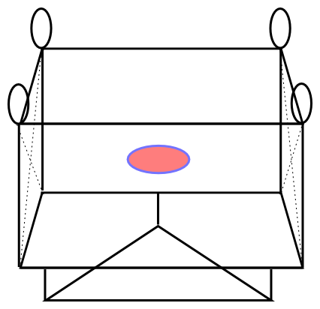
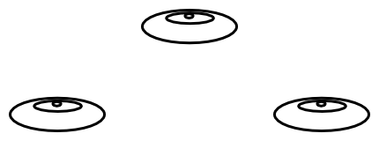
Sample Area
Plenty of available space
Custom sample environments
Fast change of sample environment
Crane/forklift accessibility
Standardized Interfaces
Data
Gas
Electronics

Slide 5
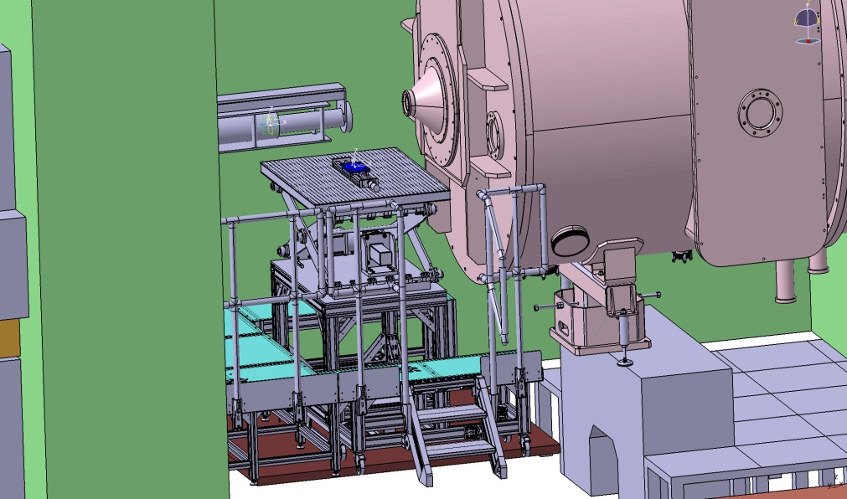
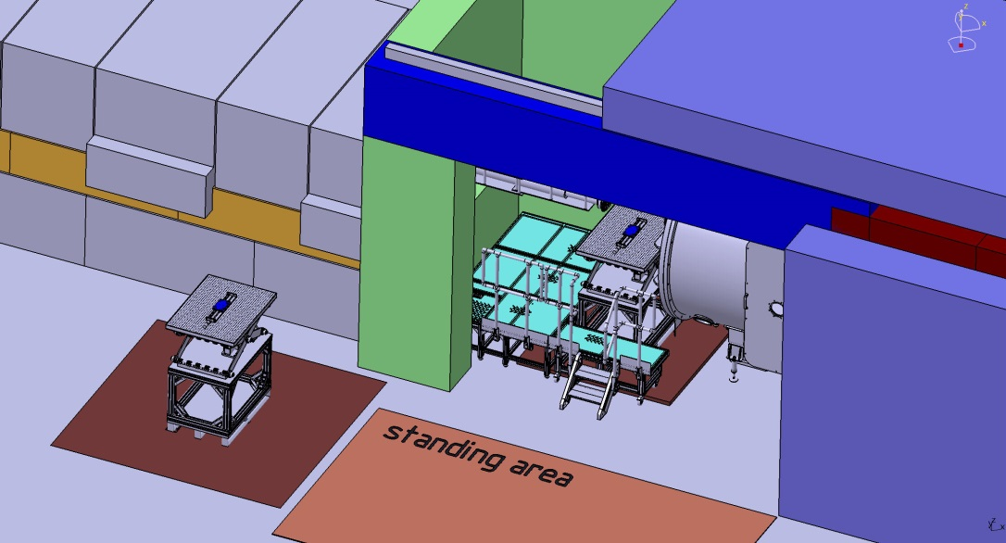
Sample area
hollow floor removable
Media readily accessible below false floor
Door minimum 2,0x2,0 m²
Door and roof panel motorized
Door also allows access to detector tube
Hollow floor on wheels in order to be readily removable

Slide 6
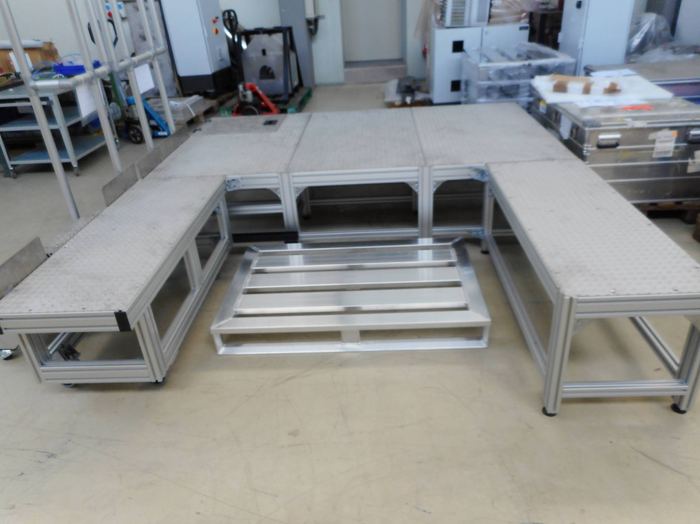
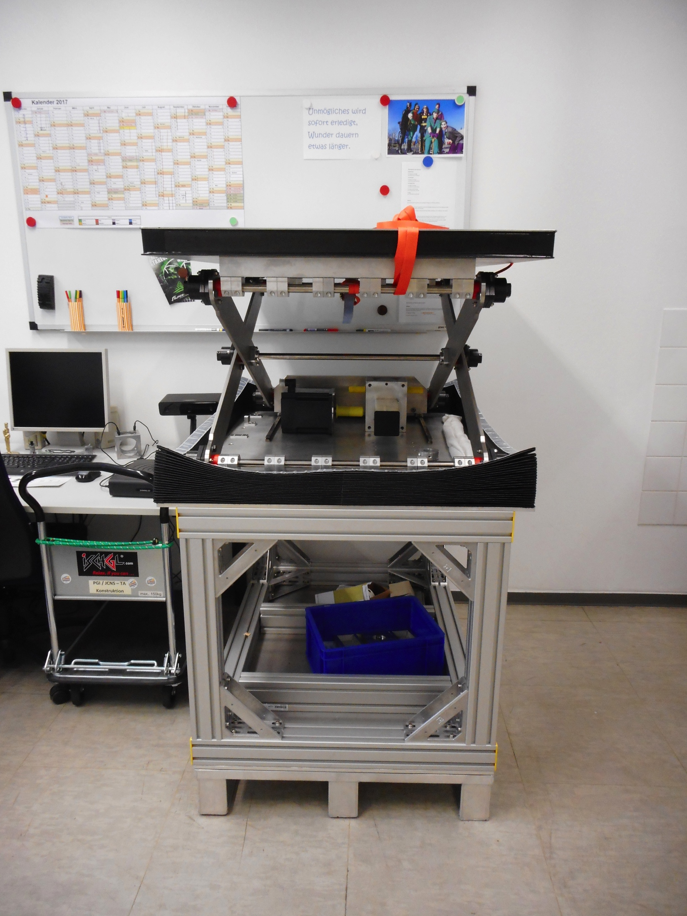
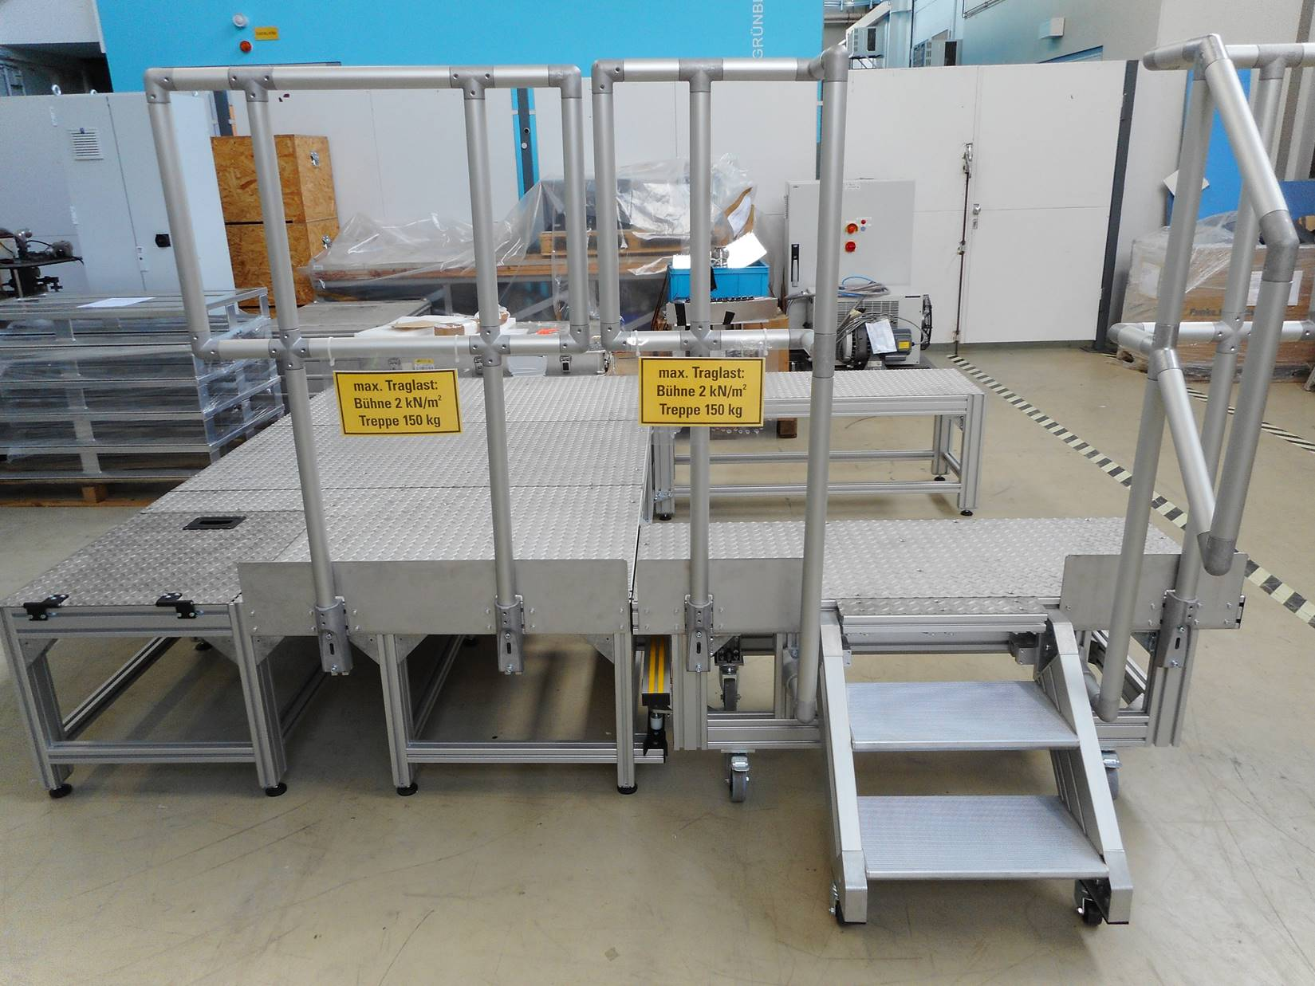
Sample Area

Slide 7
Dogleg Neutron Extraction
Goals:
High flux of usable neutrons at sample position
Low background
Go easy on budget
Requirements:
Twice out of line of sight within the bunker
Metal substrates in bunker
Manageable m-values (m <= 4)
Change request for design update submitted.

Slide 8
Dogleg Neutron Extraction
Properties:
m=4 everywhere
Al substrate
Only straight guides
Inclinations
-0.9°
-1.97°
-0.9
Offset 235 mm at bunker wall

Slide 9
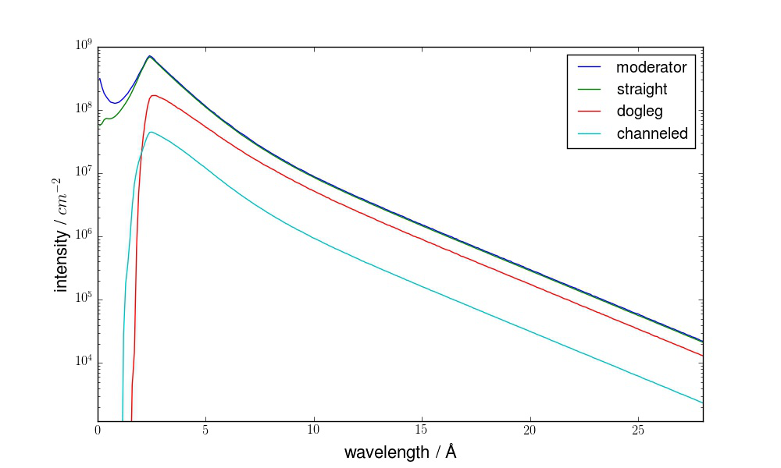
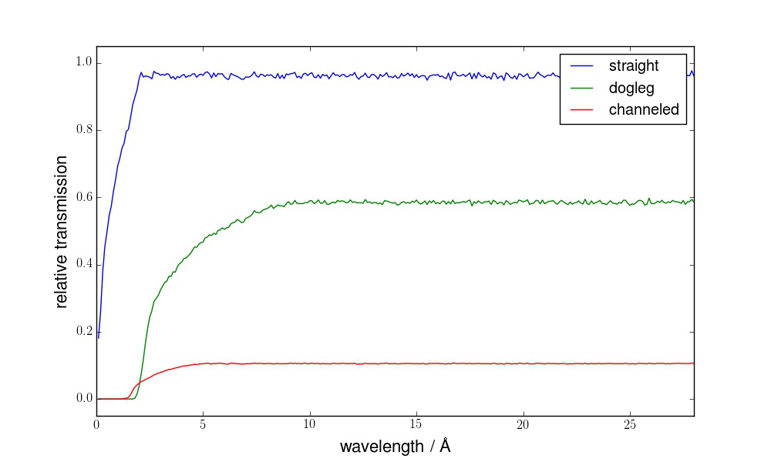
Dogleg Neutron Extraction
10⁹
Flux improvement over all wavelengths
Still reasonable suppression of low wavelengths
No distortion of phase space
10⁸
10⁷
intensity / cm²
10⁶
10⁵
10⁴
0
5
10
15
20
25
wavelength / Å
1.0
0.8
0.6
Approximately 60 % transmission plateau
In 3-8 Å band gain factor 4.4
0.4
0.2
0.0
0
5
10
15
20
25
wavelength / Å

Slide 10
Scheduling
Option 1: TG5 01/2023
Option 2: TG5 10/2021
Ongoing Discussions
Urgent partial TG3 for single components end 2017/ early 2018 necessary
Unified approach for all FZJ / LLB instruments

Slide 11
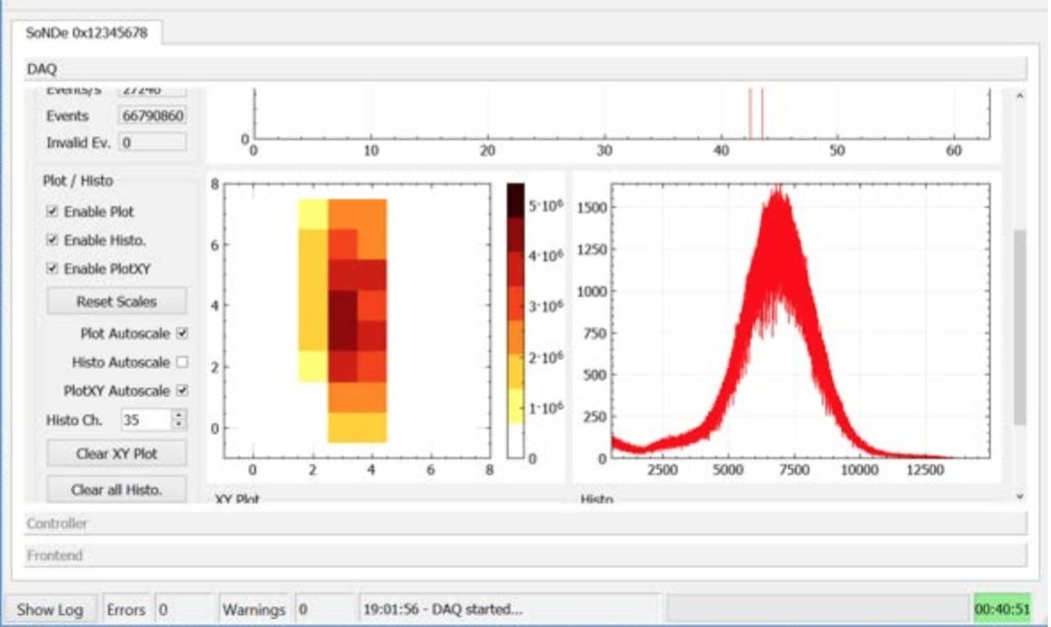
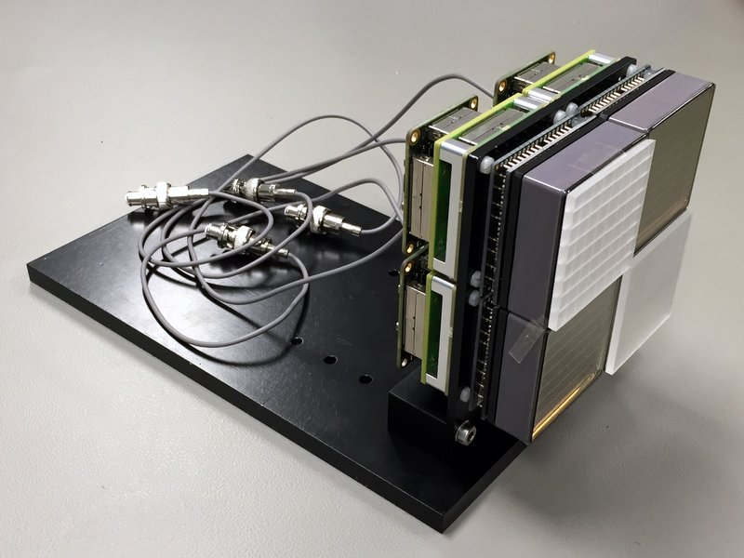
SoNDe Detector
Feasibility tests successfully completed
Model now commercially available
See talk Codin Gheorghe, Thursday 14:00

Slide 12
Thanks to ...
Sylvain Désert
Jacques Jestin
Henrich Frielinghaus
Romuald Hanslik, FZJ
Achim Gussen, FZJ
Herbert Feilbach
LLB+ JCNS Technical Groups
... and you, for your attention!

