Slide 1
Conventional Facilities General update D&E buildings Experimental Halls and galleries
Antonio Bianchi
NSS Installation Co-ordinator
European Spallation Source ERIC
www.europeanspallationsource.se
27th September 2017

Slide 2
CF scope of work
Conventional Facilities (CF) works to prepare and execute the construction of European Spallation Source ERIC. Responsibilities include all buildings and systems required for operation of Accelerator, Target and Instruments, as well as site and infrastructure preparation, construction support, all facility buildings, user and general service buildings.
With reference to NSS Division, the buildings to be delivered are the following:
Building | Description | Delivery date (FULL ACCESS) | Building access
D01 | Experimental Hall (Hall n. 1) | 28.06.2020 | Partial Access according to the Master Schedule 3.4
D03 | Experimental (Hall n. 2) | 02.04.2020 | Partial Access according to the Master Schedule 3.4
D04 | Laboratory & Workshops | 18.08.2019
D07 | Laboratory & Workshops | 19.12.2019 Out of CF Scope | CF provides design (18 months later)
D08 | Laboratory & Workshops | 19.12.2019 | tbd
E01 | Experimental Hall (Hall n. 3) | 27.04.2019 | Partial Access according to the Master Schedule 3.4
E02 | Instruments Guide Hall | 19.12.2019 | Partial Access according to the Master Schedule 3.4
E03 | Laboratory & Workshops | 27.04.2019 | January 2019 (furnishing for sample preparation area)
E04 | Laboratory & Workshops | 27.04.2019 | tbd

Slide 3
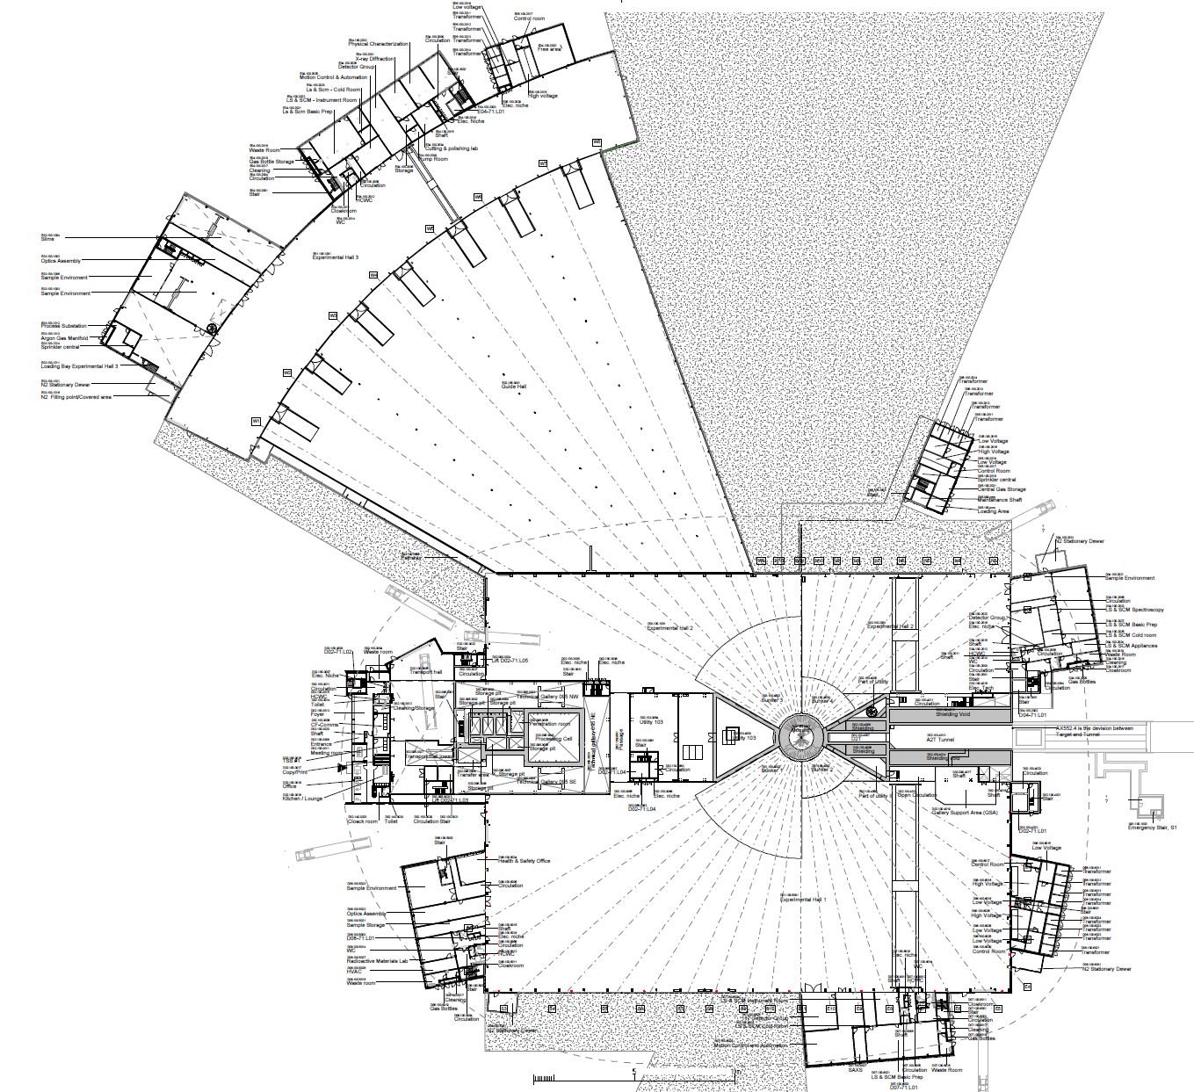
Access Dates for NSS IK partners
Hand-over dates from NSS Project to Instrument teams
E05
1a
E01 – Full Access 27-May-19 (incl. Crane)
E03, E04
Full access
27.04.2019
E04
1b
E02 Area 1 – Partial Access 27-May-19
2
E02 Area 2 – Partial Access 15-Nov-19
E01
1a
3
D03 Main Hall – Partial Access 01-Dec-19 (incl. Cranes)
E03
1b
4
D01 Area 1 Main Hall – Partial Access 06-Feb-20
(incl. Cranes)
E02
5
D01 Area 2 Main Hall – Partial Access 02-April-20
(incl. Crane)
Exact Location of Final De-Lineation Point TBC
2
D05
D04
D04 Full access
18.08.2019
3
D03
D02
D08 Full access
19.12.2019
D06
D08
5
D01
RML to be completed before B.o.T.
4
Out of CF scope
Delivered from NSS ( April 2021)
D07

Slide 4
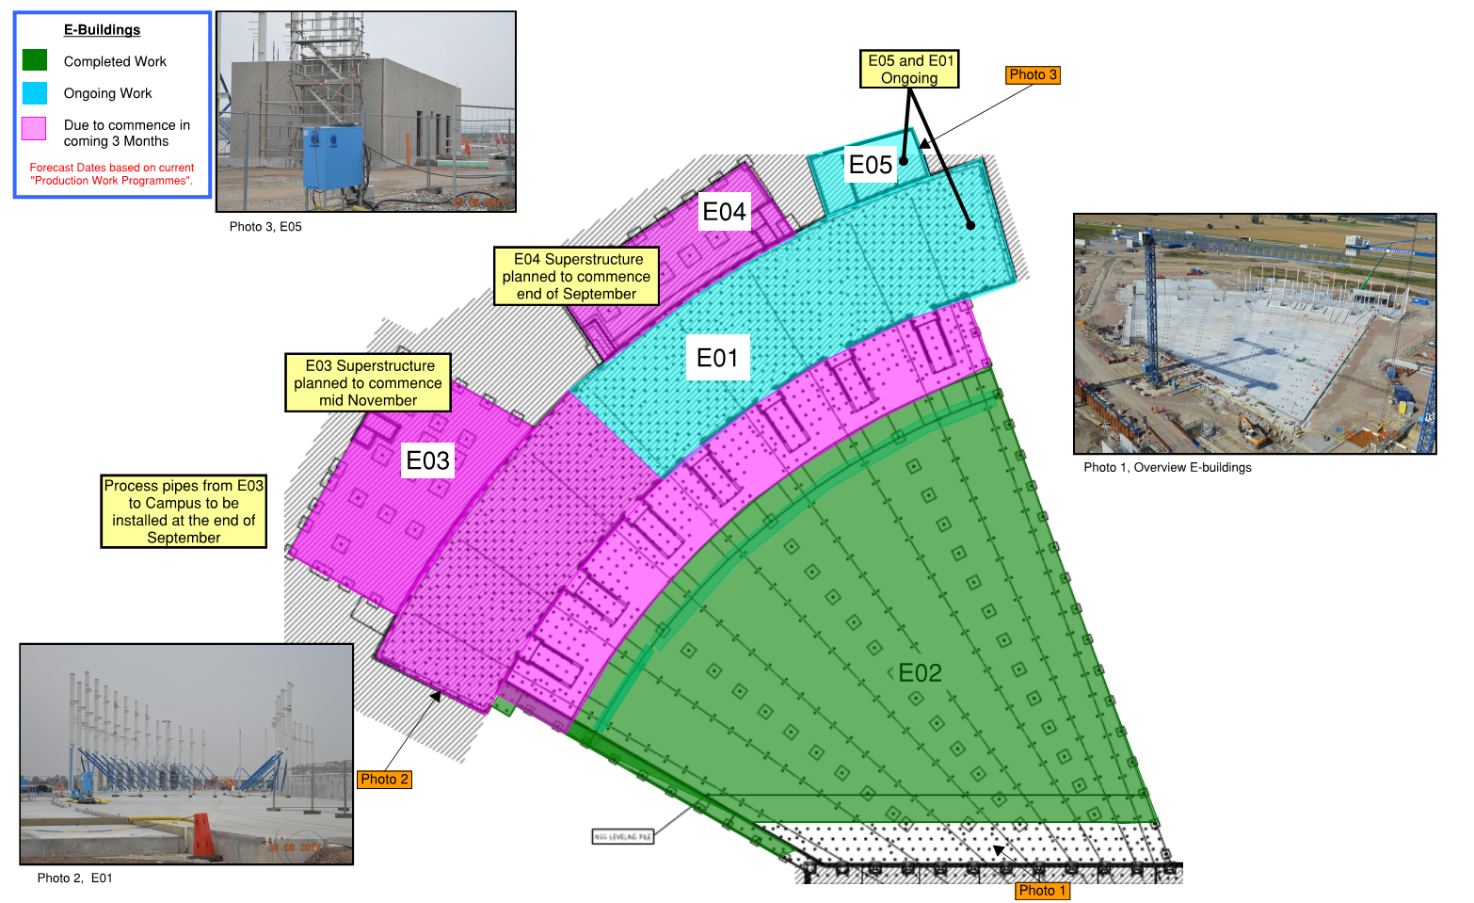
E01-E05 3-Month Lookahead

Slide 5
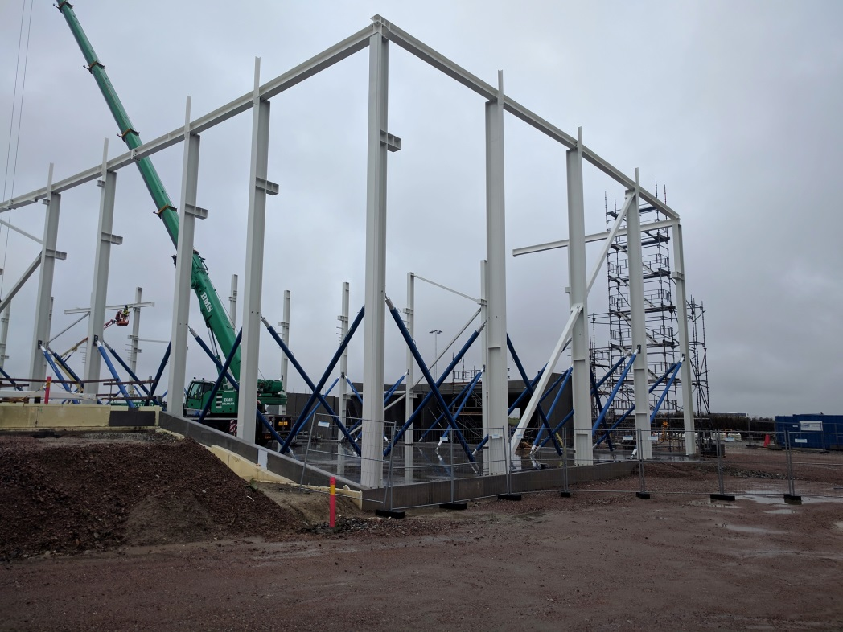
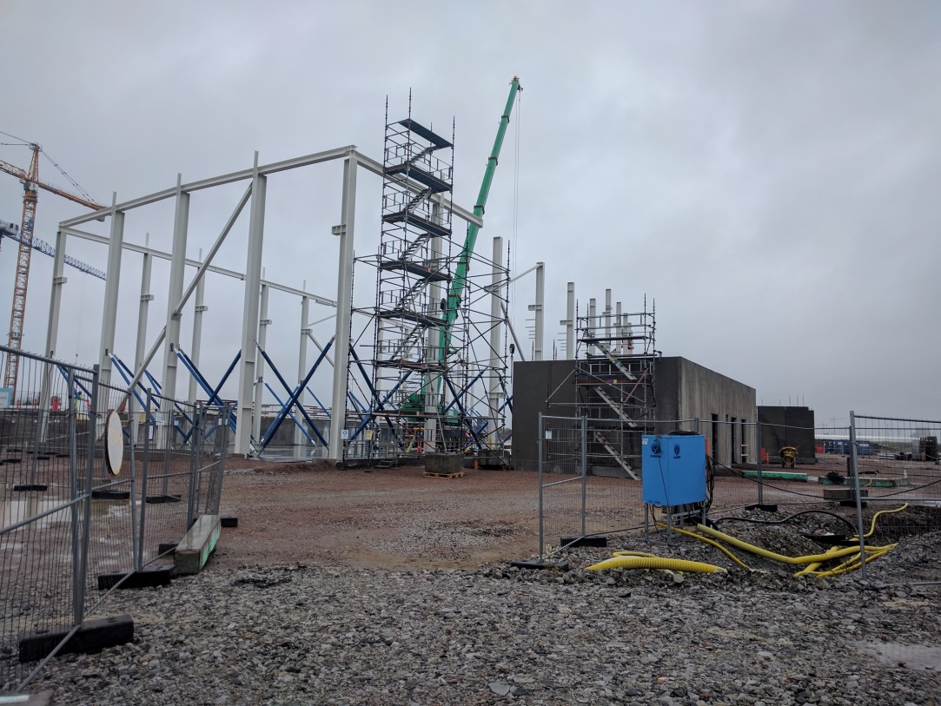
E-buildings are going up NOW!
E01, E03, E04:
full access April 2019
Sample prep labs:
furnishing to commence January 2019

Slide 6
D&E buildings - slabs load capacity
10 ton capacity
ALL AREAS

Slide 7
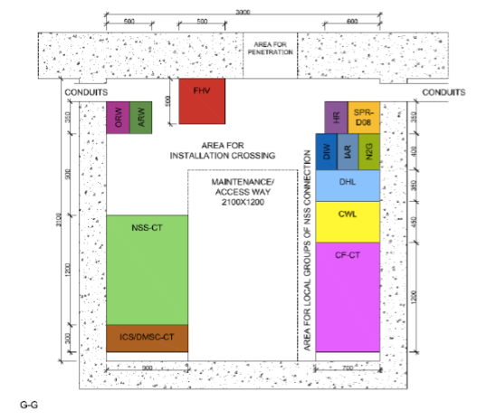
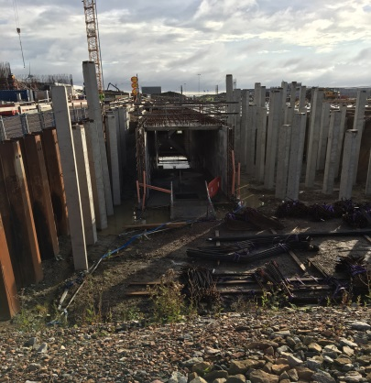
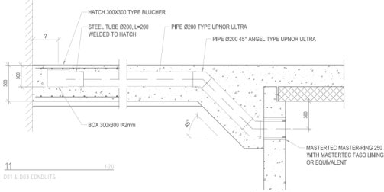
Gallery Penetrations (D03)
Penetration position to be marked from C.F.
Conduits
Penetrations not allowed
Areas suitable for penetrations

Slide 8
Logistics

Slide 9
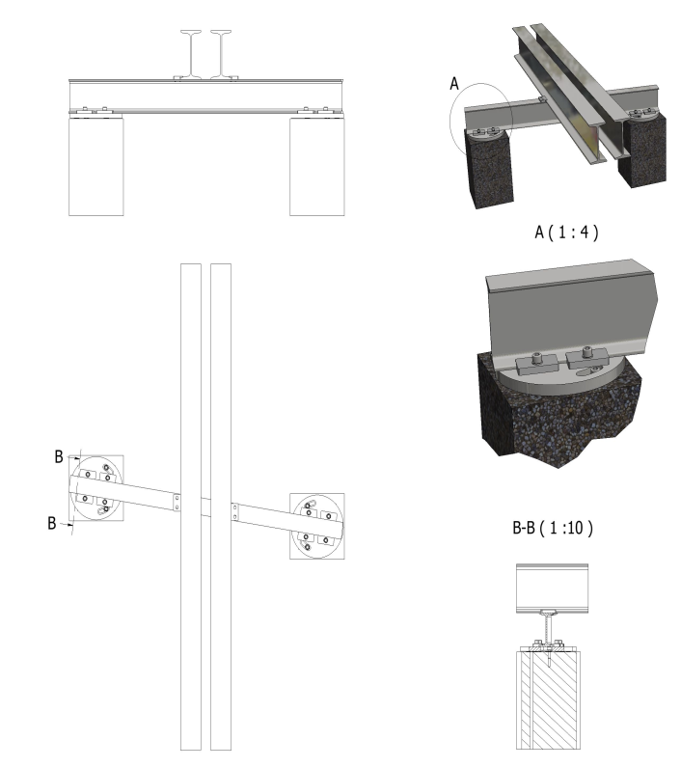
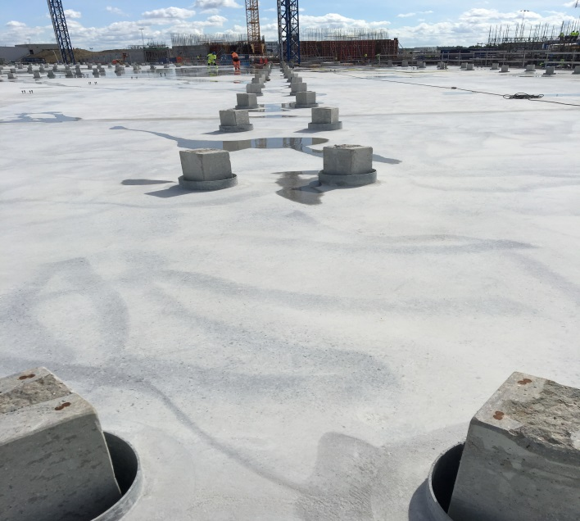
E02 Beam support concept design
From Gabor Laslo
Slab/pile joint

Slide 10
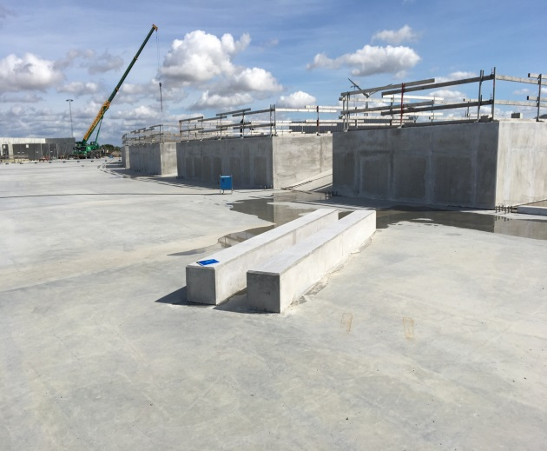
Load test E01 – Technical report
2
1
2
1
Beam over the piles row

Slide 11
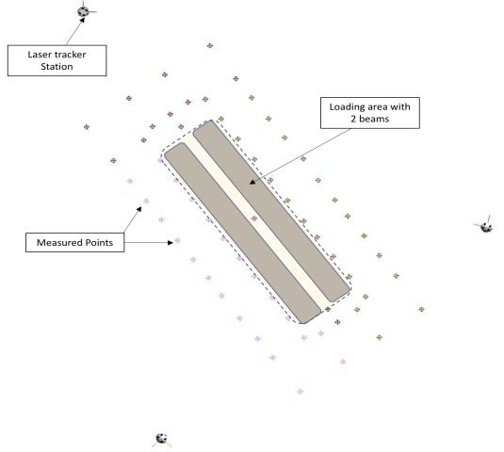
Load test design
1st step
2nd step
3rd step
Laser tracker
Laser tracker
Measured points

Slide 12
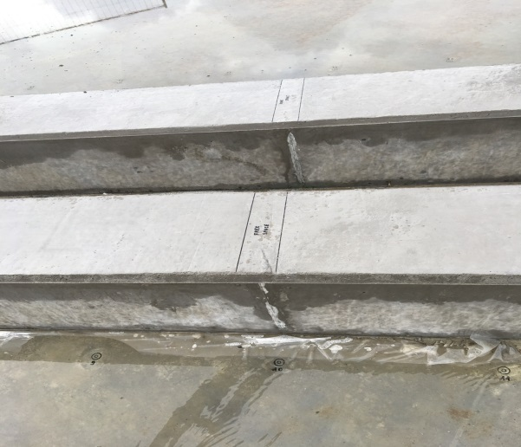
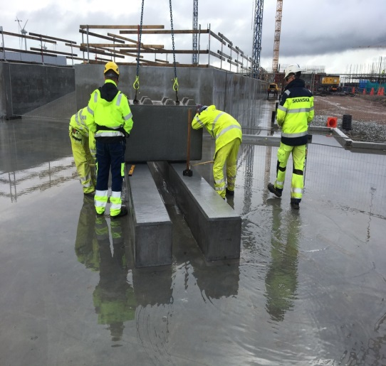
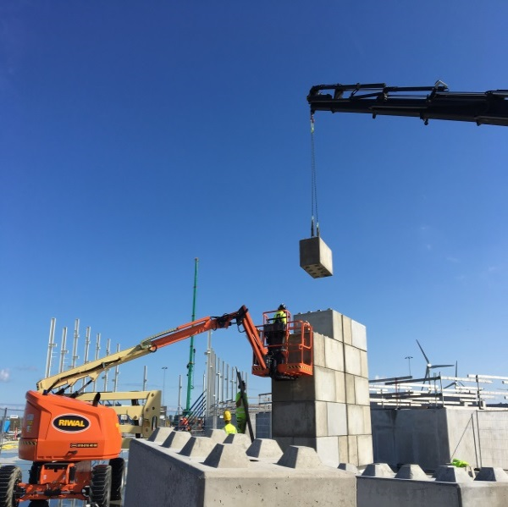
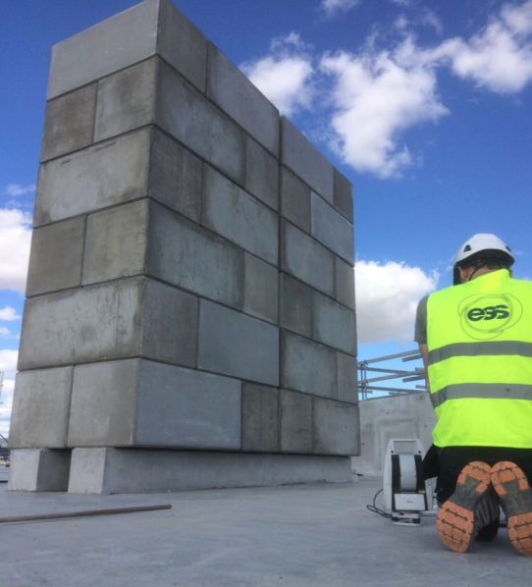
Load test E01 – August/September 2017
Section view
Little gap to measure inside

Slide 13
Load test: final result
Date | Epoch | Load (T/m2) | Comments | Deflection (mm) | Comments
17/08/2017 | 0 | No Load (only 2 beams) | Zero status | 0,0000 | Initial Measurement – No load - only 2 beams
22/08/2017 | 1 | 8.6 T/m² | 20 hours after loading | 0,3204 | 8.6 T/m² - 20 hours after loading
22/08/2017 | 2 | 16.3 T/m² | 3 hours after loading | 0,2396 | 16.3 T/m² - 3 hours after loading
23/08/2017 | 3 | 24 T/m² | 4 hours after loading | 0,3388 | 24 T/m² - 4 hours after loading
30/08/2017 | 4 | 24 T/m² | 7 days after loading | 0,3760 | 24 T/m² – 7 days after loading
05/09/2017 | 5 | 24 T/m² | 13 days after loading | 0,5484 | 24 T/m² – 13 days after loading
15/09/2017 | 6 | 24 T/m² | 23 days after loading | 0,7103 | 24 T/m² –23 days after loading
22/09/2017 | 7 | 4 days after NO LOAD | 4 days after NO LOAD | 0,5539 | 4 days after NO LOAD
NSS requirement: 3+3 mm (3 mm elastic + 3 mm plastic)
Final total deflection: 0,71 mm

Slide 14
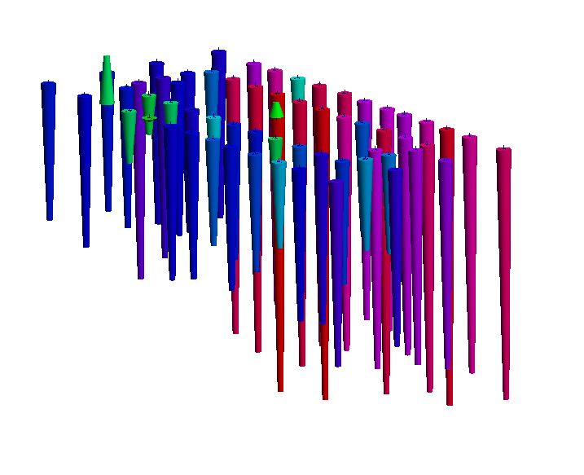
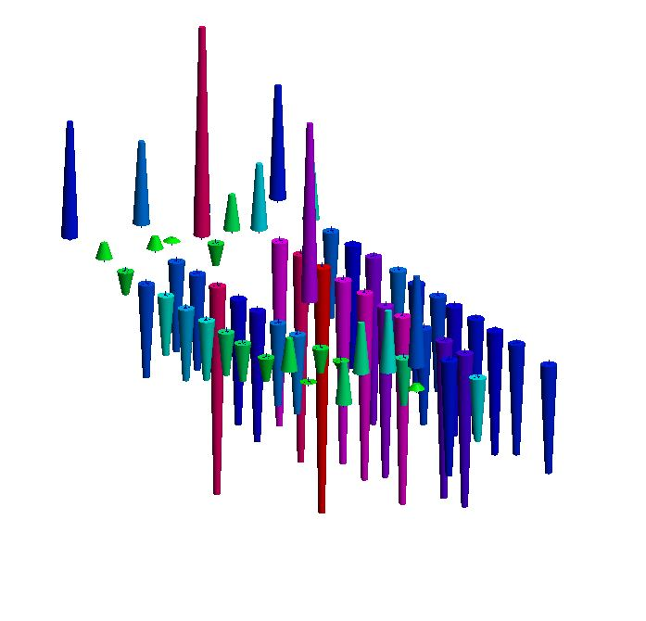
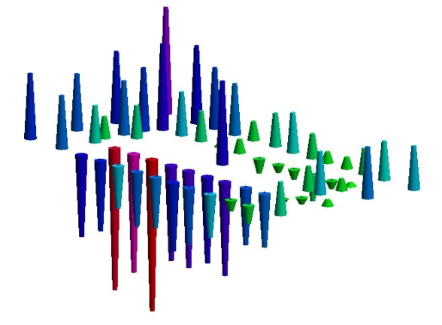
Deformation diagrams
Epoch 1 : 8.6 t/m2 20 hours after loading
0,3204 mm
Epoch 2: 16.3 T/m² - 3 hours after loading
0,2396 mm
Epoch 3: 24 T/m² - 4 hours after loading
0,3388 mm

Slide 15
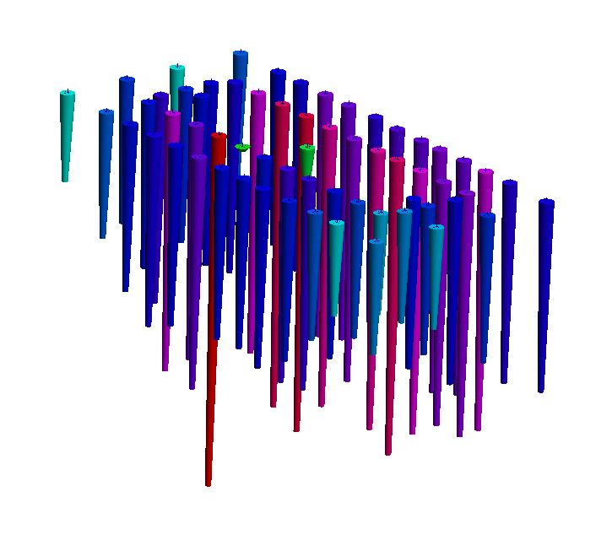
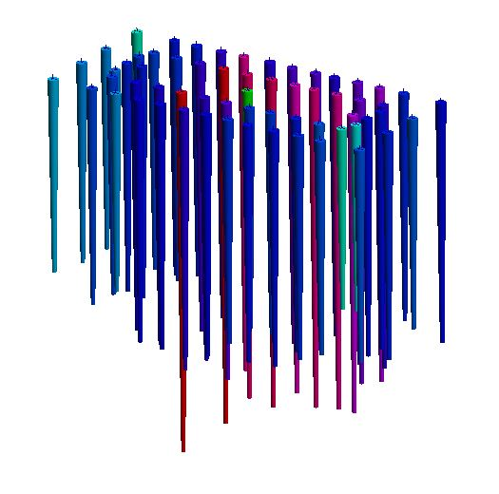
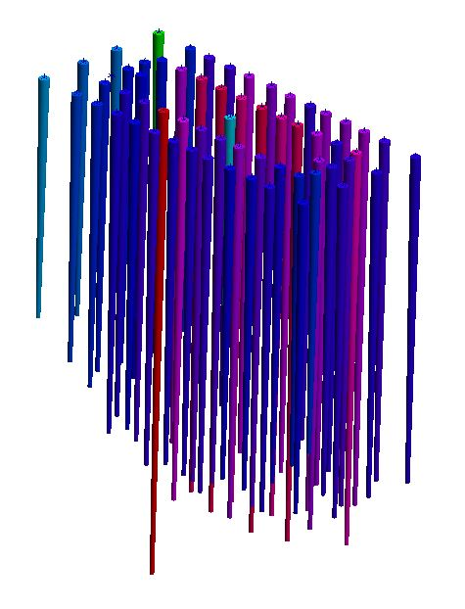
Deformation diagrams
Epoch 4 : 24 T/m² – 7 days after loading
0,3760 mm
Epoch 5: 24 T/m² – 13 days after loading
0,5484 mm
Epoch 6: 24 T/m² – 23 days after loading
0,7103 mm

Slide 16
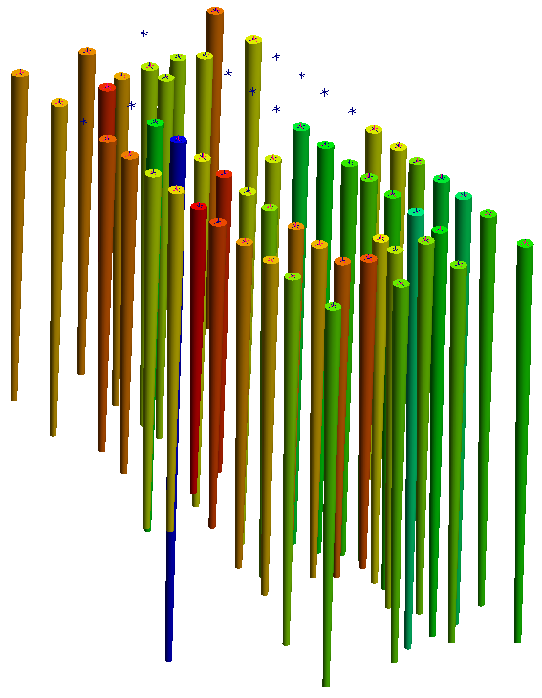
Deformation diagrams
Epoch 7: 4 days after NO LOAD
Further information available on Chess
ESS - 0134619
0,5539 mm
Comment
The concrete slab behaviour into E01 fulfil the NSS requirement and the total deflection surveyed is consistent with the structural analysis.
A single month load test provides an indication but remain a partial results on the slab behavior.

Slide 17
Naviswork - 3D coordination models
Updated coordination model D buildings | ESS-0026363 (available in CHESS)
Updated coordination model E buildings | ESS-0026362 (available in CHESS)
You can download Navisworks Freedom 2017 at: http://www.autodesk.com/products/autodesk-navisworks-family/autodesk-navisworks-freedom

Slide 18
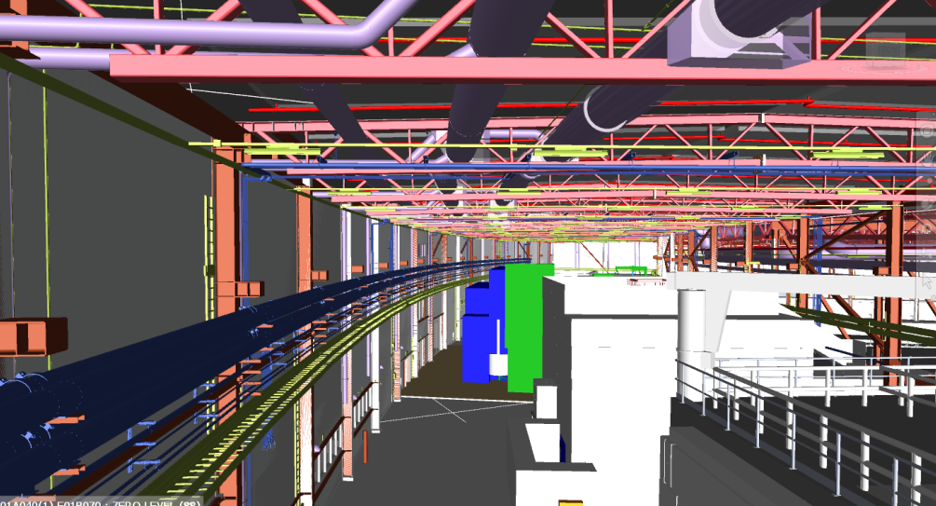
Naviswork 3D model (E01,E02,D03 buildings)
Buildings and instruments integration

Slide 19
Sections E buildings

Slide 20
Questions

