Slide 1
Instrument installation and Infrastructures incl. experimental halls, galleries, workshops and laboratories Technical workshops and workshop areas
Oliver Kirstein
www.europeanspallationsource.se
IKON 13; 26.-29. September 2017

Slide 2
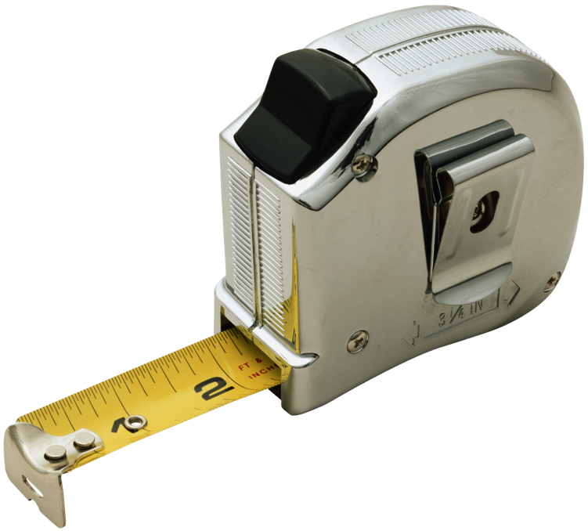
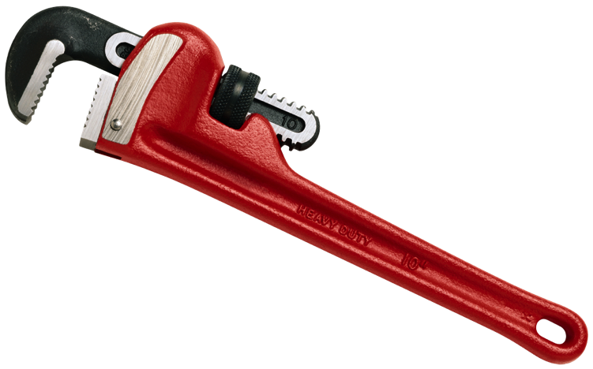
Stating the obvious
Dedicated technical areas to support instruments
Installation
Commissioning
Operation
Maintenance
Repair
Upgrades
Areas coincide with main instrument systems
Sample Environment
Chopper systems
Detector systems
Motion Control & Automation
Neutron Optics and Shielding
Placement/location strategic
Areas/facilities will become available over time
Some areas covered by the ESS Construction Project
Some areas covered within the Initial Operations period (2019-2025)

Slide 3
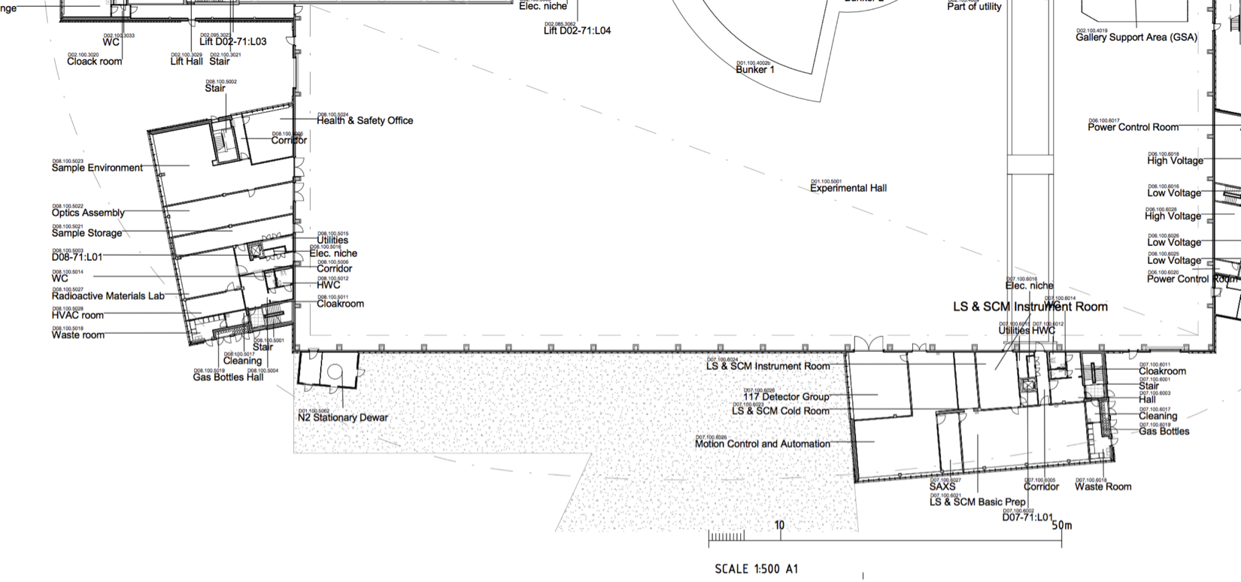
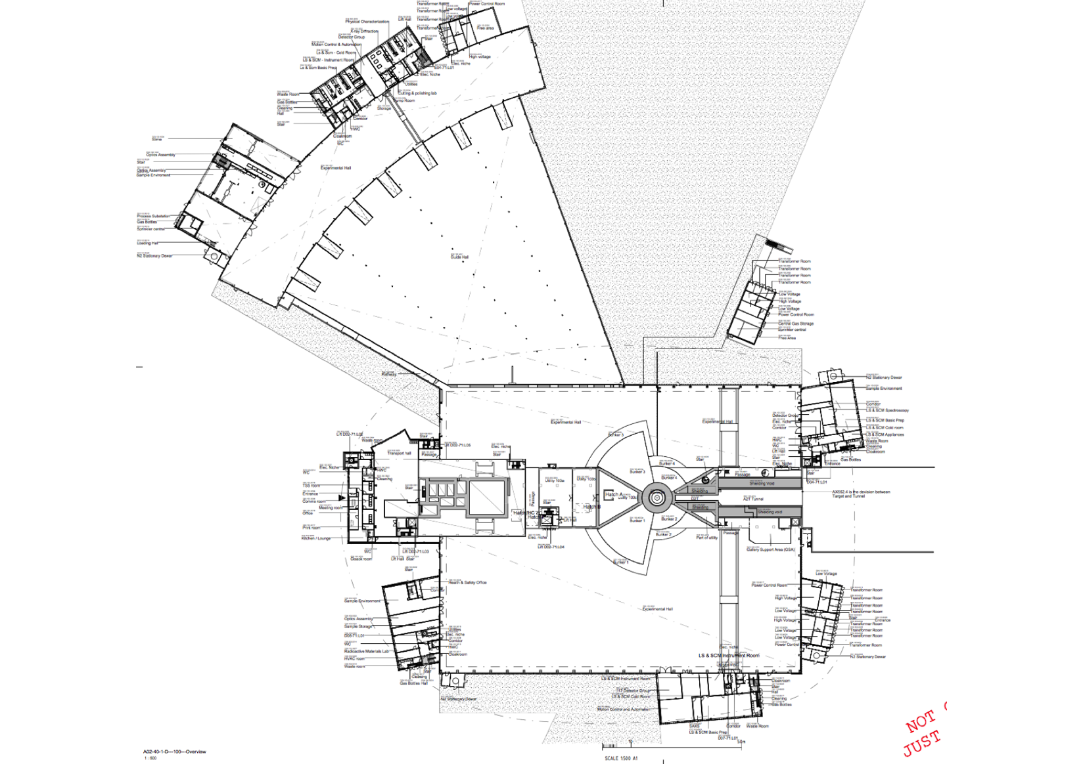
Example - D08 building
Top view of the facility
Dedicated area for Optics D08; 80m²

Slide 4
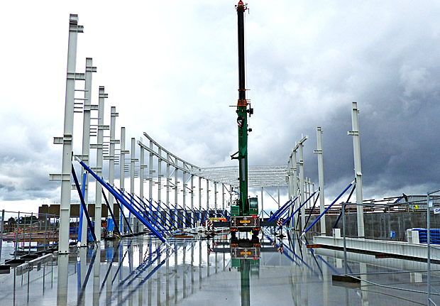
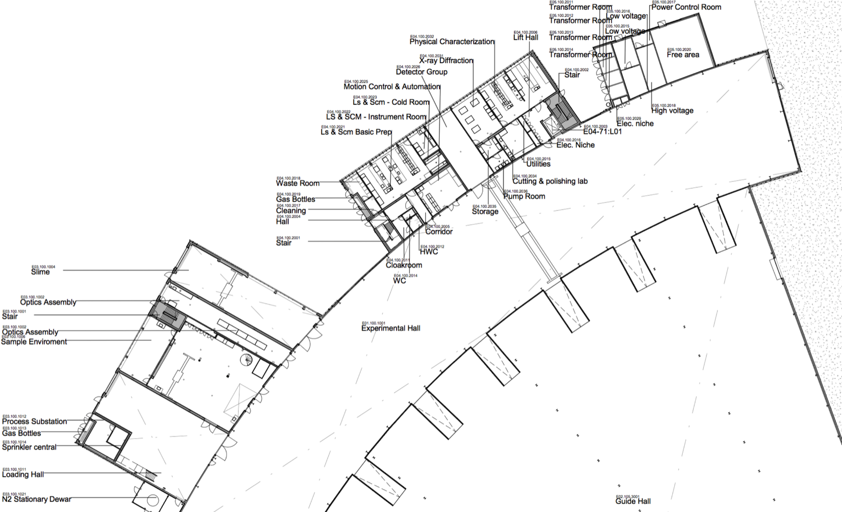
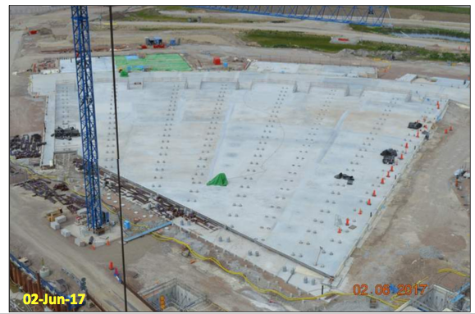
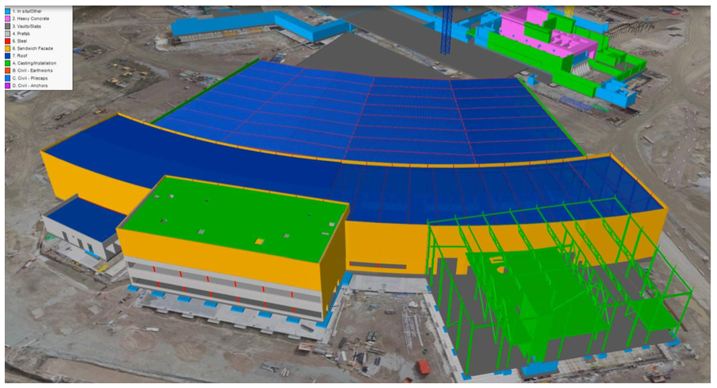
E0x Buildings

Slide 5
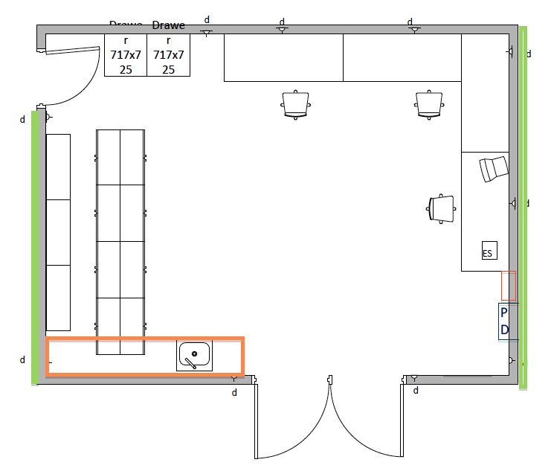
Example layout: MCA (E04)
48m²

Slide 6
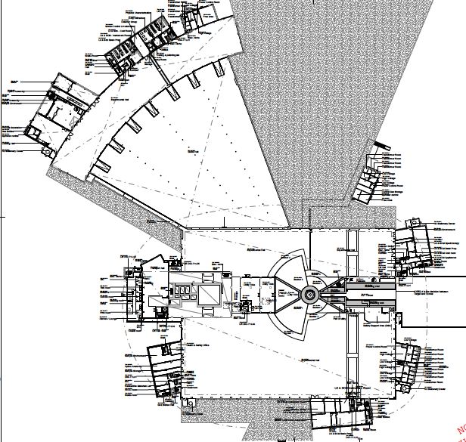
Overview of Workshops
Hall 3
E04:
MCA: 48 m²
Detectors: 85 m²
D04:
Sample environment: 64 m²
Detectors: 68 m²
E03:
Sample environment (2 floors): 2 x 333 m²
Optics: 102 m²
Loading bay (294 m2)
Hall 2
D08:
Optics: 80 m²
Sample environment: 102 m²
SE (high pressure): 49 m²
Hall 1
D07:
MCA: 159 m²
Detectors: 80 m²

Slide 7
Access dates
Hall 3
E04:
Full access: April 2019
D04:
Full access: August 2019
E03:
Full access: April 2019
Hall 2
D08:
Full access: December 2019
Hall 1
D07:
Full access: Spring 2021
Full Access = Handover to NSS; available for “use” a couple of weeks later

Slide 8
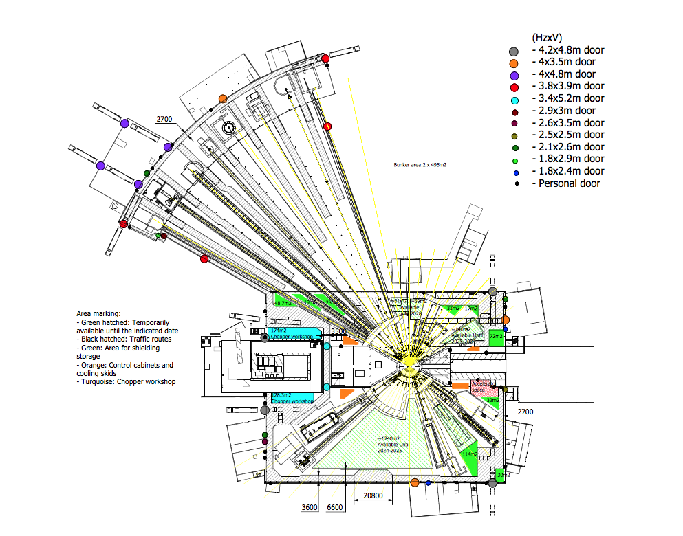
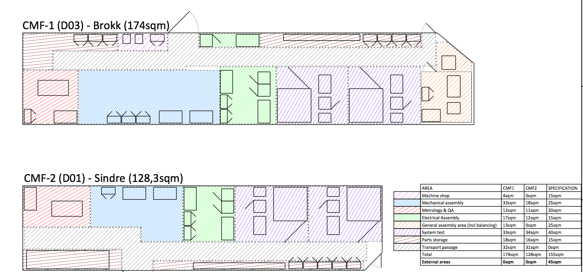
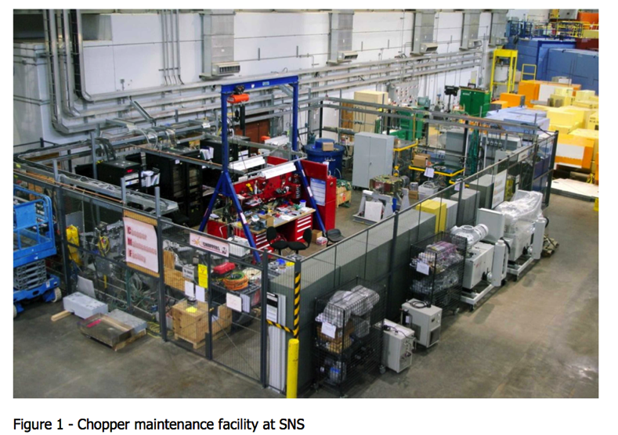
D01 and D03 Buildings
The coloured dots are doors!

Slide 9
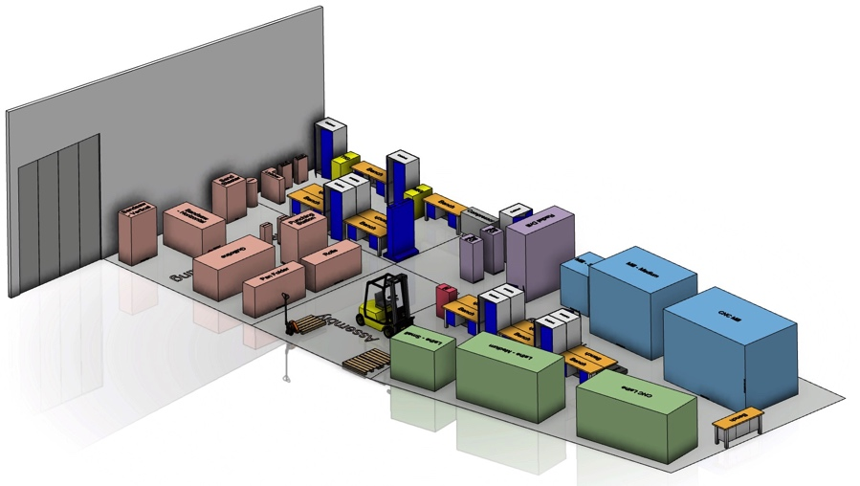
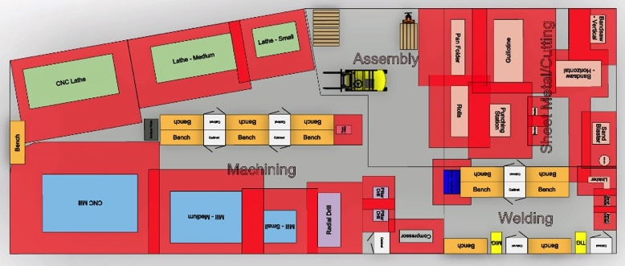
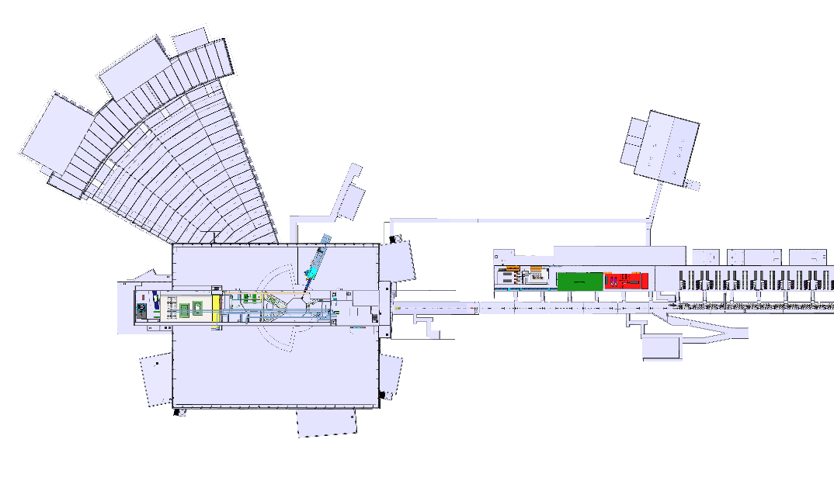
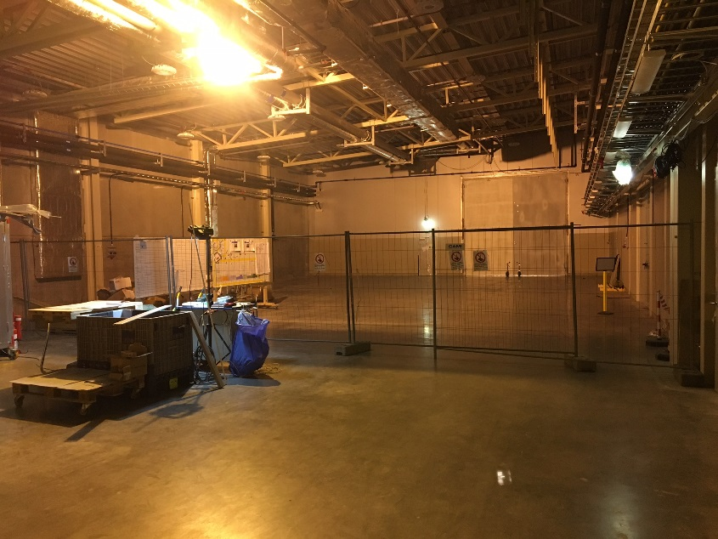
Temporary Technical Centre (TTC) Location summary
The G02 gallery building (G02.100.2001) is a viable location for the TTC
Satisfies TTC crucial requirements
Has minimal impact on stakeholders of this area with clear mitigation strategies identified (relocate to B02)
Will expedite establishment of on-site support for installation main focus on Accelerator/Target in 2018/9
~300 m
Notes:
DTL assembly and activated components. Repared more detailed budget estimates.

Slide 10
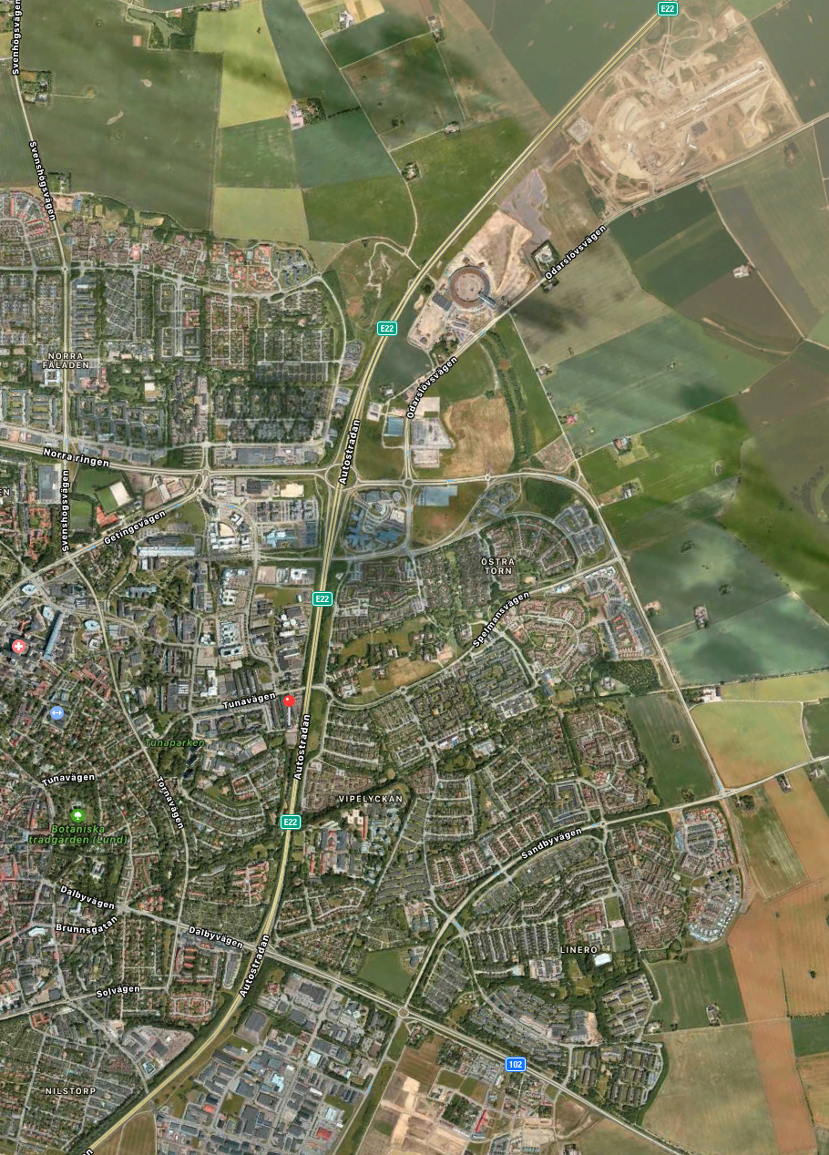
Interim Until everything is ready on site
~3 km; D08; E0x; Halls
~800m; Utgård
~2 km; EMBLA
Visit planned from 17:00 – 18:30

