Slide 1
Evaluation of detector characteristics with Geant4 simulation
676548
E. Dian^{1,2}, G. Galgóczi³, M. Klausz^{1,2}
¹HAS Centre for Energy Research
²European Spallation Source ESS ERIC
³HAS Wigner Research Centre for Physics
28 September 2017, IKON13, Lund

Slide 2
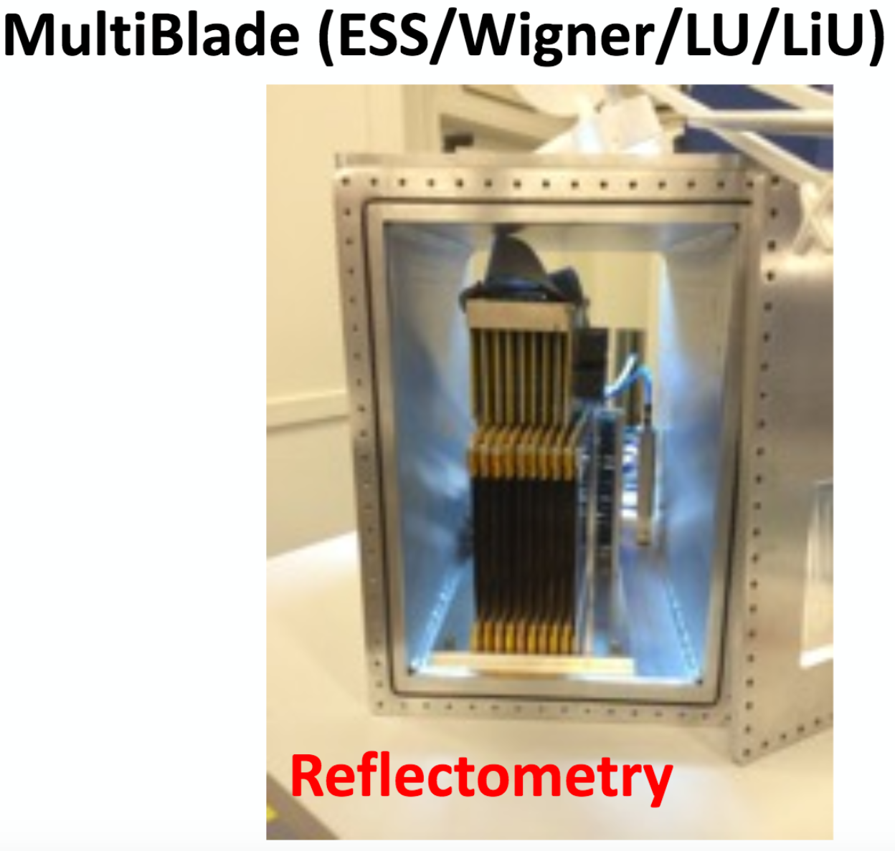
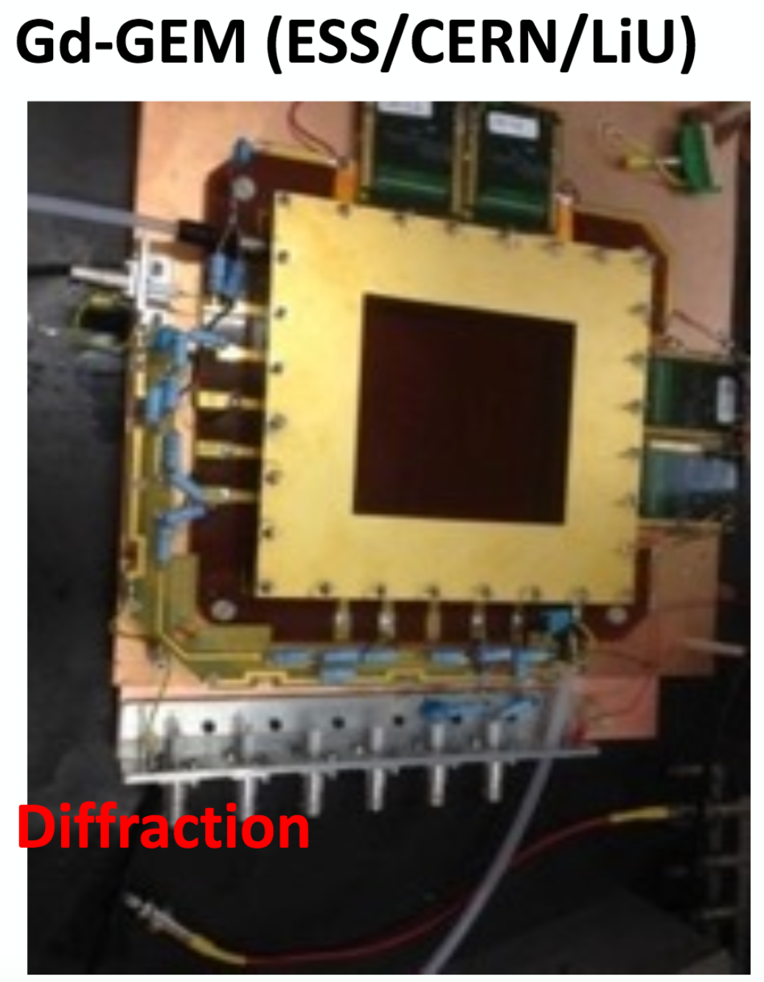
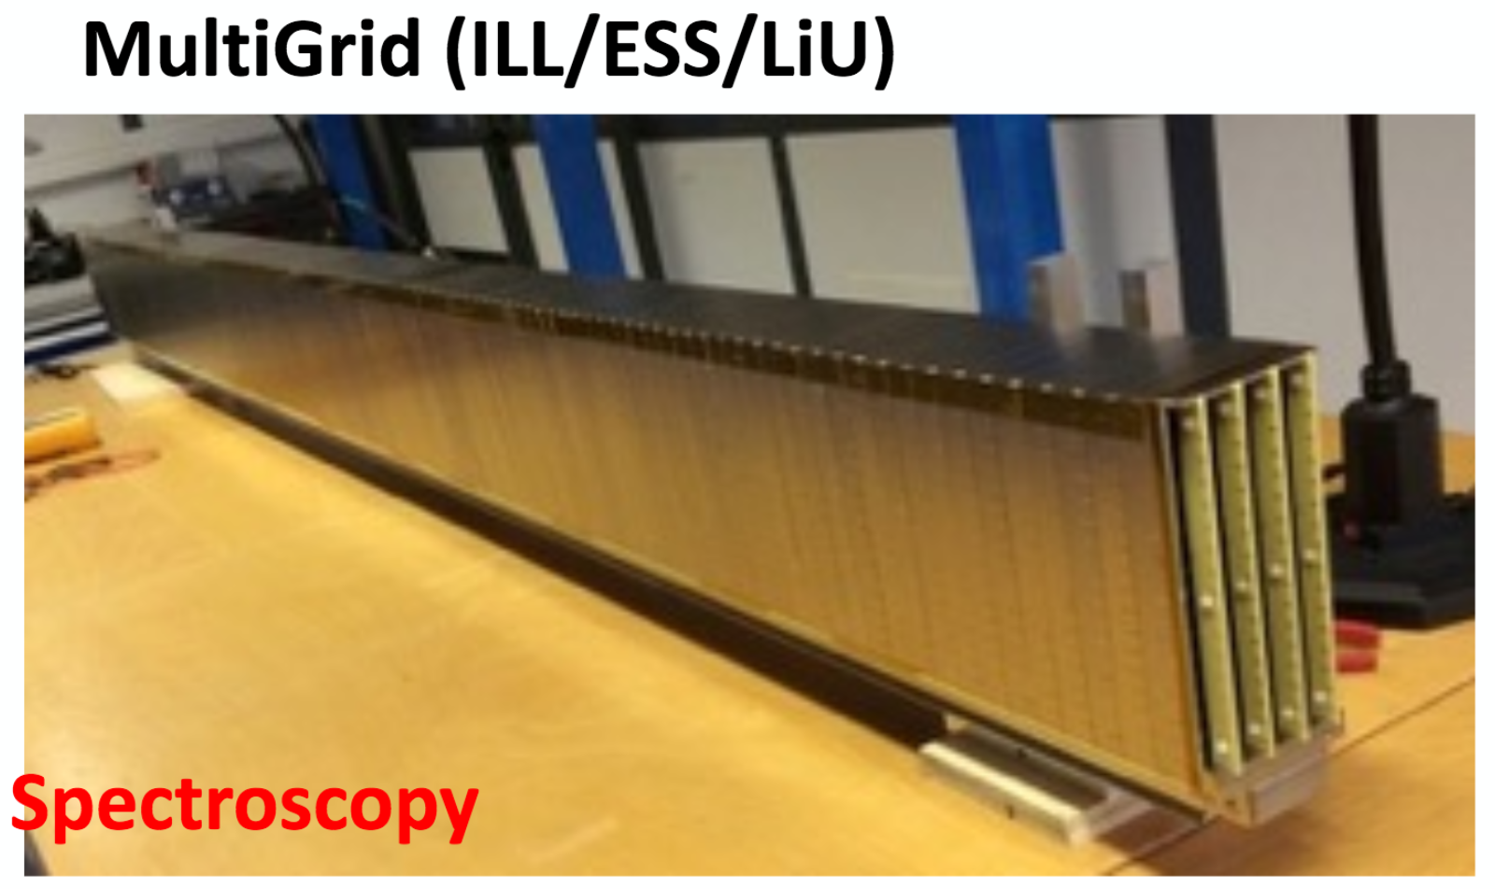
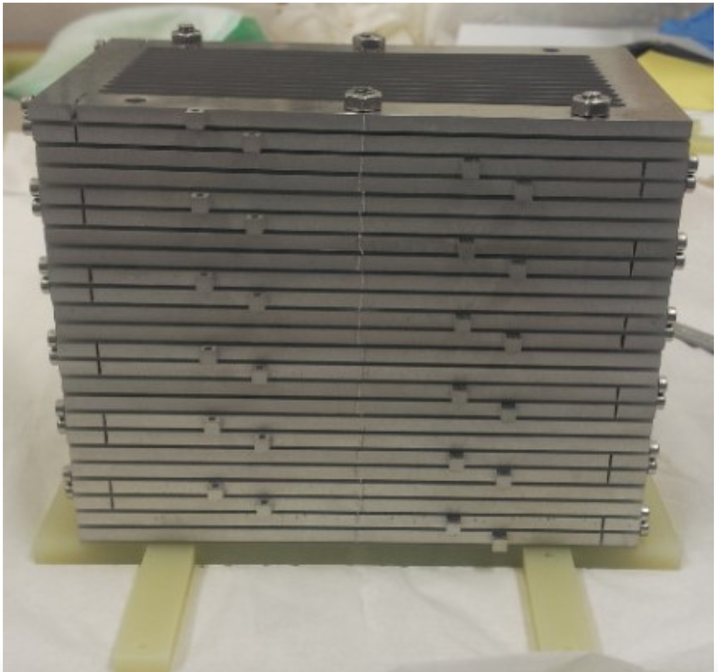
The ESS detector challenge
Various detectors for various instruments at ESS
All with different designs, all have to be optimised for respective instrument requirements
Serious efforts on detector simulations @ ESS DG
Molecular crystallography
BandGEM (Milan/CNR/INFN/CERN/ESS)
SANS
Notes:
ESS
Several detectors for various instruments, different phases of development (get nice plot from IKON12!)
Conclusion:
We cannot manage without very effective tools
Core of all measurement is the SBR. ESS increases flux, so increases Signal. Now we have to build detectors with low Bg.
(keep in mind: @CF it’s easy and fast to build up and modify geometries,
analyse and plot data, move from one code to the other safe, handles well the big amount of data)

Slide 3
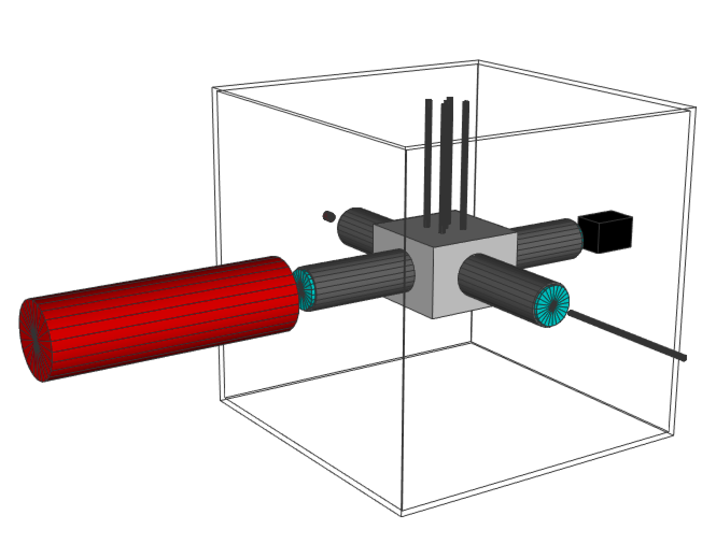
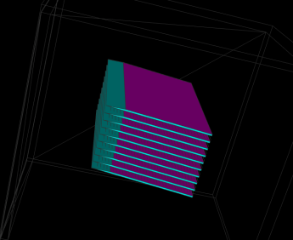
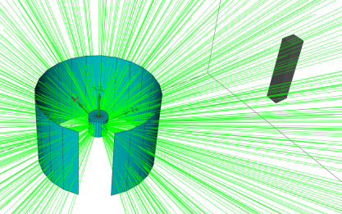
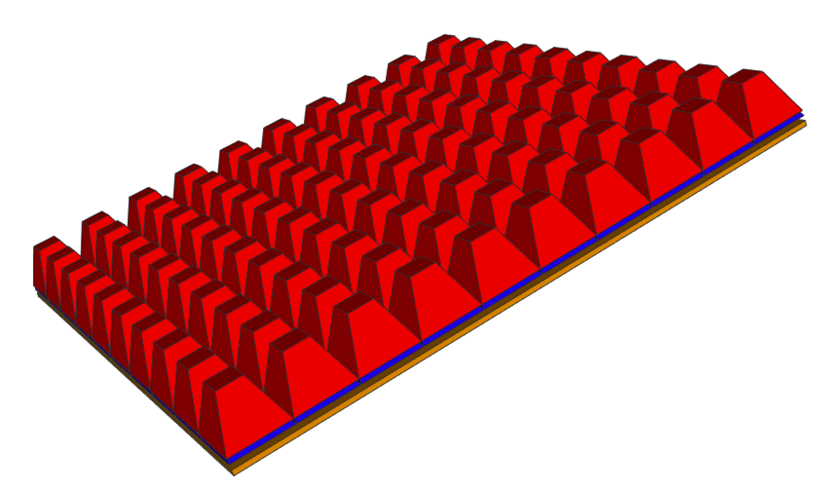
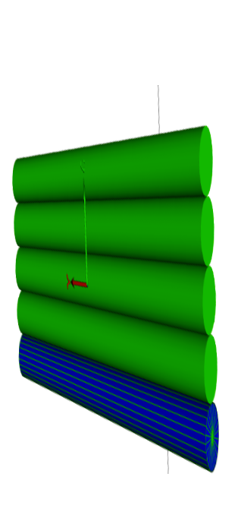
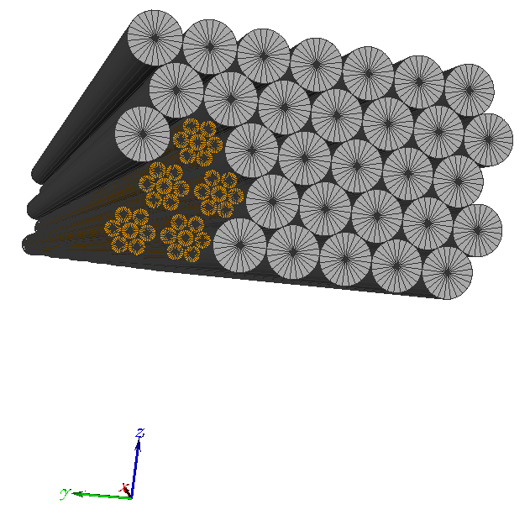
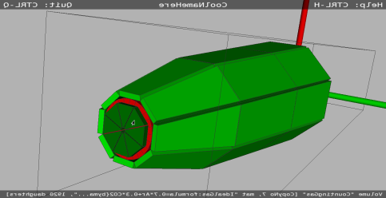
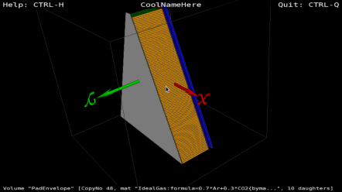
The ESS DG simulation projects
Several projects, the majority of detector demonstrators have been modeled (E. Dian, G. Galgóczi, K. Kanaki, M. Klausz, D. Lucsányi, V. Maulerova, D. Pfeiffer, I. Stefanescu, C. Sørgaard)
Multi-Grid
Multi-Blade
He-3
BAND-GEM
macro-structured MWPC
flat MWPC
plastic scintillators
Source Testing Facility@LU
B/Gd-GEM
Jalousie
Si sensors
boron-coated straws
Multi-Blade
Multi-Grid
Source Testing Facility
Si sensors
Boron-coated straws
BAND-GEM
He-3 tubes

Slide 4
The ESS DG simulation projects
Several projects, the majority of detector demonstrators have been modeled (E. Dian, G. Galgóczi, K. Kanaki, M. Klausz, D. Lucsányi, V. Maulerova, D. Pfeiffer, I. Stefanescu, C. Sørgaard)
Multi-Grid
Multi-Blade
He-3
BAND-GEM
macro-structured MWPC
flat MWPC
plastic scintillators
Source Testing Facility@LU
B/Gd-GEM
Jalousie
Si sensors
boron-coated straws
Multi-Blade
Multi-Grid
Source Testing Facility
Si sensors
Boron-coated straws
BAND-GEM
He-3 tubes

Slide 5
The ESS DG simulation projects
Several projects, the majority of detector demonstrators have been modeled (E. Dian, G. Galgóczi, K. Kanaki, M. Klausz, D. Lucsányi, V. Maulerova, D. Pfeiffer, I. Stefanescu, C. Sørgaard)
Multi-Grid
Multi-Blade
He-3
BAND-GEM
macro-structured MWPC
flat MWPC
plastic scintillators
Source Testing Facility@LU
B/Gd-GEM
Jalousie
Si sensors
boron-coated straws
Multi-Blade
Multi-Grid
Source Testing Facility
Si sensors
Boron-coated straws
BAND-GEM
He-3 tubes

Slide 6
The ESS DG simulation projects
Several projects, the majority of detector demonstrators have been modeled (E. Dian, G. Galgóczi, K. Kanaki, M. Klausz, D. Lucsányi, V. Maulerova, D. Pfeiffer, I. Stefanescu, C. Sørgaard)
Multi-Grid
Multi-Blade
He-3
BAND-GEM
macro-structured MWPC
flat MWPC
plastic scintillators
Source Testing Facility@LU
B/Gd-GEM
Jalousie
Si sensors
boron-coated straws
Multi-Blade
Multi-Grid
Source Testing Facility
Si sensors
Boron-coated straws
BAND-GEM
He-3 tubes

Slide 7
Simulation tools
New tools & utilities are recently developed for neutron studies
Physics
Coherent scattering
Inelastic scattering
Single- and poly-crystals…
And more
Communication
Visualisation
Ready-to use…
NXSG4 doi:10.1016/j.cpc.2014.11.009 http://nxsg4.web.cern.ch/nxsg4/
NCrystal https://github.com/mctools/ncrystal/wiki
MCPL - Monte Carlo Particle List
https://mctools.github.io/mcpl/
ESS Coding Framework - Geant4 simulation framework Developed by ESS Detector Group doi:10.1016/S0168-9002(03)01368-8 doi:10.1088/1742-6596/513/2/022017
19 Sept. NSS Seminar K. Kanaki, X X. Cai, E. Dian: Optimization of detector design for instruments with simulations: Tools and applications

Slide 8
Detector background study with Monte Carlo codes
Sources of neutron detector background
Neutron induced gamma background (MCNP6)
Prompt gamma radiation from neutron capture
Decay gammas from neutron activation
Scattered neutrons (Geant4)
Elastic, inelastic
Coherent, incoherent
General neutron activation study prepared with MCNP6 for ESS operation conditions - Ar/CO₂ counting gas - Aluminum-frame
E. Dian et al. 10.1016/j.apradiso.2017.06.003
⁴¹Ar activity saturates at 128 mBq/cm³ low
Negligible signal from self-activation
Great impact of Coding Framework!
Notes:
General neutron activation study already prepared for B4C-based neutron detectors -> ref arXiv:1701.08117
If it weren’t negligible, we could use it as an input to G4 ☺
Run until sample, MCPL-> uniq tool to optimise det with realistic (meas or sim) data

Slide 9
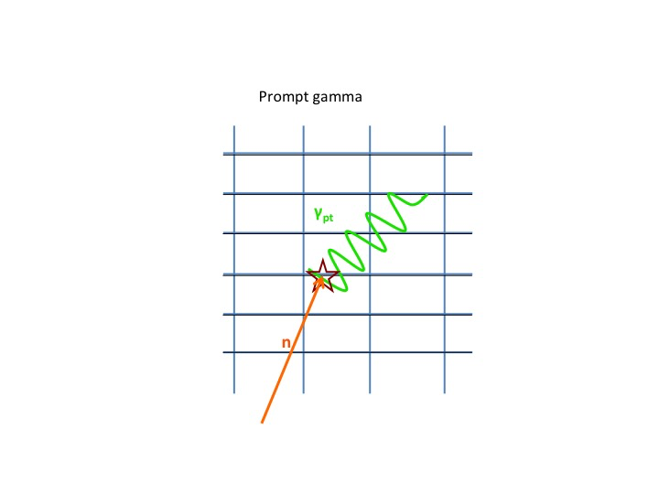
Detector background study with Monte Carlo codes
Sources of neutron detector background
Neutron induced gamma background (MCNP6)
Prompt gamma radiation from neutron capture
Decay gammas from neutron activation
Scattered neutrons (Geant4)
Elastic, inelastic
Coherent, incoherent
General neutron activation study prepared with MCNP6 for ESS operation conditions - Ar/CO₂ counting gas - Aluminum-frame
E. Dian et al. 10.1016/j.apradiso.2017.06.003
⁴¹Ar activity saturates at 128 mBq/cm³ low
Negligible signal from self-activation
Great impact of Coding Framework!
Notes:
General neutron activation study already prepared for B4C-based neutron detectors -> ref arXiv:1701.08117
If it weren’t negligible, we could use it as an input to G4 ☺
Run until sample, MCPL-> uniq tool to optimise det with realistic (meas or sim) data

Slide 10
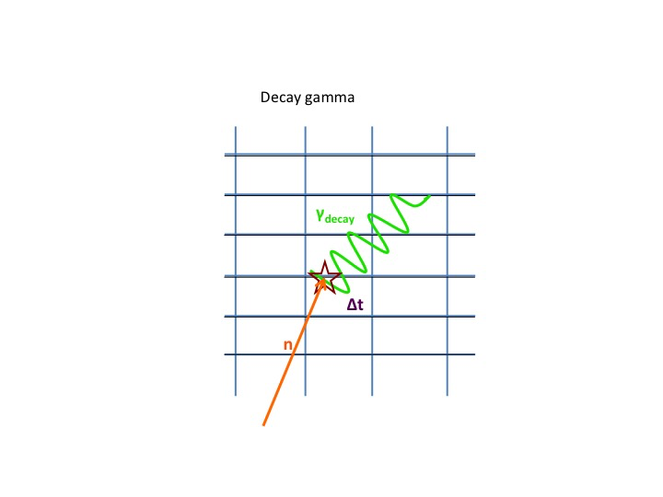
Detector background study with Monte Carlo codes
Sources of neutron detector background
Neutron induced gamma background (MCNP6)
Prompt gamma radiation from neutron capture
Decay gammas from neutron activation
Scattered neutrons (Geant4)
Elastic, inelastic
Coherent, incoherent
General neutron activation study prepared with MCNP6 for ESS operation conditions - Ar/CO₂ counting gas - Aluminum-frame
E. Dian et al. 10.1016/j.apradiso.2017.06.003
⁴¹Ar activity saturates at 128 mBq/cm³ low
Negligible signal from self-activation
Great impact of Coding Framework!
Notes:
General neutron activation study already prepared for B4C-based neutron detectors -> ref arXiv:1701.08117
If it weren’t negligible, we could use it as an input to G4 ☺
Run until sample, MCPL-> uniq tool to optimise det with realistic (meas or sim) data

Slide 11
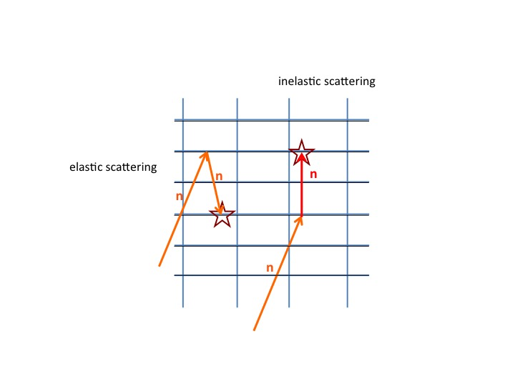
Detector background study with Monte Carlo codes
Sources of neutron detector background
Neutron induced gamma background (MCNP6)
Prompt gamma radiation from neutron capture
Decay gammas from neutron activation
Scattered neutrons (Geant4)
Elastic, inelastic
Coherent, incoherent
General neutron activation study prepared with MCNP6 for ESS operation conditions - Ar/CO₂ counting gas - Aluminum-frame
E. Dian et al. 10.1016/j.apradiso.2017.06.003
⁴¹Ar activity saturates at 128 mBq/cm³ low
Negligible signal from self-activation
Great impact of Coding Framework!
Notes:
General neutron activation study already prepared for B4C-based neutron detectors -> ref arXiv:1701.08117
If it weren’t negligible, we could use it as an input to G4 ☺
Run until sample, MCPL-> uniq tool to optimise det with realistic (meas or sim) data

Slide 12
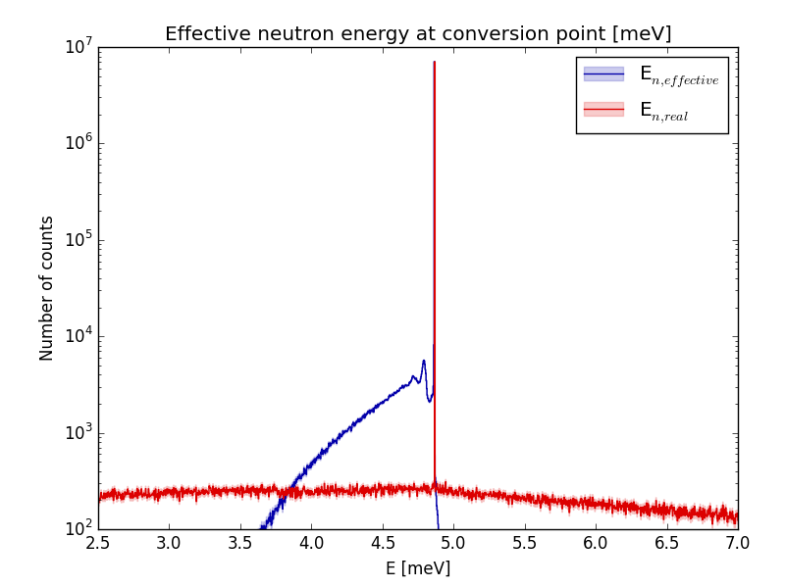
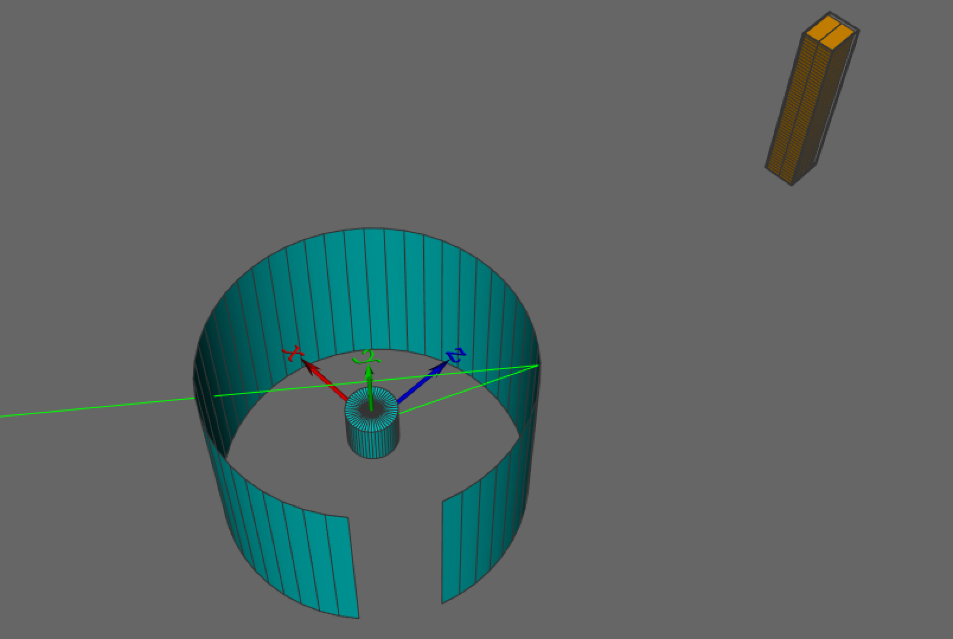
Scattered neutron background
Neutron scattering on detector and environment
Study and distinguish background effects
Guidelines for detector design
Prototype
Validation
Full-scale detector model
Optimization
Realistic simulation
Scattered neutron
Detector
Scattered neutron
Sample environment
Real and measurable neutron energy
Geant4 @Coding Framework

Slide 13
The Multi-Grid Detector Model
676548
Eszter Dian^{1,2,} Kalliopi Kanaki^{2,} Anton Khaplanov² dian.eszter@energia.mta.hu_{1,2}
¹Hungarian Academy of Sciences, Centre for Energy Research
²European Spallation Source ESS ERIC
28 September 2017, IKON13, Lund
Notes:
PhD student
Based in Hungary, HAS CER, in collaboration with DG
Modelling MG, aim: shielding optimisation to increase SNR
This is an example how to use the afore introduced tool is detector development.

Slide 14
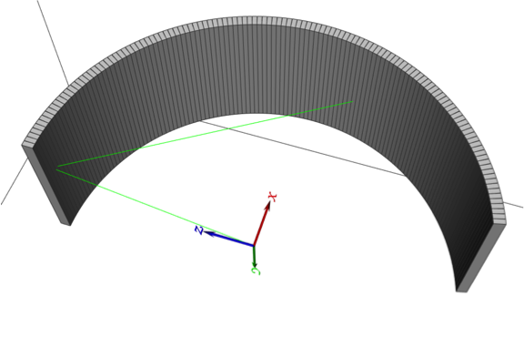
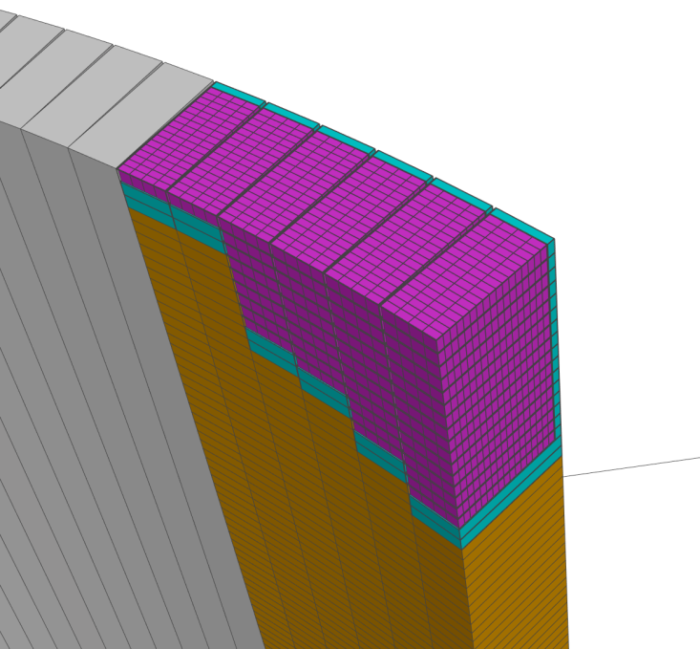
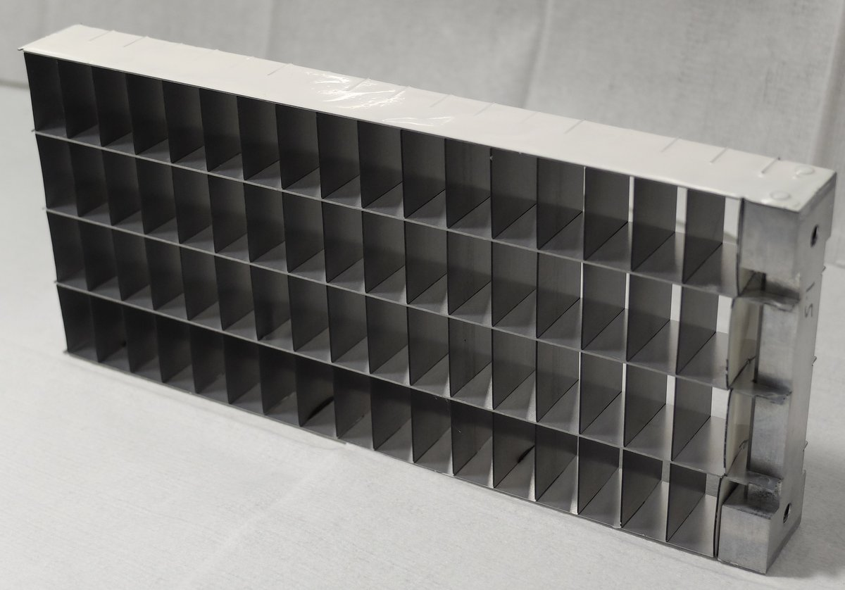
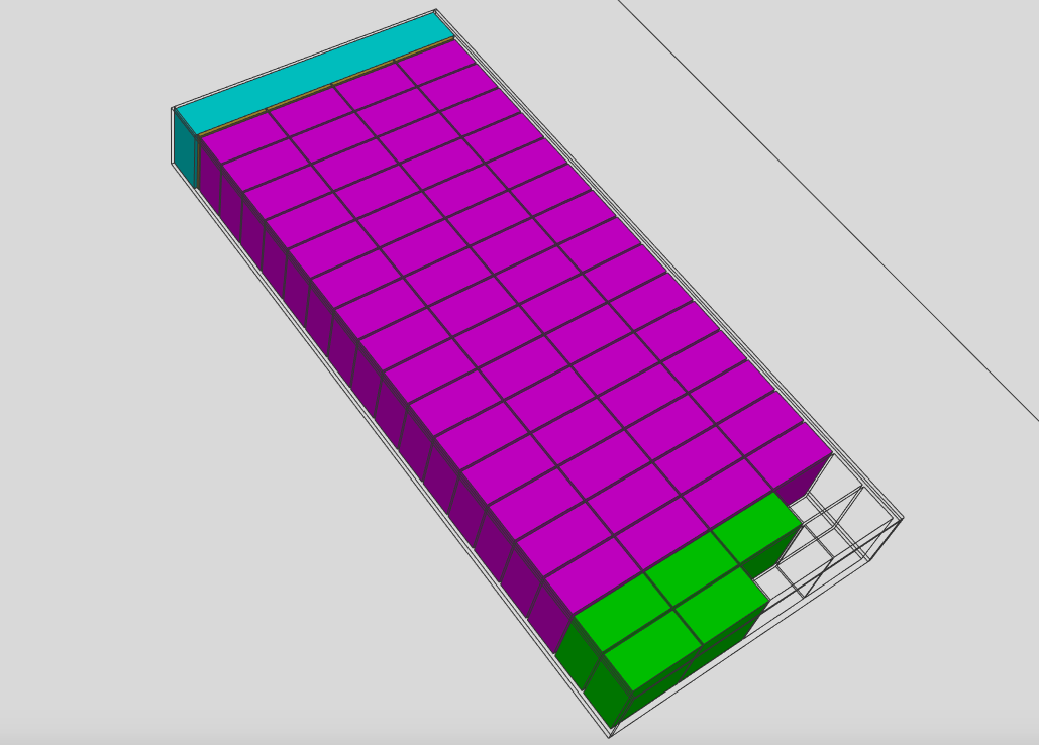
Large area detector for chopper spectroscopy – Multi-Grid
Geant4 @Coding Framework
Multi-Grid
Large area detector
Inelastic instrument, chopper spectroscopy
Solid B₄C converter + Ar/CO₂
Aluminium frame – crystalline Al
Low background is essential
Scattered neutron background induced in detector
A. Khaplanov et al.
http://dx.doi.org/10.1016/j.nima.2012.12.021
Notes:
Point out:
Need for low background
Scattering on aluminium (AL transparent d)
Visualisation with CF

Slide 15
Multi-Grid detector test at CNCS, SNS
Geant4 @Coding Framework
NXSG4
Sample environment
Detector
3.3 m
Isotropic scattering particles simulated from sample
Instrument outputs can be used as particle guns
Notes:
Origin of particles…
Realistic detector model and representative simplified sample environment was built

Slide 16
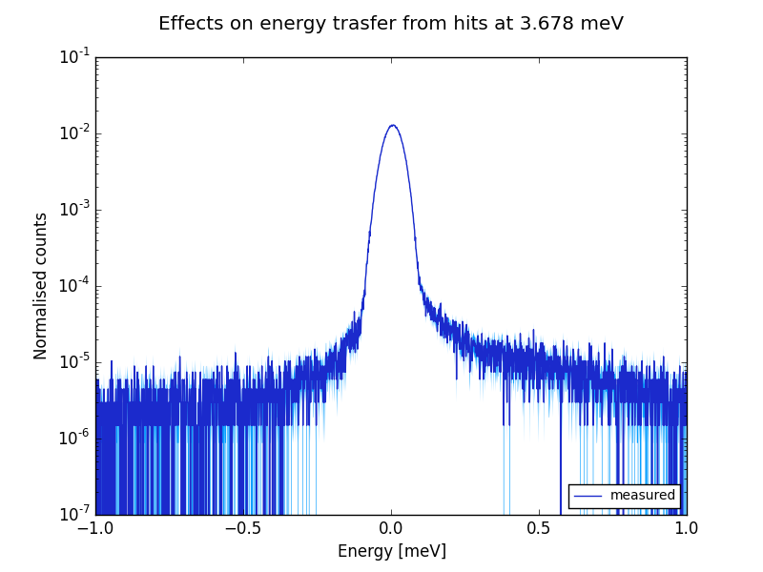
MultiGrid detector test at CNCS, SNS
Derived energy transfer at 3.678 meV from measurement
Chopper spectroscopy
Measured quantities:
ToF
detection-coordinates
Energy transfer: E_{trf} = E_{initial} – E_{final}
E_{trf} = E_{initial} - E_{final}
Counts
Anton Khaplanov et al.: Multi-Grid Detector for Neutron Spectroscopy: Results Obtained on Time-of-Flight Spectrometer CNCS
doi:10.1088/1748-0221/12/04/P04030, https://arxiv.org/abs/1703.03626

Slide 17
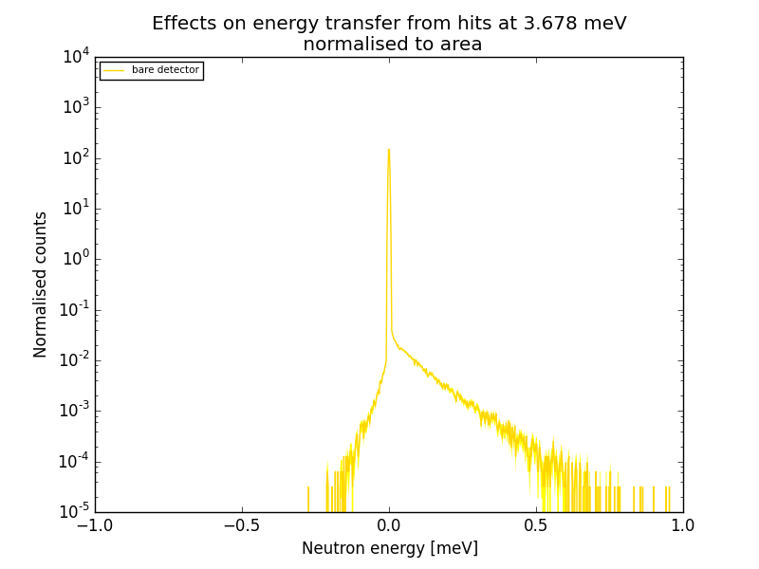
MultiGrid detector test at CNCS, SNS
Geant4 simulation
NXSG4
Elastic peak
E_{trf} = E_{initial} - E_{final}
Scattered neutron background from detector

Slide 18
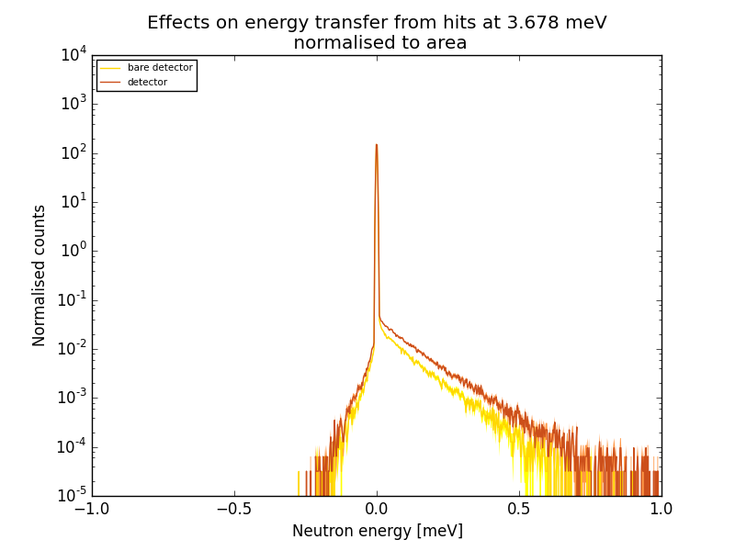
MultiGrid detector test at CNCS, SNS
Geant4 simulation
NXSG4
Elastic peak
E_{trf} = E_{initial} - E_{final}
Scattered neutron background from detector

Slide 19
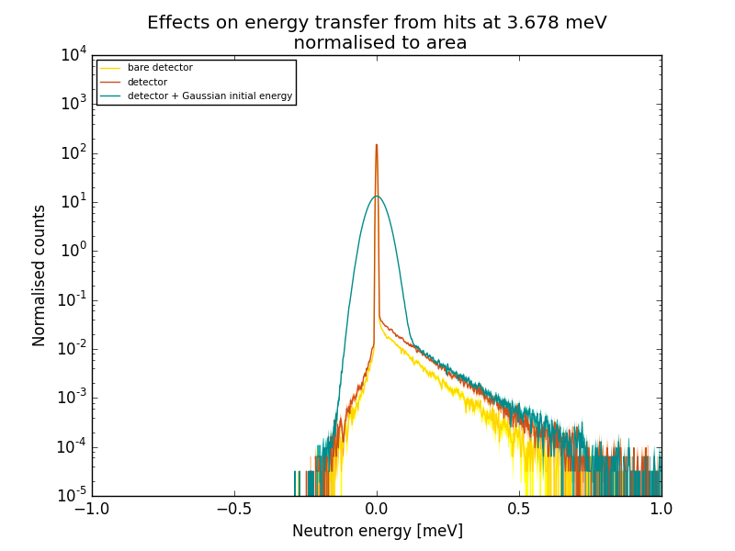
MultiGrid detector test at CNCS, SNS
Geant4 simulation
NXSG4
Elastic peak
E_{trf} = E_{initial} - E_{final}
Scattered neutron background from detector

Slide 20
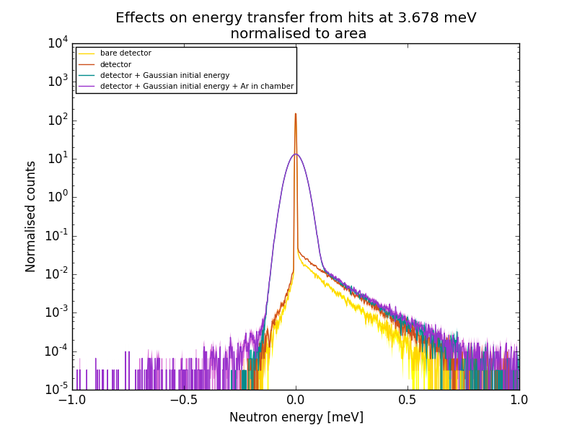
MultiGrid detector test at CNCS, SNS
Geant4 simulation
NXSG4
Elastic peak
E_{trf} = E_{initial} - E_{final}
Scattered neutron background from detector

Slide 21
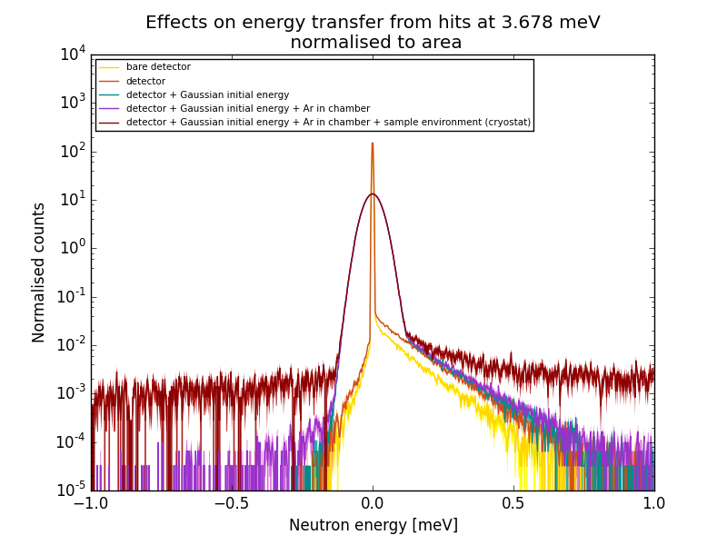
MultiGrid detector test at CNCS, SNS
Geant4 simulation
NXSG4
Elastic peak
E_{trf} = E_{initial} - E_{final}
Scattered neutron background from detector

Slide 22
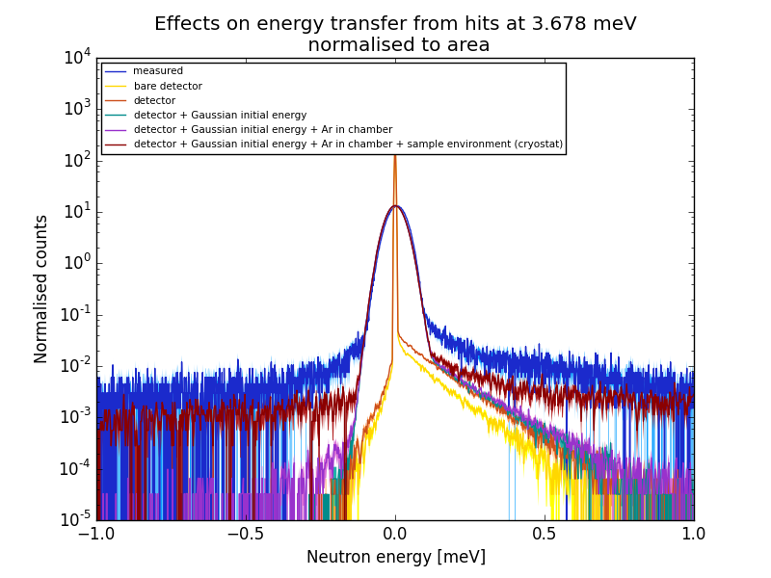
MultiGrid detector test at CNCS, SNS
Geant4 simulation
NXSG4
Elastic peak
E_{trf} = E_{initial} - E_{final}
Scattered neutron background from detector

Slide 23
MultiGrid detector test at CNCS, SNS
Validation
Energy transfer reproduced with simulation at 3.678 meV
E_{trf} = E_{initial} - E_{final}
Elastic peak
Scattered neutron background from sample environment
Scattered neutron background from detector
Distinguish different sources of background
Detailed analysis and quantification of background effects
Optimization

Slide 24
Conclusion
Realistic Multi-Grid model built
reproduced measured results from IN6 and CNCS experiments
Ready to use for optimization
Instruments with better signal-to-background ratio by design
Predicament for background sources and levels in full-scale detector
Shielding and design optimization in the level of grids, columns and full-scale detector

Slide 25
Backup slides

Slide 26
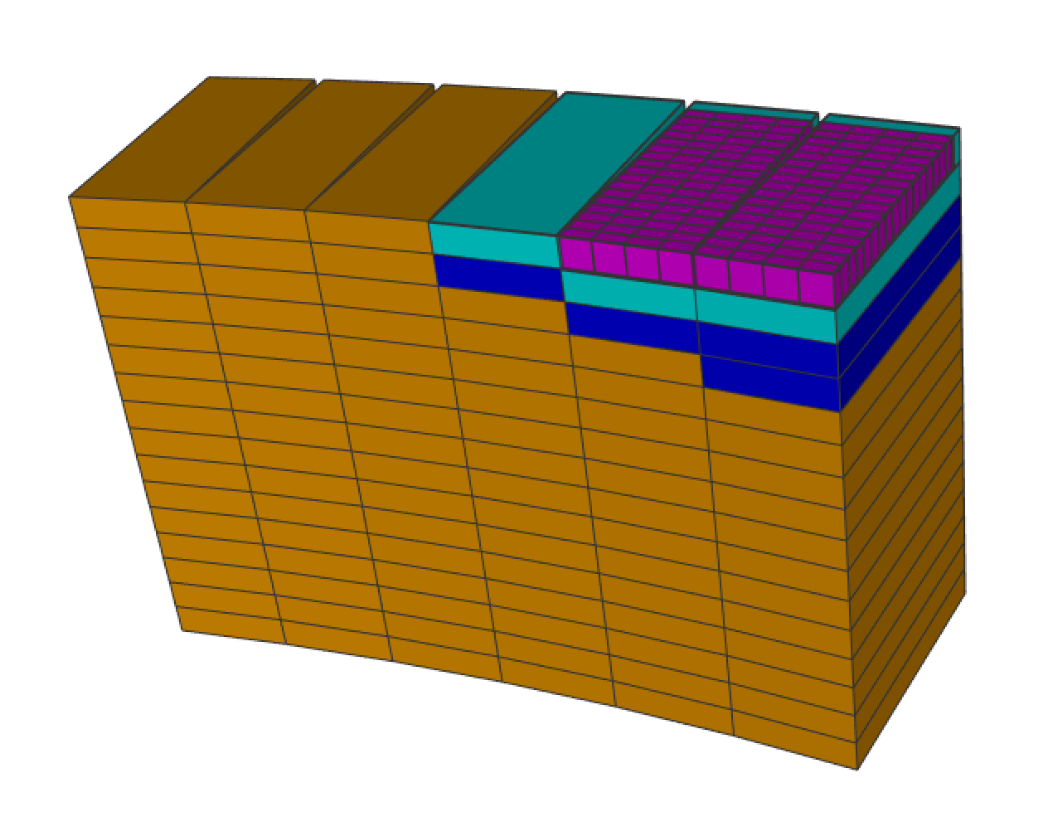
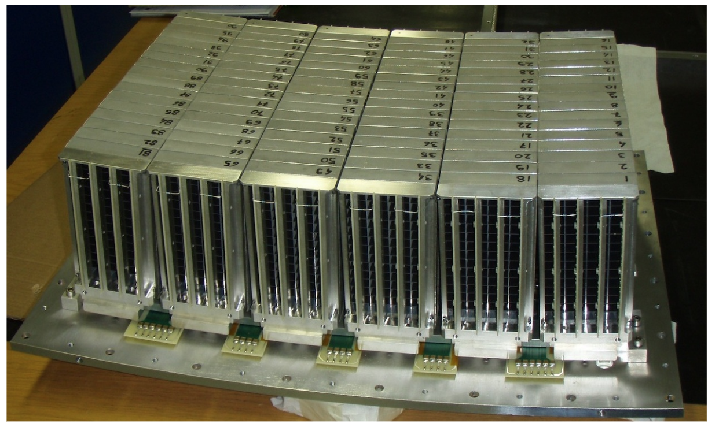
Multi-Grid detector test at ILL
Geant4 @Coding Framework
In-beam test of the Boron-10 Multi-Grid neutron detector at the IN6 time-of-flight spectrometer at the ILL
A. Khaplanov et al.
http://iopscience.iop.org/article/10.1088/1742-6596/528/1/012040/pdf
S. Agostinelli et al doi:10.1016/S0168-9002(03)01368-8
T. Kittelmann et al doi:10.1088/1742-6596/513/2/022017
No shielding on the rear wall of grids

Slide 27
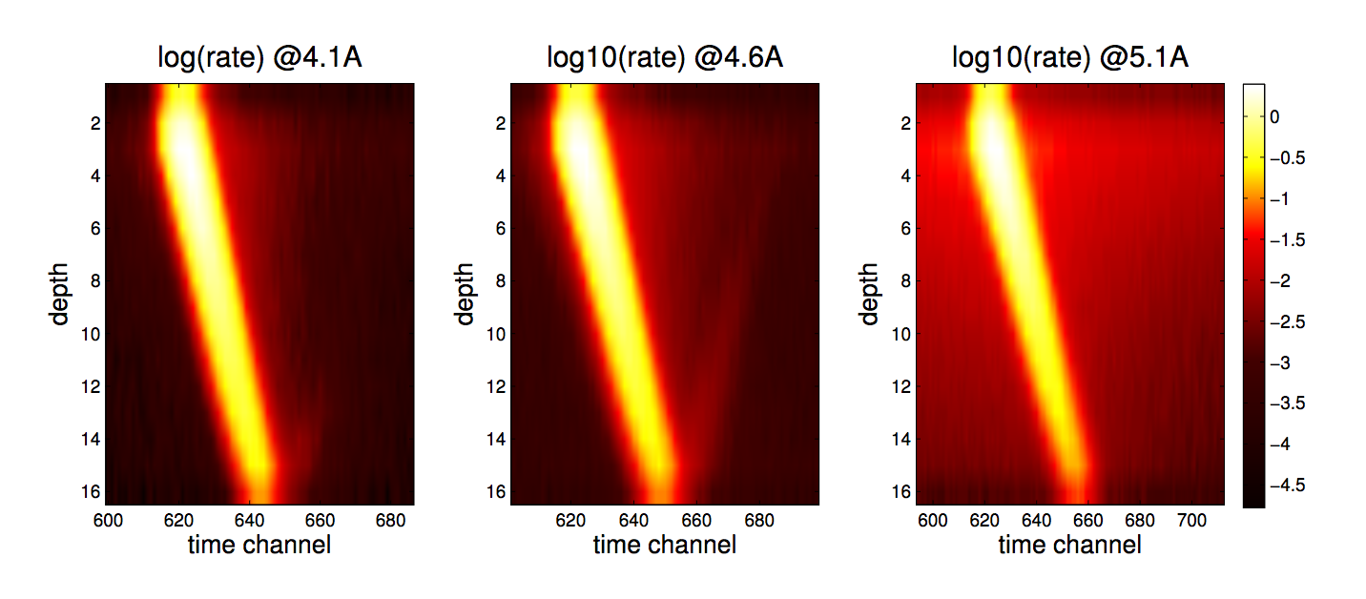
Multi-Grid detector test at ILL Measured data (ToF, depth of detection)
Measured scattering phenomena can be studied with simulation inside the detector

Slide 28
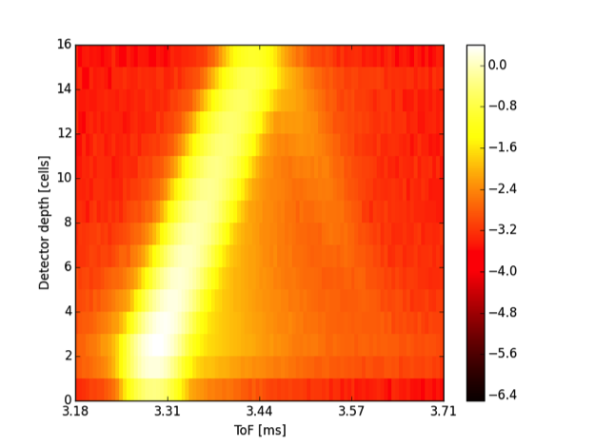
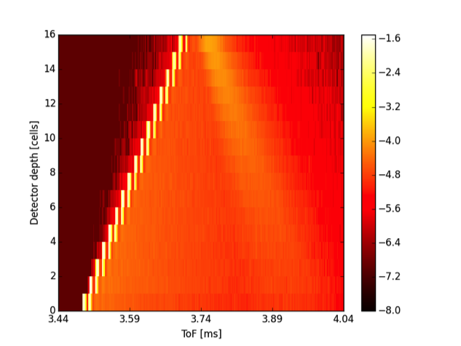
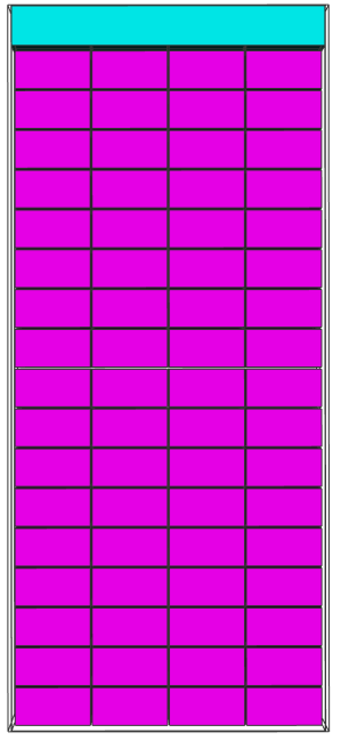
MultiGrid detector test at ILL Measured and simulated ToF-depth of detection
Geant4 @Coding Framework
Backscatter from the unshielded rear wall of the detector at 4.6 Å
NXSG4
http://nxsg4.web.cern.ch/nxsg4/
measured
simulated
Depth in detector [cells]
Depth in detector [cells]
ToF
Validation
Measured ToF-depth characteristic and backscatter phenomena reproduced with simulation at 4.1 and 4.6 Å

Slide 29
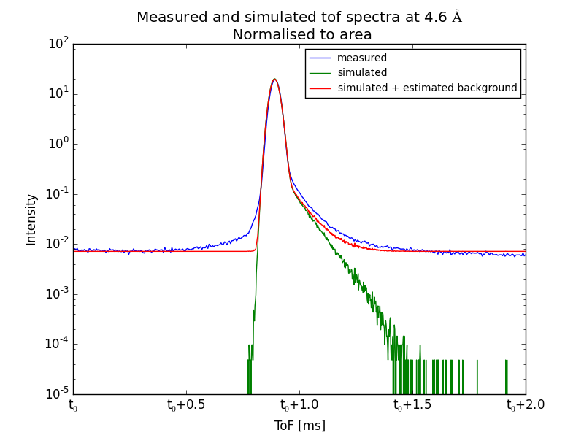
MultiGrid detector test at ILL Measured and simulated ToF spectra
NXSG4
Estimated flat alpha-background added (red), unique for this prototype
Measured ToF-spectrum reproduced with simulation at 4.1 and 4.6 Å
Validation

Slide 30
Large area detector for chopper spectroscopy – Multi-Grid
Geant4 @Coding Framework
Measured data:
ToF
Detection point coordinates
Energy
Sample – detection point distance
≠
Real neutron path
A. Khaplanov et al.
http://dx.doi.org/10.1016/j.nima.2012.12.021
Notes:
Point out:
Need for low background
Scattering on aluminium
Visualisation with CF

Slide 31
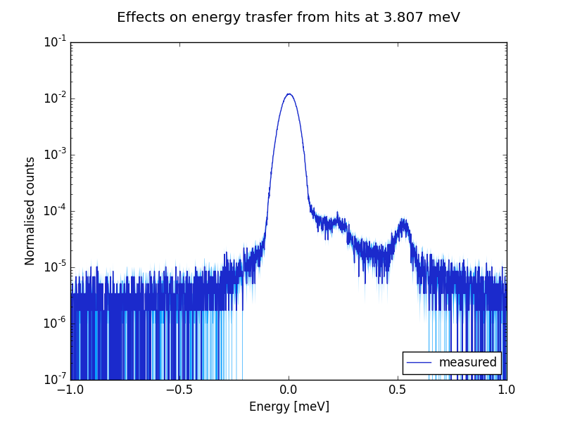
MultiGrid detector test at CNCS [Anton Khaplanov]
Derived energy transfer at 3.807 meV from measurement
Chopper spectroscopy
Measured quantities:
ToF
detection-coordinates
Energy transfer: E_{trf} = E_{initial} – E_{final}
E_{trf} = E_{initial} - E_{final}
Counts
Anton Khaplanov et al.: Multi-Grid Detector for Neutron Spectroscopy: Results Obtained on Time-of-Flight Spectrometer CNCS
Submitted to JINST arXiv:1703.03626

Slide 32
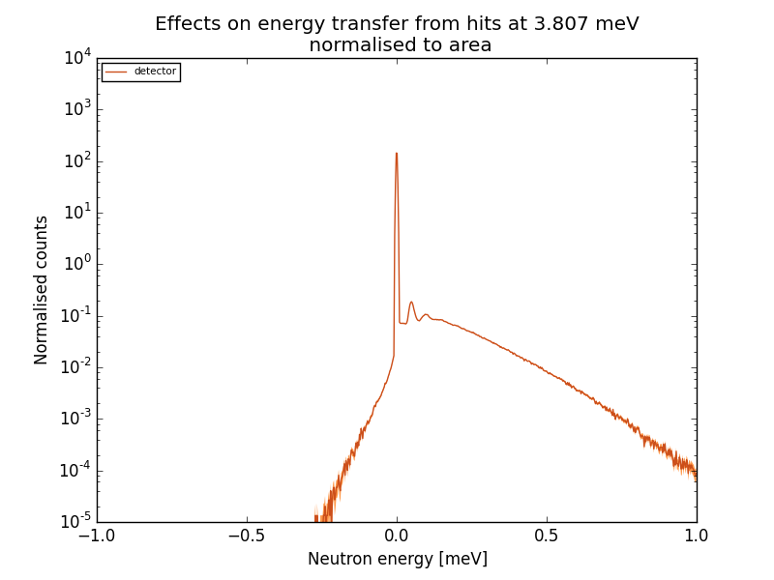
MultiGrid detector test at CNCS, SNS
Geant4 simulation
NXSG4
Elastic peak
E_{trf} = E_{initial} - E_{final}
Scattered neutron background from detector

Slide 33
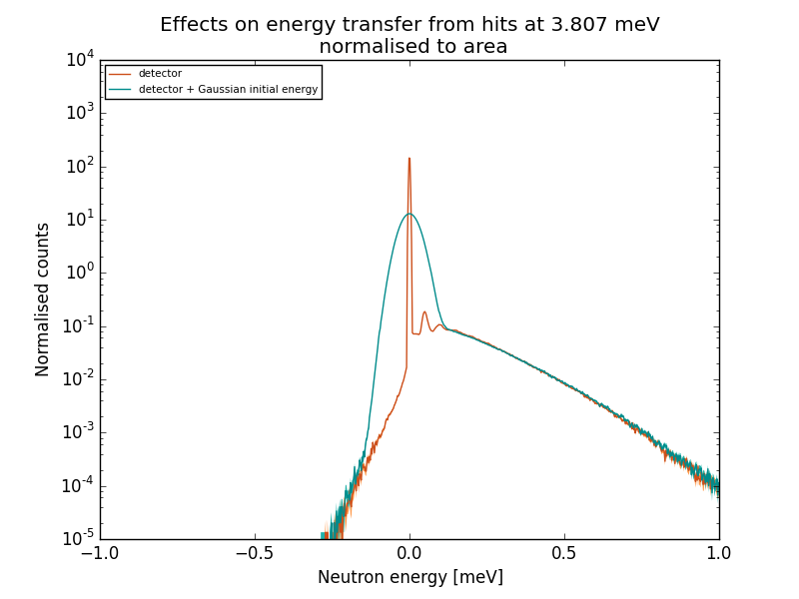
MultiGrid detector test at CNCS, SNS
Geant4 simulation
NXSG4
Elastic peak
E_{trf} = E_{initial} - E_{final}
Scattered neutron background from detector

Slide 34
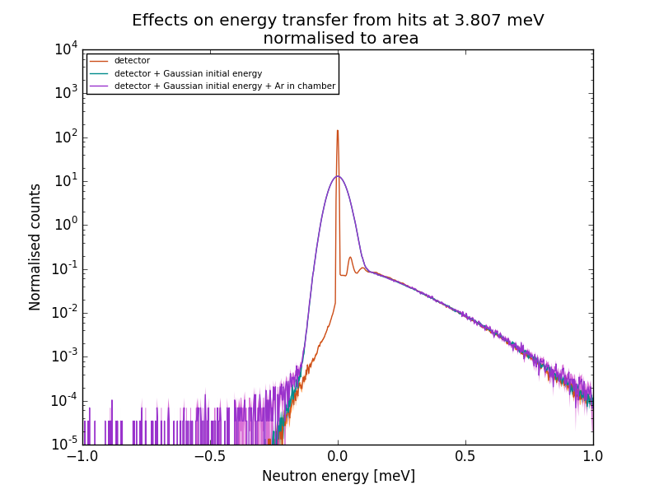
MultiGrid detector test at CNCS, SNS
Geant4 simulation
NXSG4
Elastic peak
E_{trf} = E_{initial} - E_{final}
Scattered neutron background from detector

Slide 35
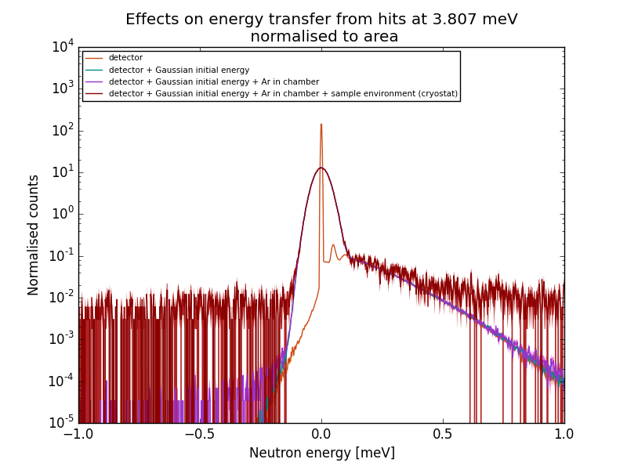
MultiGrid detector test at CNCS, SNS
Geant4 simulation
NXSG4
Elastic peak
E_{trf} = E_{initial} - E_{final}
Scattered neutron background from detector

Slide 36
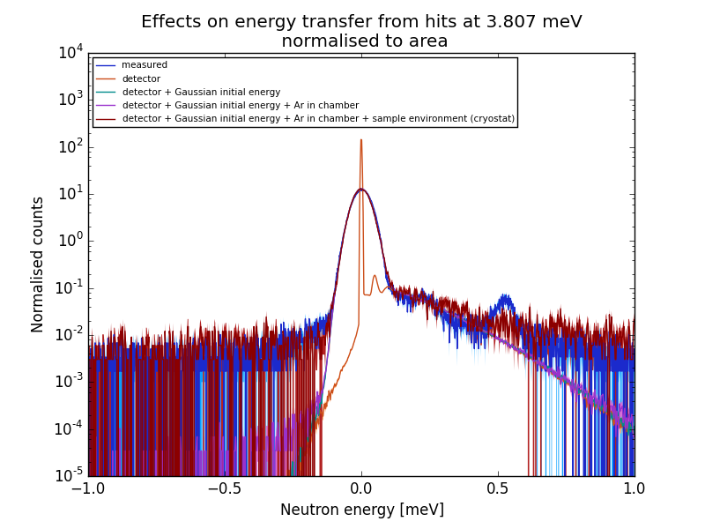
MultiGrid detector test at CNCS, SNS
Geant4 simulation
NXSG4
Elastic peak
E_{trf} = E_{initial} - E_{final}
Scattered neutron background from detector

Slide 37
MultiGrid detector test at CNCS
Distinguish different sources of background
Detailed analysis and quantification of background effects
E_{trf} = E_{initial} - E_{final}
Elastic peak
Scattered neutron background from sample environment
Scattered neutron background from detector
Energy transfer reproduced with simulation at 3.807 meV

Slide 38
Conclusion
Realistic Multi-Grid model built
reproduced measured results from IN6 and CNCS experiments
Ready to use for optimization
Instruments with better signal-to-background ratio by design
Predicament for background sources and levels in full-scale detector
Shielding and design optimization in the level of grids, columns and full-scale detector

Slide 39
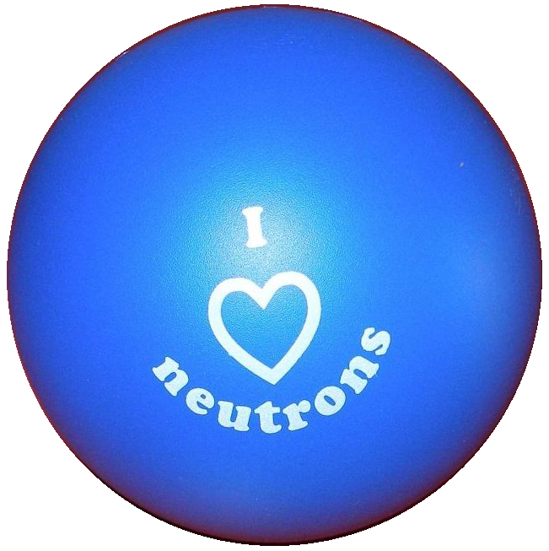
676548
Thank you for your attention!
26 September 2017, ICANS XXII, Oxford

