Slide 1

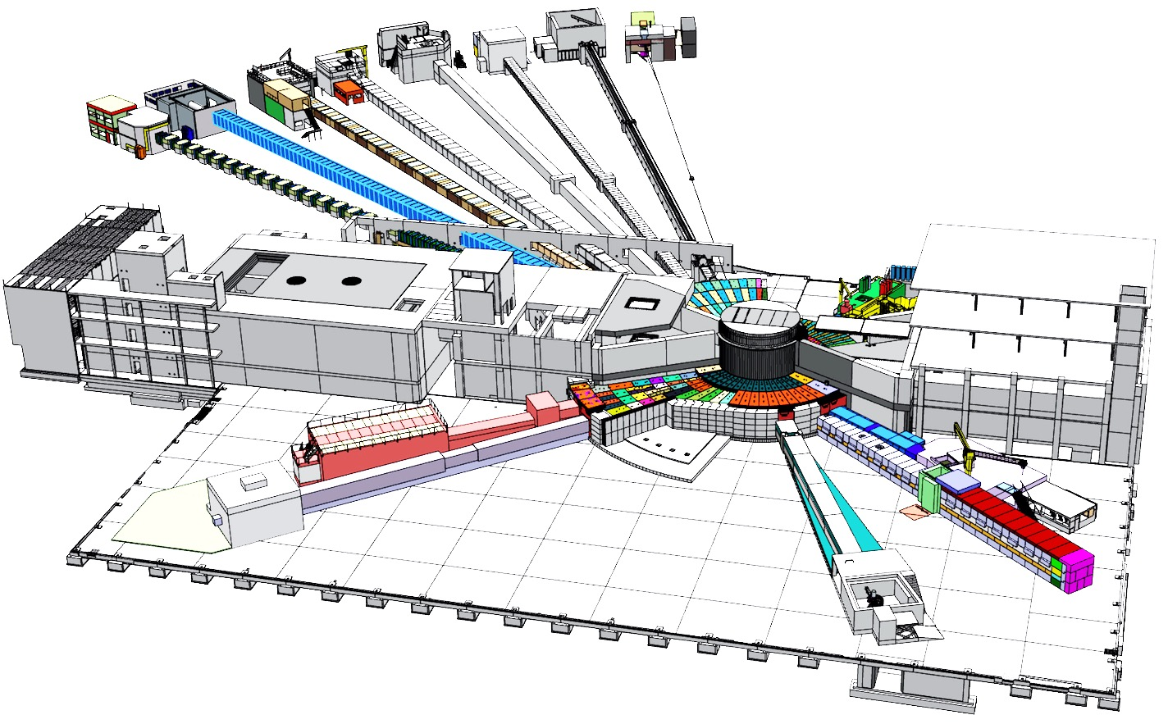

Guide Alignment
Fabien Rey
2017 07 11

Slide 2
Content
Central SAM Team
Alignment Strategy
Team
Activities up to now on site
What do we know and do not know …
Inside the Bunker
In the Experimental Halls
In the Guide Halls
In the Experimental Cabins

Slide 3
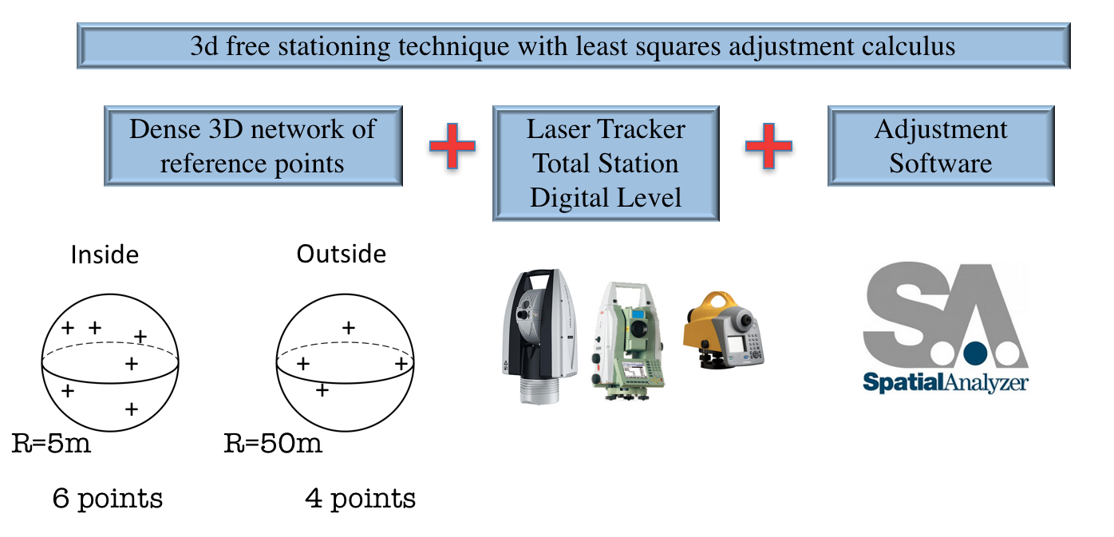
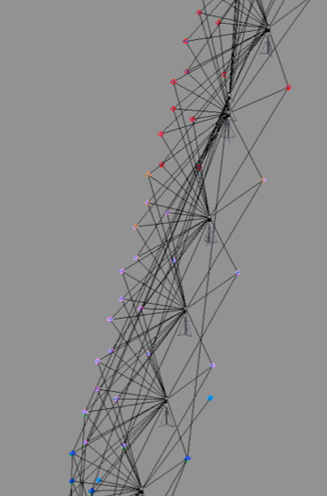
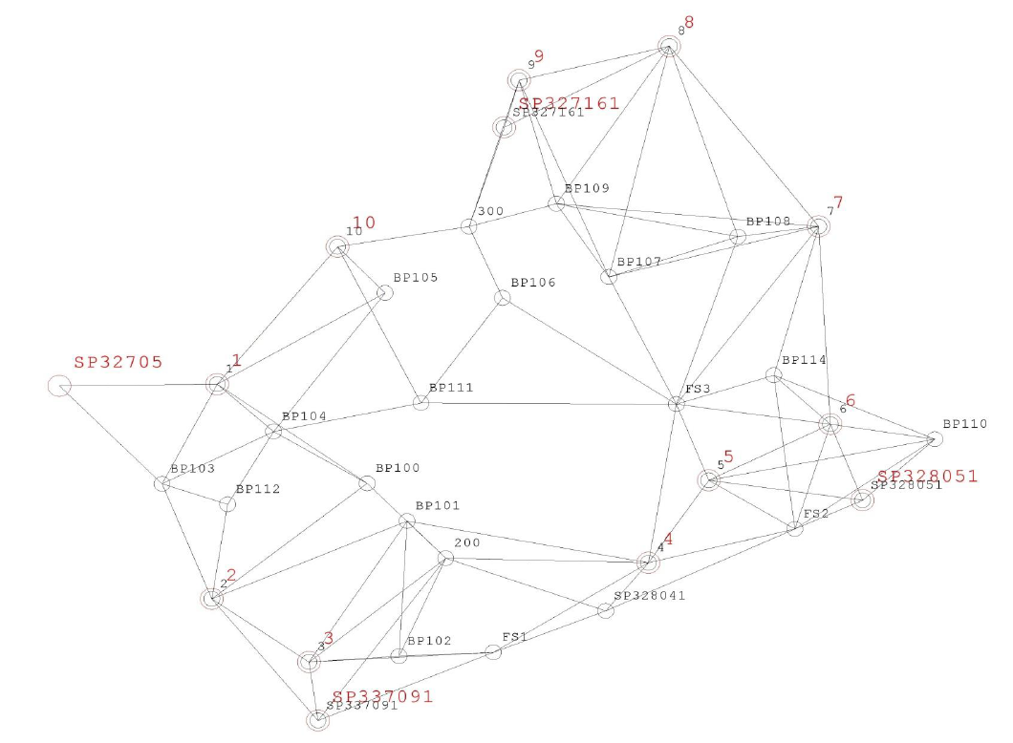
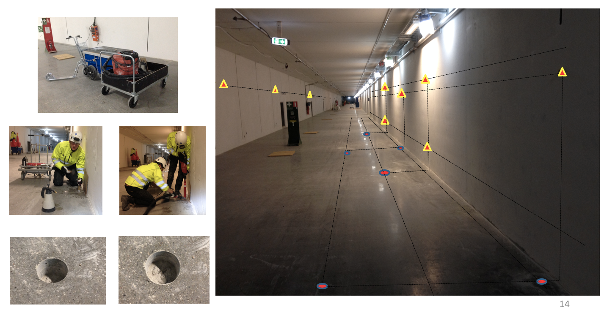
Central SAM Team
Alignment Strategy
Internal Tunnel Network
Outside Geodetic Network

Slide 4
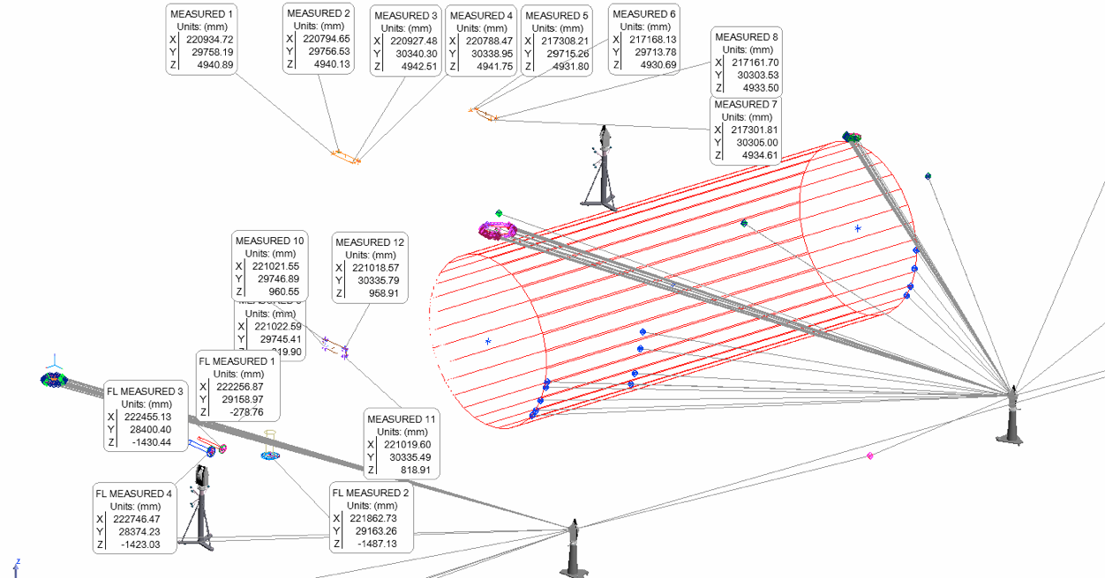
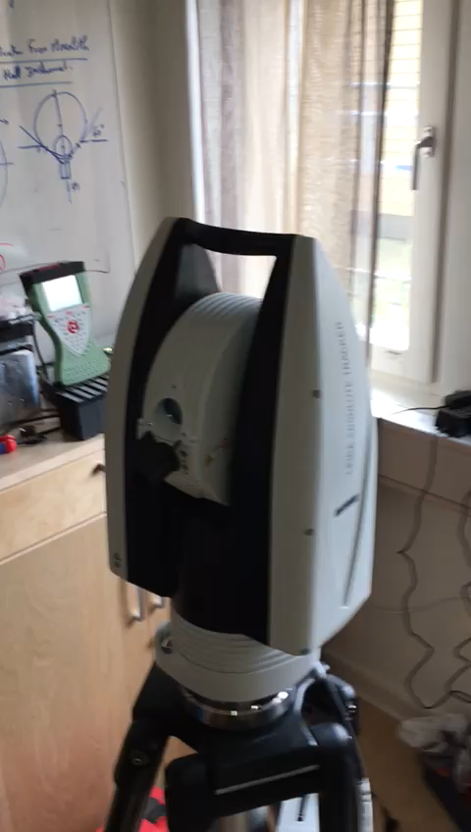
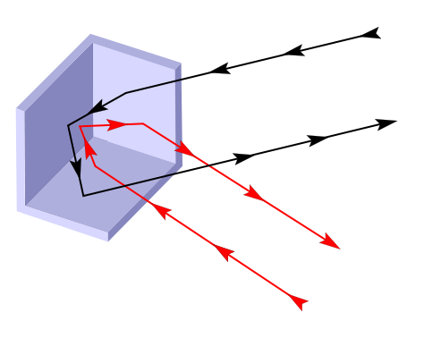
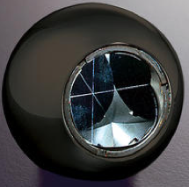
Central SAM Team
Alignment Strategy
Portable
Robust
Reliable Technology
Laser Tracker

Slide 5
Central SAM Team
Alignment Strategy
But we are also familiar with other techniques:
Optical Levelling
Theodolite
Hand Scanning
Laser Scanning
Autocollimation
3D ARM
Interferometry
Photogrammetry
Capacitive/Inductive Measuring Sensors
Hydrostatic Levelling System
Fixed Stretched Wire

Slide 6

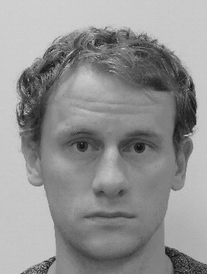
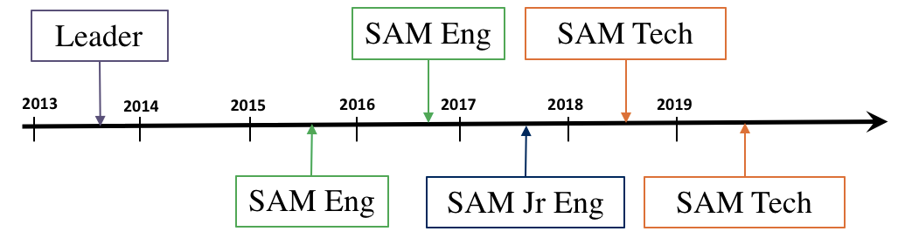


Central SAM Team
TEAM
  Trained with Instruments
  Skilled in Metrology Software
  Experienced in Precise Alignment
  Work on the field
Provide Services to whole ESS
Limited Resources and Budget

Slide 7
Central SAM Team
Activities up to now on site
Establishing Network
G01 Tunnel
G02 Gallery
D02 Target/Monolith
E02 Guide Hall
Laser Scanning
Almost all critical areas
Following Construction
High demand for Reverse Engineering as 3D As built missing
Marking
Cryogenic Equipment
Full Tunnel and Gallery coming
Alignment
ECHIR
CRYO COLD BOX

Slide 8
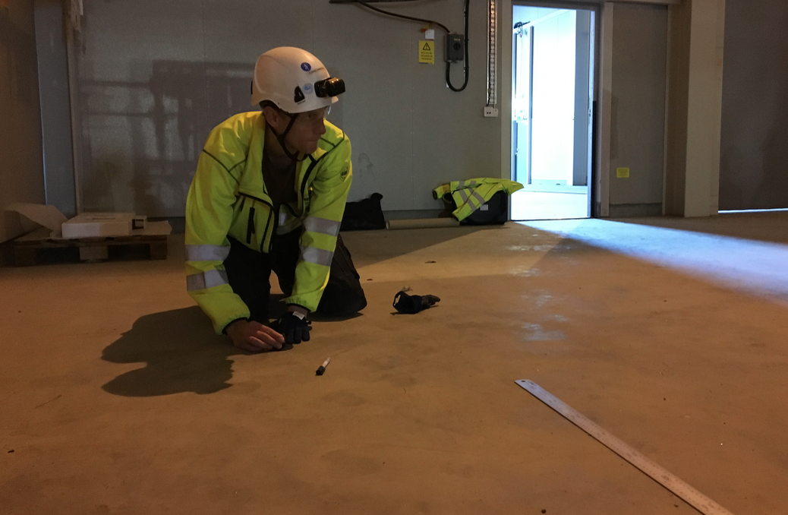
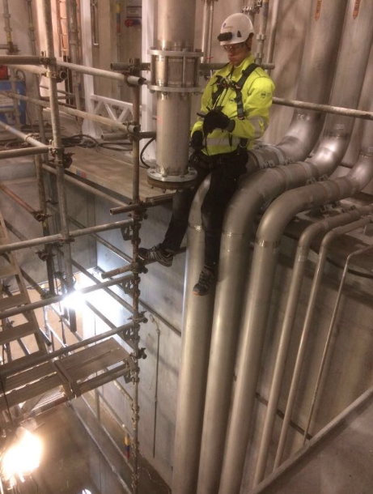
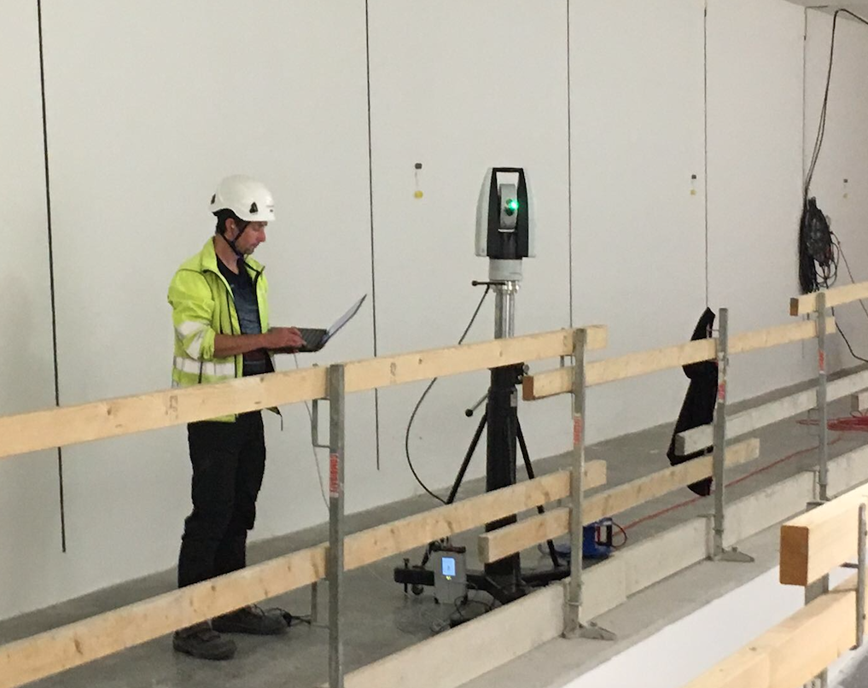
Central SAM Team
Activities up to now on site
As-built
Marking
Network Campaign

Slide 9
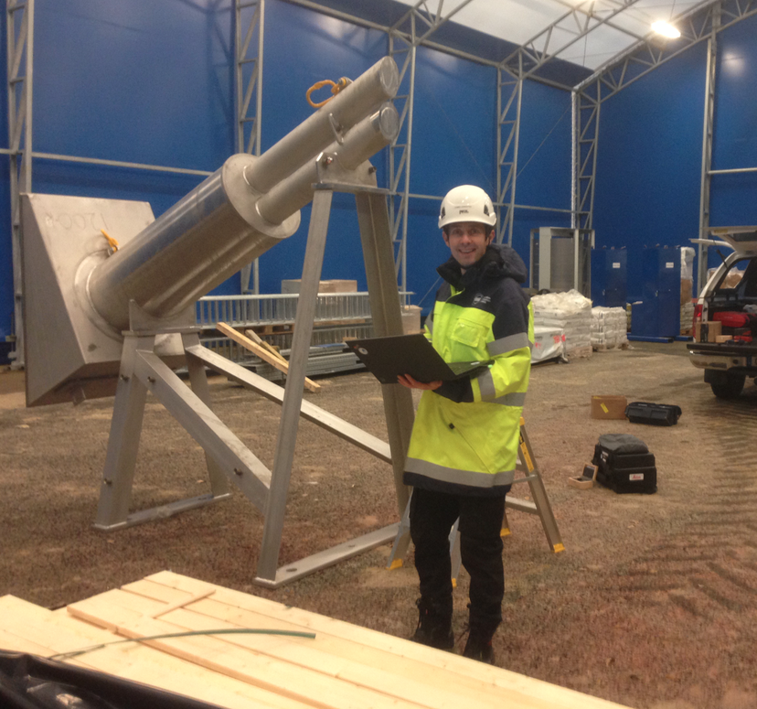
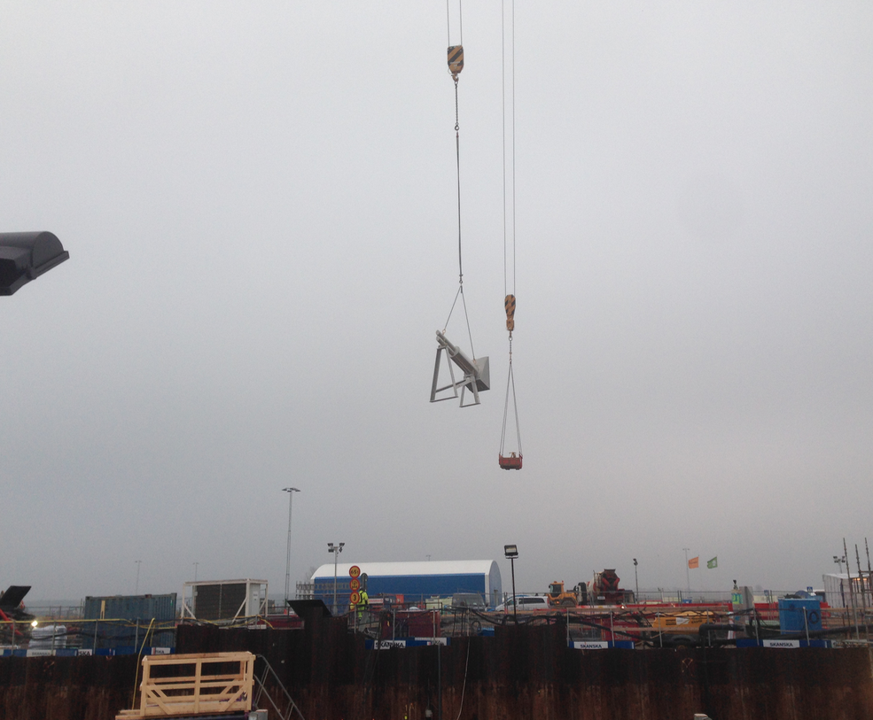
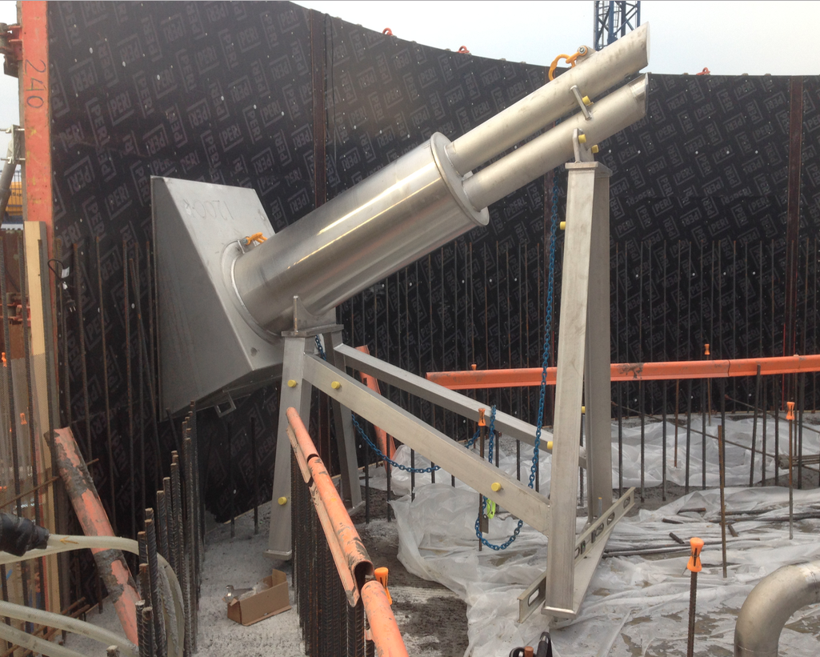
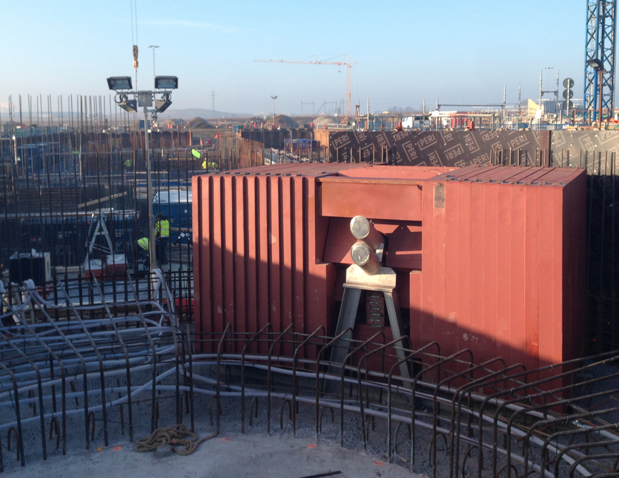
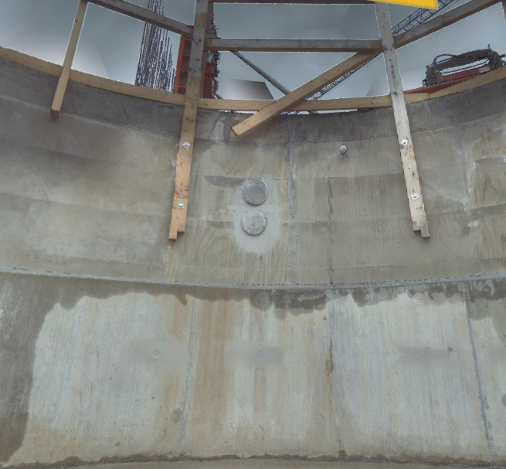
Central SAM Team
Activities up to now on site
ECHIR

Slide 10
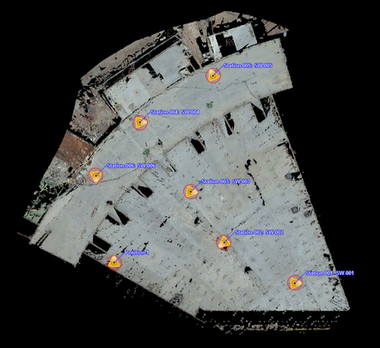
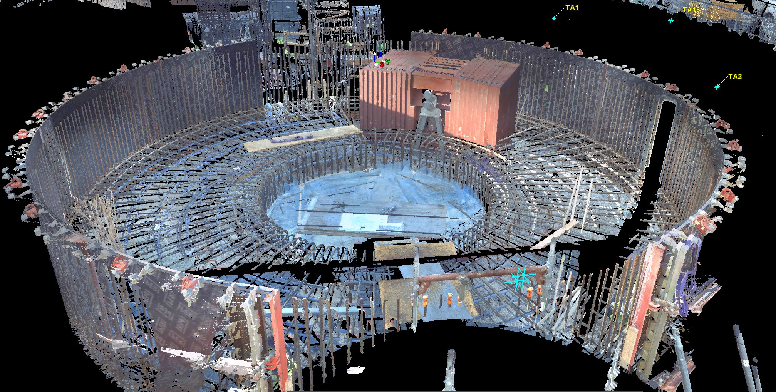
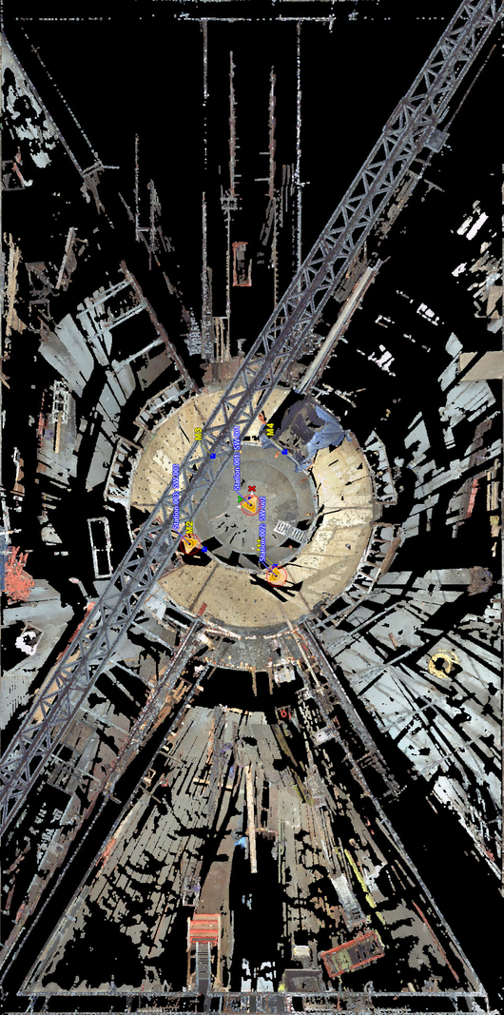
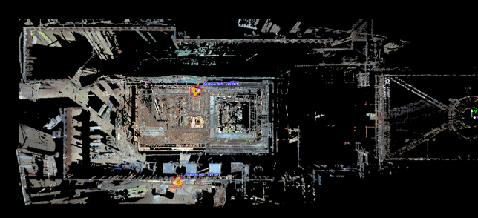
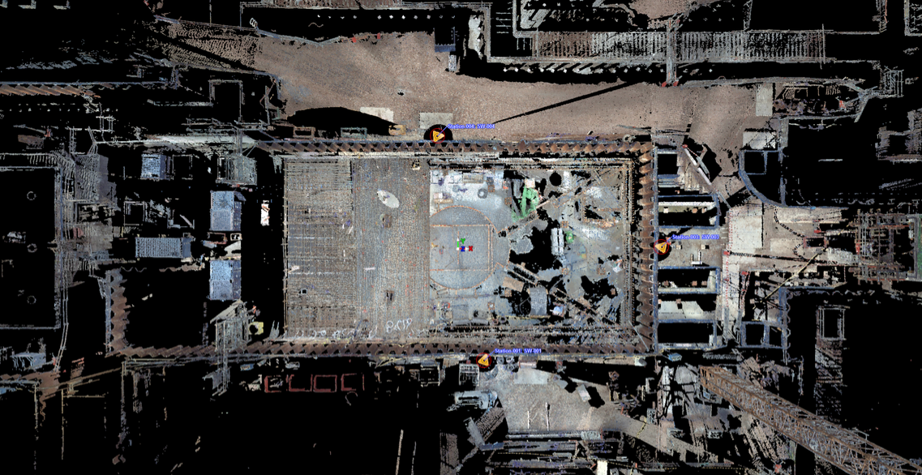
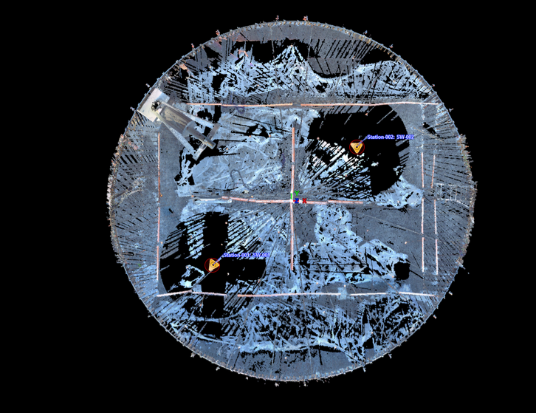
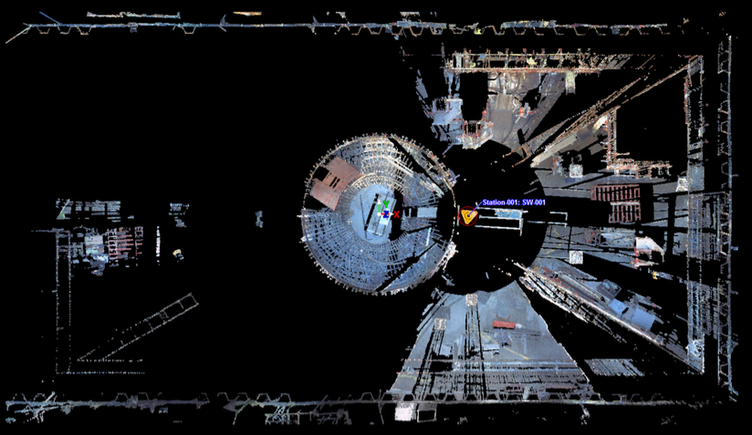
Central SAM Team
Activities up to now on site
Laser Scanning

Slide 11
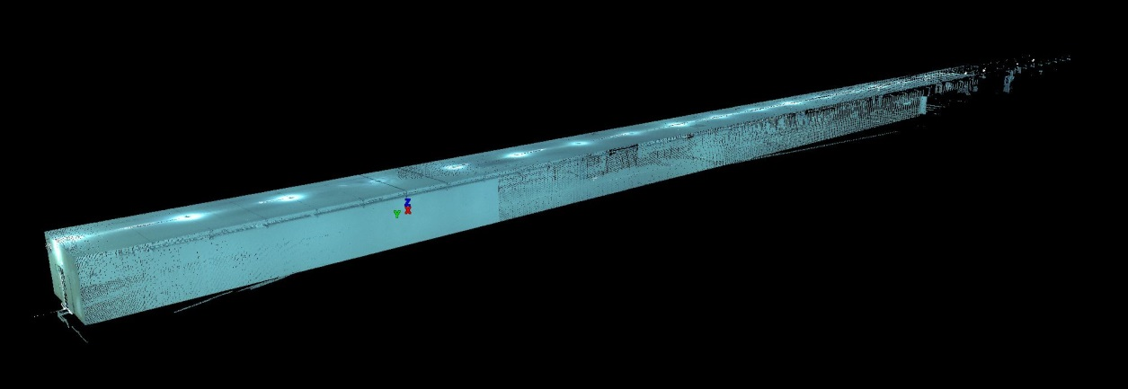
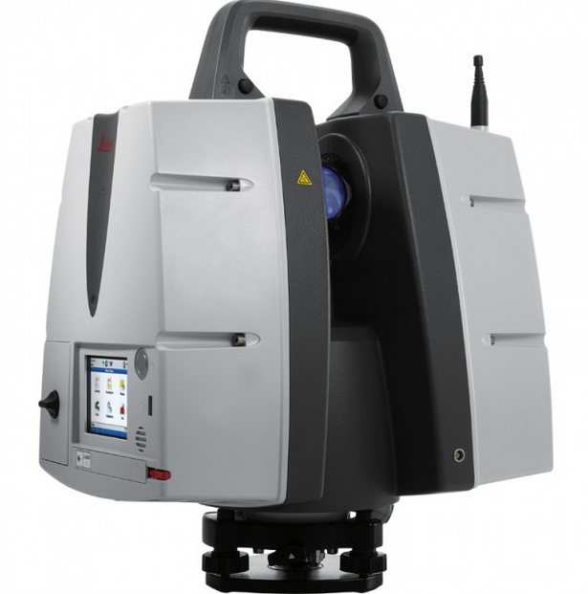
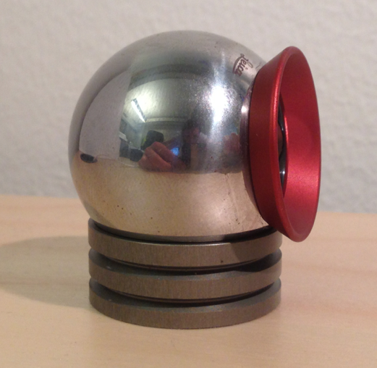
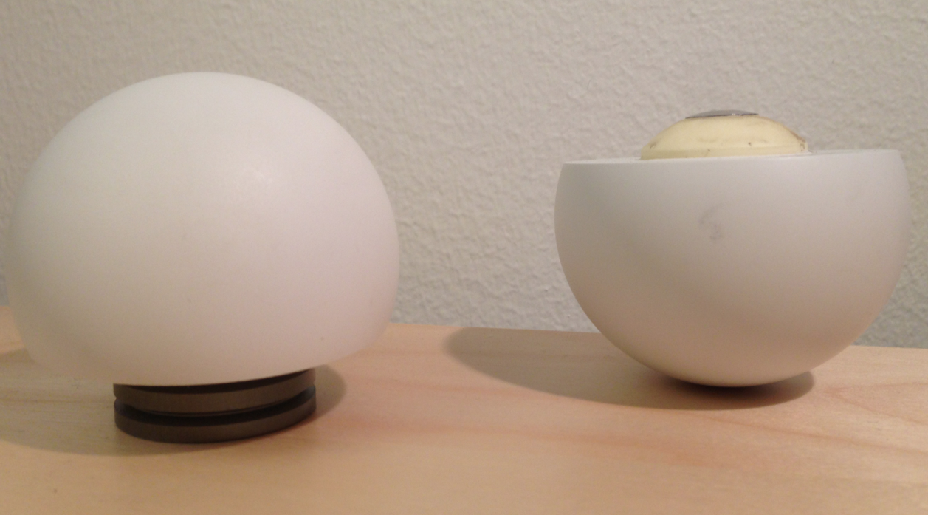
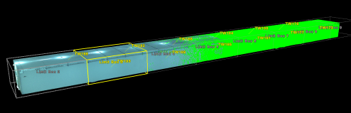

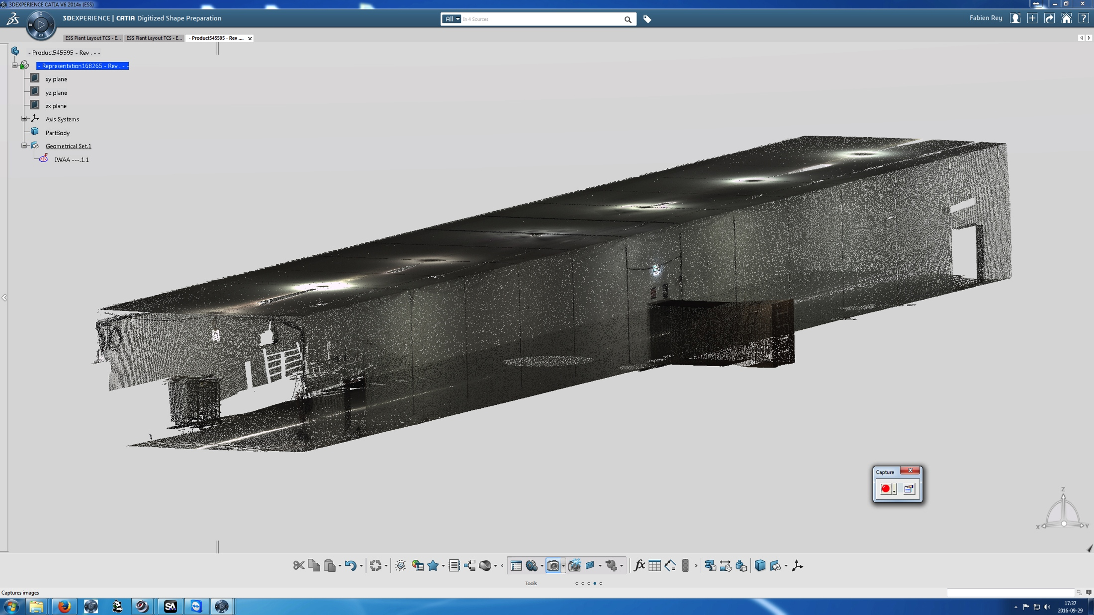
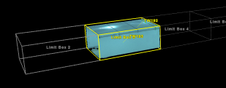

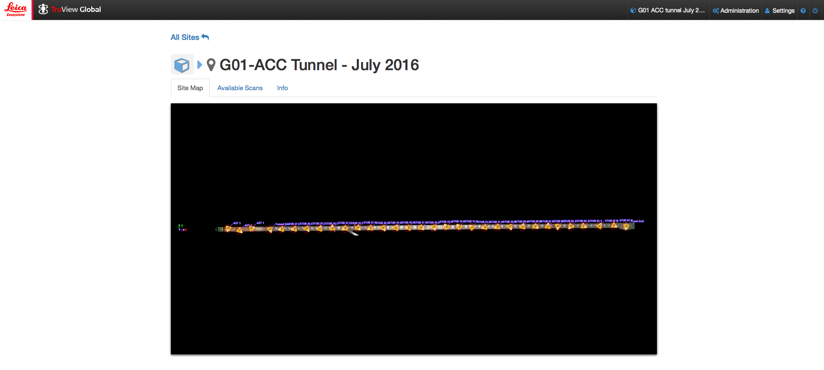
Central SAM Team
Activities up to now on site
Focus on 3D Scans
Analysis in Cyclone
Raw data Acquisition
Data Cleaning
Orientation of Scans ( registration)
Geometries created on demand
Concentric Spheres
P30
V6
For Reverse Engineering and Integration
Non CAD users
Visualization/Simple measurments
11
11

Slide 12
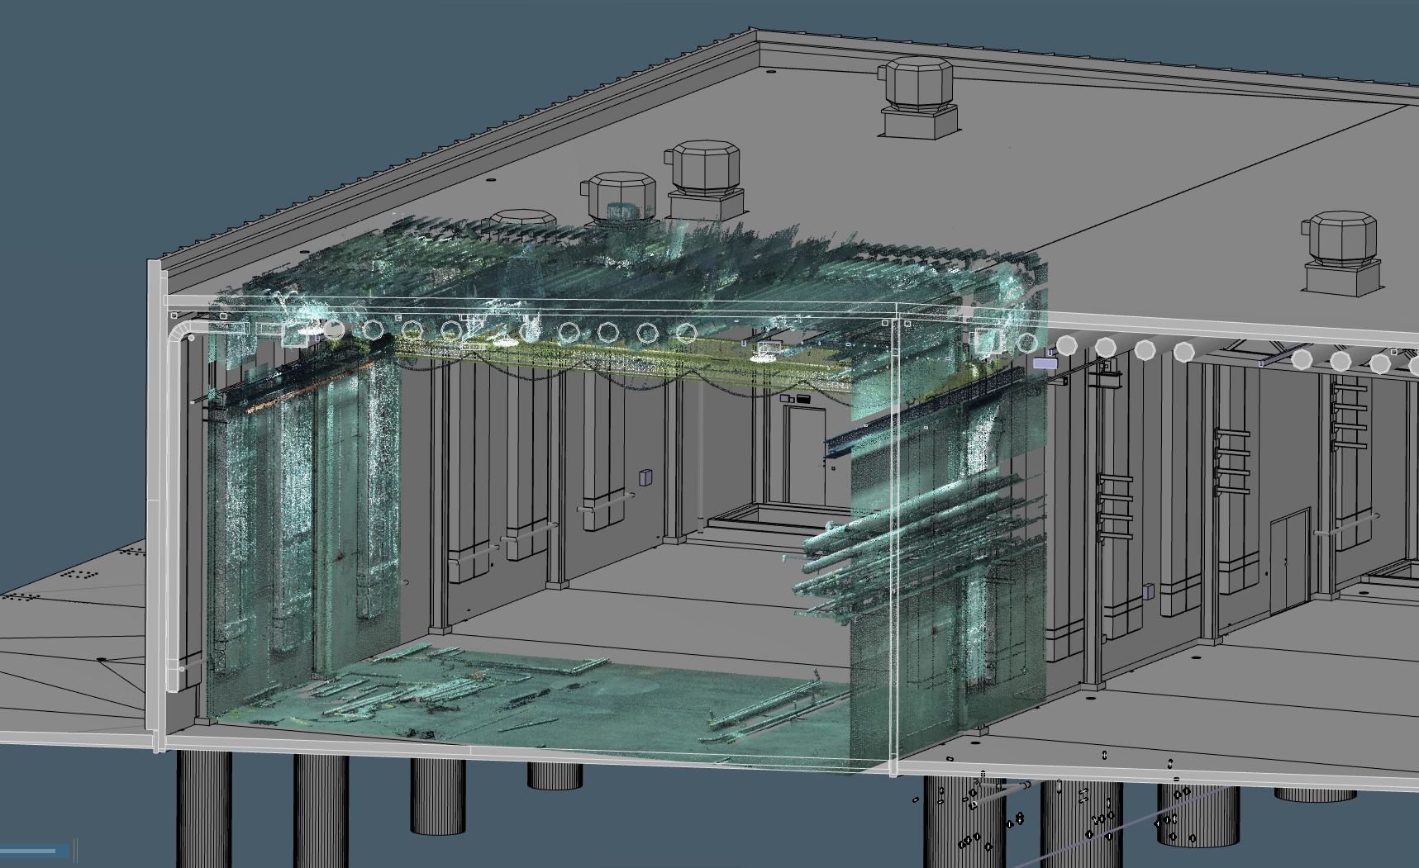
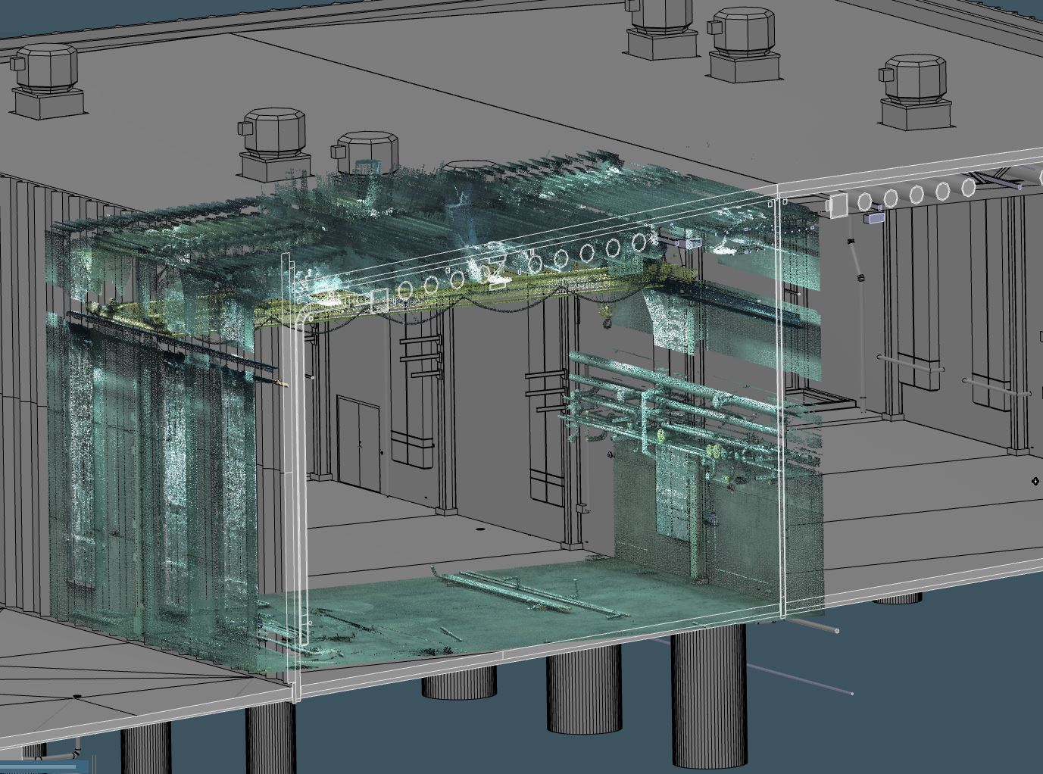
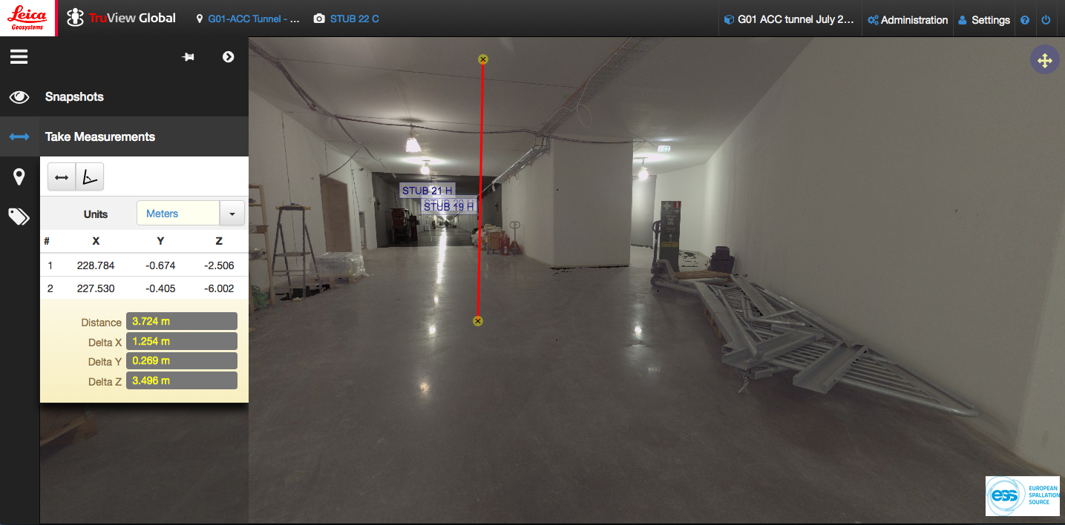
Reverse
Engineering
G04- 3D model vs SCANS
Publication
in Truview
12
12

Slide 14
What do we know and do not know …
Inside the Monolith
MONOLITH
Rigid Assembly moving independently from the other slabs
Precise alignment for guides inside Insert
Radiation
40 years operation and maintenance

Slide 15
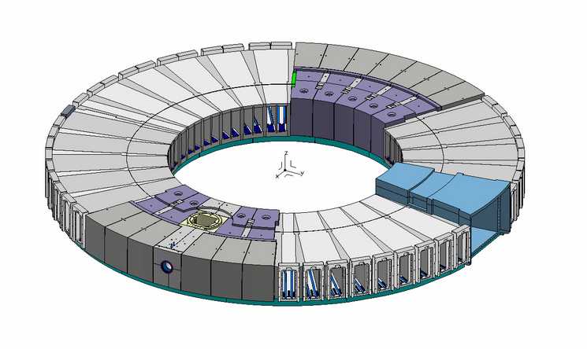
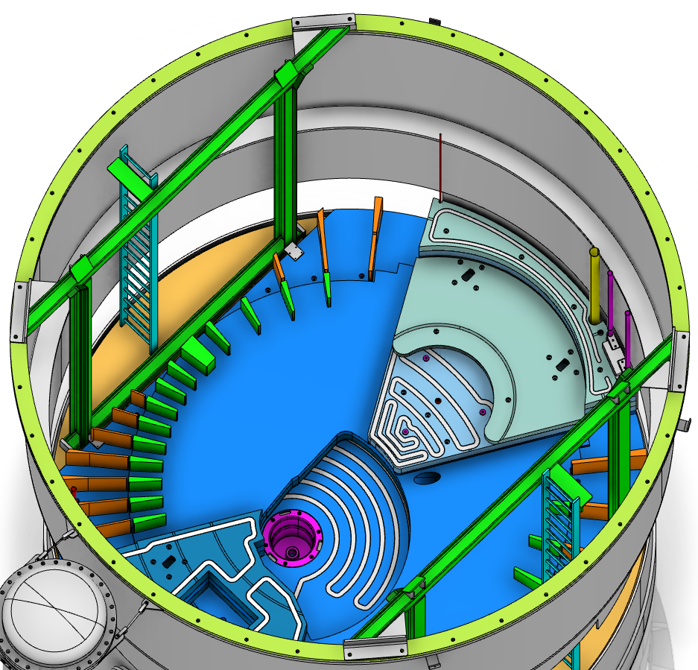
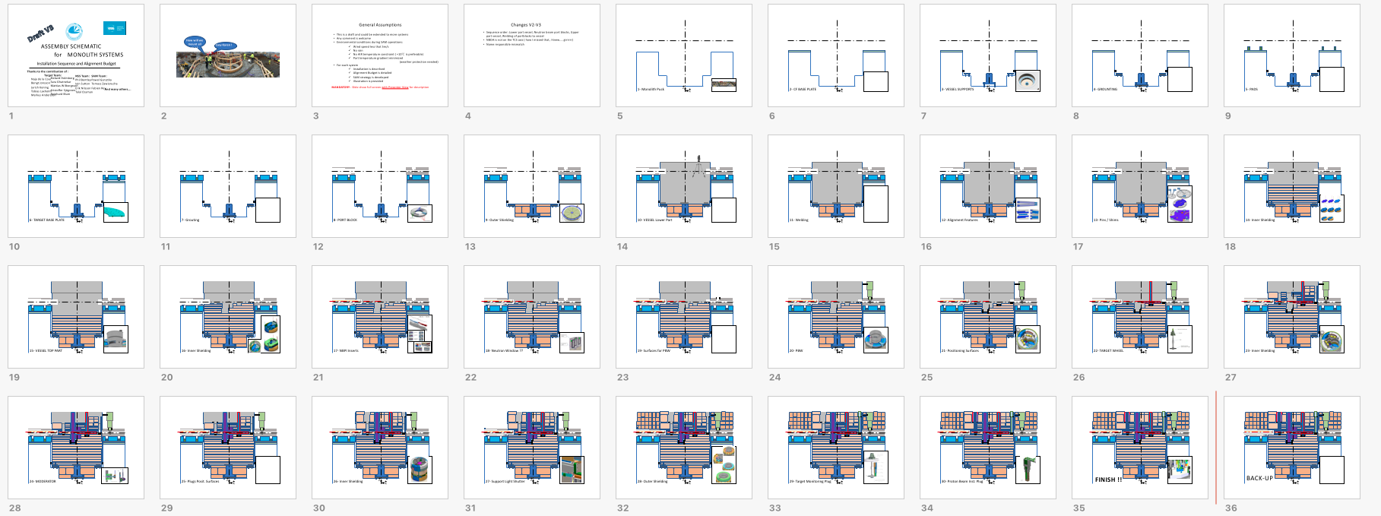
What do we know and do not know …
Inside the Monolith
Solution Proposed
Precise alignment during installation for
Alignment features inside insert
Alignment features for Moderator
Machined Parts
Precise Assembly
+
Benefits:
Minimize machining cost
Forced centring of Insert
Schematic for monolith systems assembly under progress

Slide 16
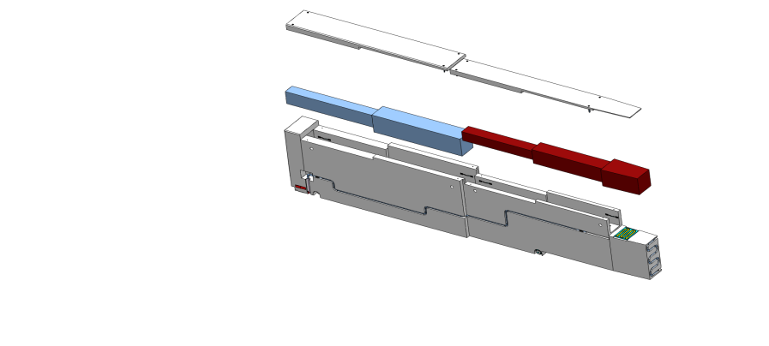
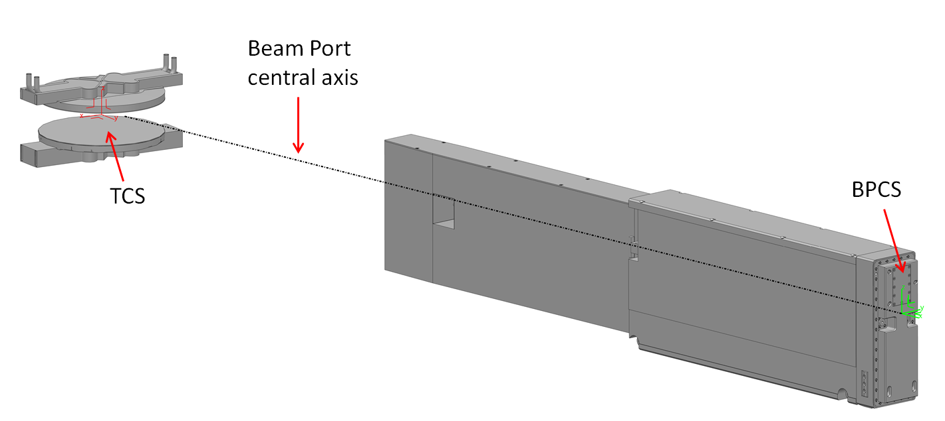
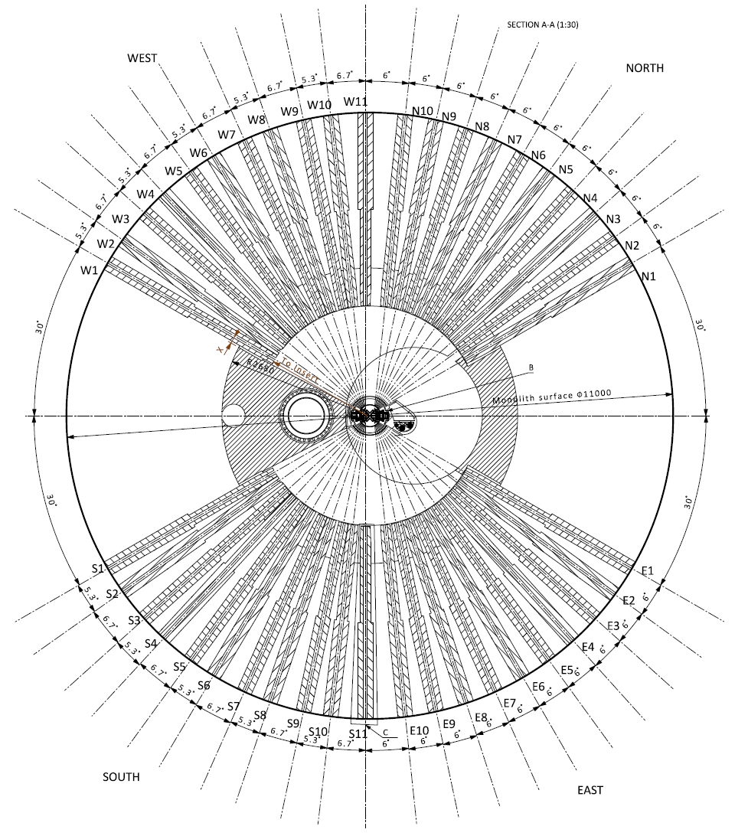
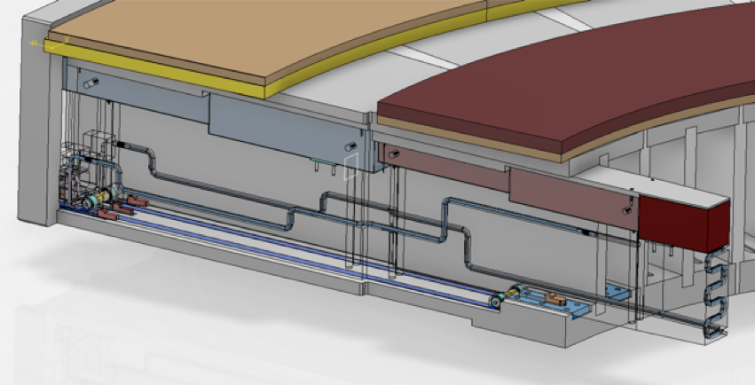
What do we know and do not know …
Inside the Monolith
Customized Insert according to your geometry!
Insert Position forced to Nominal Values !

Slide 17
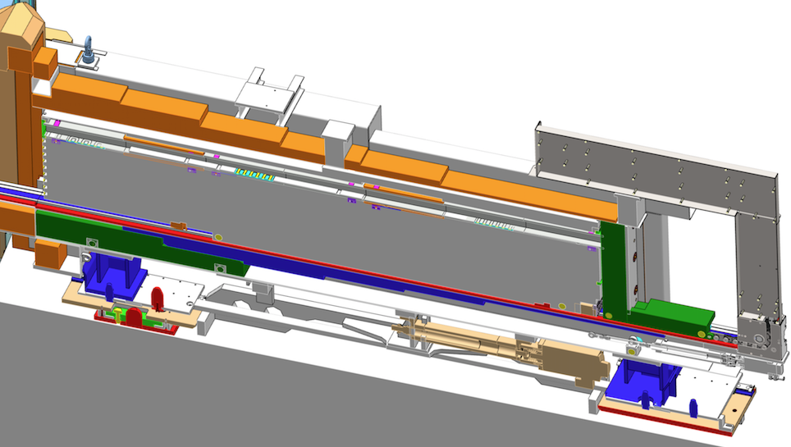
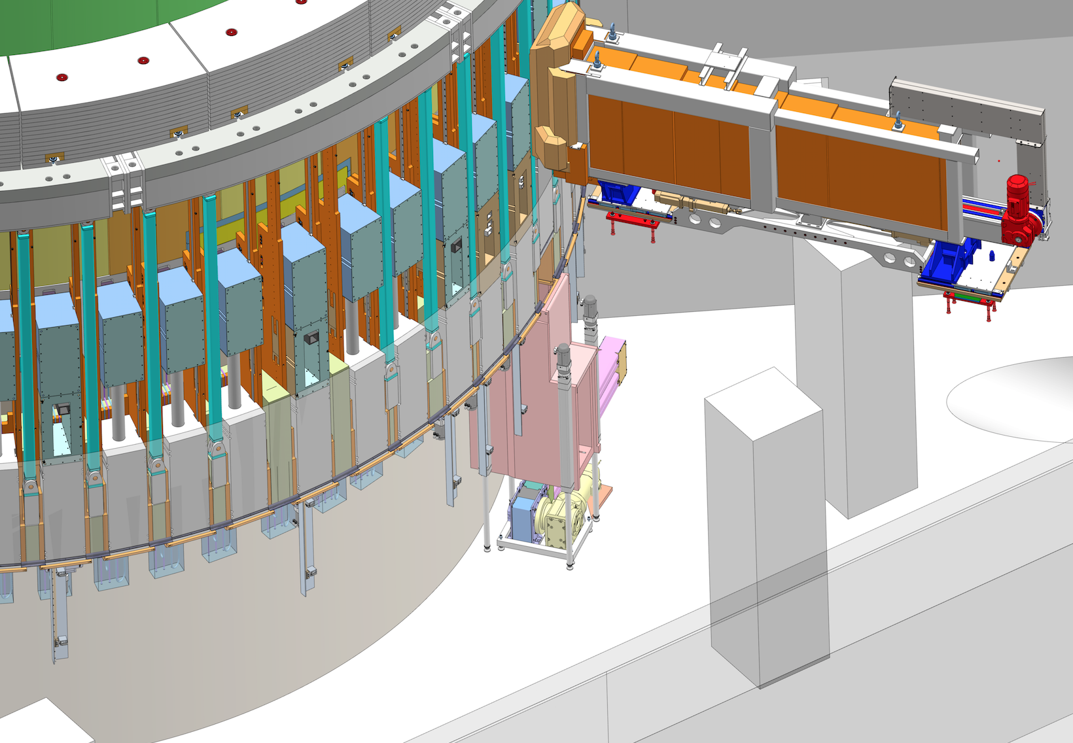
What do we know and do not know …
Inside the Monolith
Assembly and Alignment of Guides in Insert
NBEX Tool + Transportation
Location and conditions TBD
Assembly area and conditions not fully defined
Transportation test under investigation to better understand misalignment issues
How do we get organized in this assembly area:
Who does what?

Slide 18
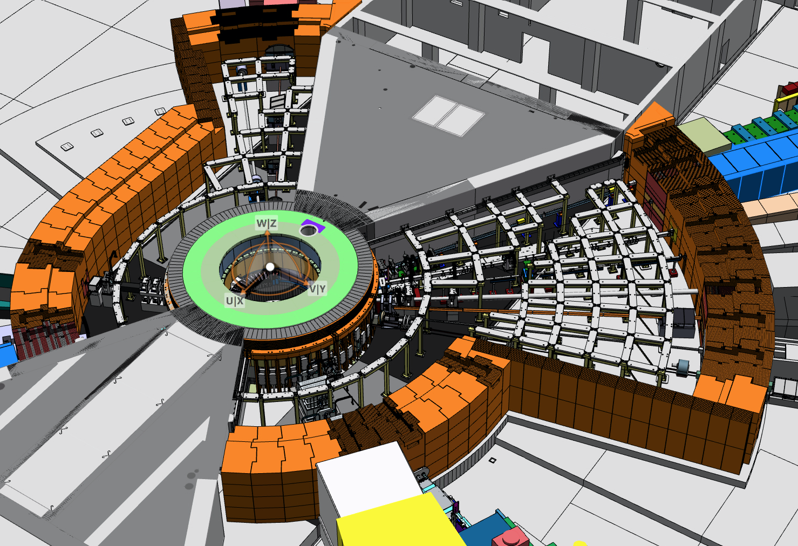
What do we know and do not know …
Inside the Bunker
Problem:
Bunker area moving independently of the Monolith
Monolith (Port Block) almost not visible from Bunker

Slide 19
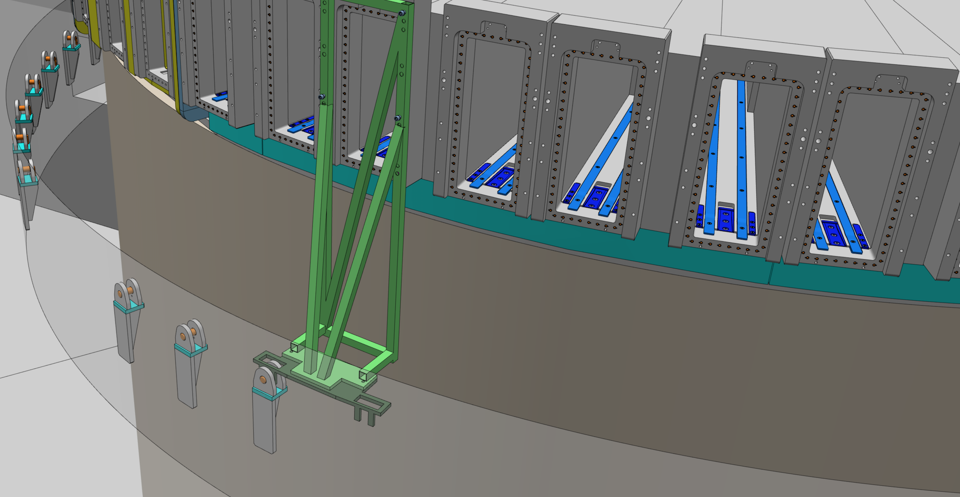
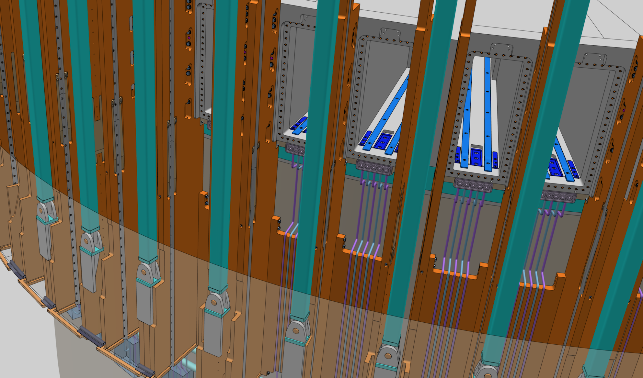
What do we know and do not know …
Inside the Bunker
Need to Provide References attached to the Port Block to propagate TCS…
but we do not see Port Block anymore!!!
Another here
Permanent corner cube reflectors under study

Slide 20
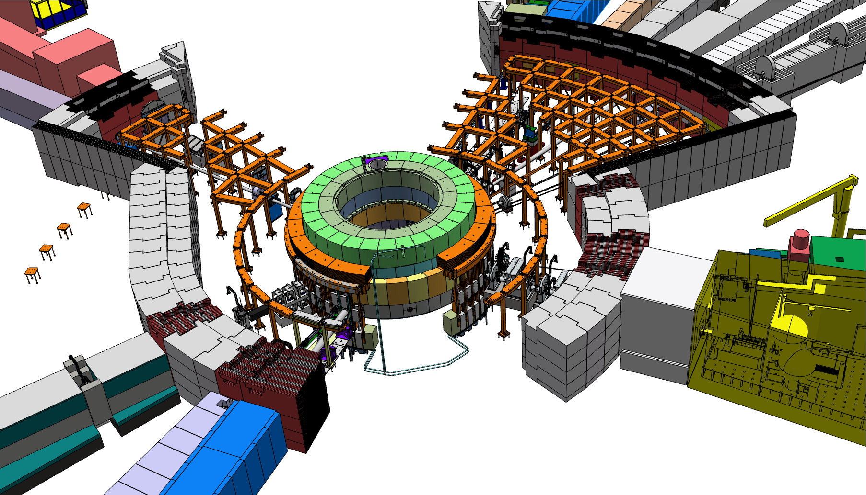
What do we know and do not know …
Inside the Bunker
Dense Network Available:
On light shutter structure ( attached to port block)
On CF walls
References on the baseplates ( cone)
Probably additional ones on Bunker walls
Reminder:
Reservation on baseplates for NBEX tool attachments
Reservation on baseplates for References ( drawing will be communicated soon)
Provide soon detail 3D model for Integration purposes

Slide 21
What do we know and do not know …
Inside the Bunker
Strategy for Alignment inside the bunker
- drop the tracker from the roof
- attach some prisms to convenient location (in situ or Remote Handling) + permanent prims on light shutter structure
- locate the tracker and measure the part to be aligned ( can be done remotely)
- track position of component while acting on adjustment systems
Not applicable for Chopper!
Forced centring with kinematic mount
How do we place/orient/remove prisms in RH mode?
How to operate the adjustment system?

Slide 22

What do we know and do not know …
In Instrument Halls
Network
Dense network on the Experimental floor ( re-measured as much as we can have access) – out of the Shielding
Additional references covered by the shielding
Network References
Vertical Absolute Reference

Slide 23



What do we know and do not know …
In Instrument Halls
Test on going for supporting system

Slide 24












What do we know and do not know …
In Instrument Halls
Loading test E01
No load
0
0.8 mm
Max : o.8mm
Max : o.5 mm

Slide 25

What do we know and do not know …
In Experimental Cabins
Network references
Around the cabin on the floor
Inside the cabin:
  On rigid walls ( can you drill the wall? Safety problem)
  On the floor ( is the floor visible )
  Connect to the outside while mounting the cabin ( for mm accuracy)
  Think on how to re measure the network through door or chicane

Slide 26




What do we know and do not know …
In Experimental Cabins
Sample Environment

Slide 27
Conclusion 1
SAM team adopted Laser tracker solution ( with limited budget and resources)
SAM team will provide dense network and updated values as much as we can.
SAM Team will make sure to propagate TCS information outside the monolith
ESS places Inserts inside the monolith
- But , how do we get organised in mounting area of guides in insert?

Slide 28
Conclusion 2
Once you have selected your guide vendors, please contact us:
- To collaborate to the design of supports , adjustment systems , and alignment strategy
- To understand who does what in each area.
- To enable SAM team to provide the best support possible.
- To agree on details: ex: exchange of data ( fiducialization ,network)

Slide 29
Thank you!
Usefull Links:
Confluence SAM page
Request for SAM services
Instructions for Point Cloud Viewer
Truview service

