Slide 1

Bridge Beam Guide, Baseplates, Bunker Wall Insert, Bunker Wall Interface
Gábor László & Valentina Santoro
NSS Lead Instrument Engineer
24.09.2017

Slide 2
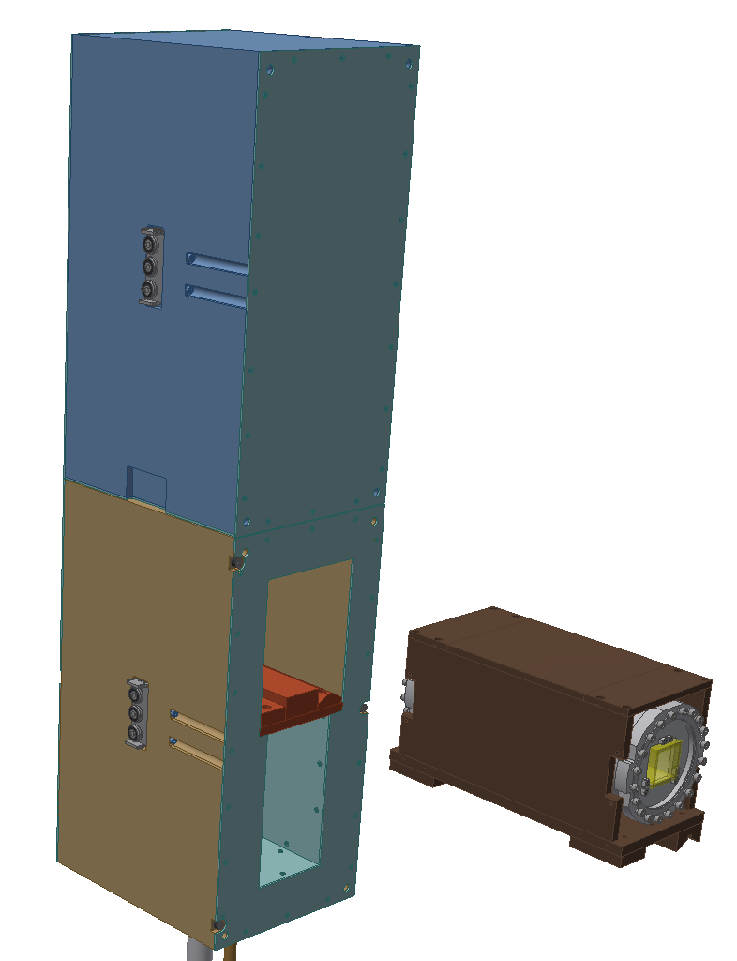
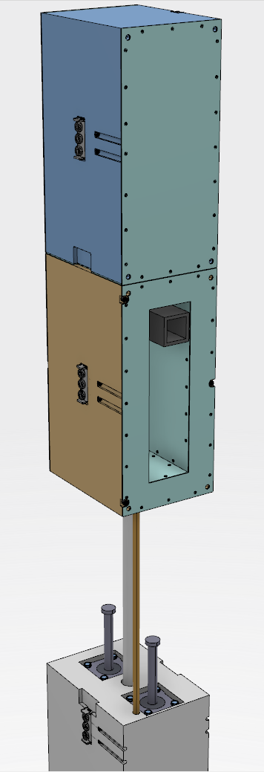
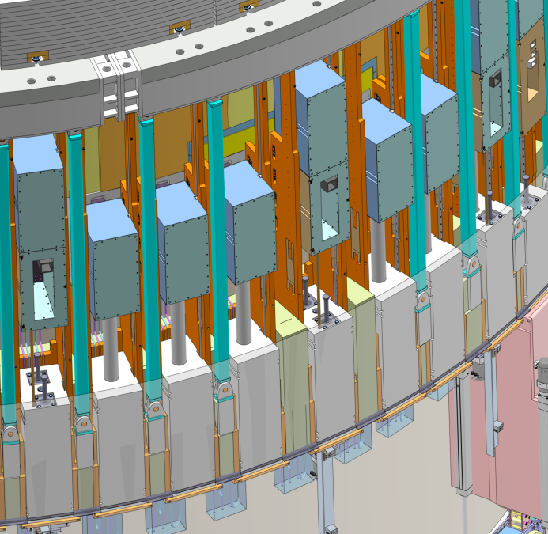
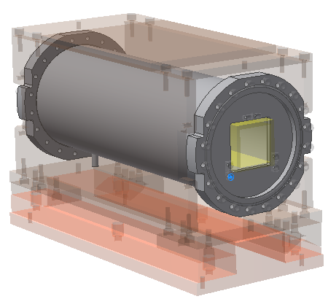
Bridge Beam Guide Housing Concept
/Shutter vault blocks: ESS-0078479/

Slide 3
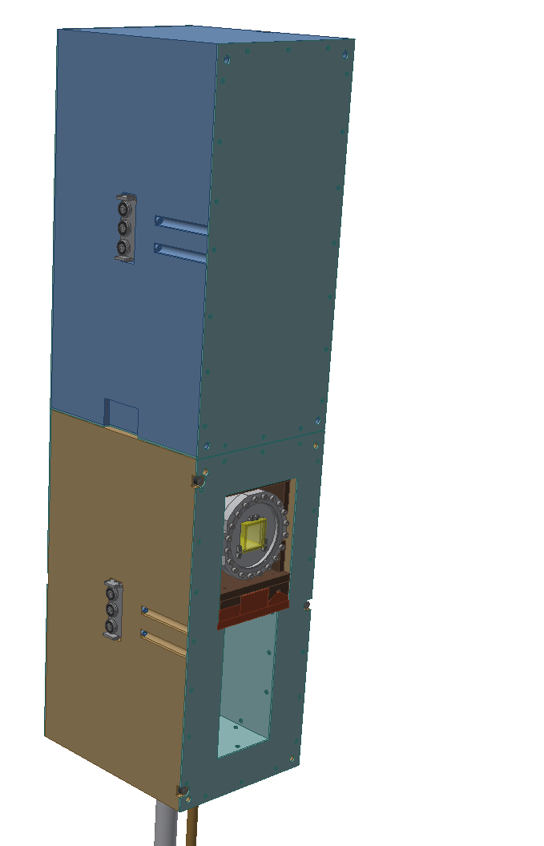
Bridge Beam Guide Housing Concept
/ESS-0126950/

Slide 4
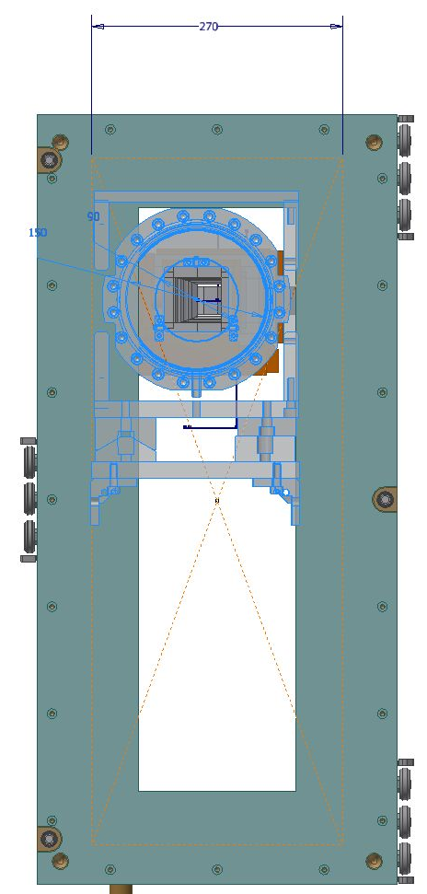
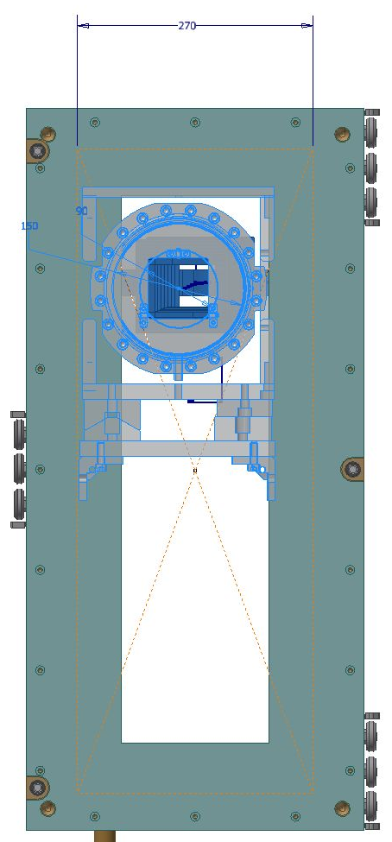
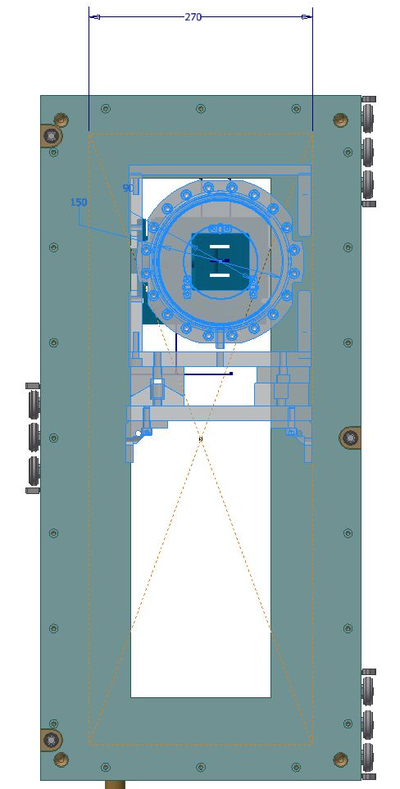
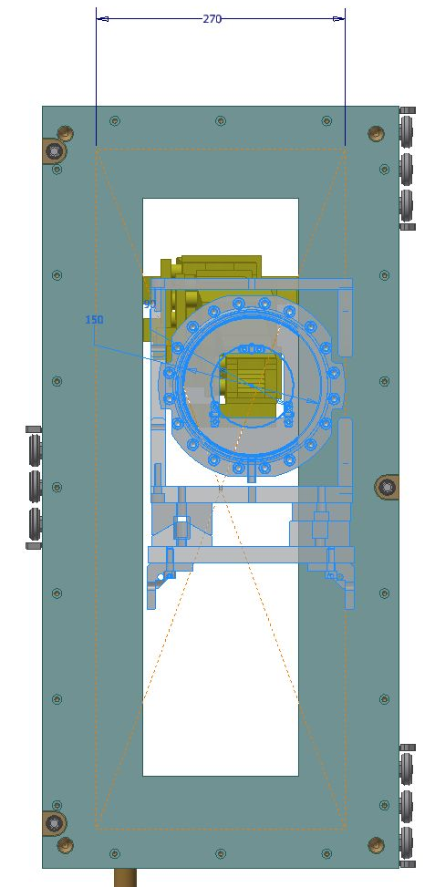
Bridge Beam Guide Housing
/ESS-0126950/
BIFROST
CSPEC
DREAM
LOKI

Slide 5
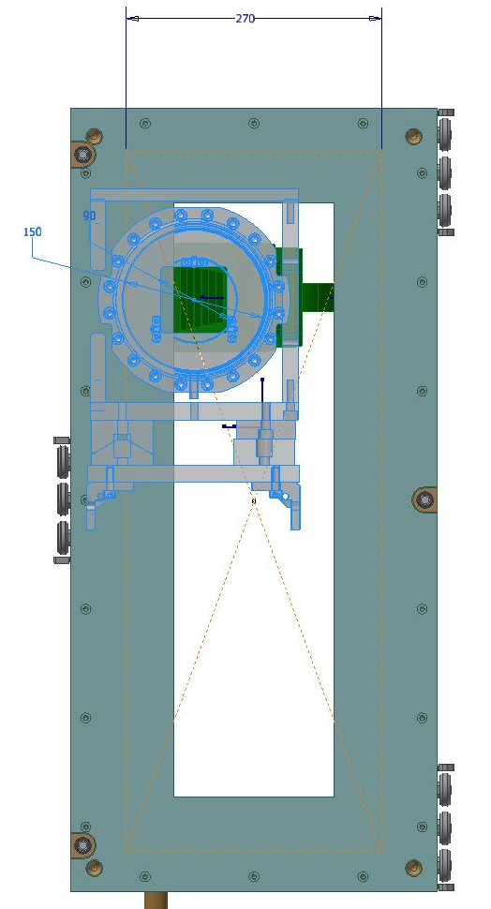
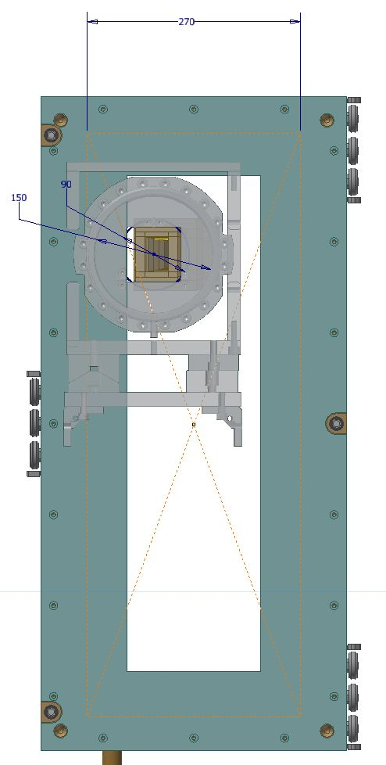
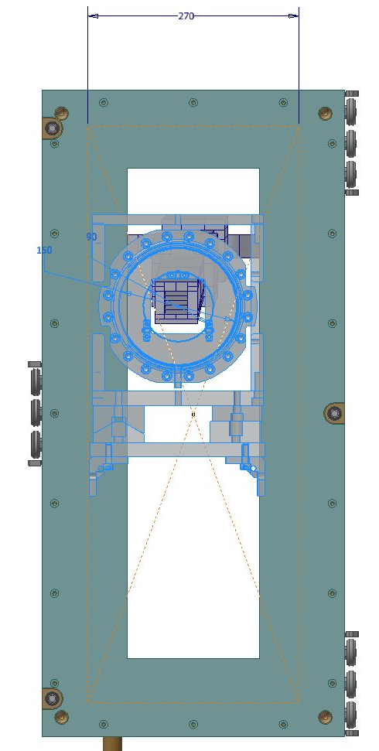
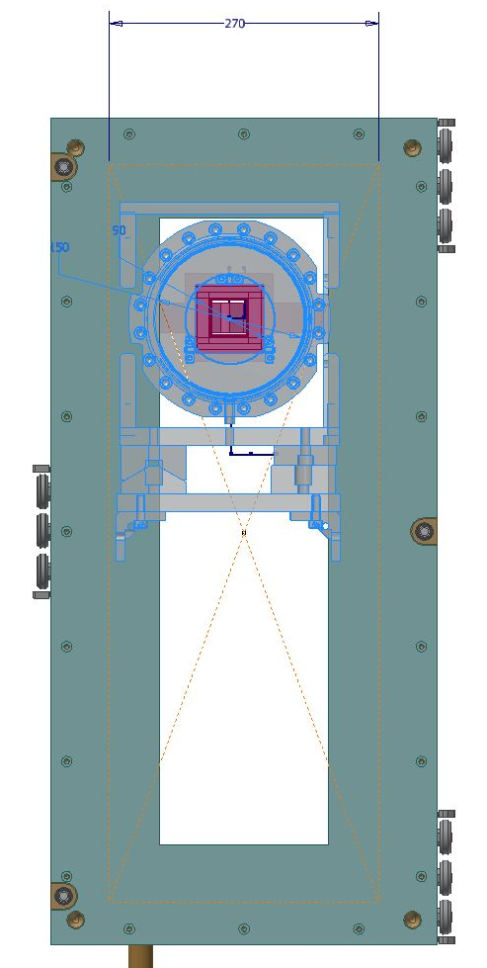
Bridge Beam Guide Housing
/ESS-0126950/
MIRACLES
NMX
SKADI
VESPA

Slide 6
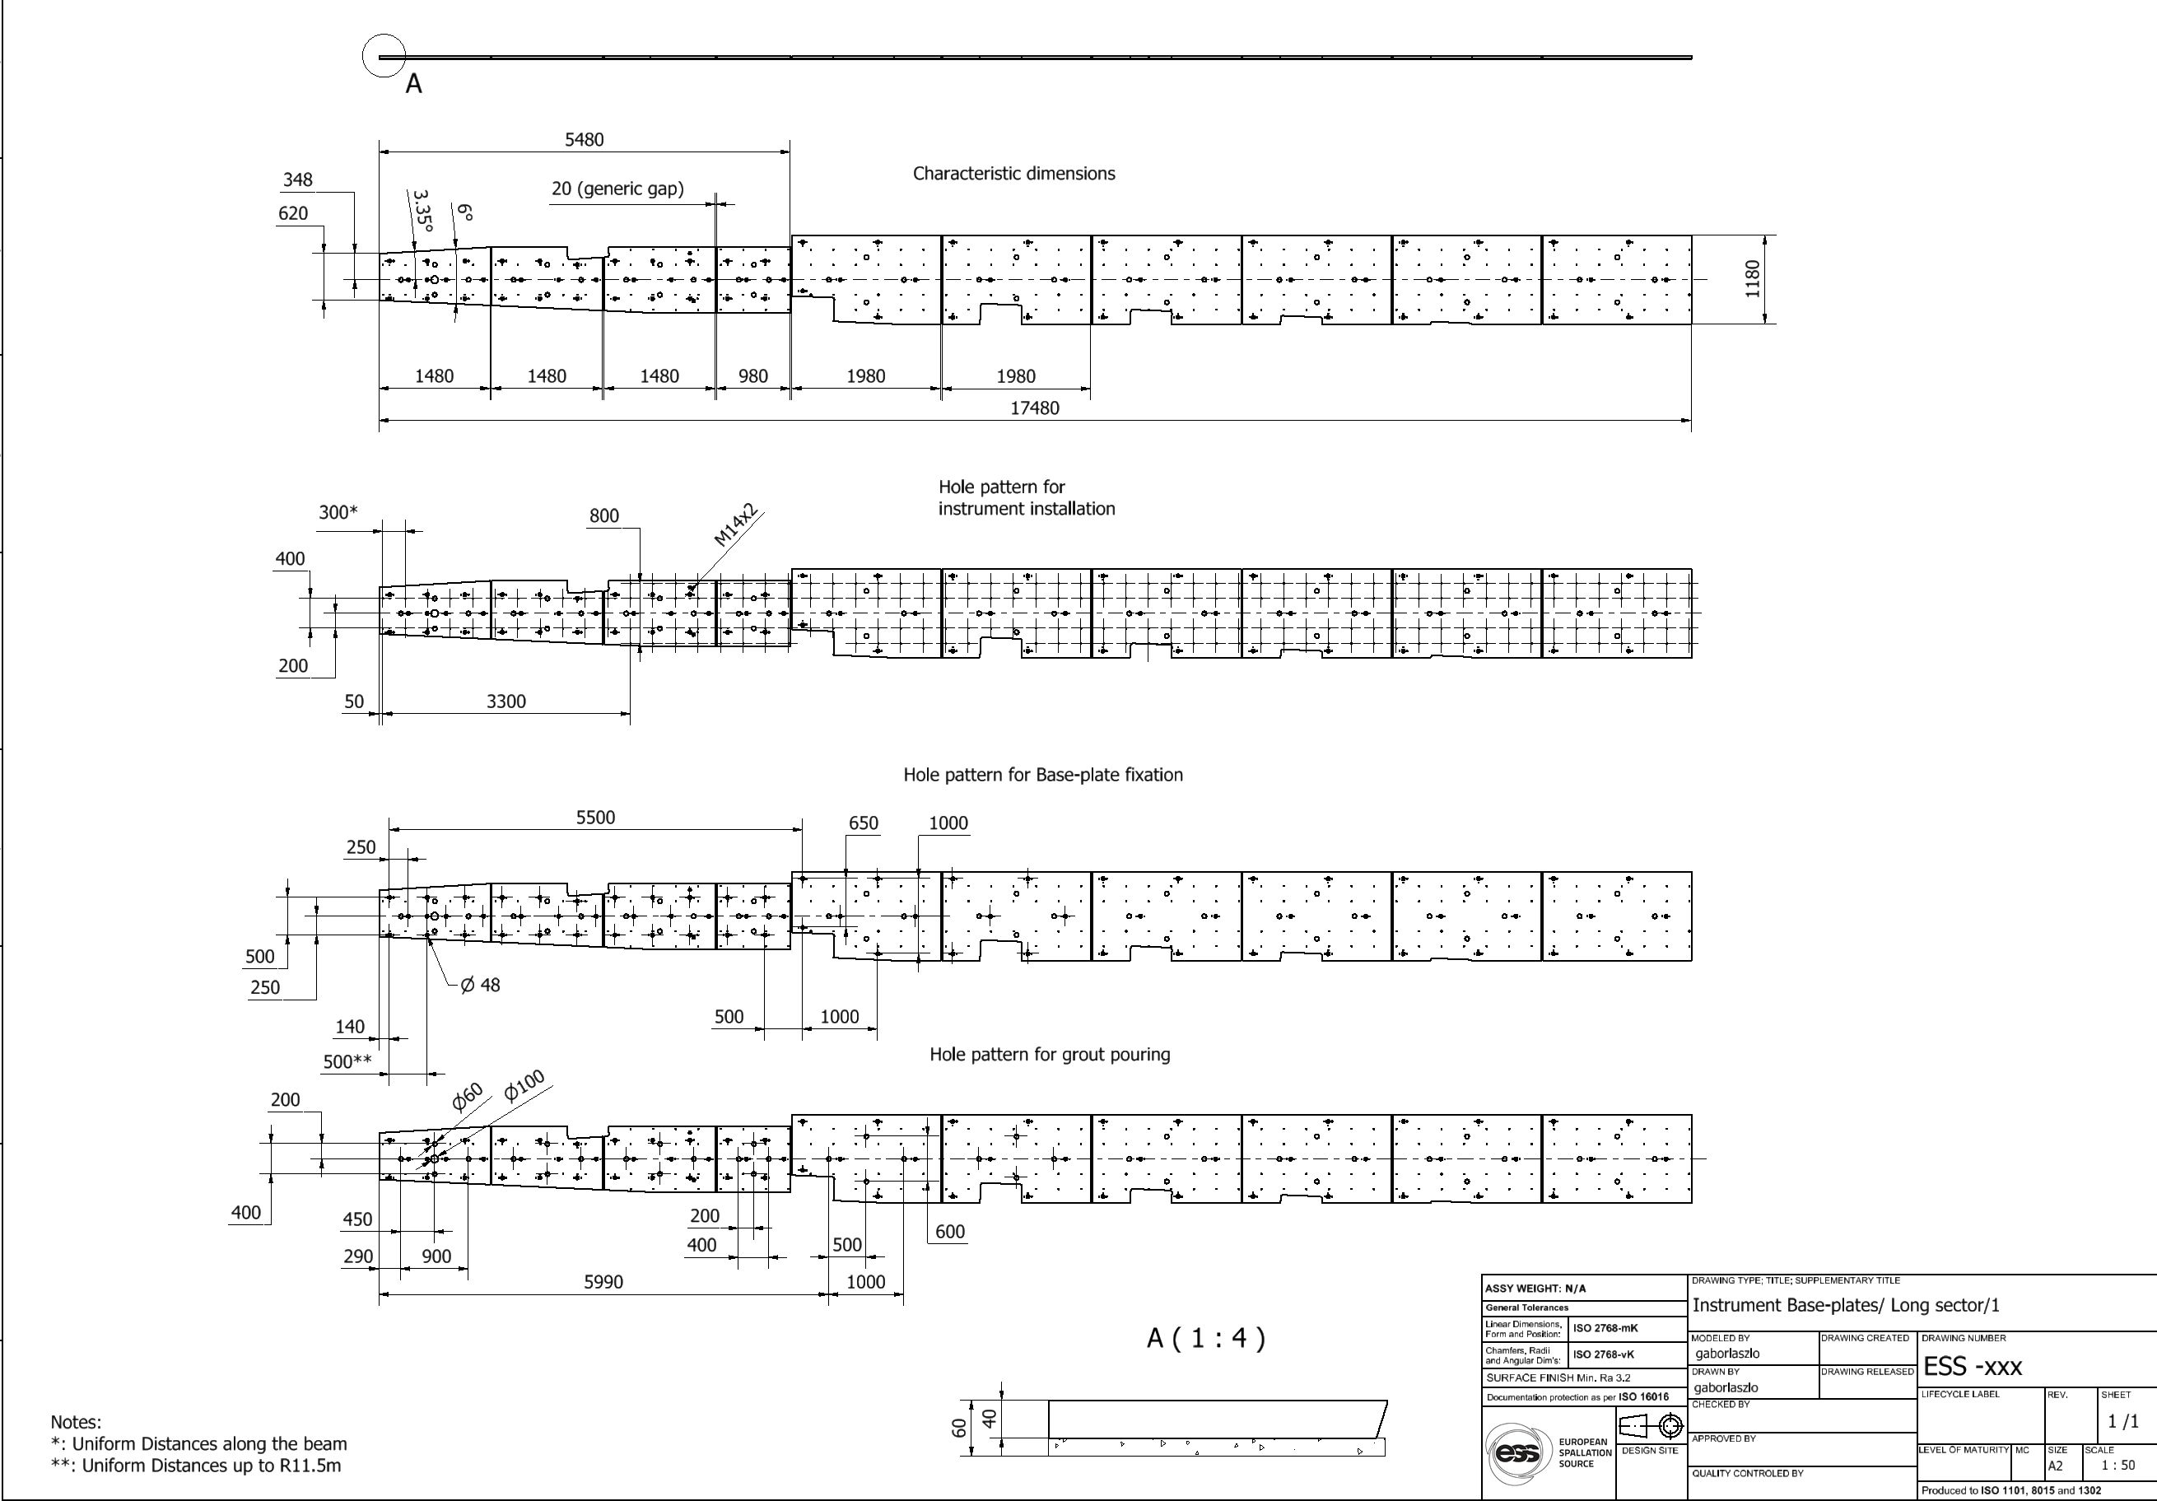
Bunker Base-plates
https://confluence.esss.lu.se/display/SPD/Bunker+baseplates

Slide 7
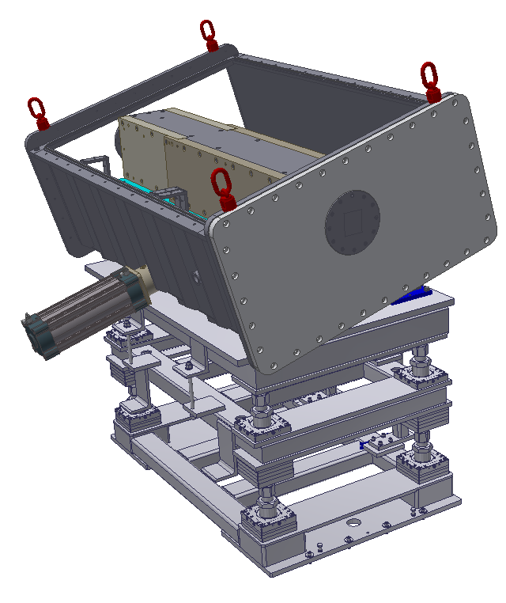
Heavy Shutter
Design of the TBL prototype is ongoing, expected CDR is in November

Slide 8
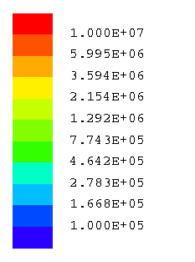
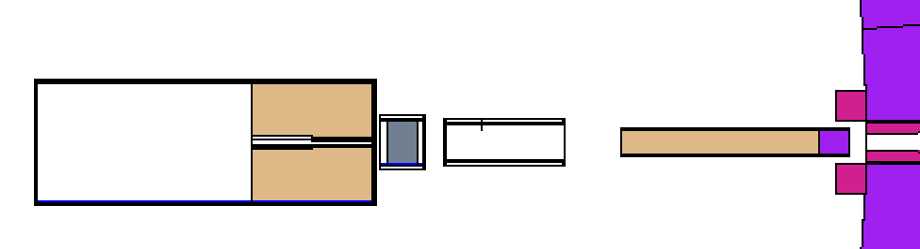
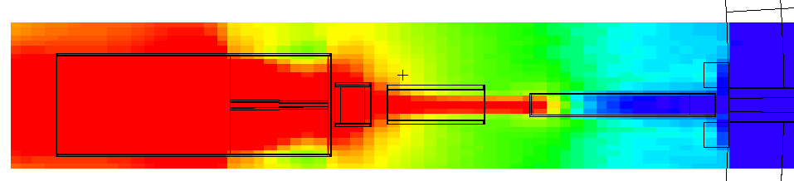
Heavy Shutter Neutron Dose map in the bunker
μSv/h
Bunker
Wall
Copper Collimator
Heavy Shutter
∼ 1.2 e⁷ μSv/h
∼ 41000 μSv/h

Slide 9
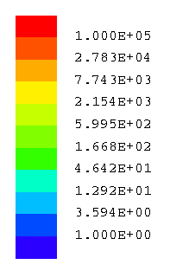
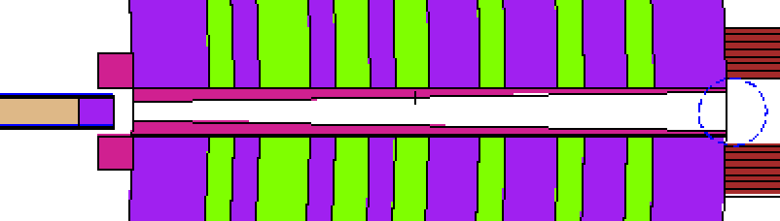
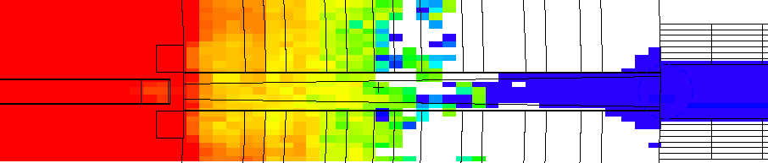
Heavy Shutter Neutron Dose map from the bunker wall to the end of the bunker wall
μSv/h
Heavy Shutter
Bunker Wall
∼ 41000 μSv/h
<1.5 μSv/h

Slide 10
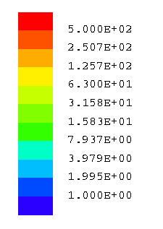
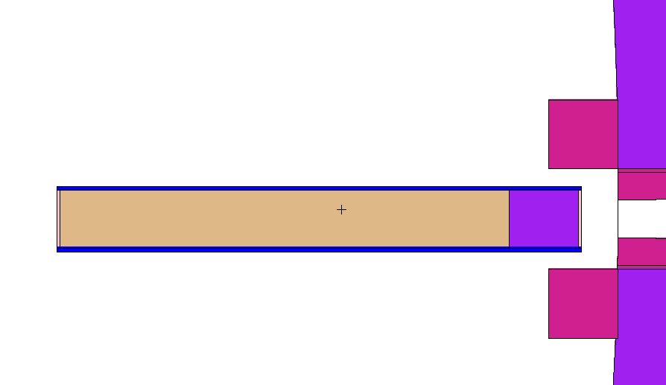
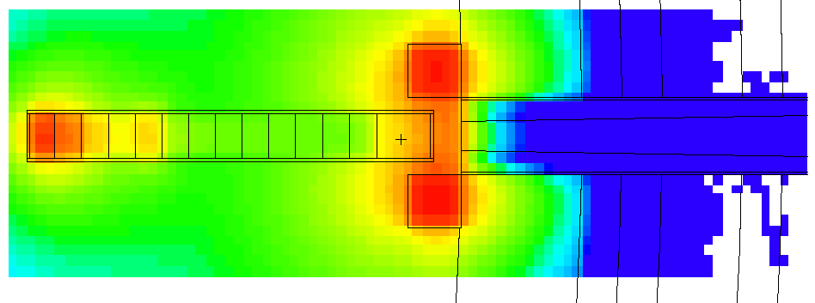
Heavy Shutter Activation after 3 days beam off
μSv/h
Steel
Copper
Steel
∼ 390 μSv/h
∼ 300 μSv/h
∼ 18μSv/h
∼ 390 μSv/h

Slide 11
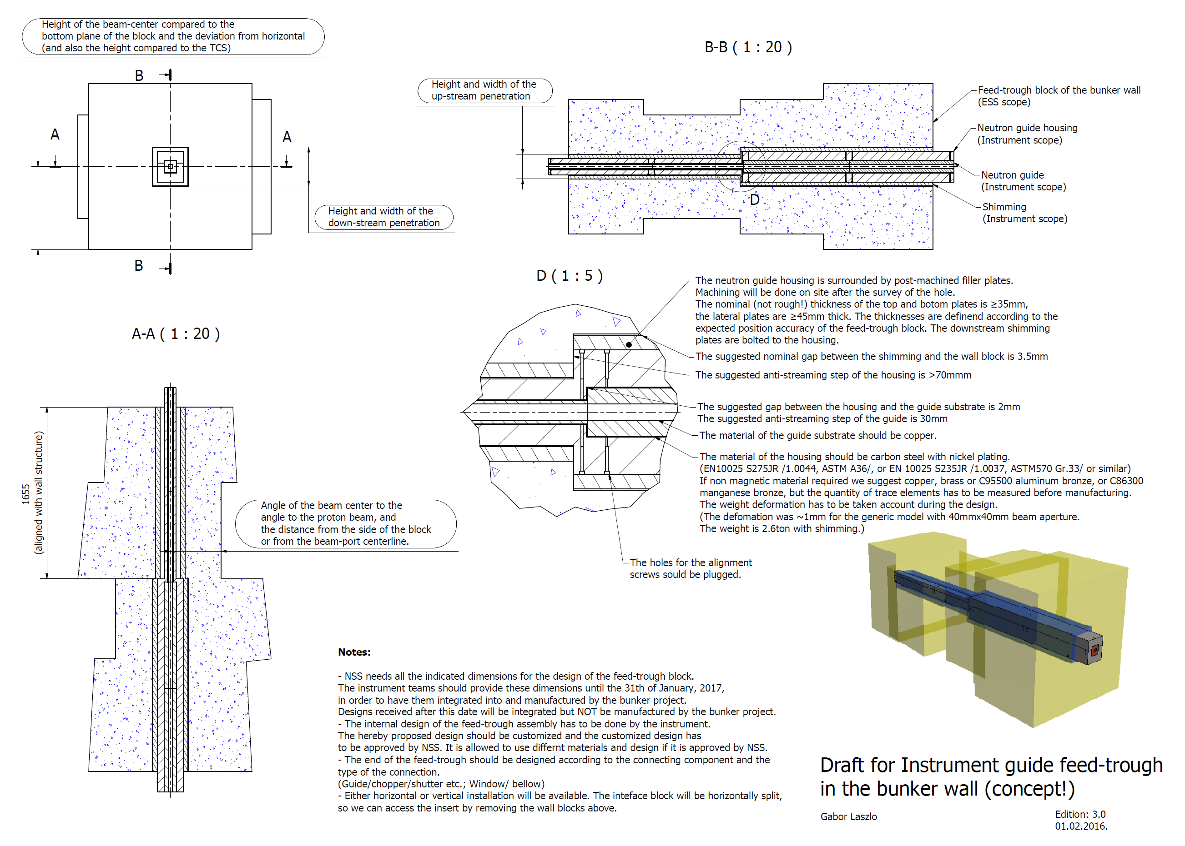
Bunker Wall Insert
/ESS-0126950/
Concept!

Slide 12
Bunker Wall Insert
/ESS-0126950/
The instrument has to make:
Mechanical design and analysis of the final structure considering:
  Preferably vertical installation/ extraction
  Weight deformation
  Alignment range (Position accuracy of the wall ±20mm, suggested fine alignment: Horizontal>2mm, Vertical>6mm /wall sinking/)
  Alignment stability under vacuum
  Support structure design (kinematic mounts)
Radiation protection validation
  The primary goal is to decrease the noise at the sample

Slide 13
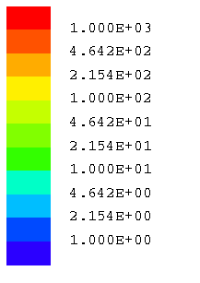
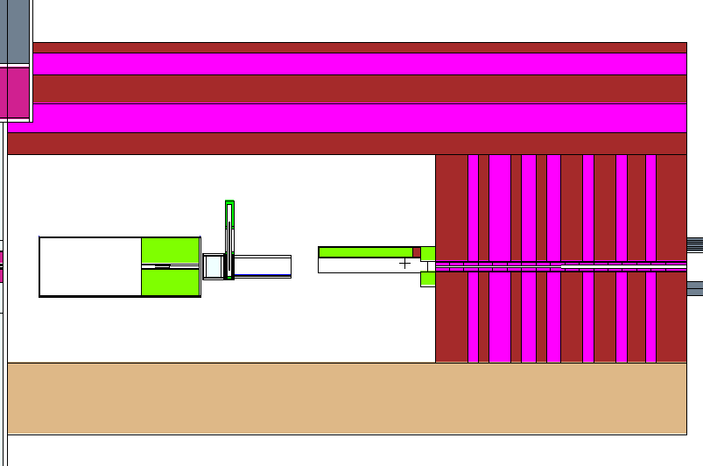
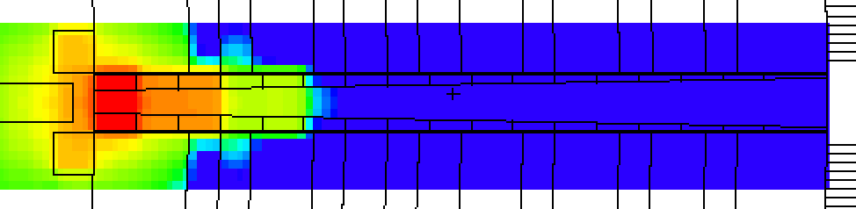
Bunker insert activation after 1 day beam-off
μSv/h
Heavy Shutter
Bunker Insert
∼ 200 μSv/h
∼ 900 μSv/h
<1 μSv/h
First part of the insert

Slide 14
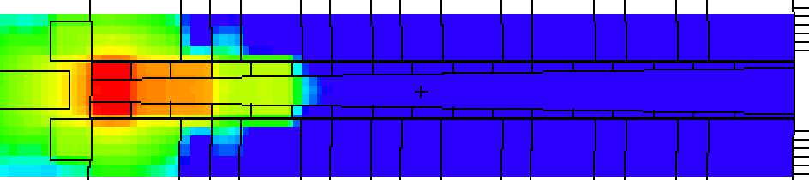
Bunker insert activation after 3 days beam-off
μSv/h
Bunker Insert
∼ 40 μSv/h
∼ 900 μSv/h
<1 μSv/h
First part of the insert

Slide 15
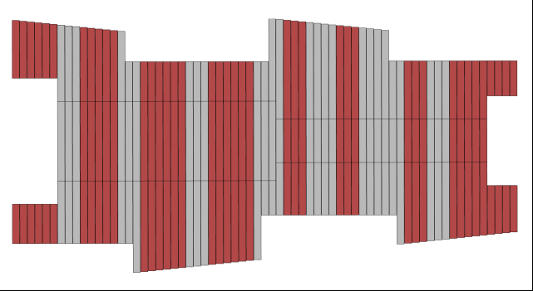
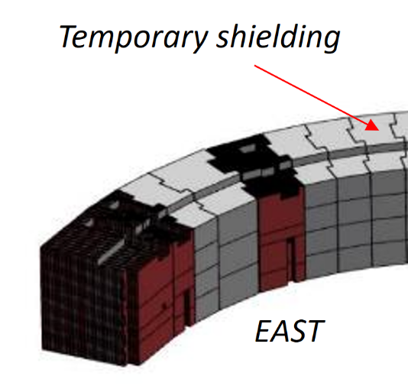
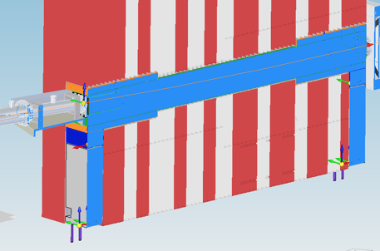
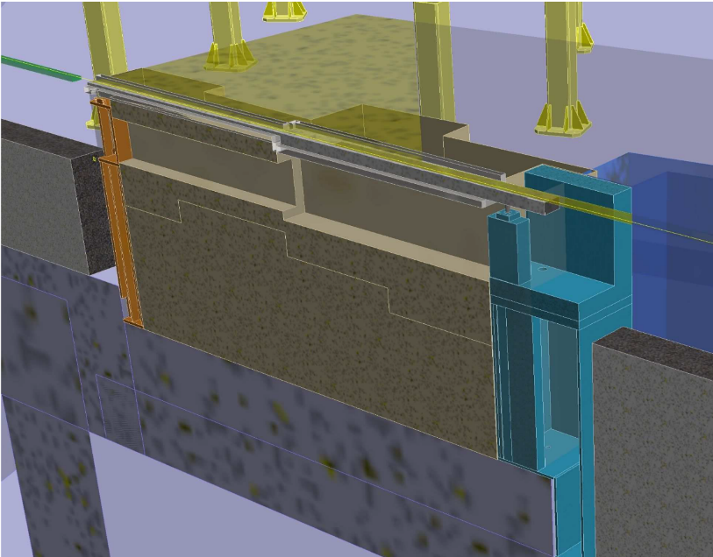
Bunker Wall Insert
/Standard Support Concept/
LOKI Insert
TBL Insert

Slide 16
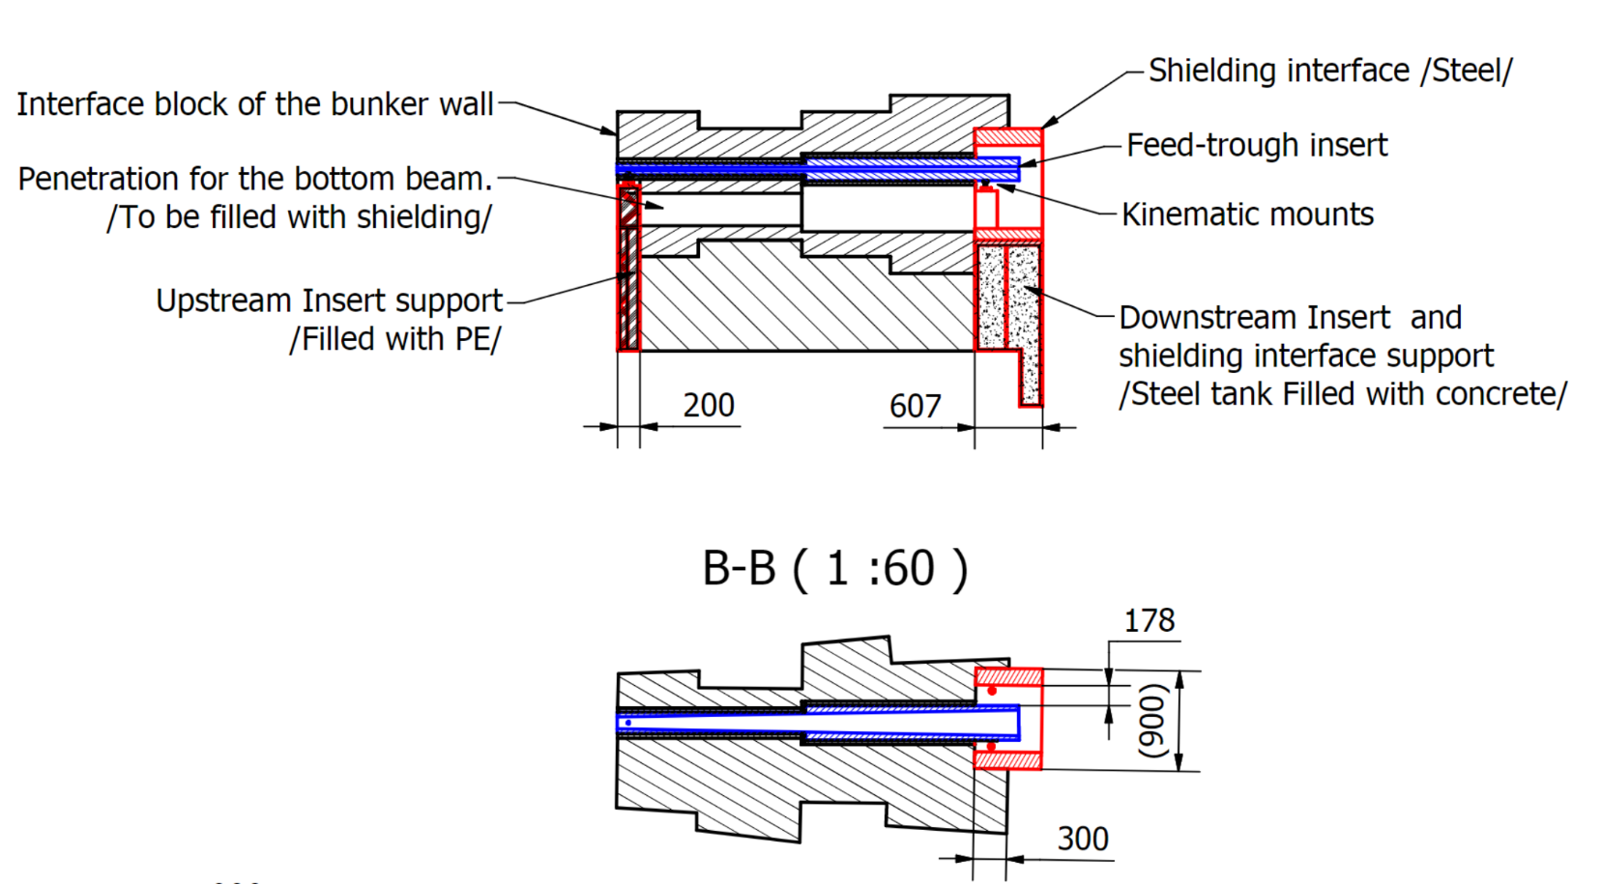
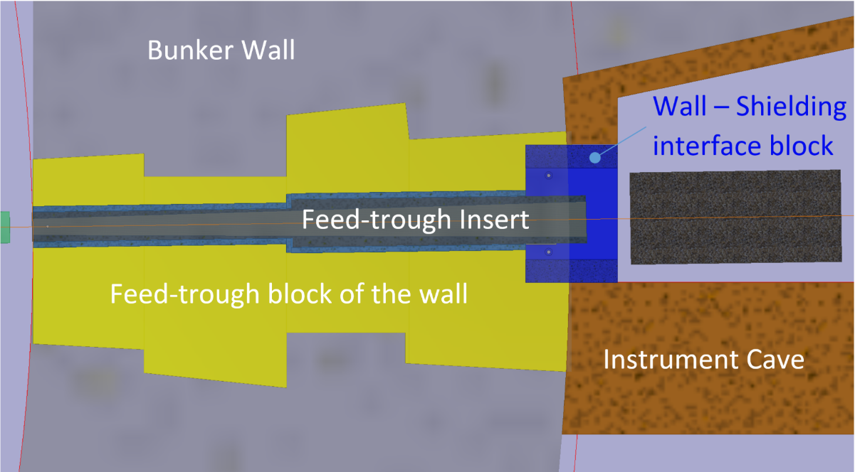
Bunker Wall Interface Geometry Concept
/ESS Test Beamline/
The Interface Composition is the Instruments responsibility

Slide 17
THANK YOU!

Slide 18
Backup slides

Slide 19
Since last IKON..
Major mile-stones in PLM Support activities, since February 2017:
New FixPack, March 2017
Large Assembly Management:
  Settings and methods for better Performance
  BI Essential customizations
  Drawing management guides and macros
  3Dindexing and 3Dthumbnail-builder in place
  Search and Filter methods
Standard Parts Catalogue in place
ESSway on Confluence:
  CAD/PLM Methods page (guides and methods at ESS)
  CAD Meetings page (uploaded presentations)
  Open Forum page (space for news and open questions)

Slide 20
Upcoming Improvements Q4 17- Q1 18
New FixPack (product corrections), end of October 2017
Q-Checker (quality control tool), November 2017
Remove Invisible, model-simplification tool, November 2017
Standard Parts Catalogue continue, Q4 2017
Standard Materials, Q4 2017
Methods for model-simplification, Q1 2018
MyPLM, central management tool for CATIA upgrades, Q1 2018
More Large Assembly Management tools and methods
ECO/release-flow improvements, Q1 2018
2016x 2.0, Q1 2018:
  Immersive toolbar
  Action pad
  Dashboard
  New Product Finder

