Slide 1
Neutron Beam Extraction System Design status for IKON-13
Jarich Koning
www.europeanspallationsource.se
26th September 2017

Slide 2
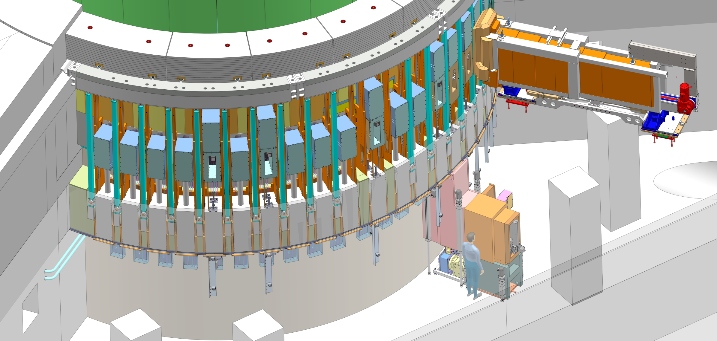
NBEX Light Shutter System
You are encouraged to interact – sheets come from interim review June 2017

Slide 3
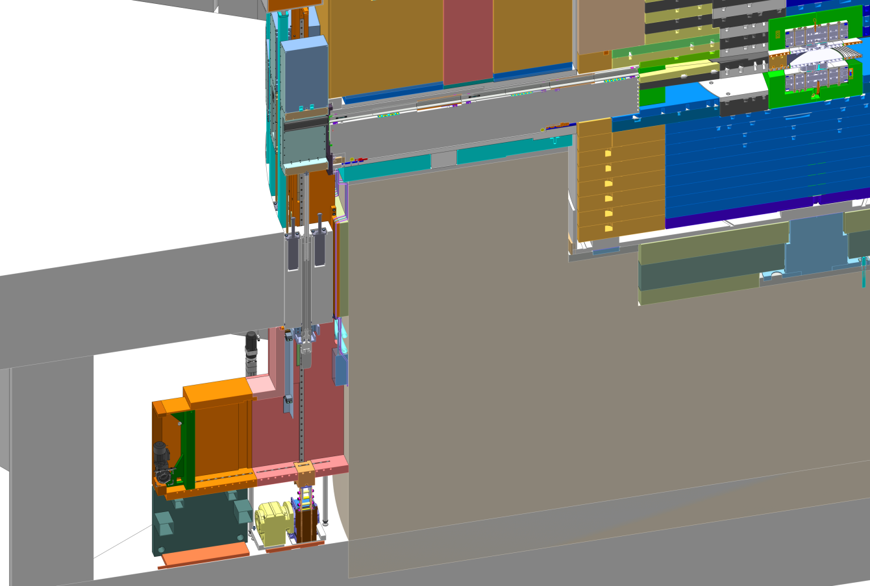
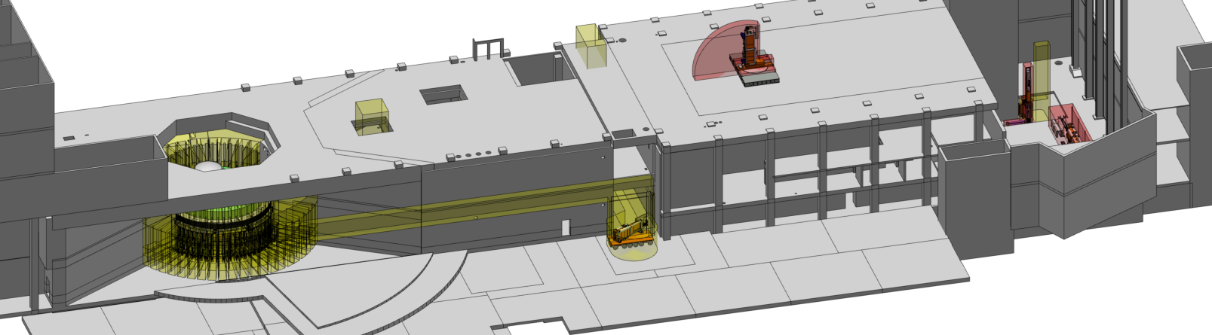
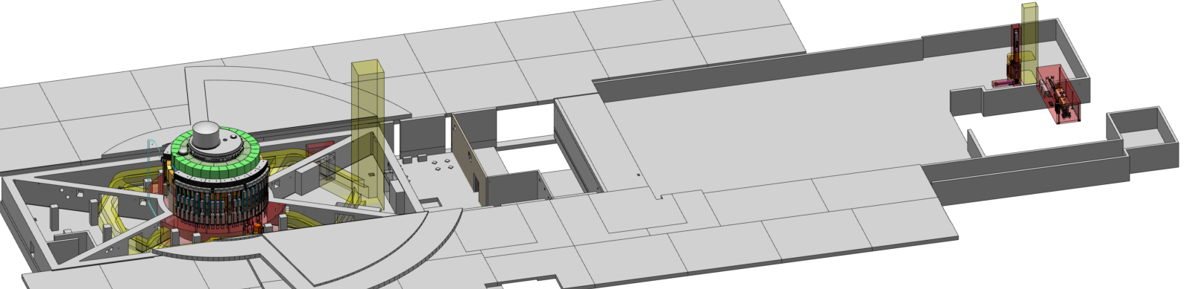
NBEX locations and volume claims
R6
R5.5
Beamline
R2.7
Permanent (red)
Transport (yellow)
IET
LSC
NBEX nominal volume
R5.3
IET transport
ACF docking
R8
Vertical handling test stand
LSC transport
Horizontal handling test stand
Basement, LVL91, Utility rooms

Slide 4
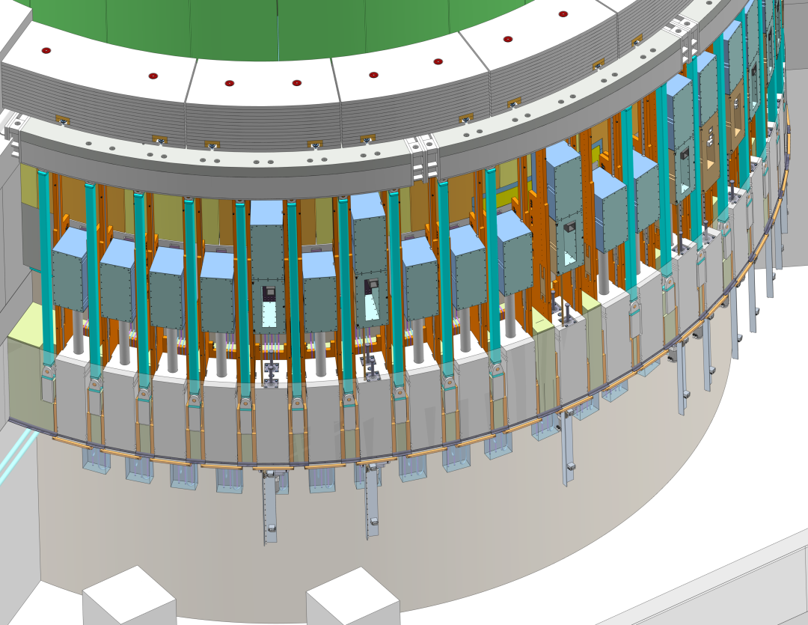
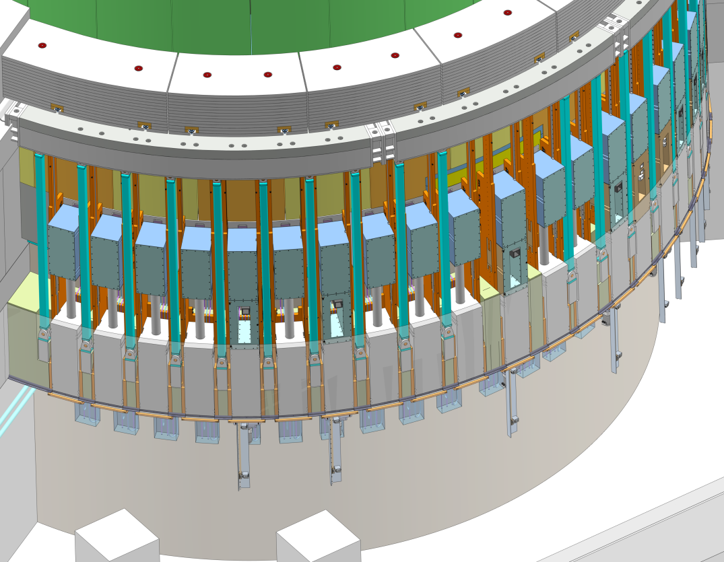
Light shutter function
Open → Closed
Optics switch function: BEER 75mm 2x, ODIN 150mm 2x, T-REX 2x100mm 3x, MAGIC 75mm 2x
No actuator at plugged ports

Slide 5
Light Shutter System
Light Shutter Frame
Port block (excerpt)
Gamma Beam Shutter
Bridge Beam Guide
GBS on top of BBG
“Light shutter” comprises GBS+BBG
BBG internals are up to instrument but not repairable
Ballscrew-style vertical actuator
Brake ‘normally open’ → power loss: GBS closes by gravity descent
Actuator positions BBG then engages brake to hold → no micro-motion possible
@maintenance, GBS will rest at beam port on hooks
Bunker-floor-to-Monolith gap shielded with FFB
400mm surplus at LSS top
LSS Frame mounted to port-block-flange
NBPI
NBW
GBS hooks
Vertical rails
Media lines
Shock absorbers
Floor Filler Block
Vertical actuator
Water valve panel
Switches beam

Slide 6
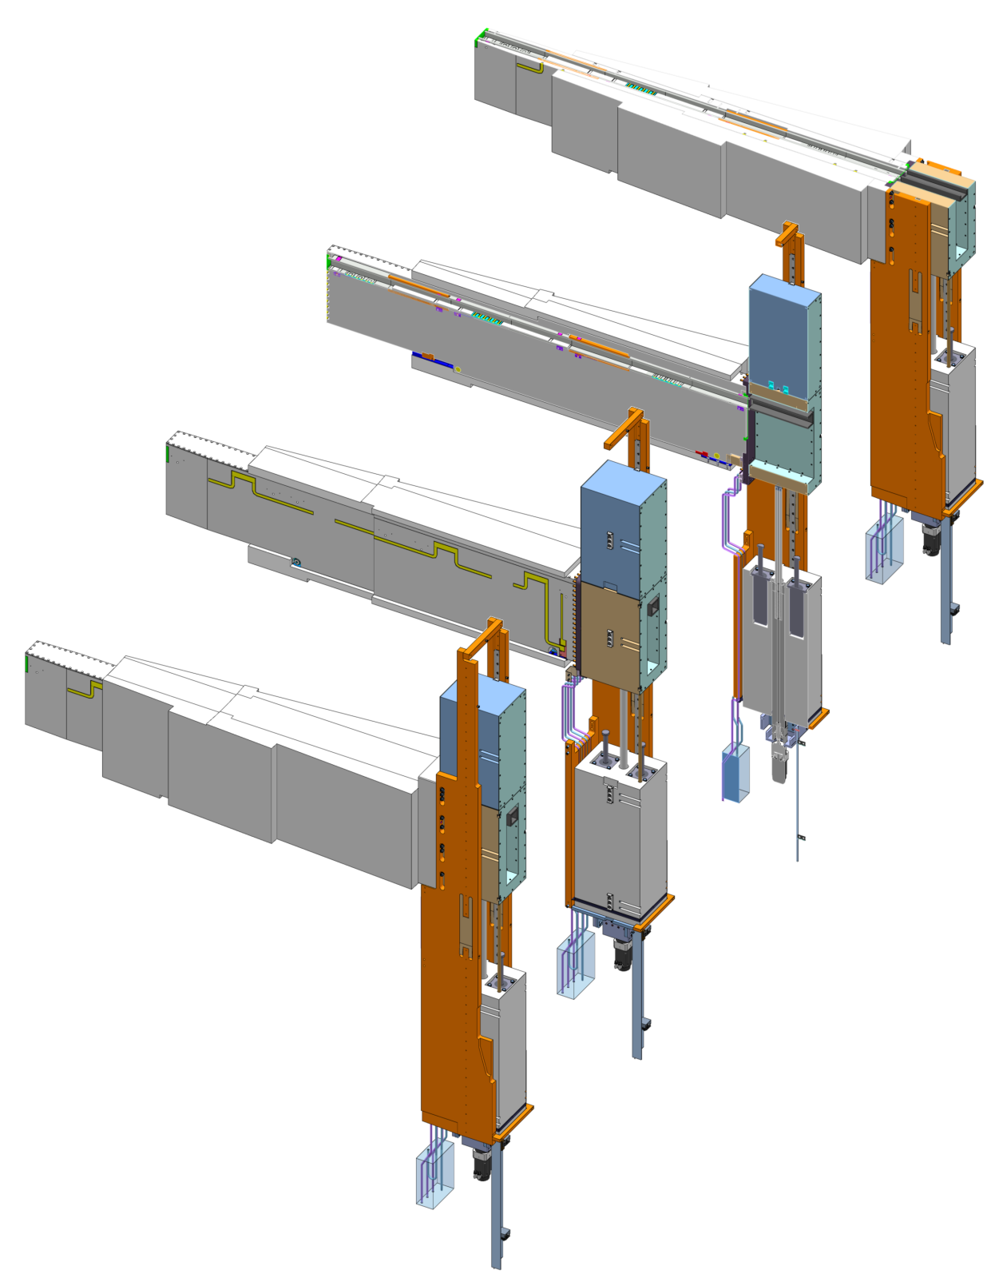
Light Shutter single port configuration
Default configuration contains
Floor Filler Block
Bridge Beam Guide
Gamma Beam Shutter
LSS frame
Neutron Beam Port Insert
Neutron Beam Window
Media lines and panel
Variants
BBG specific to instrument, can be optics switch
FFB variants per type of port and BBG height
Switch profile length / switch location

Slide 7
Neutron Beam Extraction System
Model reference: ESS-0065135
Notes:
Extra slides follow

