Slide 1
Beam Monitors
Neutron Instrument Division meeting
Fatima Issa
www.europeanspallationsource.se
17 May 2017

Slide 2
Outline
Market survey of Beam monitors
Integration of Beam monitors into ESS
Parasitic methods for monitoring the beam
Survey on BM requirements from instruments
Facility maintenance and operation

Slide 3

Beam Monitor
Sample
source
neutron guide
Window 1
Window 2
chopper
Beam monitor
Incident beam
Transmitted beam
scattered
Beam monitor
Beam monitor with low attenuation and high transmission factor
A Little detailed analysis about BM performance is available → Survey what is available on market

Slide 4
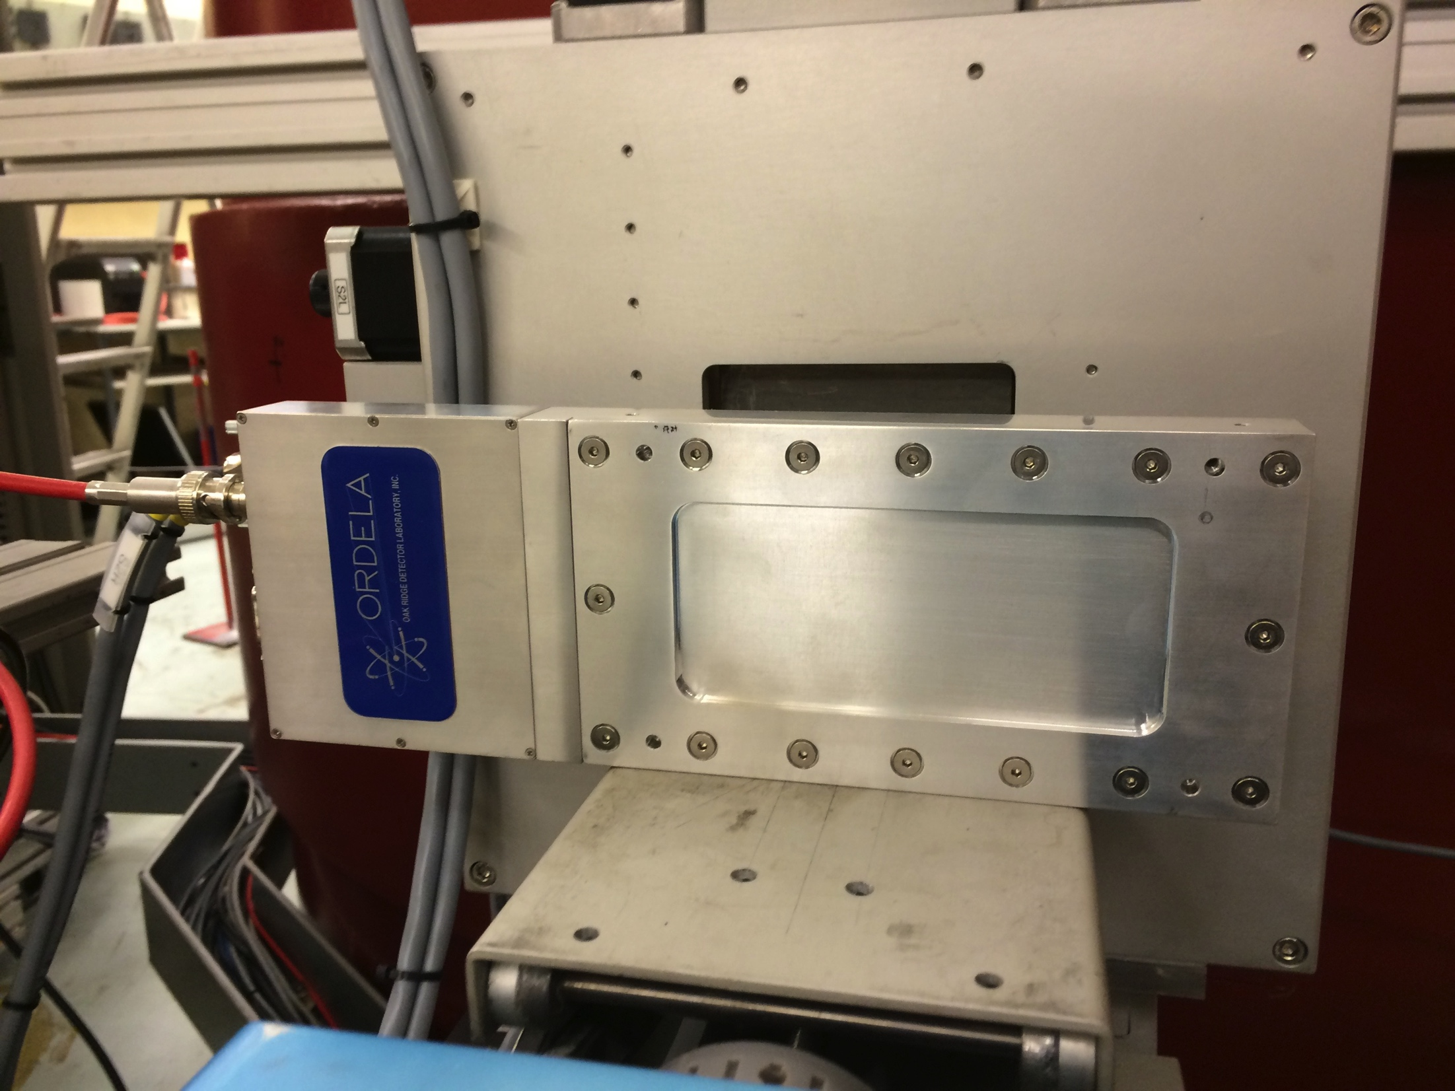
Types of Beam Monitor
Multi-wire proportional chamber (MWPC)
From Mirrotron
From ORDELA
MWPC can be filled with either ³He or ¹⁴N gas
Fission Chamber and scintillator
From LND
From Quantum detector
Fission chamber coated with ²³⁵U
Scintillator made of LiGlass beads

Slide 5
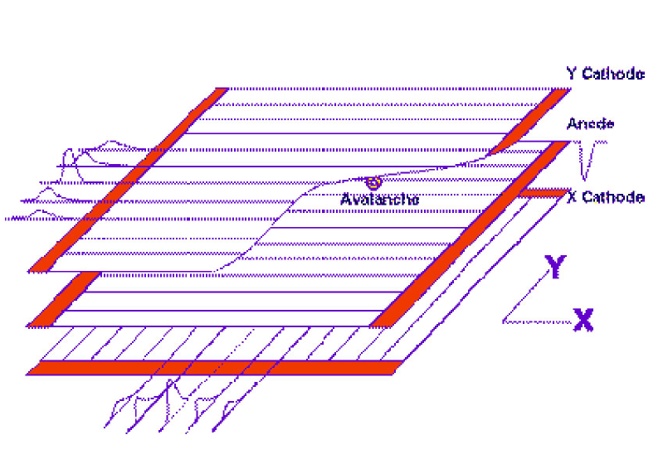
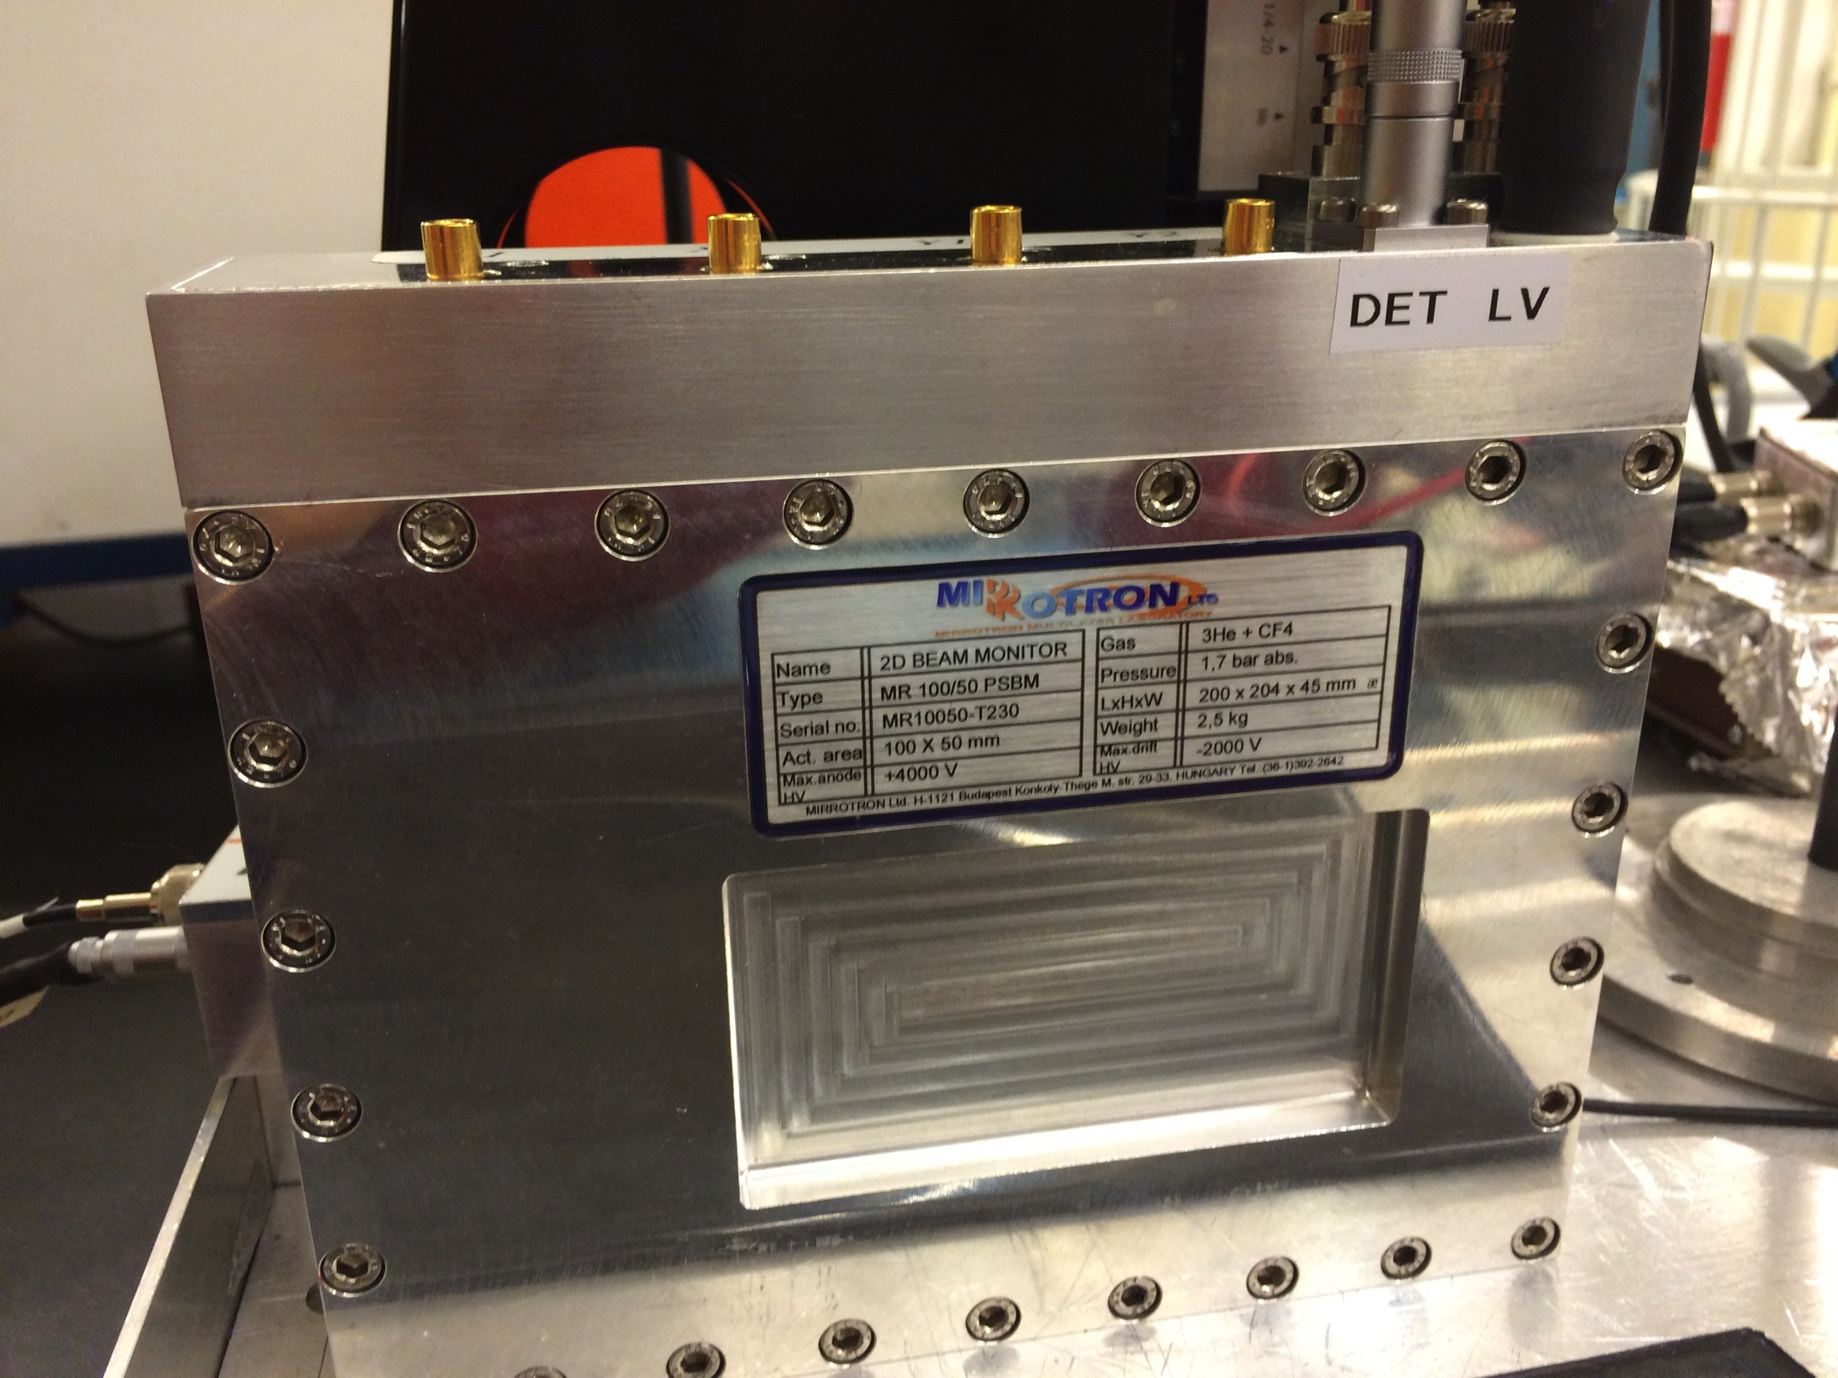
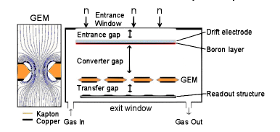
Types of Beam Monitor
Multi-wire proportional chamber (2D-MWPC)
Position sensitive BM
Monitor Manufacturer | 2D-MWPC Mirrotron | 2D-GEM CDT
Active element | ³He | ¹⁰B
Total pressure bar | 1.65 | 1
Filled gas | ³He+CF₄ | Ar+CO₂
Bias voltage (V) | Anode:-3500 Drift: 1500 | -1000
Active area (mm) | 100x50 | 100x100
Window thickness (mm) | 1 | 0.1
From Mirrotron
Gas Electron Multiplier (2D-GEM)
From CDT
0.8 μm boron layer was selected for the sake of the measurement. Thinner layer will be selected for full implementation.
G. Croci et al Progress of Theoretical and Experimental Physics, 2014(8):83H01{0, 2014.

Slide 6

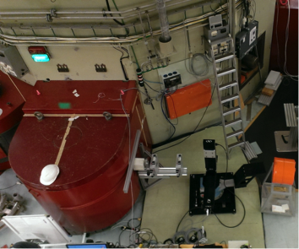
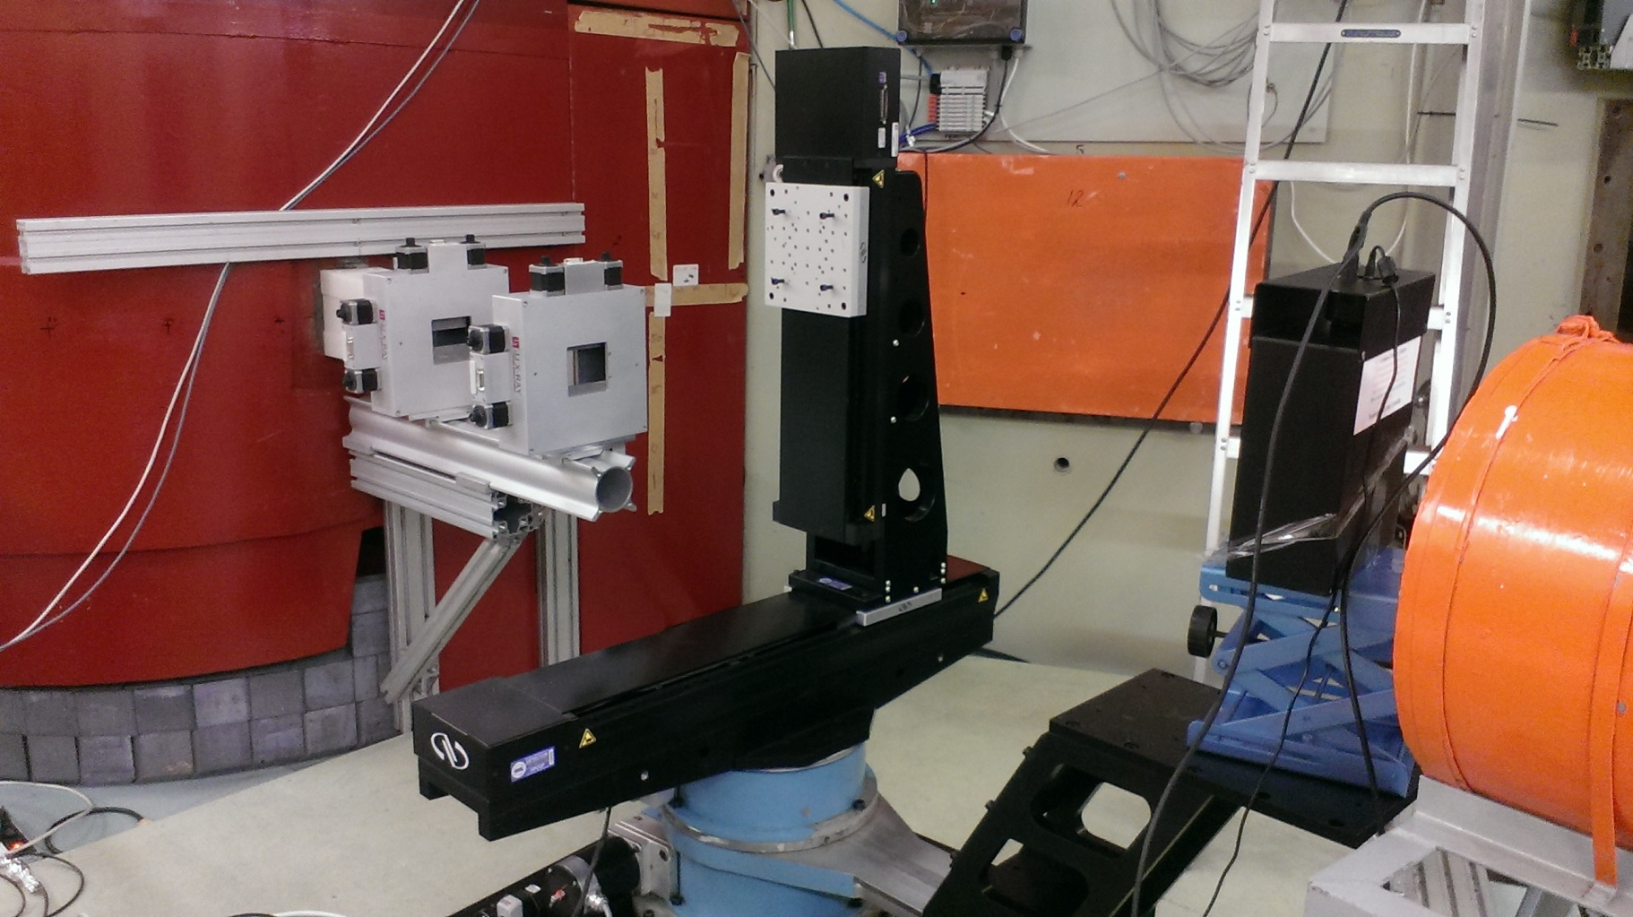
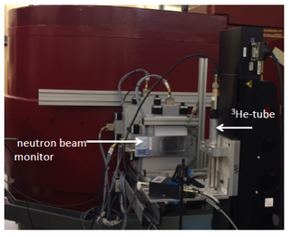
Beam Monitors- Neutron measurement at R2D2
Slit 1
Slit 2
Peak wavelength (Å)
400 2.00
911 0.878
711 1.12
511 1.54
822 0.943
311 2.41
933 0.804
Measuring:
Efficiency
Scattering
Attenuation
Linearity

Slide 7
Beam monitors-main results
 | MWPC | MWPC | MWPC BM-100X50 | 2D-MWPC | 2D-GEM | Scintillator | Fission chamber
supplier | ORDELA | ORDELA | Mirrotron | Mirrotron | CDT | Quantum detector | LND
Isotope used for neutron capture | ³He | ¹⁴N | ³He | ³He | ¹⁰B | ⁶Li | ²³⁵U
Gas pressure mbar | Partial pressure 6,0795 | Partial pressure 81,06 | Partial pressure 6,5 | Partial pressure 0.4 | Total pressure 100 | ------ | Total pressure 1013,2
Filled gas | ³He+⁴He +CF₄ | N+CF₄ | ³He+CF₄ | ³He+CF₄ | Ar/CO₂ | -------- | P10
Active Area (mm²) | 114 x 51 | 114 x 51 | 100 x 50 | 100 x 50 | Diameter 100 mm | 28 x 42 | Diameter 108.0 mm
Applied voltage (V) | 850 | 850 | 1300 | Anode at -3500V Drift at 1500V | -1000 | 650 | 300
Measured attenuation % | 4.5 | 4.4 | 2.5 | 7.3 | 10.6 | 0.4 | 3.8
Calculated attenuation % | 4.05 | 4.05 | 2.05 | 4.5 | 6.9 | 0.1 | 2.4
Measured Efficiency at 2.4Å | 1.2x10⁻³ | 2x10⁻⁵ | 1.1x10⁻³ | 1.5x10⁻⁴ | 3x10⁻² | 5x10⁻³ | 10⁻⁴
Supplier Efficiency at 1.8 Å | 10⁻³ | 10⁻⁵ | 10⁻³ | 1.5x10⁻⁴ | 3x10⁻² | 10⁻⁴ | 10⁻⁴
Scattering (%) | 3.9 ± 0.4 | 3.8±0.4 | 4±0.9 | 9±1 | 10.3±0.7 | 0.74±0.2 | 3.8±0.3
More characterization → monitors will be customized to match ESS requirements

Slide 8



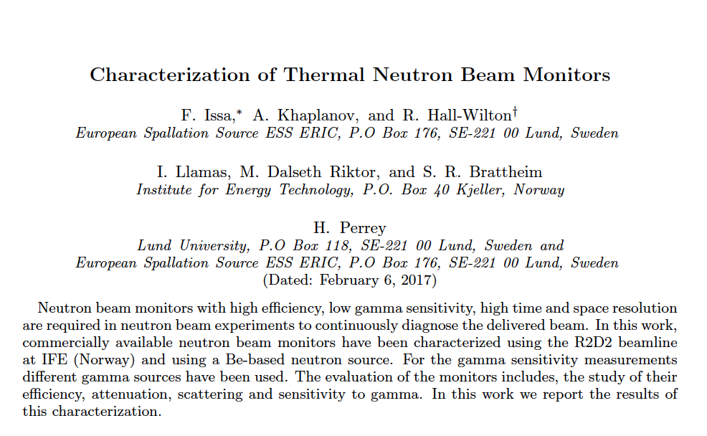
Horizon 2020 grant agreement 676548
The results of the market survey are summarized here: https://arxiv.org/abs/1702.01037
Submitted to Journal Physical Review Accelerators and Beams (PRAB)

Slide 9
Outline
Market survey of Beam monitors
Integration of Beam monitors into ESS
Parasitic methods for monitoring the beam
Survey on BM requirements from instruments
Facility maintenance and operation

Slide 10
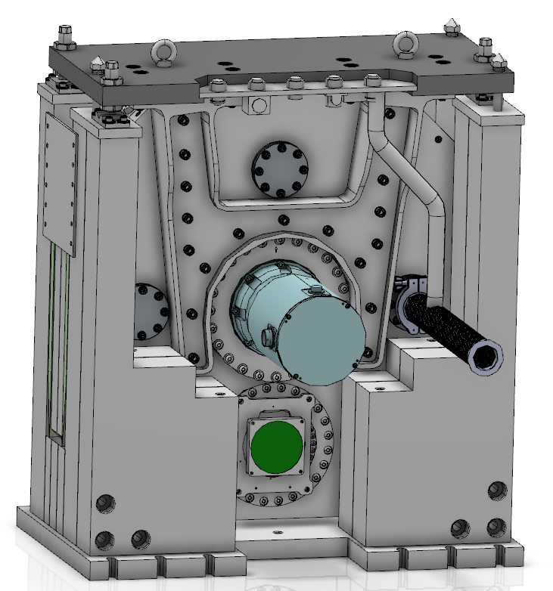
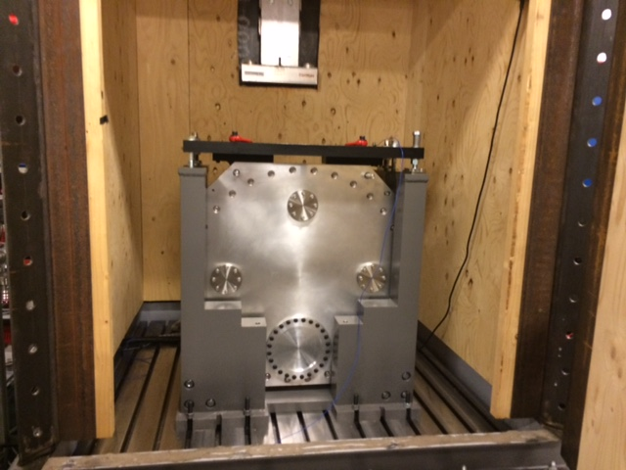
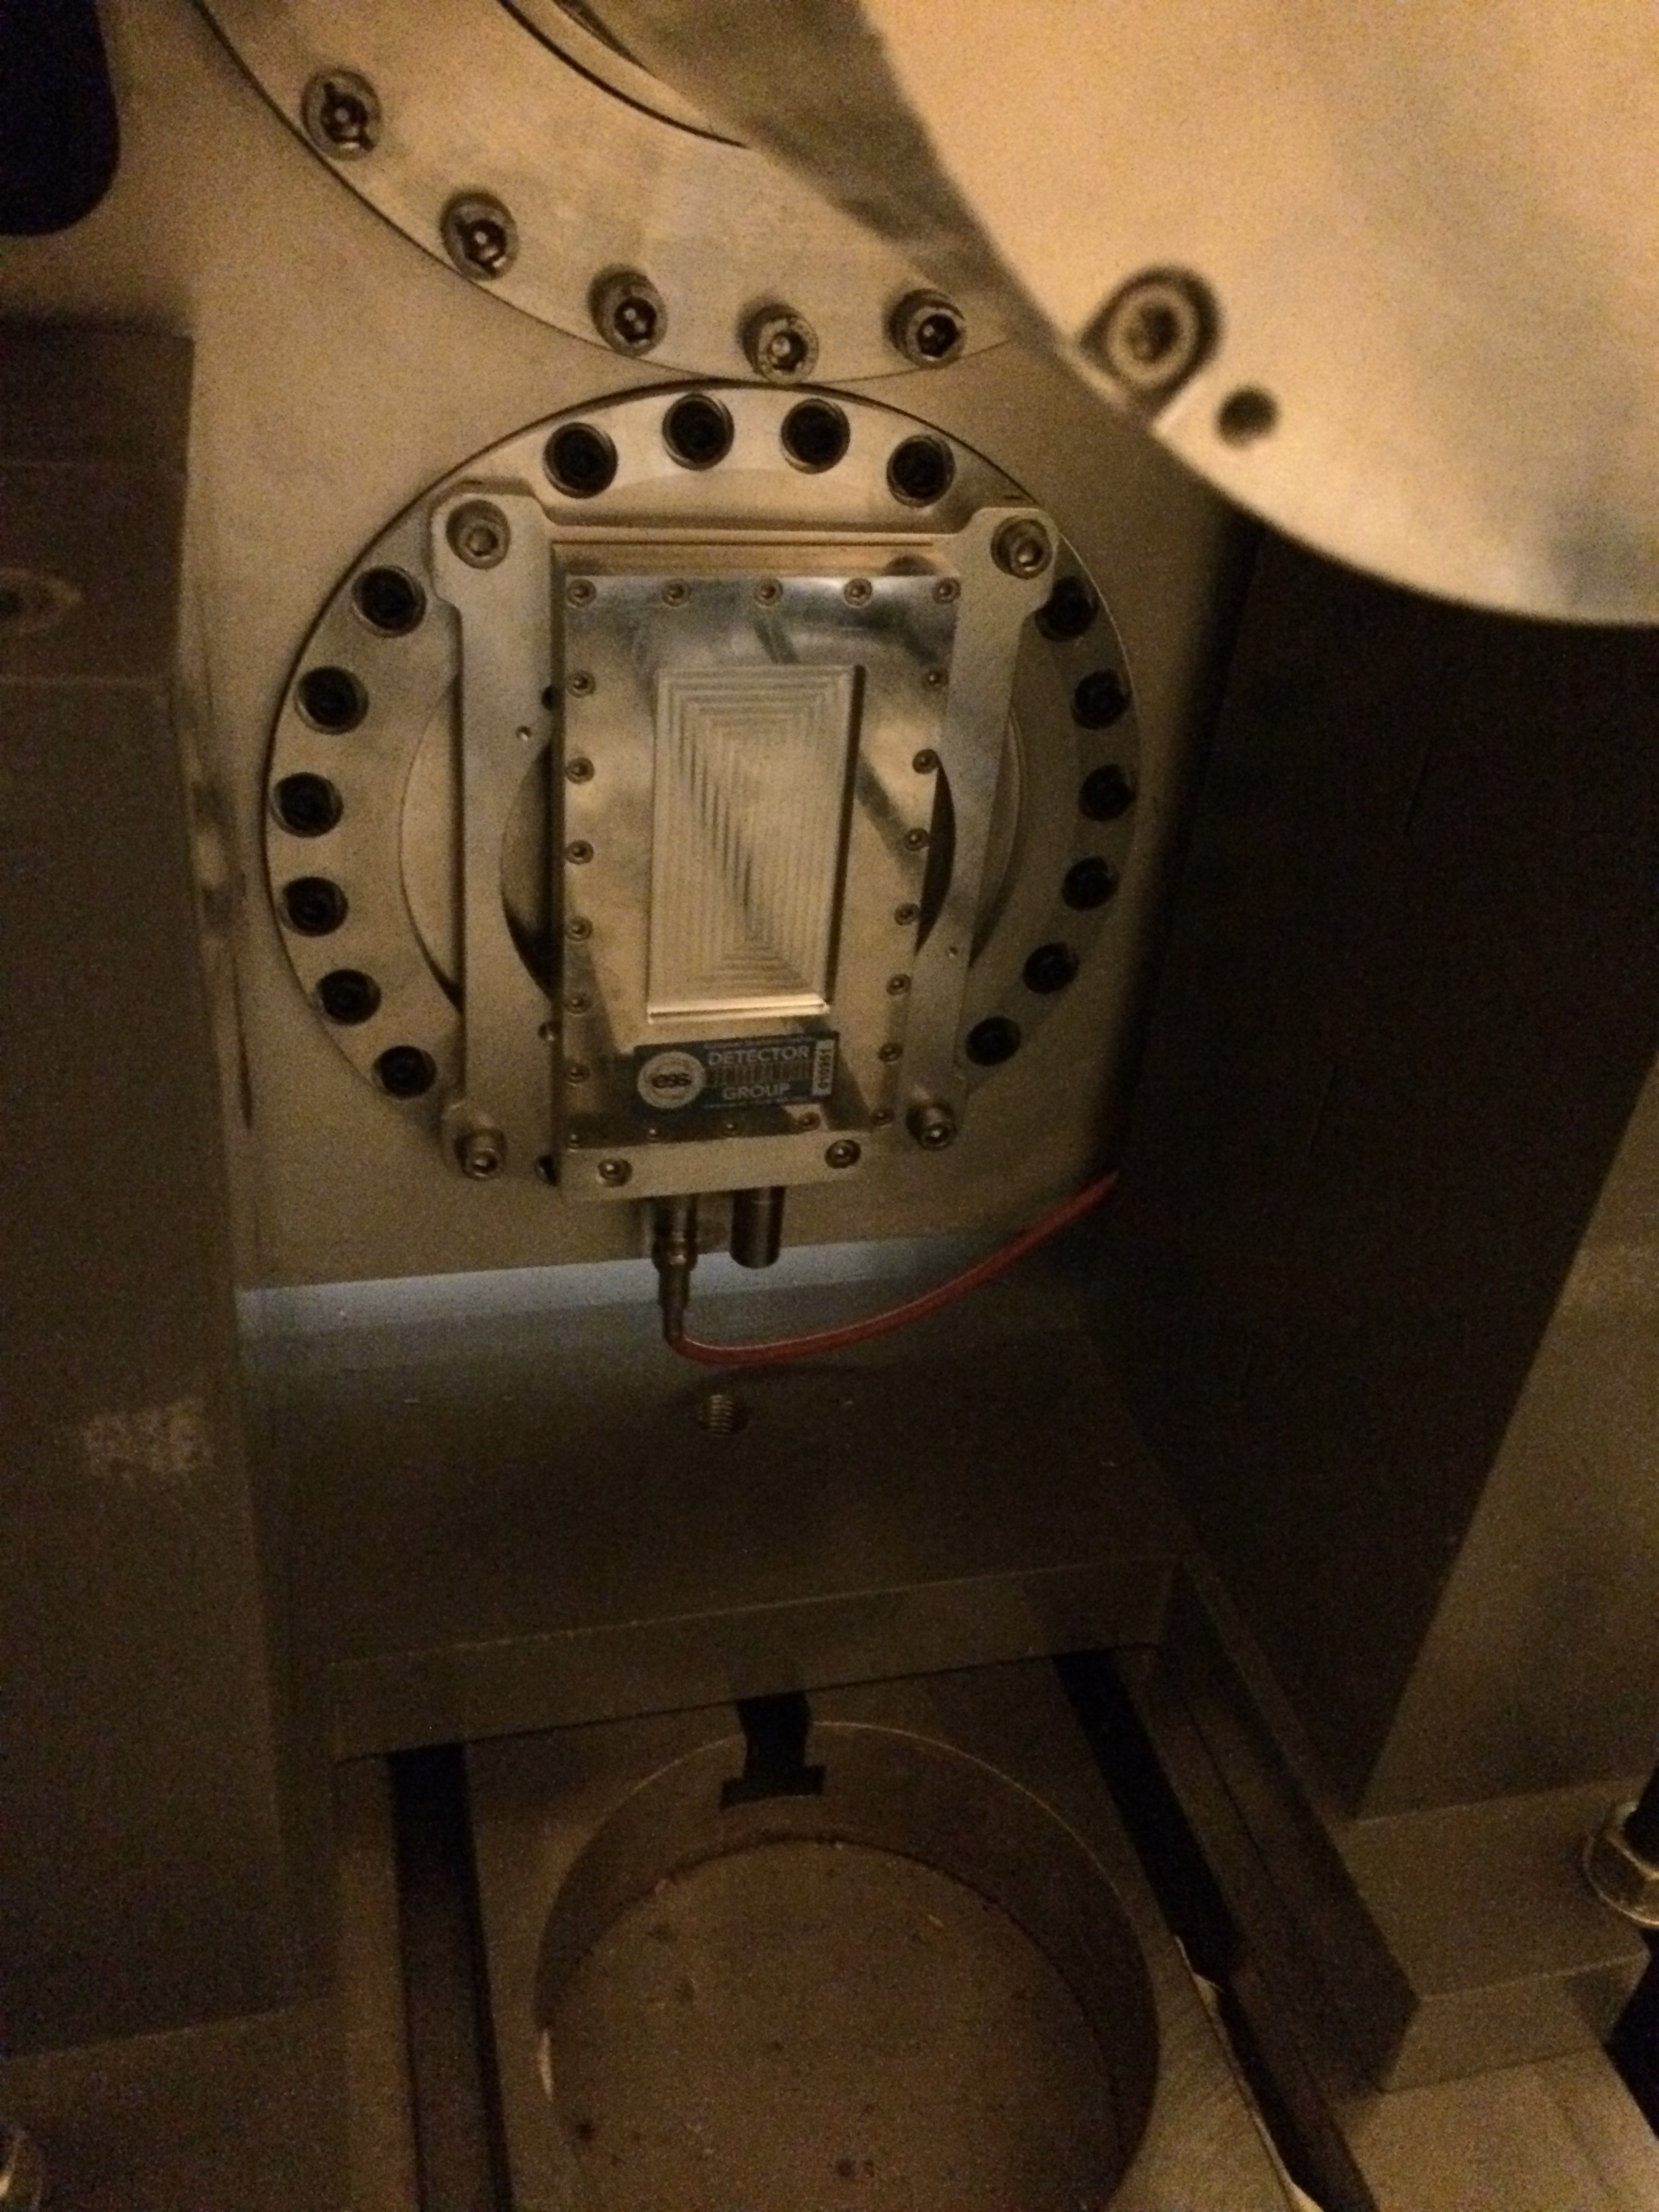
Mechanical integration
With this configuration up to 22 Hz no noticeable change in the BM response
The BM should not be in electrical contact with the chopper
Grounding is important see grounding guidelines
BM at the backside of the chopper @Embla

Slide 11
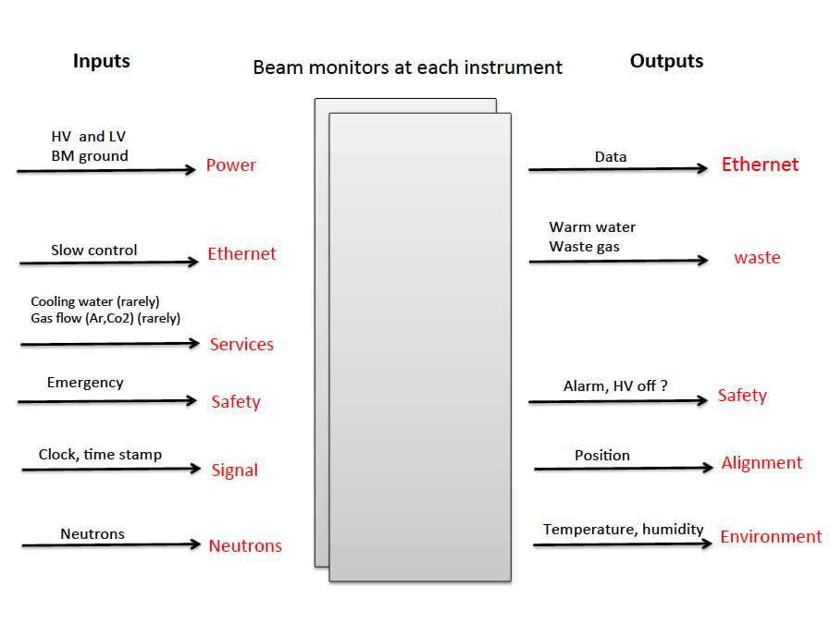
Beam monitor system Integration
All in EPICS
HV integration: Done
BM electronics: In progress
Timing EPICS
DMSC
BM
FE
AMP
DAQ
EF
ICS Tallinn board
Or DG readout as candidates

Slide 12
Outline
Market survey of Beam monitors
Integration of Beam monitors into ESS
Parasitic methods for monitoring the beam
Survey on BM requirements from instruments
Facility maintenance and operation

Slide 13
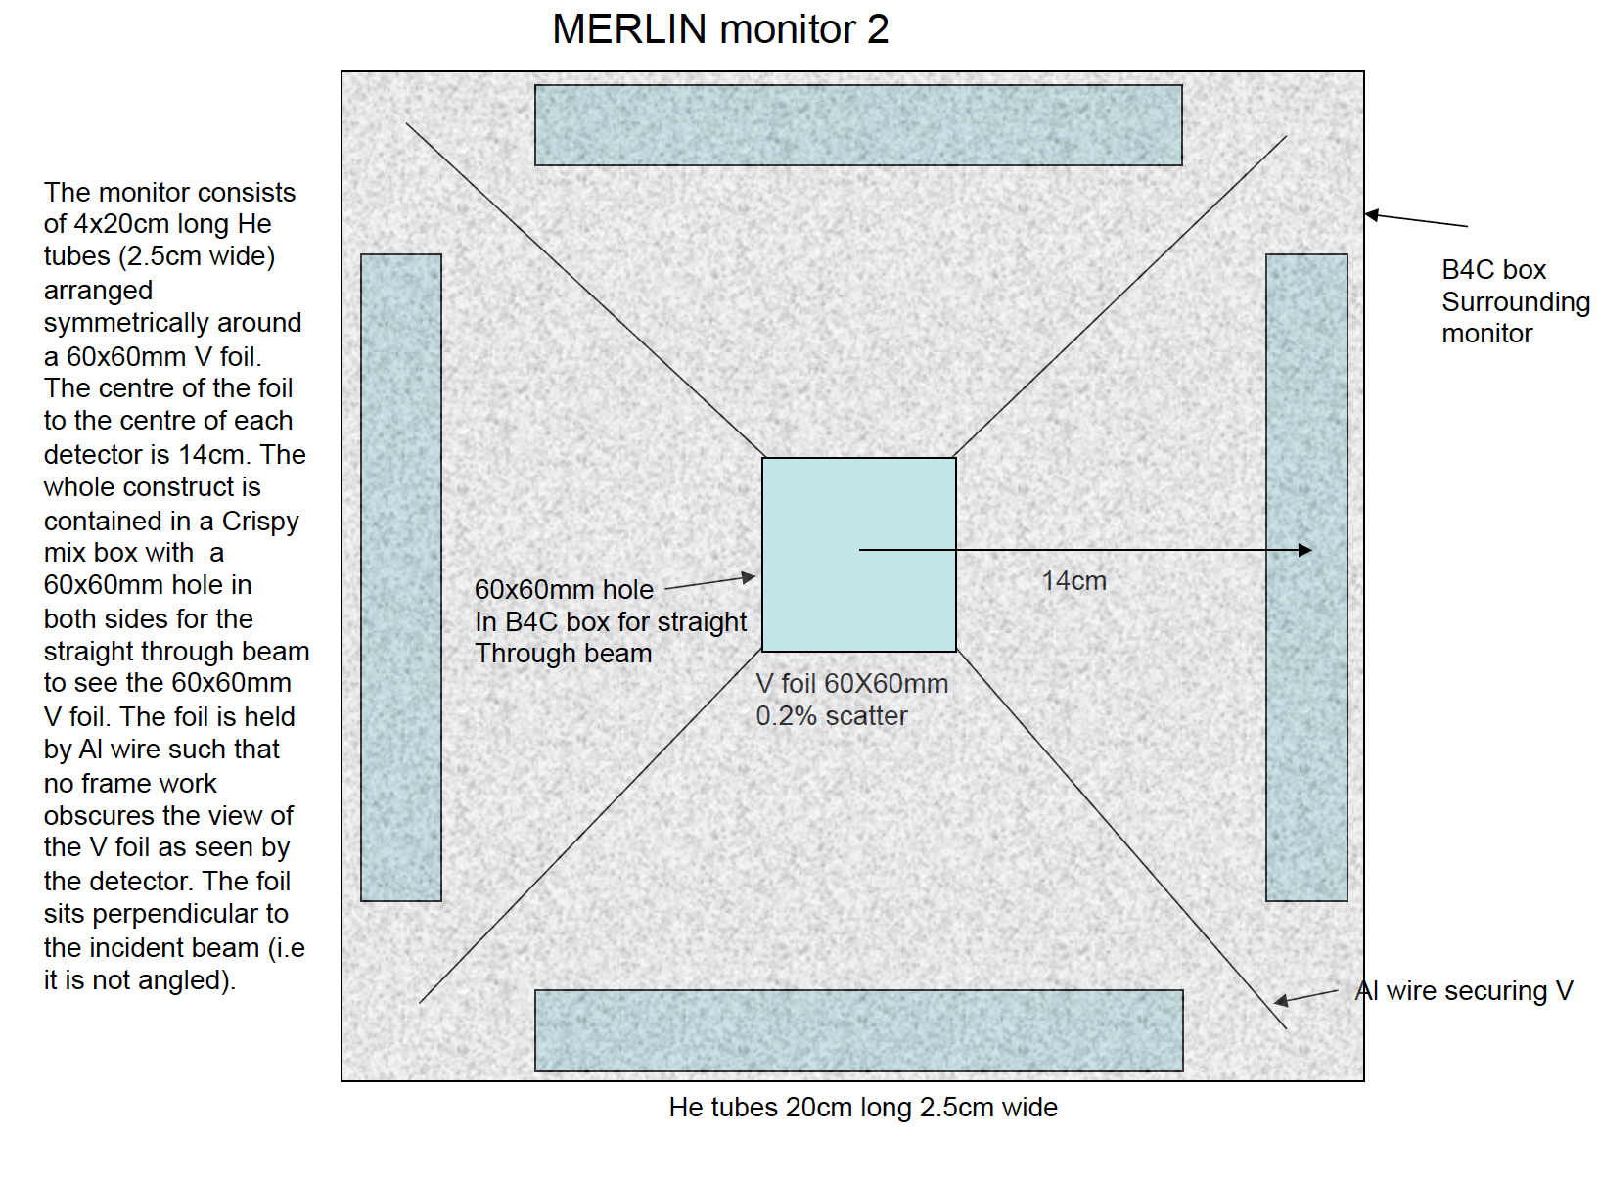
Parasitic methods for monitoring the beam
Info from
Jon Taylor and
Robert bewley (ISIS)
Thanks !!
Vanadium foil
Timing characteristics are poor
Neutron timing gets blurred out by the distance errors. Not good when accurate peak shapes and timing behind choppers are needed.
Good for looking at the white beam

Slide 14
Parasitic methods for monitoring the beam
Gamma detector
Gamma detector
Using the boron layer on the disc one can know if the beam is open or closed this is done using a gamma detector outside the beam.
emitted ϒ-rays
Incident beam
A test will be performed this summer being coordinated by the chopper group

Slide 15
Outline
Market survey of Beam monitors
Integration of Beam monitors into ESS
Parasitic methods for monitoring the beam
Survey on BM requirements from instruments
Facility maintenance and operation

Slide 16

BM requirements for each instrument
Know each instrument requirements
Reduce the number of options
Select the proper type of BM
Issue guidelines for ESS instruments
Aim: September for draft

Slide 17



BM requirements for each instrument
: document provided
: more information needed
: waiting for answer
Instruments | Answer
LOKI
FREIA
NMX

Slide 18
BM requirements for each instrument
: document provided
: more information needed
: waiting for answer
Instruments | Answer
TREX
VESPA
MIRACLES
C-SPEC
Other instruments will be sent template soon

Slide 19
Outline
Market survey of Beam monitors
Integration of Beam monitors into ESS
Parasitic methods for monitoring the beam
Survey on BM requirements from instruments
Facility maintenance and operation

Slide 20
Facility maintenance and operation Requirements
The model at ESS has very low level of support during operation available : high availability and reliability requirements
BM system
Environmental requirement (rate, humidity, temperature,..)
No access to the bunker just for BM maintenance
Diagnose flux lost
Stability
Flux along the beam line
Cross-Calibration
T0 information
Radiation hardness
(lifetime >10years @ normal flux)
Based on the market survey and the instrument requirements
Recommendation of BM that full fill each of these tasks

Slide 21
Thank you

