Slide 1
Neutron beam optics assembly
Preliminary design review
Overview
P.Bentley / I.Sutton
Neutron Instrument Technologies
www.europeanspallationsource.se
15 June, 2017

Slide 2

Agenda
Introduction to NBOA
Context
  Physical context
  Project context
Team
Stakeholders
High level requirements
Where we stand

Slide 3

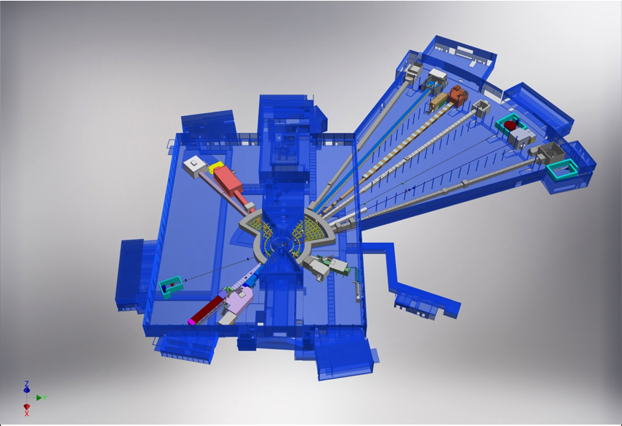











NSS Neutron Instrument
ESS Lead Partners for instrument construction
+
Nuclear Physics Institute
15 Approved Instruments
E01 (Long Hall) 8 Instruments
D01 (Short hall) 2 Instruments
D03 (Short hall) 5 instruments
NMX
BEER
+
C-SPEC
BIFROST
MIRACLES
MAGIC
ODIN
T-REX
DREAM
HEIMDAL
LoKI
VESPA
FREIA
SKADI
ESTIA
+
ESS In-Kind Partners also collaborate on technology development, sample environment, data management systems etc.
ESS Instrument Layout (December 2016)

Slide 4
Where are instrument NBOA ?
BEER
Phase 3
In-Cave
NMX
C-SPEC
BIFROST
MIRACLES
MAGIC
ODIN
T-REX
DREAM
HEIMDAL
Phase 2
In-Hall
LoKI
VESPA
FREIA
Phase 1
In-Bunker
SKADI
ESTIA
Phase 0
In-monolith

Slide 5
NBOA
– all instruments
R2 R5.5 R6.0 R11.5 (24.5) R15 (28)
IN-MONOLITH (NBOA)
Line of sight YES
Length 3.5m
Substrate Metallic
Atmosphere Vac / He
QC regime Nuclear
IN-MONOLITH (BPSO)
Line of sight YES
Length 0.5m
Substrate Metallic
Atmosphere Vac / He
QC regime Safety
5
NOT this window
‘Neutron beam window’
Notes:
Systems level (blacks box) view of where NBOA fit into the ESS facility
Engineer systems
Operational systems
Project
Identify principal types of interfaces
Technical
Operational
Project
How the interact – driving - constraining
How interactions change over time
Emergent properties

Slide 6
NBOA in a nutshell
NBOA is a 3,5m of neutron optics installed within the target monolith.
It’s job is to extract the good neutron from the moderator for use by instruments ...
…. and to stop as many of the bad ones from getting out.
The installation of NBOA is on the critical path of all instruments
The design and procurement is the responsibility of individual instrument teams …. however the integration into the facility is shared.
It is the first part of all of the facilities neutron instruments …. each one is unique and critical their performance

Slide 7
Objectives
NBOA ‘FAST TRACK’
FAST TRACK is a suit of targeted activities undertaken NSS engineering integration team with partners in addition to the normal integration and support activities.
These initiatives are reserved for system critical to the ESS or the NSS project as a whole on grounds of performance, safety, schedule, risk or cost.
The objective of these initiatives is to assist partners ensure the quality, performance, integration and timely delivery of the critical systems within their responsibility
Activities may include;
Conceptual design
Integration
Selection and validation of technical solutions
Technical support during procurement
Pre-competitive discussion with potential suppliers
Discussion with authorities

Slide 8
Scope
In scope ;
For the NBOA of first 16 instruments
  Preliminary design
  Integration into ESS systems
  Support of pre-procurement discussion with suppliers
  Definition of delivery dates and batches
  Support of quality control
  Management of on-site NBOA-NBEX integration
Excluded
  Detailed design
  Procurement
  Installation

Slide 9




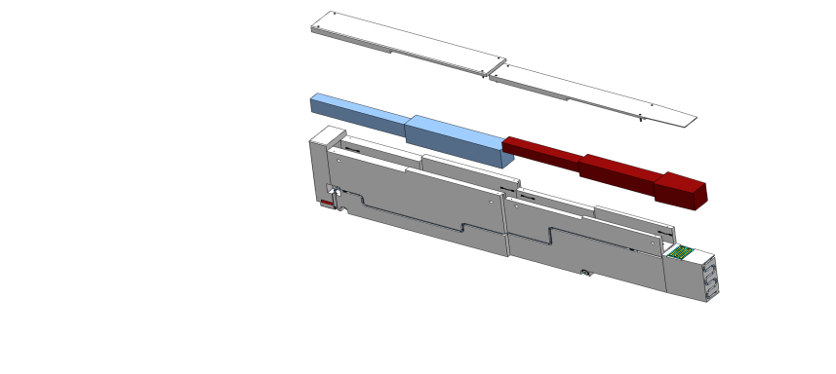

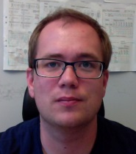



NBOA-NBEX team
NBOA (NSS)
  P.Bentley
  I.Sutton
  E.Nilsson
  T.Ossman
NBEX (TD)
  N. de la Cour
  B. Jonsson
  J.Koning
9

Slide 10
Stakeholder interaction
Suppliers
CF
RACE
ESH
Instrument 01
Waste handling
Instrument 01
Instrument 01
NBOA
team
NBEX
team
Fluids
Instrument 01
Instrument 01
Instrument 01
Instrument 01
Instrument 01
Monolith systems
Instrument 01
Instrument 01
Instrument 16
NOSG
Instrument technologies
NSS project management
Notes:
Interactions > stakeholder groups > representatives
NBOA centric Spider diagram

Slide 11
Requirements
- SH Instruments
Performance & Functionality
Compatibility with Straight / Curved / guide trajectories evolving in both vertical and horizontal planes.
Compatibility with Constant / Convergent / Divergent / Elliptical guide sections evolving in both vertical and horizontal planes.
Compatibility with Multi channel benders, Bi spectral extraction, Collimators.
Compatibility with the employ of high performance reflective coatings and non-reflective coatings.
Provide means for alignment with respect to the NBPI
Documents
NBOA design report
ESS – 00 XXXXX

Slide 12
Requirements
- SH Facility
Interfaces
NBEX
Target systems
Waste handling
Compatible with waste handling facilities and operations
Secure optical components during use installation and decommissioning operations.
Operability
Comply with NSS concepts of operation
Service life 20 years of full power operation.
Maintain acceptable performance over the service life
Safety
Comply with facility agreed regulations
Agreed materials
Hazard analysis
Performance in accidental events
Documents
NBEX ICD_R
ESS-0088184
NBPI Interface hot cell
ESS-0098694
NSS Concept of operations
ESS-0005817
PSAR (annex in prep)
ESS- 000002

Slide 13
Requirements
- SH NSS Project
Schedule
  Instrument construction schedule
  Installation schedule
Procurement
  In-kind context
  Delivery priorities
Cost
Risk

Slide 14
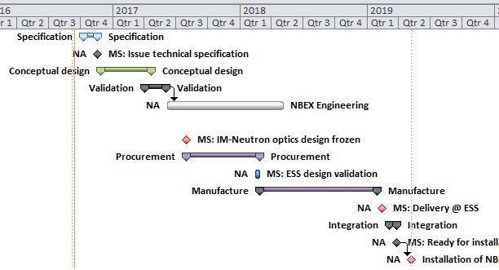
Why now ?
TODAY
DESIGN
PROCUREMENT
Instruments commencing Procurement Now !
Q4 2018
Delivery
Q2 2019
Install
Notes:
Protons on target summer 2019 (Q3)
Closure on Monolith vessel End Q2
Installation inserts Q2
Delivery of inserts Q1
Procurements – Supply ~12month
Which implies order placement for in-monolith optics Q2-Q3 2017

Slide 15
Planned order of commencement of operation of first 8 instruments
Instrument Class | Sub-class | Candidates
Large Scale Structures | Small Angle Scattering | LOKI (ISIS) or SKADI (FZJ/LLB)
 | Reflectometry | ESTIA (PSI) or FREIA (ISIS)
Diffraction | Powder Diffraction | DREAM (FZJ) or HEIMDAL (ÅU)
 | Single crystal diffraction | MAGIC (LLB) or NMX (ESS)
Engineering | Strain scanning | BEER (HZG/NPI)
 | Imaging and tomography | ODIN (TUM/PSI)
Spectroscopy | Direct Geometry | C-SPEC (TUM/LLB) or T-REX (FZJ)
 | Indirect Geometry | BIFROST (DTU), MIRACLES (Bilbao), VESPA (CNR)
First 8 instruments will be start early procurements in Q3
Order placement in Q4 2017
Next 7 instruments will be start early procurements in Q4
Order placement in Q1 2018

Slide 16
INSTRUMENT INSTALLATION COMMENCING IN …
13-1-2017
0
4
7
WEEKS

Slide 17

Thanks for joining us
Questions are welcome !
I.Sutton
On behalf of NBOA-(NBEX) team

