Slide 1
IM-Optics Supplier forum
NBOA Concept Design report
ESS
I.Sutton

Slide 2
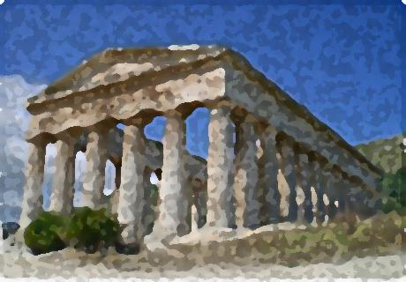
What is this all about
Context
Instrument requirements
Generic design
Architecture
Materials
Alignment
Cooling
Coatings

Slide 3
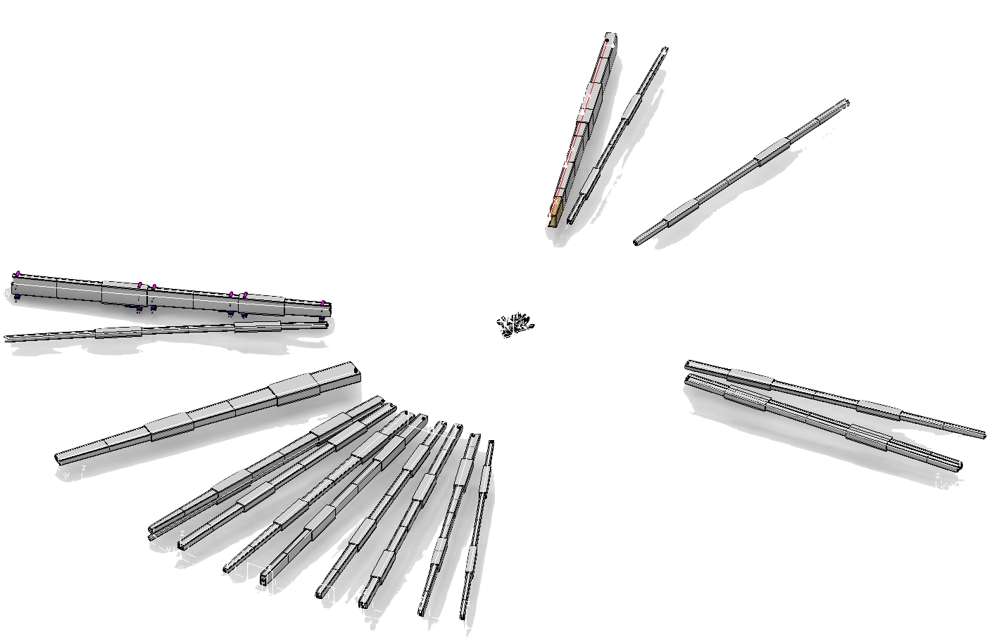
NBOA Generic
One for all … all for one !
Objective
Develop high performance, robust, cost effective design as the template for all inserts.
Conduct its integration, validation and certification
From the template develop custom designs for all instruments inserts as the basis for procurement

Slide 4
NBOA organisational context – a complex interface
NSS Hall / Logistics
(G. Lazlo / I.Sutton)
NSS Bunker (Z.Lazic)
NSS Neutron optics (P. Bently)
NSS Instruments (G. Lazlo)
Target Monolith Systems (S. Ghatnekar)
CF D02
(L. Arthursson)
Target NBEX Systems (S.Gh)

Slide 5
“NBOA” – all instruments
R2 R5.5 R6.0 R11.5 (24.5) R15 (28)
IN-MONOLITH (NBOA)
Line of sight YES
Length 3.5m
Substrate Metallic
Atmosphere Vac / He
QC regime Nuclear
IN-MONOLITH (BPSO)
Line of sight YES
Length 0.5m
Substrate Metallic
Atmosphere Vac / He
QC regime Safety
5
NOT this window
‘Neutron beam window’

Slide 6
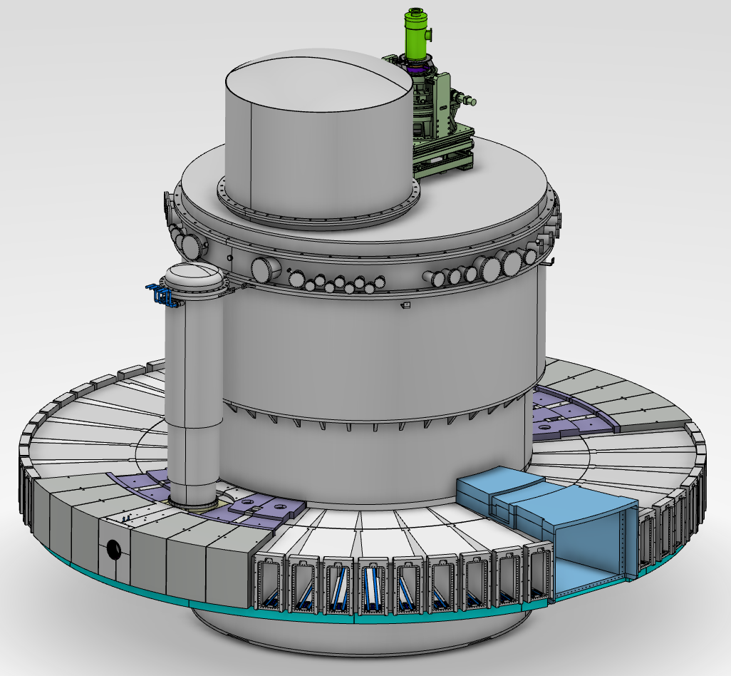
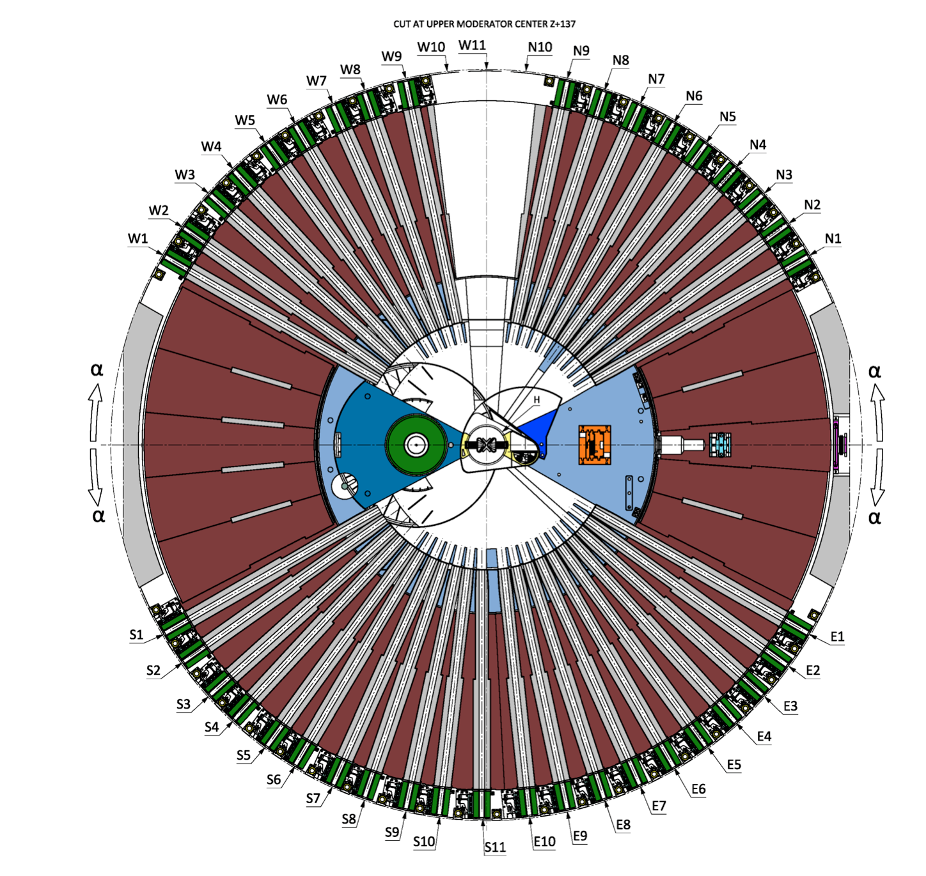
Monolith Vessel & Neutron beam ports
Moderator
Neutron beam inserts
(gray)
Light shutters
(green)

Slide 7
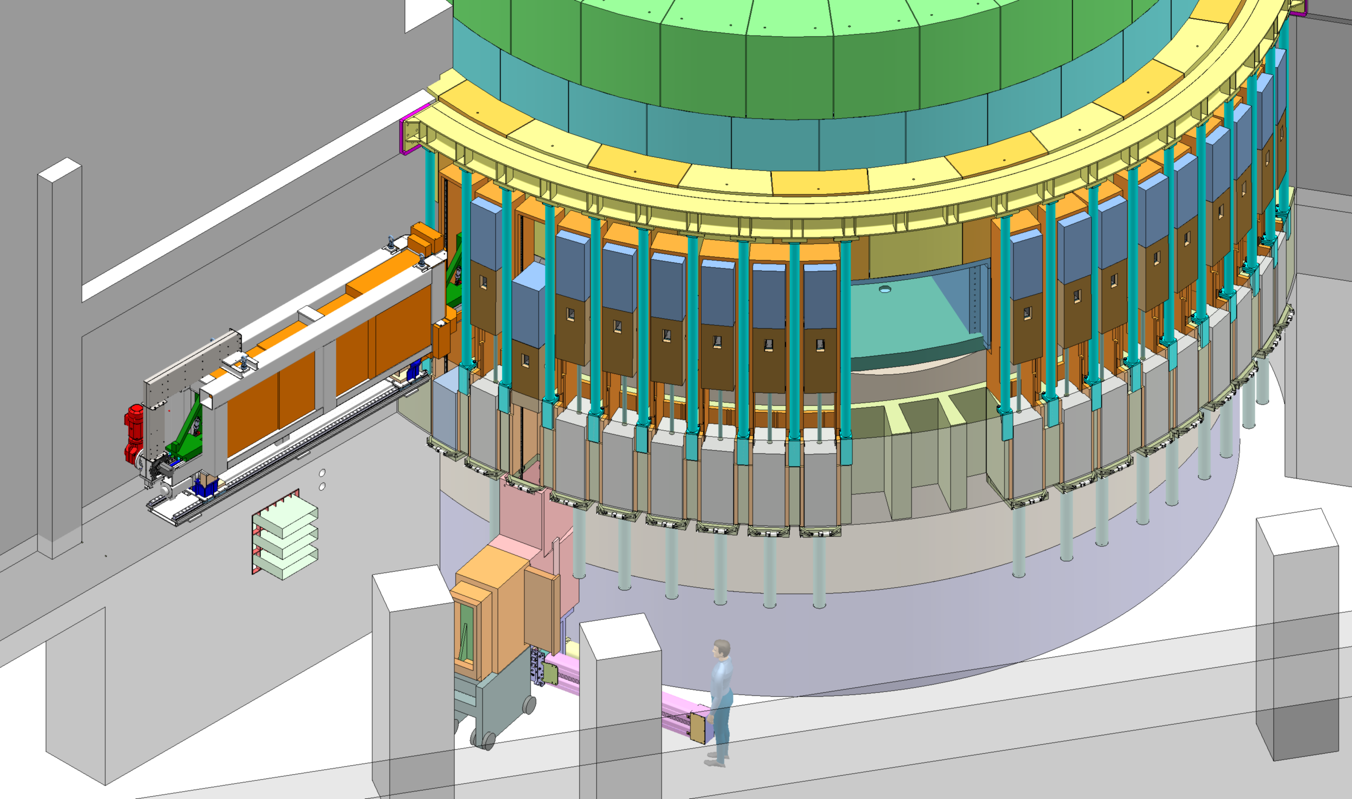
Neutron Beam Extraction System
Model reference: ESS-0065135
Notes:
Extra slides follow

Slide 8
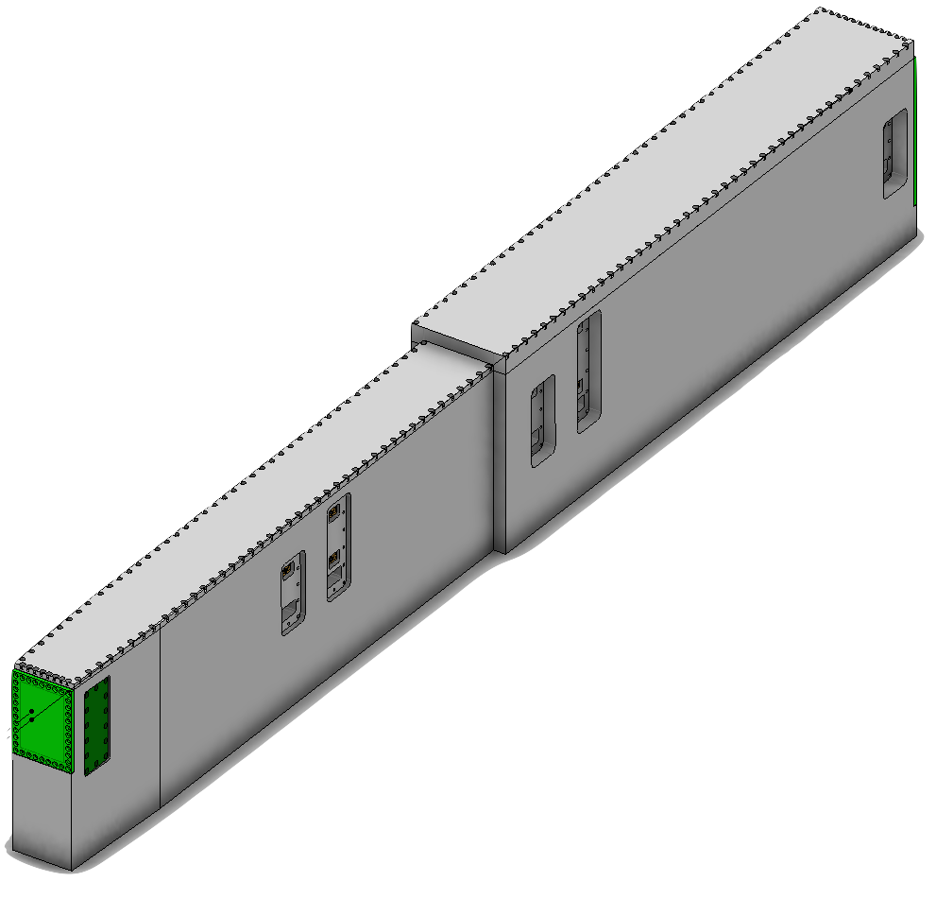
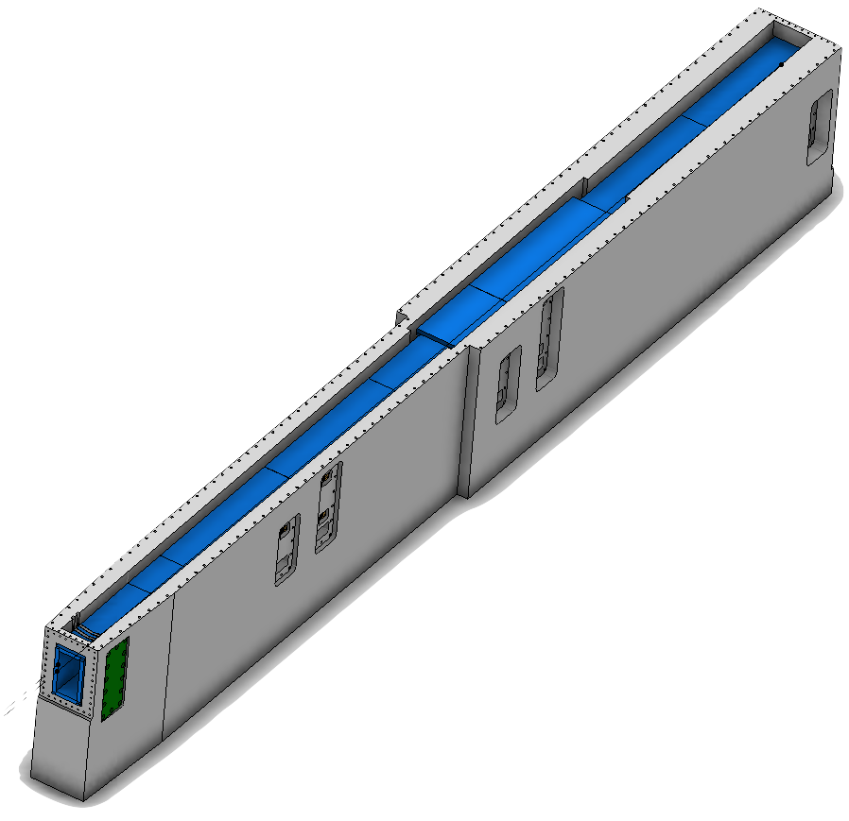
NBEX
Key stats
Length 3.5m
Mass 4700kg
Material: stainless steel 316L
Principal functions
Bulk shielding
For NBOA
Physical support
Cooling
Alignment w.r.t Moderator
Environment
NBPI A water cooled shielding block on wheels

Slide 9
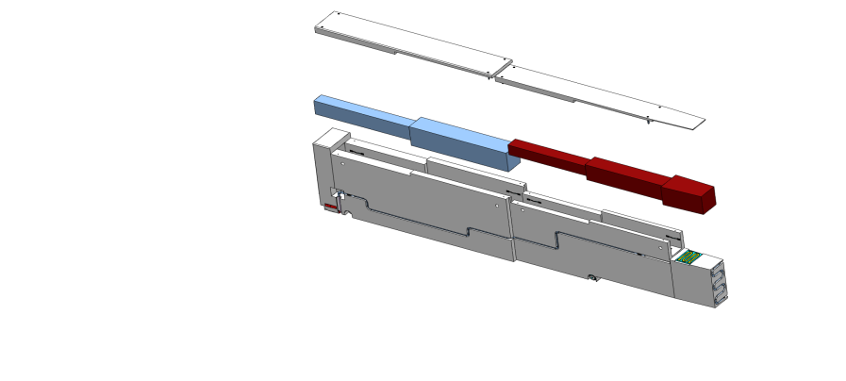


Neutron beam optical assembly (NBOA)
R2 R5.5
Neutron Beam Extraction (NBEX)
Resp: Target Division
Neutron Beam Port Insert (NBPI)
Resp: Target division
Role: Shielding & alignment
Neutron Beam optical assembly (NBOA) Resp: NSS / Instrument
Role : Beam extraction

Slide 10
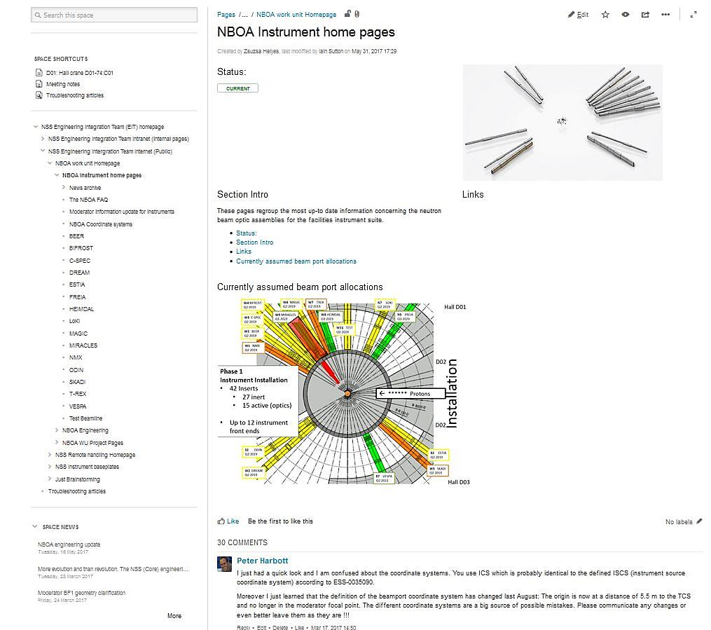
Requirement collection
3 Pronged approach
Information diffusion
  Full Project meetings IKON
  Monthly news letter
Discussion (grouped)
  Monthly skype meeting
Discussion (individual)
  Confluence
  One on one meetings
Avoid email !

Slide 11
Iterative engineering process
Instrument team
Instrument team
Experts
Suppliers
Instrument team
Experts
Internal stakeholders
Description of Surfaces
Architecture
Embodiment
Integration
Surfaces
coatings
Sectioned surfaces
Features
Realistic volumes
Full Features
Integrated volumes
validation

Slide 12
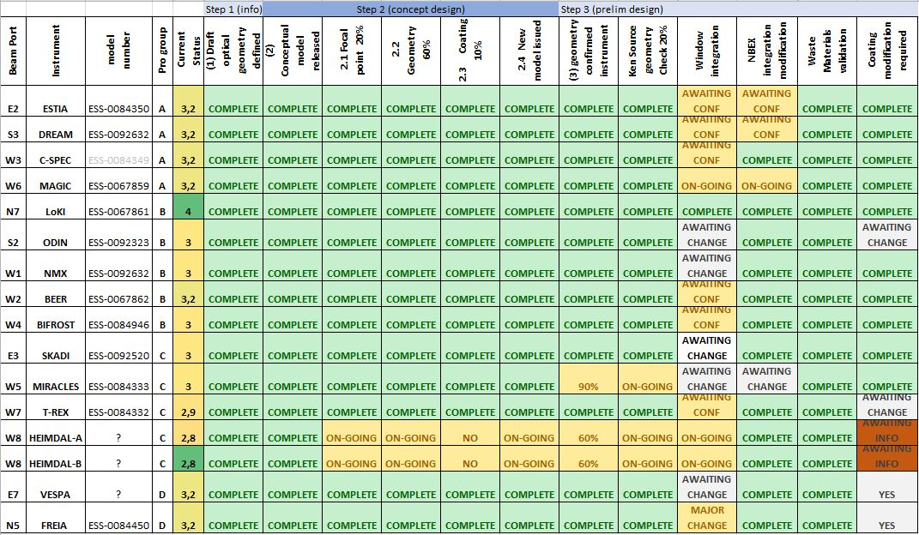
Requirement maturity

Slide 13
Understanding
Commonalities
NBOA
Bi-spectral
Bender
Elliptical
Multiple
DREAM
HEIMDAL
MAGIC
ODIN
LOKI
SKADI
BEER
BIFROST
DREAM
ESTIA
FRIEA
HEIMDAL
ODIN
T-REX
FREIA
HEIMDAL

Slide 14
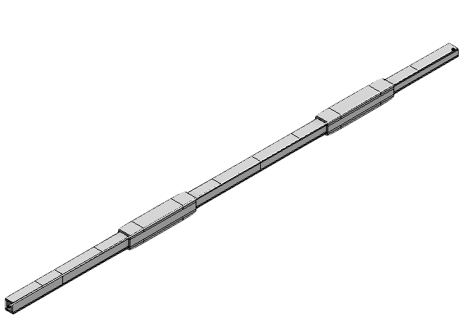
Features
Bi-spectral extraction (switch)
Engineering issues
Wide opening
High heat load
‘Switch’
Multichannel design
Issues resolved* with move of Switch to outside of monolith.
*One instrument remaining

Slide 15
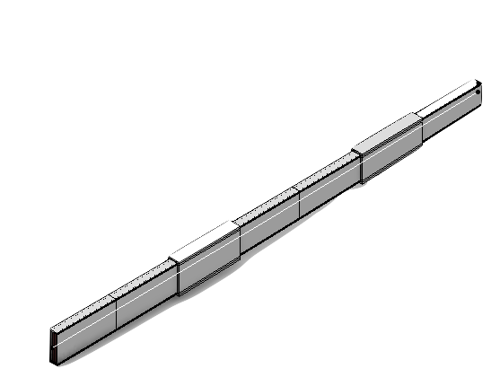
Features
Multi channel bender
Engineering issues
Multichannel design (3 & 5 channels)
Heat transport from wafers*
Alignment precision requirements.
Integration issues due to high curvature geometry
Issues resolved* with He atmosphere.
FREIA* R 130 000mm
LOKI* R 61 250mm
SKADI* R 84 000mm

Slide 16
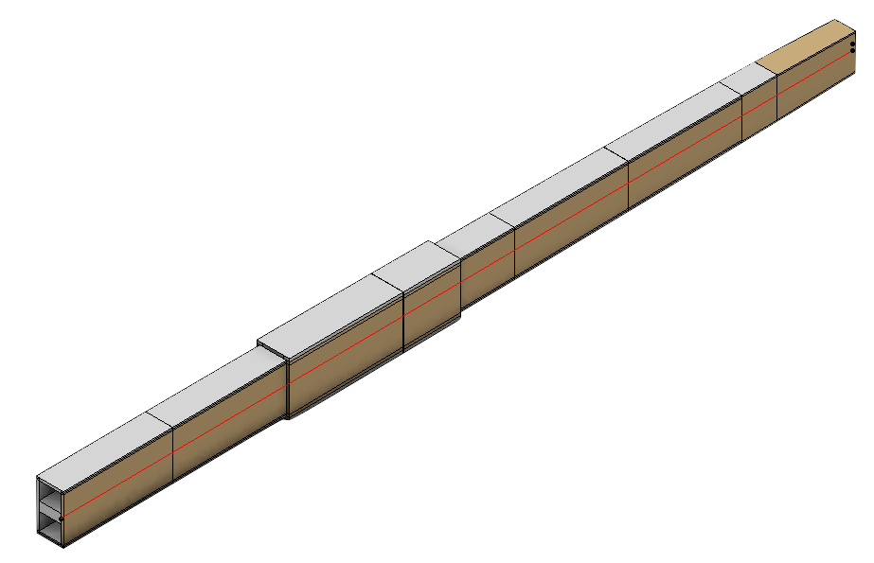
Features
Elliptical surfaces
Engineering issues
Integration issues due to high curvature geometry
Manufacture due to high curvature geometry*
Issues resolved* with reduced substrate thickness.
BEER (Top & Bottom)
BIFROST (ALL)
DREAM (Top & Bottom)
ESTIA (Top, Bottom & Right)
FREIA (Top & Bottom)
HEIMDAL-THERMAL (ALL)
ODIN (ALL)
T-REX (Top & Bottom)

Slide 17
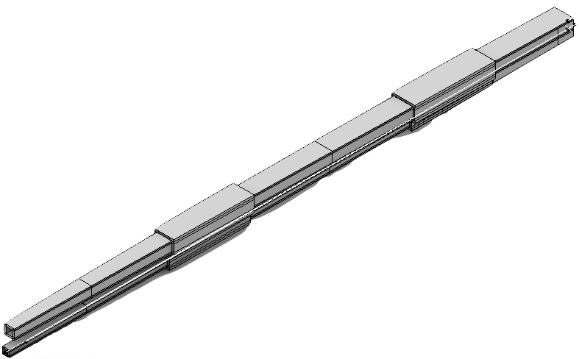
Features special cases
ESTIA
  Collimator section
  Uncoated left side
HEIMDAL
  Dual guide
MAGIC
  No super coated mirrors
ODIN
  Right side open first 300 mm.

Slide 18

Design philosophy
“True performance can only be judged over the long term ….”
Critical systems shall be;
Robust
Performant
Cost effective
…..in a word simple !

Slide 19
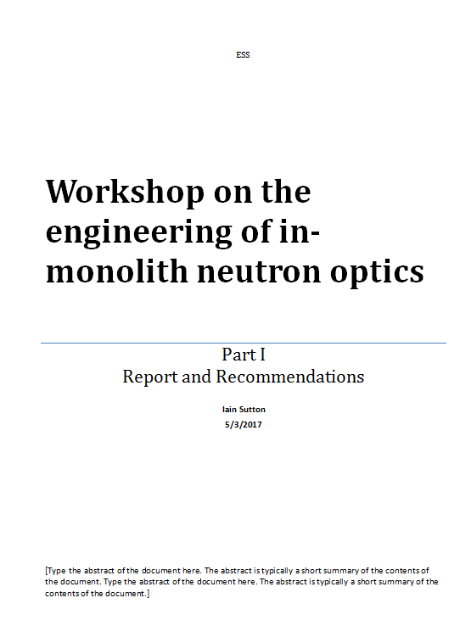
Recommendations &
Decisions
Validation of designs key points
Architecture
Cooling
Materials
Coatings
Alignment

Slide 20
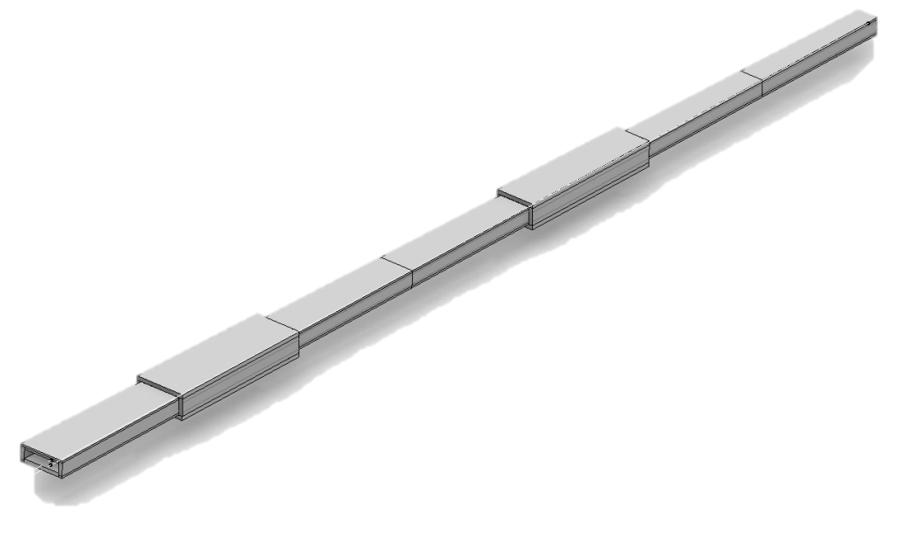
Architecture
Overview
Construction in 3 sections
Small gaps between sections enable independent alignment and compensate for thermal expansion
Justification
Ease of manufacture
Ease in installation
Ease of alignment
Cooling

Slide 21
Architecture
Schematic
N
SECTION 01
SECTION 02
SECTION 03
ALIGNMENT & RETENTION FEATURES
ALIGNMENT
ALIGNMENT
ALIGNMENT
ALIGNMENT
ALIGNMENT
ALIGNMENT
ALIGNMENT
ALIGNMENT
ALIGNMENT
ALIGNMENT
ALIGNMENT
ALIGNMENT

Slide 22
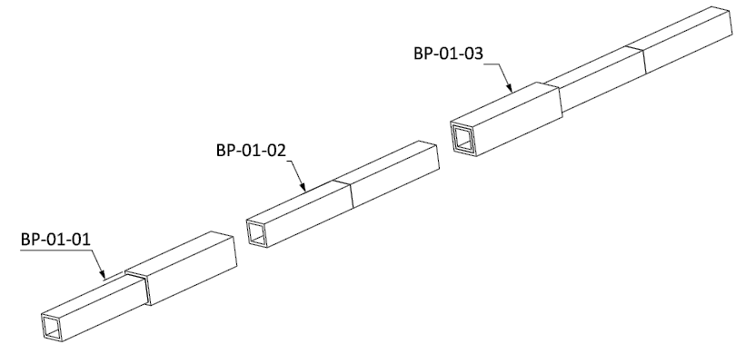
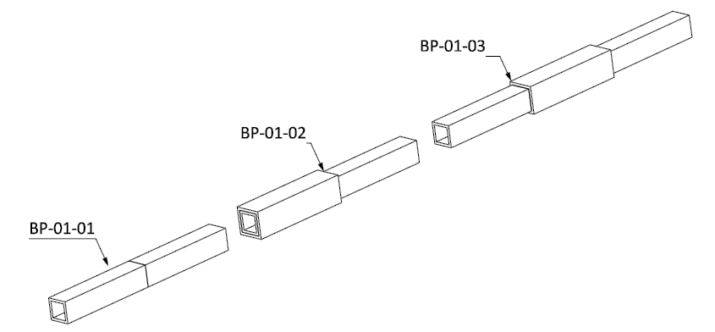
Architecture
Chicanes
A
2mm (nominal) gap between NBOA and NBEX pocket
2 chicanes along the streaming path
  Step >13mm
Shielding steps are >500mm long & separated by at least 1000mm.
Jackets shall be gap less with respect to substrate.
.
B
C

Slide 23
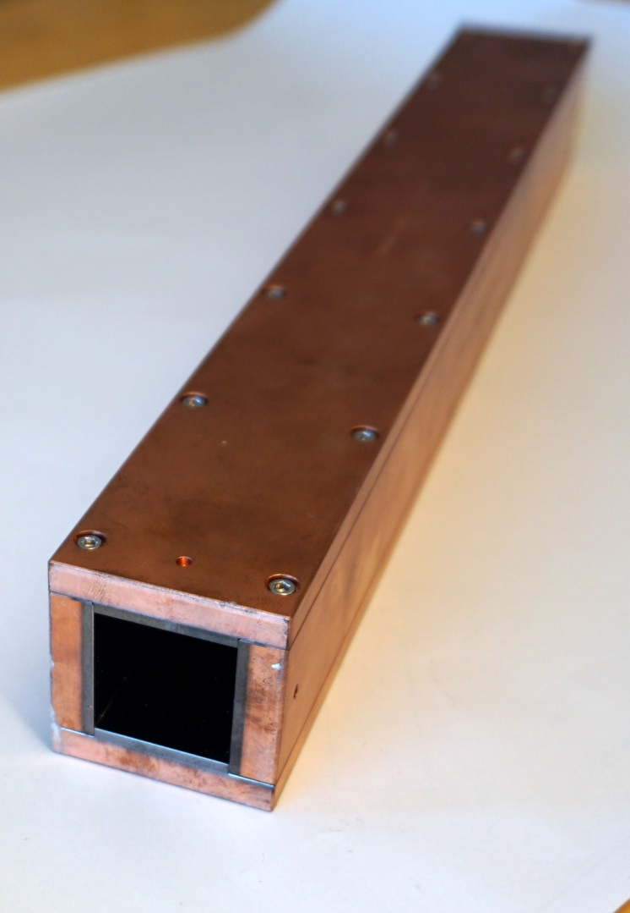
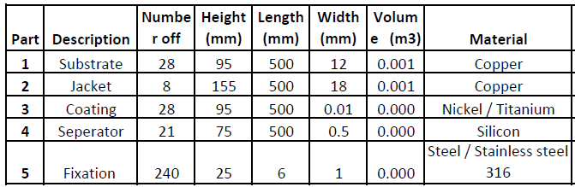
Construction
Materials
Optical substrates
Copper (Pure O2 free)
Benefits
Radiation resistance
Shielding properties
Thermal conduction
Compatibility with coatings
.

Slide 24
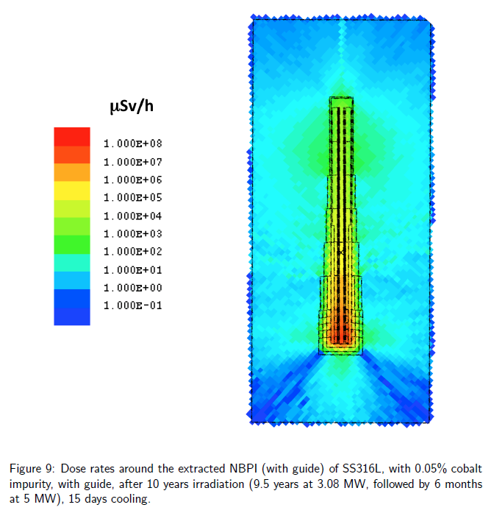
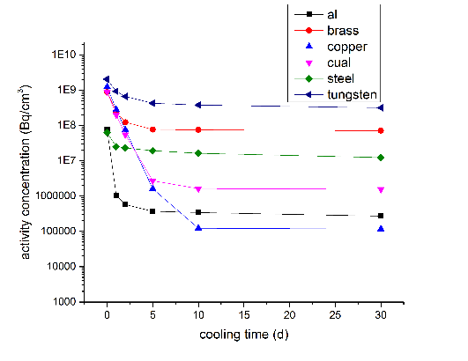
Activation
NBOA = 100 - 300kg of copper
Copper substrates will become activated
With respect to human safety
In this application the activation of the coppers is considered a significant issue because
After 15d Copper 1/1000 activity of Steel
NBOA is shielded within Steel
Removal of NBEX is an RH activity
With respect to Waste disposal
Considered integrally with NBEX
Compatibility of Design & Materials with waste handling stream confirmed

Slide 25
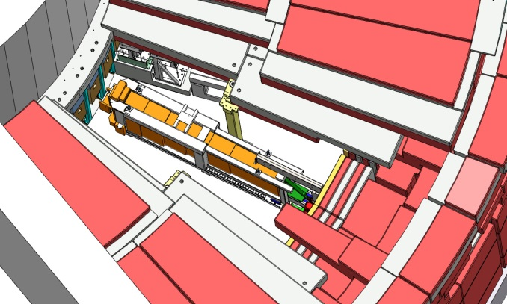
NBOA
Replacement
Initial suite
Potentially 10 -16 additional beam ports will be activation within the first 10 years of operation
Late arrivals ?
Instruments 17-22
End of life Replacement
Instruments 23 - 28

Slide 26
Alignment
Requirements
Movement +/- 1mm
Resolution 0.01mm
Long term Stability
Key features
Positioning alone ‘long side’
Solid screws opposed by strip springs
Vertical jacks
Support on balls
Retaining pins
Spring side
Solid side

Slide 27
Retention
Constraints from hazard analysis
Retain components during H3 seismic event
Constraints from Decommissioning
.. All components shall remain within NBEX during transport to disposal facility ….
    Solution: windows on NBPI
….sectioned components shall be retained during handling ….
    Solution: Retaining pins on all guides sections
Design requirement
resist acceleration 2g in all planes
sectioned component

Slide 28
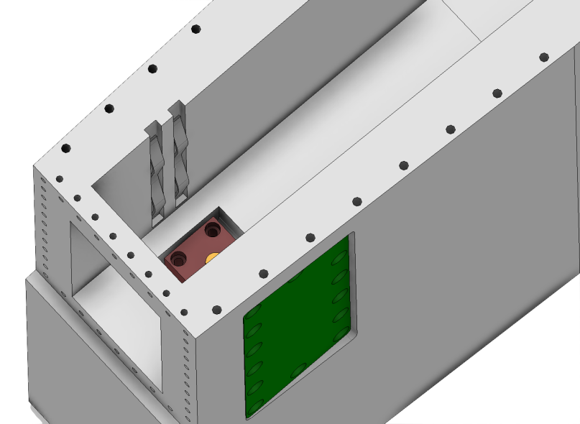
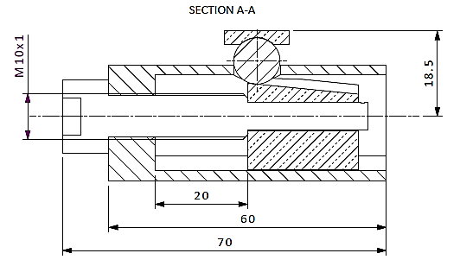
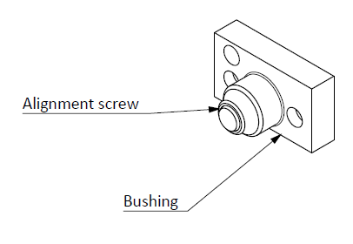
Alignment details
Side
Fine pitch screw
Lock screw
Spherical ball contact
Screw in pocket acts as retaining pin
Below
Screw + ramp
Ball + cup contact

Slide 29
Thermal management
- Context
Target monolith
Water cooled shielding
‘Air cooled’ shielding
Source
Instruments
R1.0
R2.0
R2.5
R5.5

Slide 30
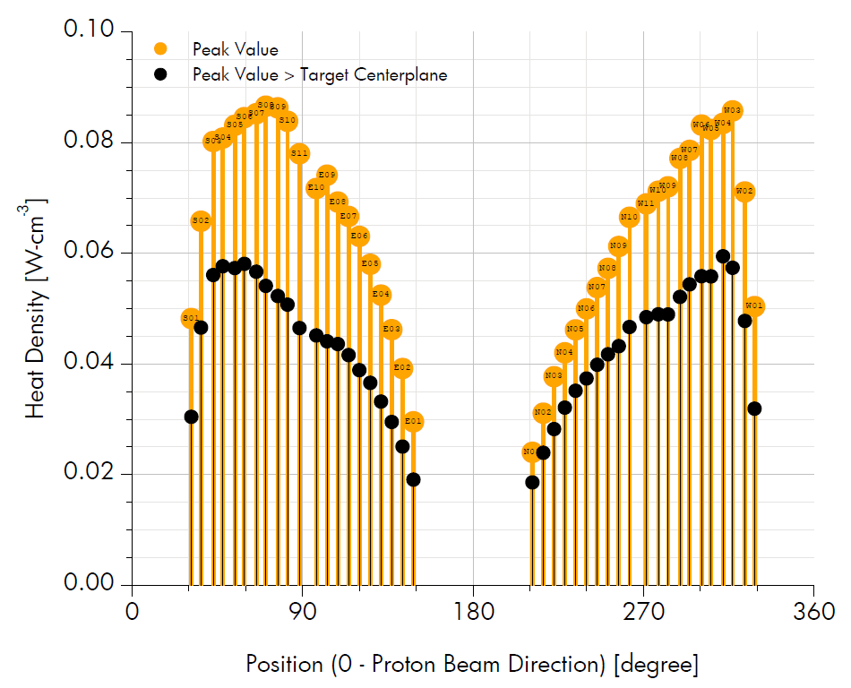
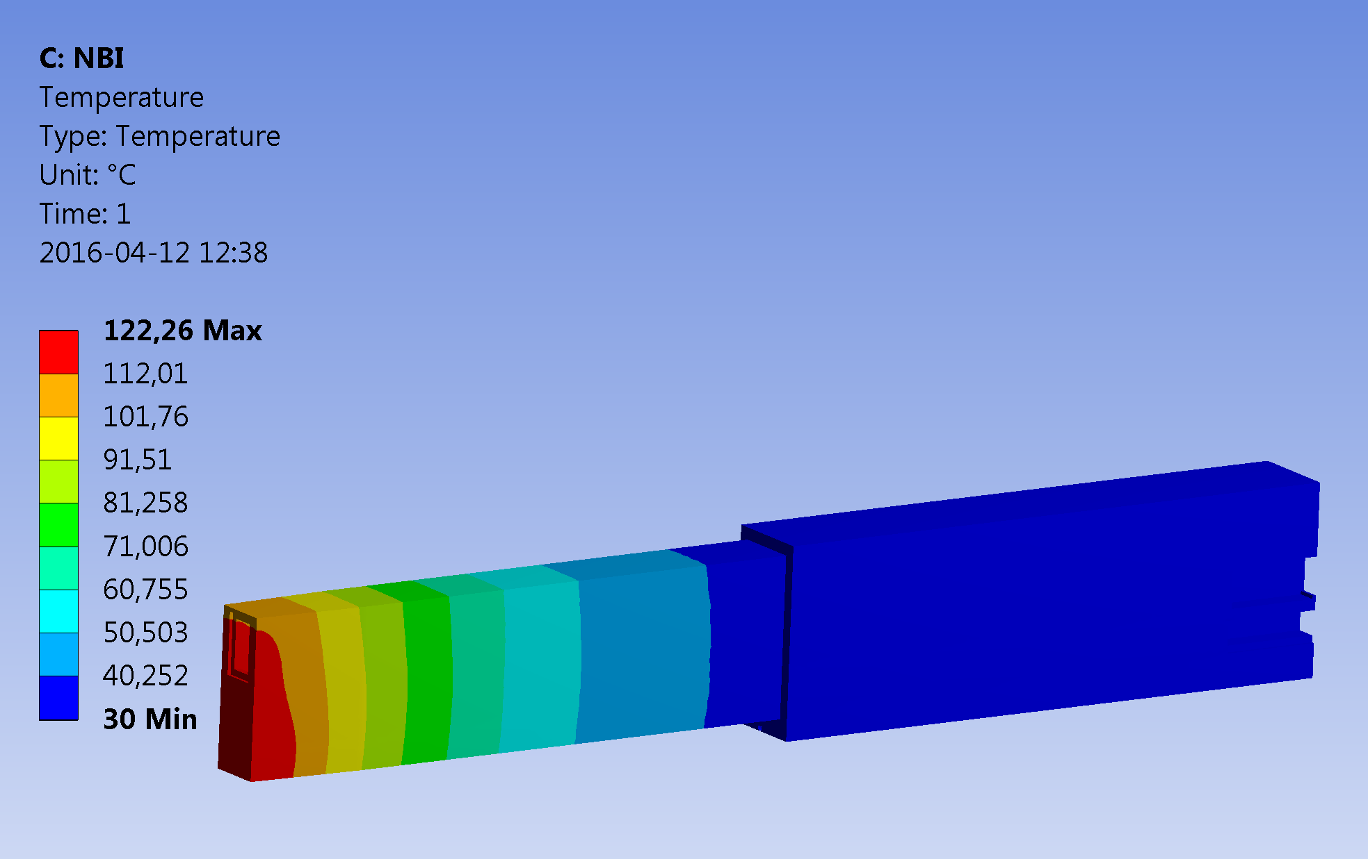
Thermal management
- heat load
Heat load due to gamma heating
NBEX up to from 150 - 350w
beam port dependent
Initial study NBEX operates within vacuum
Minimal conduction path point contact
Heat dissipation by irradiation to neighboring blocks (cooled – uncooled)
Without cooling temperature peak ~125c
To maintain a stable and acceptable operating temperature NBPI is water cooled to 35 - 40c
Source: Alan Takibayev 4-2017
Source: Anders Olsson 5-2017

Slide 31
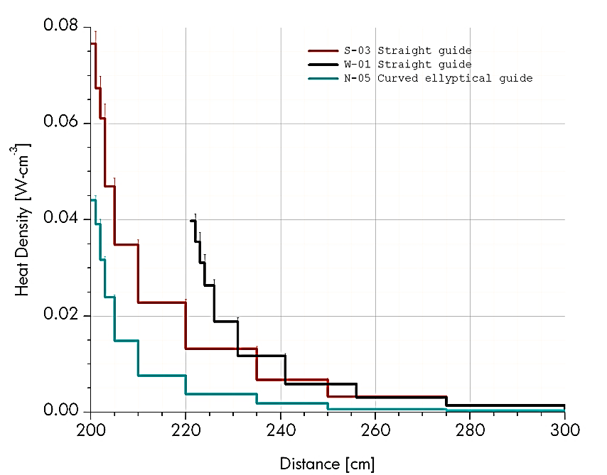
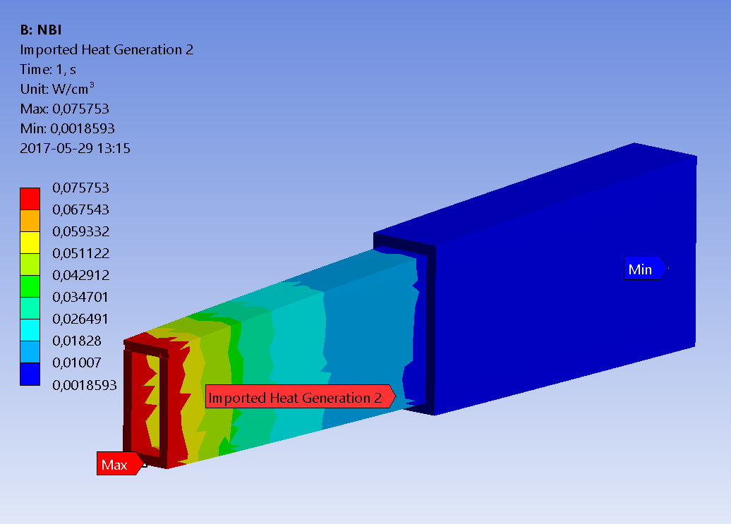
Thermal management
- heat load (NBOA)
Heat load due to gamma heating
NBOA 50 - 100w (beam port dependent)
  (30% more in copper than in steel, less in silicon )
Deposition profile is geometry dependent
  Straight
  Curved
  Converging
Initial studies with a cooled NBPI
  Straight geometry
  In vacuum
  Conduction via point contact
  Heat dissipation by irradiation
Without cooling temperature peak ~100c
Recommended operating temperature is 60c
Source: Anders Olsson 5-2017
Source: Anders Olsson 5-2017

Slide 32
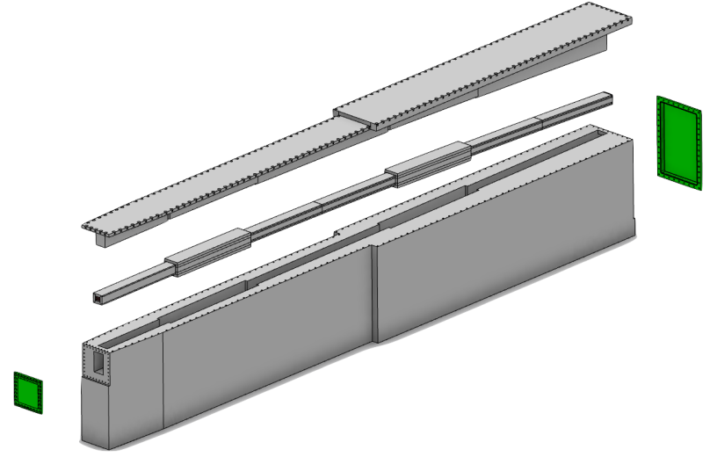
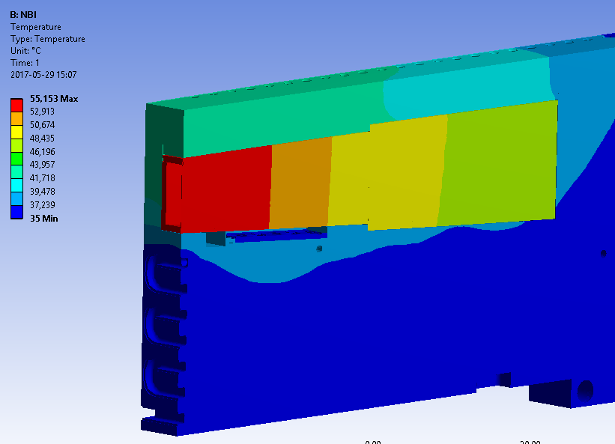
Thermal management
- heat load (NBOA)
Need to improve heat conduction
within NBOA to reduce ‘hot spots’
Need to improve heat dissipation from NBOA > NBPI
Following recommendation, decision taken to close NBPI volume and adopt Helium atmosphere.
Study with helium, worst case geometry, worst case heat load
Peak temperature ~55c
Source: Anders Olsson 5-2017

Slide 33
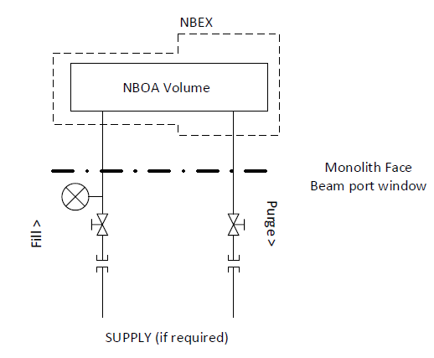
Thermal management
- atmosphere
Volume : 10 - 60ltr
Pressure : 200 - 500mbar (TBD)
Operating temperature 40c +/- 5
Media : Pure Helium
Flow : None
The volume is expected to remain closed during operation and topped up ‘annually’
The pressure may change during operation between the limits indicated

Slide 34

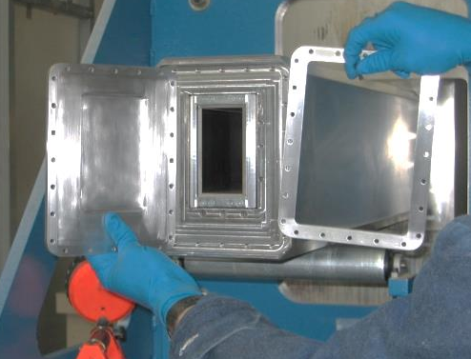
Thermal management
- sealing
Seals
Front window – NBPI body
  Knife edge
Rear window - NBPI body
  Knife edge
NBPI Lid - NBPI Body
  Energized crushable metallic
Ports – NBPI body (~20)
  Energized metallic
Alternative sealing type under study
Crushable wire
Lip weld
2
3
4
1

Slide 35
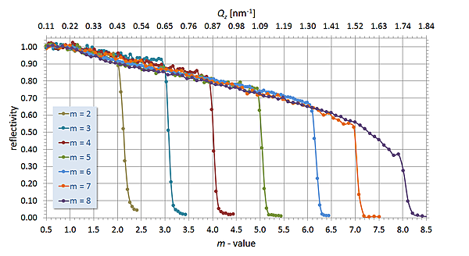
Coatings
ESS Decision
Cap coatings of in-monolith optics in a general case to < M = 4.0
Use of coatings above this value is exceptional with the express consent of ESS
Prohibited in-monolith

Slide 36
Coatings
Cap at 4 ? Who is affected ?
4 instruments are effected
Study of changes is underway
Instrument | Top | Bottom | Left | Right
BEER | 4 | 4 | 2.5 | 2.5
BIFROST | 3.5 | 3.5 | 3.5 | 3.5
C-SPEC | 3 | 3 | 4 | 3.5
DREAM | 4 | 4 | ? | 3.5
ESTIA | 4 | 4 | - | 4
FREIA | 1 | 1 | 4.4 | 2.5
HEIMDAL- THERMAL | ? | ? | ? | ?
HEIMDAL- COLD | ? | ? | ? | ?
LOKI | 3 | 3 | 3 | 3
MAGIC | - | - | - | -
MIRACLES | 3 | 3 | 3 | 3
NMX | 2 | 2 | 2 | 2
ODIN | 4 | 4 | 5 | 5
SKADI | 3 | 3 | 3 | 3
T-REX | 5 | 5 | 1.5 | 1.5
VESPA | 6 | 6 | 6 | 6

Slide 37
Outstanding technical issues
No major technical issues outstanding
Minor issues
NBOA
Coating changes – 3 instruments
NBOA – NBEX
Beam window thickness optimisation
Operating temperature
  Requirement to be confirmed
  Technical solution requires

Slide 38








Thanks for joining us
Questions are welcome !
NBOA – NBEX Team

Slide 39
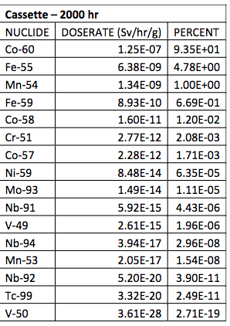
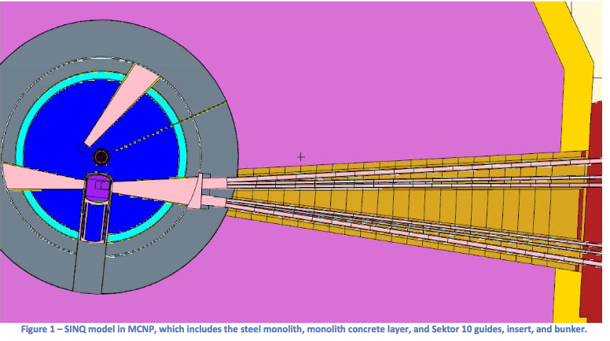
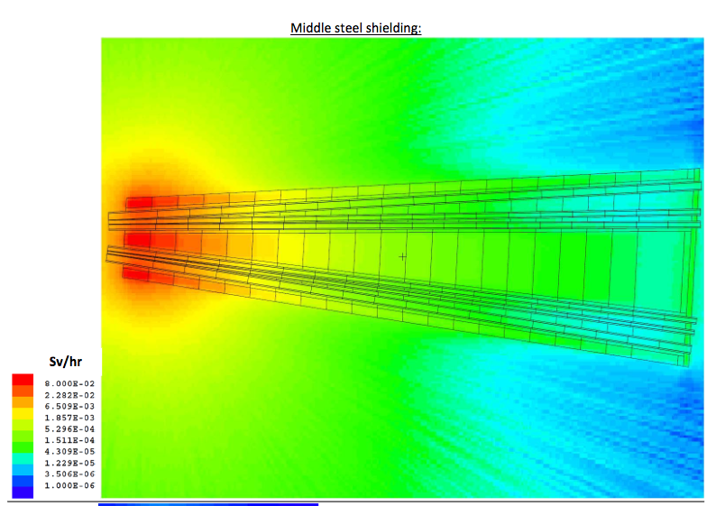
Activation of Steel Components
T_{1/2} = 5.27 a
Distance to source: 1.5 - 2.1 m
decay time: 2000 hours
Max dose rate: 50 – 80 mSv/h

