Slide 1
Neutron beam optics assembly
Preliminary design review
Challenges & Philosophy
I. Sutton
Neutron Instrument Technologies
On behalf of NBOA – (NBEX) engineering team
www.europeanspallationsource.se
15 June, 2017

Slide 2

What is this presentation about
Key technical challenges
Collaborative engineering
Design philosophy
Design approach

Slide 3
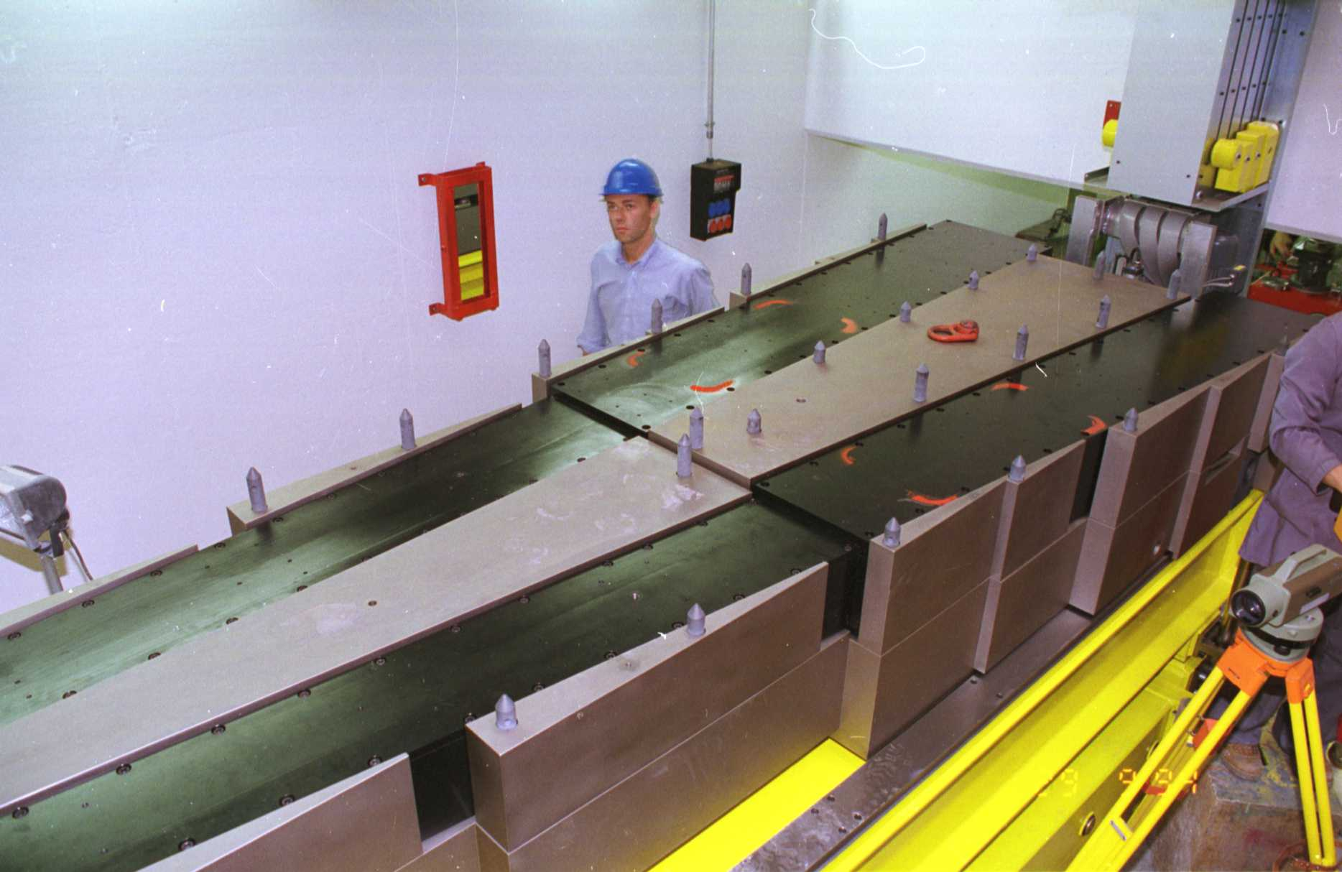
Key technical challenges
Common issues
Long term performance of optics
  Radiation hardness
  Radiation Shielding
Mechanical Integration
Validation/ Certification
Buildability
Alignment
Notes:
A first time at ESS a unique facility
But many issues are not unique to ESS and are faced at all neutron facilities

Slide 4
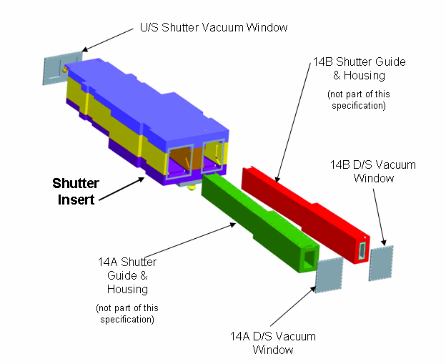










State of the art
Looking for experience from the community
The ESS project community
The DENIM community
Expert panel
Notes:
Protons on target summer 2019 (Q3)
Closure on Monolith vessel End Q2
Installation inserts Q2
Delivery of inserts Q1
Procurements – Supply ~12month
Which implies order placement for in-monolith optics Q2-Q3 2017

Slide 5
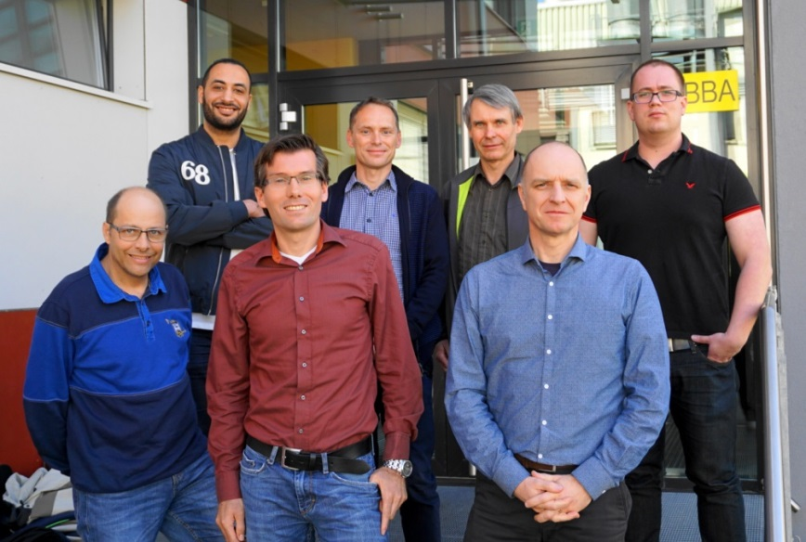

Collaborative effort
Expert panel (and us)
PSI 11 April 2017
Topics
Name | Role | Facility
Dr Phil Bentley | Presenter | ESS
Iain sutton | Presenter | ESS
Erik Nilsson | Participant | ESS
Talal Ossman | Participant | ESS
Dr Uwe Filges | Panel | PSI
Dr Peter Link | Panel Chair | FRM2-TUM
Christian Breunig | Panel | FRM2-TUM
Dr MENELLE Alain | Panel | LLB
Dr Michael Kreuz | Panel | ILL
Dr CALZAVARA Yoann | Panel | ILL
Radiation heating and thermal management strategies.
Long term radiation, thermal and mechanical damage
Operating atmospheres
Sealing and windows
Alignment strategy
Risk mitigation (Contamination, leakage, Failure)
Waste management

Slide 6
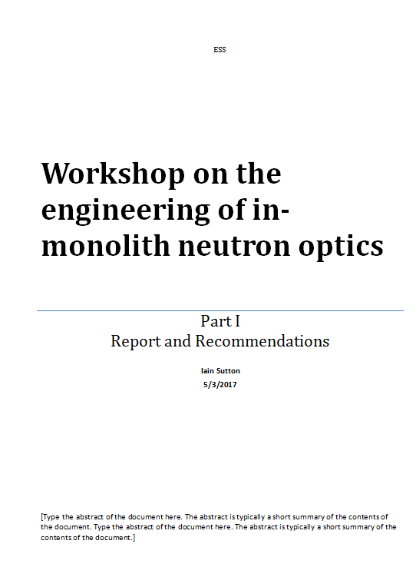
Recommendations &
Decisions
Validation of designs key points
Architecture
Cooling
Atmosphere
Materials
Coatings
Alignment

Slide 7

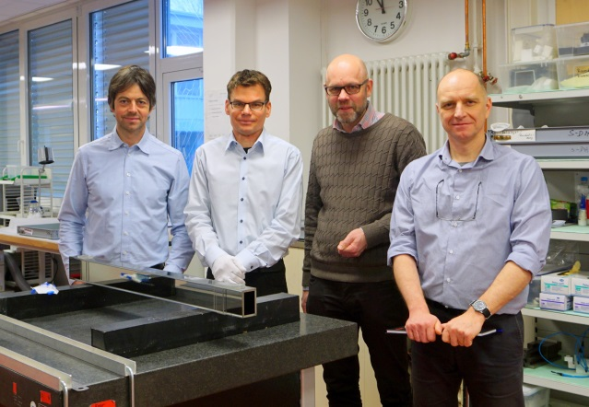

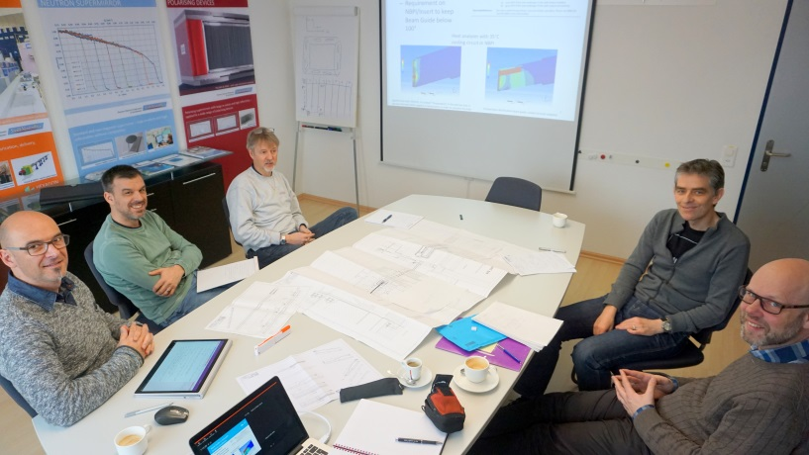

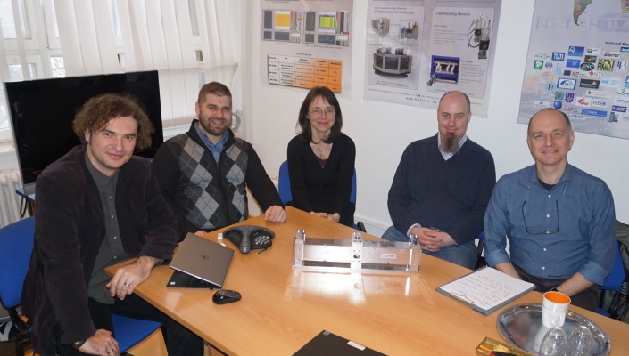
Supplier input
All Major European suppliers consulted
Buildability
Materials
Performance
Cost reduction
Design for manufacture !

Slide 8

Design philosophy
“KISS”
Critical systems shall be;
Robust
Performant
Cost effective
…..in a word simple !

Slide 9
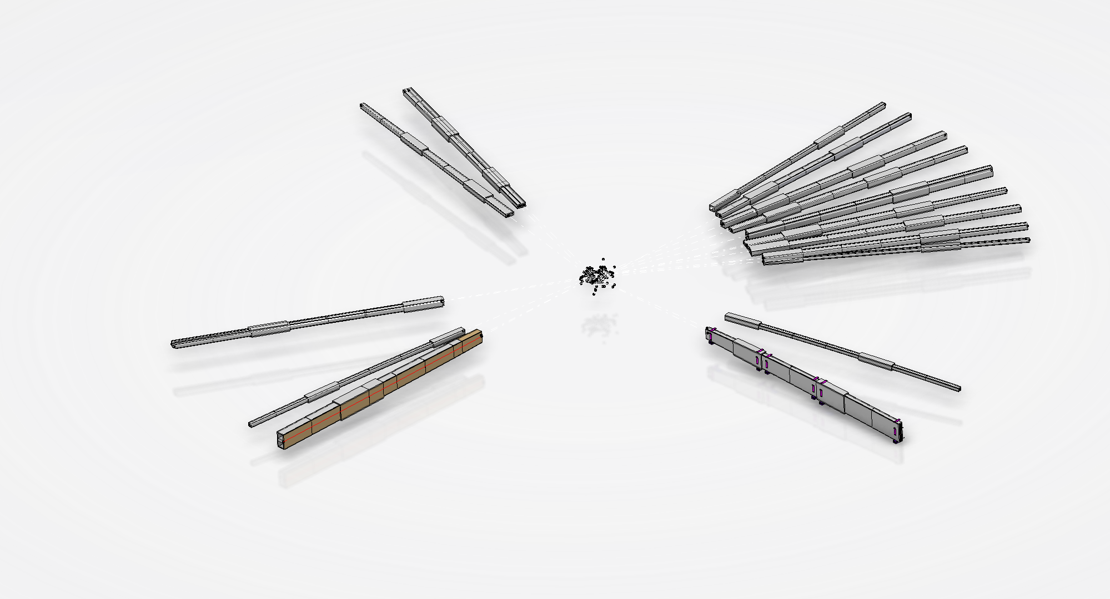
Approach
As challenges are shared by all guides solutions should be also …
Develop high performance, robust, cost effective generic & modular design as the template for all inserts.
Use generic design for integration, validation and certification of whole suite
Develop custom designs for all instruments inserts as the basis for procurement
Commonality mitigates risks and reduces costs

Slide 10

Thanks for joining us
Questions are welcome !
I.Sutton
On behalf of NBOA-(NBEX) team

