Slide 1
Neutron beam optics assembly
Preliminary design review
Project
P.Bentley / I.Sutton
Neutron Instrument Technologies
www.europeanspallationsource.se
15 June, 2017

Slide 2

WHY this Presentation ?
Objectives
Progress
Schedule
Resources
Risks
Hazards
Procurement
The plan for here on …..

Slide 3
Objectives
NBOA ‘FAST TRACK’
FAST TRACK is an in-house name for a suit of targeted activities undertaken NSS engineering integration team with partners in addition to the normal integration and support activities.
These initiatives are reserved for system critical to the ESS or the NSS project as a whole on grounds of performance, safety, schedule, risk or cost.
The objective of these initiatives is to assist partners ensure the quality, performance, integration and timely delivery of the critical systems within their responsibility
Activities may include;
Conceptual design
Integration
Selection and validation of technical solutions
Technical support during procurement
Pre-competitive discussion with potential suppliers
Discussion with authorities

Slide 4
Scope
In scope ;
For the NBOA of first 16 instruments
  Preliminary design
  Integration into ESS systems
  Support of pre-procurement discussion with suppliers
  Definition of delivery dates and batches
  Support of quality control
  Management of on-site NBOA-NBEX integration
Excluded
  Detailed design
  Procurement
  Installation

Slide 5
Deliverables
Preliminary design phase
  Validated preliminary design (model & drawings)
  Template procurement specification
  NBOA Integration & Installation plan
Detailed design phase
  Participation in integration activities
Procurement phase
  Technical support to procurement discussions
  Delivery dates
  Support to QC (on request)
Installation phase
  Management of NBOA integration activities
  ESS participation to SAT
  Technical support to installation

Slide 6
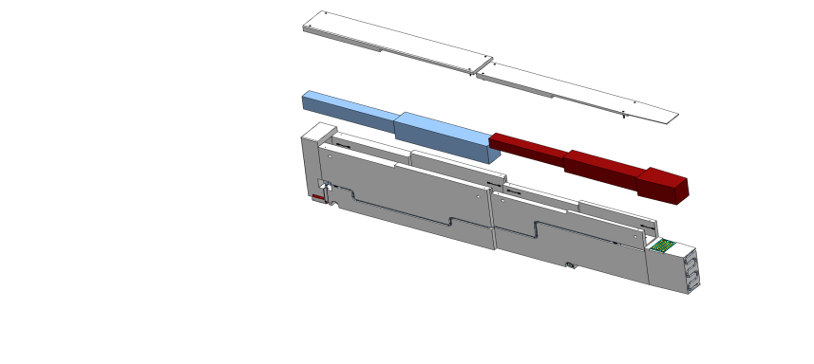


NBOA-NBEX team
NBOA (NSS)
  P.Bentley
  I.Sutton
  E.Nilsson
  T.Ossman
NBEX (TD)
  N. de la Cour
  B. Jonsson
  J.Koning

Slide 7
Structure
IM-Expert WG
DENIM Community
CF
Suppliers
RACE
ESH
Instrument 01
Waste handling
Instrument 01
Instrument 01
NBOA
team
NBEX
team
Instrument 01
Fluids
Instrument 01
Instrument 01
Instrument 01
Instrument 01
Monolith systems
Instrument 01
NOSG
Instrument 01
Instrument 16
Instrument technologies
NSS project management
Notes:
Interactions > stakeholder groups > representatives
NBOA centric Spider diagram

Slide 8
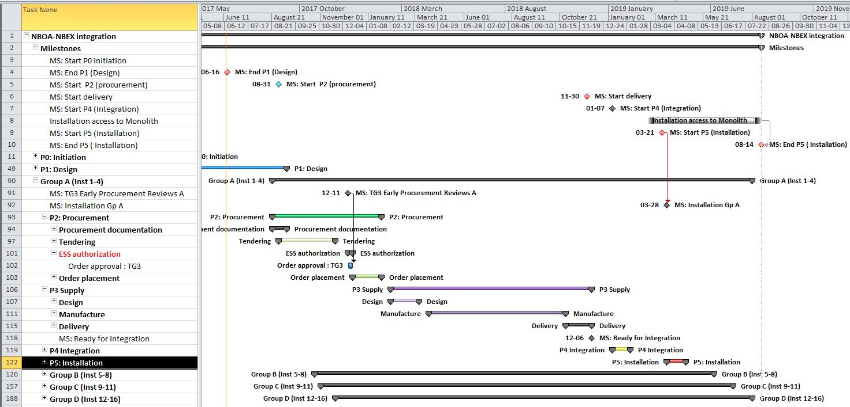
Schedule
Long term (Phases 2-5)
DESIGN
PROCURE
MANUFACTURE
INT
INST

Slide 9
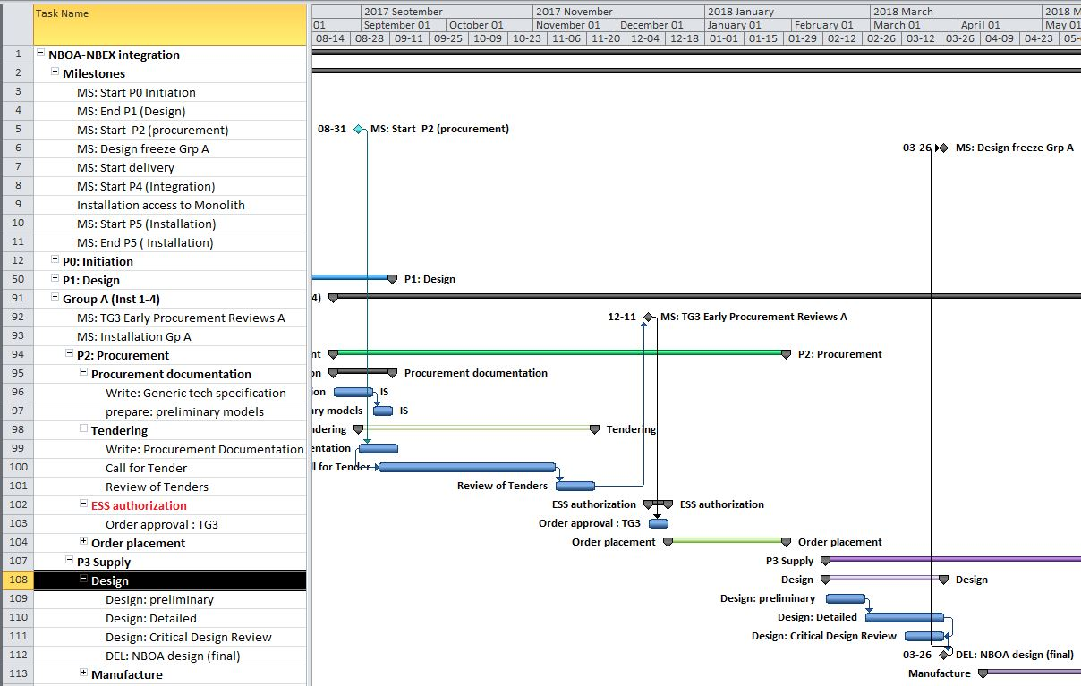
Schedule
Short term Phase 2
Preliminary models
Final

Slide 10
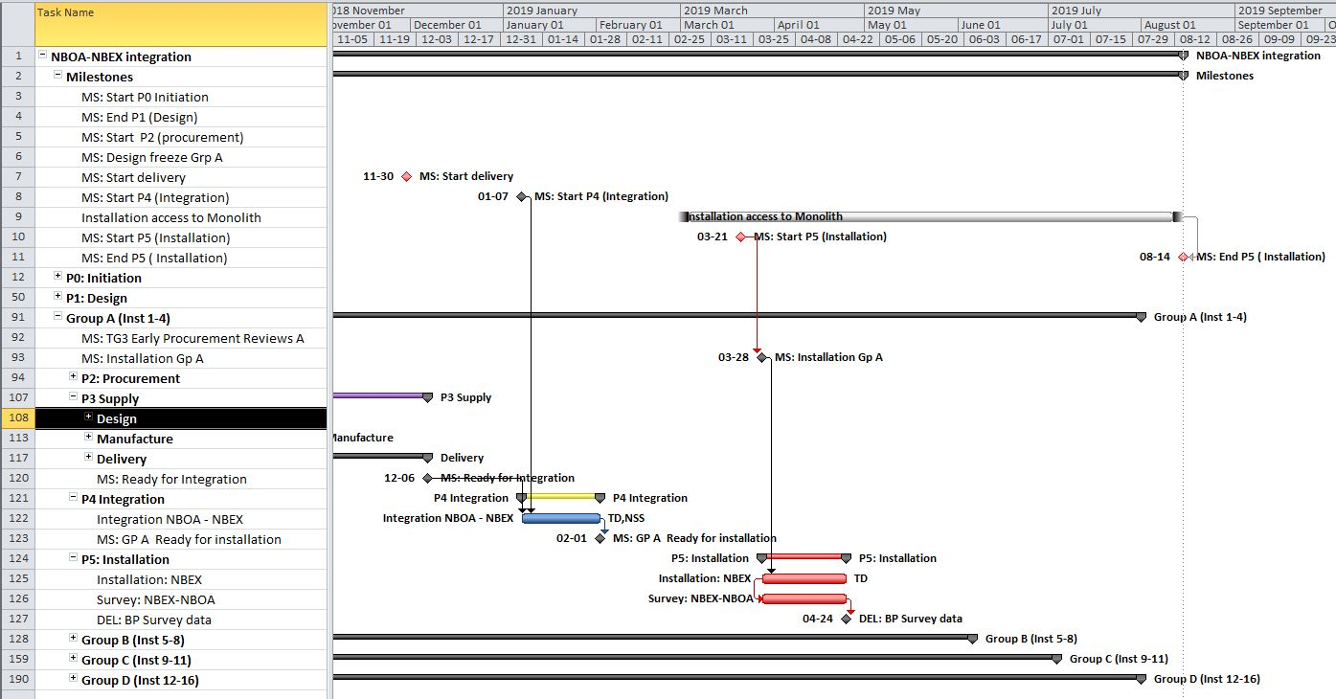
Schedule
Critical
Monolith
construction
Bunker
Bunker
Instruments
Notes:
Why is this nessisary ?

Slide 11
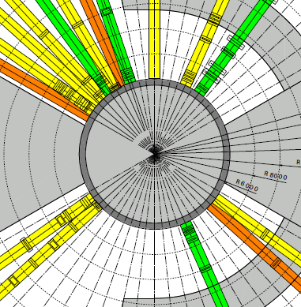
W4 BIFROST
Q2 2019
W6 MAGIC
Q2 2019
W7 TREX
Q2 2019
N7 LOKI
Q2 2019
Hall D01
W3 C-SPEC
Q2 2019
W5 MIRACLES
Q1 2022
W8 HEIMDAL
Q3 2023
N5 FREIA
Q3 2023
W2 BEER
Q2 2019
W11 TEST
Q2 2019
W1 NMX
Q2 2019
D02
Phase 1
Instrument Installation
42 Inserts
  27 inert
  15 active (optics)
Up to 12 instrument front ends
Installation
← ****** Protons
D02
S2 ODIN
Q2 2019
E2 ESTIA
Q2 2019
W2 DREAM
Q2 2019
W3 SKADI
Q2 2019
E7 VESPA
Q2 2022
Hall D03

Slide 12
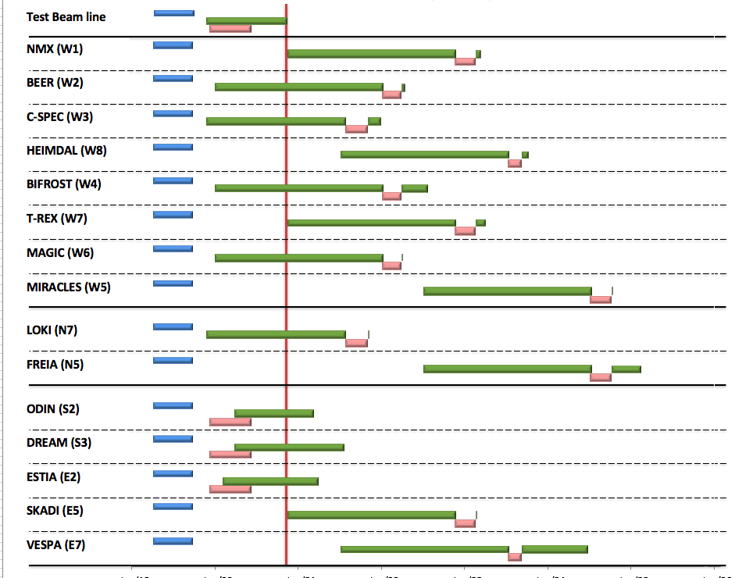

Internal* NBI Installation Schedule (> TG4)
Draft for Discussion (derived from V3.3, 10th June 2017)
* BOT still under discussion with ESS-ERIC Council
Hot Commission
instruments
Start User Program
Beam on Target
NOTES:
Plan aligned with access dates to D & E buildings
Installation & Integration (TG4) + Hot Commissioning (TG5) for first 8 NBIs aligned with draft BOI plan (schedule match typically within 1 month)
Alignment with TG5 for NBI 9-15 not yet complete
On-site Resource plan under development
In monolith complete
In bunker complete
Out of bunker
2019 2020 2021 2022 2023 2024 2025

Slide 13
Phase 3 Procurement
- The ESS Collaboration Framework
ESS Project
In-kind Partner
Industrial Partner
Industrial Liaison Officers
In-kind Review Committee
Funding Agency
ESS ERIC Council

Slide 14

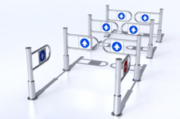
Phase 3
ESS In-kind contributions – In-Kind process
ESS Programme Plan
WPs/WU 1
WPs/WU 2
WPs/WU 3
WPs/WU 4
EOI
response
ESS + Potential party discussion
Contract proposal
IKC frame contract + technical annex
Design, Production
Delivery
(Integration commissioning, acceptance test)
IKRC + Council approval
Transfer of ownership
IKRC recommendation + Council approval
ESS + Partner follow up and review
ESS + Partner final acceptance
IKC value crediting to member country

Slide 15
Phase 3 Procurement
Broader context
In-mono
15 x 3.5
= 52.5m
In-bunker
7 x15 + 8 x30
= 350m
PHASE 0
In-mono
PHASE I
in-bunker
Install window:
Pre mono-closure
(Q2 2019)
Installation window:
Pre Beam on Target (Q3 2019 – Q2 2020)
SOURCE
In-hall
7 x15 + 8 x30
= 1400m
PHASE 2
In-hall
Installation window:
Post hall access (Q3 2019 onwards)
SAMPLE

Slide 16
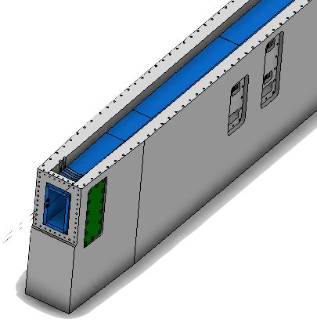
Phase 4
Integration activities
Activity Responsible
Delivery
Inspection
Preparation
Integration
Alignment
Clean up
Close up
P. Test
NSS
NSS
NSS
Spring side
NSS
Solid side
NSS
NSS / TD
TD
TD

Slide 17
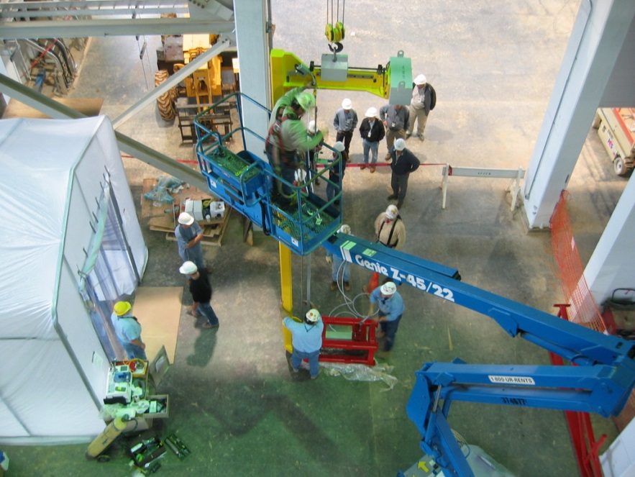
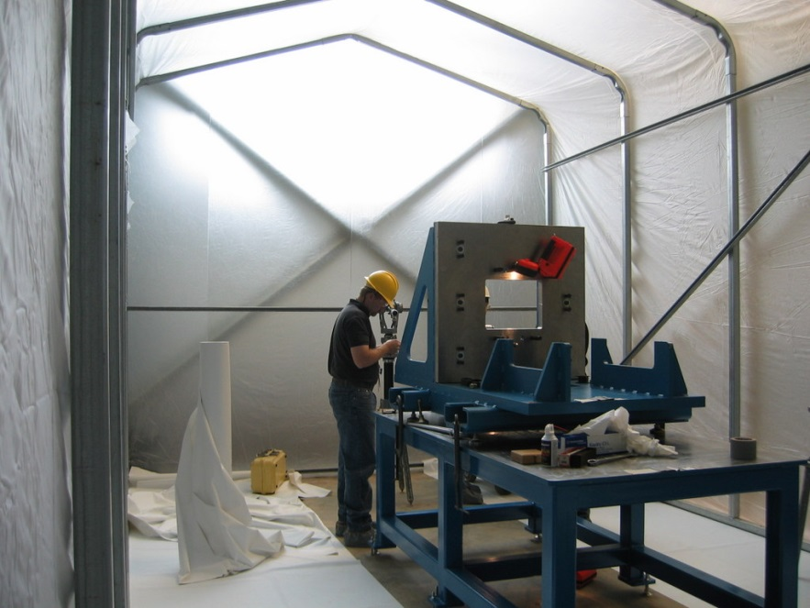
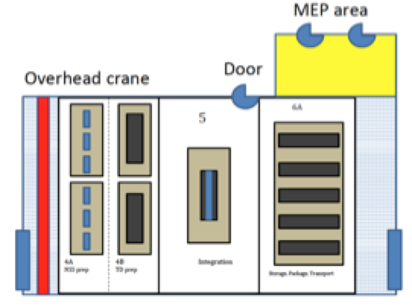
Phase 4 Integration
NBOA-NBEX Integration area
No area for NBOA alignment, and installation in NBPI & NBEX tool when we need it !
Requirements:
Operational Feb 2019 - Oct 2019
Capacity of 16 optical inserts
and 26 “blind-plugs”

Slide 18
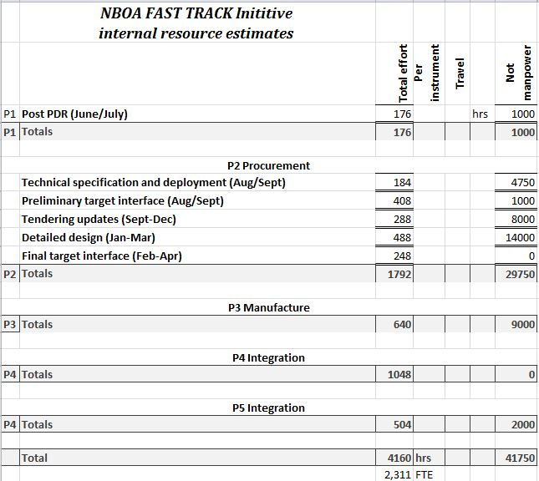
Resources
Resource breakdown
  Admin 20%
  Engineering 20%
  CAD 40%
  Optics QC 20%

Slide 19
Risks
Technical
Installed components do not provide expected performance
Probability :
  Moderate
Consequence:
  An Instrument performance is reduced for many years
  Facility scientific production is reduced ?
Cause:
  Coating failure
  Misalignment (internal)
  Production problem / Poor QC
Mitigation:
  Design robust systems
  Provide re-alignment provisions
  Conduct QC Inspections

Slide 20
Risks
Technical
Installed components do not provide expected performance
Probability :
  Moderate
Consequence:
  An Instrument performance is reduced for many years
  Facility scientific production is reduced ?
Cause:
  Poor neutronic design
  Requirements mis-understood
Mitigation:
  Verify neutronic design
  Verify designs regularly with teams

Slide 21
Risks
Project (1)
Critical components are delivered late (NBOA)
Probability :
  High
Consequence:
  Instrument(s) can not be installed – delay 24month ?
  Facility can not deliver instrument to scientific production 2023
Cause:
  Late procurement
  Late design change
  Insufficient production capacity
  Production problem / Poor QC
Mitigation:
  Manage procurement priorities
  Commence procurement early
  Employ engineering version control
  Ensure good communication with suppliers

Slide 22
Risks
Project (2)
Critical components are delivered late (NBEX)
Probability :
  Unknown
Consequence:
  Instrument(s) can not be installed – delay 24month ?
  Facility can not deliver instrument to scientific production 2023
Cause:
  Late procurement
  Late design change
  Insufficient production capacity
  Production problem / Poor QC
Mitigation:
  Manage procurement priorities
  Commence procurement early
  Employ engineering version control
  Ensure good communication with suppliers

Slide 23
Risks
Project (3)
Procurement process commences late ( for delivery date)
Probability :
  High
Consequence:
  Instrument(s) NBOA can not be installed – delay 24month ?
  Facility can not deliver instrument to scientific production 2023
Cause:
  Instrument team insufficiently prepared (design maturity)
  In-house procurement delays
  In-kind procurement issues
  Cash flow issues
Mitigation:
  Raise awareness
  Accelerate design (FAST TRACK initiative)
  Support instrument teams procurement

Slide 24
Risks
Project (4)
Installation can not be conducted on schedule
Probability :
  High
Consequence:
  NBEX Installation delay 3 – 6 months
  Knock on delays to instrument install
  Facility can not deliver instrument to scientific production 2023
Cause:
  Instrument halls in complete or un accessible
  Target monolith construction incomplete
  NBOA-NBEX Integration area not available
  Installation tool/NBOA/NBEX is late, does not work or insufficient in number
Mitigation:
  Ensure good project communication CF/NSS/TD
  Support technical integration activities NSS/TD
  Develop integrated schedule with instrument
  Ensure schedule robustness with ‘scenario planning’

Slide 25
End of P1
Outstanding issues
Technical
  Preliminary design tidy up
  Freeze interface with NBEX
  Prepare procurement documentation
Project
  Allocation of resources for P2 – P5
  Hand over to new project leader / team

Slide 26
INSTRUMENT INSTALLATION COMMENCING IN …
13-1-2017
0
4
7
WEEKS

Slide 27



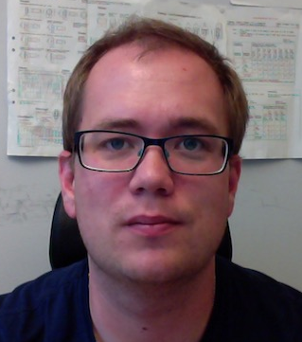



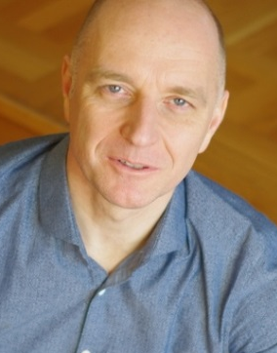
Thanks for joining us
Questions are welcome !
NBOA – NBEX Team

Slide 28
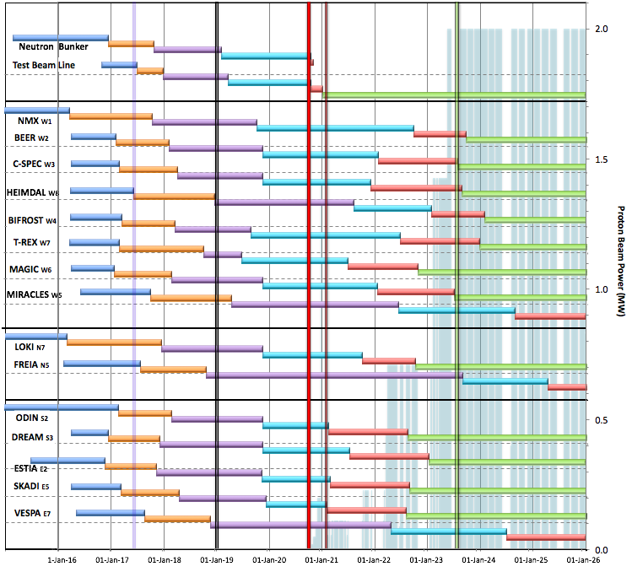
Internal* Neutron Beam Instrument Schedule
Draft for Discussion V3.3, 10th June 2017
Current date
First access to NSS areas
Hot Commission
instruments
Start User Program
* still under discussion with ESS-ERIC Council
Beam on Target
NOTES:
Assumes 2MW maximum power until end 2025
Phases aligned with TG2 reviews on 1st 9 NBIs
Installation & Integration (TG4) + Hot Commissioning (TG5) for first 8 NBIs aligned with draft BOT plan (schedule match typically within 1 month)
West sector
North sector
East and South sectors
Preliminary Design
Detailed Design
Manufacturing & Procurement
Installation & Integration
Hot Commissioning/Early science
Operation
2016 2017 2018 2019 2020 2021 2022 2023 2024 2025
Installation for most instruments begins in Q2/2019 with in-monolith optics
Access to other “instrument construction areas” will be later

Slide 29
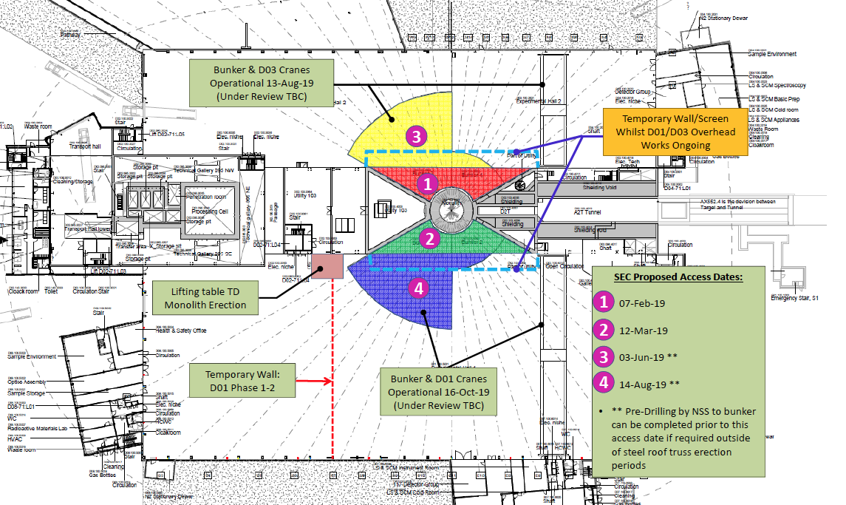
Phase 4
Integration – Installation

Slide 30
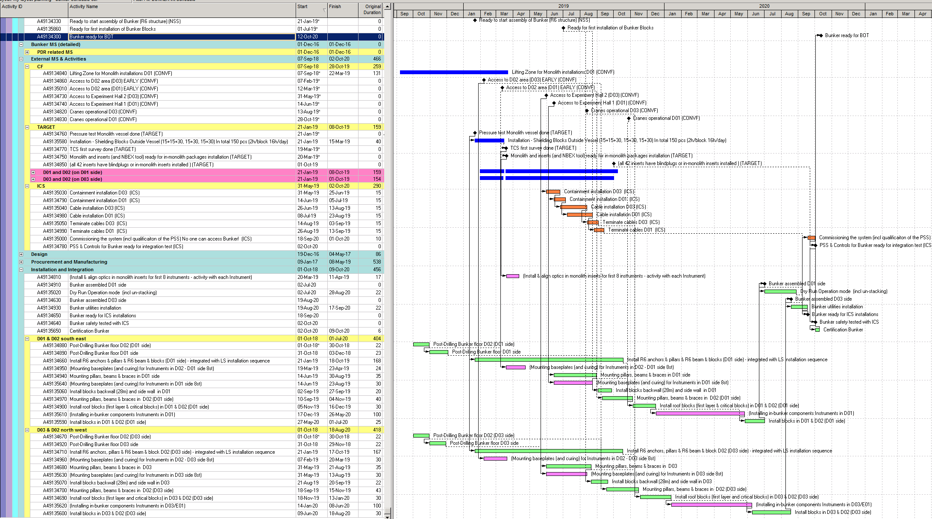
Schedule
Phase 3 (Installation)
CLOSURE OF Monolith
monolith
DELIVER
INTEGRATE
INSTALL
SECTOR 1
SECTOR 2
Bunker
SECTOR 3
SECTOR 4
Bunker
Bunker
Bunker
Instruments
Notes:
Why is this nessisary ?

Slide 31

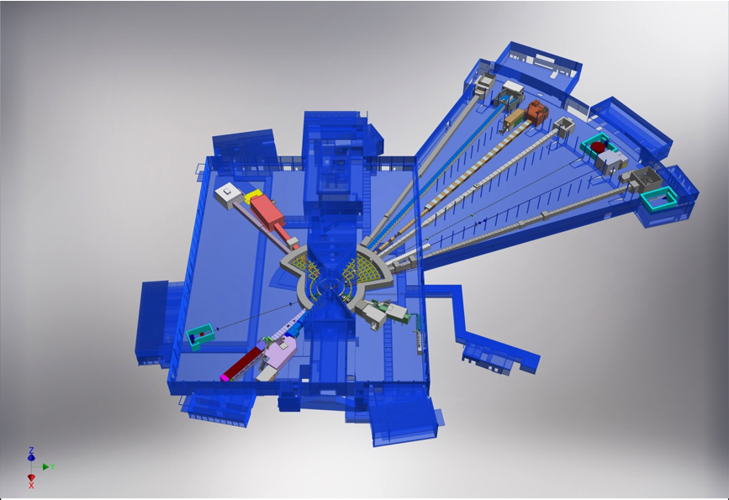











NSS Neutron Instrument
ESS Lead Partners for instrument construction
+
Nuclear Physics Institute
15 Approved Instruments
E01 (Long Hall) 8 Instruments
D01 (Short hall) 2 Instruments
D03 (Short hall) 5 instruments
NMX
BEER
+
C-SPEC
BIFROST
MIRACLES
MAGIC
ODIN
T-REX
DREAM
HEIMDAL
LoKI
VESPA
FREIA
SKADI
ESTIA
+
ESS In-Kind Partners also collaborate on technology development, sample environment, data management systems etc.
ESS Instrument Layout (December 2016)

Slide 32
STRATEGY (Q2 2019-Q2 2020)
Draft priorities
Full install in-monolith components of ‘group A B C’
Install in-monolith components of ‘group D’
Full install in-bunker ‘A + B’ instrument components
Install in-bunker ‘C’ instruments components
R2 R5.5 R6.0 R11.5 (24.5) R15 (28)
IN-MONOLITH (NBOA)
IN-BUNKER OPTICS (IBO)
BUNKER WALL OPTICS (BWO)

Slide 33
Instrument installation phases
‘inside out’ and ‘outside in’
Phase 3
In-Cave
NMX
BEER
C-SPEC
BIFROST
MIRACLES
MAGIC
ODIN
T-REX
DREAM
HEIMDAL
Phase 2
In-Hall
LoKI
VESPA
FREIA
Phase 1
In-Bunker
SKADI
ESTIA
Phase 0
In-monolith
ESS Instrument Layout (December 2016)

