Slide 1
Neutron beam optics assembly
Engineering implementation
E.Nilsson
Neutron Instrument Technologies
On behalf of NBOA – (NBEX) engineering team
www.europeanspallationsource.se
14 June, 2017

Slide 2
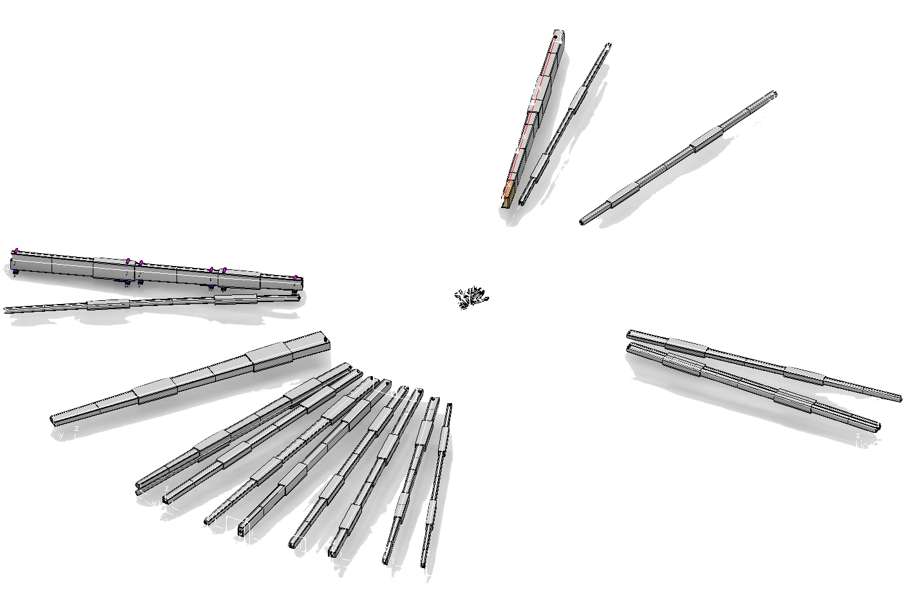
NBOA Generic
One for all … all for one !
Objective
Develop high performance, robust, cost effective design as the template for all inserts.
Conduct its integration, validation and certification
From the template develop custom designs for all instruments inserts as the basis for procurement

Slide 3

Design philosophy
“True performance can only be judged over the long term ….”
Critical systems shall be;
Robust
Performant
Cost effective
…..in a word simple !

Slide 4
Diversity
NBOA
Tall
Wide
Small
Unique
HEIMDAL
No-optics
MAGIC
Intermediate
BEER
BIFROST
C-SPEC
DREAM
ESTIA
FREIA
LOKI
SKADI
MIRACLES
NMX
ODIN
T-REX
VESPA
Tall = Height >2x width
Wide = Width >2x height
Small = Smaller than 30x30
Intermediate = Other geometries

Slide 5
Diversity
NBOA
Bi-spectral
Bender
Elliptical
Multiple
DREAM
HEIMDAL
MAGIC
ODIN
LOKI
SKADI
BEER
BIFROST
DREAM
ESTIA
FRIEA
HEIMDAL
ODIN
T-REX
FREIA
HEIMDAL

Slide 6
Beam Profiles
Instrument | IN (H*W) | OUT (H*W)
BEER | 35x85 | 60x30
BIFROST | 34,6x68,7 | 48,8x51
C-SPEC | 55x70 | 55x70
DREAM | 23,9x44/23,9x32,3 | 37,6x29,5
ESTIA | 134x67 | 191,9x96
FREIA | 120x40 | 242x40
HEIMDAL- THERMAL
HEIMDAL- COLD | 20x20 | 20x20
LOKI | 25x30 | 25x30
MAGIC | 30x124 | 30x42
MIRACLES | 49x60,5 | 71x46,6
NMX | 28x30 | 45x30
ODIN | 33x43,8 | 52,6x37
SKADI | 30x30 | 30x30
T-REX | 30x90 | 44,4x63,8
VESPA | 35x35 | 40x40

Slide 7
TALL
Issues
Parameters
Height up to 250mm tall (+substrate)
Weight up to 200kg
Specific challenges related to this group
NBPI Integration,
  Vertical space (clashes)
  Complex shapes
Alignment
  Vertical axis
  Highest weight on alignment features
Largest sets of windows
Highest heat load on optics
Outstanding issues
Increased vertical view of moderator ?
NBOA
Tall
ESTIA
FREIA

Slide 8
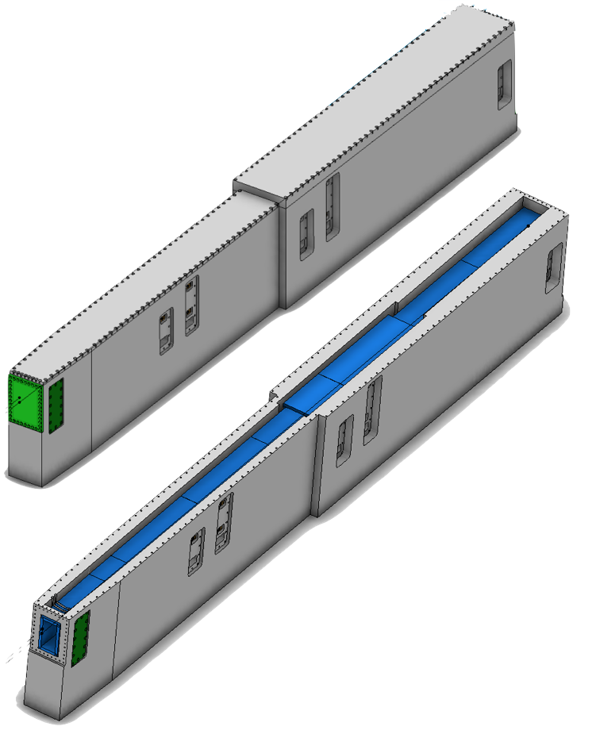
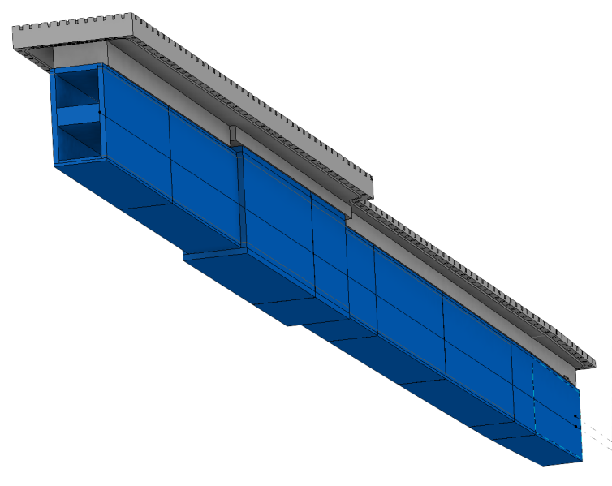
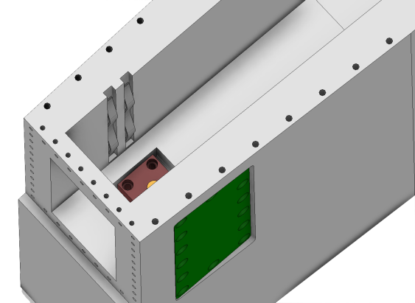
TALL
Solutions
NBPI Integration
  Several complex geometries, such as true elliptical curves, to be machined in NBPI.
  Space required for Window frame and lid reduced to accommodate guides
Alignment
  Heavy section drives design of features, both side and vertical alignment
  Compensated by double springs
Straight elliptical guide
Integration of alignment features

Slide 9
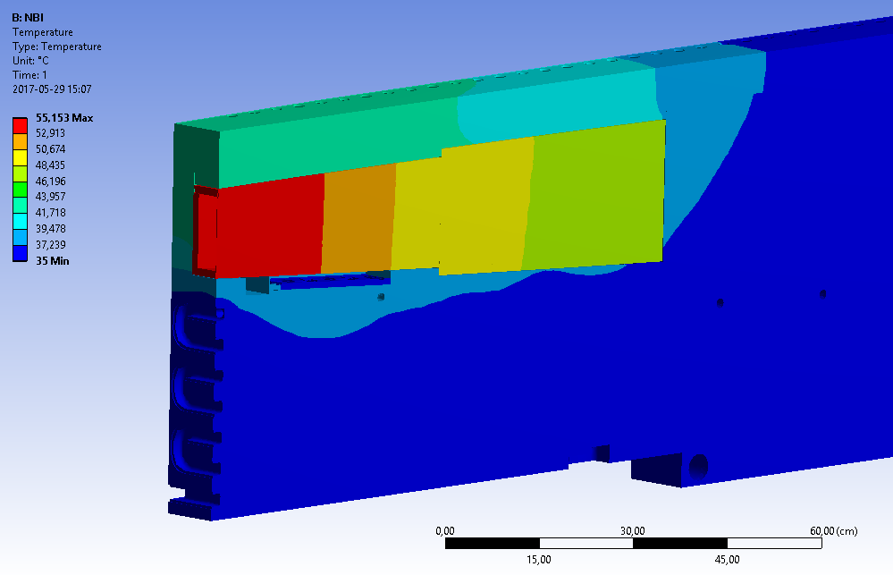
TALL
Solutions
Windows and seals
  Largest set of windows (250x150mm).
  Size of gasket driven by largest size.
Heat load
  Standard solution sufficient.
  Calculated based on Tall use case
Heat map on FREIA NBOA

Slide 10
FREIA
Multichannel bender (R130m)
Elliptical top and bottom section
M=1-4.4

Slide 11
ESTIA
Initial 300mm collimator section
Elliptical right, tope and bottom sides
Uncoated left side
M=4

Slide 12
WIDE
Issues
Parameters
Width up to 100mm wide (+substrate)
Specific challenges related to this group
NBPI Integration,
  Horizontal space (clashes)
  Complex shapes (ellipses, transforming, etc.)
Alignment, width in NBPI for side alignment
Outstanding issues
Increased vertical view of moderator?
NBOA
WIDE
BEER
DREAM
T-REX

Slide 13
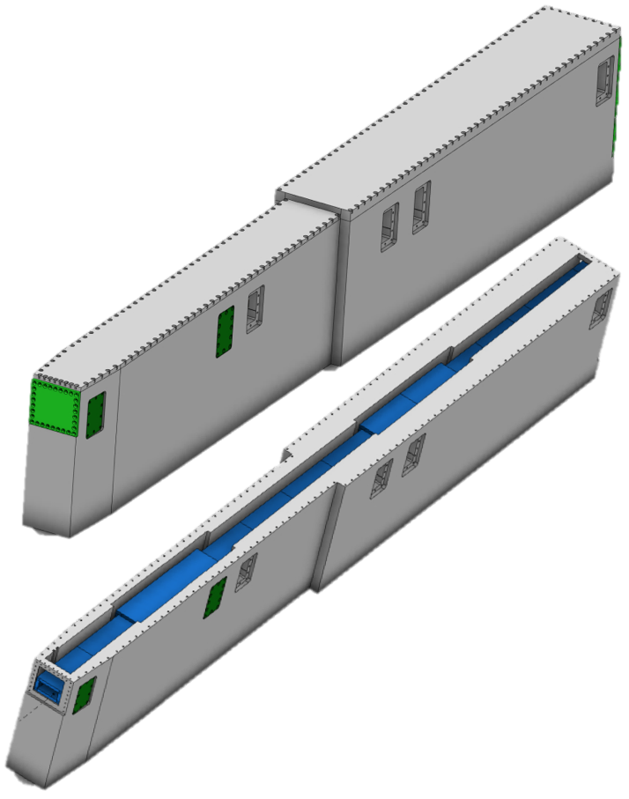
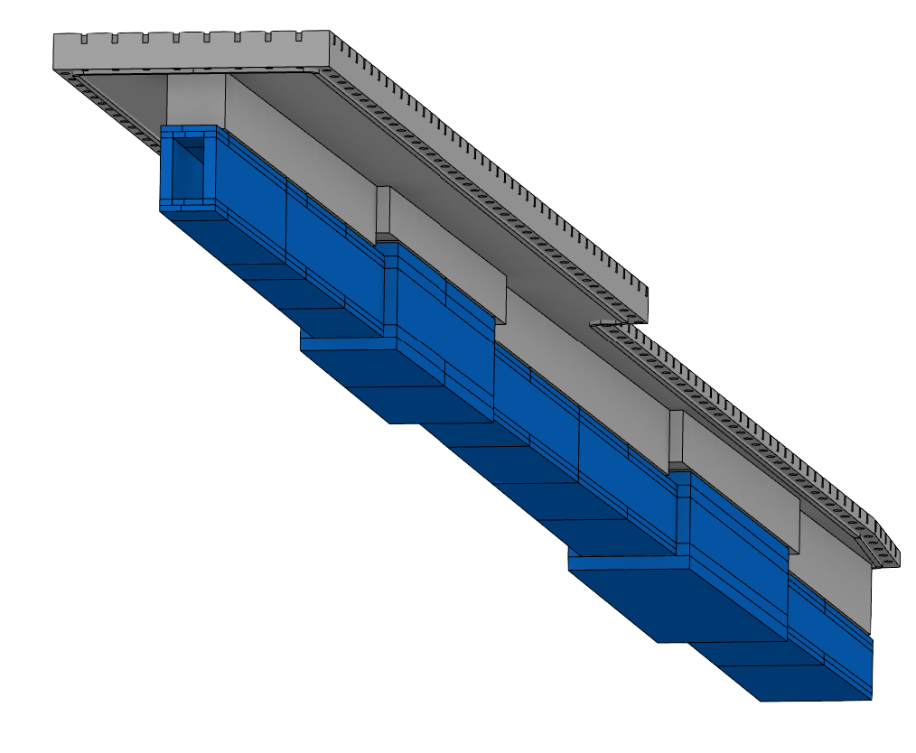
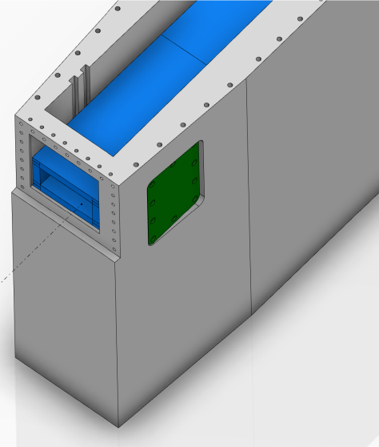
WIDE
Solutions
NBPI Integration
  Moved jacket section to second location to reduce clashes.
  Several complex geometries, such as true elliptical curves, to be machined in NBPI.
Alignment
  Alignment features can be placed on either side of NBOA.
  Wave spring solution reduces required space.
Straight elliptical guide
Window position

Slide 14
BEER
Bispectral
Tapered left and right
Elliptical top and bottom
M=2.5-4

Slide 15
DREAM
Bispectral
Double guide section
Tapered left and right
Elliptical top and bottom
M=2.5-4

Slide 16
T-REX
Tapered left and right
Elliptical top and bottom
M=1.5-5

Slide 17
SMALL
Issues
Parameters
Height up to 30mm tall (+substrate)
Specific challenges related to this group
NBPI Integration,
  Deep and narrow cuts
Alignment
  Limited space for alignment features
Outstanding issues
Increased vertical view of moderator?
NBOA
SMALL
LOKI
NMX
SKADI

Slide 18
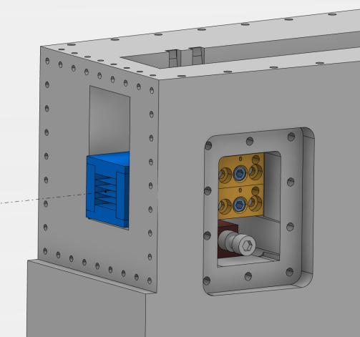
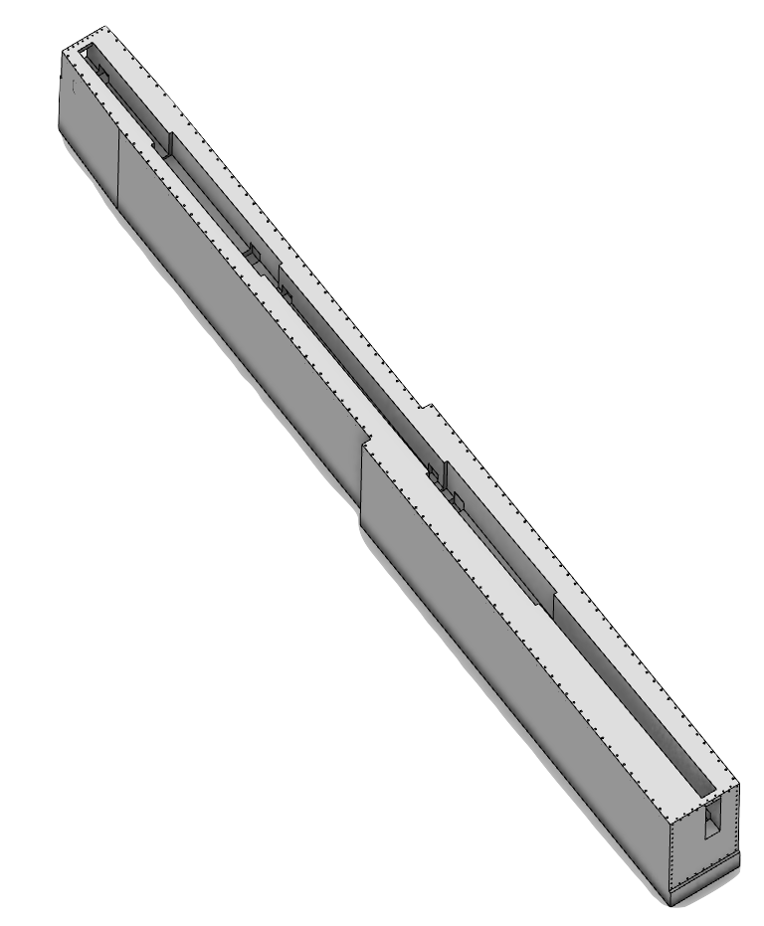
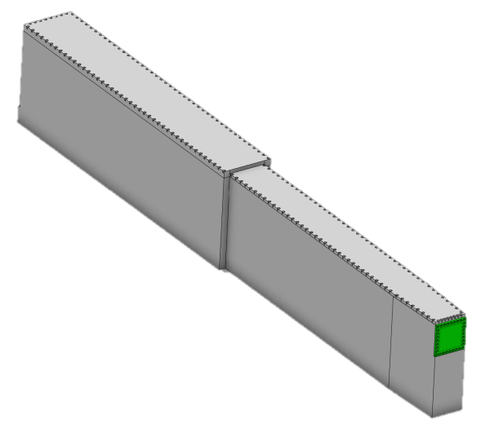
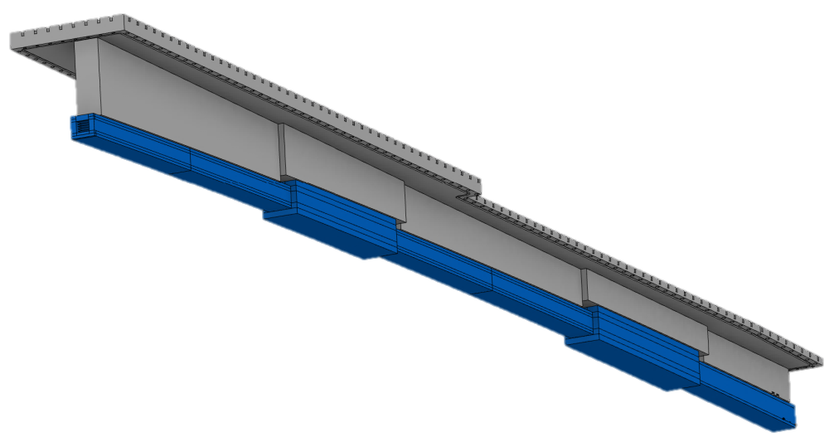
SMALL
Solutions
NBPI Integration
  Deep cuts and ridge on NBPI due to vertical benders, solved in detail design of NBPI.
Alignment
  Optimized size alignment features.
  Potentially reduced dimension of alignment features.
Integration of alignment features
Vertical bend
Deep pocket

Slide 19
LOKI
Multichannel bender (R61,25m)
Constant cross-section
M=3

Slide 20
NMX
Constant cross-section
M=2

Slide 21
SKADI
Multichannel bender (R84m)
Constant cross-section
M=3

Slide 22
INTERMEDIATE
Issues
Parameters
Height up to 70mm tall (+substrate)
Width up to 70mm wide (+substrate)
Specific challenges related to this group
NBPI Integration,
  Complex shapes
Outstanding issues
Increased vertical view of moderator?
NBOA
INTERMEDIATE
BIFROST
C-SPEC
MIRACLES
ODIN
VESPA

Slide 23
INTERMEDIATE
Solutions
Issues covered by the other variants

Slide 24
BIFROST
All sides elliptical
M=2,5-3.5

Slide 25
C-SPEC
Constant cross-section
M=3-4

Slide 26
MIRACLES
All sides tapered
M=4

Slide 27
ODIN
Bispectral with blades
Initial 300mm open on right side
All sides elliptical
M=2,5-5

Slide 28
VESPA
All sides tapered
M=6

Slide 29
UNCOATED
Issues
Parameters
Width up to 125mm wide (+substrate)
Specific challenges related to this group
No optical requirements
  More available space for geometry
Excluded from NBOA preliminary design
Outstanding issues
Need a conceptual design of NBEX without substrates -i.e. an empty cavity!
  Applicable for test beamline as well
NBOA
UNCOATED
MAGIC

Slide 30
MAGIC
Bispectral
Tapered left and right
Constant height
No coated mirrors

Slide 31
UNIQUE
Parameters
Width up to 125mm wide (+substrate)
Specific challenges related to this group
Dual guide
Specific integration and support requirements
Alignment issues
Excluded from NBOA preliminary design
Outstanding issues
NBOA standard preliminary design not suitable for HEIMDAL
Individual integration solution for HEIMDAL needed
NBOA
UNIQUE
HEIMDAL

Slide 32
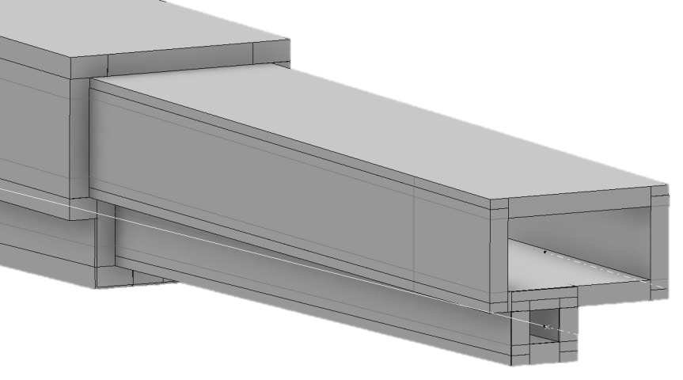
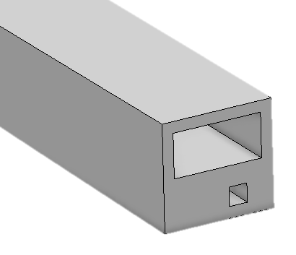
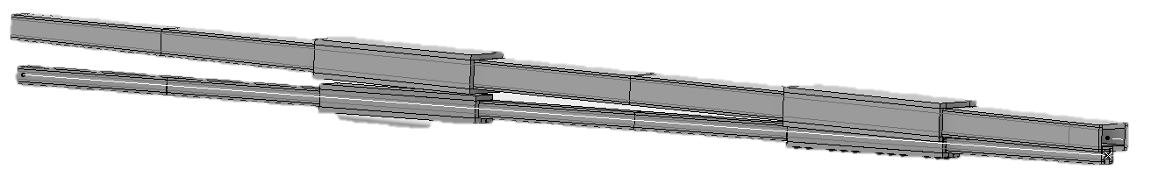
Dual
Solutions
Complex integration
Potential jacket solution

Slide 33
Outstanding issues
Clash checks and coating updates
NMX – No comments on clash issues
SKADI – No comments on clash issues
ODIN – No comments on clash or coating issues
VESPA – Unresolved coating issue
T-REX – Unresolved coating issue
Geometry updates
C-SPEC requested NBOA geometry update (changed radius)
FREIA geometry issues (Solved week 25)
Engineering issues
Conceptual design for MAGIC NBOA
Conceptual design for Heimdal NOBA

