Slide 1


CDR: BEAM CURRENT MONITORS
12-13 July 2017, Bilbao
S. Varnasseri
On behalf of BCM team

Slide 2
OUTLINE:
Location of toroids
Interfaces
Toroid’s functions
ACCT1
ACCT1 installation
Radiation aspects
Combo ACCT2/FCT
Magnetic shielding effectiveness
Combo structure
Installation and integration
Electrical specifications
Verifications and measurements (I)
Verifications and measurements (II)
Delivery by ESS Bilbao
Provisional delivery calendar
CDR: BCM

Slide 3
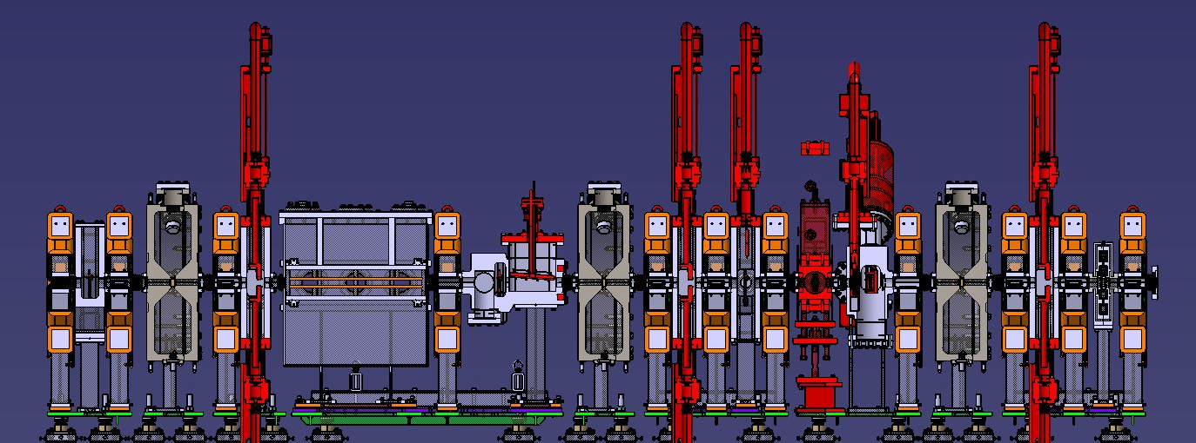
LOCATION OF TOROIDS
ACCT1
ACCT2/FCT

Slide 4
INTERFACES
Flanges tolerances from adjacent devices
Magnetic Shielding design
External fields from quadrupoles
Combo ACCT2/FCT
Integration within beam line (Vacuum)
Cable length to electronics
Electrical specifications
Electrical specifications
Beam dump vessel design
Cable length to electronics
ACCT1
EPDM gasket (Vacuum)
External fields from quadrupoles
Radiation aspects
CDR: BCM

Slide 5
TOROIDS FUNCTIONS:
  ACCT1, ACCT2: MEBT beam current, macropulse
  FCT: Chopper rise/fall time, Beam fast timing characteristics
Main measurement requirements of toroids
ACCT bandwidth (3 dB) | ≥1 MHz
ACCT lower cut-off (3 dB) | 3 Hz
Beam current (nominal) | 80 mA
Electronics full scale range | ±10 V
FCT bandwidth | >352 MHz
FCT readout rise/fall time | <10 ns
CDR: BCM

Slide 6
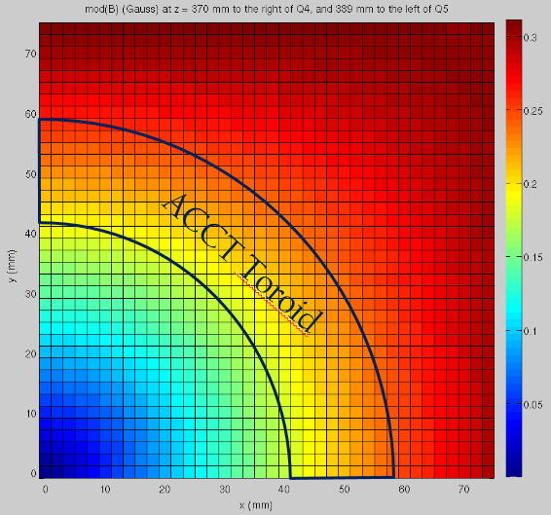
ACCT1
External magnetic field sources for ACCT1
Quadrupoles field data
Q4 Gradient | 5 T/m | +20%
Q5 Gradient | 6.5 T/m | +20%
ACCT1 distance from Q4 | 373 mm
ACCT1 distance from Q5 | 339 mm
The external magnetic fields generated by quadrupoles are far lower than ACCT1 toroid limit.
Radial: 2 mT max
Transverse : 10 mT max
CDR: BCM

Slide 7

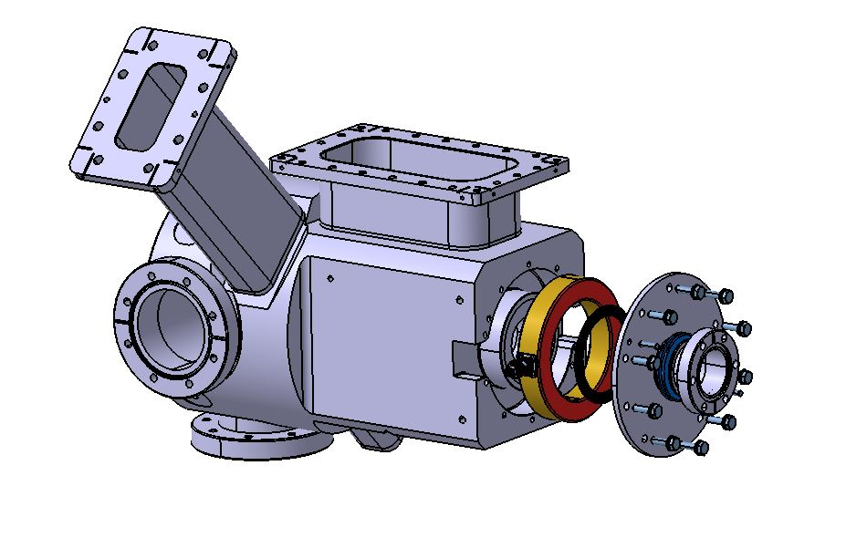
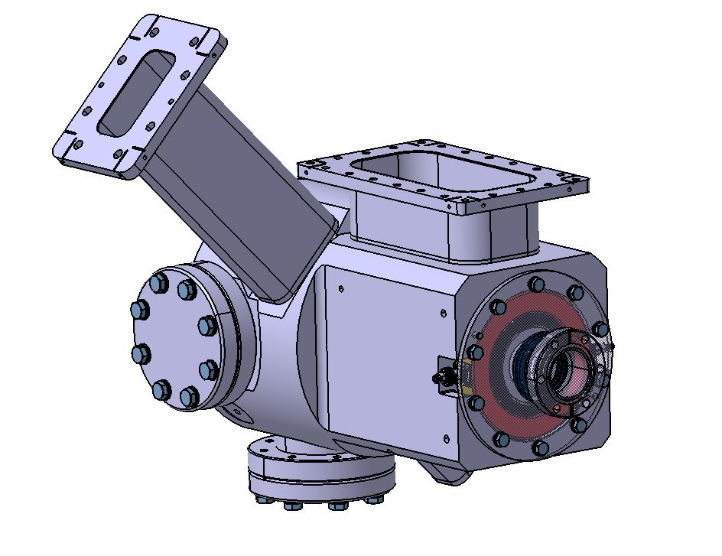
ACCT1 Location
Calibration
Signal
CDR: BCM

Slide 8
RADIATION ASPECTS
Since the ACCT1 is located just after beam dump, the radiation aspects of the toroid has been investigated. The expected radiation dose calculation in the document ESS-0087737 )
ACCT Component | Material | Radiation Resistance (Gy)
Wiring Insulation | PVC | 2x10⁵ | Ok
 | Fiber Glass | >10⁸ | Ok
 | +Rubber Adhesive | >10⁶ | Ok
Stress Absorbent | Silicon Rubber Tape SIR | 5x10⁵ | Ok
 | Silicon Rubber SIR | 2x10⁵ | Ok
BNO | ETFE Tefzel | 10⁶ | Ok
SMA (Rad-Hard) | PEEK | 6x10⁷ | Ok
SMA | PTFE | 10³ | Not used
CDR: BCM

Slide 9
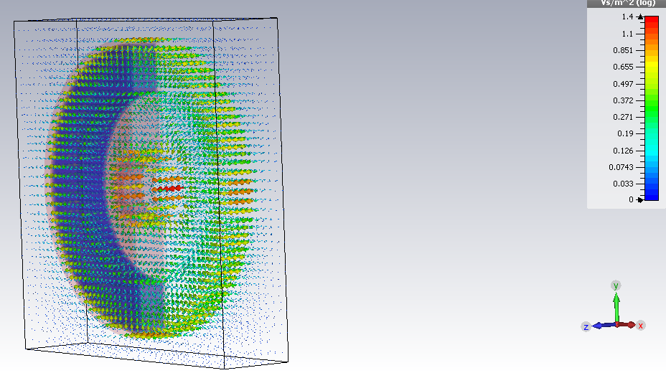
Combo ACCT/FCT
External field data
Q10 (negative or Vertical) | -31.5 T/m | 220 A (nominal) | 300 A
Q11 (positive or Horizontal) | 24.02 T/m | 168 A (nominal) | 300 A
Distance Combo-Q10 (center to center) | 100 mm
Distance Combo-Q11 (center to center) | 100mm

Slide 10
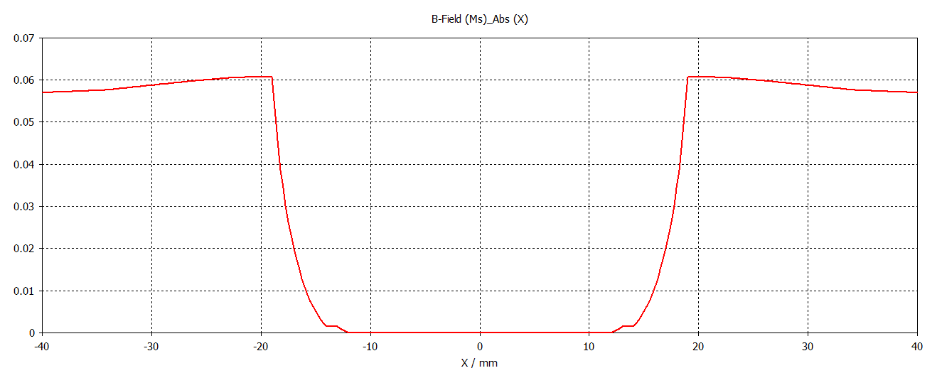
MAGNETIC SHIELDING EFFECTIVENESS
Magnetic field outside and after attenuation in the toroids region
Magnetic field (T)
S-Iron
Mu-Metal
Toroids
Toroids
CDR: BCM

Slide 11

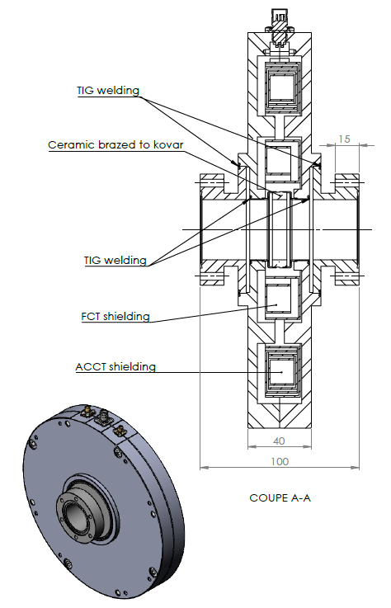
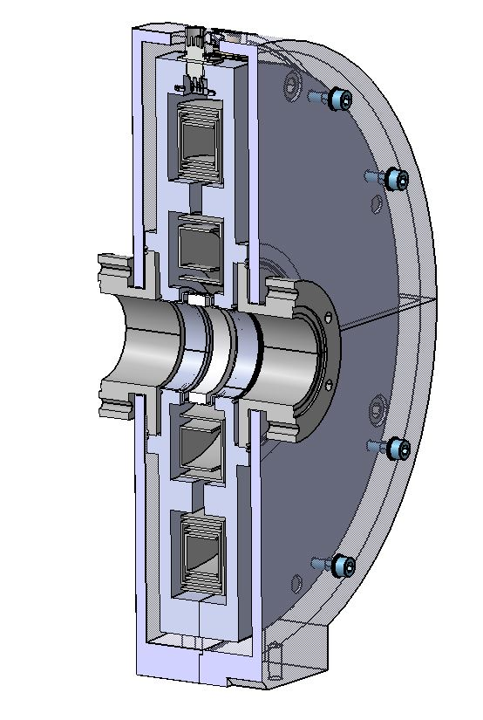
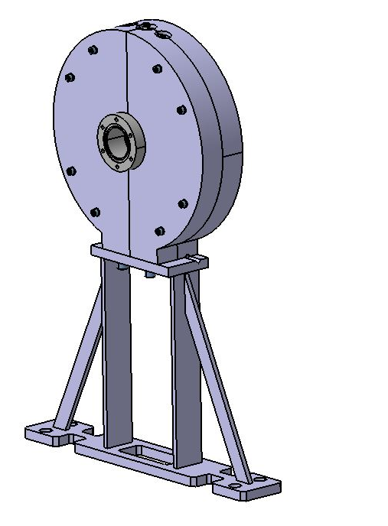
COMBO STRUCTURE
Pre-CDR comment
CDR: BCM

Slide 12
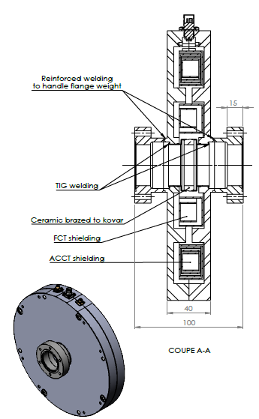
SOLUTION TO THE COMMENT RID#1:
The gap has been removed. And a reinforced welding is done to to ensure that the flange weight can be handled once the assembly will be mounted in the beam line.
CDR: BCM

Slide 13
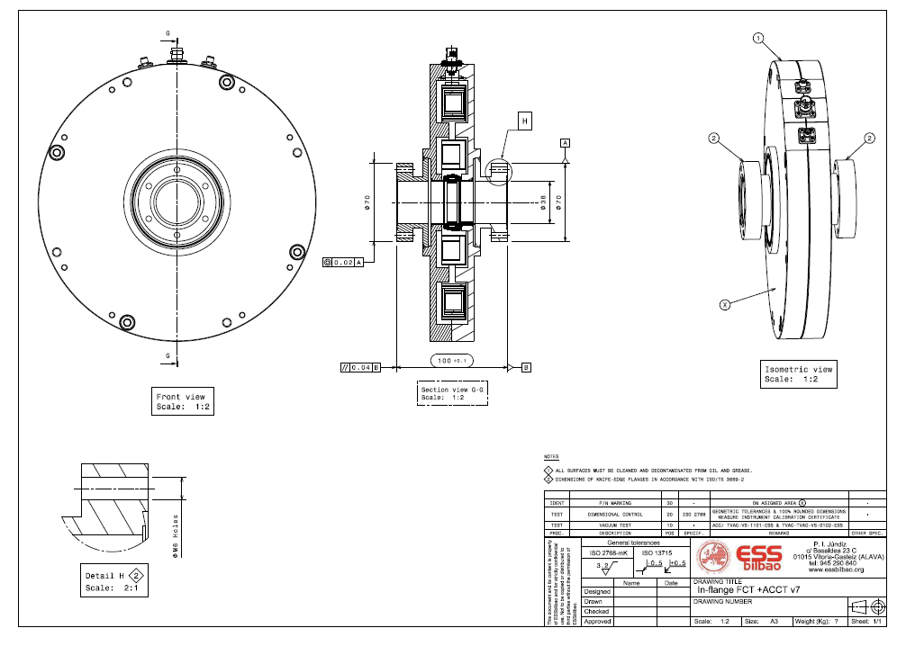
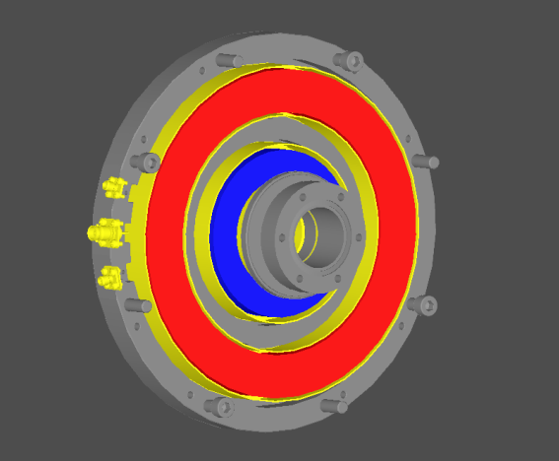
CDR: BCM

Slide 14
ELECTRICAL SPECIFICATIONS
Full scale range | ±80 mA (±10V)
Lower cutoff frequency (-3dB) | 3Hz
Droop | < 2%/ms
Upper cutoff frequency (-3dB) | 1 MHz
Rise time | 350 ns
ACCT1/ACCT2
Sensitivity | 2.5 V/A
Turns ratio | 10:1
Rise time | 585 ps
Droop | < 10 %/us
Upper cutoff frequency (-3dB) | 600 MHz
Max. charge/pulse (pulses <1ns) | 0.2
Combo (FCT)
CDR: BCM

Slide 15
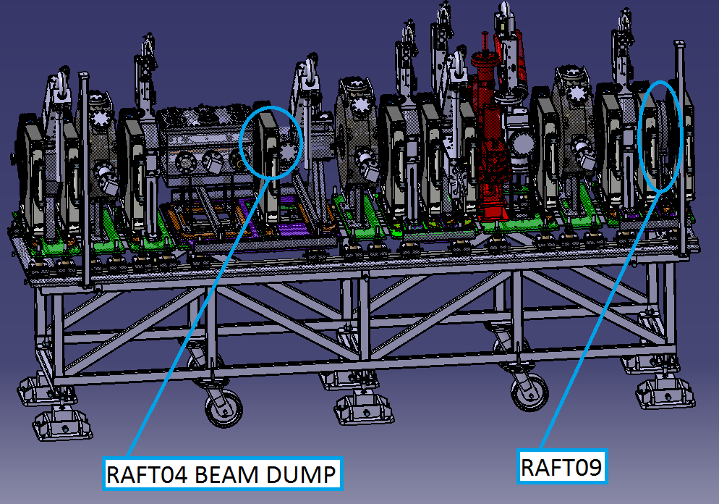
INSTALLATION AND INTEGRATION: BCT LOCATIONS ON RAFTS
CDR: BCM

Slide 16
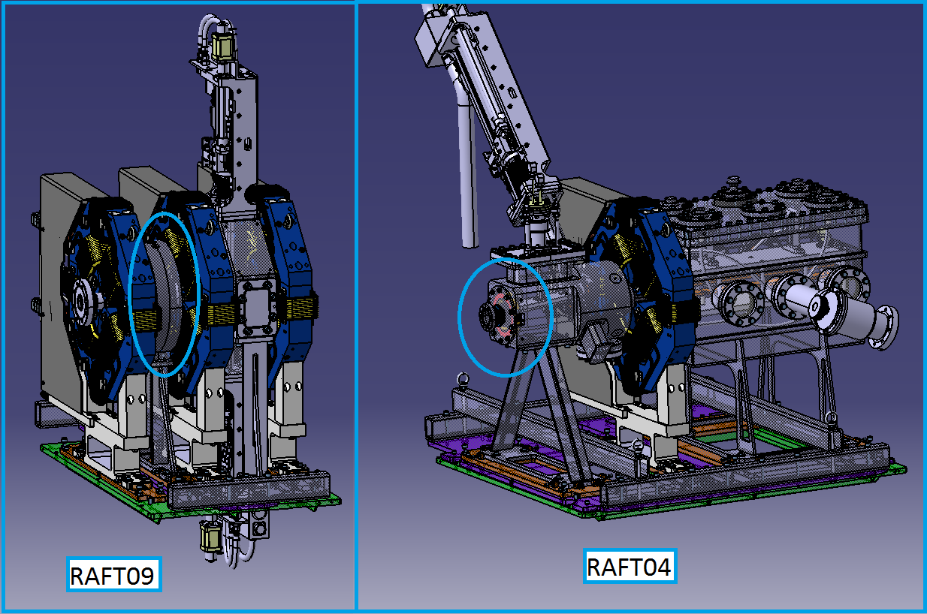
RAFT09 AND RAFT04 INTEGRATION

Slide 17
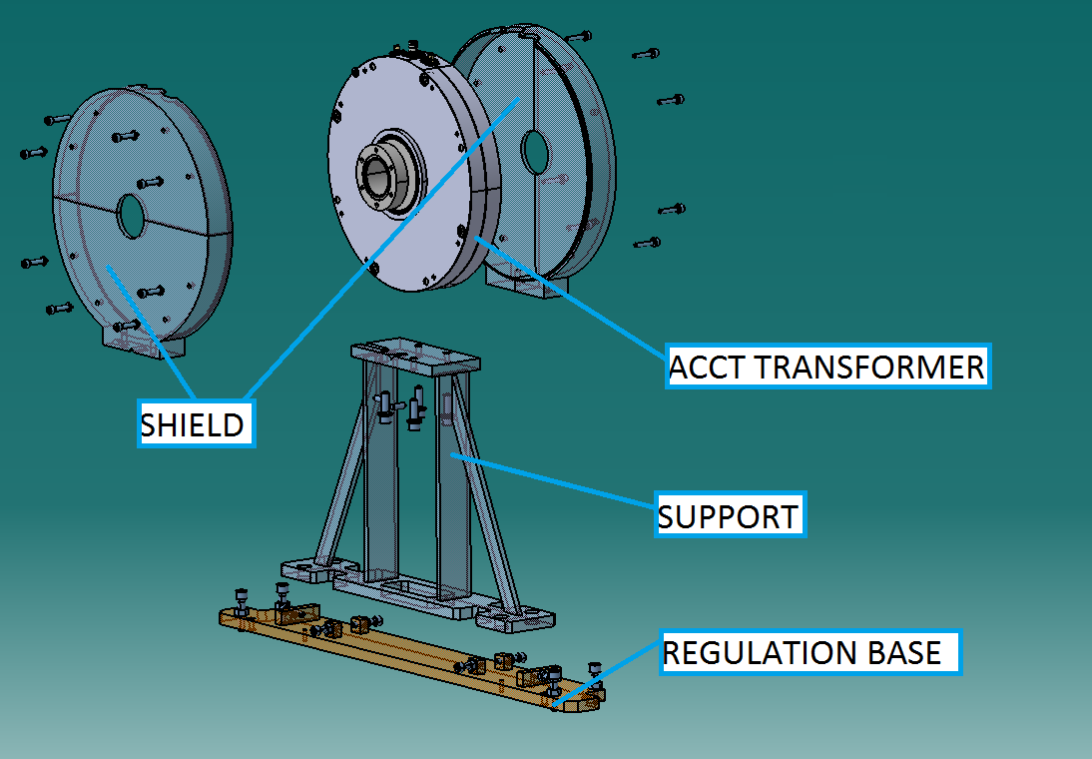
RAFT09 INTEGRATION 1/4
Assembly of Shielding
COMBO TRANSFORMER
CDR: BCM

Slide 18
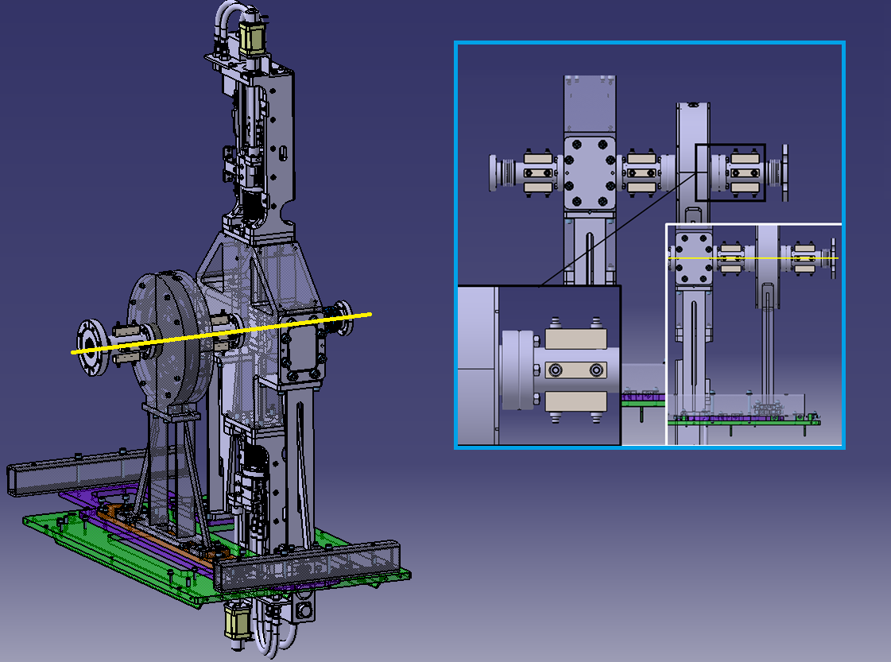
RAFT09 INTEGRATION 2/4
Integration of Scrapper chamber and vacuum system.
Fulfill vacuum and position requirements.
CDR: BCM

Slide 19
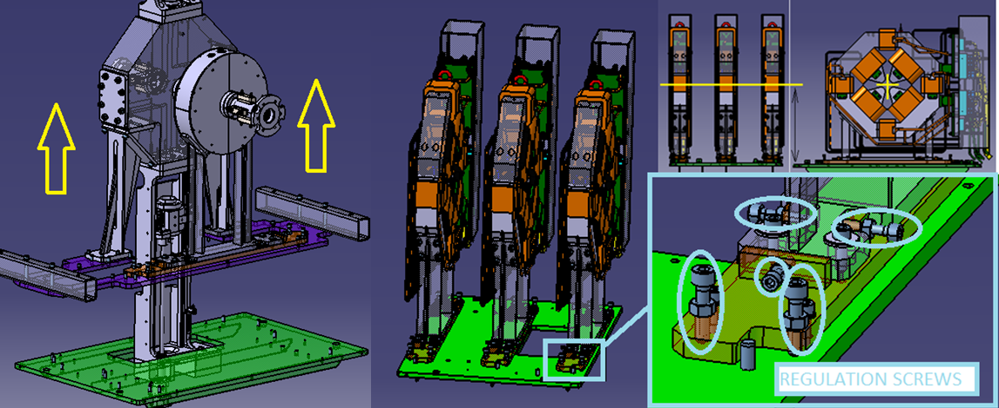
RAFT09 INTEGRATION 3/4
Disassembly of vaccum system and integration of quadrupoles.
CDR: BCM

Slide 20
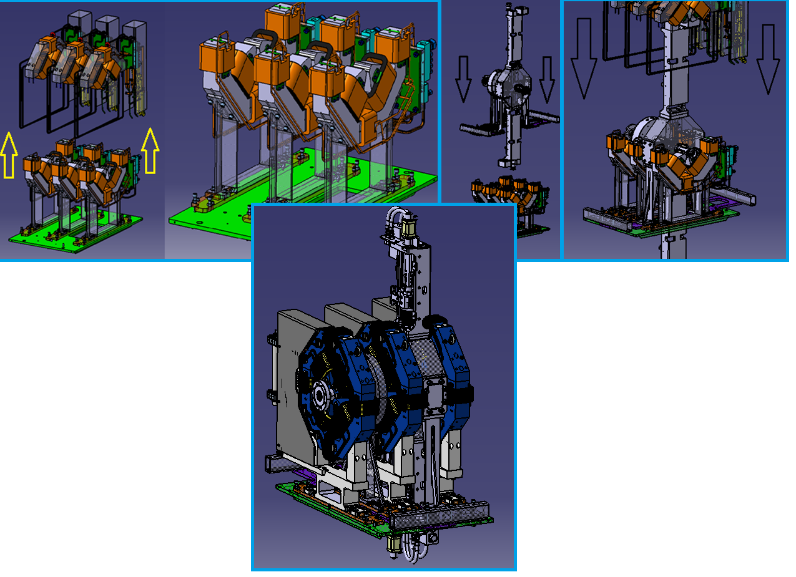
RAFT09 INTEGRATION 4/4
Final installation of vaccum system and quadrupoles.
CDR: BCM

Slide 21
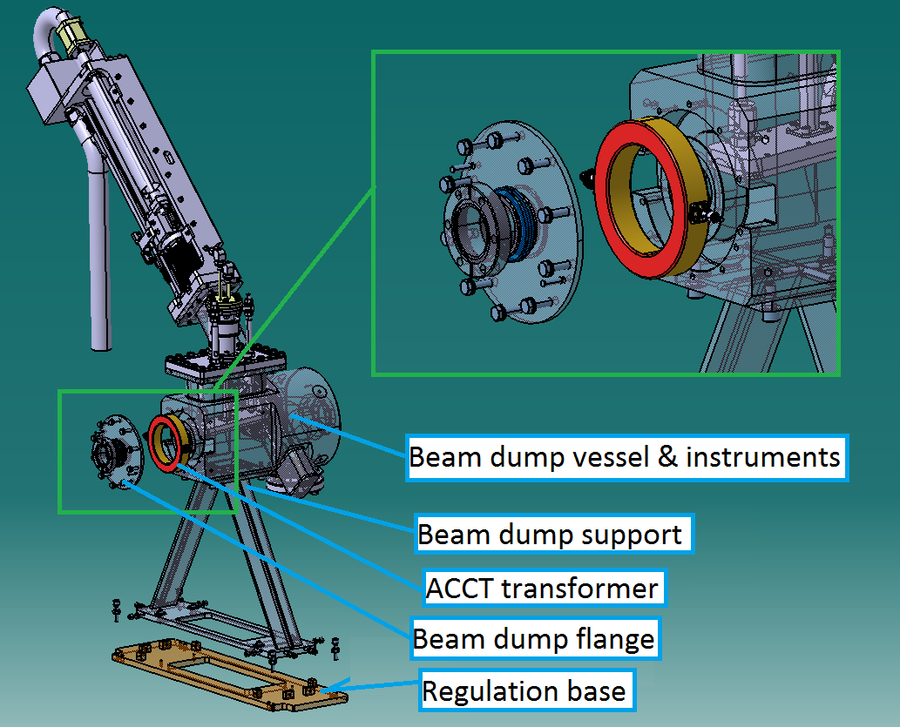
RAFT04 INTEGRATION 1/2
Assembly of Beam Dump.

Slide 22
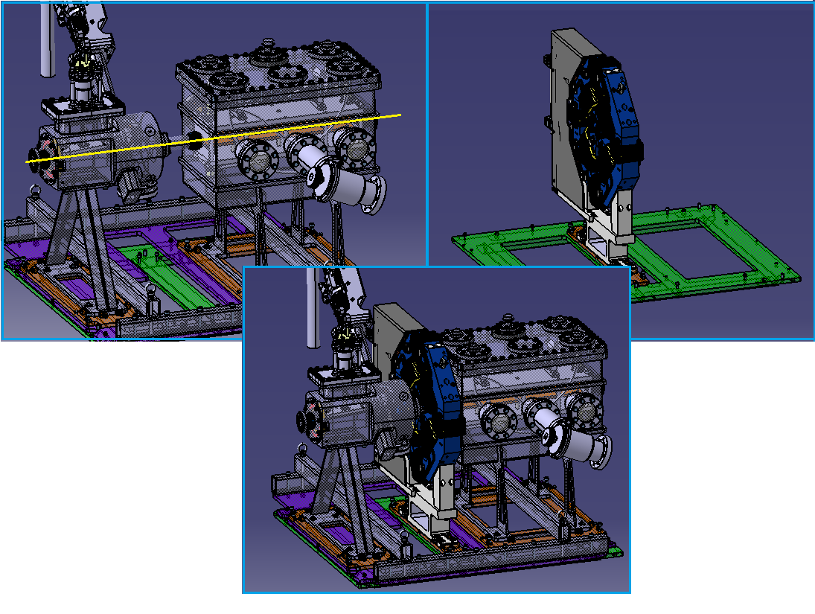
RAFT04 INTEGRATION 2/2
Same integration steps of Raft09.
CDR: BCM

Slide 23
VERIFICATION AND MEASUREMENTS(1)
Verifications for ACCT1
Frequency response from 5 Hz to 3 MHz.
Time response to a step to measure the ACCT output rise time.
Time response to a long pulse, typ. 30 us.
Differentiation measurement to measure the droop of the ACCT
Noise measurement
Verification for ACCT2
Frequency response from 5 Hz to 3 MHz.
Time response to a step to measure the ACCT output rise time.
Time response to a long pulse, typical 30 us.
Differentiation measurement to measure the droop of the ACCT
Noise measurement
CDR: BCM

Slide 24
VERIFICATION AND MEASUREMENTS(2)
Verifications for FCT
Frequency response over the full bandwidth
Time response to a short pulse, typical 250 ps rise time.
Time response to a step
Differentiation measurement to measure the droop of the FCT
CDR: BCM

Slide 25
DELIVERABLE BY ESS BILBAO
Item | Description | Comments | References in technical design document MEBT-BI-BC91-04
ACCT1 | In-Air, ID82 | Installed within Beam Dump | Section 5.1 Section 3
ACCT2/FCT | Combo In-Flange | Includes the mu-metal layers, soft iron layer and two toroids ACCT and FCT with CF flanges | Section 5.2 Section 3
ACCT1-E cable | 20m, Mulrad-2 | BNO connectors | Section 6.2.1
ACCT2-E cable | 20m, Mulrad-2 | BNO connectors | Section 6.2.1
ACCT1 Analogue electronics | Full scale: ±80mA Output: ±10 V | In: BNO female Out: BNC female | Section 3
ACCT2 Analogue electronics | Full scale: ±80mA Output: ±10 V | In: BNO female Out: BNC female | Section 3
CDR: BCM

Slide 26
PROVISIONAL DELIVERY CALENDAR
Item | Start | Finish
Finish design (including Mechanical) | 15- July- 2016 | 15- April- 2017
Detailed drawings (Joint Bilbao with Bergoz) | 02- May- 2017 | 15- June- 2017
Review of the Technical Report | 1- June-2017 | 15-June-2017
Technical Tender Document | 20- July- 2017 | 30- August- 2017
Tender offer/Order | 17- Oct- 2017
FAT | 21-Feb- 2017
Delivery to ESS Bilbao | 12-March- 2017
Verification at ESS Bilbao | 2-April- 2018 | 19- April- 2018
Documentation | 2-May- 2018 | 30- May- 2018
Ready for Installation | June- 2018
CDR: BCM

