Slide 1


Wire Scanner CDR
A. Vizcaíno
Bilbao, 12/07/2017

Slide 2
Introduction
The final concept design of the Wire Scanner instrument and actuator are shown in this presentation.
The integration of the three Wire Scanner inside the vacuum vessels is presented.
The mechanical description of the main components is presented.
The test done to accept Aluminium wires as vacuum seal are described.
An assembly process is shown for the actuator in order to guarantee the correct alignment of the instrument.
The Wire Scanner cabling path is presented.
Risks evaluation.
Status of the Project.
Delivery Calendar.
ESS-Bilbao and Elettra Interfaces.

Slide 3
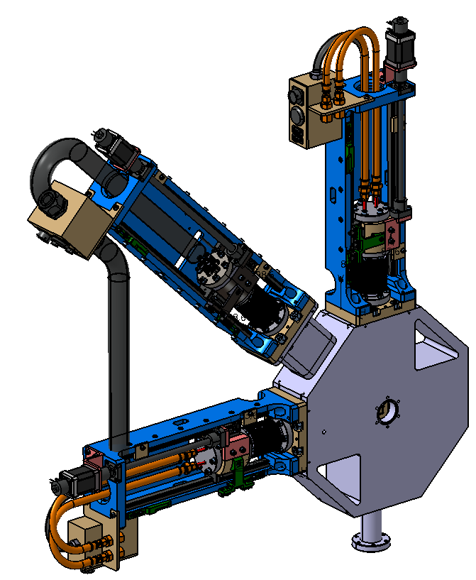
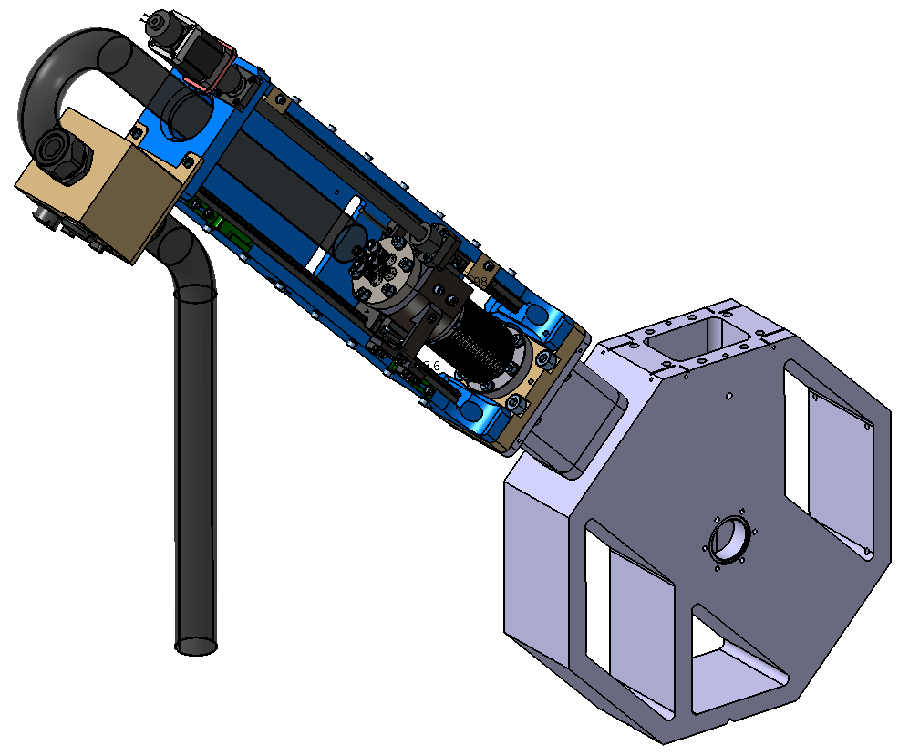
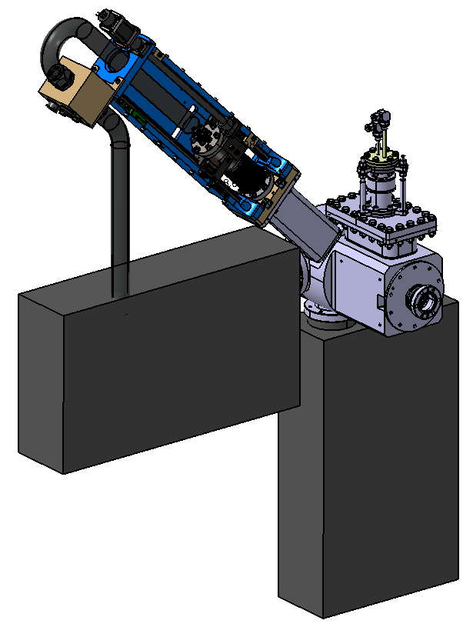
Wire Scanner Vessel Integration

Slide 4
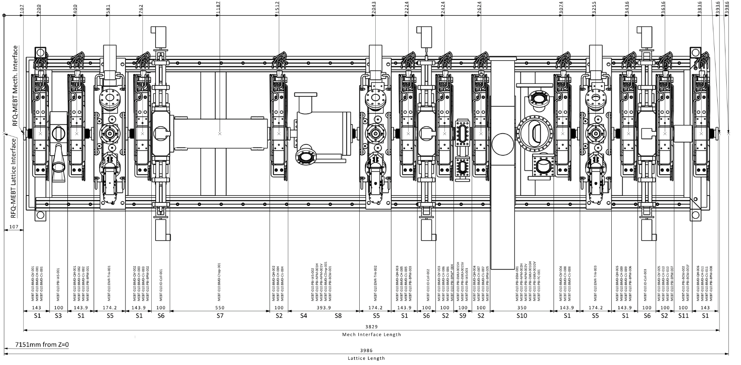
MEBT View
MEBT-WS-2000-ESS
MEBT-BD-2000-ESS
MEBT-SL-2000-ESS

Slide 5
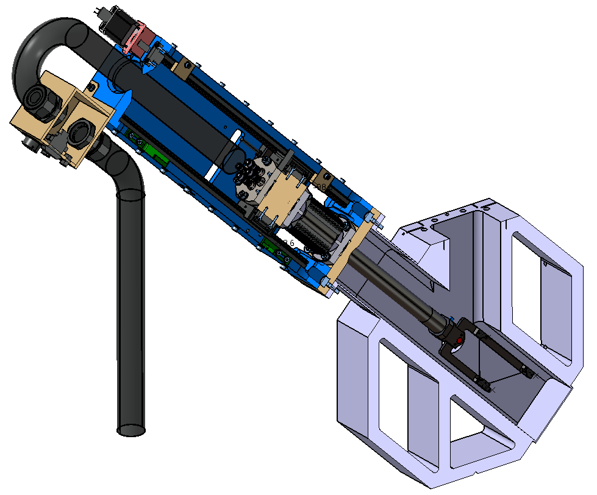
Vessel MEBT-WS-2000-ESS
WS

Slide 6
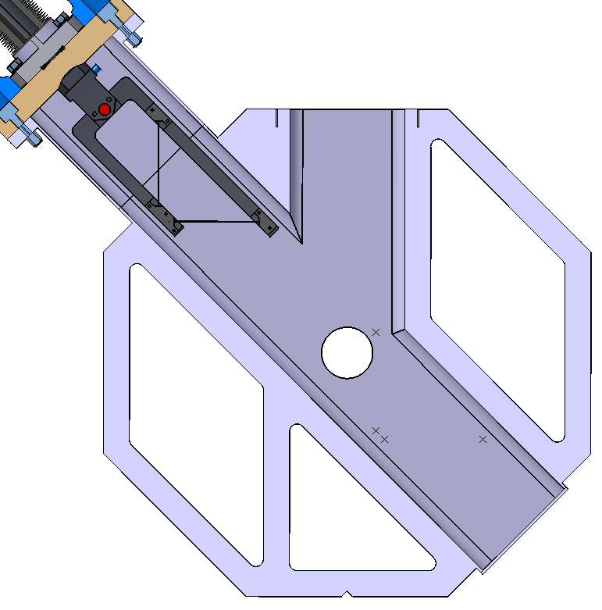
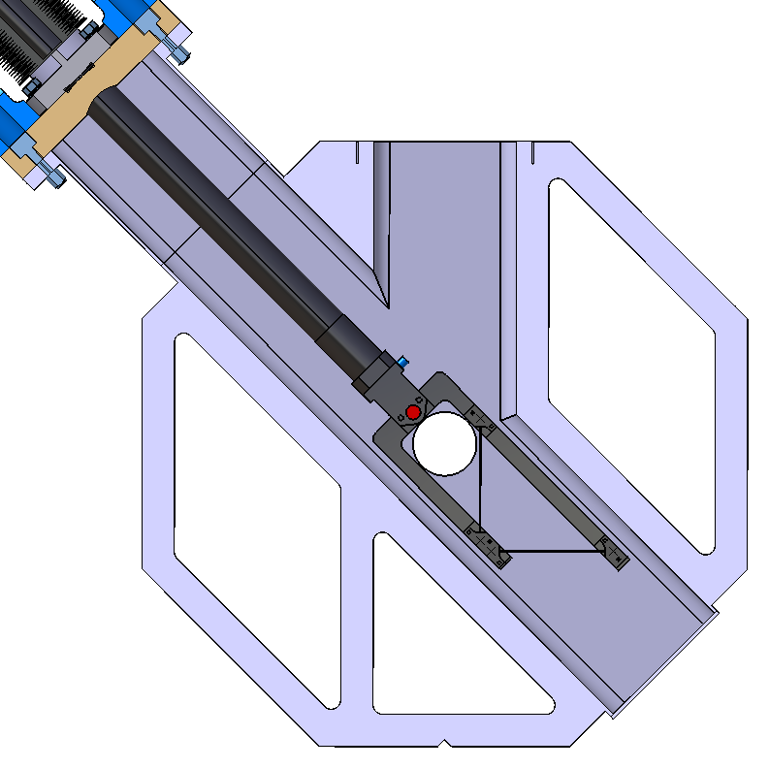
Vessel MEBT-WS-2000-ESS
WS Parking position
(0 mm)
WS Final position
(240 mm)

Slide 7
Vessel MEBT-BD-2000-ESS
WS
DUMP
NPM
NPM

Slide 8
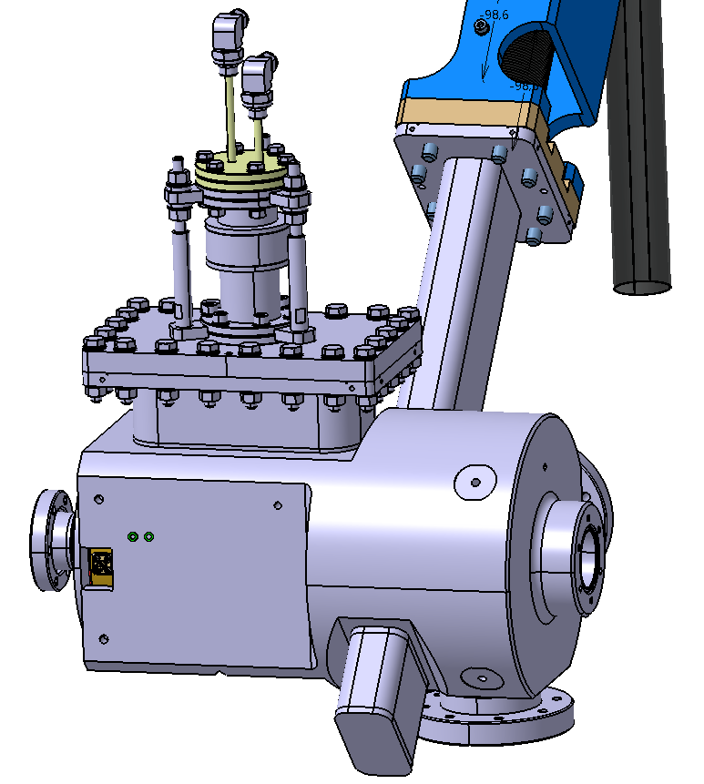
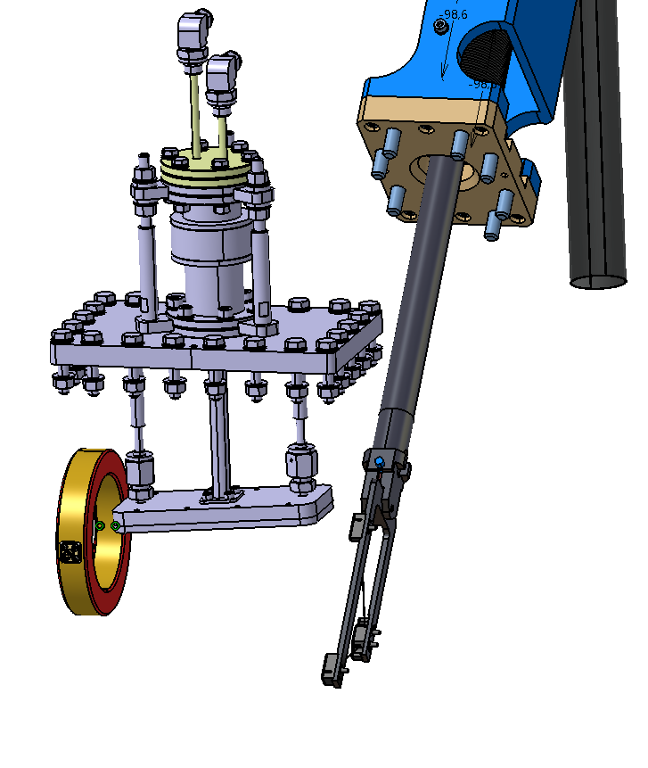
Vessel MEBT-BD-2000-ESS
DUMP
ACCT
WS

Slide 9
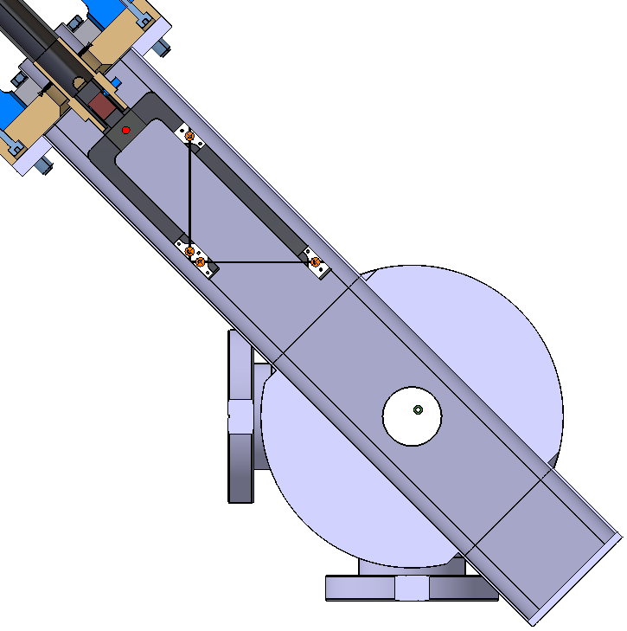
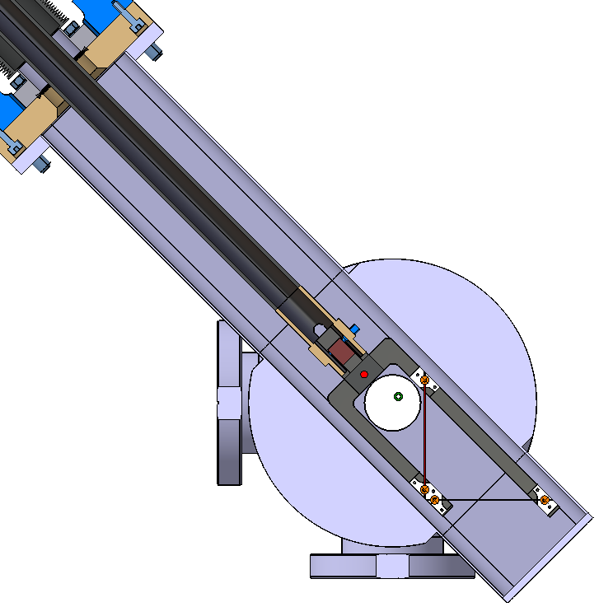
Vessel MEBT-BD-2000-ESS
WS Parking position
(0 mm)
WS Final position
(240 mm)

Slide 10
Vessel MEBT-SL-2000-ESS
WS
SLIT
SLIT

Slide 11
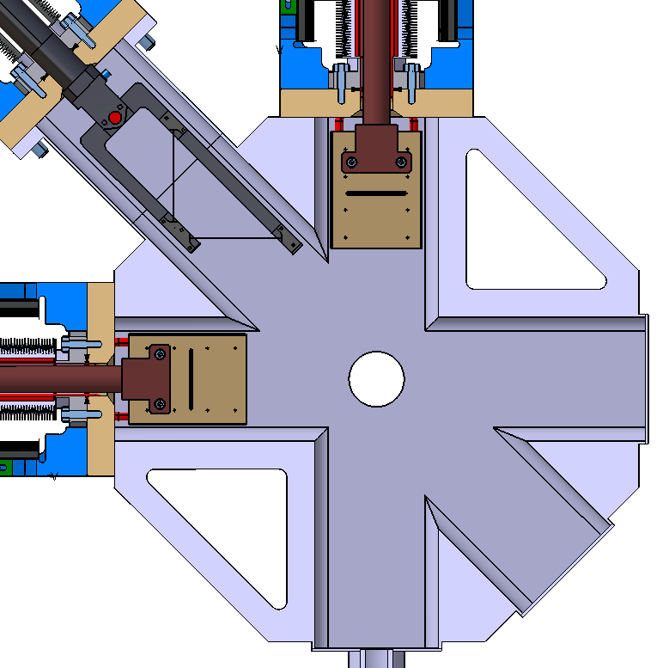
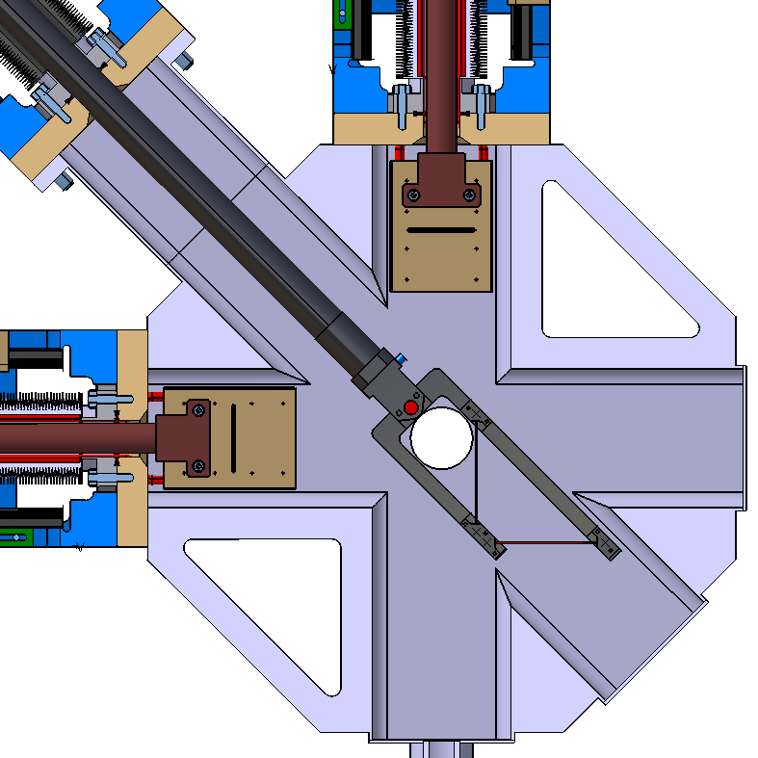
Vessel MEBT-SL-2000-ESS
WS Parking position
(0 mm)
WS Final position
(240 mm)

Slide 12
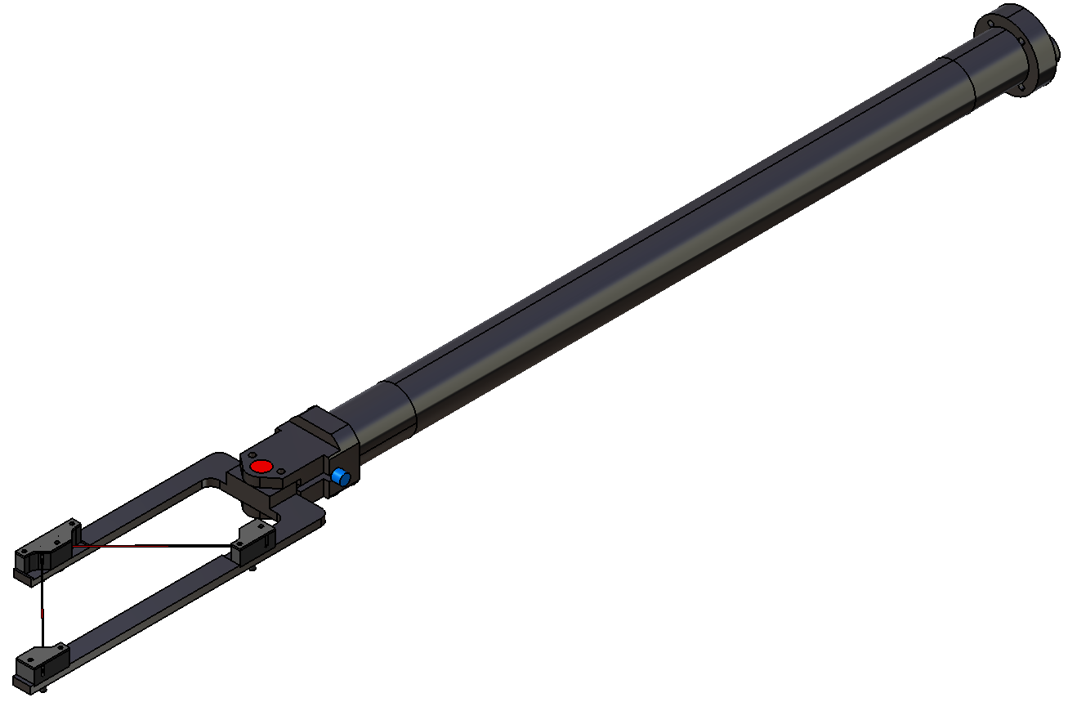
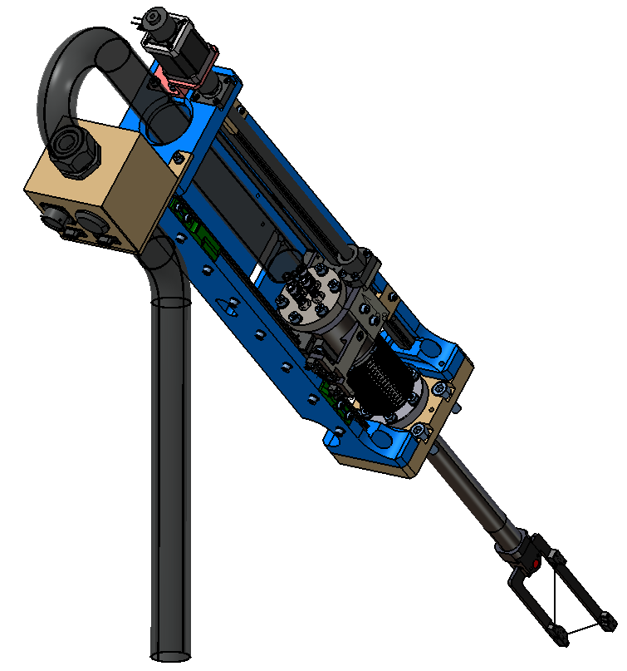
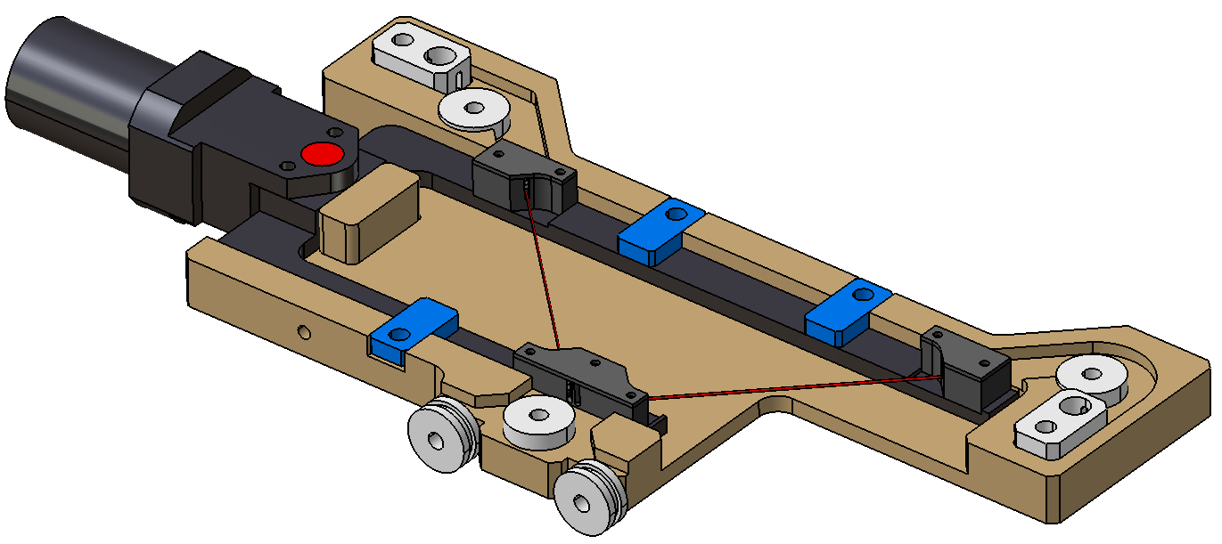
Wire Scanner mechanical design

Slide 13
Wire Scanner mechanical design
Main Properties:
33 um Carbon Wires
240 mm of stroke
Aluminium Wires as vacuum seal
Linear Guides concept
Compact concept

Slide 14
Wire Scanner instrument mechanical design
Shaft
Alignment
System
Fork
Carbon Wires
Clampers

Slide 15
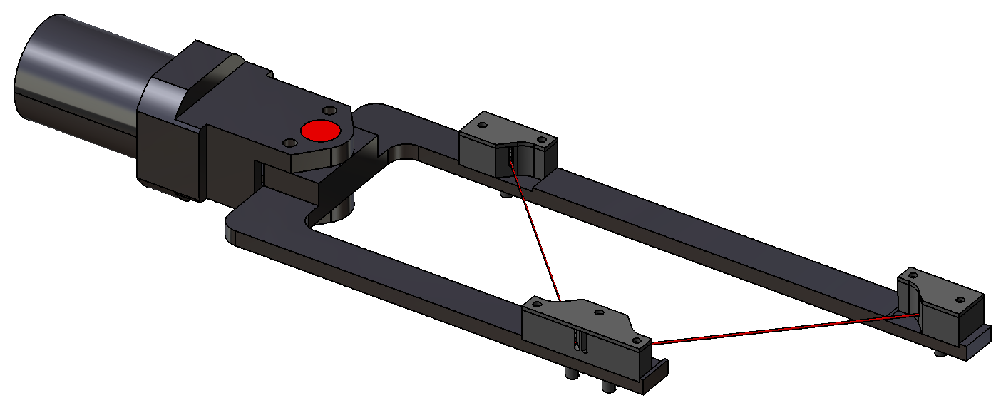
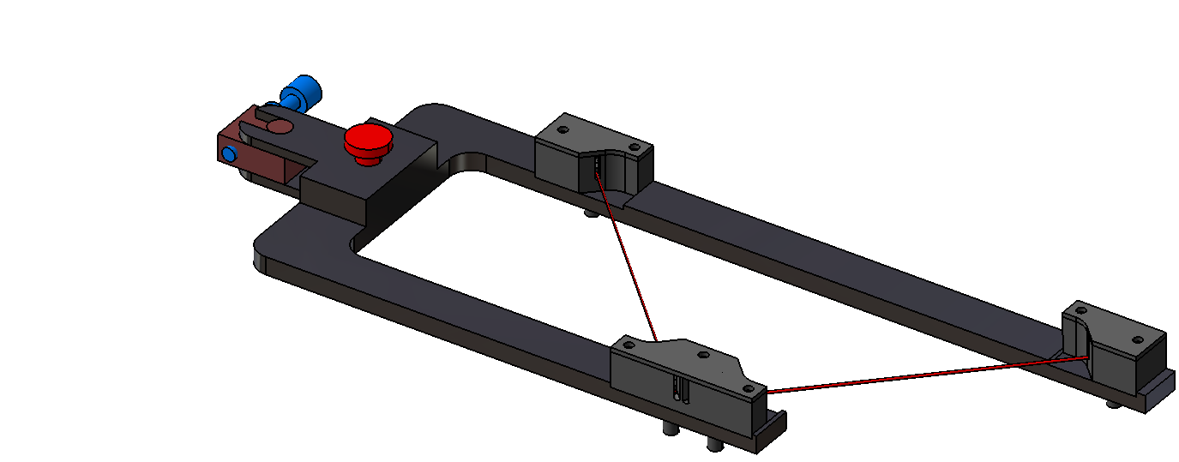
Wire Scanner instrument mechanical design
Alignment
Screw
Alignment
Axis
33 um Carbon Wires
Carbon Wires
Clampers

Slide 16
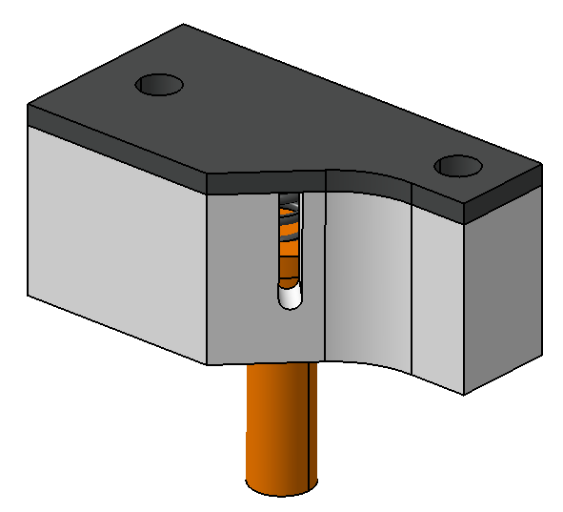
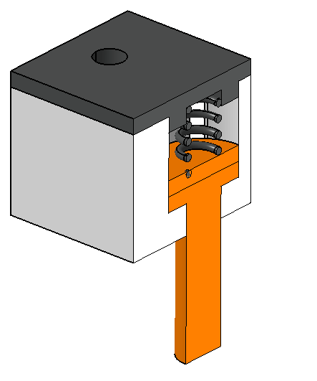
Wire Scanner instrument mechanical design
Clampers
Signal
Pin
Insulator

Slide 17
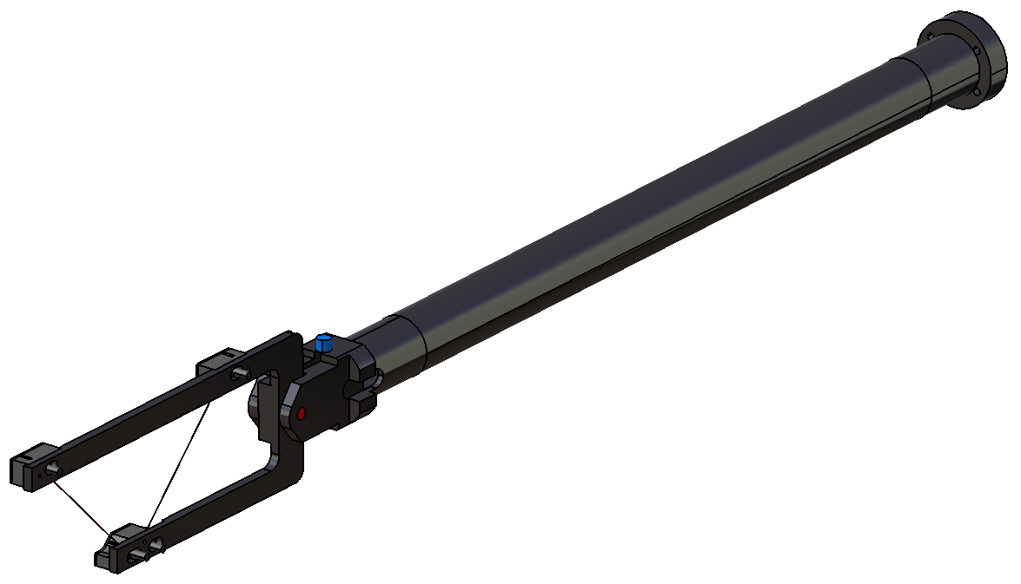
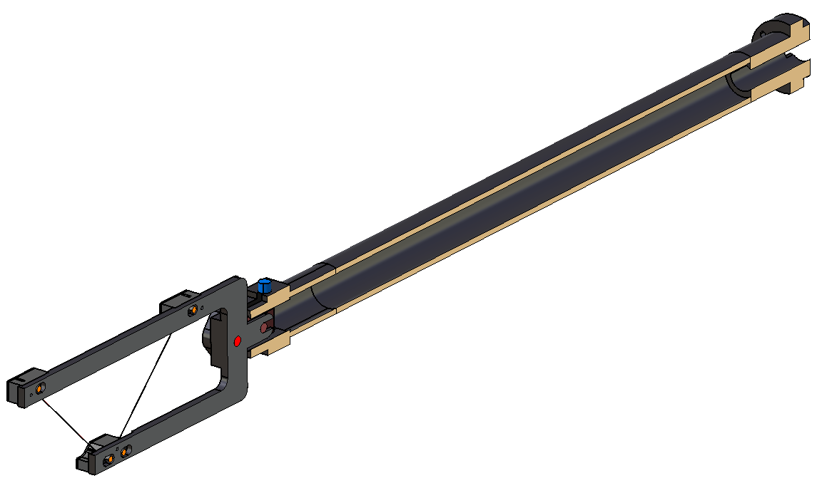
Wire Scanner instrument mechanical design
Hole for cables
insertion
Hollow Shaft

Slide 18
Wires Alignment Toolkit mechanical design
Alignment Rollers
Fork Clampers
Tension Rollers

Slide 19
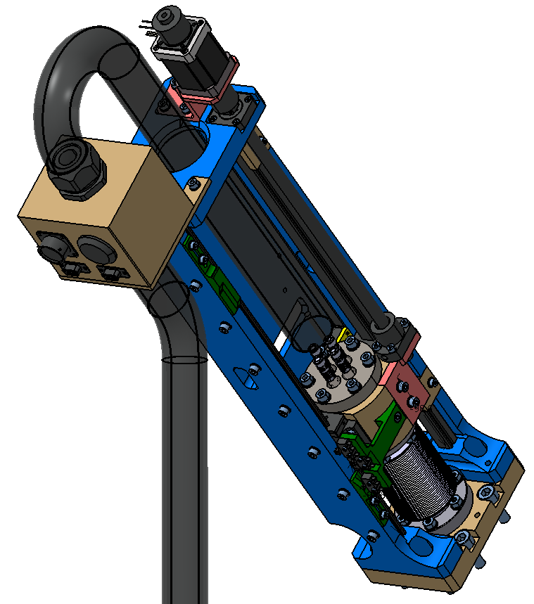
Wire Scanner actuator mechanical design
Motor and Break
Spindle
Linear Guides
Cables Protector
Vacuum Feedthrough
Patch Panel
Bellow

Slide 20
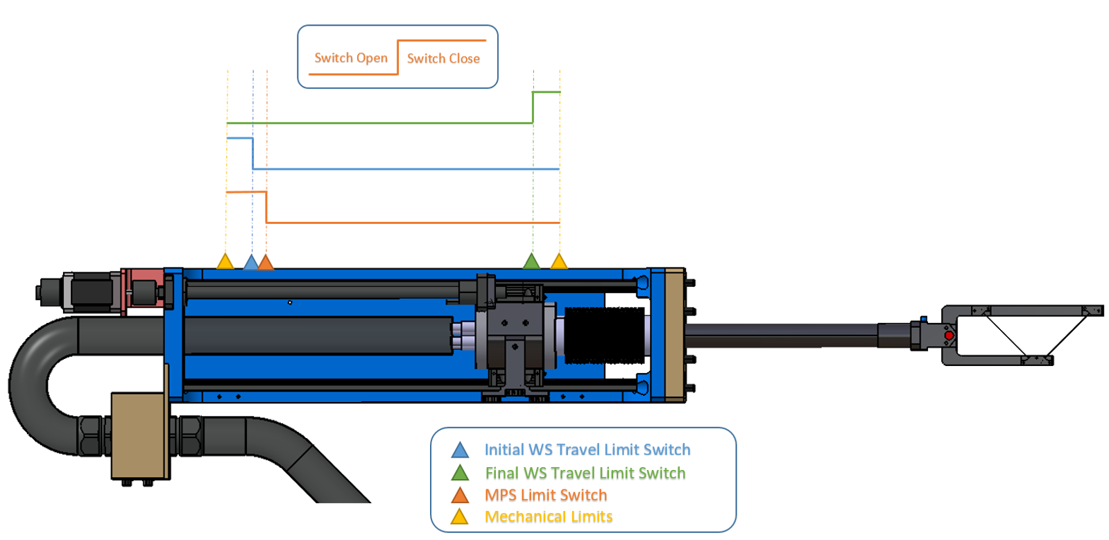
Wire Scanner actuator –
Limit Switches functionality

Slide 21
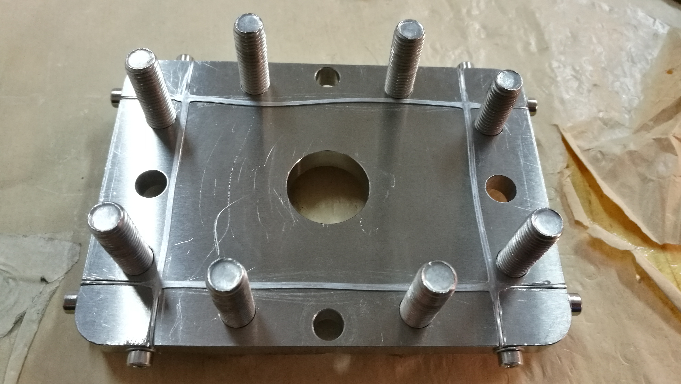
Aluminium Wire Tests

Slide 22
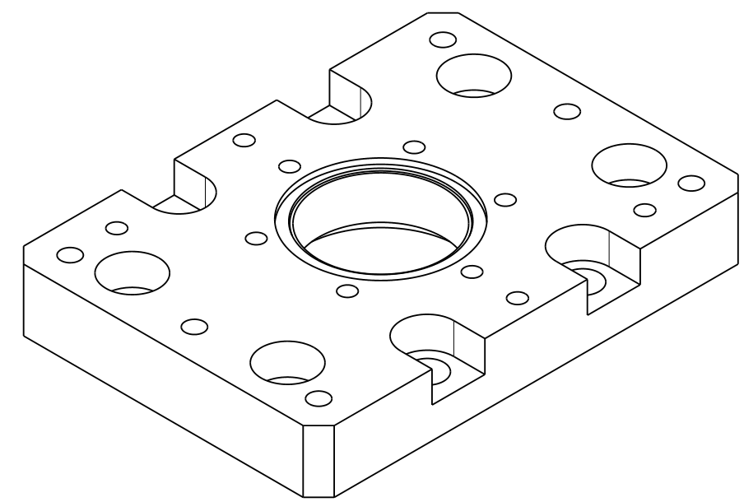
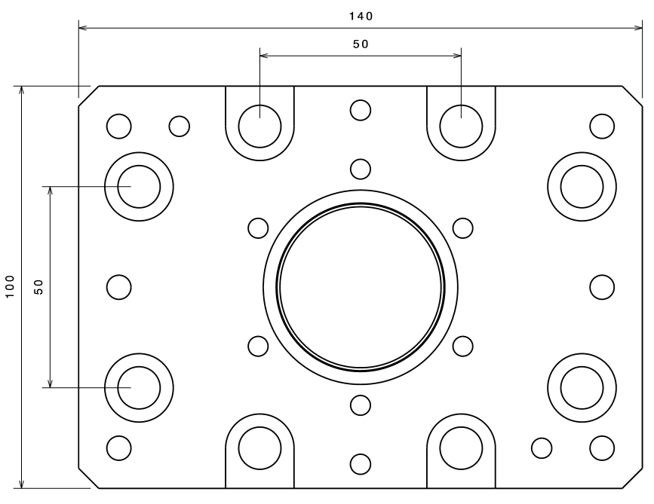
Aluminium Wire Test
A pattern of 8 screws will be used to close vacuum.
M10 AG screws will be used.

Slide 23
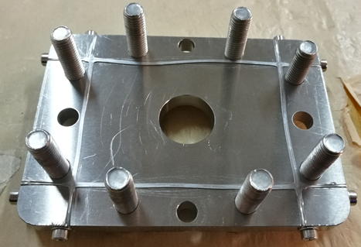
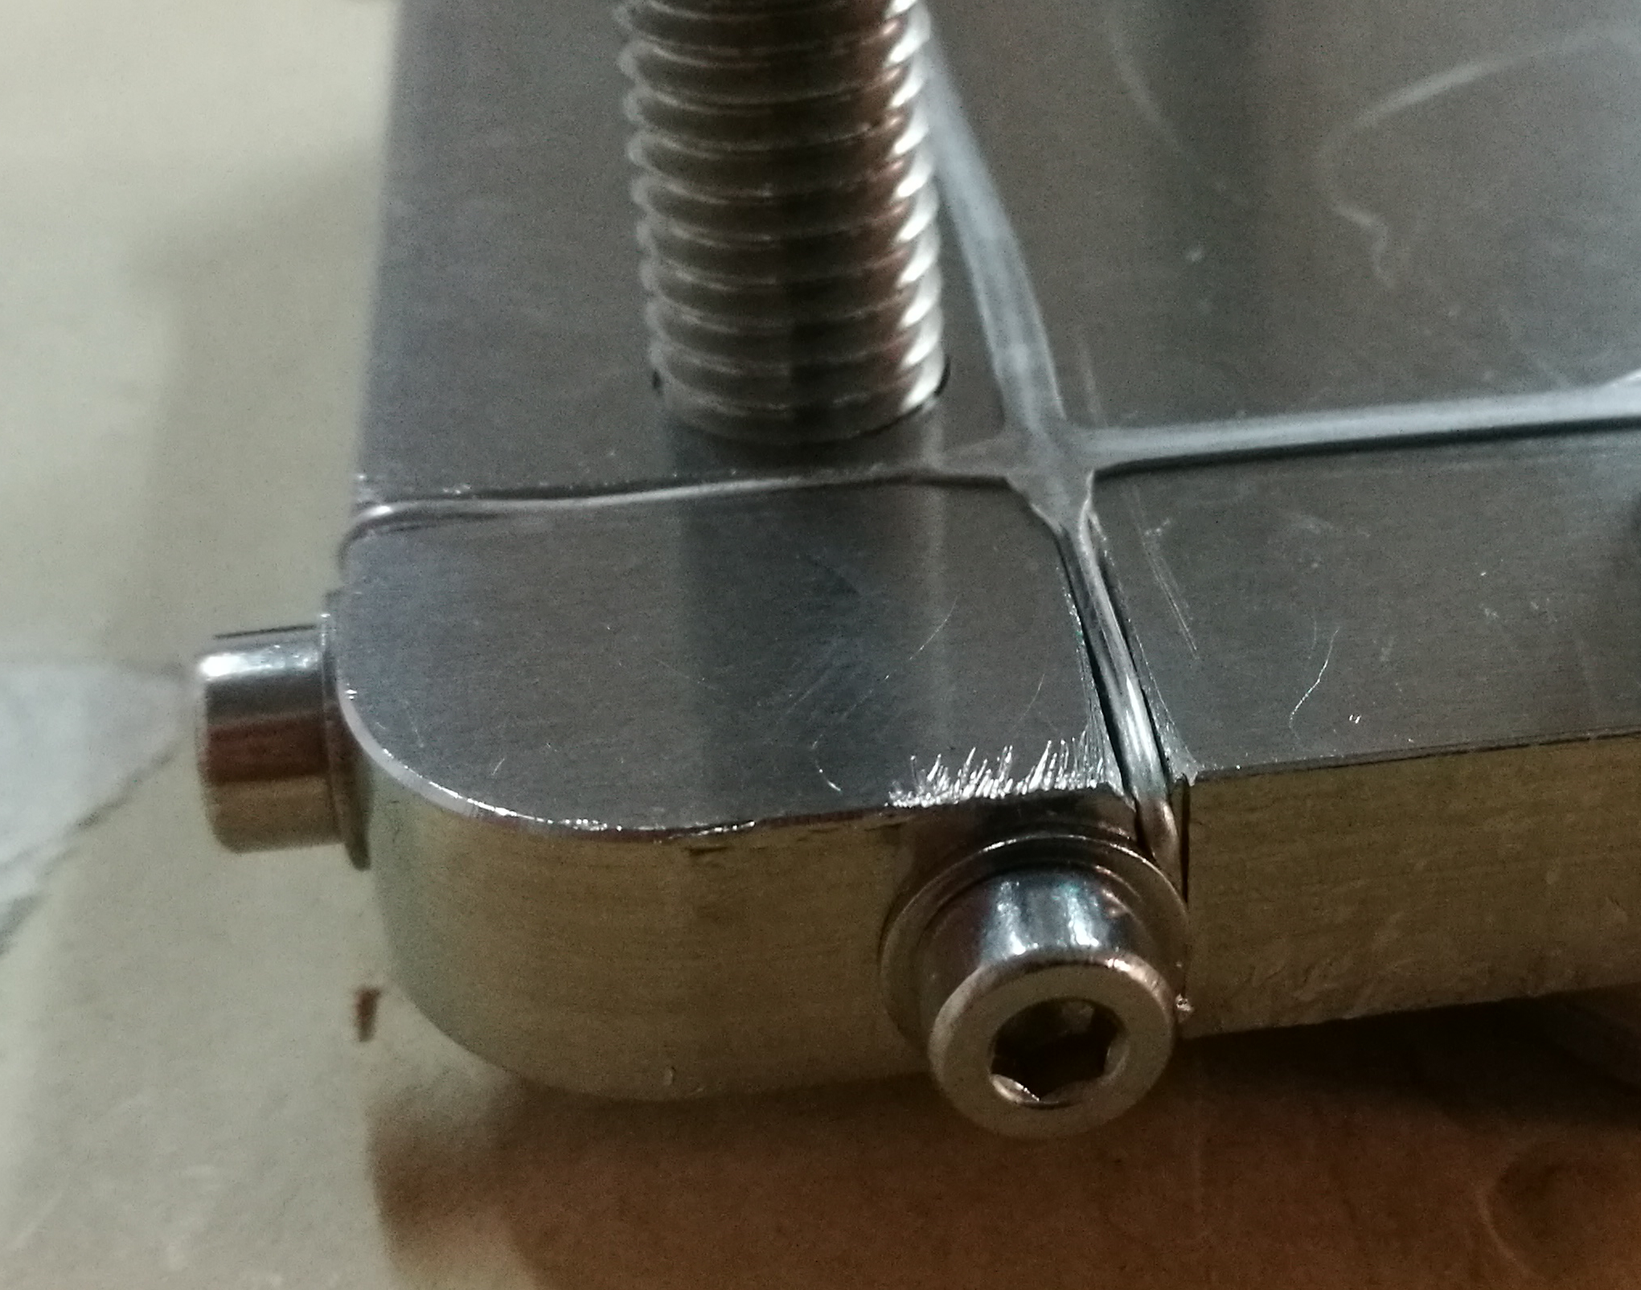
Aluminium Wire Test
A vertical and horizontal release channels should be mechanize in the corner of the flange.

Slide 24
Aluminium Wire Test
 | Screw Type | Diameter (mm) | Torque (Nm) | Force per Screw (N) | Nº screws | Total Force (N) | Leak Rate (mbar *l/sec)
Test 1 | M10 AG | 10 | 40 | 3.333,33 | 8 | 26.666,67 | -11
Test 2 | M10 AG | 10 | 40 | 3.333,33 | 8 | 26.666,67 | -11
Test 3 | M10 AG | 10 | 40 | 3.333,33 | 8 | 26.666,67 | -11
Test 4 | M10 AG | 10 | 40 | 3.333,33 | 8 | 26.666,67 | -11
Test 5 | M10 AG | 10 | 40 | 3.333,33 | 8 | 26.666,67 | -11

Slide 25
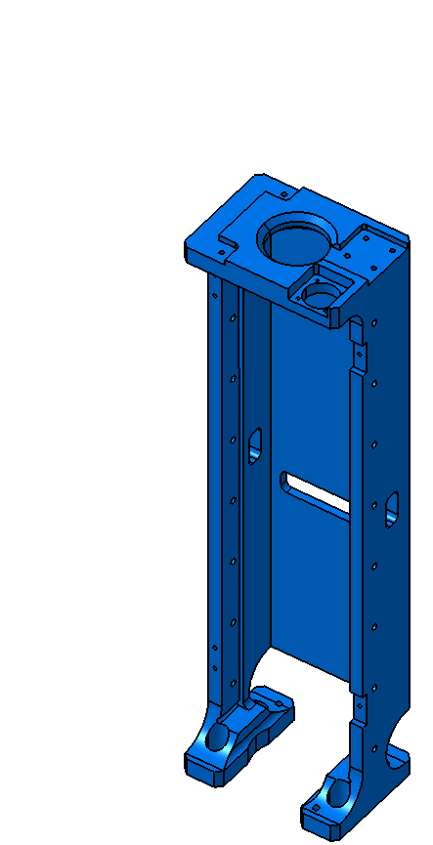

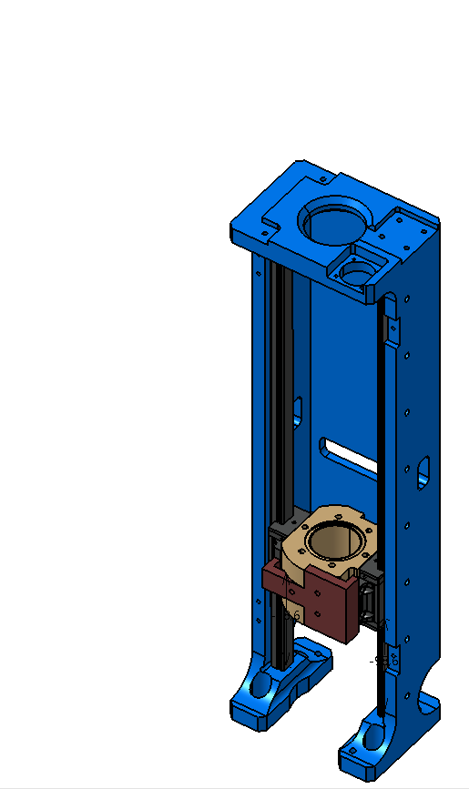
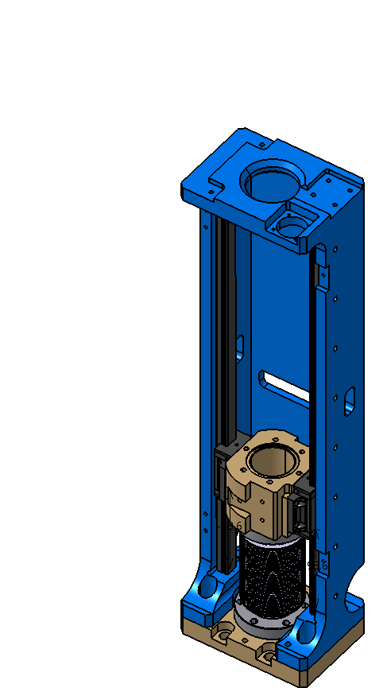
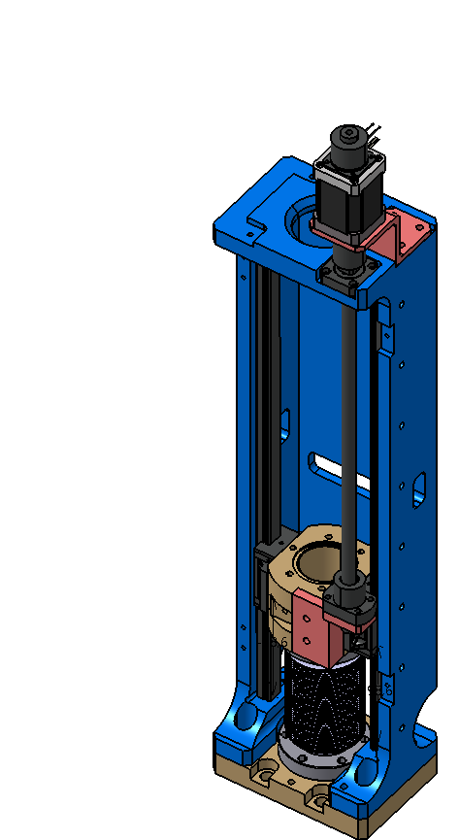
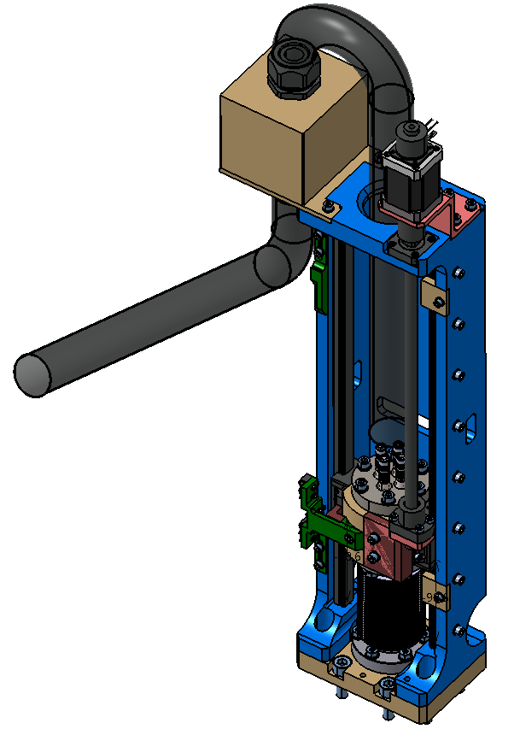
Wire Scanner Assembly process

Slide 26
Wire Scanner actuator – Assembly process
Step 0:
The Linear Guides Support is the frame of the actuator. This main objective of this piece is to have enough rigidity to permit the linear guides movements with the precision required by the instrument.

Slide 27
Wire Scanner actuator – Assembly process
Step 0:
This piece has two important mechanical reference planes machined:
A reference plane to align the linear guides.
Two precision holes to insert alignment pin during the assembly of the Rectangular Flange.
Linear Guides reference surface
Precision holes

Slide 28
Wire Scanner actuator – Assembly process
Step 1:
The step one is to assemble the linear guides into the linear guides support.
The assemble should be done positioning the linear guides over the referece face machined in the linear guide support to this purpose.
Linear Guides

Slide 29
Wire Scanner actuator – Assembly process
Step 2:
The step two is to assemble the Shaft Support between the two linear guides.
In this step an alignment piece should be used to well align this piece with respect to the linear guides.
Shaft Support
Shaft Support aligner

Slide 30
Wire Scanner actuator – Assembly process
Step 3:
In the step three the Shaft Support aligner will be removed and the Bellow and Rectangular Flange will be installed.
The alignment between the Rectangular Flange and The Linear Guides Support will be made by two precision pins.
Bellow
Rectangular Flange

Slide 31
Wire Scanner actuator – Assembly process
Step 4:
In the next step all the movement system will be installed (Motor, Break and Spindle) in orther to check the correct displacement of the movable parts.
Some menor adjustments could be done to avoid any displacement problems.
Motor and Break
Spindle
Spindle Support

Slide 32
Wire Scanner actuator – Assembly process
Step 5:
Finally all the other actuator components could be assemble.

Slide 33
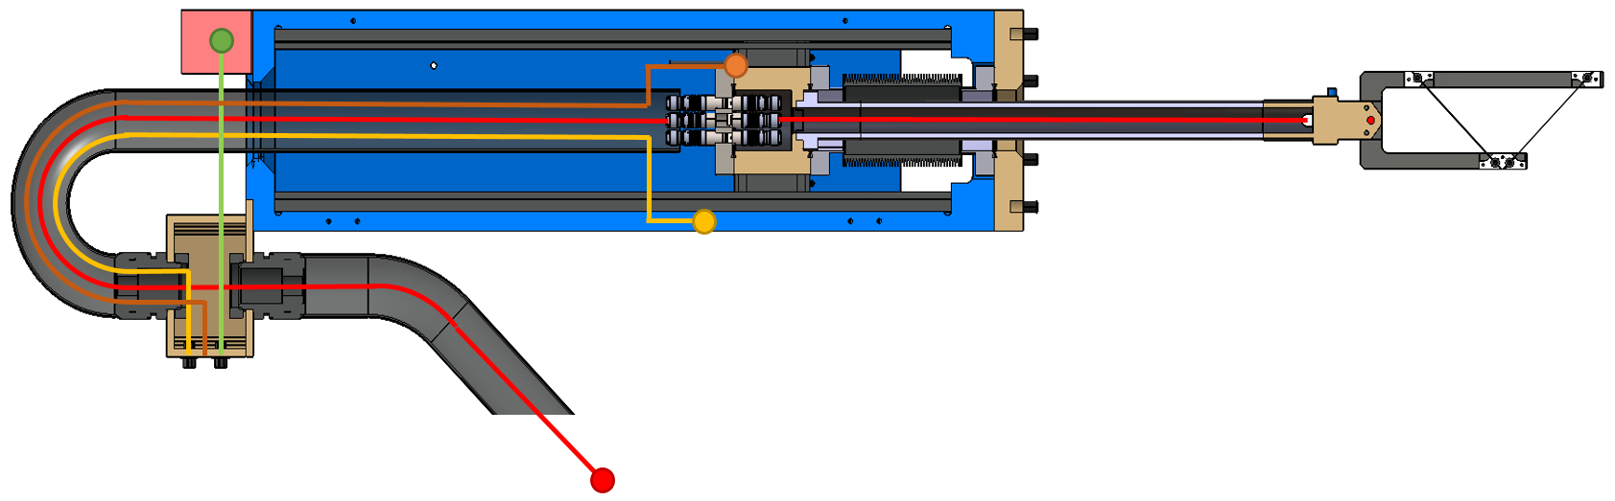
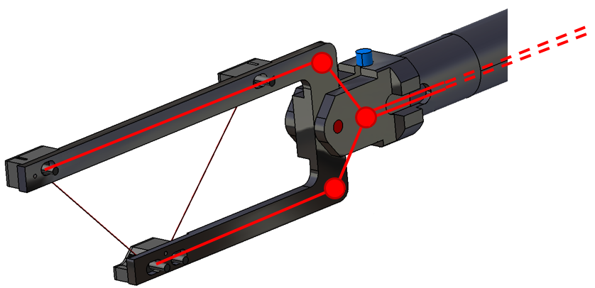
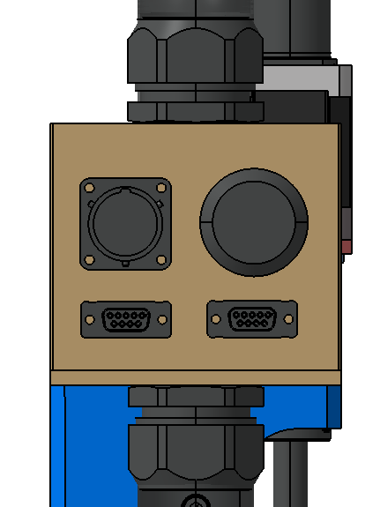
Wire Scanner Cabling

Slide 34
Wire Scanner actuator – Cabling
Signal Pins
Cables insertion hole
Wires clampers

Slide 35
Wire Scanner actuator – Cabling
Signal cables (4 channels): From the copper pins to the vacuum feedthrough (coaxial) and from the vacuum feedthrough to the acquisition box (triaxial).
Limit Switches cables: From the Limit Switches position to the Patch Panel.
Motor and Break cables: From the Motor and Break position to the Patch Panel.
Encoder cable: From the Encoder position to the Patch Panel.

Slide 36
Wire Scanner actuator –
Patch Panel
Motor and Break connector
(SOURIAU UT00128SH)
MPS Limit Switch
(LEMO EGG.4k.312.CYM)
Travel Limit Switches
(DB9)
Encoder connector
(DB9)

Slide 37
Wire Scanner Tests, Acceptance and Verification Plan

Slide 38
Contractor Actions
Once the instrument has been manufactured the contractor shall make the following test:
Metrology: The contractor shall check all the measurements with tolerances under 0.1 mm of all the pieces directly related to fulfilling the wires orientation angular error specifications.
Cleaning: All the pieces must be cleaning to be provided free of contamination, greases or other substances no Ultra High Vacuum compliance.
Leaking Test: The contractor shall guarantee a leakage rate of no more than 2,0*10E-10 mbar*l/sec
Storage, packaging and delivery: The contractor shall ensure that the equipment is stored in an area where the condition of the components is not altered. The packaging shall be a simplified vessel with an Nitrogen overpresure of 10 mbar.

Slide 39
ESS-Bilbao Acceptance Plan
Once the instrument has been received in the ESS-Bilbao facilities the instrument will be accepted based on the following plan:
Storage: The instrument will be storage with the delivery vessel in a proper enviroment until the beginning of the tests.
Check the contractor documentation: Check all the information about the contractor tests.
Visual inspection: Visual inspection for damages.
Vacuum Tests: A leaking test and a RGA test shall be done to check the results of the contractor vacuum tests.
Electrical Tests: Verification of the electrical connections in all the connectors and cables.
Metrology: A revision of the metrology supply by the contractor could be checked.

Slide 40
ESS-Bilbao Verification Plan
Once the instrument has been accepted a verification of the other instruments characteristics shall be done:
Movement tests:
  Motor Test
  Break Test
  Encoder Test
  Limit Switches Test
  Repeteability Tests
  Vibration Test
Vacuum Tests:
  Movement Test under vacuum
  Leak Test
  RGA

Slide 41
Risks, Status, Delivery Calendar and Interfaces

Slide 42
Wire Scanner mechanical design Risks
Risk | Treatment Plan | Responsible
Coordination with Elettra | Regular meetings. | ESS-Bilbao and Elettra
Wires mechanical tension | A series of simulations have been done to validate the model. A pretensión of 1g is enough to maintain the mechanical tensión required. | ESS-Bilbao
Wires Clamping | A soft and pressure regulable system has been design to clamp the carbon wires in a safe way. | ESS-Bilbao
Wire Angular Error | A Wire Alignment Toolkit has been design. | ESS-Bilbao
Dimensional quality | A dimensional control will be done by the contractor after fabrication. ESS-Bilbao could repeat the dimensional test to validate the instrument. | Proactive R&D
Vacuum quality | A vacuum control will be done by the contractor after fabrication. ESS-Bilbao could repeat the vacuum tests to validate the instrument. | Proactive R&D

Slide 43
Wire Scanner mechanical design Risks
Risk | Treatment Plan | Responsible
Delivery of the instrument | The instrument will be deliver in a vessel with a Nitrogen overpressure of 10mbar | Proactive R&D
Mechanical and electronic integration | A plan need to be developed to integrate the ESS-Bilbao and Elettra parts of this project. | ESS

Slide 44
Status of the project
The Call for Tender of the instrument has been completed.
The selected company to elaborate the bluprints and fabricate the instrument has been Proactive R&D.
The Kick-Off meeting of the Project was held last June 27th 2017 with Proactive R&D.
The final 3D design and the bluprints are under developement by Proactive R&D.
The last meeting with Elettra was held last May 5th 2017.

Slide 45
Delivery Calendar
Milestone | Date
Contract Formalization | June 27th 2017
Delivery of Blueprints | July 25th 2017
Acceptance of Blueprints | September 12th 2017
Manufacture and delivery of WS1 and Verification Documents | November 7th 2017
Acceptance of WS1 | December 5th 2017
Manufacture and delivery of WS2 and WS3 and Verification Documents | February 13th 2018
Acceptance of WS2 and WS3 | March 13th 2018
Integration and tests | May 15th 2018
Delivery | May 31th 2018

Slide 46
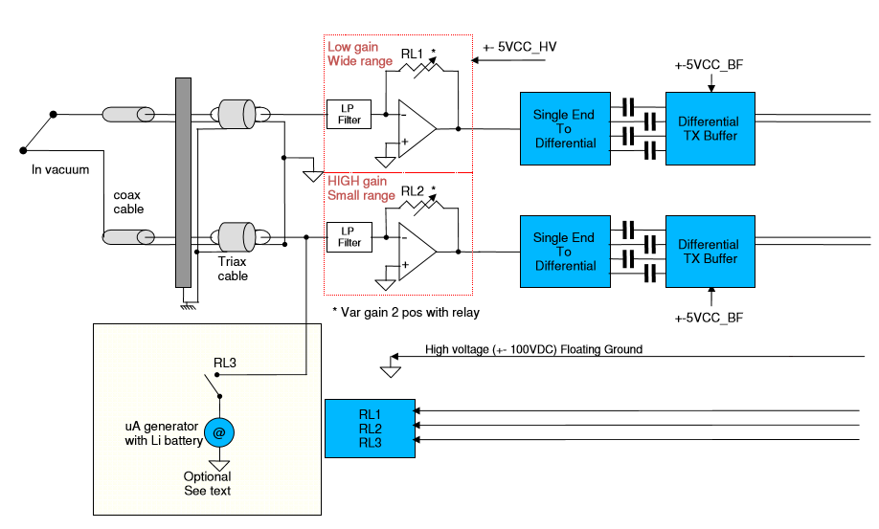
ESS-Bilbao and Elettra Interfaces
ESS-Bilbao Scope
Elettra Scope
Picture from “ESS WS ACQ SYS PDR-1” presentation. Author: Sandi G.

Slide 47
Thank you for your attention.

