Slide 1


Critical Design Review of the ESS MEBT Faraday Cup
FC Team
ESS-Bilbao
Beam Instrumentation Group
July – 2017

Slide 2
Summary
Introduction
Conceptual Design
Mechanical Design
Analog Front End
Control System
Product Integration
Conclusions

Slide 3
Summary
Introduction
Conceptual Design
Mechanical Design
Analog Front End
Control System
Product Integration
Conclusions

Slide 4
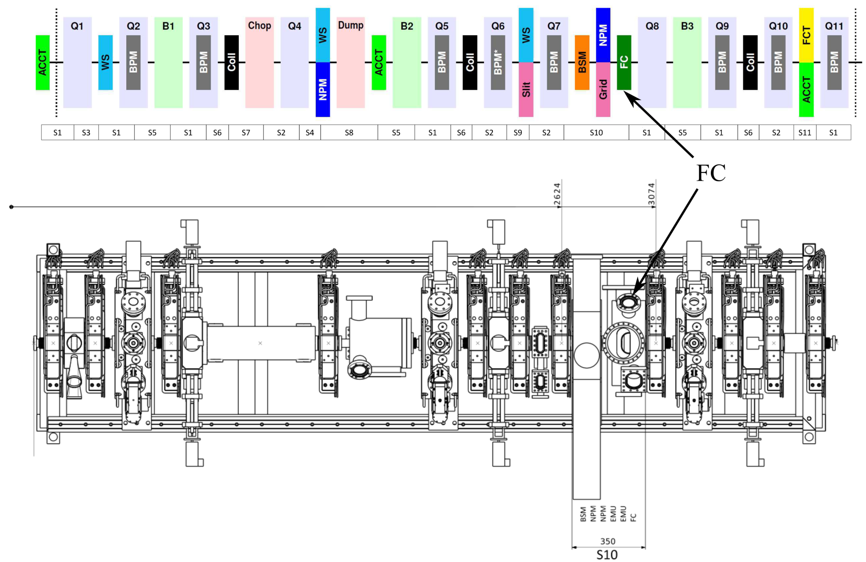
ESS MEBT

Slide 5
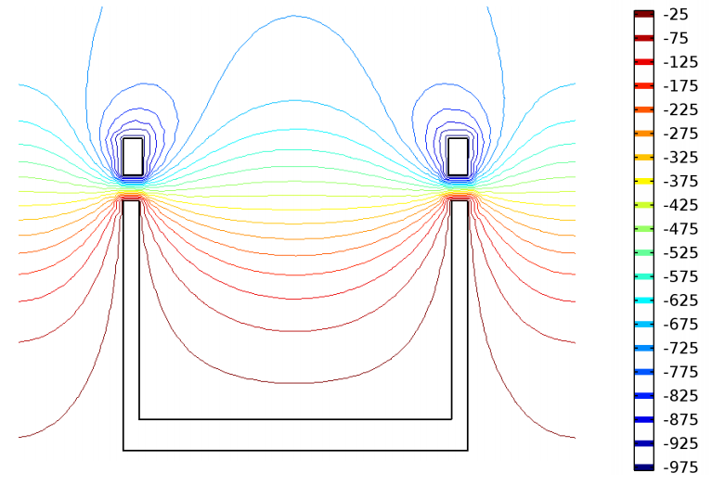
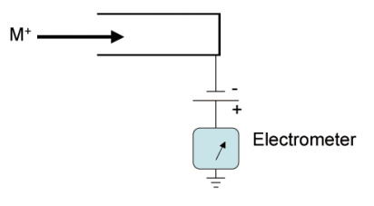
ESS MEBT FC
Beam Instrumentation is required in order to characterize beam current, size, emittance, etc
The Faraday Cup purpose is to stop a pulsed proton beam to measure the total beam current.
Faraday Cup is irradiated in Fast and Slow tuning modes.
Proton
Beam
Proton
Beam

Slide 6
ESS Requirements
L4_Requirements_MEBT_PBI_2016-11-09
User Defined ID | DOORS-ID | Name | Description
 |  | MEBT PBI energy range | Proton beam instrumentation in the MEBT section shall function over a proton beam energy range of 3.0 MeV - 3.8 MeV.
MEBT-L4-PBI-010 | MEBT.PBI-44 | MEBT PBI peak current range | Proton beam instrumentation in the MEBT section shall function over a peak beam current range of 3 mA to 65 mA.
MEBT-L4-PBI-340 | MEBT.PBI-77 | MEBT invasive measurements beam modes | All invasive measurements in the MEBT section shall be possible for beam pulse lengths of 5 microseconds at 14 Hz and 50 microseconds at 1 Hz.
 |  | MEBT beam current invasive calibration measurement | There shall be a possibility to measure beam current with higher accuracy for calibration purposes in the MEBT section. This measurement can be invasive.
 |  | MEBT beam current invasive calibration measurement error | The high accuracy beam current measurement shall have a total measurement error of less than ±0.1 mA.
 |  | MEBT beam current invasive calibration measurement precision | The high accuracy beam current measurement shall have a precision of sigma ≤ 0.01 mA.
 |  | MEBT beam current invasive calibration measurement integration time | The high accuracy beam current measurement time resolution, defined as the interval between independent reported measurement readouts, shall be ≤ 1 µs.
MEBT-L4-PBI-060 | MEBT.PBI-49 | MEBT beam stopper | The MEBT shall be equipped with an insertable beam stop.

Slide 7
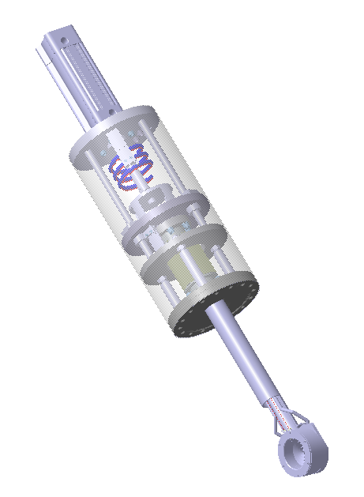
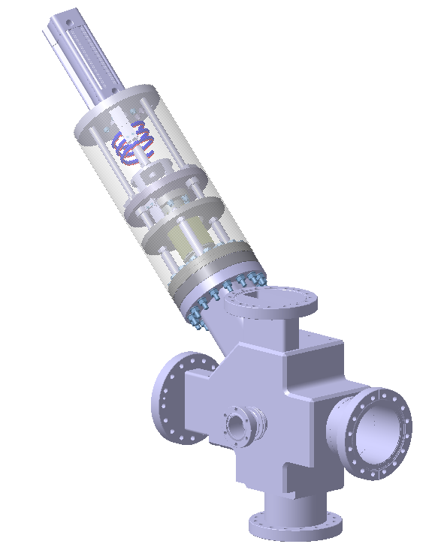
Design Parameters
Parameter | Value
Proton Energy | 3.63 MeV
Intensity | 62.5 mA
Mode I: Fast Tuning | 5 µs - 14 Hz - 16 W
Mode II: Slow Tuning | 50 µs - 1 Hz - 11 W
Beam size | σ_{x} 2.48 mm
 | σ_{y} 2.62 mm
Sample Frequency | >= 2 MHz
Measurement Error | < 0.1 mA
Measurement Precision | σ < 0.01 mA
Repeller Voltage | 0/-1000 V

Slide 8
Summary
Introduction
Conceptual Design
Mechanical Design
Analog Front End
Control System
Product Integration
Conclusions

Slide 9
Conceptual Design
Repeller Voltage Analysis
  MEBT-BI-FC02 Preliminary electron suppression studies for the MEBT Faraday Cup
Thermomechanical Analysis
  MEBT-BI-FC91 Thermo-Mechanical Analysis of the ESS MEBT FC

Slide 10
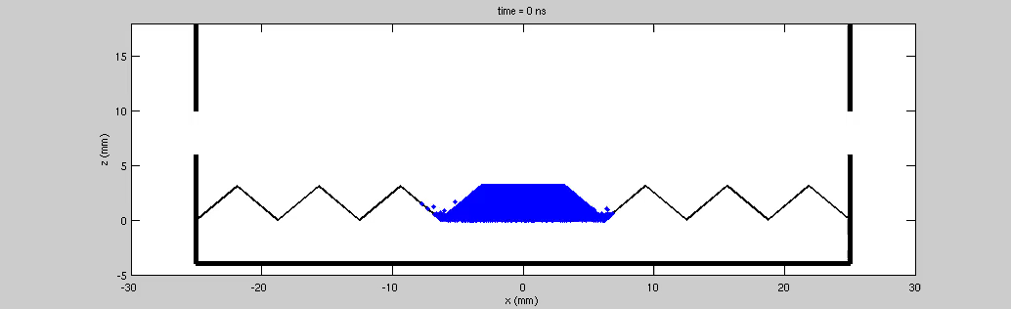
Repeller Analysis
Electrostatic field simulations made with Comsol, particle
dynamics studies performed with GPT.
Considerable effort to create an accurate secondary electron beam (beam footprint, collector angle, emission angle probability and energy distribution, etc).

Slide 11
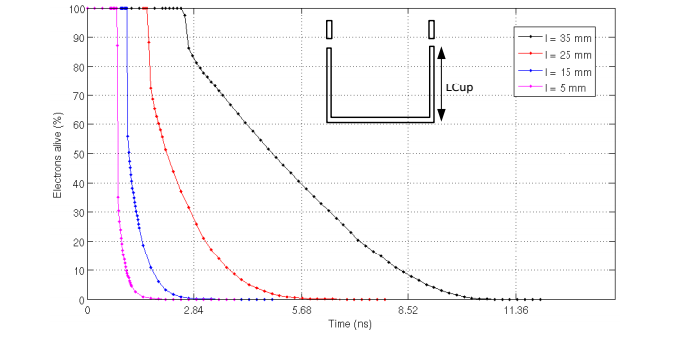
Repeller Analysis
Geometry Collector-Repeller

Slide 12
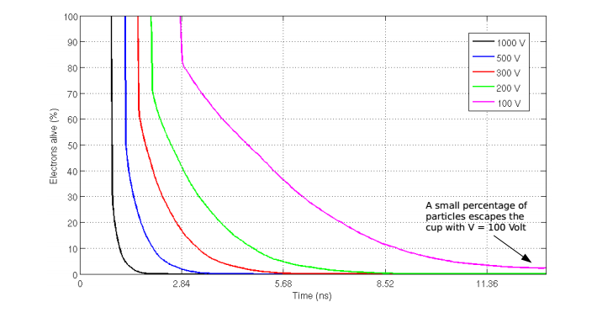
Repeller Analysis
Repeller Voltage

Slide 13
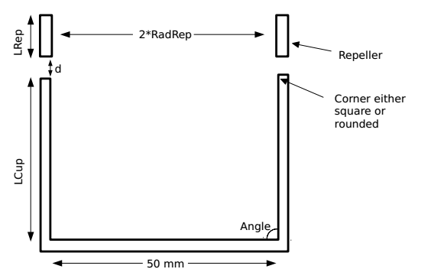
Repeller Analysis
Basic simulations indicate that we can achieve a 100% electron suppression in the Faraday Cup. Full recapture times typically take a few ns.
A full recapture can also be achieved if the suppressor voltage is lowered down to 200 V, although the total capture time is obviously longer.
The final design assumes:
  Voltage: 1 kV
  LCup: 10 mm
  LRep: 10 mm
  d: 4 mm

Slide 14
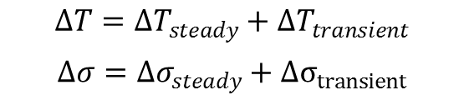
Thermo-Mechanical: Design Criteria
Mode I: Fast tuning is used for steady state analysis, the average power if 16 W, for pulses of 5 µs at 14 Hz.
Mode II: Slow Tuning is used in the transient analysis. The coating materials have to withstand ∼230 kW during 50 µs with at frequency of 1 Hz, for an average power of 11 W
A criterion σ_{Max} ≤ 2/3 σ_{Strength} is used.
$$ΔT={ΔT}_{steady}+ΔT_{transient}$$
$$Δσ={Δσ}_{steady}+Δσ_{transient}$$
Mat. Limit | Graphite
Melt Temp. (K) | 3773
Ult. Tensile Strength / Design Limit (MPa) | 40 / 26
Ult. Comp. Strength / Design Limit (MPa) | 125 / 83

Slide 15
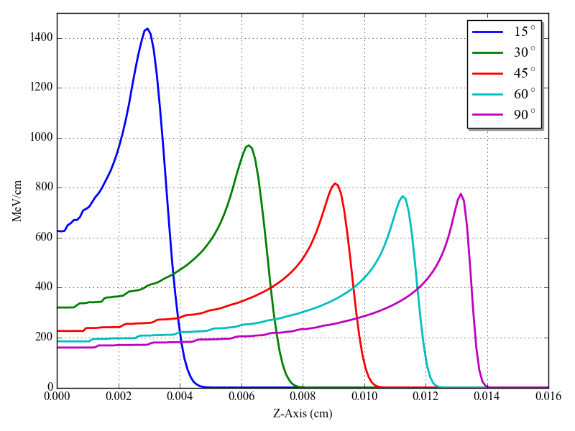
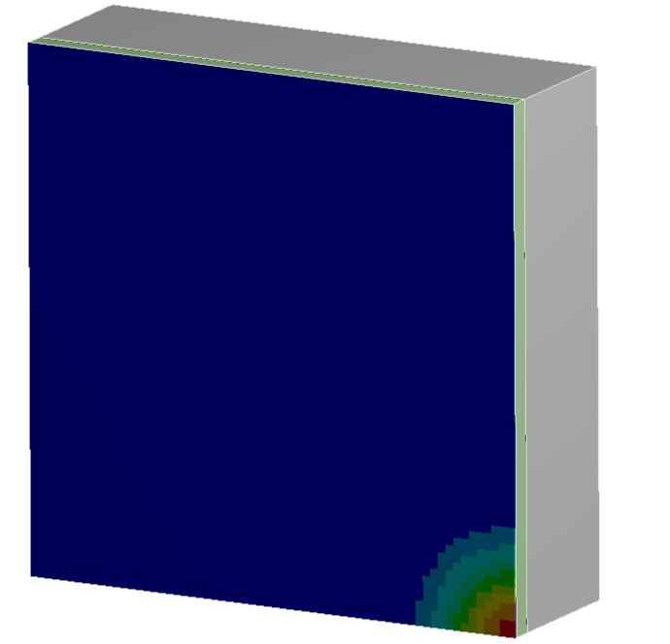
Transient effects
Irradiation is highly concentrated in spots ~mm and depths ~100 µm. This leads to high temperatures and stresses during the transient (50 µs).
Graphite is in contact with refrigerated substrate to dissipate heat in the steady state.
Parameter | Value
Proton Energy (MeV) | 3.63
Beam Current (mA) | 62.5
Pulse duration (μs) | 50
Pulse Energy (J) | 11
Peak Power (kW) | 227
Beam Sigma (cm) | 0.25
Beam Spot (cm²) | 0.4
Beam Current(mA/cm²) | 159
Beam Current(μC/cm²) | 8.0
Stopping Power (MeV/cm) | 775
Energy Deposition (MW/cm³) | 123
Energy Deposition (kJ/cm³) | 6

Slide 16
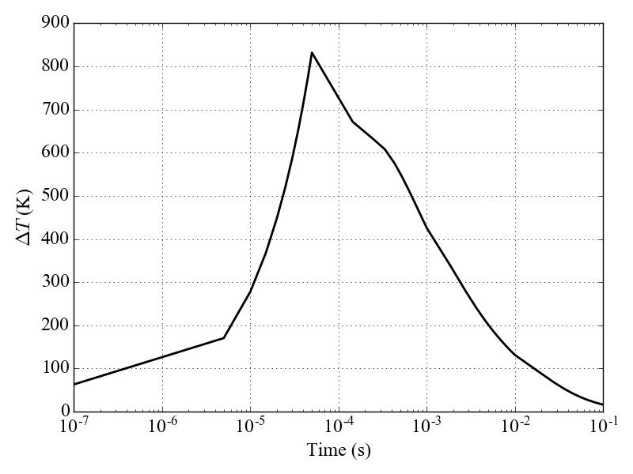
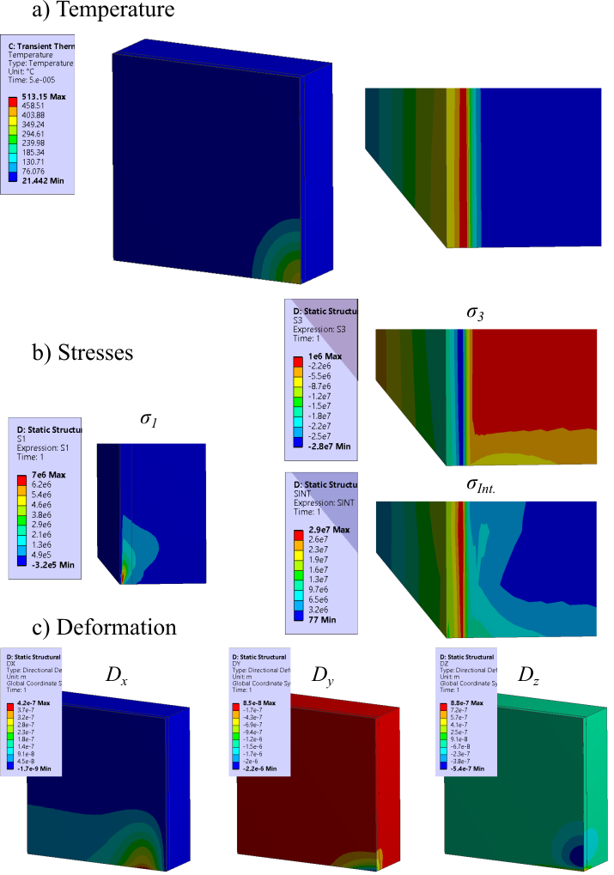
Transient Analysis
Irradiation arrives and heats the surface.
Material expands and compressive stresses appear.
After the pulse the material cools down.
Case | I'' (μC/cm²) | ΔT (K) | σ_{Int} (MPa) | σ_{Int}/σ_{Lim.}
FC: 90º | 8.0 | 832 | 56 | 67%
FC: 45º | 5.6 | 731 | 50 | 60%
FC: 30º | 4.0 | 659 | 45 | 54%

Slide 17
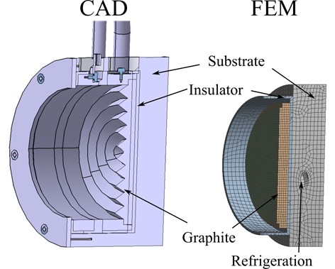
Stationary State
Graphite heat dissipation (~16 W) through a refrigerated body (substrate).
Cooled by water channels in the FC body
We do analysis with copper and steel body (substrate).
We choose a steel body for a more simple manufacturing.

Slide 18
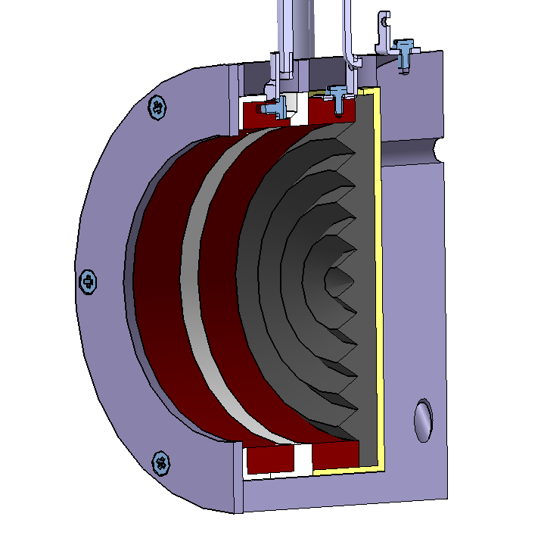
Stationary State
Heat Dissipation dependant on contact conductivity, roughness and microhardness
  Contact Pressure ∼1 MPa, Force 500 N
Thermal Contact is only effective where contact pressure is applied.
Force
Contact Pressure
~MPa

Slide 19
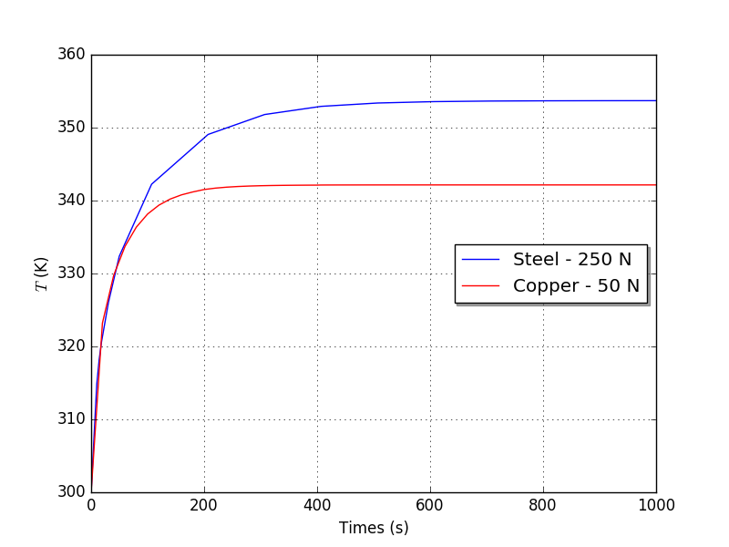
Stationary State
Thermal contact between graphite/insulator/steel body.
Stationary state is attained in ~300 s
Low temperature gradient (<100 K)
Low stresses (∼1 MPa)
Contact Pressure ∼1 MPa, Force 500 N
Small Deformations (10-20 μm)

Slide 20
Stationary State
Thermal contact between graphite/insulator/steel body.
Stationary state is attained in ~300 s
Low temperature gradient (<100 K)
Low stresses (∼1 MPa)
Contact Pressure ∼1 MPa, Force 500 N
Small Deformations (10-20 μm)
Steel – 500 N

Slide 21
Stationary + Transient State
Case | ΔT (K) | σ₁ (MPa) | σ₃ (MPa) | σ_{Int} (MPa) | σ_{Int}/σ_{Lim.} | Max. Def. (μm)
Initial | 300 | 0 | 0 | 0 | 0 | 0
Transient at Initial (300 K) | 659 | 1.8 | -44 | 45 | 54% | 0.6
Transient at Steady (385 K) | 620 | 1.6 | -44 | 44 | 53 % | 0.6
Steady | 85 | 0.7 | -1.8 | 1.8 | 2 % | 20
Total (Init. + Steady + Transient) | 1005 | 1.6 | -44 | 44 | 53% | 20

Slide 22
Summary
Introduction
Conceptual Design
Mechanical Design
Analog Front End
Control System
Product Integration
Conclusions

Slide 23
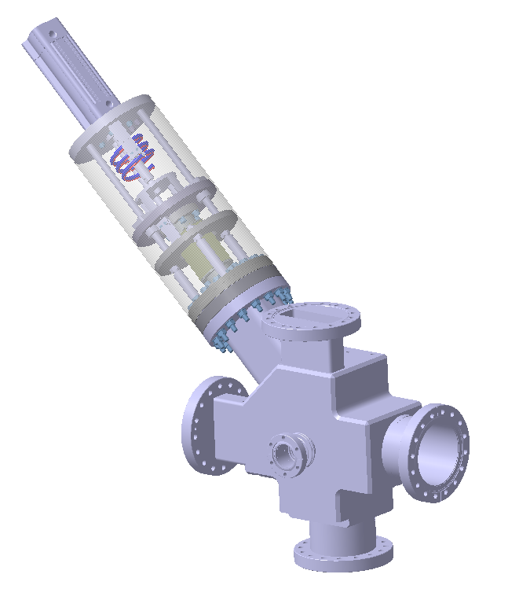
Mechanical Design
MEBT-BI-FC90 Technical Specifications for the ESS MEBT FC
FC Drawings
CAD Conceptual Design

Slide 24
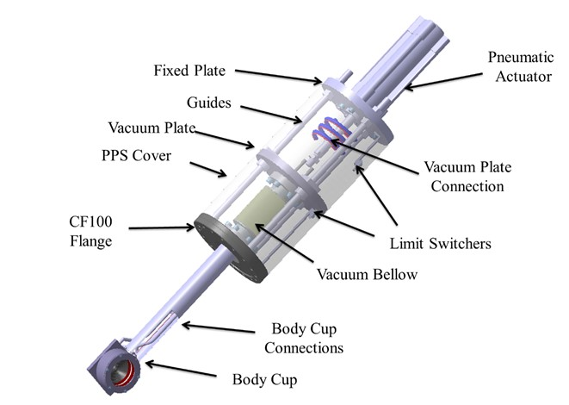
Mechanical Design

Slide 25
FC Requirements
Parameter | Description
Beam Irradiation | 3.63 MeV - 62.5 mA
Peak Beam Power | 230 kW
Average Beam Power | 16 W
Temperature | Body Cup 5-200 ºC Actuator System 5-50 ºC
Vacuum Conditions | 10⁻⁷ mbar
Refrigeration | 25 ºC, 5 bar, 2 l/min
Faraday Cup Weight | ~10 kg
Body Cup Weight | ~1 kg
Body Cup Materials | Graphite Collector Stainless Steel Body Copper Repeller Alumina/Macor Insulators
Mounting Orientation | 45º
Mounting Flange | CF100
Mounting flange to beam axis distance | 273 mm
Mounting Flange Aperture | 86x58 mm
Body Cup Diameter | 70 mm
Body Cup Aperture | 48 mm
Stroke Distance | 80 mm
Repeller Voltage | 1000 V
Collector Signal Connection | BNC or SMA
Repeller Power Supply Connection | MHV
Pneumatic Actuator | 5-10 bars
Automatic Actuator Retraction | Spring > 250 N
Machine Protection System Limit Switchers | Integrated in the frame
Local Control Limit Switchers | Integrated in actuator

Slide 26
Proposal of Components
Component | SubComponents | Proposed Component
Vessel (Out of the scope) (MEBT-FC-2000-ESS)
Faraday Cup (MEBT-FC-1000-ESS)
Body Cup (in vacuum) (MEBT-FC-1100-ESS - CAD Model & blue prints) | Steel Body | SS316L
 | Graphite Collector (Out of the scope) | SGL R7550
 | Copper Wall Collector | Copper OFHC
 | Repeller | Copper OFHC
 | Alumina Insulator | Alumina 99%
 | Macor Insulators | Macor
 | Lid | SS316L
Actuator System (MEBT-FC-1200-ESS - CAD Model) | Body Cup Connections (in vacuum) | - Refrigeration: f6 mm - Repeller Voltage: Allectra 380-MHVor equivalent - Data Signal: Allectra 311-KAP50or equivalent
 | CF100 Flange (in vacuum) | DN 100-40 CF Flange. Pfeiffer 420FLR100-040 or equivalent
 | Vacuum Bellow (in vacuum) | CF40, 8mm stroke vacuum bellow. Vacom EWB40R-80 or equivalent.
 | Vacuum Plate (in vacuum) | - CF40 flange - Refrigeration feedtrough: f6 mm - Data Signal feedtrough: Allectra SMA 50 Ω or equivalent - Repeller Voltage feedtrough: Allectra 241-MHV or equivalent
 | Vacuum Plate Connections | Hosing, cabling 200 mm
 | Guides | - Guides NIM12SS-0300 or equivalent - Linear Bearings SFPM12 or equivalent
 | Fixed Plate | Stainless Steel f150
 | Pneumatic Actuator | - Cylinder: Festo DSCB, DNC or equivalent - Electrovalve: Festo CPE or equivalent - Limit Switcher: Festo SME or equivalent
 | External Limit Switchers | OMRON SS-01GL2-E or equivalent
 | PPS Cover | Plastic cover f150 mm
* Final components yet to be defined in collaboration with Product Supplier

Slide 27
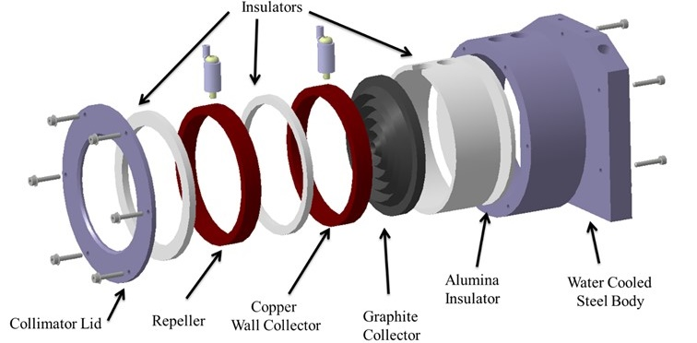
FC Body Cup

Slide 28
FC Body Cup
Drawings ready for manufacturing

Slide 29
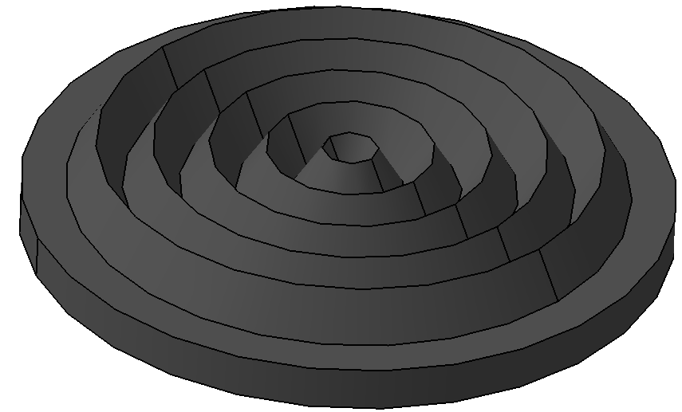
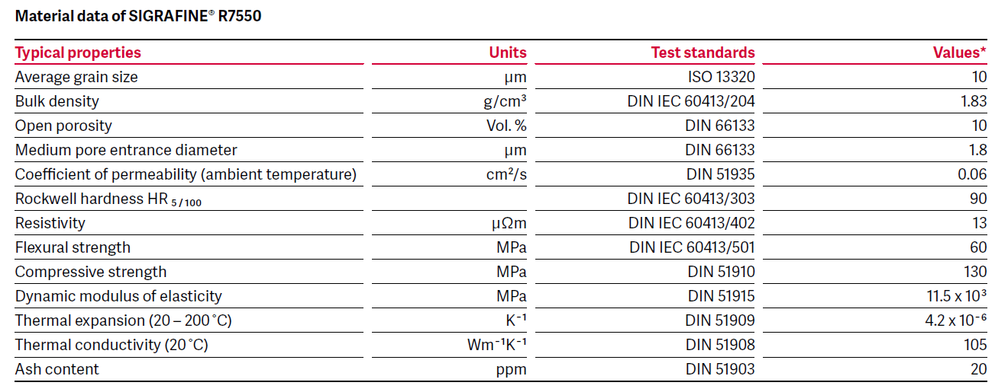
Graphite Collector
Isostatic fine grain graphite SGL Sigrafine R7550 P5D
Graphite plate with indented surface for better performance under irradiation.
Plate of 58 mm diameter, 4 mm thickness and 4.33 sawteeth height sawteeth with angles of 30º

Slide 30
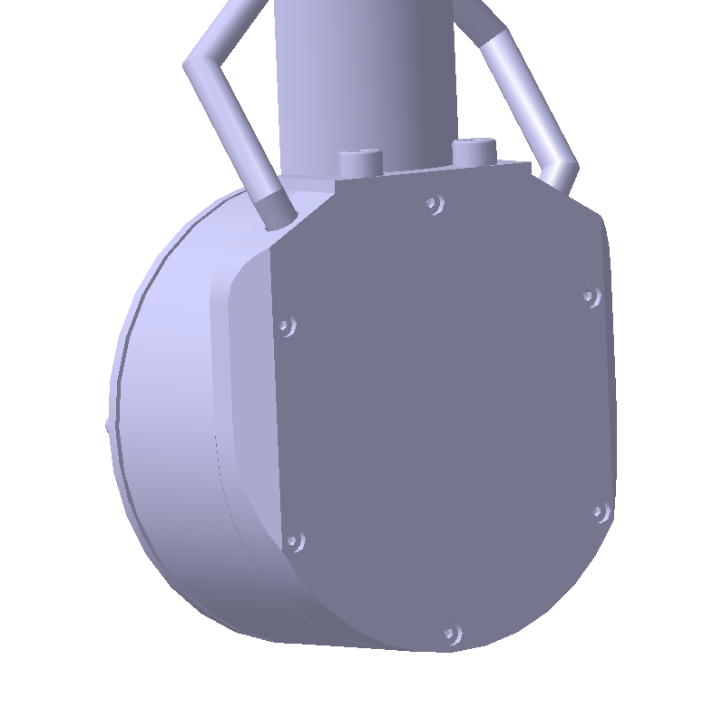
Refrigerated Body
V-Shaped robust Refrigeration
Nominal Diam. 6 mm (Internal)
Water at 1 m/s or 2 l/min

Slide 31
Actuator System
Technical Requirements for Product Supplier
Specific components and Final Design to be defined by Product Supplier

Slide 32
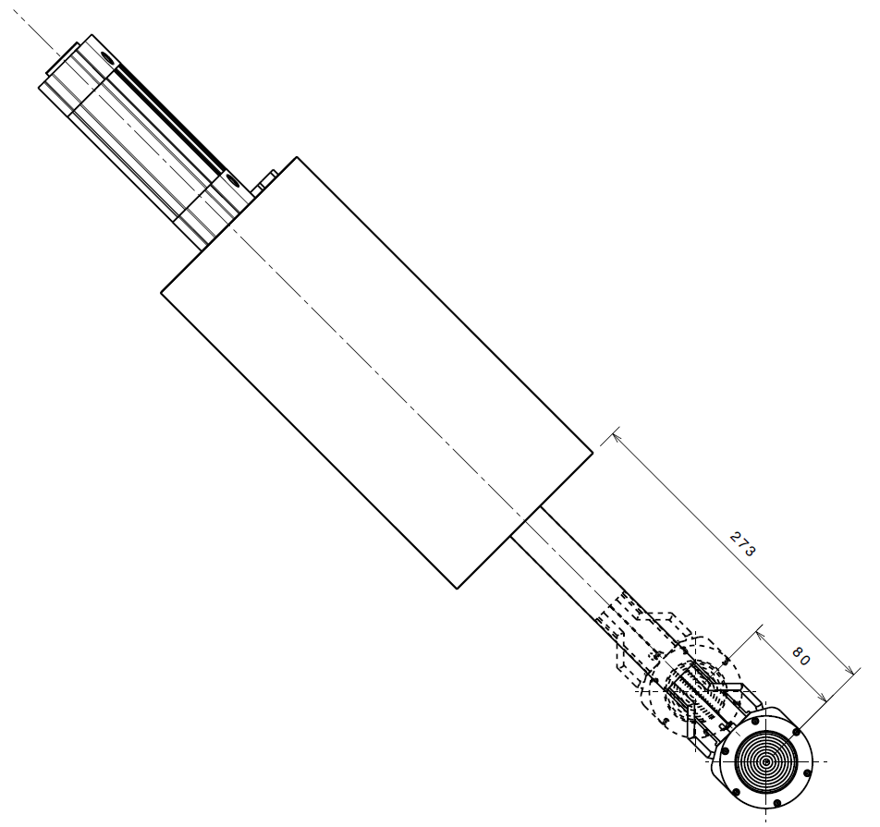
Actuator
The FC will be actuated with a pneumatic actuator, controlled by an electro-valve.
The actuator will operate with compressed air 5-10 bars.
The actuator stroke will be of 80 mm. A piston diameter of ϕ 40 mm is proposed.
The actuator will by default be in the retracted position
  Automatic retraction to protect the cup is required in case of failure.
  The retraction will be done with a spring.
A pair of limit switchers shall be installed on the FC actuator for the motion control system.
The electro-valve will operate with a voltage of 24 V.
The limit switchers will operate with a voltage of 30 V.

Slide 33
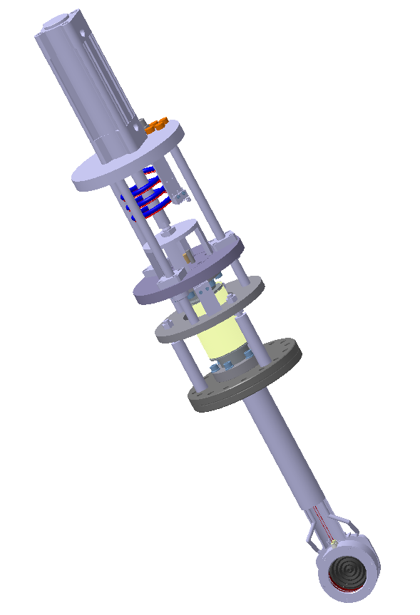
Limit Switchers
One pair in actuator for Local Control System.
One external pair for MPS
  This pair of switches will be cabled separately and used solely by the Machine Protection System (MPS) of ESS.
  Mounted in supports that correspond to the beginning and end positions of the vacuum plate.
  The external limit switchers will be completely independent from the limit switchers integrated in the actuator.
Upper
Limit Switcher
Lower
Limit Switcher

Slide 34
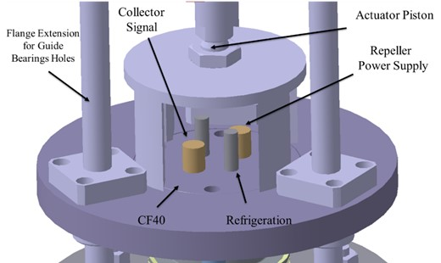
Vacuum Plate
The Vacuum plate could be connected to the vacuum bellow with a CF40 flange.
In the CF40 flange the feedthrough for refrigeration, collector signal and repeller power supply will be included.

Slide 35
Product Positioning
Positioning in a ± 5 mm.
Final Design to be defined by supplier.

Slide 36
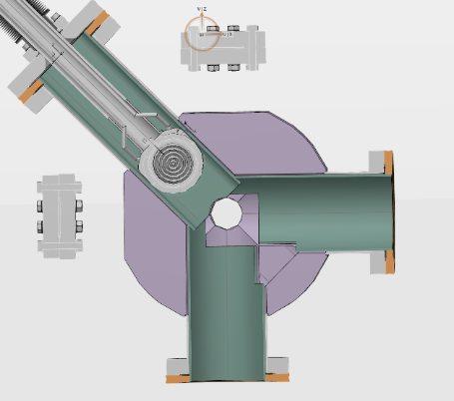
Product Mounting
Mechanical Integration
Complete MEBT: MEBT-00-0000-ESS_ASSY_PROC-REV2
FC Raft: MEBT-00-0800-ESS_ASSY_PROC-REV2
Adapted for NPM Cover Flange

Slide 37
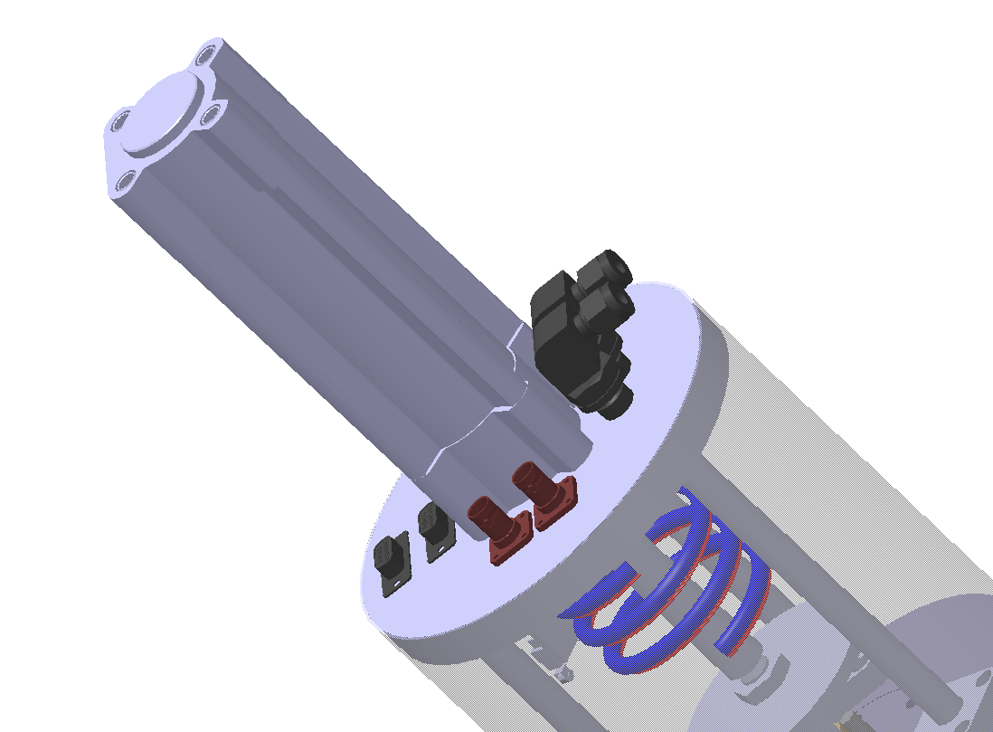
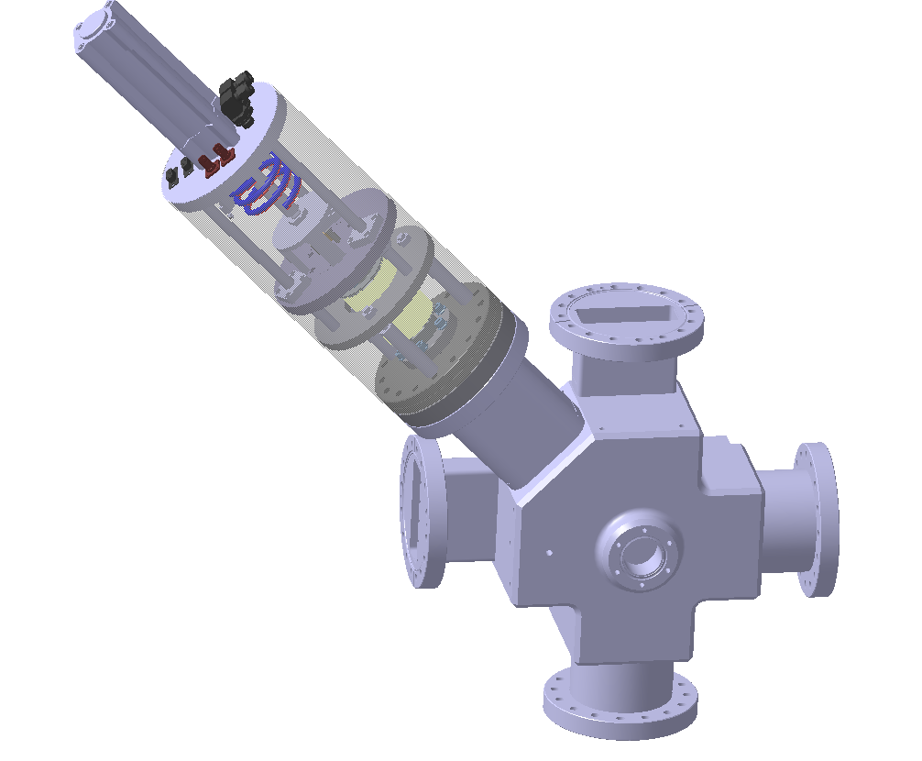
Interfaces
Patch panel to be defined with supplier:
  BSP (ISO) Parallel Thread
  BNC or SMA for Data Signal
  MHV for Repeller Voltage
  DB9 or similar for digital signals (Electro-valve, limit switchers)
BSP
BNC or SMA
MHV
DB9

Slide 38
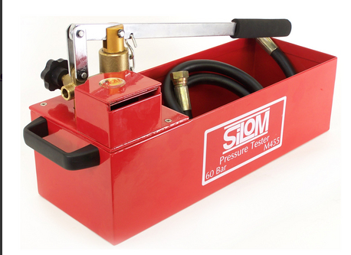
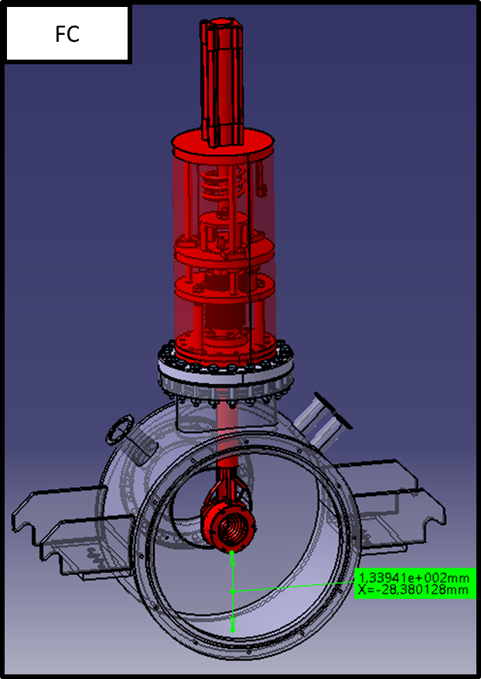
Acceptance Tests
FAT (by supplier see MEBT-BI-FC90 )
SAT (by ESS-Bilbao)
  Pressure Tests
    16 Bar – 15 min
    Silom M455
  Motion Tests
  Electric Tests
    Data Signal
    Repeller PS (ISEG DPR)
  Vacuum Leak Tests
    < 10⁻⁹ mbar/l s
    ISHP-DV vessel

Slide 39
Summary
Introduction
Conceptual Design
Mechanical Design
Analog Front End
Control System
Product Integration
Conclusions

Slide 40
FC Cabling Layout
Label | Name | Connector 1 | Connector 2
1A | 311-KAP50-RAD | Open end | SMA/BNC
1B+1C | TE Connectivity RG178 CLFH-178CK0135 | SMA/BNC | SMA/BNC
2A | 311-KAP50-RAD | SHV | SHV
2B | FLAMEX RG 214 | SHV | SHV
1D | Coaxial Huber+Suhner S-12272-04 | BNC | Open end
3D | 12 conductors Lapp 1123080 | Souriau M10 | Souriau M10
2D | FLAMEX RG 214 299958 | SHV | SHV

Slide 41
Repeller Power Supply
ISEG DPR 10 106 24 10 ESH
  Vout: 0 to –1000 V
  Imax: 10 mA
  Vin/Iin: 24 V/0.8 A
  Control Signal 0-10 V
  Ripple/Noice: 2/7 mV
  SHV output
  DB9 control signal

Slide 42
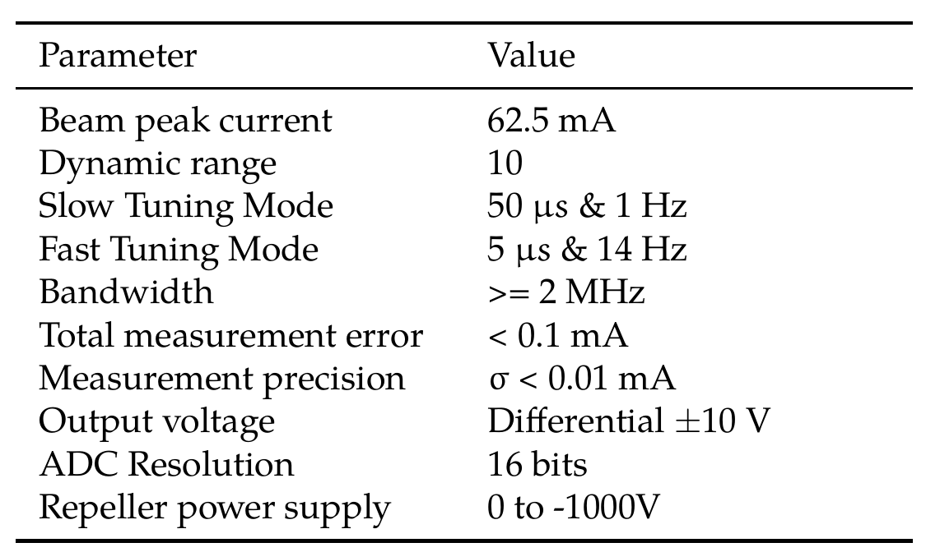
Front-End Requirements

Slide 43
Front-End Design Process
Preliminary Design
Calcs. and simulations
Protoboard settings
Prototype design
Prototype tests
Aux. systems (BackEnd)
Mechanical design
Final release
Validation plan

Slide 44
Front-End Schematic
“MEBT-BI-FC09 FC Front-End Design Document”

Slide 45
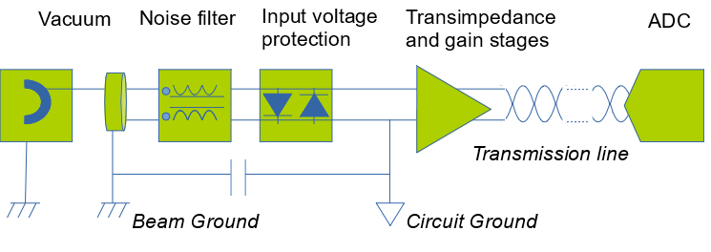
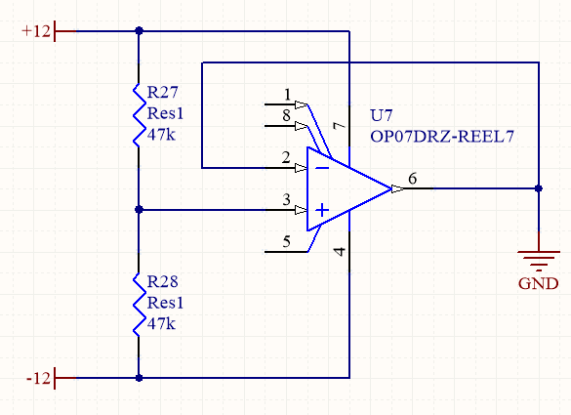
Front-End Grounding
Circuit Ground isolated from Beam Ground (Machine)
Circuit Ground isolated
from Power Supply (Gallery)

Slide 46
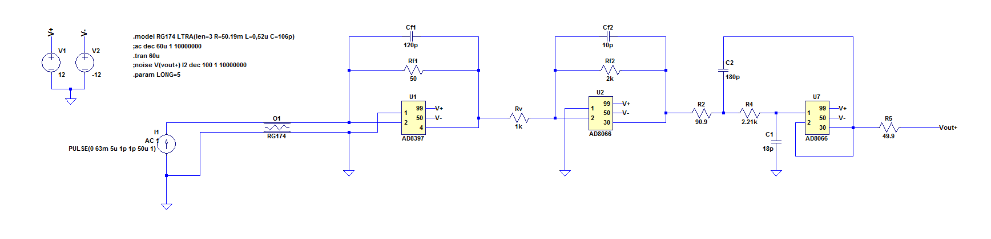
Front-End Simulations
Design validated using LT-Spice

Slide 47
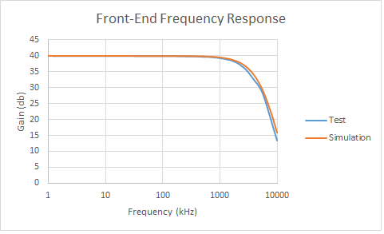
Front-End Prototype Tests
“MEBT-BI-FC08 FC Front-End Prototype Tests”

Slide 48
Front-End + ADC
Integration with VME Control System

Slide 49
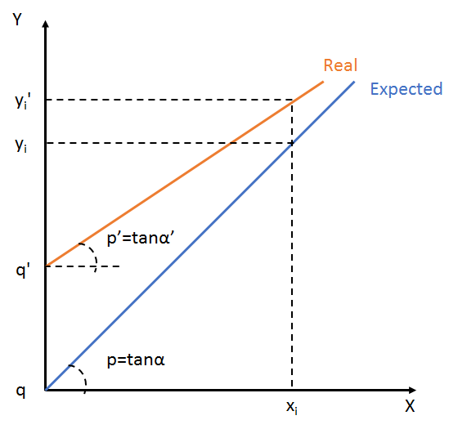
Calibration & Validation
Calibration method
  Find calibration factors p’ q’
  Defined as Process Variables
Validation plan
  Standalone FE (input = current source, output = oscilloscope)
    Step response
    Linearity
    AC response
    Noise analysis
  Vertical Test (input = current source, output = µTCA, final cables)

Slide 50
Summary
Introduction
Conceptual Design
Mechanical Design
Analog Front End
Control System
Product Integration
Conclusions

Slide 51
Introduction
HW description
SW description
  Functionality
  Engineering GUI
  EPICS development
Based on documents:
MEBT-BI-FC81 FC MEBT Faraday Cup Software Design Document
MEBT-BI-FC82 MEBT Faraday Cup Software Development Document
MEBT-BI-FC83 MEBT FC GUI Description

Slide 52
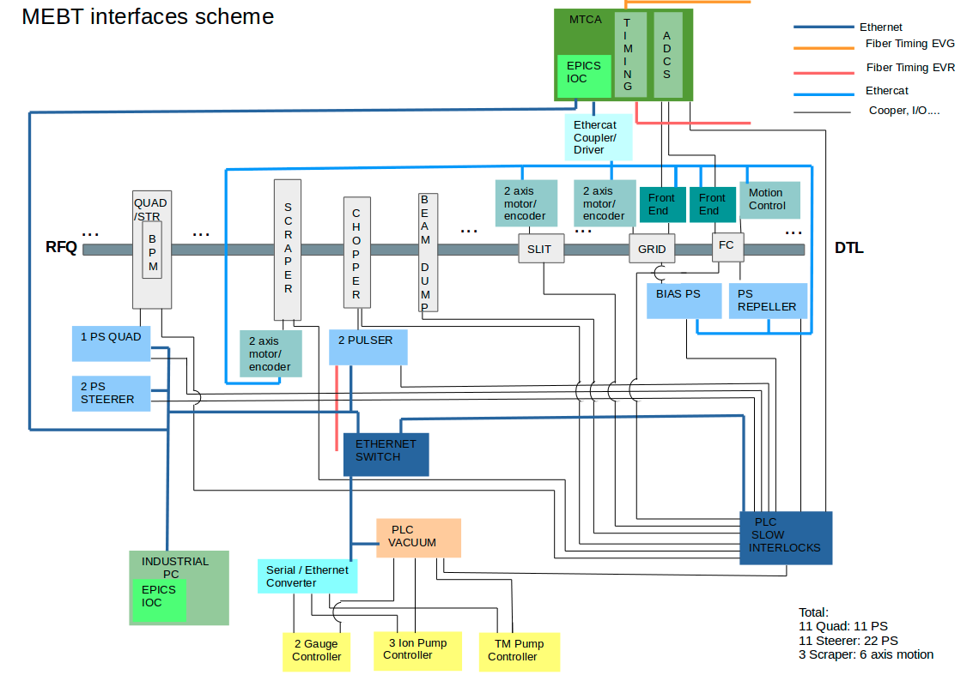
HW description MEBT General interface layout

Slide 53
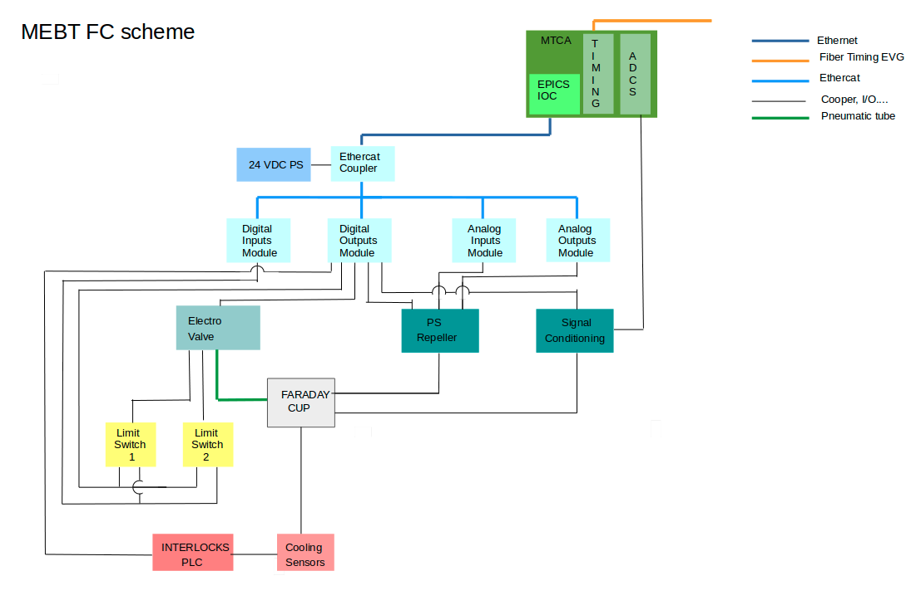
HW descripiton FC General interface layout

Slide 54
HW description 1
FC shares crate and CPU with EMU and Scrappers.
Actual developments based on VME platform.
VME crate: ELMA Type 39 Horizontal, 4U, 84HP.
CPU: IFC1210-Intelligent FPGA Controller P2020 VME64x from IOxOS.
Digitizer board: D-Tacq ACQ420FMC-4-2000-16: 4 analog channels, 2 MSPS, 16 bits.
Event Receiver Board PMC-EVR-230 from MRF.
Planned to migrate to mTCA platform.
More interesting HW changes:
CPU: IOxOS IFC_1410 QorIQ T2081 & Kintex UltraScale AMC.
Shared digitizer board with EMU: IOxOS FMC ADC3117 20 channels ADC 16-bit 5 Msps.
Event Receiver Board PMC-EVR-300 from MRF.
MCH from NAT.
For testing purposes at the lab there is also an Event Generator Board that in operative conditions will be in an external subsystem
Event Generator MRF VME-EVG-230 from MRF

Slide 55
HW description 2
External integrated systems controlled from the previous crate HW:
FC insert/retraction: solenoid valve.
Repeller control for voltage supplying.
Interlocks interface.
These external systems controlled by the CPU through the Beckhoff automation technology system modules connected by ethercat bus.
Solenoid valve:
Digital outputs module.
Repeller:
Digital outputs module, analog outputs module and analog input module.
Beam Permit from MPS: Digital input module.
The system also is provided with an Interlocks Siemens PLC for cooling and interlocks functions.

Slide 56
SW general control
FC SW modules:
EPICS module: FC_MEBT.
EPICS module: Ethercat_MEBT: shared with EMU and Scrapers.
Application flow:
1. Settings configuration
Acq420 control settings.
Repeller configuration and activation.
Data acquisition settings.
2. Push Insert in the menu of Position
3. Application running
Data acquisition
Store number of pulses needed for background calculation
Each #Acq Pulses:
      Background subtraction calculation.
      Statistics calculation.
4. Push Retract in the menu of Position

Slide 57
SW calculation
Background subtraction:
Each number of pulses defined in #Acq Pulses
Background subtraction applied to the last income pulse: evaluating pulse.
Statistics calculation.
Background subtraction calculation:
Calculated over the last read pulses.
Number of pulses involved for background subtraction defined in #Bgnd Pulses.
Calculates averages of each i sample all over the pulse: average[i].
If each sample from evaluating sample[i] – threshold > average[i].
then evaluating sample[i] = average[i].
Calculated statistical values:
• Peak current value.
• Minimum current value.
• Standard deviation.
• Average current value.

Slide 58
SW: Interlocks
Cooling and interlocks control on Interlocks PLC.
Inputs to interlocks PLC:
Water cooling temperature.
Water pressure at input/output.
Power supplies behavior.
Interlocks PLC calculations:
Temperature is within normal operational limits.
Pressure within normal operational limits.
Power supplies are healthy.
Output from interlocks PLC to MPS:
FC status.
Input from MPS to IOC through Beckhoff EtherCAT system:
FC permitted to insert: BEAM PERMIT.

Slide 59
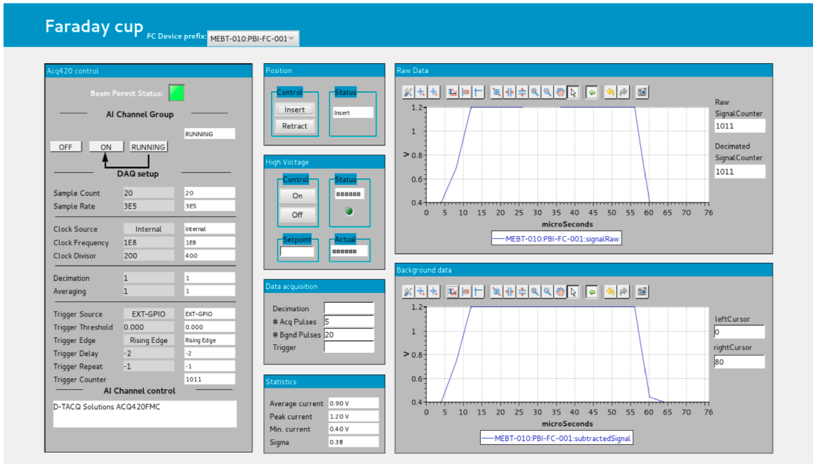

SW: Engineering GUI

Slide 60
SW: Engineering GUI fields
Acq420 control: Settings from ifcdaq module to control ADC.
Position: Insert / Retract the FC.
High Voltage: Repeller control.
Data acquisition: Settings to additional functions.
Statistics: Result values.
Raw data: Raw pulse monitoring.
Background data: Background applied to pulse.

Slide 61
SW: EPICS modules
Drivers needed for HW and VME standardization:
IOxOS VME drivers
MRF (Timing) drivers.
EPICS modules for the SW solution:
System and device support related modules: environment, pevdrv, nds3epics, nds3, asyn
Specific digitizer hardware related modules: ifcdaq
Event receiver related module: mrfioc2
Specific application related module: FC_MEBT.
MEBT Ethercat related moduel: MEBT_ethercat.

Slide 62
Complementary Information
New terms of control under study by ICS.
GUI development:
Move the CSS BOY OPI to Display Builder.
Migration from VME to mTCA:
ICS in the development team at ESS Bilbao.
Date availability of new mTCA HW to be defined:
  CPU board and Digitized board, HW drivers, and device support under development.
  Event Receiver Board AMC-EVR-300 from MRF, under development.
Changes in the HW, and SW architecture:
One CPU: IOxOS IFC_1410 QorIQ T2081 & Kintex UltraScale AMC in exclusive for FC.
One IOxOS FMC ADC3111 8 channels ADC 16-bit 250 Msps.
One IOC running on the CPU, with Ethercat integrated.

Slide 63
Summary
Introduction
Conceptual Design
Mechanical Design
Analog Front End
Control System
Product Integration
Conclusions

Slide 64
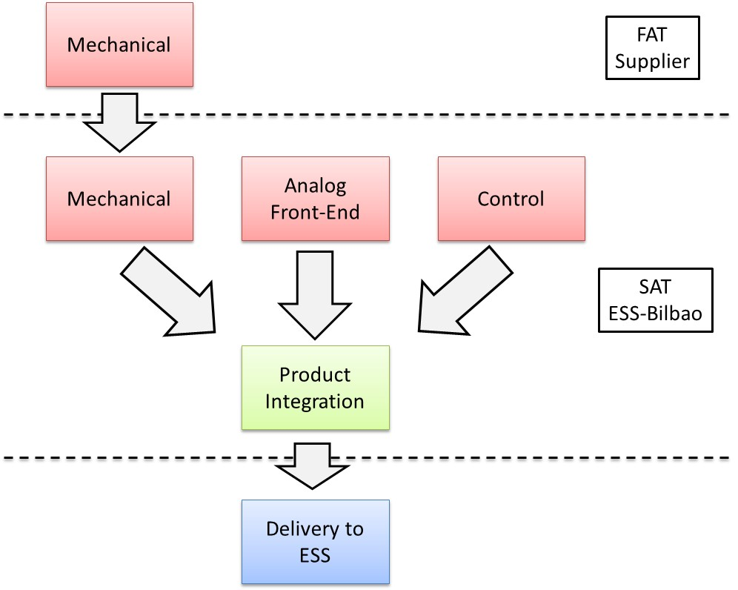
Product Acceptance

Slide 65
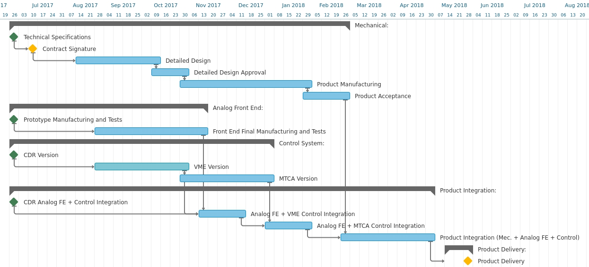
Project Schedule

Slide 66
Risk Assessment
ID | Event | Cause | Impact | Treatment Plan
MEBT-PBI-FC-101 | Incorrect Product Specifications | Bad communication ESS and ESS-Bilbao | Product not working in the required conditions. | Discussion of specifications and design with ESS
MEBT-PBI-FC-102 | Incorrect Product Operation | Not foreseen errors, incorrect specifications, incorrect manufacturing by suppliers, etc. | Product not working correctly. | Product verification in different stages: part by part and product integration.
MEBT-PBI-FC-103 | Delay in Product Delivery | Delay in suppliers, integration tests. | Delay in MEBT commissioning. | Develop Project schedule.

Slide 67
Risk Assessment
ID | Event | Cause | Impact | Treatment Plan
MEBT-PBI-FC-01 | 1Hz, 50μs beam mode not acceptable | Beam irradiation conditions. | Integrity of device under risk | Problem studied in MEBT-BI-FC91. Correct operation is expected. Limit for maximum allowed density current established (6 μC/cm²).
MEBT-PBI-FC-02 | Proposed collector geometry may arise fabrication problems | Withstanding a 50 μs pulse requires steep “teeth”. Preserving the total FC length demands the “teeth” to be short and narrow (and therefore to have more or them) | Schedule delay, not meeting performance requirements | Graphite manufacturers contacted. No problem is expected.
MEBT-PBI-FC-03 | Bunker for active electronics | No foreseen bunker for analog electronics | Integrity of device is under risk | Finally it was decided by ESS that there will be no bunker. The analog electronics will be placed in the tunel.
MEBT-PBI-FC-04 | Impacts of Emissions. | Bilbao should note that emissions (outgassing, ablation, etc.) from interceptive PBI, induced by the beam, may have impact on other devices like insulators for BPM / CT, electrodes on BPM, vacuum valves. | Effect on vacuum, impact on other components. | PBI Outgassing Included in Vacuum Analysis. MEBT-BI-FC91 we study that no ablation is expected for interceptive PBI. Allocate budget for spare parts. Develop maintenance plan for graphite collector in order to detect possible irradiation damage an proceed to its substitution.
MEBT-PBI-FC-05 | Bad Contact | Bonding technologies. Bilbao should consider alternate bonding technologies, such as High Pressure assembly (HiP) because of problems with thermic contact between tungsten, graphite and copper. HiP technology such as that implemented at CEA Liten may be foreseen (950°C / 1400 bar / 2 H. See also Recommendation #6. | Bad signal measurement. Excessive heating. | In MEBT-BI-FC91 we study that mechanical contact guarantees good thermal contact. We also evaluated the use of HiP or brazing. HiP may work well in metals but difficult to implement in graphite. Brazing could be used, however mechanical contact is preferred since it is a simpler solution and allows for a modular design.
MEBT-PBI-FC-06 | Vacuum Suitability | Bake Out. Check to see if any components require bakeout to comply with ESS requirements. | Bad vacuum conditions | Checked with suppliers no bake out will be necessary for operation at 10⁻⁷ mbar.

Slide 68
Risk Assessment
ID | Event | Cause | Impact | Treatment Plan
MEBT-PBI-FC-07 | Effects of cables on signal | Cable Testing. Bilbao and ESS to consider signal transmission testing for long cables. | Introduce of noise/errors on signal. | Studied in MEBT-BI-FC08 FC Front-End Prototype tests
MEBT-PBI-FC-08 | Noise in the signal from secondary electrons | Secondary electron bad supresion. The fields of the proton beam could affect the secondary electrons. Assure that this does not significantly impact the signal from the Faraday cup. | Biased signal. | Study of SE suppression in MEBT-BI-FC02 Preliminary electron suppression studies for the MEBT Faraday Cup. Inclusion of a 1 kV repeller.
MEBT-PBI-FC-09 | Portability for MTCA | MTCA is the standard platform for ESS high performance electronics but some systems are currently being prototyped in VME | Schedule delay, failure at the integration | Develop plan to migrate to µTCA Confirm delivery dates for HW and SW
MEBT-PBI-FC-10 | FE not meeting design goals. | Unexpected causes (bad design, failure, etc) | Biased or wrong measurements. | Detailed design of electronics in MEBT-BI-FC09. Part by part testing of components and vertical integration.
MEBT-PBI-FC-11 | Failure during product assembly. | Unexpected causes (bad design, failure, etc) | Wrong operation, delay in product acceptance. | Requirements specified in MEBT-BI-F90. Details about assembly will be discussed with product supplier.
MEBT-PBI-FC-12 | Final position miss-adjustment | Wrong product integration/Incorrect design | The collector does not fall in the beam axis | Requirement for position adjustment in MEBT-BI-F90. Collimator lid larger than beam-pipe. Modular design.
MEBT-PBI-FC-13 | Failure on limit switcher | Bad connection, failure, etc | Unknown FC status | Redundancy of limit switchers.
MEBT-PBI-FC-14 | Wrong product integration in MEBT. | Bad definition of interfaces. | Delays, redefinition of interfaces, use of adapters. | Definition of interfaces between different groups.

Slide 69
Summary
Introduction
Conceptual Design
Mechanical Design
Analog Front End
Control System
Acceptance Tests
Conclusions

Slide 70
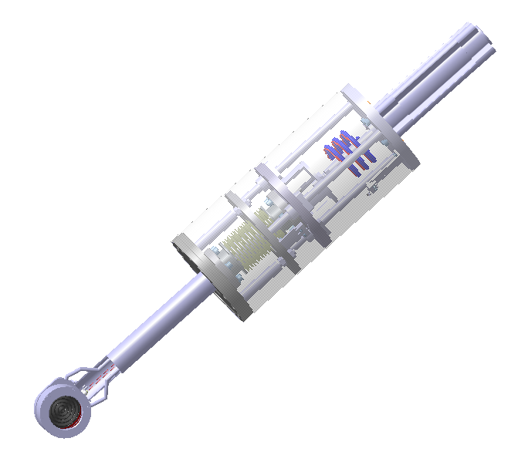
Conclusions
Conceptual Design
Detailed Design
Manufacturing
Testing, Integration & Delivery
I. Bustinduy
D. de Cos
C. de la Cruz
I. Mazkiaran
A. Milla
R. Miracoli
T. Mora
A. Ortega
J. Ortega
A. R. Páramo
I. Rueda

Slide 71
Conclusions
Thank you for your attention

