Slide 1


Status of the
ESS MEBT EMU
EMU Team
ESS-Bilbao
Beam Instrumentation Group
July – 2017
Notes:
Decir que hablo en parte del equipo de ESS-Bilbao
Decir que es básicamente el trabajo presentado para el CDR.

Slide 2
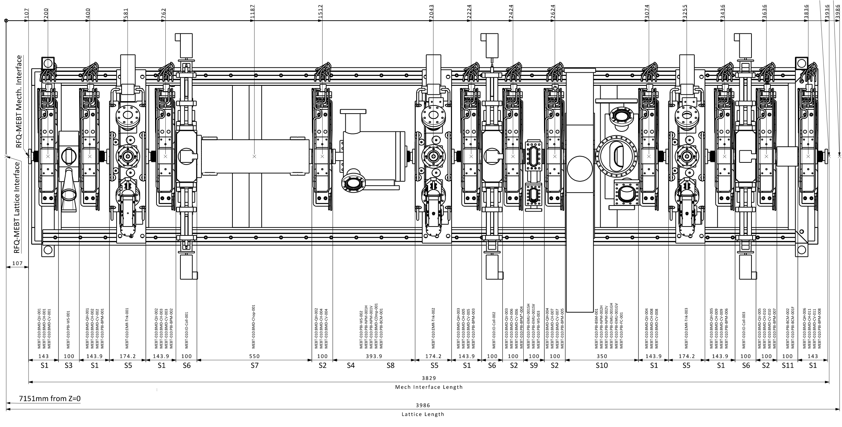
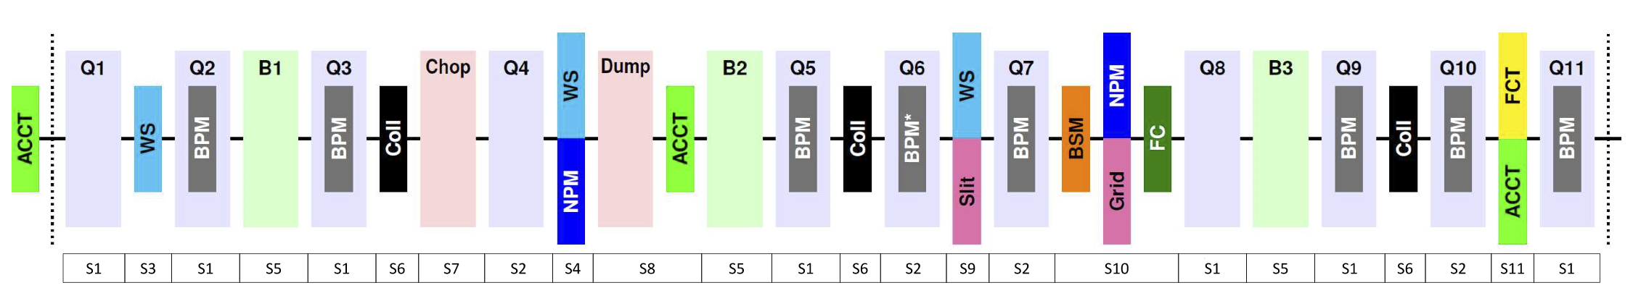
ESS MEBT
SLIT
GRID

Slide 3
L4 Requirements
User Defined ID | DOORS-ID | Name | Description
 |  | MEBT transverse phase space measurement | The beam distribution in transverse phase space shall be measured in the MEBT section. The measurement can be invasive.
MEBT-L4-PBI-110 | MEBT.PBI-54 | MEBT transverse phase space measurement planes | The transverse phase space measurement shall consist of one horizontal and one vertical measurement. Both measurements shall independently fulfil all requirements.
MEBT-L4-PBI-120 | MEBT.PBI-55 | MEBT transverse phase space 95% emittance measurement error | The transverse emittance containing 95% of the beam shall be measured with a total measurement error of less than ±10 % of the measured value.
 |  | MEBT transverse phase space RMS emittance measurement error | The transverse RMS emittance shall be measured with a total measurement error of less than ±10 % of the measured value.
 |  | MEBT transverse phase space measurement dynamic range | The transverse phase space measurement shall have a dynamic range of 1000.
Notes:
Invasive measurement of phase space
Independently measure horizontal and vertical BUT NOT at the same time!
The 95% and RMS emittance reconstruction within ±10%
Dynamic range 1000

Slide 4
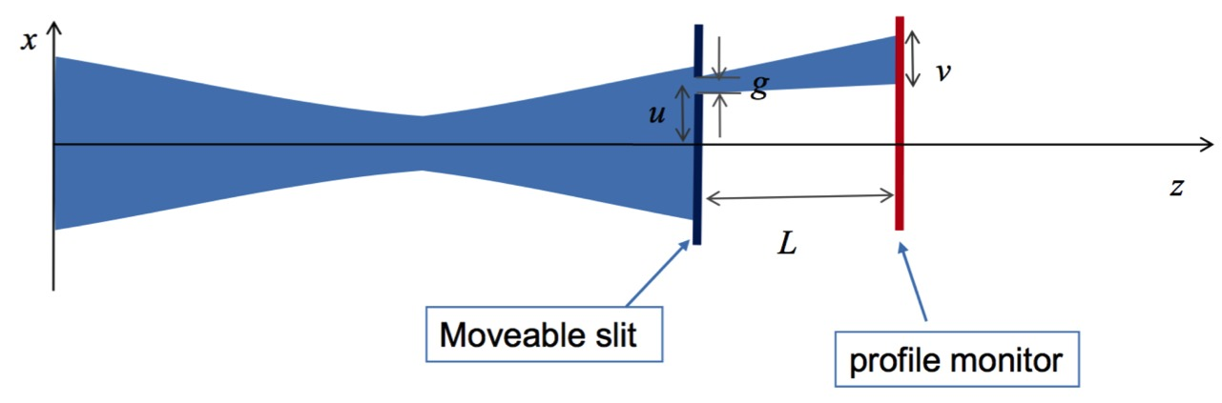
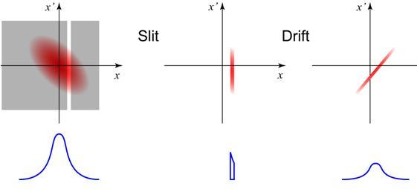
EMU Measurement

Slide 5
EMU Measurement

Slide 6
Main parameters
These are the main parameters that affect to the reconstruction of the emittance
Distance Slit – Grid: 362.9 mm
Slit aperture: 100 µm
Slit thickness: 200 µm
Grid wires: 24
Wires diameter: 35 µma
Grid pitch: 500 µm
Expected maximum signal ~100 µA
Notes:
Parameters coming from Benjamin’s design report

Slide 7
Error assignment
The error in the emittance reconstruction depends in the Slit – Grid distance. For 400 mm the main contribution to the error are:
  Error in the position of slit and grid ~2%
  Error due to scattering (200 µm thickness slit) ~1%
  Error due to space charge ~1.5 %
Sum of errors ~5%
We still have some margin for the 10% goal
Notes:
Data comming from Benjamin’s report

Slide 8
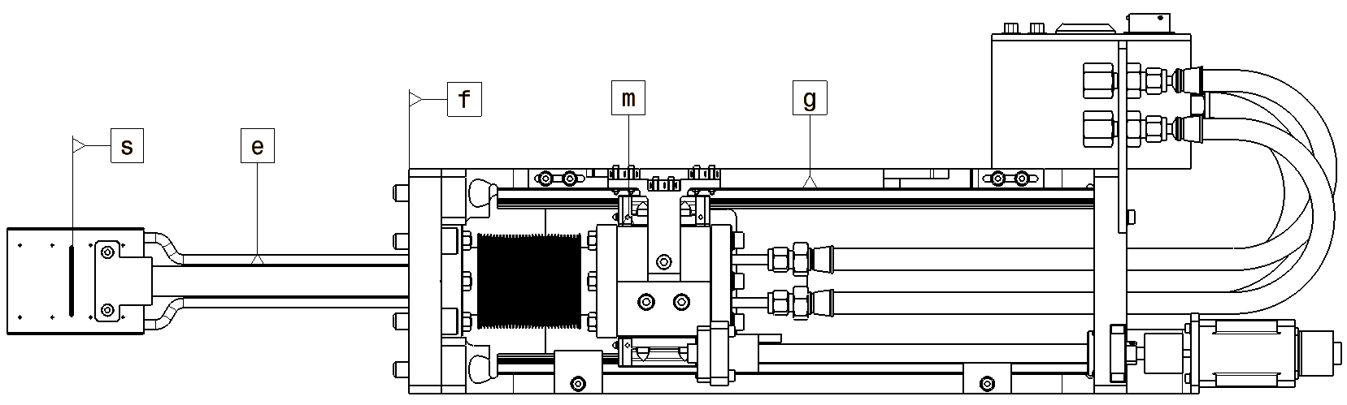
Slit design
Error | Description | Responsable
∆αfg | Angular error between the fixed flange of the actuator (f) and the linear guides (g) | Contractor
∆αgm | Angular error between the guides (g) and the mobile flange of the actuator (m) | Contractor
∆αme | Angular error between the mobile flange (m) and the shaft (e) | Contractor
∆αes | Perpendicularity between the shaft (e) and the Slit apperture (s) | Contractor
∆αfs | Total angular error between the fixed flange of the actuator and the reference plane of the Slit aperture | Contractor
Notes:
Allowed mechanical errors
0.5 degree of angular precision in all directions (slit aperture and flange)
Slit aperture 100 microm +- 20 microm

Slide 9
Mechanical requirements
0.5 degree of angular precision in all directions
(slit aperture and flange)
Slit aperture 100 µm ± 20 µm

Slide 10
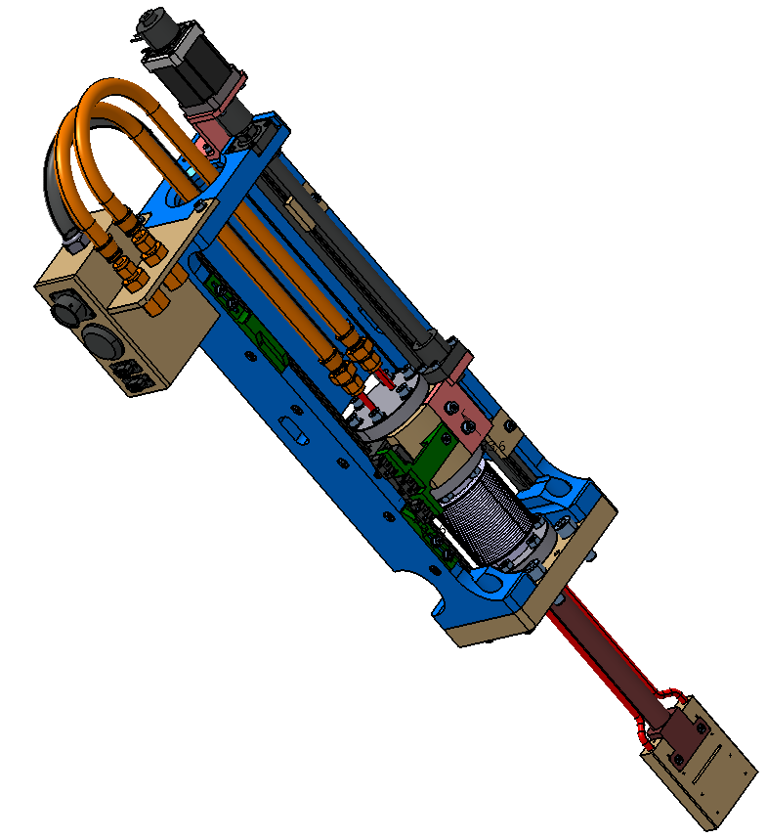
Slit subsystem
155 mm stroke
WS design as baseline
Actuator
Slit arm

Slide 11
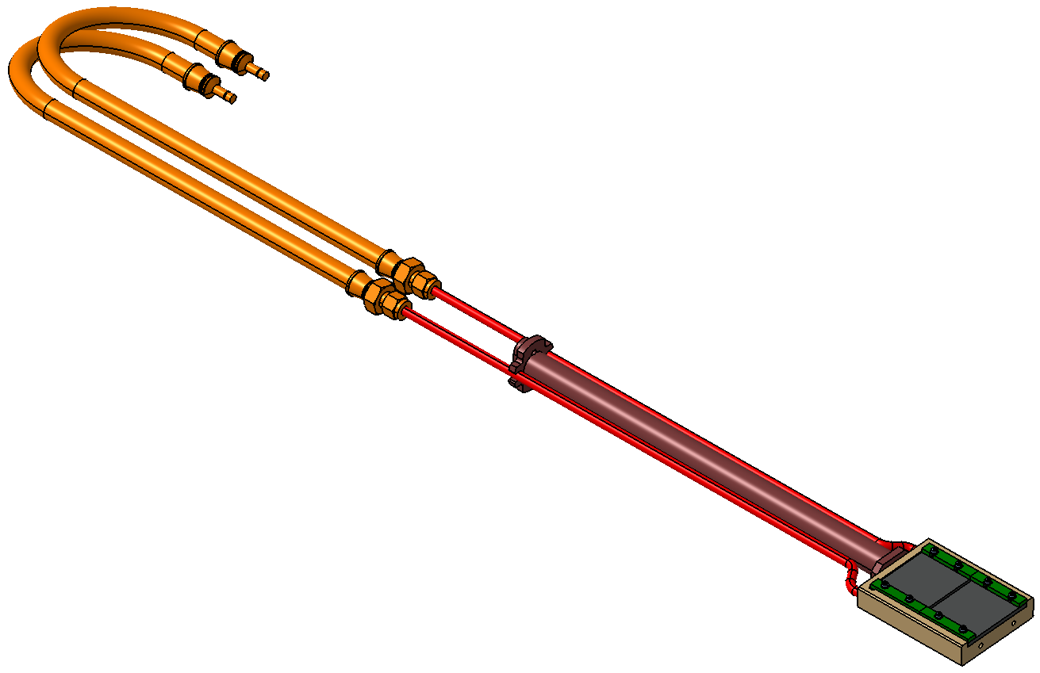
Slit arm
A – Graphite plates; B – Substrate; C – Cooling tubs
D – Shaft; E – Shaft holding piece
E
D
C
A
Slit head
B

Slide 12
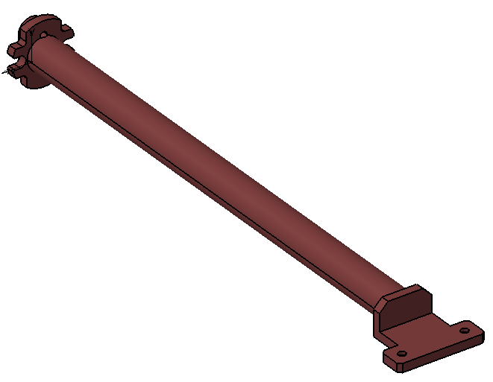
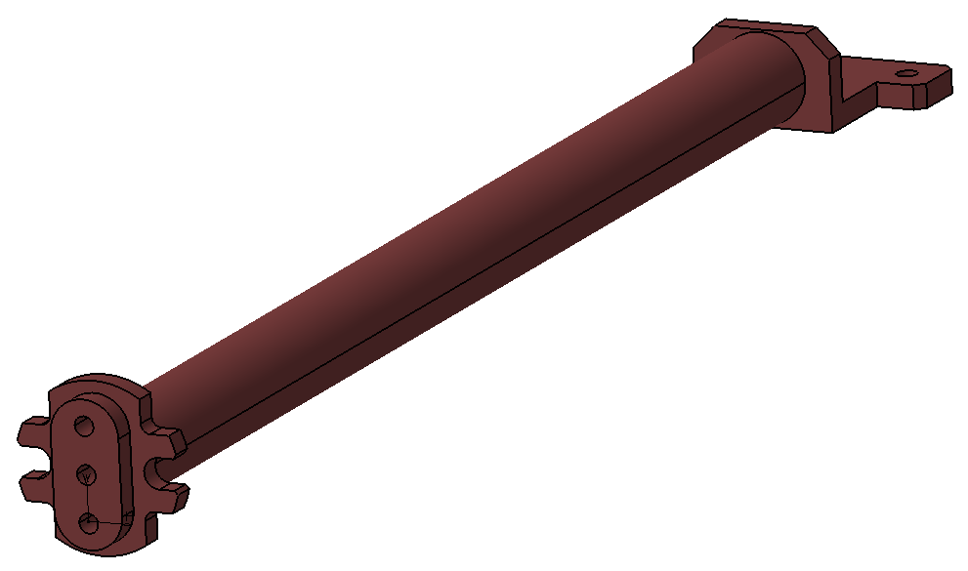
Slit Shaft
Welled to the top holding piece
Screwed in the bottom part

Slide 13
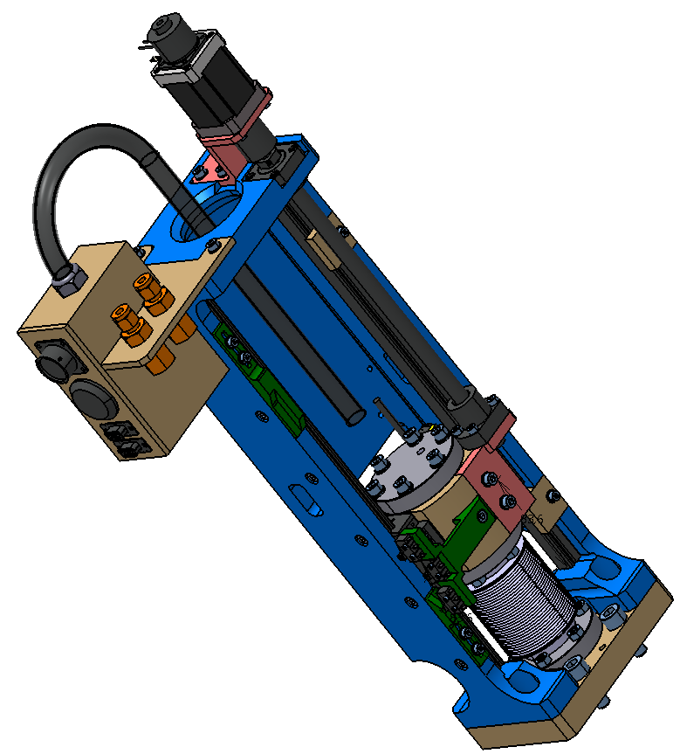
Slit Actuator
N
M
Same design as WS
O
Q
H
F
E
R
B
G
S
L
P
C
D
I
J
K
A

Slide 14
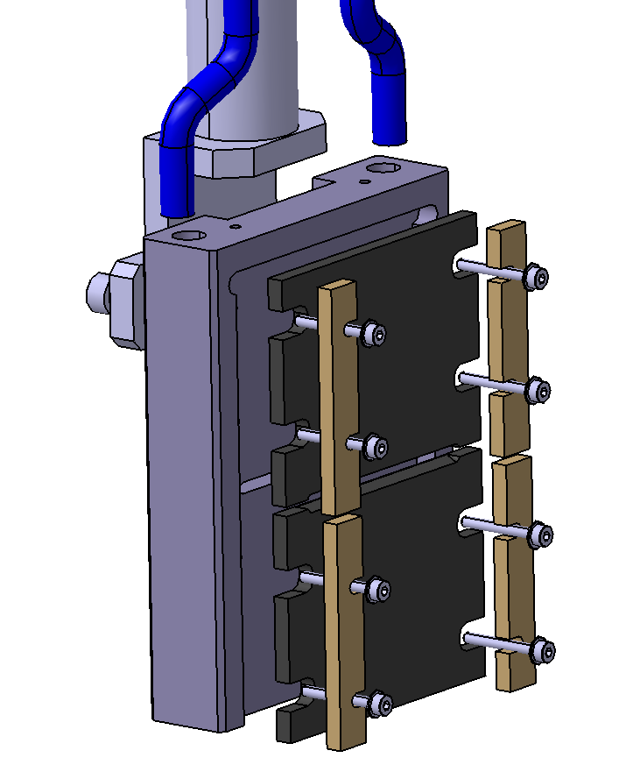
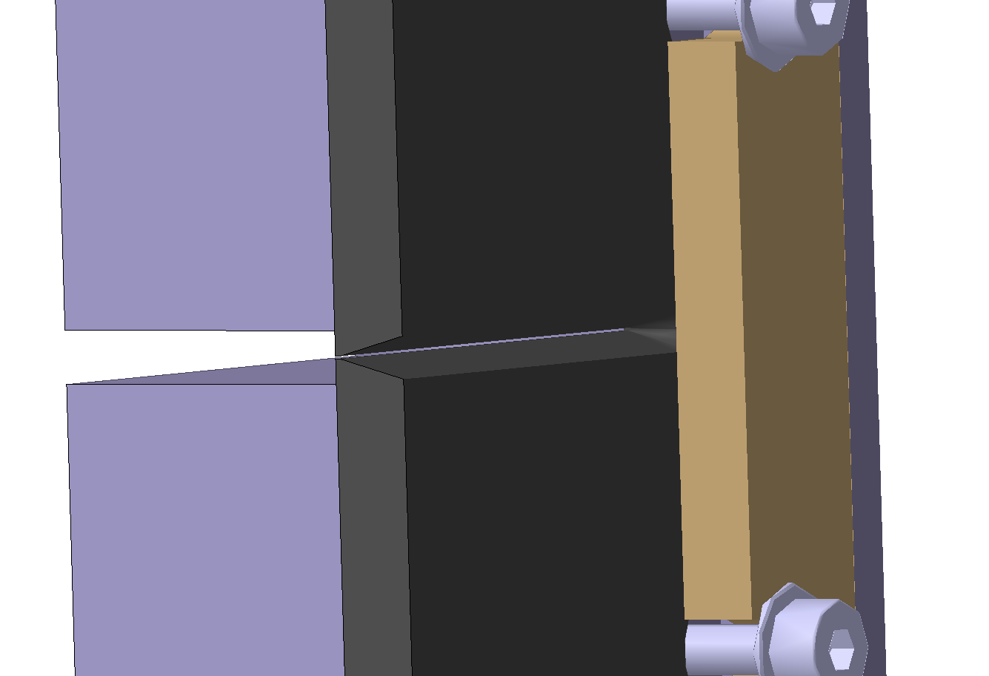
Slit design
B
A
Chamfer
Two Graphite plates – A chamfer to get 200 µm thickness
50 µm rabbet to get 100 µm aperture

Slide 15
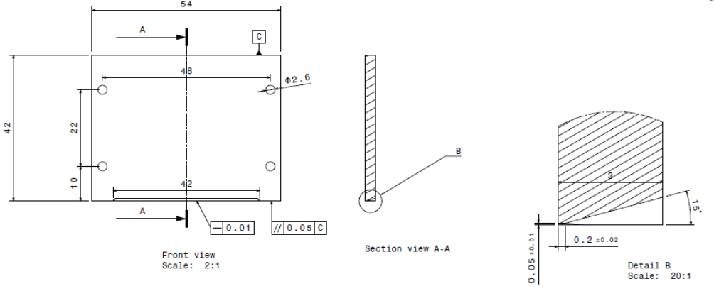
Graphite Plates

Slide 16
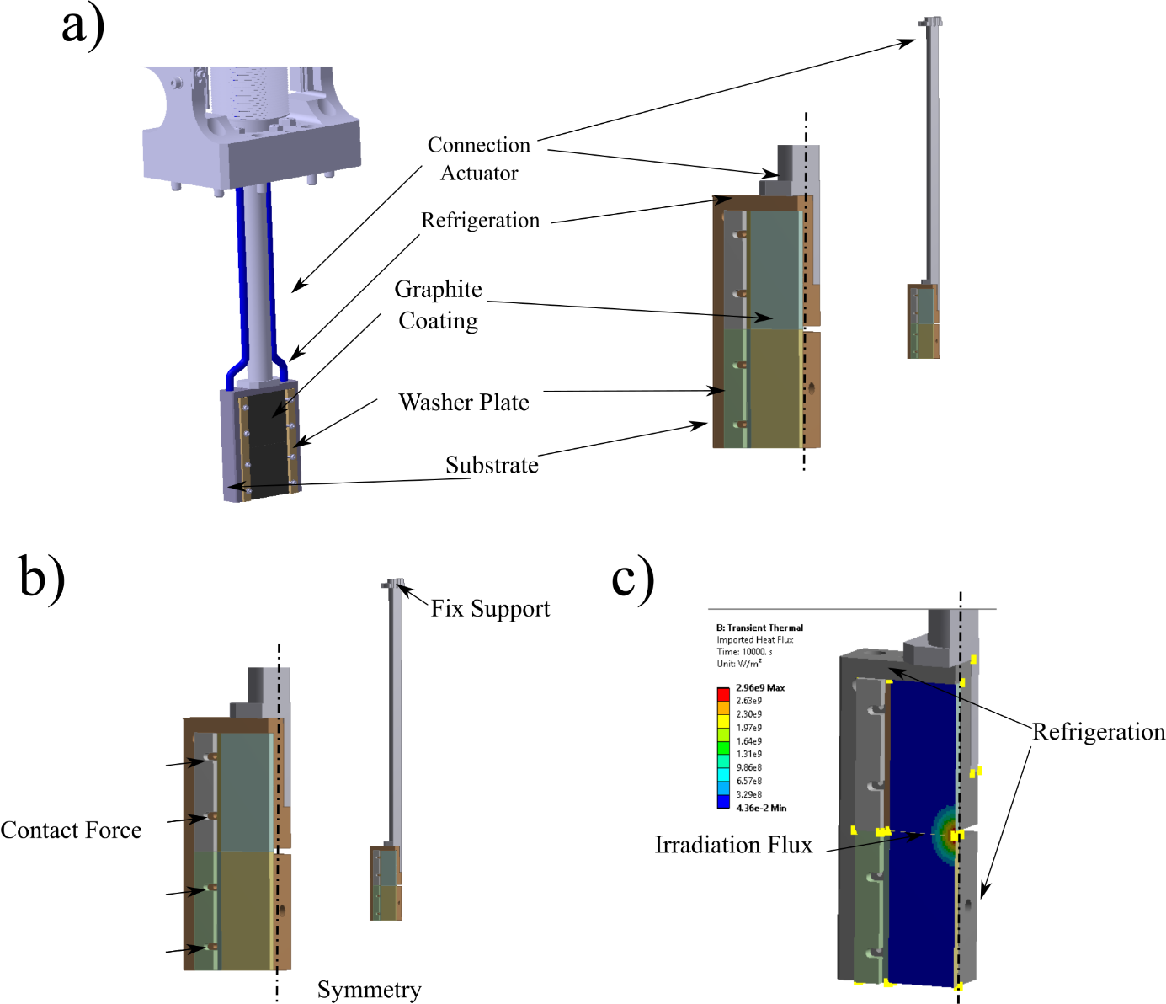
Slit Thermomechanical design
FEM model

Slide 17
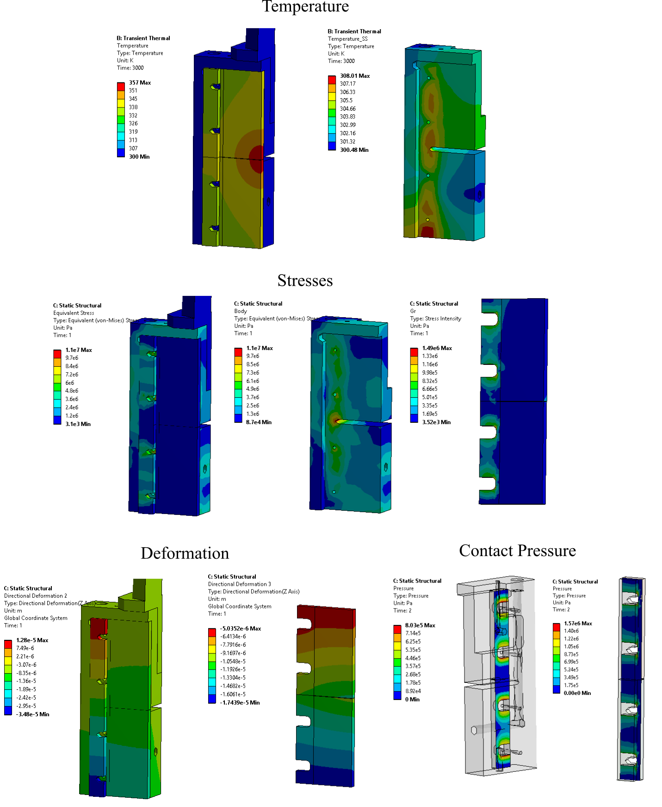
Slit Thermomechanical design
Deformation

Slide 18
Slit Thermomechanical design
Results for Stainless Steel (250 N contact force)
Case | ΔT (ºC) | σ₁ (MPa) | σ₃ (MPa) | σ_{Int} (MPa) | σ_{Int}/σ_{Lim.} | Slit. Def. (μm)
Initial | 17 | 0 | 0 | 0 | 0 | 0
Steady | 57 | 0.75 | -1.5 | 1.5 | 2 % | 2
Transient | 463 | 7.6 | -26 | 27 | 32% | 2.3
Total (Init + Steady + Transient) | 537 | 7.6 | -26 | 27 | 32% | 4.3

Slide 19
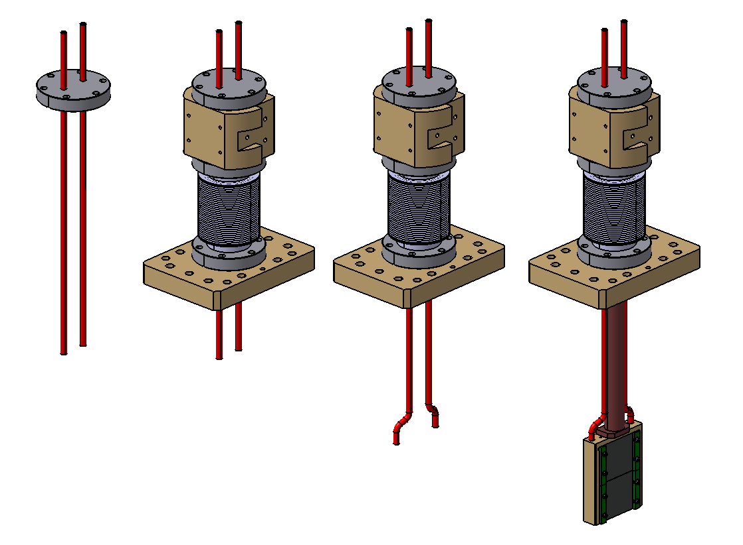
Assembly
A
B
C
D
Notes:
A – Weld channel
B – Assembly actuator components: support, below, flange
C – Weld new section of cooling tubes
D – Up vacum feedthrough, inssert shaft, screw from interior and lower feedtrhugh Then, Weld cooling tuve.

Slide 20
Slit Cooling
The refrigeration circuit flexible tubing:
  6 mm fitting in one side
  adaptor to a 6 mm pipe on the other side,
The cooling feedthroughs:
  6 mm tube fitting in one side
  Female tapered cylindrical BSP connector in the other side (Cooper gasket)

Slide 21
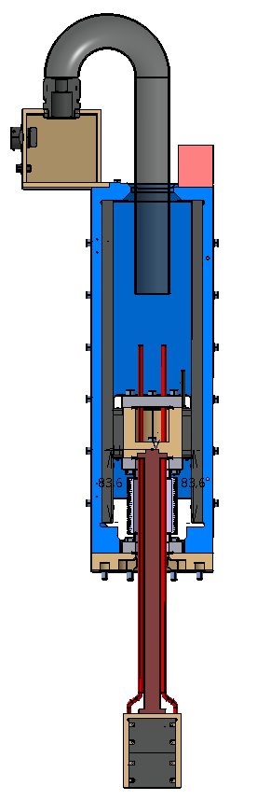
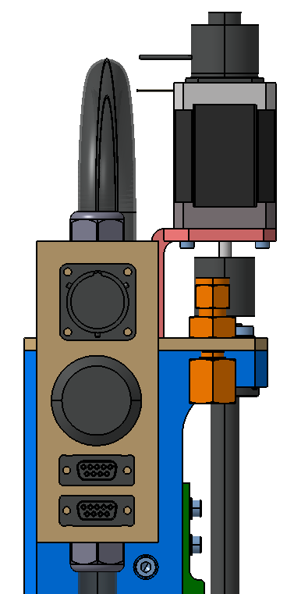
Slit Cabling Path
Cables to the Patch Panel (C):
Limit switches from switches position (D)
Motor and brakes from motor position (A)
Encoder cable from encoder position (B)
C
A
E
A
B
D
B
C
D
Patch Panel:
Motor and brake
travel limit switches
MPS Limit Switch (LEMO)
Encoder
Connector to fix cables and protection

Slide 22
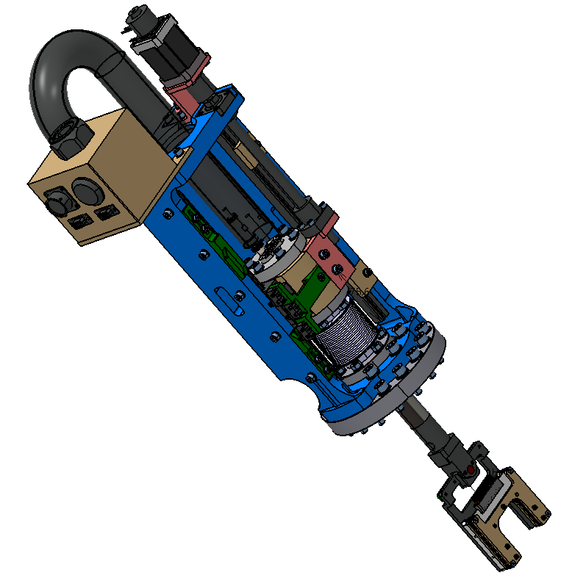
Grid Subsystem
80 mm stroke
CF40
Actuator
Z
Y
X
Grid arm

Slide 23
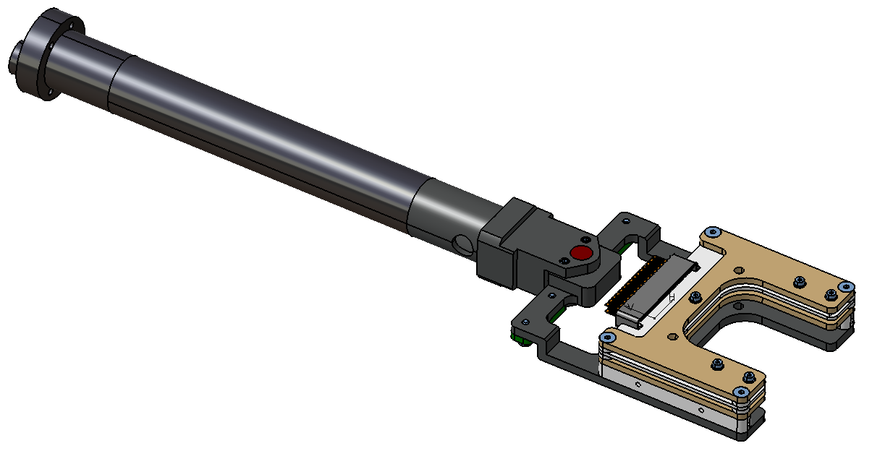
Grid arm
A – Wire PCB; B – Bias plates; C – Alignment system
D – Shaft; E – Shaft holding piece
E
D
Grid Head
C
B
A

Slide 24
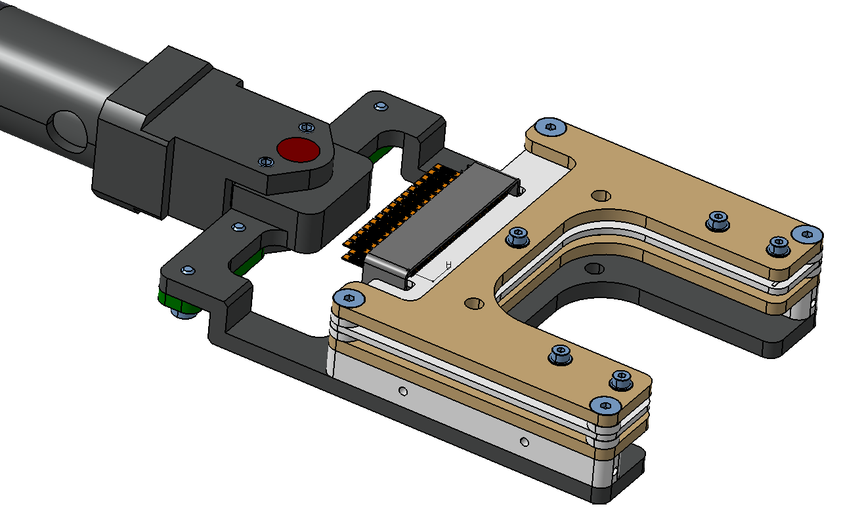
Grid head
A – Wire PCB; B – Bias plates; C – Screws for bias wires D – Signal connector; E – Alignment system,
F – Fork, G – Screws, H – Holes for precision pins
E
D
C
B
G
H
A
F

Slide 25
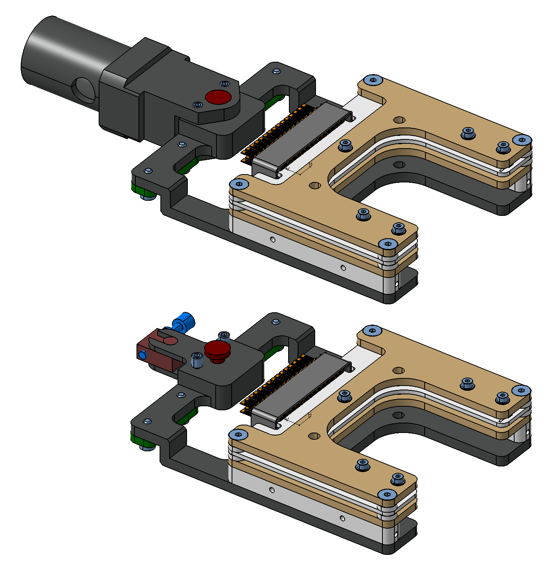
Alignment system
A – Precision Pin; B – Screw ; C – Guide
(system similar to WS)
B
C
A

Slide 26
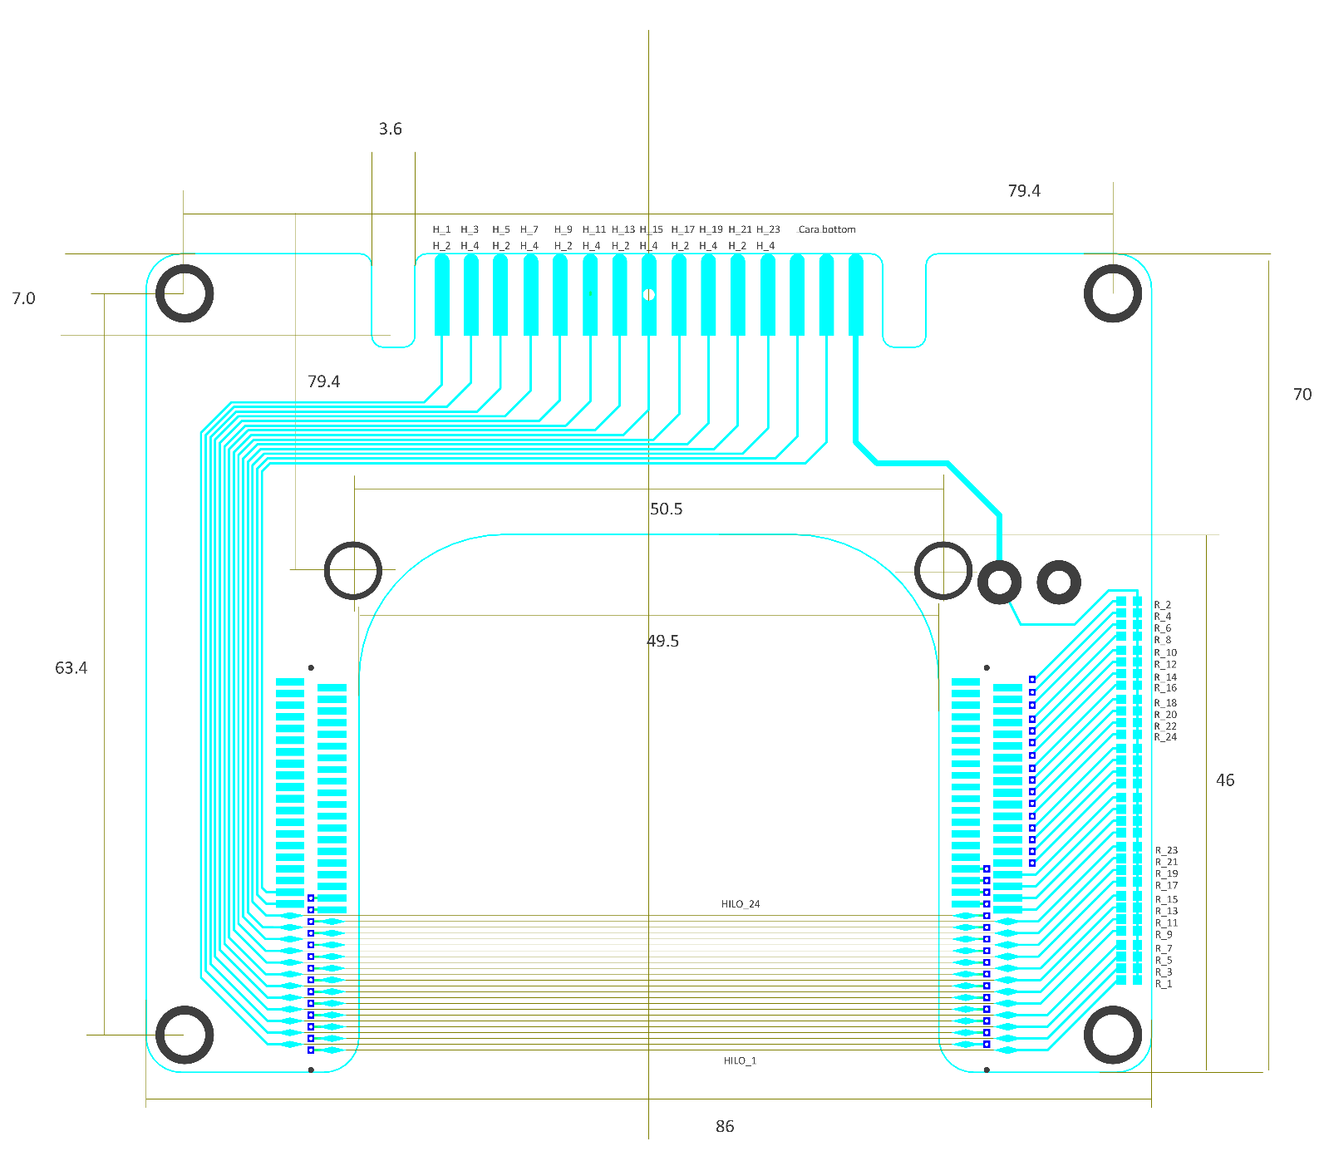
Wires PCB design
24 Tungsten wires
35 µm diameter
~50 mm long
500 µm pitch
Covers 11.5 mm
Glued with
H20E Epoxy
24 pin vacuum connector

Slide 27
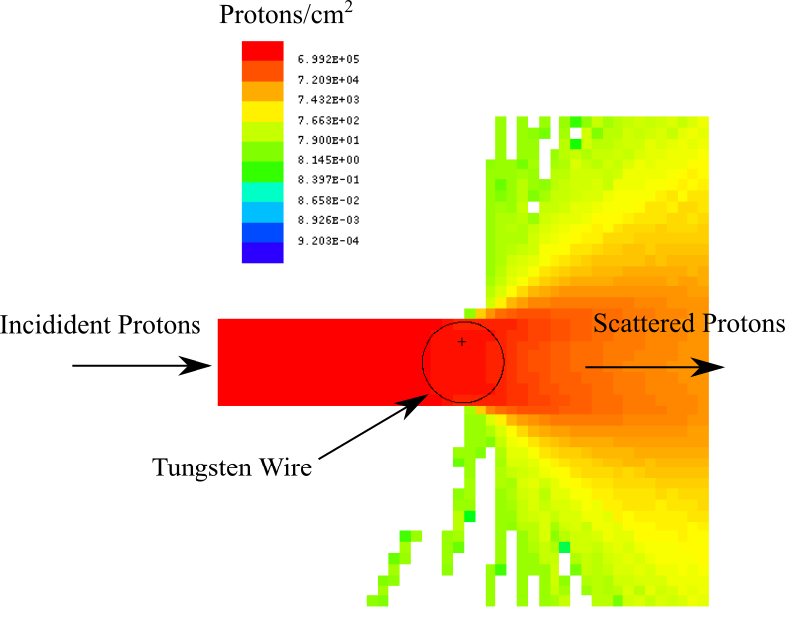
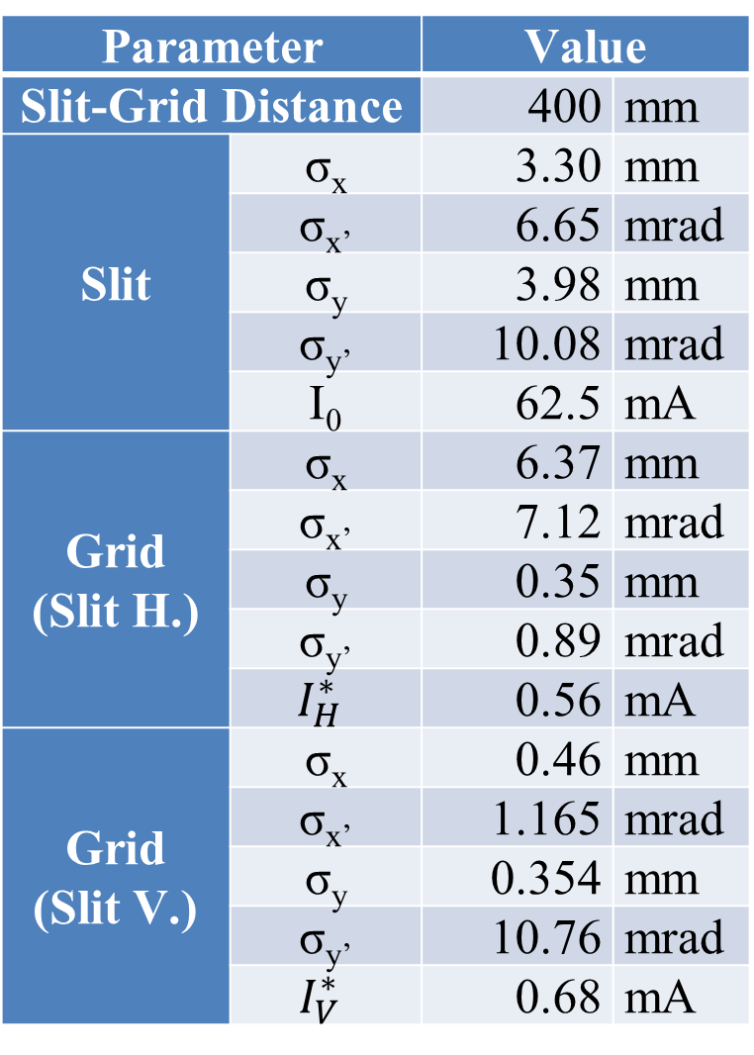
Grid thermomechanical design
Parameter |  | Value
Slit-Grid Distance |  | 400 | mm
Slit | σ_{x} | 3.30 | mm
 | σ_{x’} | 6.65 | mrad
 | σ_{y} | 3.98 | mm
 | σ_{y’} | 10.08 | mrad
 | I₀ | 62.5 | mA
Grid (Slit H.) | σ_{x} | 6.37 | mm
 | σ_{x’} | 7.12 | mrad
 | σ_{y} | 0.35 | mm
 | σ_{y’} | 0.89 | mrad
 | $$I_{H}^{∗}$$ | 0.56 | mA
Grid (Slit V.) | σ_{x} | 0.46 | mm
 | σ_{x’} | 1.165 | mrad
 | σ_{y} | 0.354 | mm
 | σ_{y’} | 10.76 | mrad
 | $$I_{V}^{∗}$$ | 0.68 | mA

Slide 28
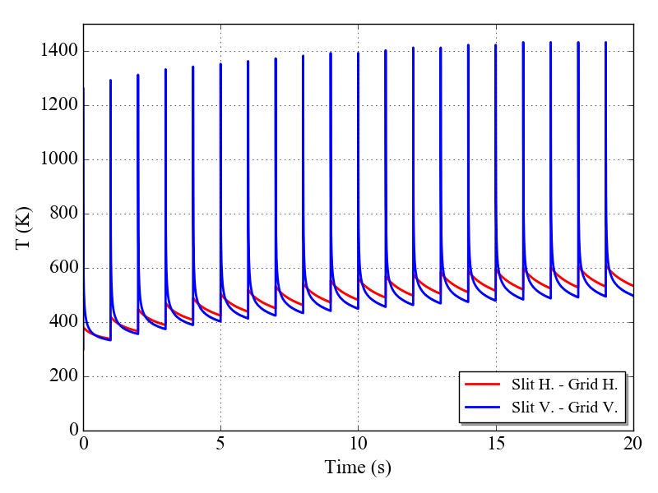
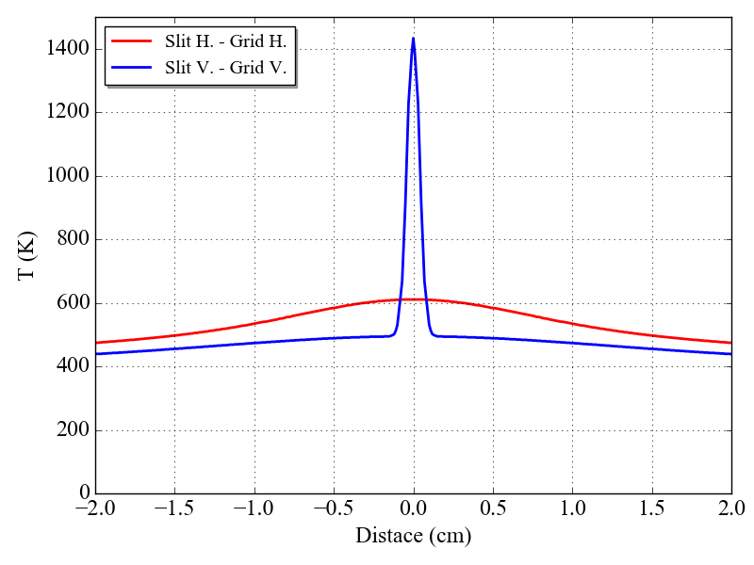
Grid thermomechanical design
Temperature evolution
Temperature distribution
Temperature below thermionic limit < 1500 K
Wire Pretension > 40 g (0.4 N)

Slide 29
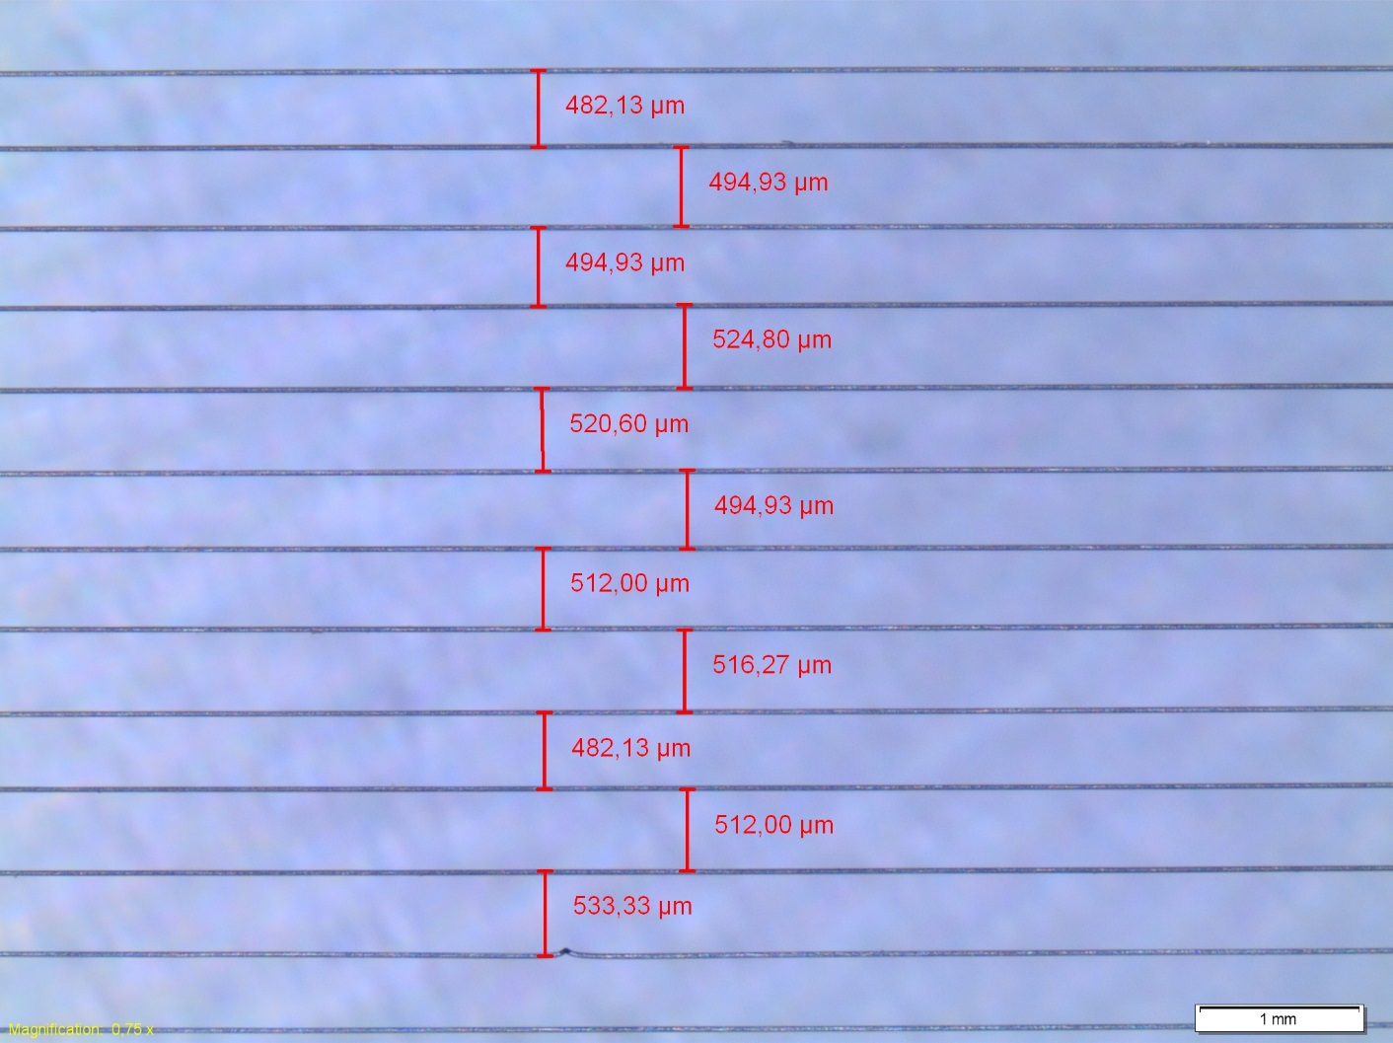
Wires PCB Prototype
Distance between wires: 500 ± 50 µm
100 g of preload tension

Slide 30
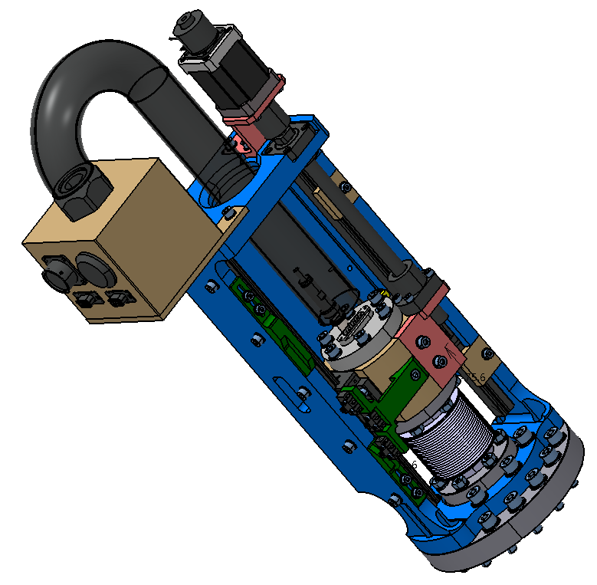
Grid actuator

Slide 31
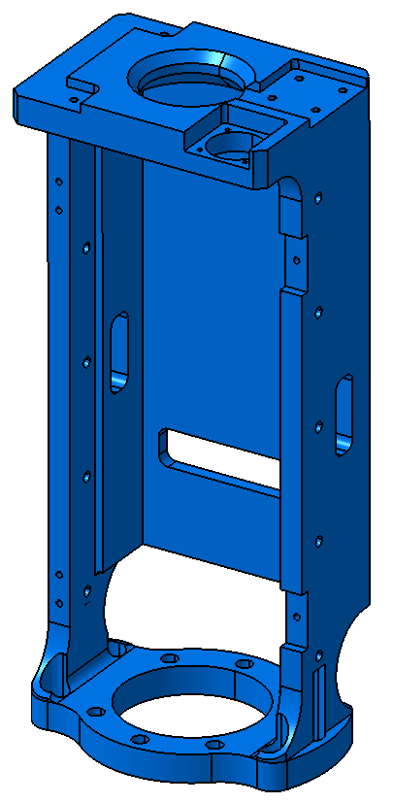
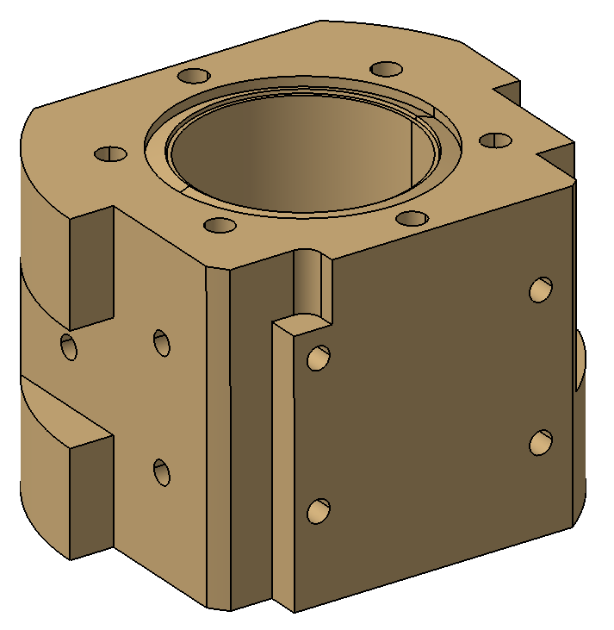
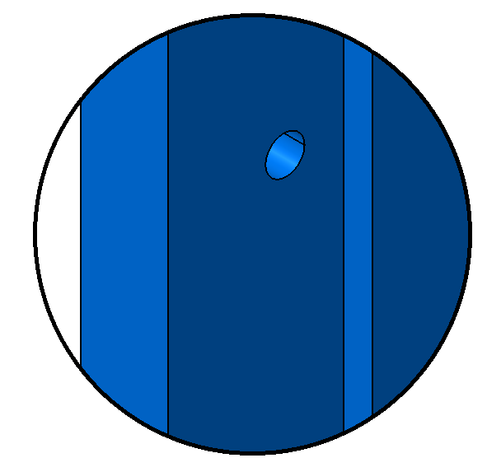
Small differences with Slit actuator
A

Slide 32
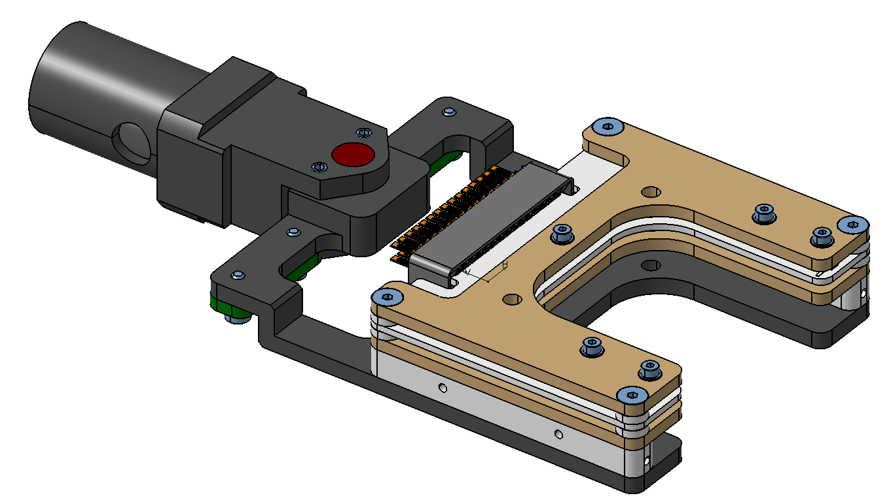
Cabling
Bias wire goes through the screws
Signal cables go through the connector

Slide 33
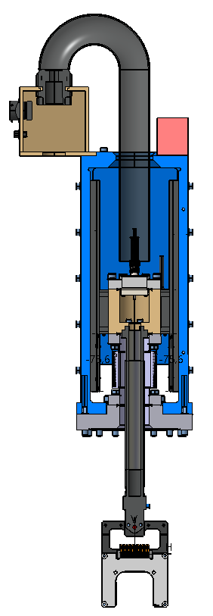
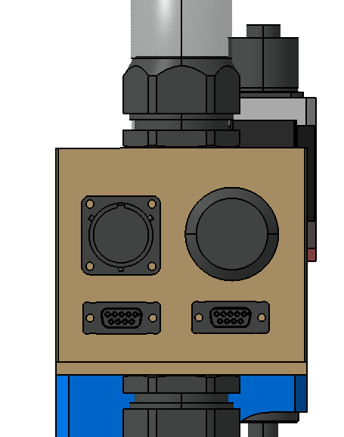
Grid cabling path
Cables to the Front-End:
Signal cable
Cables to the Patch Panel (C):
Limit switches from switches position (D)
Motor and brakes from motor position (A)
Encoder cable from encoder position (B)
E
C
E
A
C
B
D
B
A
D
F
Patch Panel:
Motor and brake
travel limit switches
MPS Limit Switch (LEMO)
Encoder
Connector to fix cables and protection

Slide 34
Acceptance
Vacuum test
  Test each subsystem to the required vacuum + rga
Metrology test
  Ensure fundamental measurement are OK
Hydraulic test
  Test the slit cooling circuit for leakage
Actuator verification

Slide 35
Verification
Motors & control
Analog FE & control
Complete system
  Cross-talk
  Integrity check

Slide 36
Schedule
Milestone | Delivery Term
Contract Formalization | T0
Delivery of Blueprints | T1 = T0 + 1 month
Acceptance of Blueprints | T2 = T1 + 1 month
Manufacture and delivery of EMU-H and Verification Documents | T3 = T2 + 3 months
Acceptance of EMU-H | T4 = T3 + 1 month
Manufacture and delivery of EMU-V and Verification Doc. | T5 = T4 + 5 months
Acceptance of EMU-V | T6 = T5 + 1 month
Vertical Test | T7 = T6 + 3 months
Total Duration of the Project | 15 Months

Slide 37
Risks
Id | Event | Cause | Impact | Treatment plan | Responsible for risk treatment | Status
MEBT-PBI-EMU-01 | Problems with postioning the wires. Incorrect distance between wires | Dedicated experience is mandatory | Precision in the measurements | 1- Find partners 2- Build a prototype in advance | BIO | Treated
MEBT-PBI-EMU-02 | Wire breaks | Handling during assambly/instalation | Schedule delay, failure at the integration | Consider spares in budget | BIO | Teated
MEBT-PBI-EMU-03 | Wire breaks | During operation in commissioning | Schedule delay, failure at the integration | Incorporate “wire integrity” check | BIO | Teated
MEBT-PBI-EMU-04 | Grid Actuator specification not meet | Misunderstanig with contractor about specification | Precision in the measurements | Elaborate MEBT-BI-EM90-06 with specifications, and follow up. | BIO | Teated
MEBT-PBI-EMU-05 | Grid Actuator Missalignemnt (tilt) | Impossibility to meet tolerances by contractor | Precision in the measurements | Design Grid with alignment screw | BIO | Teated
MEBT-PBI-EMU-06 | FE not meeting design goals | Inadequate design | Precision in the measurements | Build and test prototype | BIO | Treated
MEBT-PBI-EMU-07 | FE radiation sensitive |  | Integrity of device is under risk | Request ESS a dedicated bunker in the tunnel | ESS | Treated

Slide 38
Risks
Id | Event | Cause | Impact | Treatment plan | Responsible | Status
MEBT-PBI-EMU-08 | Noise in the signal from secondary electrons | Not handling SE particles | Precision in the measurements | Integrate a bias voltage +-1kV in the design | BIO | Treated
MEBT-PBI-EMU-09 | Slit graphite not meeting specification | Misunderstanig with contractor about specification | Precision in the measurements | Follow manufacturing with bi-wekly report | BIO | Started
MEBT-PBI-EMU-10 | Cross-talk between signal wires | Vacuum cables have no enough insulation | Precision in the measurements | Measure cross-talk in sample cable/Study alterative design | BIO | Started
MEBT-PBI-EMU-11 | Graphite plates break | Handling during assambly/instalation | Schedule delay, failure at the integration | Allocate budget for spare parts | BIO | Started
MEBT-PBI-EMU-12 | Slit Actuator specification not meet | Misunderstanig with contractor about specification | precision in the measurements | Elaborate MEBT-BI-EM90-06 with specifications, and follow up. | BIO | Teated
MEBT-PBI-EMU-13 | Development in VME | Restricted market for µTCA | Schedule delay, failure at the integration | Develop plan to migrate to µTCA Confirm delivery dates for HW and SW | ESS | Started
MEBT-PBI-EMU-14 | Migrate to new framework for GUI | New framework not finished yet | Schedule delay, failure at the integration | Clarify migration responsibility | ESS | Started

