Slide 1


Status of the
ESS MEBT EMU:
CONTROL
EMU Team
ESS-Bilbao
Beam Instrumentation Group
July – 2017
Notes:
Decir que hablo en parte del equipo de ESS-Bilbao
Decir que es básicamente el trabajo presentado para el CDR.

Slide 2
Introduction
HW description
SW description
  Functionality
  Engineering GUI
  EPICS development

Slide 3
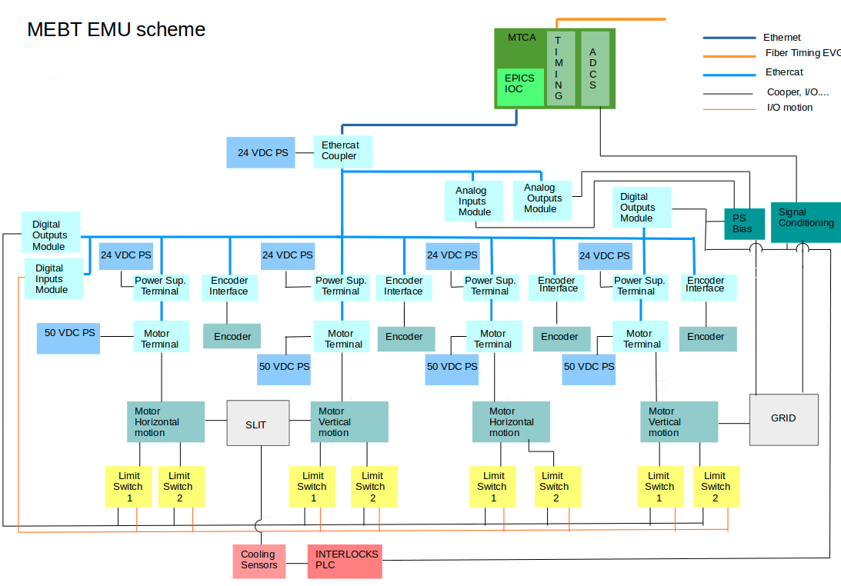
HW description General interface layout

Slide 4
HW description General interface layout

Slide 5
HW description 1
Actual developments based on VME platform.
  VME crate: ELMA Type 39 Horizontal, 4U, 84HP.
  CPU: IFC1210-Intelligent FPGA Controller P2020 VME64x from IOxOS.
  Digitizer board: D-Tacq ACQ420FMC-4-2000-16: 4 analog channels, 2 MSPS, 16 bits.
  Event Receiver Board PMC-EVR-230 from MRF.
Planned to migrate to MTCA platform.
  More interesting HW changes:
  CPU: IOxOS IFC_1410 QorIQ T2081 & Kintex UltraScale AMC.
  2 Digitizer boards: IOxOS FMC ADC3117 20 channels ADC 16-bit 5 Msps.
  Event Receiver Board PMC-EVR-300 from MRF
For testing, we have an Event Generator Board
  Event Generator MRF VME-EVG-230 from MRF

Slide 6
HW description 2
External integrated systems controlled from the previous crate:
  Motion Control: Bus ethercat, linear motion.
  Power supply control for BIAS voltage supplying.
  Analogue front-end interrelation for signal conditioning.
  Interlocks interface.
These external systems controlled by the CPU through the Beckhoff automation technology system modules connected by ethercat bus.
The system also is provided with an Interlocks Siemens PLC for cooling and interlocks functions.

Slide 7
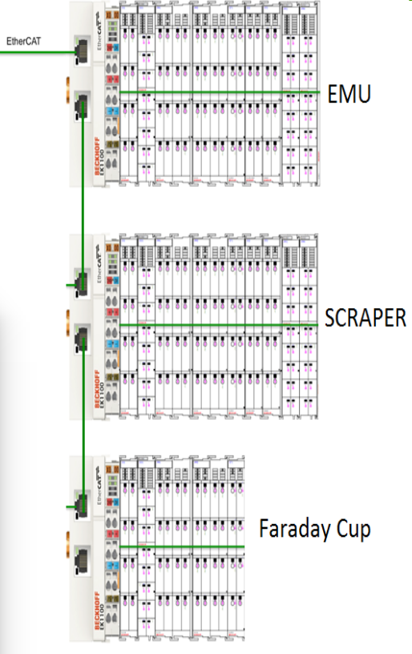
HW Ethercat Beckhoff modules
  Motion Control:
  4 stepper motors modules .
  4 incremental encoders modules.
  8 limit switches: digital inputs modules, digital outputs modules.
  4 MPS limit switches: digital inputs module, digital outputs modules.
  BIAS power supply:
  Digital outputs module, analog outputs module and analog input module.
  Analogue front-end control:
  Plane change, wire integrity check, electronic check: digital outputs module.
  Beam Permit from MPS:
  Digital input module.

Slide 8
SW general control
EMU SW modules
  EPICS module: EMU_daq.
  EPICS module: Ethercat_MEBT: shared with FC and Scrapers.
SW based in sscan recursive records for Slit and Grid.
Measures from DTAQ digitizer board upon the 4 channels, but code as GUI is programmed for 24 channels.

Slide 9
SW general control (2)
States of the application:
INIT state: if not beam permit GUI is disabled
SETTINGS state: settings can be changed.
  ADC settings: sample rate, trigger source, trigger threshold, number of samples...
  Scan settings: motion settings for slit and grid.
  Scan mode: linear or precalculated positions.
  BIAS settings: voltage to be applied.
  ADC Gain for each wire.
  Slit/grid plane: horizontal or vertical.
RUNNING state:START MEASUREMENT button
PAUSE state: EMU application paused.

Slide 10
SW: Acquisition
Acquisition of the voltage in the wires is when slit and grid reach their position.
Settings:
  Number of consecutive reads in each position.
  Sample rate.
  Pretrigger.
  Number of pulse samples.
Information arrays obtained:
  x, y: slit position array.
  x’, y’: angle of grid wires position respect slit position.
  Avg: average in volts of the current induced by the beam in the wires.

Slide 11
SW: Acquisition (2)
Background substraction:
  Operator sets two time intervals (prepulse and postpulse) for the background estimation.
  Background value is calculated as an average of these intervals. This value is subtracted to the average of the samples in the ROI (region of interest).

Slide 12
SW: Data analysis
Magnitudes:
  Emittance RMS
  Twiss parameters: alpha, beta and gamma
Input for those magnitudes calculation:
Samples from ROI delimited by user limit settings.
Background subtraction applied to samples on ROI.
Threshold percent of the maximum in ROI.

Slide 13
SW: Data analysis (2)
Bias voltage
  Voltage configurable from the GUI.
  Bias power supply status flag status.
Wire integrity
  Checking at beginning of measurement/disabled.
  Power supply applies 10 V to each wires.
  Wire integrity flag status.
Calibration
  Analog calibration for the FE electronic and digitizer board ADC.
  Calibration is made at least once at manufacturer facilities.
  Optional connection for calibration power supply

Slide 14
SW: Interlocks
Cooling control and interlocks control on Interlocks PLC.
Inputs to interlocks PLC from slit:
  Water cooling temperature.
  Water pressure at input/output
  Motion axes behaviour.
Inputs to interlocks PLC from grid:
  Power supplies behaviour.
  Motion axes behaviour.

Slide 15
SW: Interlocks (2)
Cooling control and interlocks control on Interlocks PLC.
Interlocks PLC calculations:
  Temperature is within normal operational limits.
  Pressure within normal operational limits.
  Power supplies are healthy.
  Motion axes are not stuck.
Output from interlocks PLC to MPS:
  EMU status.
Input from MPS to IOC through Beckhoff EtherCAT :
  EMU permitted to insert: BEAM PERMIT.

Slide 16
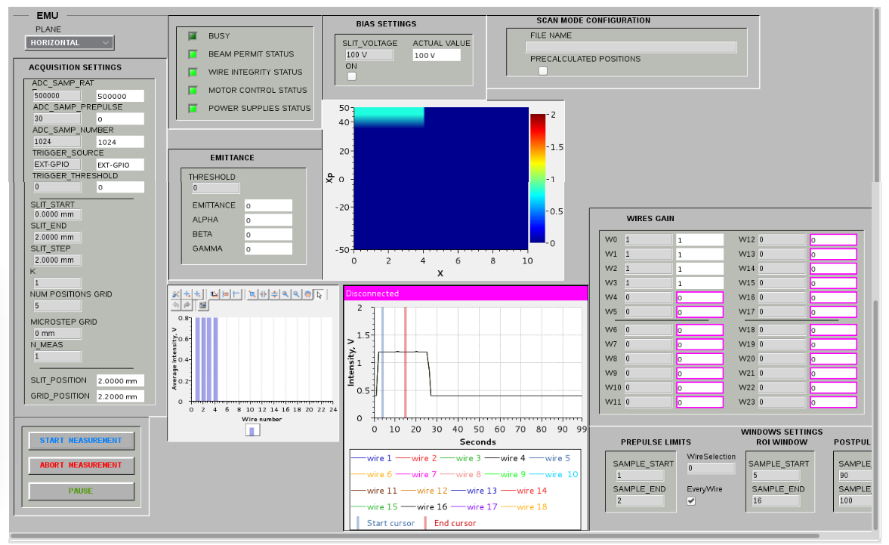

SW: Engineering GUI

Slide 17
SW: Engineering GUI fields
EMU flow control.
Settings of motion control, data acquisition, bias voltage, ADC gain.
Screen of wire average voltage.
Screen of voltage pulse measurement per wire.
Screen of intensity phase space surface.
Several Status flags
RMS Emittance and Twiss parameters.
Precalculated positions motion configuration file.

Slide 18
SW: EPICS modules
Drivers needed for HW and VME standardization:
  IOxOS VME drivers
  MRF (Timing) drivers.
EPICS modules for the SW solution:
  System and device support related modules: environment, pevdrv, nds3epics, nds3, asyn
  Specific digitizer hardware related modules: ifcdaq
  Event receiver related module: mrfioc2
  Motor module: motor
  Specific application related module: EMU_daq.
  MEBT Ethercat related moduel: MEBT_ethercat.

Slide 19
SW: EPICS Data Base
EMUFunctions.template:
  BEAM permitted checking, status of the power supplies, wire integrity and configuration of bias voltage. Flags status.
EMUSlit.template:
  PVs associated to the Slit.
EMUGrid.template:
  PVs associated in general GRID motion calculation.
EMUGridProcess.template:
  PVs associated to the acquisition in the wires.
EMUMotionMode.template:
  PVs associated related to the motion modes.s

Slide 20
SW: EPICS Data Base
EMUDAQConfigure.template:
  PVs associated to the configuration of the samples acquisition.
EMUDAQWindows.template
  PVs associated to the windows on the raw data screen.
EMUEmittance.template
  PVs associated to the calculation of the emittance and the TWISS parameters.
slitGridScanner.substitutions
  Compilations of components from scanning module.

