Slide 1


Status of the
ESS MEBT EMU:
FE
EMU Team
ESS-Bilbao
Beam Instrumentation Group
July – 2017
Notes:
Decir que hablo en parte del equipo de ESS-Bilbao
Decir que es básicamente el trabajo presentado para el CDR.

Slide 2
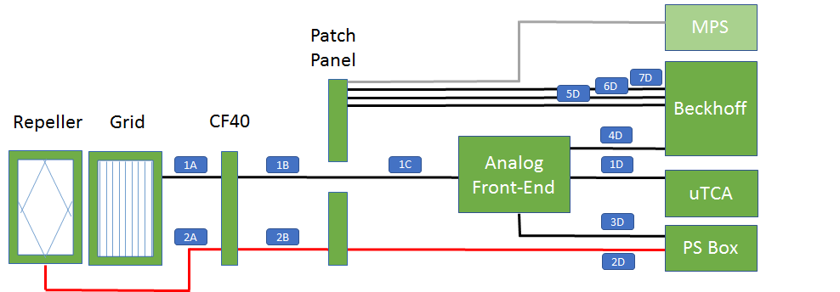
Grid Cabling Layout
Label | Name | Connector 1 | Connector 2
1A | 2 x 311-KAP-RIB15 (RAD) | Open end | Allectra 25 pin
1B/1C | Alpha Wire 78444 | Allectra 25 pin | DB25
2A | 311-KAP50-RAD | Open end | SHV
2B | FLAMEX RG 214 | SHV | SHV
1D | Alpha wire 78458 | MOLEX Triad 48P | Open end
4D | 3 conductors, 21 AWG | LEMO FGG 0B 303 | Open end
3D | Lapp 1123080 | Souriau M10 | Souriau M10
2D | Coaxial RG 214/U Type 5kV rated | SHV | SHV
Notes:
The aims of the studies are:
To determine the geometrical shape that favors a more
efficient recapture.
To study the electron recapture map (in case some parts
need protection).
To evaluate the voltage level needs of the repeller.
Electrostatic field simulations made with Comsol, particle
dynamics studies performed with GPT.
A considerable effort was made to create an accurate secondary electron beam (beam footprint, collector angle, emission angle probability and energy distribution, etc).
The video below, created from the results of a typical simulation, allows to observe the electron trajectories, impact position and recapture time.

Slide 3
Bias Power Supply
ISEG DPR 10 106 24 10 ESH
  Vout: 0 to 1000 V (bipolar)
  Imax: 10 mA
  Vin/Iin: 24 V/0.8 A
  Control Signal 0-10 V
  Ripple/Noice: 2/7 mV
  SHV output
  DB9 control signal
Notes:
The aims of the studies are:
To determine the geometrical shape that favors a more
efficient recapture.
To study the electron recapture map (in case some parts
need protection).
To evaluate the voltage level needs of the repeller.
Electrostatic field simulations made with Comsol, particle
dynamics studies performed with GPT.
A considerable effort was made to create an accurate secondary electron beam (beam footprint, collector angle, emission angle probability and energy distribution, etc).
The video below, created from the results of a typical simulation, allows to observe the electron trajectories, impact position and recapture time.

Slide 4
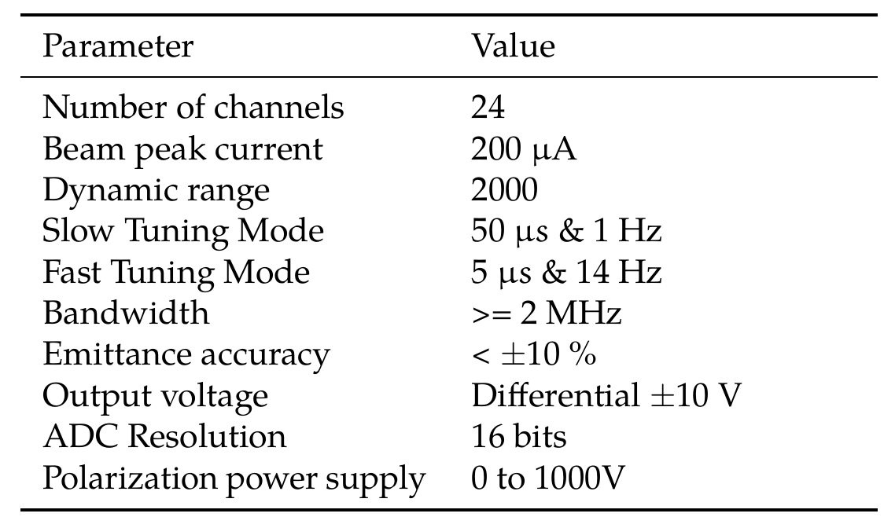
Front-End Requirements
Notes:
The aims of the studies are:
To determine the geometrical shape that favors a more
efficient recapture.
To study the electron recapture map (in case some parts
need protection).
To evaluate the voltage level needs of the repeller.
Electrostatic field simulations made with Comsol, particle
dynamics studies performed with GPT.
A considerable effort was made to create an accurate secondary electron beam (beam footprint, collector angle, emission angle probability and energy distribution, etc).
The video below, created from the results of a typical simulation, allows to observe the electron trajectories, impact position and recapture time.

Slide 5
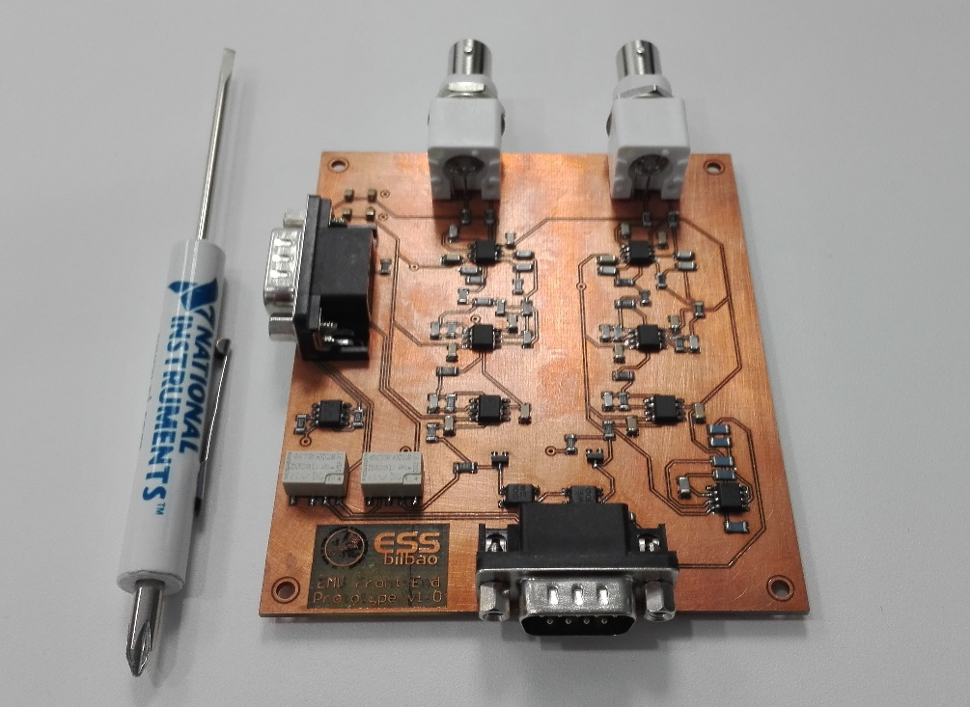
Front-End Design Process
Preliminary Design
Calcs. and simulations
Protoboard settings
Prototype design
Prototype tests
Aux. systems (BackEnd)
Mechanical design
Final release
Validation plan
Notes:
The aims of the studies are:
To determine the geometrical shape that favors a more
efficient recapture.
To study the electron recapture map (in case some parts
need protection).
To evaluate the voltage level needs of the repeller.
Electrostatic field simulations made with Comsol, particle
dynamics studies performed with GPT.
A considerable effort was made to create an accurate secondary electron beam (beam footprint, collector angle, emission angle probability and energy distribution, etc).
The video below, created from the results of a typical simulation, allows to observe the electron trajectories, impact position and recapture time.

Slide 6
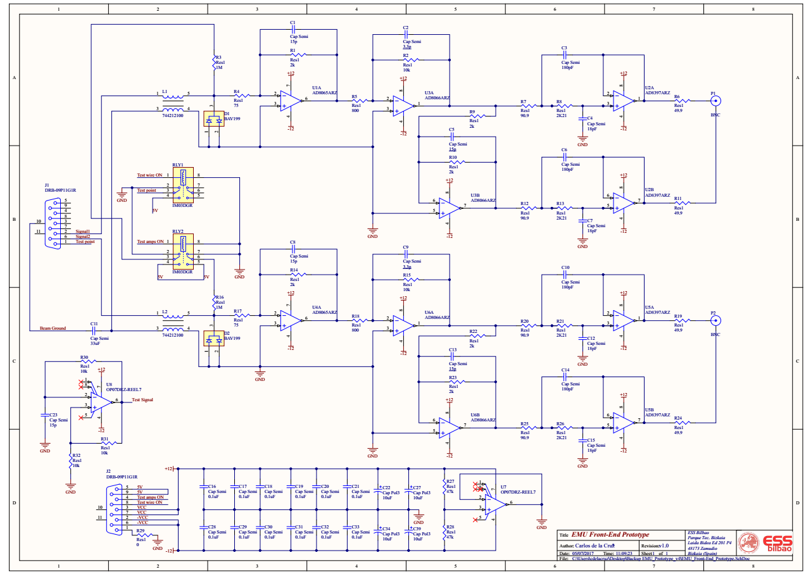
Front-End Schematic
Notes:
The aims of the studies are:
To determine the geometrical shape that favors a more
efficient recapture.
To study the electron recapture map (in case some parts
need protection).
To evaluate the voltage level needs of the repeller.
Electrostatic field simulations made with Comsol, particle
dynamics studies performed with GPT.
A considerable effort was made to create an accurate secondary electron beam (beam footprint, collector angle, emission angle probability and energy distribution, etc).
The video below, created from the results of a typical simulation, allows to observe the electron trajectories, impact position and recapture time.

Slide 7
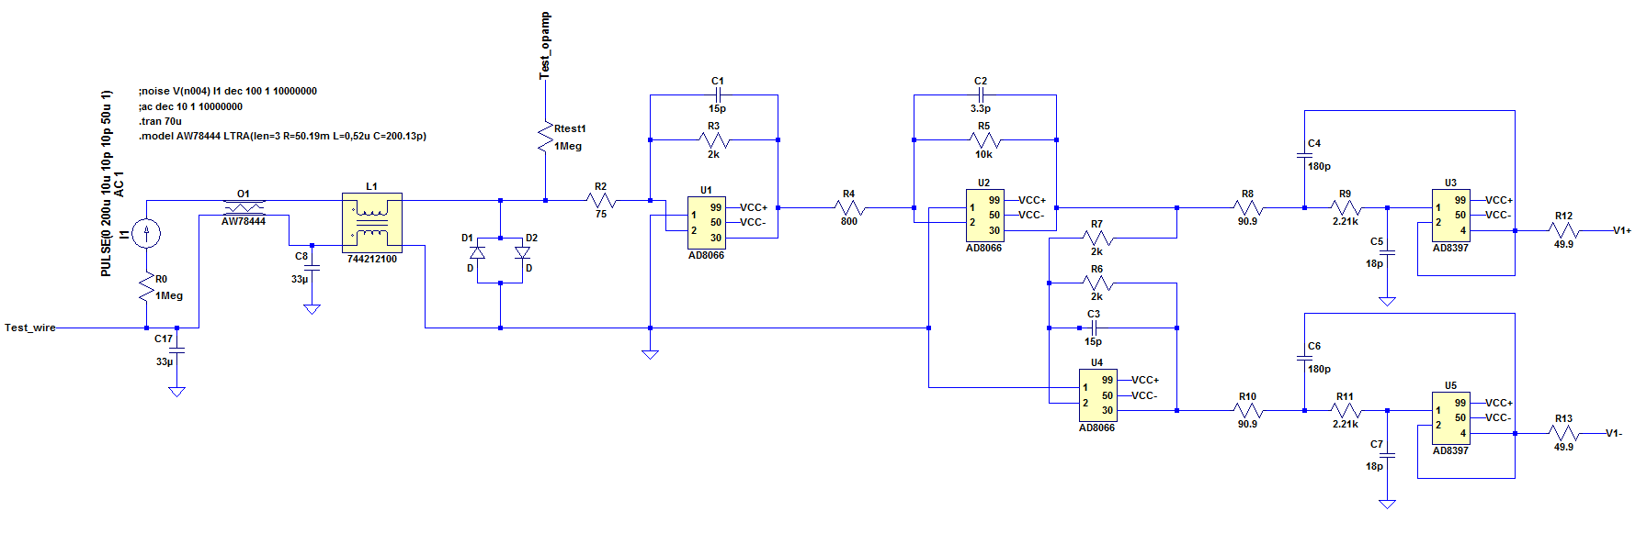
Front-End Simulations
Design validated using LT-Spice
Notes:
The aims of the studies are:
To determine the geometrical shape that favors a more
efficient recapture.
To study the electron recapture map (in case some parts
need protection).
To evaluate the voltage level needs of the repeller.
Electrostatic field simulations made with Comsol, particle
dynamics studies performed with GPT.
A considerable effort was made to create an accurate secondary electron beam (beam footprint, collector angle, emission angle probability and energy distribution, etc).
The video below, created from the results of a typical simulation, allows to observe the electron trajectories, impact position and recapture time.

Slide 8
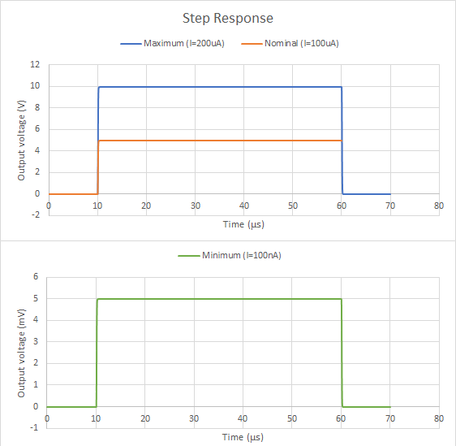
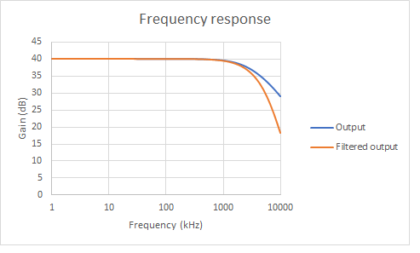
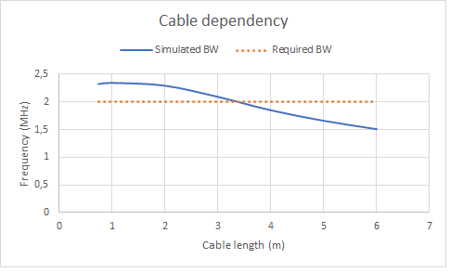
Front-End Simulations
Notes:
The aims of the studies are:
To determine the geometrical shape that favors a more
efficient recapture.
To study the electron recapture map (in case some parts
need protection).
To evaluate the voltage level needs of the repeller.
Electrostatic field simulations made with Comsol, particle
dynamics studies performed with GPT.
A considerable effort was made to create an accurate secondary electron beam (beam footprint, collector angle, emission angle probability and energy distribution, etc).
The video below, created from the results of a typical simulation, allows to observe the electron trajectories, impact position and recapture time.

Slide 9
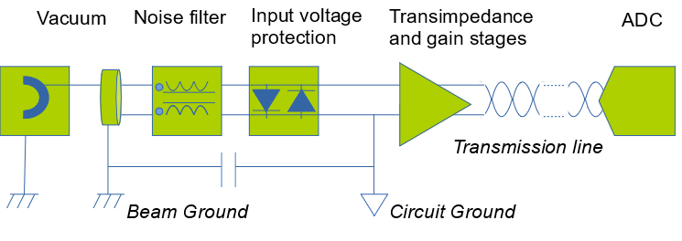
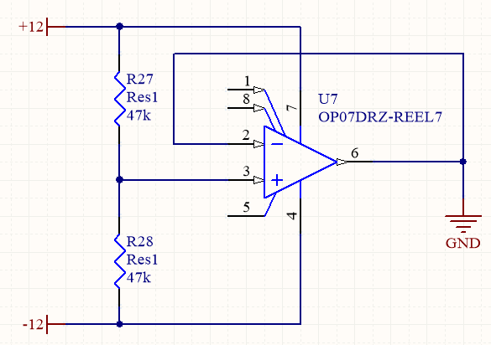
Front-End Grounding
Circuit Ground isolated from Beam Ground (Machine)
Circuit Ground isolated
from Power Supply (Gallery)
Notes:
The aims of the studies are:
To determine the geometrical shape that favors a more
efficient recapture.
To study the electron recapture map (in case some parts
need protection).
To evaluate the voltage level needs of the repeller.
Electrostatic field simulations made with Comsol, particle
dynamics studies performed with GPT.
A considerable effort was made to create an accurate secondary electron beam (beam footprint, collector angle, emission angle probability and energy distribution, etc).
The video below, created from the results of a typical simulation, allows to observe the electron trajectories, impact position and recapture time.

Slide 10
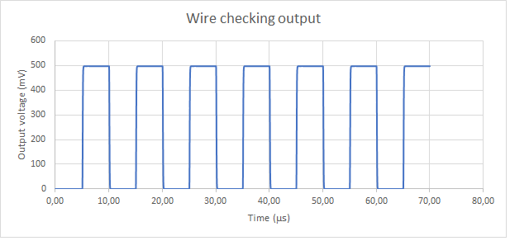
Front-End Wire Checking
Test_opamp 1
Test_opamp 2
Test_opamp n
OPAMP n
Vacuum
test n
OPAMP 2
OPAMP 1
test 2
test 1
Test_ wire 2
Test_wire n
Test_ wire 1
Test voltage
Notes:
The aims of the studies are:
To determine the geometrical shape that favors a more
efficient recapture.
To study the electron recapture map (in case some parts
need protection).
To evaluate the voltage level needs of the repeller.
Electrostatic field simulations made with Comsol, particle
dynamics studies performed with GPT.
A considerable effort was made to create an accurate secondary electron beam (beam footprint, collector angle, emission angle probability and energy distribution, etc).
The video below, created from the results of a typical simulation, allows to observe the electron trajectories, impact position and recapture time.

Slide 11
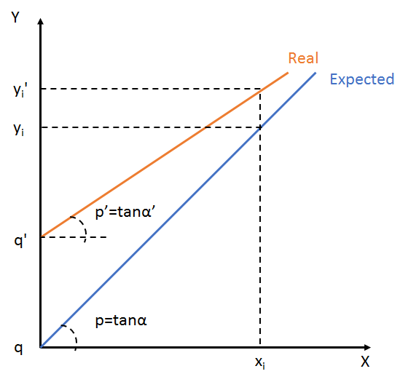
Calibration & Validation
Calibration method
  Find calibration factors p’ q’
  Defined as Process Variables
Validation plan
  Standalone FE (input = current source, output = oscilloscope)
    Step response
    Linearity
    AC response
    Noise analysis
    Channel checking
  Vertical Test (input = current source, output = µTCA, final cables)
Notes:
The aims of the studies are:
To determine the geometrical shape that favors a more
efficient recapture.
To study the electron recapture map (in case some parts
need protection).
To evaluate the voltage level needs of the repeller.
Electrostatic field simulations made with Comsol, particle
dynamics studies performed with GPT.
A considerable effort was made to create an accurate secondary electron beam (beam footprint, collector angle, emission angle probability and energy distribution, etc).
The video below, created from the results of a typical simulation, allows to observe the electron trajectories, impact position and recapture time.

