Slide 1


MEBT Scraper Critical Design Review
SC Team
ESS-Bilbao
Beam Instrumentation Group
July – 2017
Notes:
Decir que hablo en parte del equipo de ESS-Bilbao
Decir que es básicamente el trabajo presentado en para el PDR.

Slide 2
Summary
Technical Design
Technical Prescriptions
Scrapper Basic Control
Tests, Risks and Delivery Calendar

Slide 3


MEBT Scraper Technical Design
(aka Collimator)
A. R. Páramo
Bilbao, 13/02/2017

Slide 4
Technical Design Summary
Introduction
Technical Design
Conclusions

Slide 5
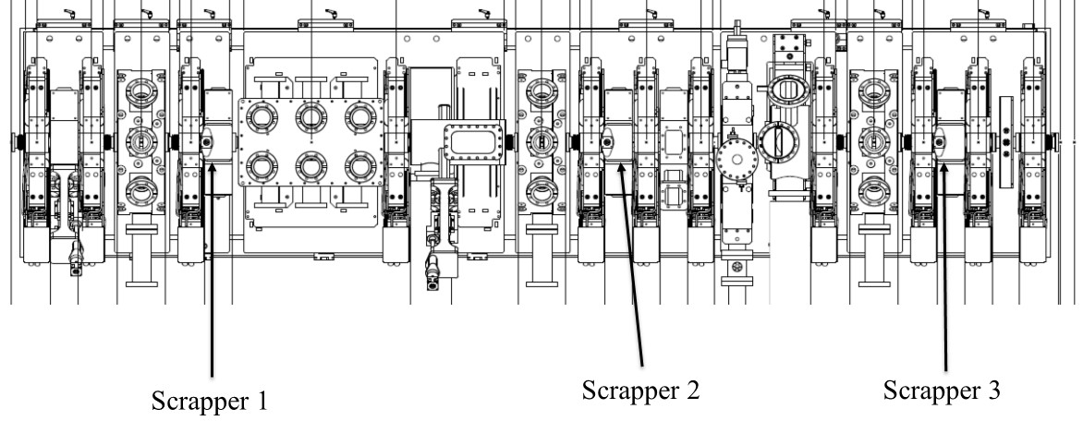
Introduction

Slide 6
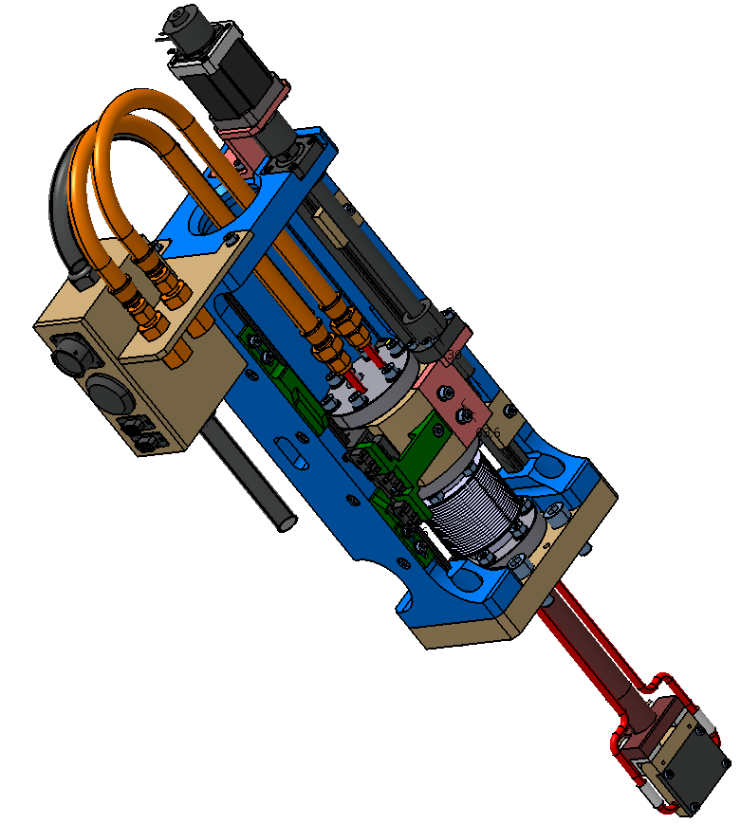
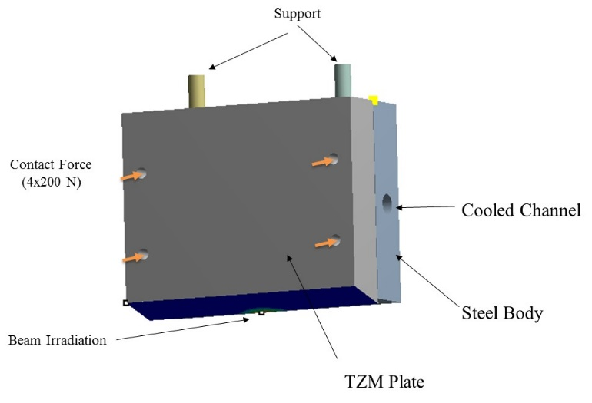
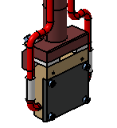
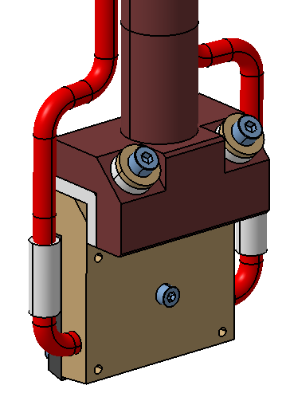
Introduction
Technical Design
(MEBT-BI-SC91)
Technical Prescriptions
(MEBT-BI-SC90)

Slide 7
Introduction
TZM has been chosen as the material for the scrappers.
TZM capabilities to withstand thermal shock are similar to tungsten while it is easier to machine.
Compared with graphite, TZM do not have proton-material interaction that forms carbides as the case of graphite.
MEBT-BI-SC91 Technical Design of the MEBT Scrappers
  G. Bakedano, “Basic Scraper Thermomechanical Analysis,” ESS-Bilbao, Internal ESS-Bilbao MEBT-BI-SC02, Sep. 2016.
  M. Magan and I. Bustinduy, “Basic Scrapper Beam Design analysis,” ESS-Bilbao, Internal ESS-Bilbao MEBT-BI-SC01, Jan. 2016.
  M. Magan et al. “Conceptual calculations and proposal for the ESS Beam Scrappers”, Internal ESS-Bilbao Feb 2013.
MEBT-BI-SC90 Index Of Specific Technical Prescriptions

Slide 8
L4 Requirements
L4_MEBT_ID_20161101_ID.xlsx
User Defined ID | Name | Description
MEBT-L4-ID-010 | Beam collimator: collimation peak power | Each jaw of the beam scraper shall be able to withstand a minimum peak power of 625 W for the nominal beam duty cycle and pulse length
NEW (20161010) | Beam collimator: beam size at the collimator location | The calculations for the design optimization shall consider a proton beam whose distribution is Gaussian on the projection of both horizontal and vertical plane with transverse sizes given by a sigma of 0.9 mm.
MEBT-L4-ID-020 | Beam collimator: number and location | Scrapers shall be placed at 3 different locations in the MEBT based on the integrated lattice design
MEBT-L4-ID-030 | Beam collimator: position adjustment precision | The scraper jaw transverse position adjustment resolution shall be better than ±50 µm.
MEBT-L4-ID-040 | Beam collimator: charge measurement | Each scraper jaw shall be instrumented such as to measure a minimum charge of 1 nano-Coulomb integrated over a period of 50 micro second*
MEBT-L4-ID-050 | Beam collimator: jaw translation range | Each scraper jaw shall be movable independently such that its lower part can be located between 2.8 and 20 mm with respect to the beam axis

Slide 9
Design Conditions
Parameter | Value |  | Parameter | Value
Proton Energy | 3.63 | MeV | Scrapper 1
Intensity | 62.5 | mA | Position | 862 mm
Frequency | 14 | Hz | σ_{x} | 1.813 mm
Pulse Duration | 2860 | μs | σ_{y} | 3.251 mm
 |  |  | Scrapper 2
Scrapping Requirement | 0.25 | %/blade | Position | 2324 mm
Scrapping Peak Power | 625 | W/blade | σ_{x} | 3.114 mm
Scrapping Average Power | 24.5 | W/blade | σ_{y} | 3.853 mm
 |  |  | Scrapper 3
Design Beam Size ( σ_{x} ) | 2.5 | mm | Position | 3536 mm
Design Beam Size ( σ_{y} ) | 0.9 | mm | σ_{x} | 2.548 mm
 |  |  | σ_{y} | 0.986 mm
* Beam conditions from MEBT 2015 v0c Layout

Slide 10
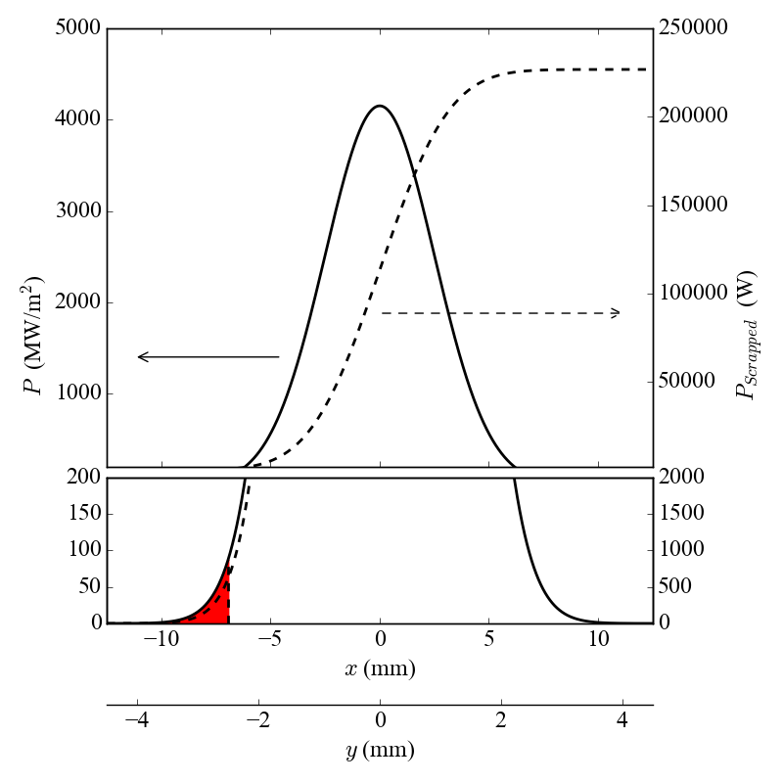
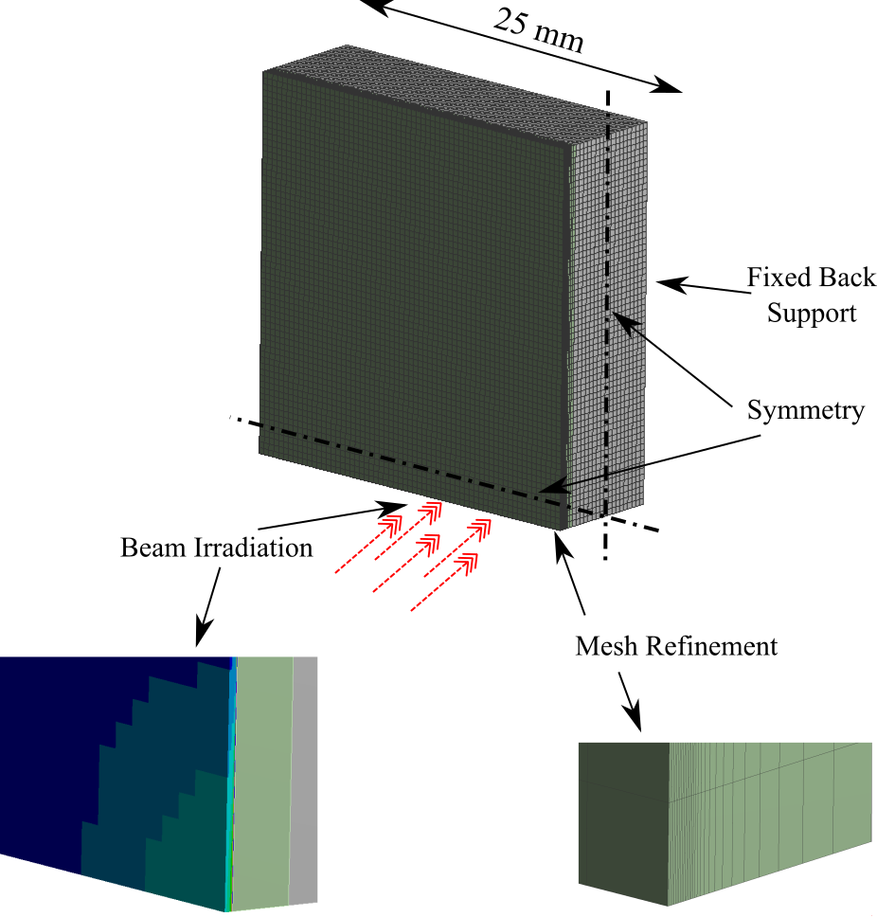
Model Description
Component | Value
Irradiated Plate | TZM – 15º
Body | Steel
Dimensions | 50x40 mm
TZM Inclination | 15º
Water Channel Inner Diameter | 4 mm
Film Coefficient | 5000 W/m2K
Water Temperature | 300 K
a) Position Estimation
  0.25% - 625 W
c) Steady State Operation
b) Transient Effects
15º

Slide 11
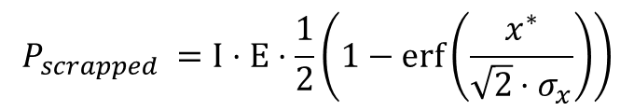
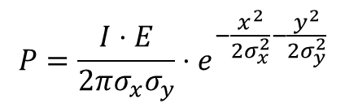
Position Estimation
Gaussian Beam Assumption
Estimation of insertion position (x*,y*)
$$P=\frac{I⋅E}{2πσ_{x}σ_{y}}⋅e^{−\frac{x^{2}}{2σ_{x}^{2}}−\frac{y^{2}}{2σ_{y}^{2}}}$$
$$P_{scrapped} =I⋅E⋅\frac{1}{2}\left(1−\operatorname{erf}\left(\frac{x^{∗}}{\sqrt{2}⋅σ_{x}}\right)\right)$$
Table: MEBT Scrappers position in order to scrap 625 W of 0.28 % of beam power. Scrappers with an inclination angle of 15º.
Component | σ_{x} (mm) | σ_{y} (mm) | x* (mm) | y* (mm) | P (MW/m²) | P_{scrapped} (W) | P_{scrapped} (%)
Scrapper 1 | 1.8 | 3.2 | 5.04 | 9.04 | 33 | 625 | 0.28 %
Scrapper 2 | 3.1 | 3.8 | 8.66 | 10.71 | 16
Scrapper 3 | 2.5 | 0.9 | 7.08 | 2.74 | 78
Scrapper Design | 2.5 | 0.9 | 6.94 | 2.50 | 88

Slide 12
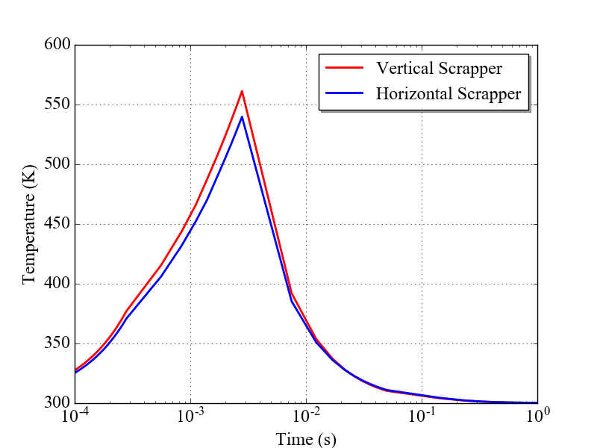
Transient effects
Irradiation is highly concentrated in spots ~mm and depths 10-50 µm (15º/90º).
This leads to high temperatures and stresses during the transient (2860 µs).
  Irradiation arrives and heats the surface.
  Material expands and compressive stresses appear.
  After the pulse the material cools down.
TZM is in contact with refrigerated substrate to dissipate heat in the steady state.
Notes:
Comentar que los efectos son combinados del estado estacionario mas el transitorio. Pero el estacionario como veremos apenas afecta.
En la imagen de irradiación se debería meter algún ángulo.

Slide 13
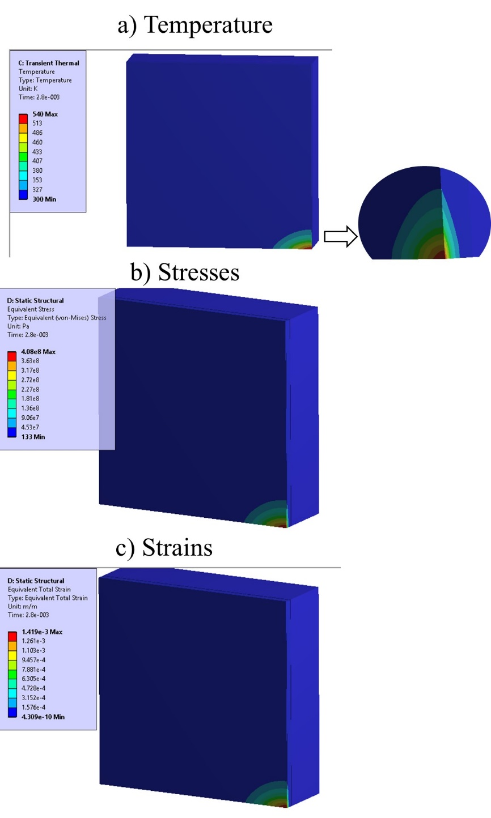
Transient Effects
Case | x* (mm) | y* (mm) | P (MW/m²) | P_{scrapped} (W) | ΔT (K) | σ_{VM} (MPa) | σ_{yield} (MPa) | σ_{VM}/σ_{yield}
Vertical | 6.94 | - | 88 | 625 | 261 | 429 | 681 | 63%
Horizontal | - | 2.50 | 88 | 625 | 240 | 408 | 685 | 60%

Slide 14
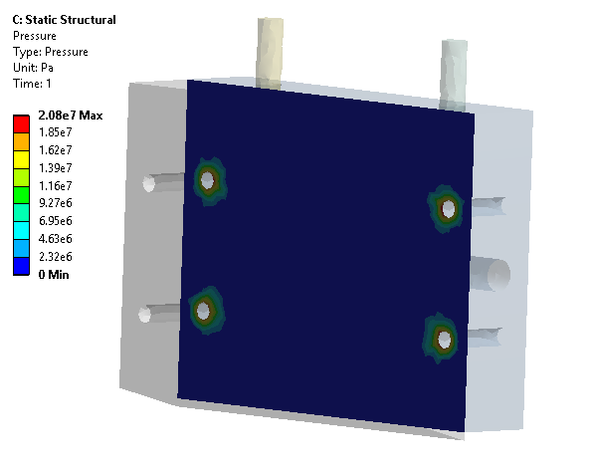
Cooling System
Cooling Conditions
Contact Conditions
Parameter | Value | Unit
Refrigerated Power | 24.5 | W
Inner Diameter | 4 | mm
Water Velocity | 1 | m/s
Water Flow | 1.75 | l/min
Film Coefficient | 5000 | W/m² K
Pressed Contact
No Contact

Slide 15
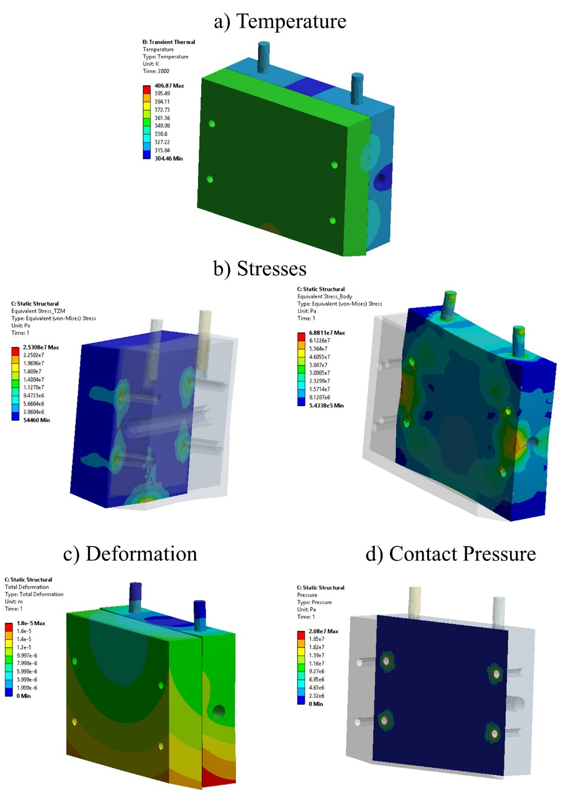
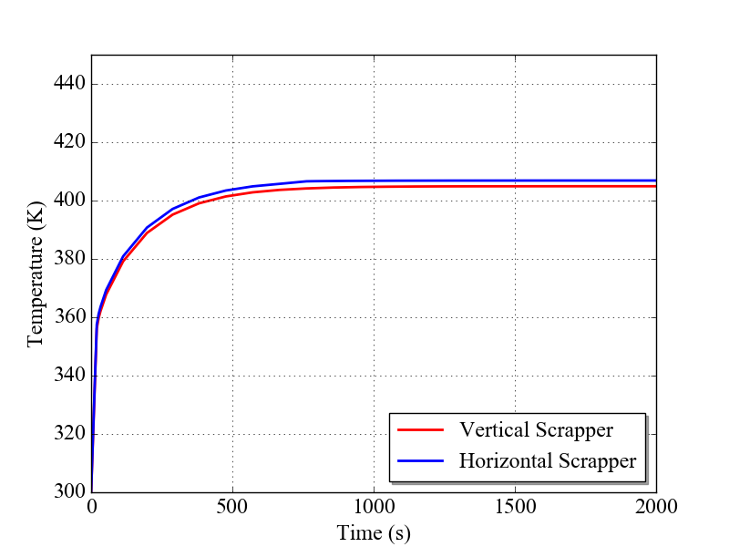
Steady State Operation
Case | x* (mm) | y* (mm) | P_{average} (W) | ΔT (K) | Def. (μm) | σ_{VM} (MPa) | σ_{yield} (MPa) | σ_{VM}/σ_{yield}
Vertical | 6.94 | - | 25 | 105 | 18 | 17.2 | 720 | 2%
Horizontal | - | 2.50 | 25 | 107 | 18 | 25.3 | 719 | 4%

Slide 16
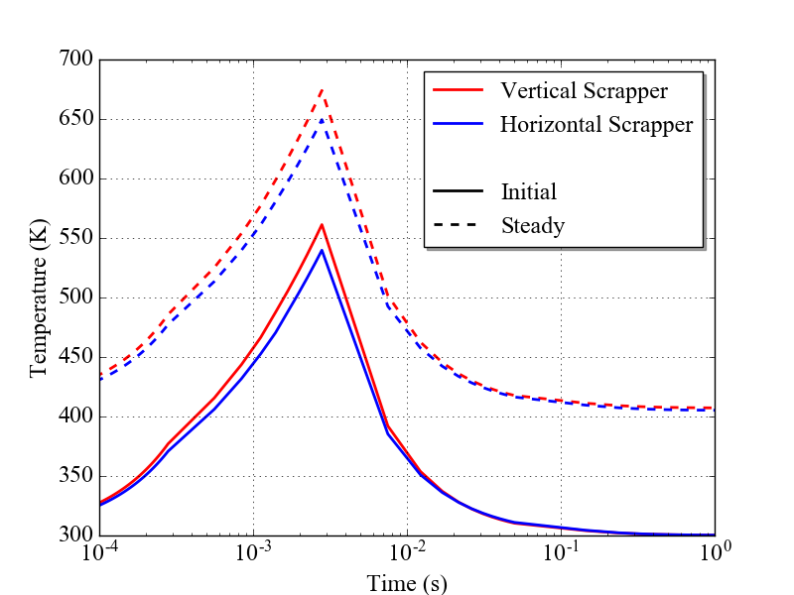
Steady State Operation
Case | ΔT max (ºC) | Def (μm) | Δσ_{VM} (MPa) | σ_{yield} (MPa) | σ_{VM}/σ_{yield}
Horizontal Scrapper
Initial | 27 | 0 | 0
Steady | 107 | 18 | 25.3 | 719 | 4%
Transient 2800 μs (Initial T=27 ºC) | 240 | - | 408 | 685 | 60%
Transient 2800 μs (Steady T=134 ºC) | 245 |  | 430 | 684 | 63%
Total 2800 μs (Init. + Steady + Transient) | 379 | 18 | 455 | 665 | 68%
Vertical Scrapper
Initial | 27 | 0 | 0
Steady | 105 | 18 | 17.2 | 720 | 2%
Transient 2800 μs (Initial T=27 ºC) | 261 | - | 429 | 681 | 63%
Transient 2800 μs (Steady T=132 ºC) | 267 | - | 454 | 679 | 67%
Total 2800 μs (Init. + Steady + Transient) | 399 | 18 | 471 | 663 | 71%

Slide 17
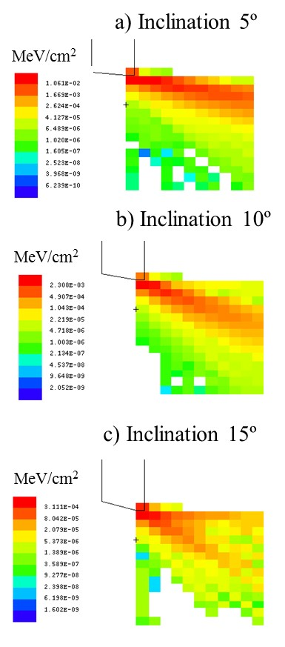
Vessel Irradiation
For 15º inclination Scrapper, vessel irradiation is much below steel limit.
Angle |  | Scattered Beam (%) | Scattered Energy (%) | Scattered Flux at 5 mm P (MW/m²) | Stresses in steel at 5 mm σ_{VM} (MPa)
15 | Hor. | 0.89% | 0.17% | 0.2 | 7
 | Ver. |  |  | 0.1 | 4
10 | Hor. | 6.35% | 1.91% | 0.6 | 20
 | Ver. |  |  | 0.8 | 29
5 | Hor. | 25.62% | 12.90% | 4.0 | 141
 | Ver. |  |  | 5.9 | 211
* Actual distance Scrapper Vessel is 30 mm
** Stresses calculated with simple 1D FEM Model (see MEBT-BI-SC91)

Slide 18
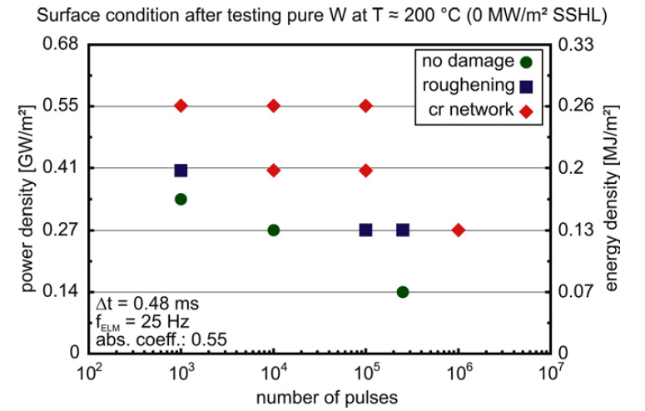
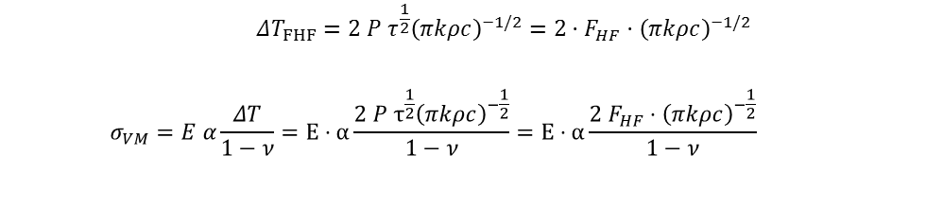
Fatigue Analysis
After continuous irradiation (~10⁶) cycles degradation of the TZM plate may take place.
 | $$ΔT_{FHF}=2 P τ^{\frac{1}{2}}{\left(πkρc\right)}^{−1/2}=2⋅F_{HF}⋅{\left(πkρc\right)}^{−1/2}$$ | ( 8 )
$$σ_{VM}=E α\frac{ΔT}{1−ν}=E⋅α\frac{2 P τ^{\frac{1}{2}}{\left(πkρc\right)}^{−\frac{1}{2}}}{1−ν}=E⋅α\frac{2 F_{HF}⋅{\left(πkρc\right)}^{−\frac{1}{2}}}{1−ν}$$
Material | F_{HF} (MW m⁻² s^{1/2}) | Comment
W | 5.2 | 1D FEM Plastic Limit
TZM | 4.7 | 1D FEM Plastic Limit
W | 5.9 | ~10⁶ pulses (e-beam) [Ref.]
W | 3 | >10⁶ pulses (e-beam) [Ref.]
TZM | 5.3 | ~10⁶ pulses (Estimation)
TZM | 2.7 | >10⁶ pulses (Estimation)
- | 4.7 | Operation with 2.86 ms in ESS-MEBT
Figure from “Evolution of tungsten degradation under combined high cycle edge-localized mode and steady-state heat loads” Loewenhoff et al. 2011
Notes:
Tener las fechas en la cabeza

Slide 19
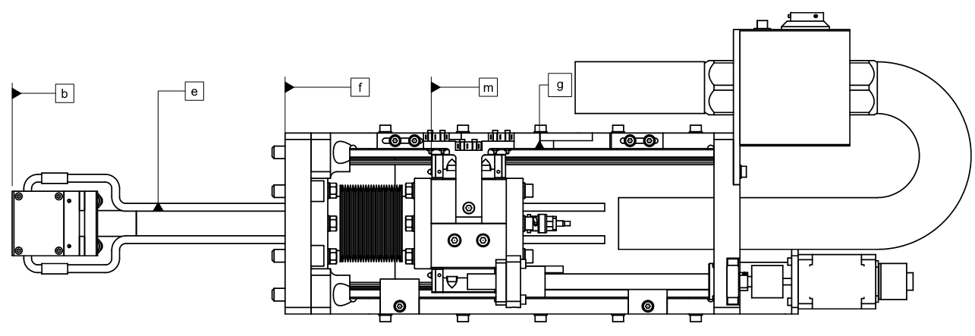
Technical Design Conclusions
We have evaluated the thermomechanical effects of irradiation in the MEBT scrappers.
We performed the analysis for an irradiated TZM and we conclude that the desired operational conditions (625 W-0.25% scrapped per blade) can be withstood using a 15º chamfered TZM plate.
We perform the analysis with design conditions. Attention should be paid to off-design conditions, guaranteeing that the irradiation does not exceeds 88 MW/m² for pulses of 2.86 ms.
Notes:
Tener las fechas en la cabeza

Slide 20
MEBT Scraper Technical Prescriptions
A. Vizcaíno
Bilbao, 13/02/2017

Slide 21
Introduction
The final concept design of the Scraper shown in this presentation.
The integration of the Scrapers inside the vacuum vessels is presented.
The mechanical description of the main components is presented.
The Scraper cabling path is presented.

Slide 22
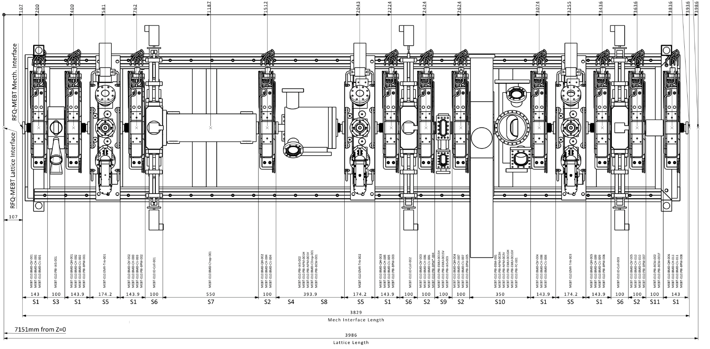
MEBT View
MEBT-SC-2000-ESS
MEBT-SC-2000-ESS

Slide 23
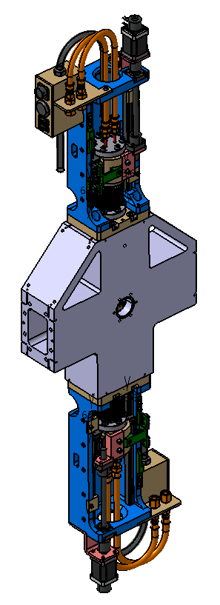
Scraper Vessel Integration

Slide 24
Vessel MEBT-SC-2000-ESS
Scraper
Scraper

Slide 25
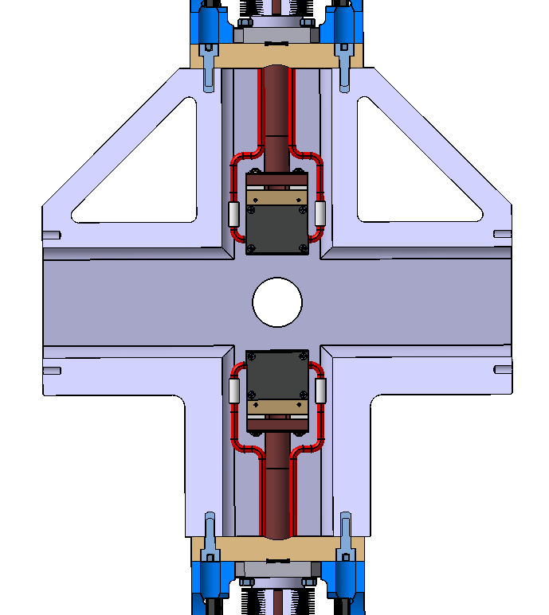
Vessel MEBT-SC-2000-ESS

Slide 26
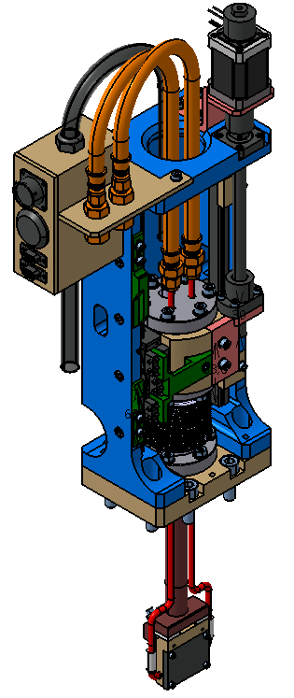
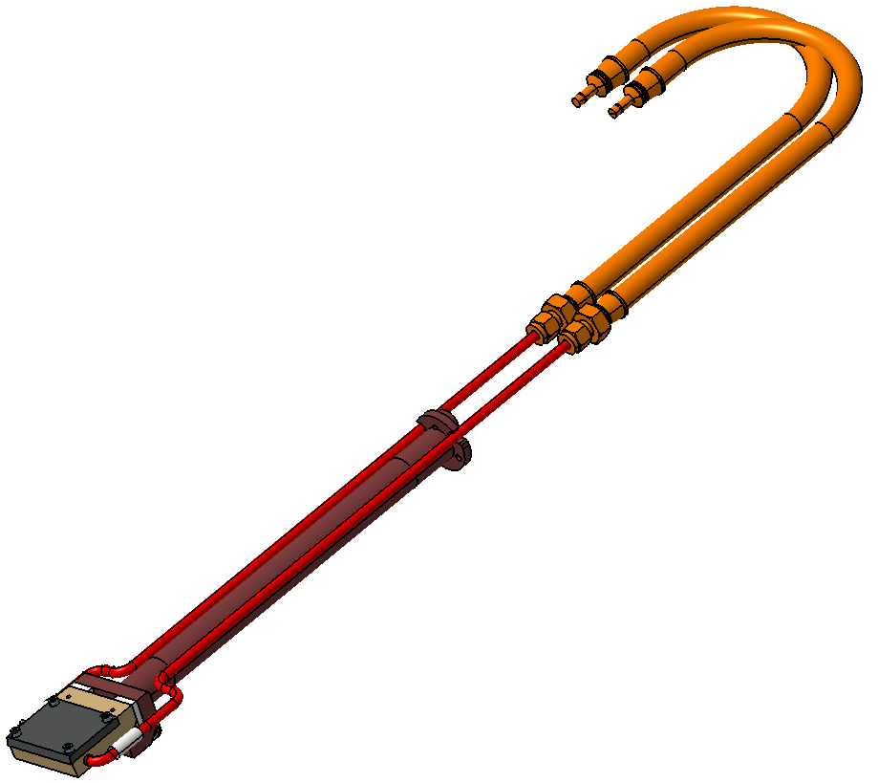
Scraper mechanical design

Slide 27
Scraper mechanical design
Main Properties:
5mm TZM Plate thickness
60mm of stroke
Instrument insolated & cooled
Aluminium Wires as vacuum seal
Linear Guides concept
Compact concept

Slide 28
Blade mechanical design
Cooling Hose
Shaft
TZM Plate
Cooling Pipes
Cooling Pipes Insulators

Slide 29
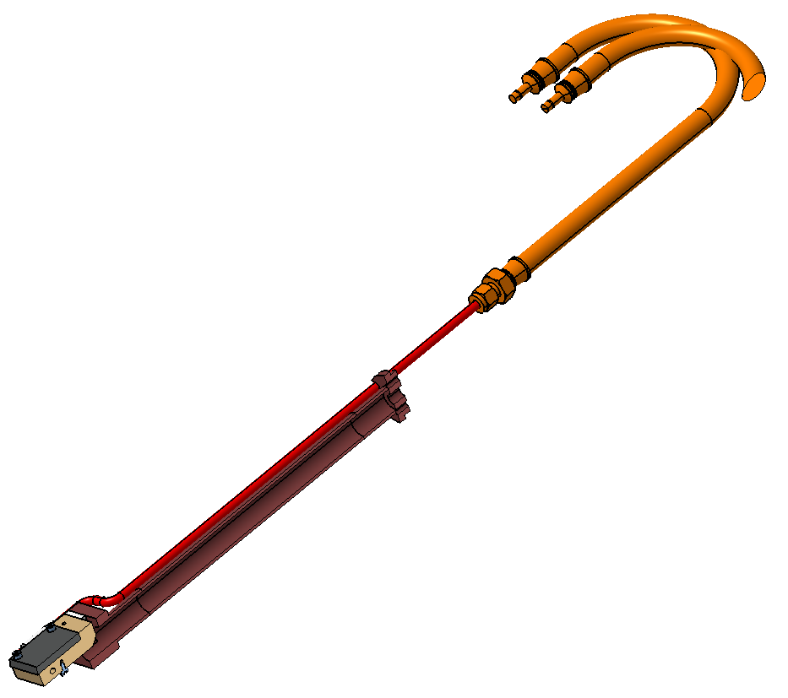
Blade mechanical design
Hollow Shaft
Screw for wire
Signal acquisition

Slide 30
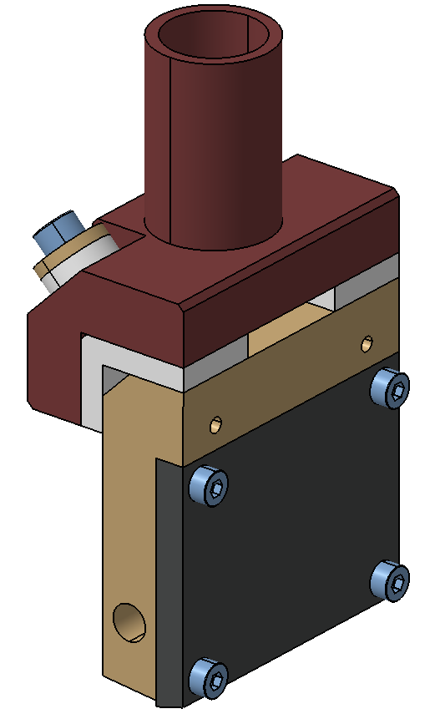
Blade mechanical design
Insulators
Refrigeration
Plate
TZM Plate
15 degrees
blade

Slide 31
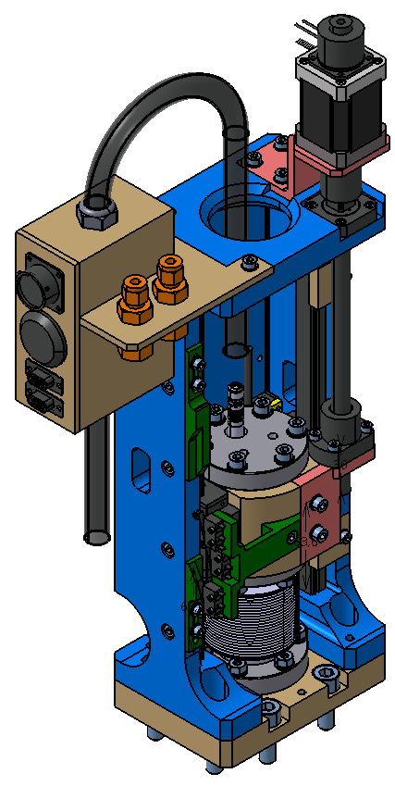
Actuator mechanical design
Motor and Break
Cables Protector
Spindle
Linear Guides
Patch Panel
Vacuum Feedthrough
Cooling
Feedthrough
Bellow

Slide 32
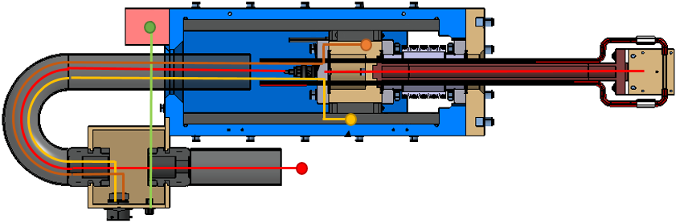
Scraper Cabling

Slide 33
Scraper actuator – Cabling
Signal cable: From the blade to the vacuum feedthrough (coaxial) and from the vacuum feedthrough to the acquisition box (triaxial).
Limit Switches cables: From the Limit Switches position to the Patch Panel.
Motor and Break cables: From the Motor and Break position to the Patch Panel.
Encoder cable: From the Encoder position to the Patch Panel.

Slide 34
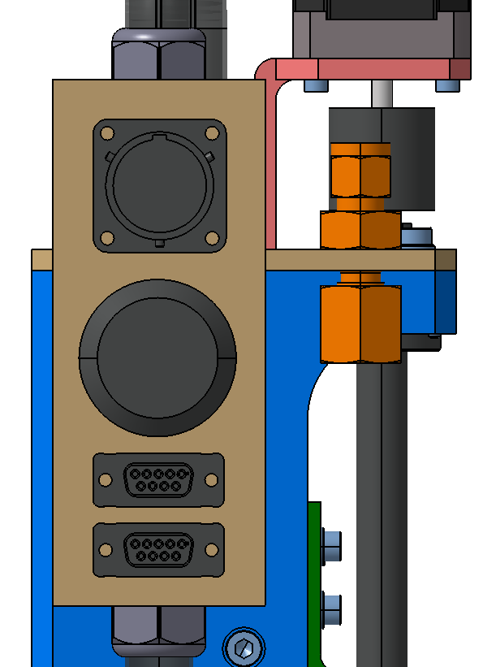
Scraper actuator –
Patch Panel
Motor and Break connector
(SOURIAU UT00128SH)
MPS Limit Switch
(LEMO EGG.4k.312.CYM)
Encoder connector
(DB9)
Travel Limit Switches
(DB9)

Slide 35
MEBT Scraper BASIC Control
I. Mazkiaran
Bilbao, 13/07/2017

Slide 36
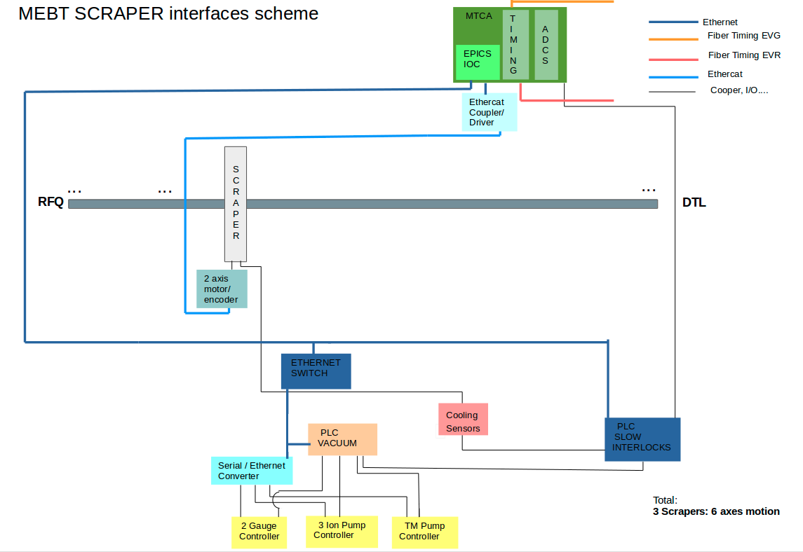
HW description Scraper general interface Layout

Slide 37
HW description 2
Controlled by µTCA crate.
More interesting HW features:
CPU: IOxOS IFC_1410 QorIQ T2081 & Kintex UltraScale AMC.
1 Digitizer board: IOxOS FMC ADC3117 20 channels ADC 16-bit 5 Msps.
External integrated systems controlled from the previous crate HW:
Motion Control: Bus ethercat, linear motion.
Analogue front-end interrelation for signal conditioning.
Interlocks interface.
These external systems controlled by the CPU through the Beckhoff automation technology system modules connected by ethercat bus.
The system also is provided with an Interlocks Siemens PLC for cooling and interlocks functions.

Slide 38
SW general control
SC SW modules:
EPICS module for Scraper control developed by ICS ESS ERIC.
EPICS module: Ethercat_MEBT: shared with EMU and FC developed by ESS Bilbao.
Cooling and slow interlocks developed by ESS Bilbao.
Some features:
Three set of scrapers: 2 blades each.
6 motion axes with stepper motors and incremental encoders.
6 analogue channels for charge measurement.
Provided functionality by Bilbao:
Motion tests.
Analog I/O, Digital I/O availability and control in BECKHOFF system.

Slide 39
SW: Interlocks
Cooling control and interlocks control on Interlocks PLC.
Inputs to interlocks PLC from blade:
Water cooling temperature.
Water pressure at input/output.
Motion axes behaviour.
Interlocks PLC calculations:
Temperature within normal operational limits.
Pressure within normal operational limits.
Motion axes are not stuck.
Output from interlocks PLC to MPS:
Scraper health status.
Input from MPS to IOC through Beckhoff EtherCAT system:
BEAM PERMIT: Scraper permitted to insert.

Slide 40
Tests, Risks and Delivery Calendar

Slide 41
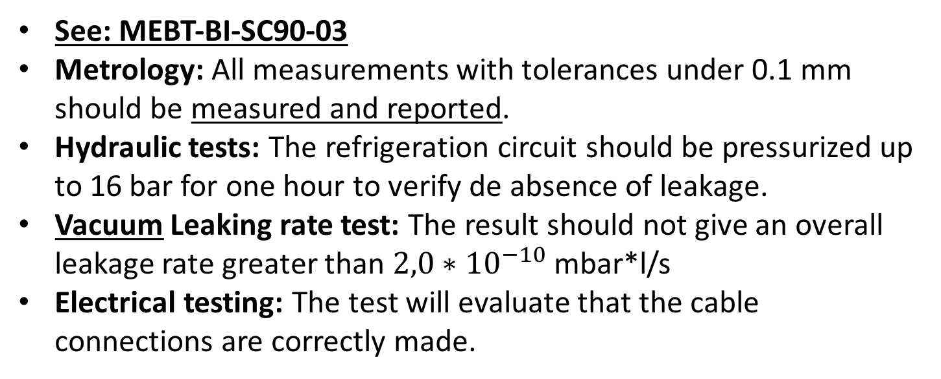
Contractor Tests (FAT)
See: MEBT-BI-SC90-03
Metrology: All measurements with tolerances under 0.1 mm should be measured and reported.
Hydraulic tests: The refrigeration circuit should be pressurized up to 16 bar for one hour to verify de absence of leakage.
Vacuum Leaking rate test: The result should not give an overall leakage rate greater than ${2,0∗10}^{−10}$ mbar*l/s
Electrical testing: The test will evaluate that the cable connections are correctly made.

Slide 42
ESS-Bilbao Acceptance Plan
Once the instrument has been received in the ESS-Bilbao facilities the instrument will be accepted based on the following plan:
Storage: The instrument will be storage with the delivery vessel in a proper enviroment until the beginning of the tests.
Check the contractor documentation: Check all the information about the contractor tests.
Visual inspection: Visual inspection for damages.
Vacuum Tests: A leaking test and a RGA test shall be done to check the results of the contractor vacuum tests.
Electrical Tests: Verification of the electrical connections in all the connectors and cables.
Metrology: A revision of the metrology supply by the contractor could be checked.

Slide 43
ESS-Bilbao Verification Plan
Once the instrument has been accepted a verification of the other instruments characteristics shall be done:
Movement tests:
  Motor Test
  Break Test
  Encoder Test
  Limit Switches Test
  Repeteability Tests
  Vibration Test
Control
Vacuum Tests:
  Movement Test under vacuum
  Leak Test
  RGA

Slide 44
Risks
Risk | Treatment Plan | Responsible
Blade Angular Error | It is required by Contract | ESS-Bilbao
Dimensional quality | A dimensional control will be done by the contractor after fabrication. ESS-Bilbao could repeat the dimensional test to validate the instrument. | Contractor
Vacuum quality | A vacuum control will be done by the contractor after fabrication. ESS-Bilbao could repeat the vacuum tests to validate the instrument. | Contractor
Delivery of the instrument | The instrument will be deliver in a vessel with a Nitrogen overpressure of 10mbar | Contractor
Irradiation damage in TZM plate | Define a limit for operation (88 MW/m²). Avoid operation in off-design conditions. Define a maintenance plan for product. | ESS
Delivered system will not provide full functionality. | Bilbao proposed to provide a full integrated system. This option was rejected by ESS. | ESS

Slide 45
Delivery Calendar
Aceptance Milestone | Date
Contract Formalization | T0 (Kick-Off meeting date)
Delivery of Blueprints | T1 = T0 + 1 month
Acceptance of Blueprints | T2 = T1 + 1 month
Manufacture and delivery of Scraper 1 and Verification Documents | T3 = T2 + 2 months
Acceptance of Scraper 1 | T4 = T3 + 1 month
Manufacture and delivery of Scraper 2, 3, 4, 5 and 6 and Verification Documents | T5 = T4 + 4 months
Acceptance of Scraper 2, 3, 4, 5 and 6 | T6 = T5 + 2 months
Scraper verifications and control integration | T7 = T6 + 3 months
Total duration | 14 months

Slide 46
Thank you for your attention

