Slide 1
Integration of MEBT diagnostics to the ESS control system
Henrik Carling
Integrated Controls System Division
www.europeanspallationsource.se
2017-07-12

Slide 2
ICS Technical Update

Slide 3
Control system infrastructure components
MTCA.4
  Crates, MCH, Cooling Units, PSU
  Platform Management
  Crate variants: 12-slot and 6-slot
I/O and processing
  Digital platforms IFC14x0 and their status
Network and servers
Timing System
  EVG, EVR, Distribution System
EPICS and associated software
Configuration management tools

Slide 4
MTCA base infrastructure
Crates in two variants
12-slot, 9U crate
  For (LL)RF systems that can utilize many slots
  Has been in use, stable configuration
6-slot, 3U crate
  For smaller, more distributed systems (saves rack space)
  Backplane issues
    Vendors consider MTCA backplanes as “custom”
    Defined an “ESS-specific” backplane – follows layout of the bigger crate
  Cooling and airflow issues with prototype
    Added one fan to improve airflow
    Front-to-rear cooling is challenging due to small air inlet area
MCH (Micro Channel Hub) standardized on N.A.T.
Power supplies need final definition
  Wiener has good noise performance but issues with size

Slide 5
MTCA Crate variants
3U, 6-slot crate
4 slots with place for rear transition module
CPU, EVR in remaining slots
9U, 12-slot crate
12 slots with place for rear transition module
2 MCH slots (redundancy)
4 PSU slots (2 with double width, e.g. WIENER)

Slide 6
Timing system
MRF Event System
  Components defined
  Uses latest design with active delay compensation
    Higher frame rate possible
    Unlimited fan-out depth
    Etc.
  MTCA.4 version with backplane trigger and clock support
    Software support to be finalized
Details of interfacing to BI (and other) systems to be discussed and finalized
  A preliminary, incomplete definition exists (ESS-0088633)

Slide 7
Structure of the timing system
RF Master Oscillator
88 MHz
Master Event Generator
fanout
Event
receiver
Event
receiver
fanout
Event
receiver
Event
receiver
Event
receiver
Event
receiver
Event
receiver
Event
receiver
Master Event Generator (EVG) generates a continuous data stream (next slide)
The (accelerator) synchronization frequency (of 88 MHz) will be fed into the master event generator and used as the system clock. Event receivers synchronize to that clock.
The 14 Hz operating frequency will be generated by down conversion from RF in the event generator (divide 88.0525 MHz by 6289464 to get 14.00000064 Hz)
All timing sequences, events, etc., generated in hardware
Notes:
Remember: eye pattern
14 Hz will be generated internally in the EVG. De facto decision.

Slide 8
Accelerator sequences
14 Hz <-> 71.4 ms
71.4 ms
71.4 ms
71.4 ms
…
t
Beam Off, t=0+3395 us
Beam On,t=0+535 us
RF Pulse, t=0+530 us
DATA
Modulator, t=0+500 us
Transmit (well) before next cycle
Pre-programmed sequences repeat at 14 Hz
  Sequencer with a RF-synchronous 88 MHz clock (can be changed)
  “programming” can happen in less than a millisecond
“Data”, i.e., beam envelope mode, etc., transmitted in parallel
  Contains “plan” for the next cycle: envelope mode, beam/no beam, pulse counter, rep rate,…
  Mode changes require a handshake with BIS
    When mode change is transmitted, timing does not send beam before MPS/BIS gives OK

Slide 9
Digital platforms, status and support
IFC1410
  Hardware ready for production
    In-kind partner (PSI) preparing procurements of production batches
    Limited pre-production hardware exist/may be initiated
  Firmware framework - TOSCA - available
    Supports all available features of the board
      PCIe, DMA engines, interrupts, shared memory, etc.
      Earlier firmware applications (for IFC1210) have been ported or in progress
      ICS are tracking/treating some minor issues- this should not prevent work
  Software support - Linux kernel/drivers and EPICS
    PSI is working on upgraded drivers (see following slides)
      Two stage approach how to transition from existing pev/tsc drivers
      Meanwhile, the pev/tsc drivers are fully functional but need improvement
    Linux Yocto runs on the IFC1410
  FMCs integrated
    ADC3110/3111 - 8 channels @ 16 bits @ 250 MSPS
    ADC3117 - 20 channels @ 16 bits @ 5 MSPS
    ADC3112 - 4 channels @ 12 bits @ 1 GSPS - implementation ongoing
    On the list to be integrated: Specialized digitizers, Quad SFP+, Digital I/O …

Slide 10
Digital platform (IFC/IOxOS) support from PSI
Scope of ICS Digital Platform in-kind project with PSI
1410/1420 test/devl. environment setup
  1410 Prototype tests
  Procurement of 1410
1420 prototype tests
  Porting FW & SW packages (from IFC1210)
  Procurement of 1420 (1411 + DAQ 1430)
Series production
Software/firmware maturation support
Integration support
Final reports

Slide 11
IFC_1410 board without FMC modules

Slide 12
IFC1410 overview
BIS special
Mezzanine
(backside mounted)
FMC slot #1
CPU
FPGA
Xilinx
KU040
FMC slot #2
BIS interface can also be implemented on a Rear Transition Module

Slide 13
IFC1420
The IFC1420 is a specialized variant of IFC1410 consists of two parts
  FMC carrier (IFC1411)
  Mezzanine ADC module (IFC1430) connecting to the RTM connector
    ADC: 10 channels @ 16 bits @ 250 MSPS
    DAC: 4 channels @ 16 bits @ 2.5 GSPS
  The IFC1411 has two standard HPC/FMC slots where one can be used by the 1430
In IFC1420 configuration, front plate space can still be used for a BIS mezzanine
  One FMC slot still remains free for use (SFP, additional ADCs, DI/O, …)
Other specifications similar to the IFC1410
  Differences obviously in the digital vs. analog RTM interface
  Firmware and software very similar except some signal routing

Slide 14
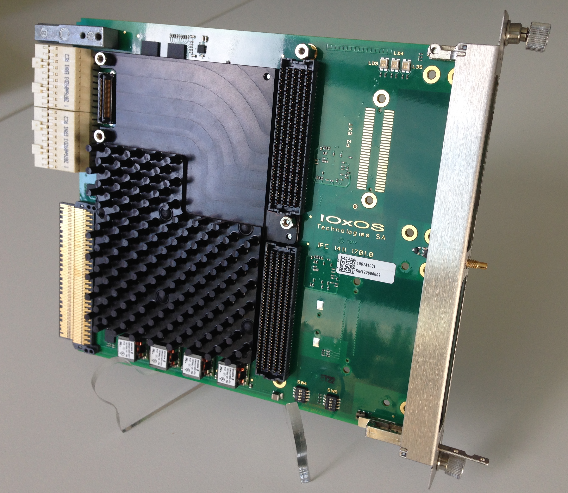
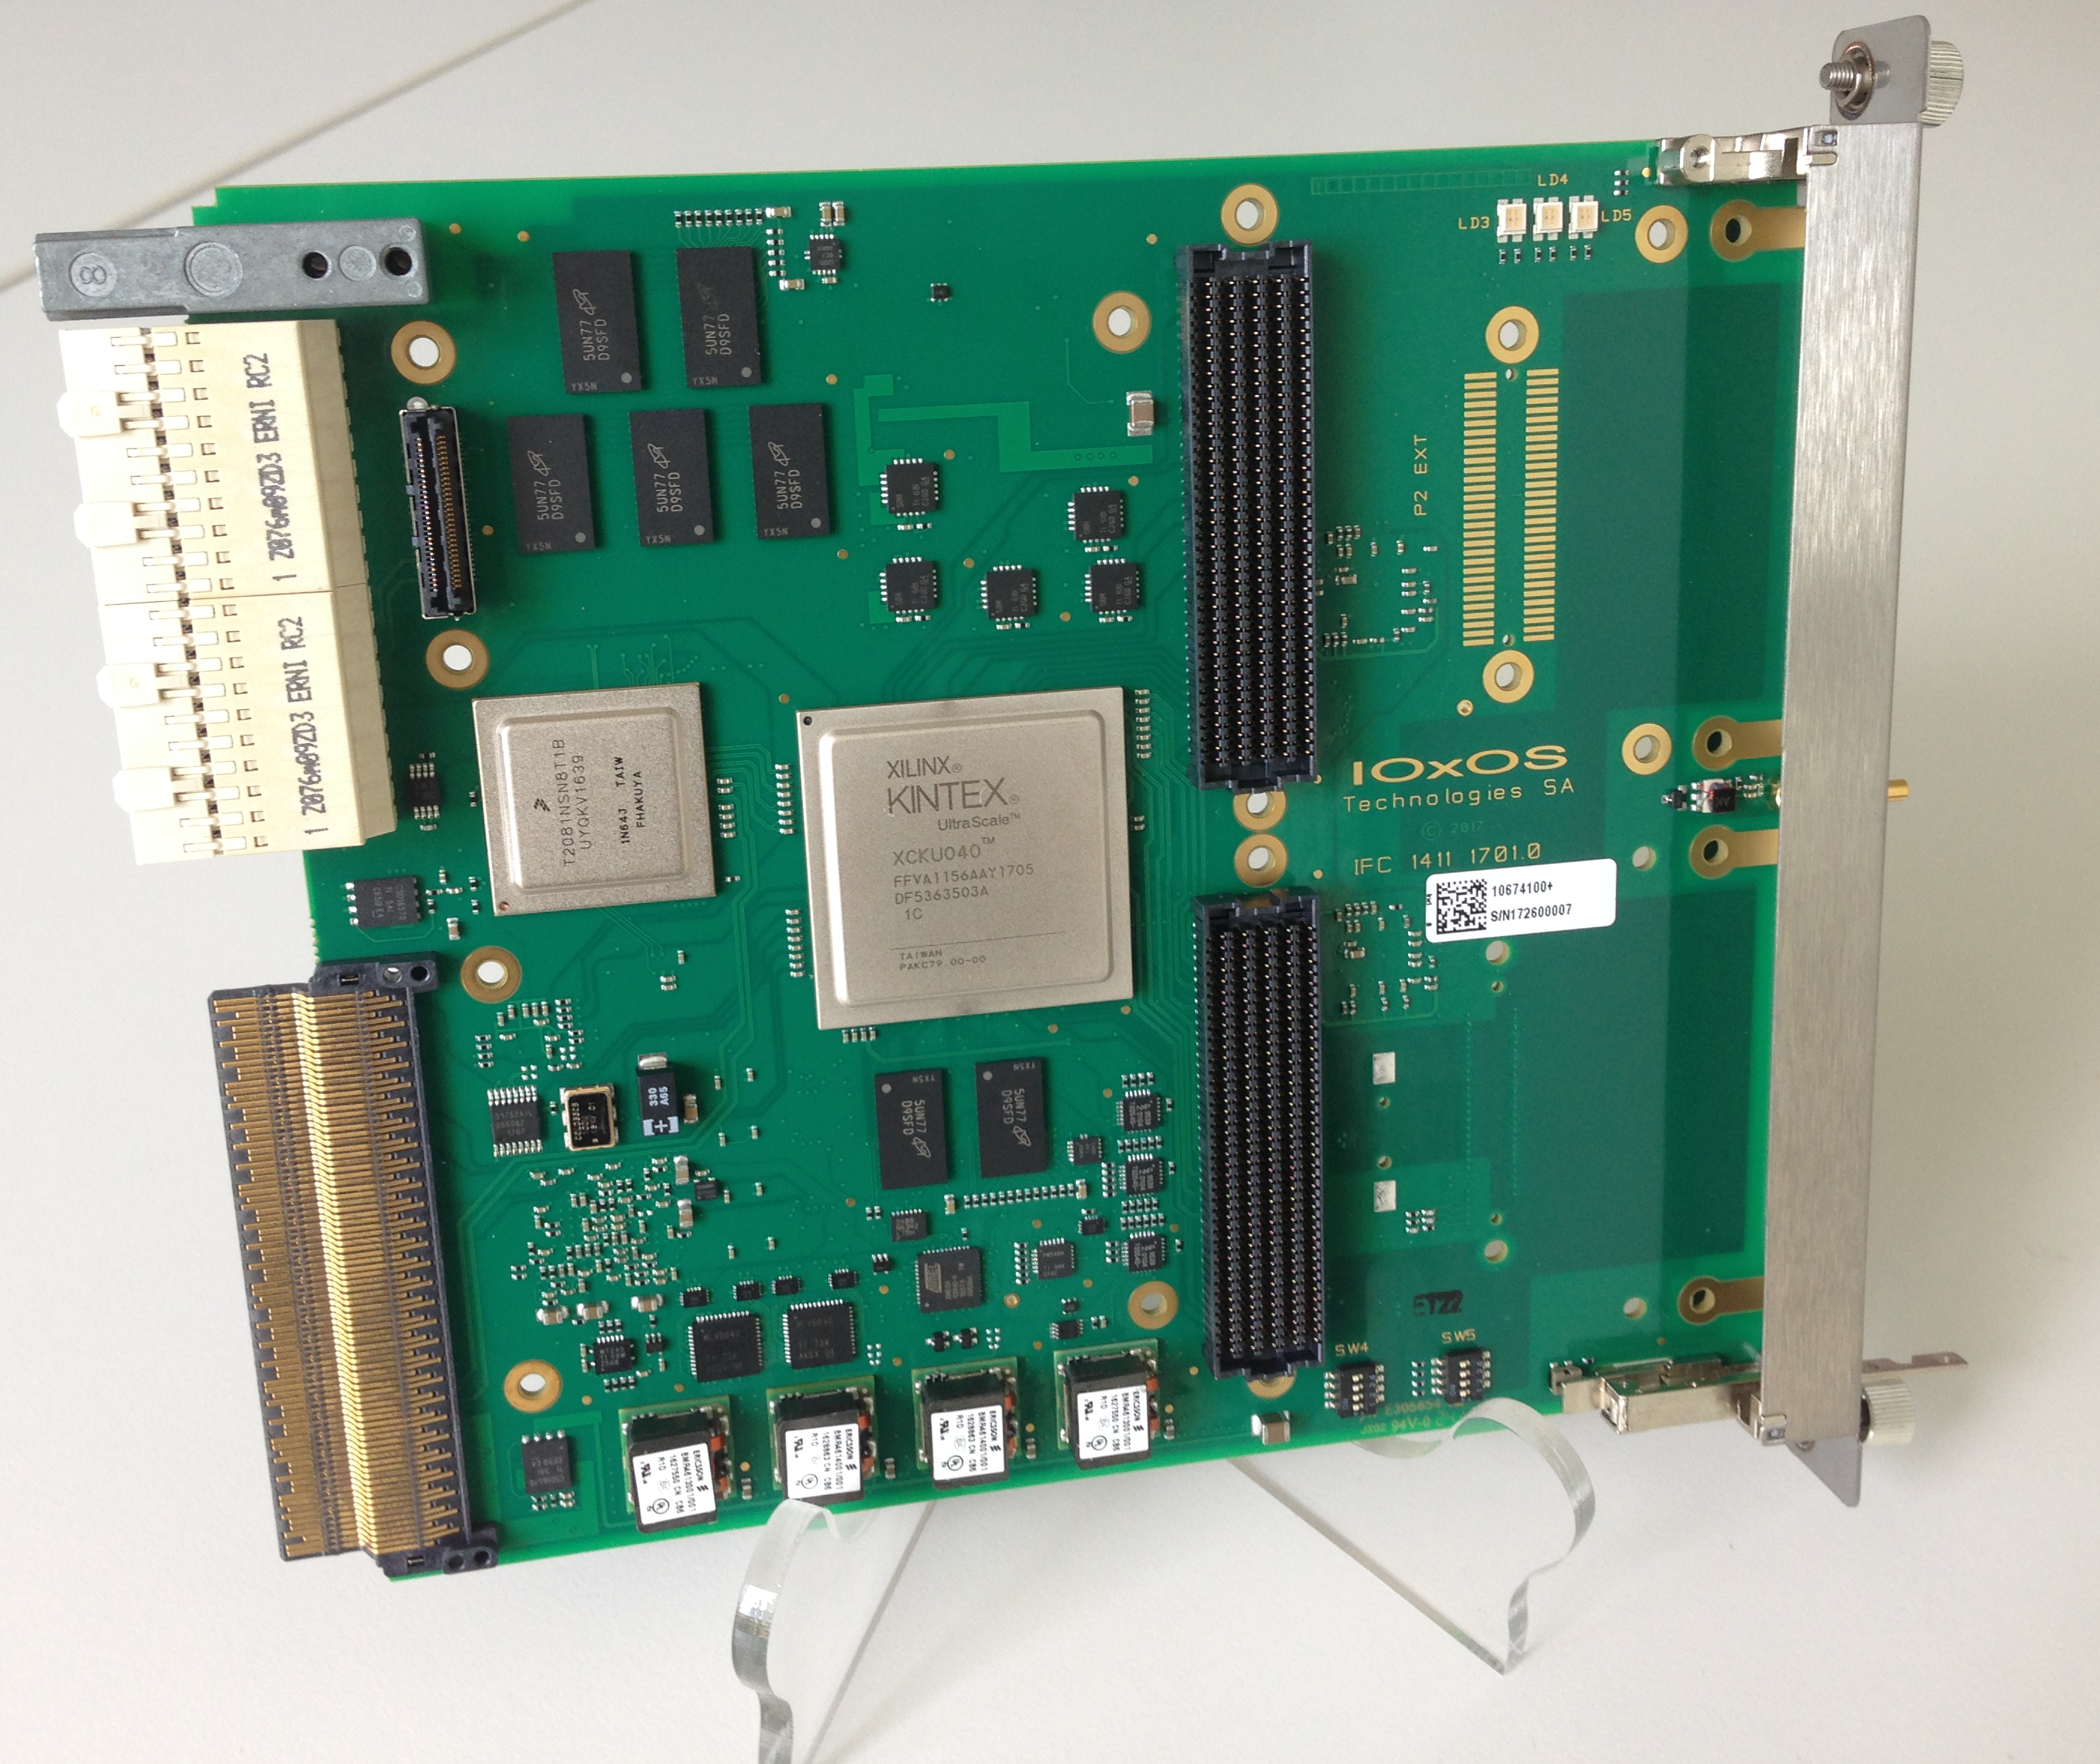
IFC1411
With heatsink mounted
Without heatsink - similar to IFC1410
IFC1411 has an analog mezzanine connector
  For signals from Zone 3 to the DAQ_1430 mezzanine
DAQ1430 is functionally equivalent to an ADC3110 FMC
  Except for having 10 ADC and 2 DAC channels (instead of 8 CH ADC).

Slide 15
IFC1420 layout overview
ADC Mezzanine (1430)
FMC slot #1
BIS special
mezzanine
FMC slot #2
Notes:
IFC1411 can be used with two FMCs! (i.e., both FMC slots are forward-facing)

Slide 16
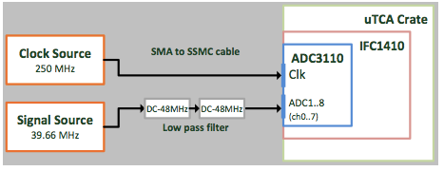
IFC1410/ADC3110 analog performance
    The ADC3110: 8 channels @ 16 bits @ 250 MSPS
  Characterized on IFC1410 at PSI performance measurement lab
  250 MHz clock, 39.66 MHz signal
    Noise floor ~120 dBFS, integrated noise floor ~75 dbFS
    SNR ~73 dBFS, SFDR ~85 dBFS, SINAD ~73 dBFS, ENOB 11.8
  Full report available
    This type pf characterizations are part of the PSI/ESS in-kind contribution
    Will/can be repeated on other components/parameters

Slide 17
Networks and servers
Network design done
  Technical network backbone
  State-of-the-art performance level
  Hardware in-kind contribution from Norway
  Installation, cabling is underway
    System-level connection details to be defined
Some EPICS IOCs already running on site
  CF systems with PLCs
Temporary control room being equipped
  As well as server infrastructure (also temporary until server room ready)

Slide 18
Development environment support
EPICS base infrastructure
  EEE (ESS EPICS Environment) is designed to support
    Distributed development
    Continuous integration, test procedures
    Closed loop from development to deployment
  Scripting support (Python, P4P)
EPICS (7) services
  Archiving, alarm system, save&restore
  Channel Finder for (flat) namespace management
    Generate higher level abstraction(s) and grouping
Notes:
P4P is Michael’s new Python support. pvaPy is another library that comes from Argonne Nat Lab. P4P seems to have a nicer API and better performance. Hopefully we will converge into one in the long run. Bob Dalesio’s (weak) recommendation was to use P4P (essentially meaning that it will be supported long term.)

Slide 19
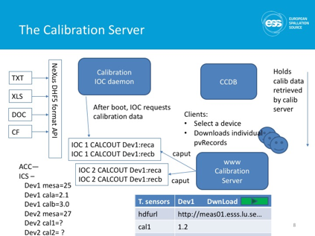
ICS Software
Configuration management
  Controls configuration DB
  IOC Factory
  Cable DB
  Naming service
Data management tools (ongoing)
  Calibration data for various devices
  Storage and indexing of measurement results

Slide 20
Summary
MTCA base infrastructure defined
  Crates and related components, platform boards, FMCs
Timing system components defined
  Procurement process in preparation
Platform support improving
  IFC (IOxOS) platform support catching up after a slow start
Control system services defined but more details to be discussed
  Definition of PVs for operation (waveforms, integrated values,…)
  Archiving requirements
  Post-mortem and beam-synchronous data handling
  Calibration requirements
  Etc.

Slide 21
ICS support for MEBT

Slide 22

General Architecture
EMU, Faraday cup, Collimators
MTCA Environment
Gigabit Ethernet
Timing Signals (Triggers, clocks)
IFC1410
RSP1461
RTM
IFC1410
RSP1461
RTM
IFC1410
RSP1461
RTM
MRF
Event
Receiver
MCH
ADC3117
FMC
ADC3117
FMC
ADC3117
FMC
Control
Network
Beckoff EtherCAT
Beckoff EtherCAT
Beckoff EtherCAT
Timing System
Emittance Meter Unit
Slit and grid motion control;
Test voltage for the grids;
Analog data acquisition;
Faraday Cup
FC insertion control;
Repeller control;
Analog data acquisition;
Collimators (Scrapers)
Blades insertion motion control;

Slide 23
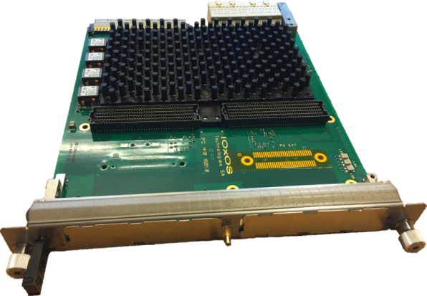
MicroTCA development environment
Development environment
NFS mount
IFC1410:
ESS Bilbao
EEE Server
Linux Kernel
T208x Freescale PPC architecture
2GB DDR3 memory
Device Tree
Xilinx Kintex Ultrascale FPGA
NFS mount
2x HPC FMC support
Root File System
D1.4 RTM support
Kernel Modules
(MRF EVR,IFC1410, EtherCAT)
TFTP
U-boot scripts
FPGA bitstreams
Two options exist for ESS Bilbao to utilize the development environment
  ICS can provide the development environment as a stand-alone system on a MTCA CPU card with local storage
  ESS Bilbao can set up any regular PC as a boot server for the MTCS system
All software modules listed will be provided by ICS using an on-line BitBucket repository
  ESS Bilbao will have instant access to all updates (such as updates of kernel modules or new FPGA firmware versions)

Slide 24
Evolution of EPICS modules for IFC1410
ESSB modules
ESSB modules
ESSB modules
ifcdaq
ifcdaq
ifcdaq2
NDS
ESS
NDS
areaDetector
ESS
ifcdaqdrv
ESS
ifcdaqdrv
ifcdaqdrv2
pevdrv
tsclib
Userspace
Legacy
PSI
pev
tsc
TOSCA
PSI
Kernel
VME-based prototypes
(to be phased out)
MTCA prototyping
Stage 1
MTCA migration:
Stage 2
EPICS device support for data acquisition will be based on areaDetector, which is largely used in the EPICS community
Kernel driver TOSCA will be provided by PSI (in partnership with commercial suppliers)
  This driver replaces the tsc driver, improving the interface with the firmware running on the FPGA
    DMA operations
    Interrupt handling
    Register-mapped access
    ... and more
The software changes will be transparent for ESS Bilbao, since the interface layer (ifcdaq) will be unchanged
ICS will support ESS Bilbao in case of any modification that need to break backwards compatibility

Slide 25
Timeline (tentative)
2017-09
2017-11
MTCA migration:
Stage 1
MTCA migration:
Stage 2
ICS Deliverables
MTCA crate and infrastructure
Boot server with software facilities
Timing receiver
IFC1410 with ADC3117
EtherCAT master
tsc driver and NDS device support
Prototype ready to test EMU and FC with waveform acquisition rate (EPICS level) of 5 times per second;
ICS Deliverables
MTCA crate and infrastructure
Boot server with software facilities
Timing receiver
3 x IFC1410 with 3 x ADC3117
EtherCAT master
TOSCA driver
areaDetector device support
Complete system for integration of FC, EMU and Collimators. Waveform acquisition rate (EPICS level) of 14 Hz;

Slide 26

Integrated control system
Thank you for your attention
If you want more information, subscribe to the ICS weekly report

