Slide 1



Simulation Tools for Detector and Instrument Design
676548
Kalliopi Kanaki
on behalf of the ESS Detector Group
European Spallation Source ERIC
ICNS conference, Daejeon, July 2017

Slide 2
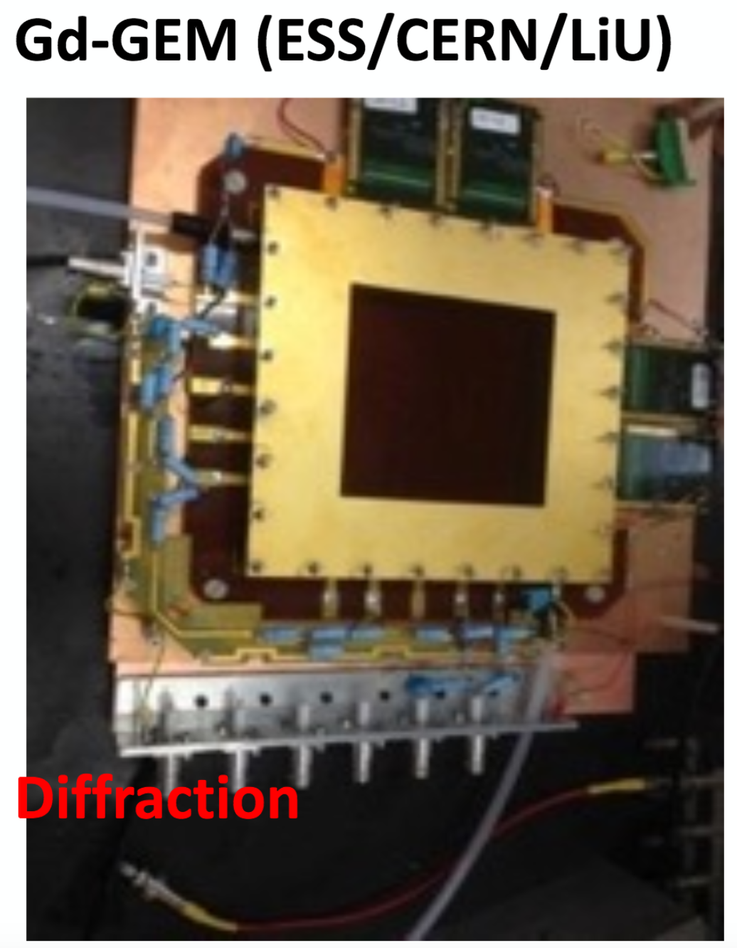
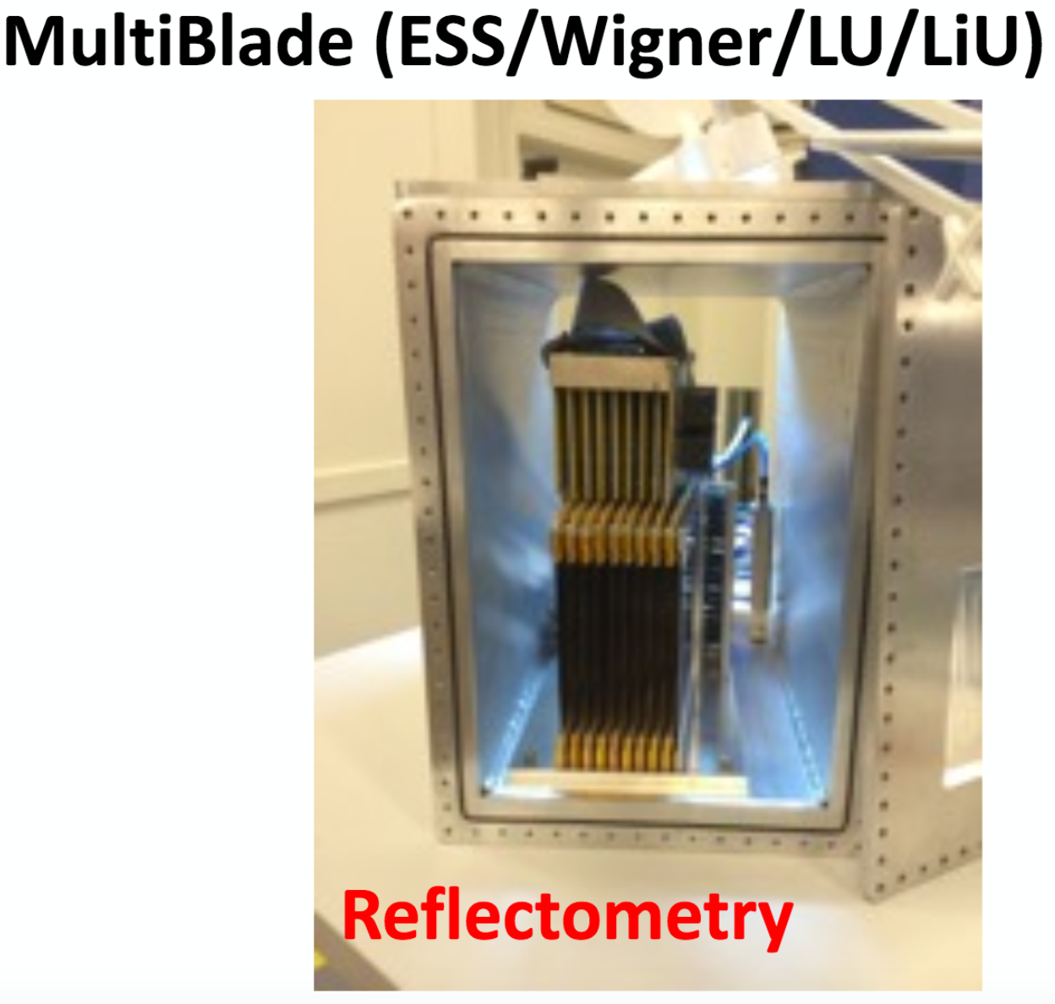
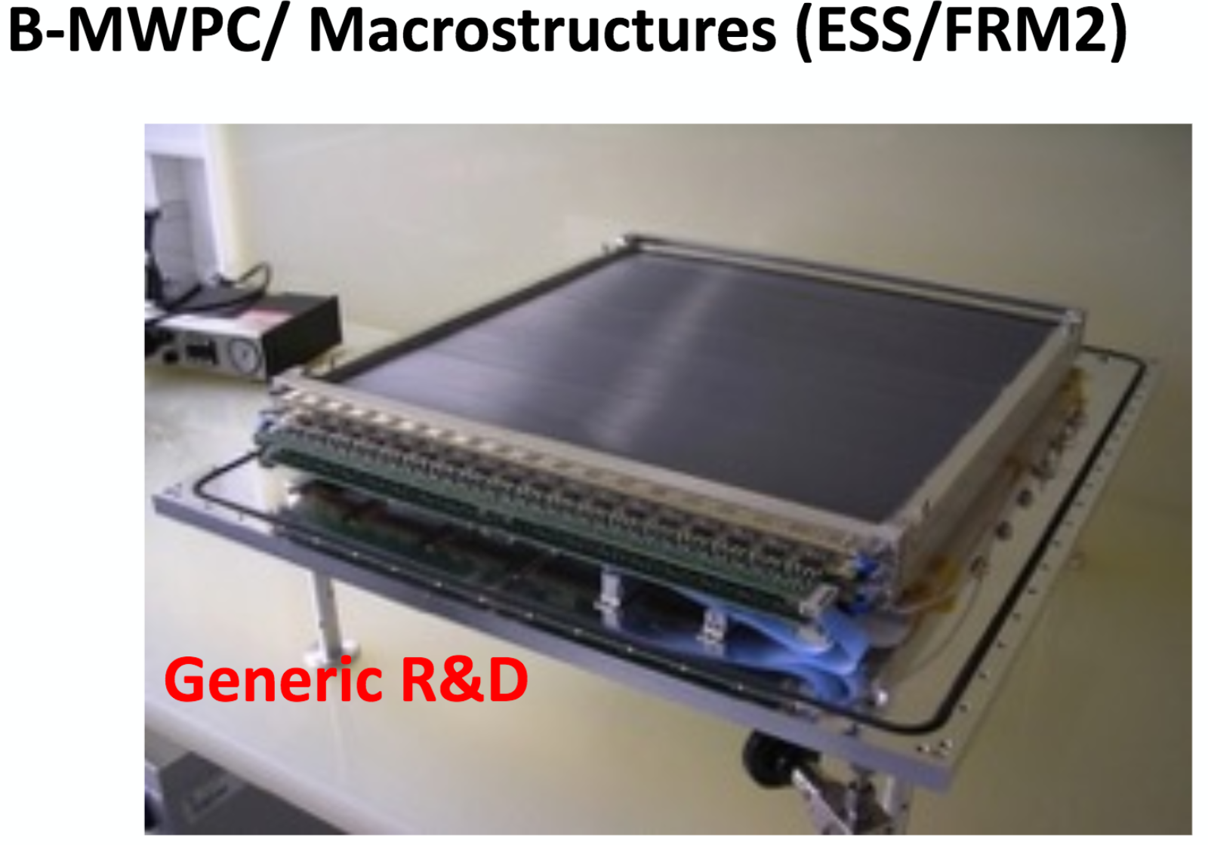
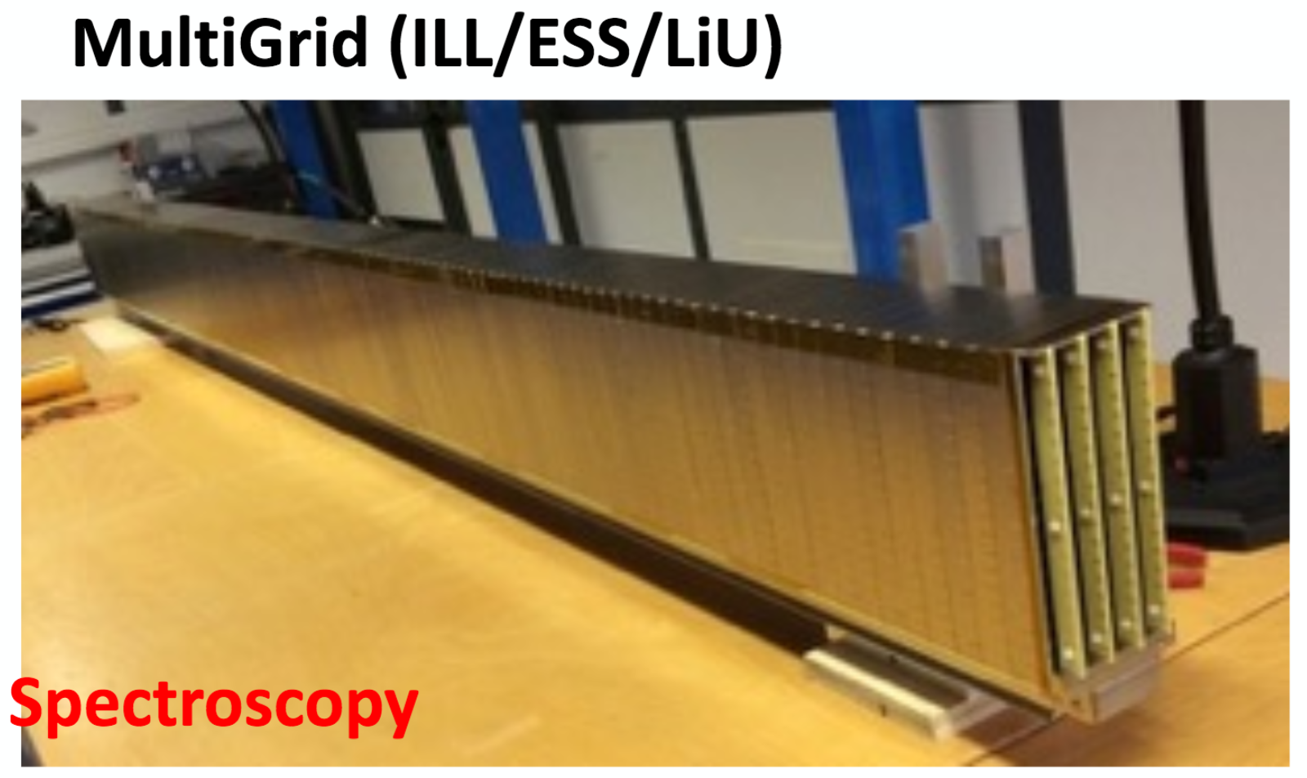
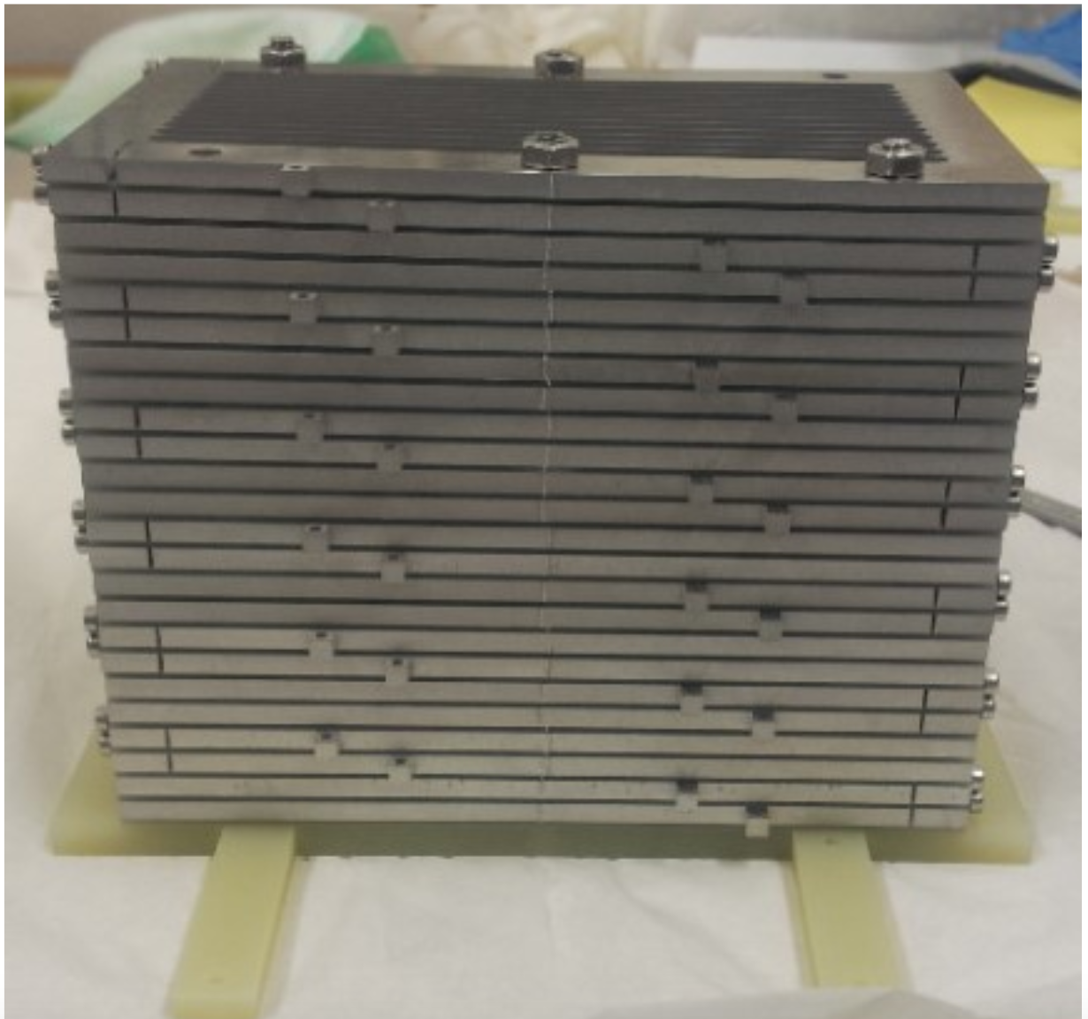
Introduction
Numerous advances in neutron detector technologies for upcoming ESS instruments
New simulation tools are available to the community.
Possible to tailor the detector design to the application
Speed up the development period
Molecular crystallography
BandGEM
(Milan/CNR/INFN/CERN/ESS)
SANS

Slide 3
Geant4: GEometry ANd Tracking
Monte Carlo toolkit for simulating passage of particles through matter
Contains facilities to handle geometry,
detector response, visualization and analysis
Created at CERN by high energy physics
community
Other applications include:
  Space physics
  Radiation
  Medical physics
Expanding to
neutron scattering
tomography
space physics
DNA radiation
damage
particle and nuclear physics (p+p and heavy ion collisions)
Nuclear Instruments and Methods in Physics Research A 506 (2003) 250-303
IEEE Transactions on Nuclear Science 53 No. 1 (2006) 270-278
Nuclear Instruments and Methods in Physics Research A 835 (2016) 186-225

Slide 4
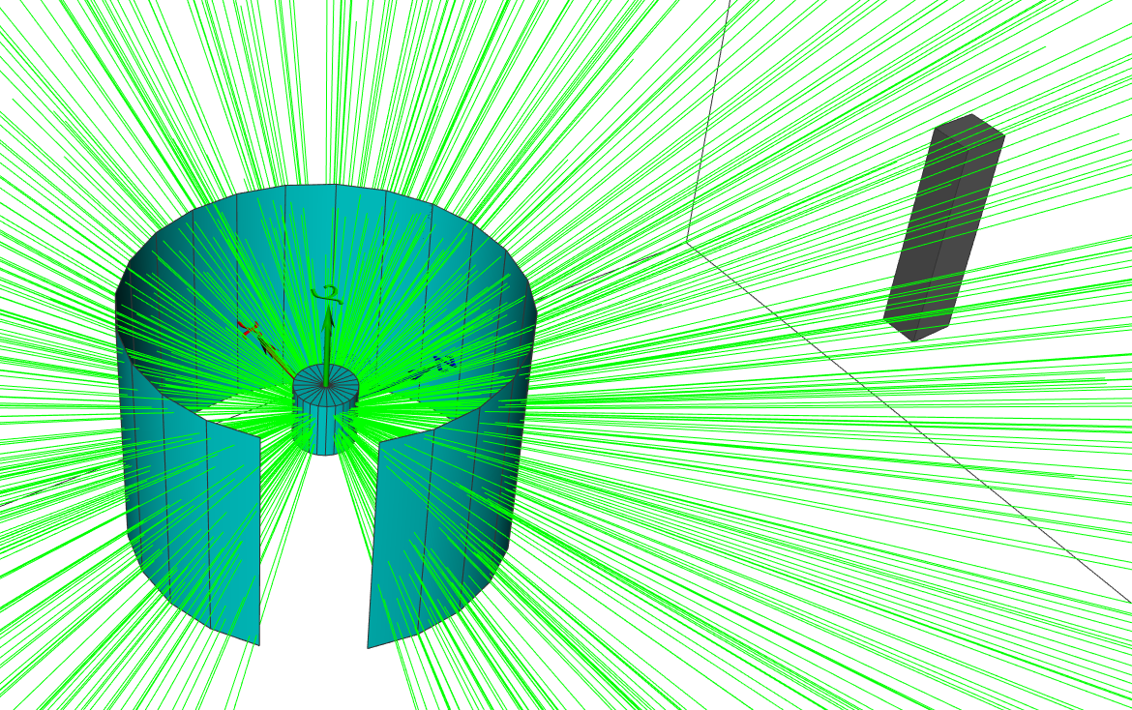
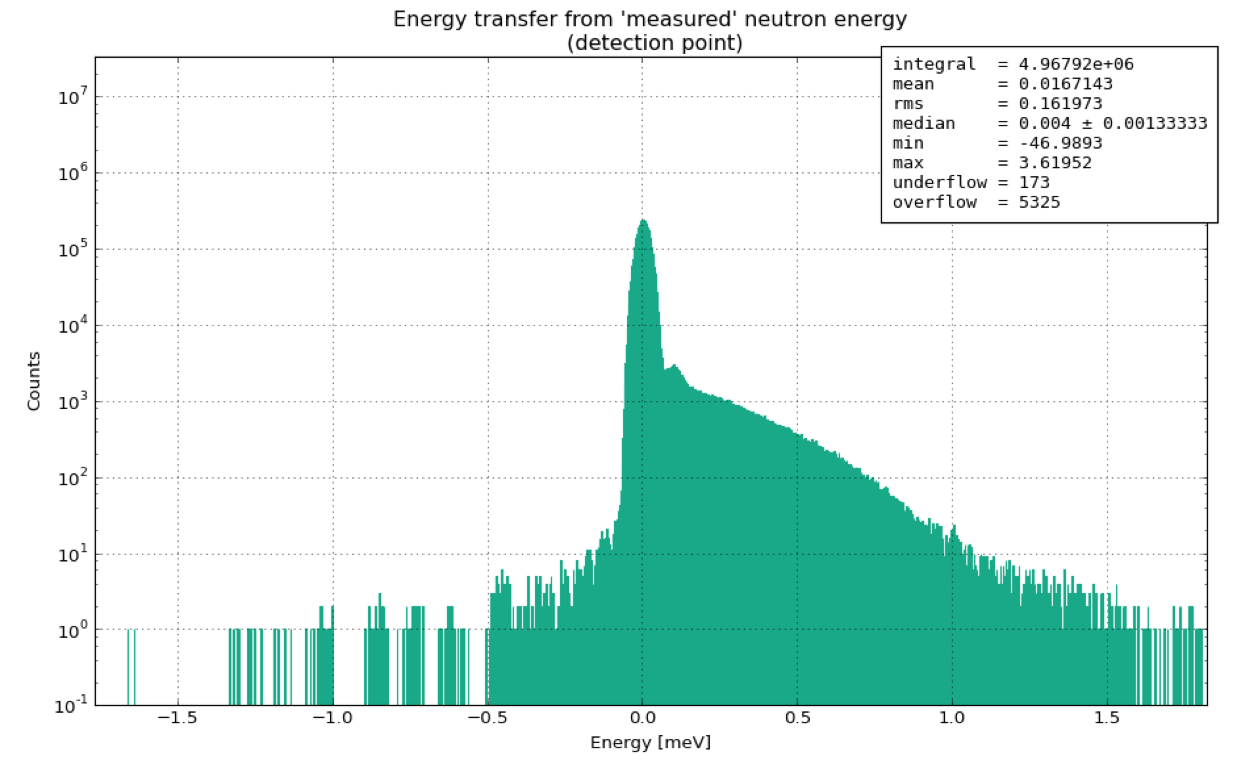
ESS Detector Group Simulation Framework
(T. Kittelmann, X. X. Cai, K. Kanaki)
Sample environment
Detector
Geant4 simulation framework
  Developed by ESS Detector Group
  Used by other ESS groups e.g. Accelerator Division,
  Target Division, Neutron Optics and Shielding Group,
  in-kind collaborators
Includes:
  User-friendly build system
  Python interface
  3D visualisation (via Open Scene Graph)
  Easy-to-handle histograms for analysis
  Griff: an user-friendly binary format for saving results
  Powerful parameter scanning without source code recompilation
Intuitive & well documented
Fast development of new simulations
A subset of its tools is presented in this talk
Isotropic scattering
particles simulated from sample
Available, just send an e-mail!
Contact:
Thomas Kittelmann: thomas.kittelmann@esss.se
Xiao Xiao Cai: xcai@dtu.dk
Kalliopi Kanaki: kalliopi.kanaki@esss.se
T. Kittelmann et al., “Geant4 based simulations for novel neutron detector development”, arXiv:1311.1009v1

Slide 5
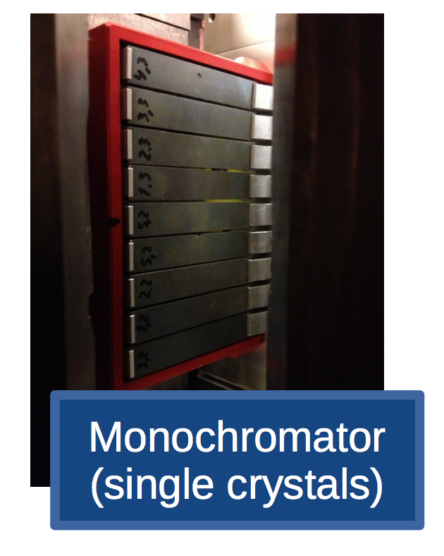
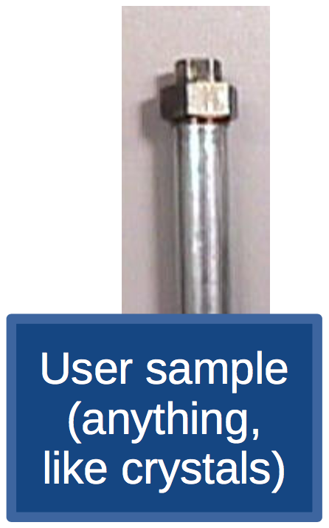
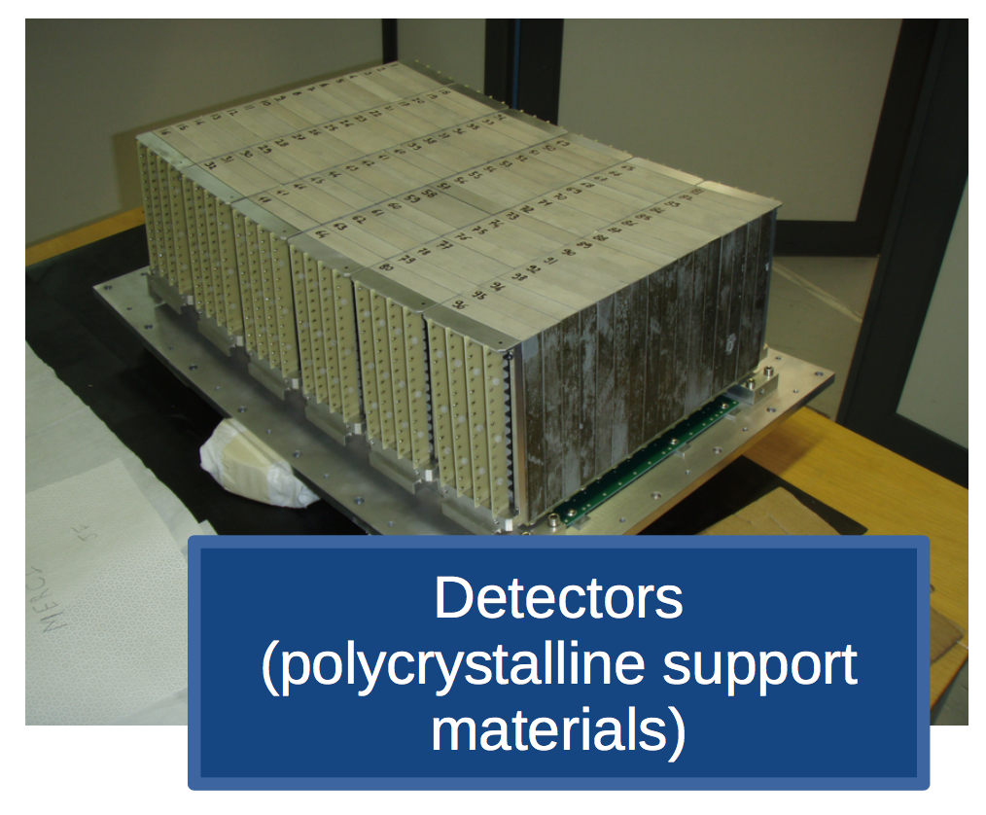
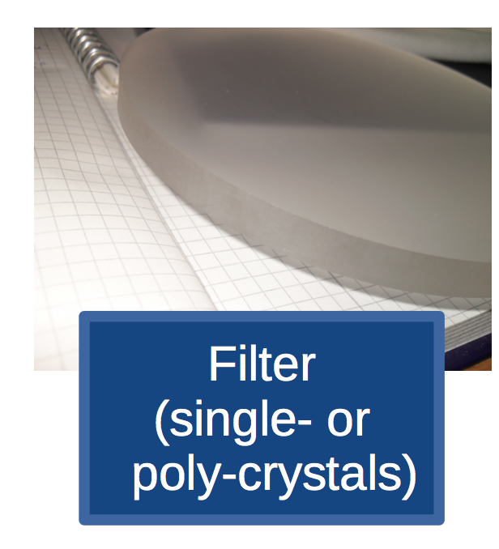
The NCrystal project
(X. X. Cai, T. Kittelmann)
Several crystalline components in a neutron instrument → correct modelling of interaction with poly- and single-crystal materials is essential.
NXSG4 library created to handle Bragg scattering on poly-crystalline materials (T. Kittelmann, M. Boin. "Polycrystalline neutron scattering for Geant4: NXSG4", Computer Physics Communications 189, 114-118 (2015), doi:10.1016/j.cpc.2014.11.009)
NCrystal advances this effort
Validated cross section curves available to Geant4, McStas or any other application via a well-defined interface
NCrystal 1.0 prerelease is already available within the ESS simulation framework.
  Includes single- and poly-crystal Bragg scattering
  Simple (empirical or first principle) parameterization of background contributions
NCrystal 2.0 is on its way
  Improved treatment of inelastic scattering with sampling of 2D scattering kernels or 1D phonon spectra
Will appear at: https://github.com/mctools (mid-July)
Notes:
1.0: 0.5 on github,
support of lau laz ncmat nxs files

Slide 6
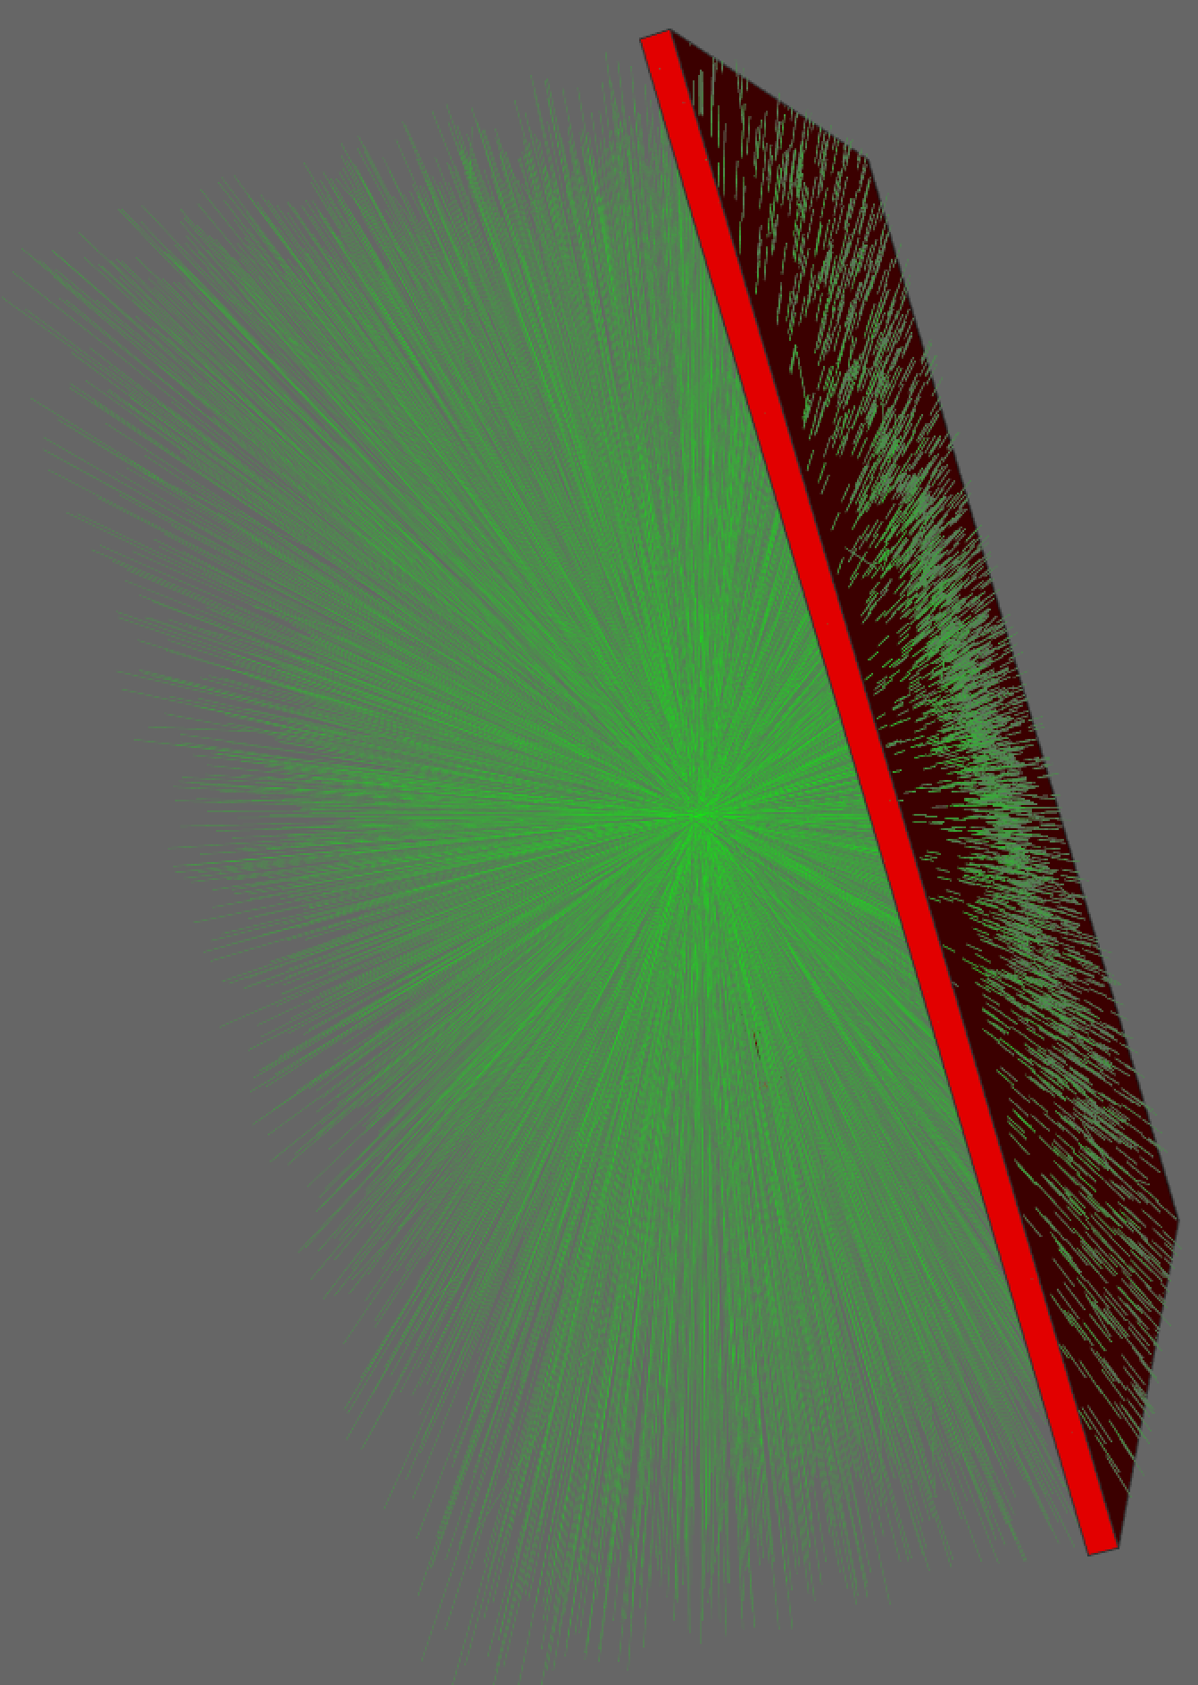
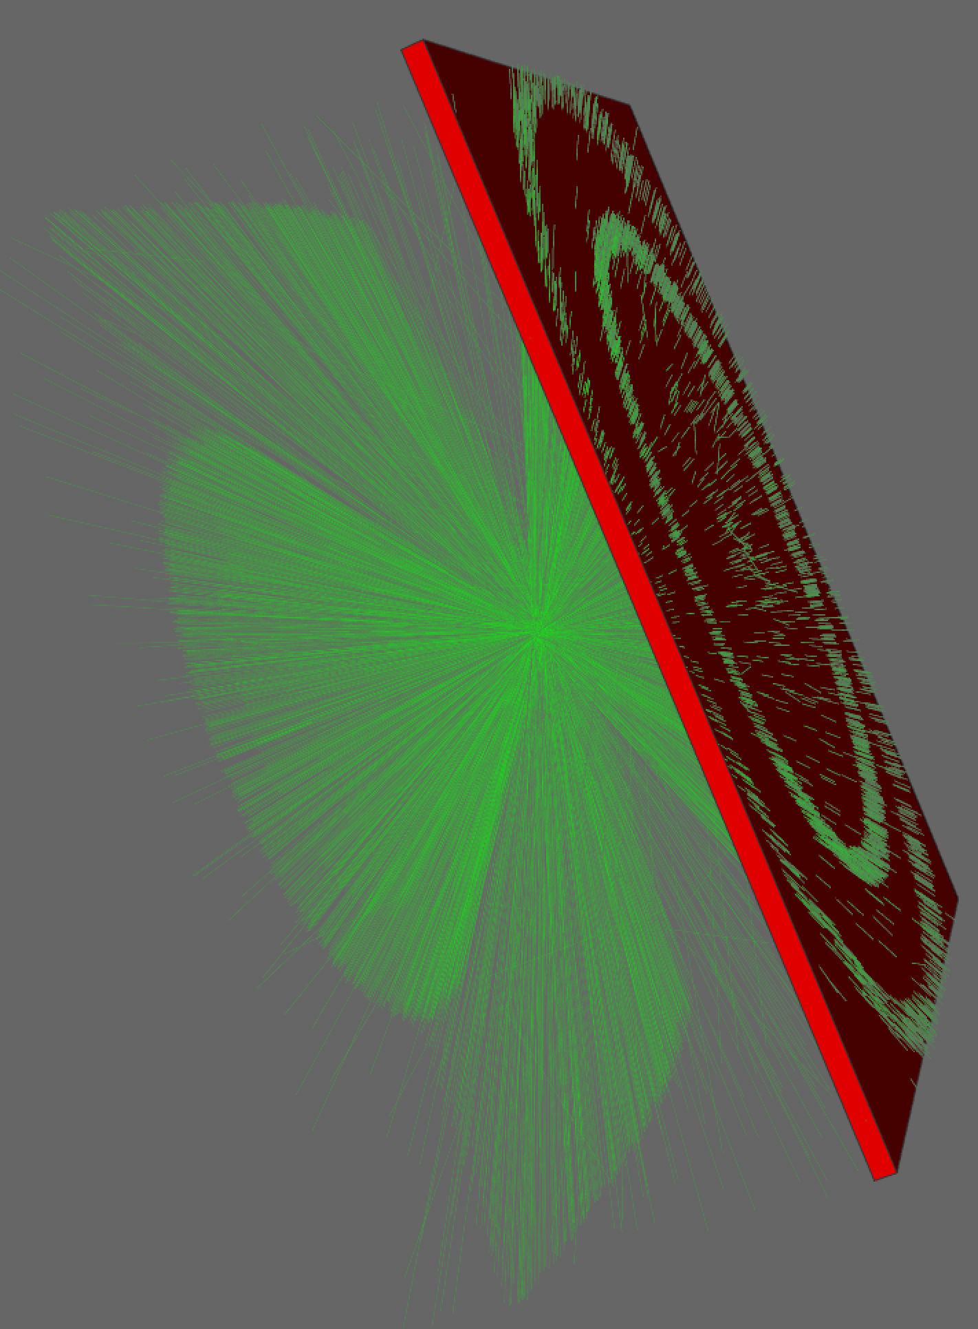
Scattering in Geant4 without and with NCrystal
polycrystalline
material
free-gas model
Al
Al
n
n
Cu total cross section vs. E
Agreement between NCrystal cross sections and
published data
Notes:
Documentation in the publication

Slide 7
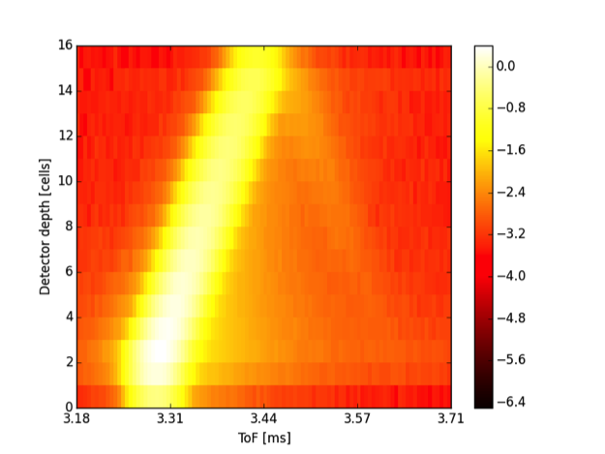
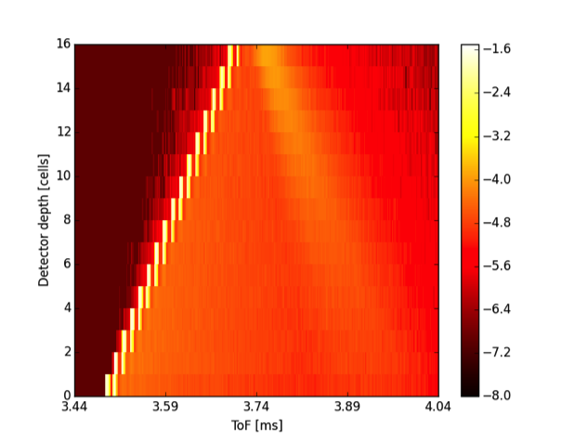
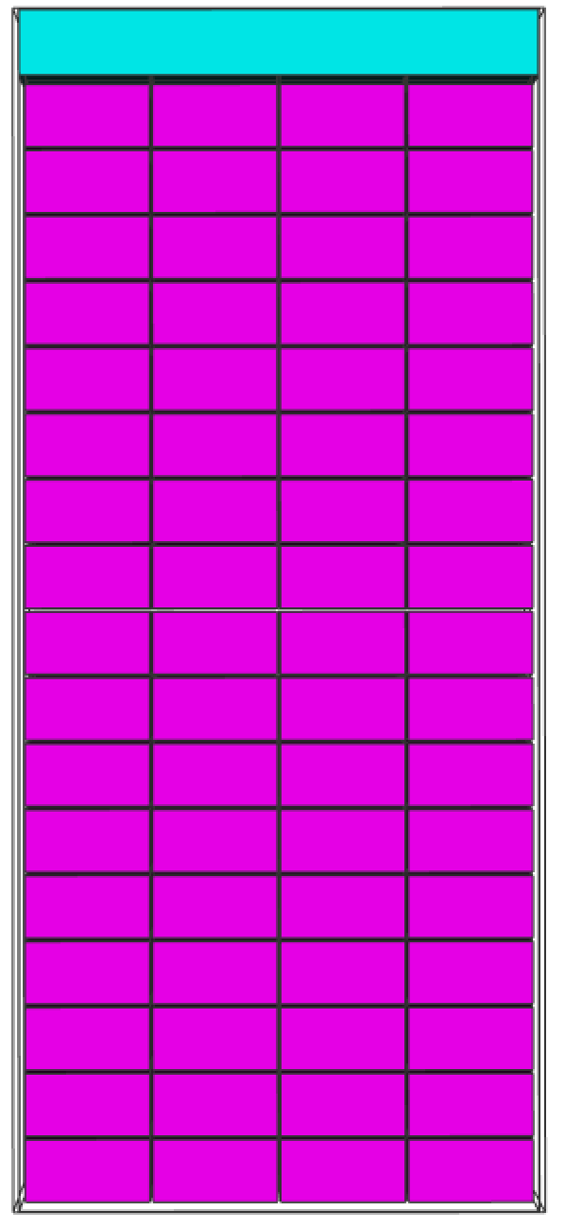

Reproduction of Bragg scattering in Geant4
(E. Dian, see A. Khaplanov’s talk in ThuB1-1, 13.07, 10:00)
Back-scatter from the unshielded rear wall of the detector at 4.6 Å
measured
simulated
Multi-Grid detector
Depth in detector [cells]
Depth in detector [cells]
ToF
Measured ToF-depth characteristic and backscatter phenomena reproduced with simulation at 4.1 and 4.6 Å
A. Khaplanov et al. "In-beam test of the Boron-10 Multi-Grid neutron detector at the IN6 time-of-flight spectrometer at the ILL",
Journal of Physics: Conference Series 528 (2014); doi:10.1088/1742-6596/528/1/012040

Slide 8
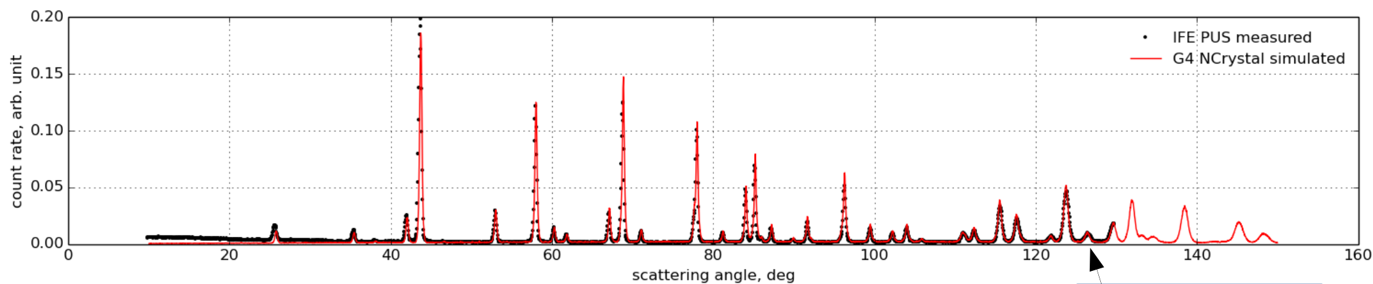
Simulation of the PUS@IFE diffractometer
(X. X. Cai)
IFE PUS measured
G4 NCrystal simulated
Simulation includes collimator, Ge monochromator, Al₂O₃ sample, shielding between sample and monochromator
  Very good agreement with the measured diffraction pattern at intensities, peak positions and widths
  Discrepancy at low angles understood and will improve with NCrystal 2.0
Long list of materials are validated and available (~50 materials validated, simple and compound)
NCrystal currently being integrated with Geant4 and McStas
NCrystal is a crucial component to a complete simulation of a neutron instrument.

Slide 9
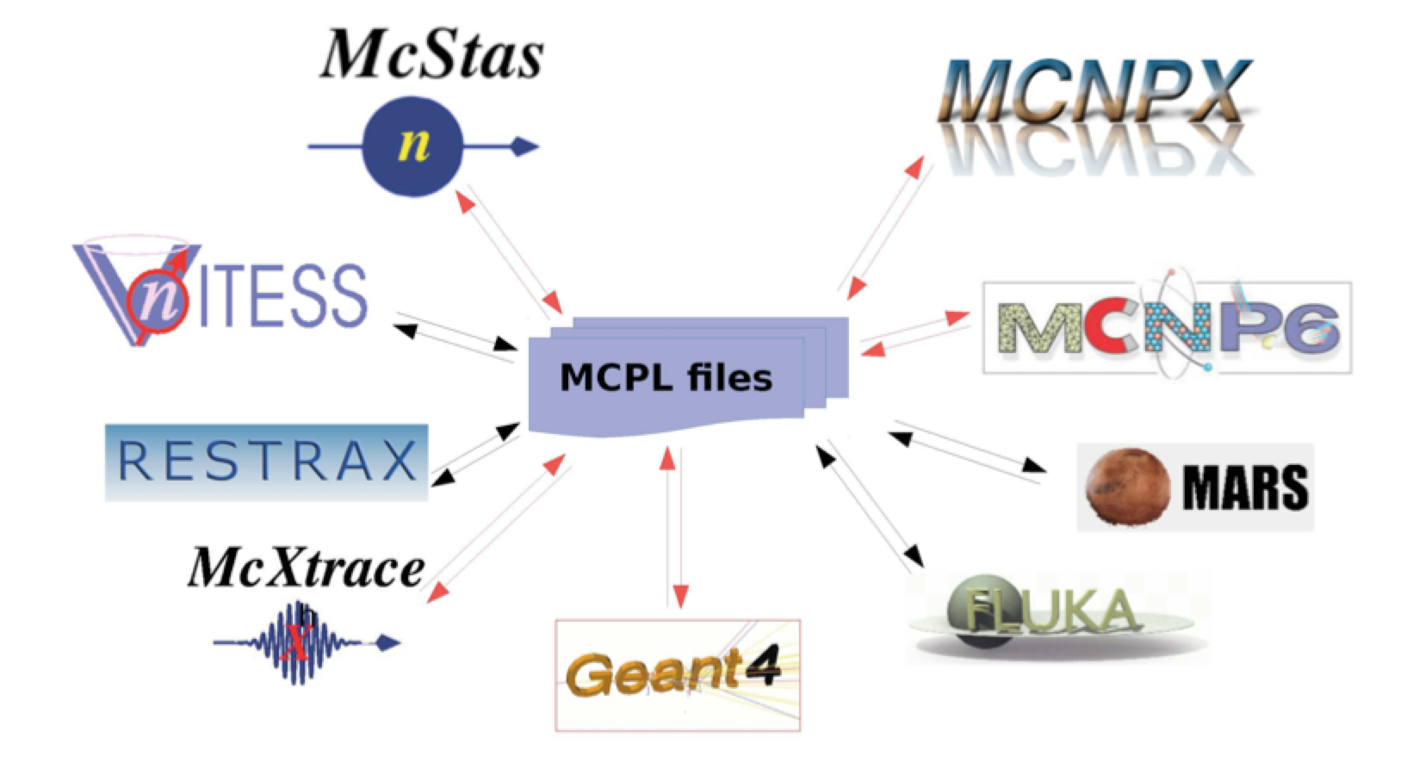
Monte Carlo Particle Lists: MCPL
(T. Kittelmann, E. Klinkby, E. B. Knudsen, P. Willendrup)
  Well-defined and flexible binary file format containing full information of particle properties
  Facilitates communication among software packages (e.g. McStas, Geant4, MCNP)
    Can be easily implemented for other simulation packages
    C/C++/python hooks available
  Can be used within a single software application
  MCPL files can be modified, merged, filtered and histogrammed
    With a single terminal command
    Enhanced facilities within the ESS simulation framework
  https://mctools.github.io/mcpl/
  Open source tool, available to everyone
Red: already implemented, MCNP5 added recently
Contact:
mcpl-developers@cern.ch
T. Kittelmann et al., “Monte Carlo Particle Lists: MCPL”, Computer Physics Communications,
Volume 218, September 2017, Pages 17-42, ISSN 0010-4655
https://doi.org/10.1016/j.cpc.2017.04.012
http://sine2020.eu/news-and-media/mcpl-a-new-format-that-simplifies-data-interchange-between-applications.html
Notes:
1.1.0 published, 1.2.0 with python support

Slide 10
MCPL use-case for detector optimization
Detector design can benefit from optimization against ‘realistic’ input (not only monochromatic or pencil beams)
Simulate the McStas instrument output at the sample position
Use the MCPL output file as input for Geant4 detector simulations
Study detector rates, efficiency, scattering, resolution effects
Look at scientific quantities from detector simulation
Raw Q intensity distribution
for a configuration of the LoKI instrument
on a sample of 200 Å spheres
T. Kittelmann et al., “Monte Carlo Particle Lists: MCPL”, Computer Physics Communications,
Volume 218, September 2017, Pages 17-42, ISSN 0010-4655

Slide 11
Summary
676548
Advances and improvements in simulation tools for the neutron scattering community are presented.
NCrystal allows a detailed evaluation of instrument and detector performance.
  Bragg scattering on polycrystalline materials
  Bragg scattering on single crystals
  Accurate treatment of inelastic scattering component
  Includes library of validated materials
MCPL, an efficient exchange file format, improves communication between simulation tools
Tools publicly available for everyone to use (and expand)
  Already available in the ESS simulation framework

Slide 12
Thank you for your attention!

